Slide 1
Digital Portfolio
STUDENT NAME:GIRIDHARAN. J
REGISTER NO AND NMID: 222407619
DEPARTMENT: BSC
COLLEGE: VEL TECH RANGA SANKU ARTS COLLEGE/ UNIVERSITY OF MADRAS

Slide 2
PROJECT TITLE
DIGITAL PORTFOLIO

Slide 3


AGENDA
★Problem Statement
★Project Overview
★End Users
★Tools and Technologies
★Portfolio design and Layout
★Features and Functionality
★Results and Screenshots
★Conclusion
★GithubLink
3/21/2024 Annual Review

Slide 4

PROBLEM STATEMENT
★Lack of a professional online identity for students. ★Traditional resumes are static and less engaging. ★Need for a digital portfolio that highlights projects, skills, and achievements effectively.

Slide 5

PROJECT OVERVIEW
★A Personal Portfolio Website built using HTML, CSS, and JavaScript.
★Provides structured sections: About, Skills, Certificates, Projects, and Contact.
★Designed to be responsive, interactive, and user-friendly.

Slide 6

WHO ARE THE END USERS?
★Students who want to showcase their academic and project work.
★Recruiters/HR professionals searching for talent.
★Teachers and mentors evaluating project submissions.
★General qudience interested in portfolioreference designs

Slide 7
TOOLS AND TECHNIQUES HTML – Structure CSS – Styling & Layout JavaScript – Functionality VS Code – IDE GitHub – Version Control & Hosting

Slide 8
POTFOLIO DESIGN AND LAYOUT
★Header & Navbar → Quick navigation
★Hero Section → Introduction + Tagline
★About Section → Bio + Image
★Skills Section → Progress bars
★Certificates Section → Achievements list
★Projects Section → Showcase with cards
★Contact Section → Form + Social links
★Footer → GitHub & LinkedIn
8

Slide 9
FEATURES AND FUNCTIONALY ★ Responsive navigation bar mobile and desktop view). Dark mode toggle Interactive skill progress bars. ★Contact form with validation & success message Project showcase using cards with hover effects.Social links for networking (GitHubLI & Linkedln)

Slide 10
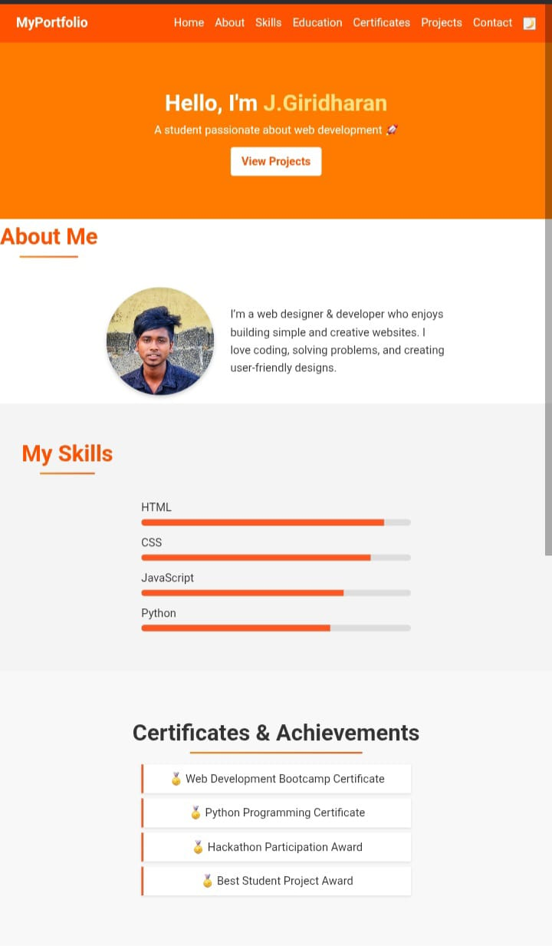
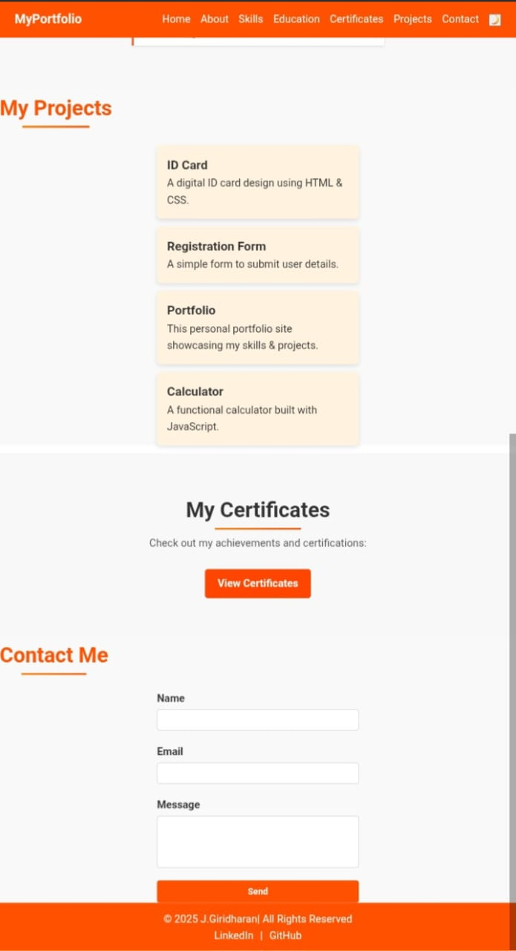

RESULTS AND SCREENSHOTS
★Completed a working digital portfolio website ★Successfully integrated skills, projects, and certificates ★Screenshots of key sections: Home Page ★Skills Page ★Project Showcase Contact Page
3/21/2024 Annual Review
10

Slide 11
CONCLUSION ★The project demonstrates web development skills. ★Provides a digital resume for better professional visibility. ★Increases chances of internships and job opportunities.
11

