Slide 1
Digital Portfolio
STUDENT NAME: JANAKIRAMAN H
REGISTER NO AND NMID: 222407627 / asunm1453222407627
DEPARTMENT: B.Sc Computer Science
COLLEGE: VEL TECH RANGA SANKU ARTS COLLEGE,
UNIVERSITY OF MADRAS

Slide 2
PROJECT TITLE
DIGITAL PORTFOLIO

Slide 3


AGENDA
Problem Statement
Project Overview
End Users
Tools and Technologies
Portfolio design and Layout
Features and Functionality
Results and Screenshots
Conclusion
GitHub Link
3/21/2024 Annual Review

Slide 4

PROBLEM STATEMENT
Students often lack a professional online presence.
Recruiters and faculty need a single place to view skills, projects, and achievements.
Traditional resumes are static and don’t showcase creativity.

Slide 5

PROJECT OVERVIEW
A responsive digital portfolio built using HTML, CSS, and JavaScript.
Includes About Me, Skills, Projects, Certificates, Testimonials, and Contact sections.
Styled with an orange gradient theme for a modern professional look.

Slide 6

WHO ARE THE END USERS?
Recruiters & Hiring Managers
Faculty & Academic Reviewers
Fellow Students & DevelopersPersonal Network (friends, Instagram, LinkedIn, etc.)

Slide 7

TOOLS AND TECHNIQUES
HTML, CSS, JavaScript
Google Drive (for certificates storage)
GitHub (for code hosting)

Slide 8
POTFOLIO DESIGN AND LAYOUT
Fullscreen responsive sections (Hero, About, Skills, Projects, Certificates, Testimonials, Contact)
Navbar with mobile-friendly toggle
Footer with Social Media links & Gmail integration
8

Slide 9
FEATURES AND FUNCTIONALITY
Responsive Design (desktop + mobile view)
Projects with live links
Certificates hosted on Google Drive
Contact form with success message
Social media integration (LinkedIn, GitHub, Instagram, Gmail)

Slide 10

RESULTS AND SCREENSHOTS
Screenshots of portfolio homepage, projects, certificates, and contact form.
Show how it looks on desktop & mobile.
3/21/2024 Annual Review
10

Slide 11
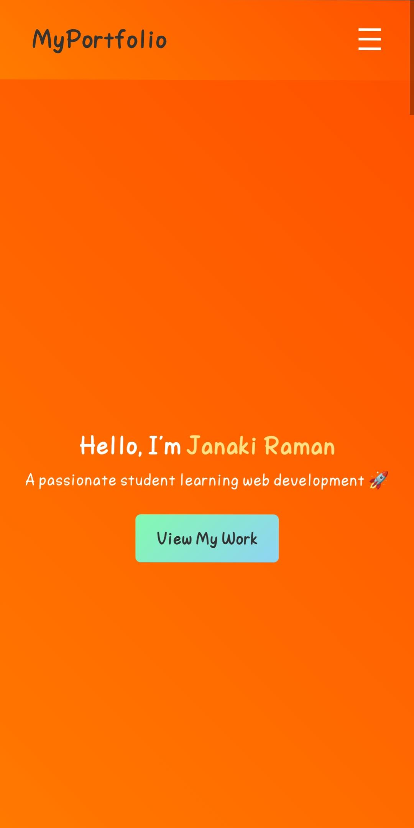
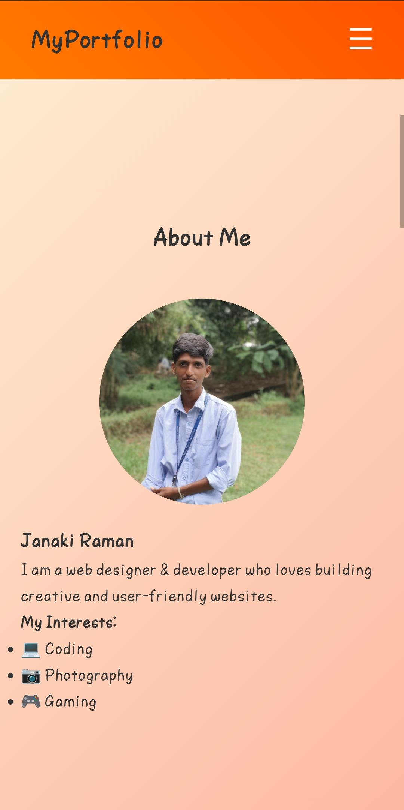
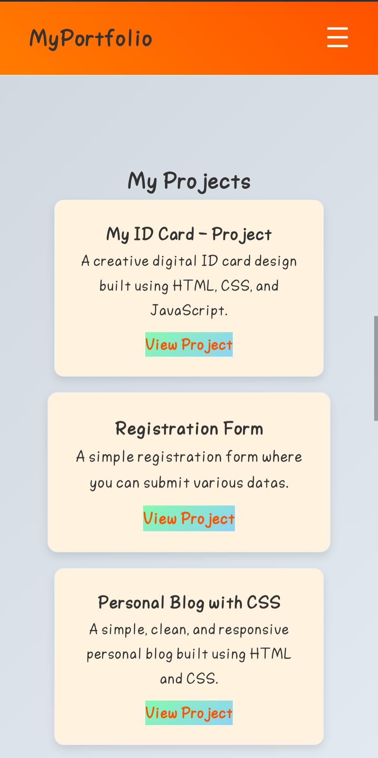
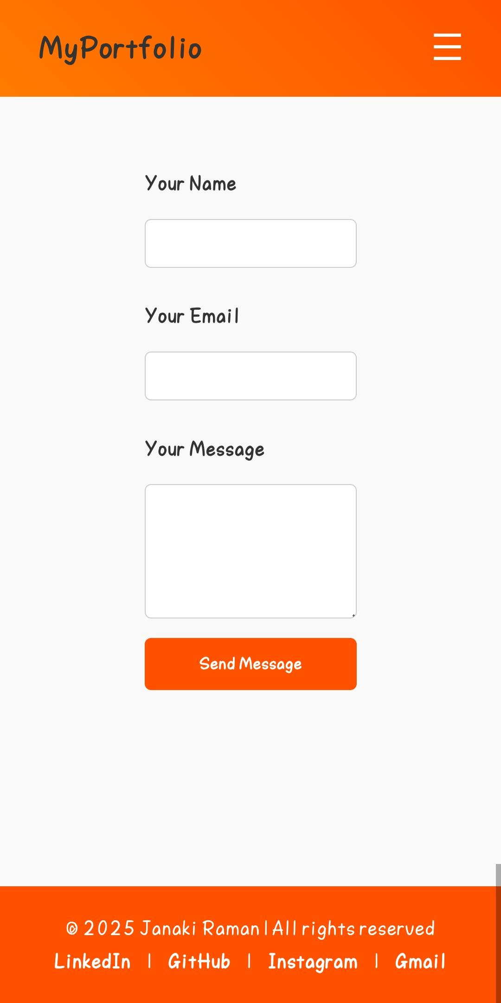
Final Course Project – Personal Portfolio

Slide 12
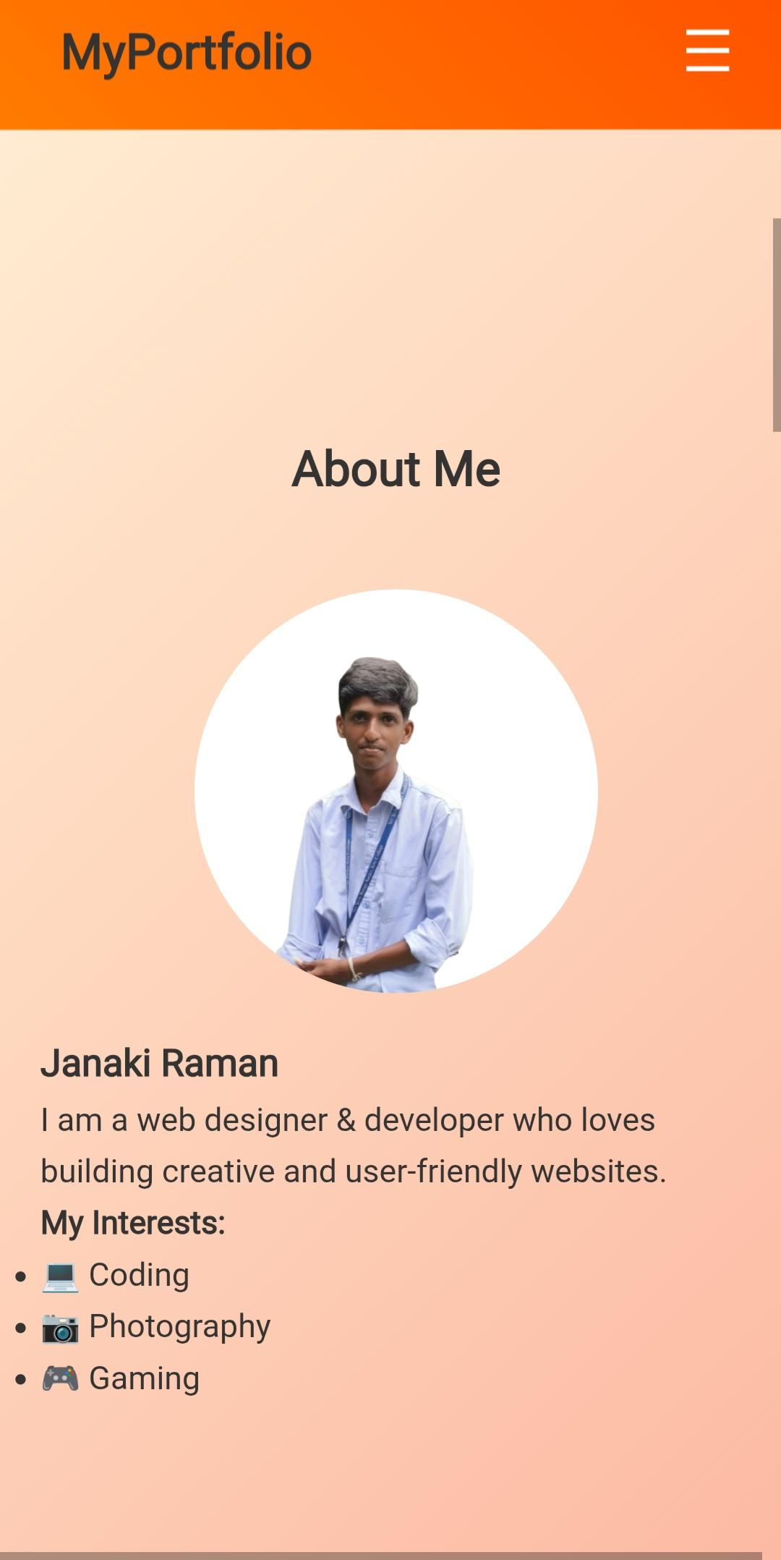
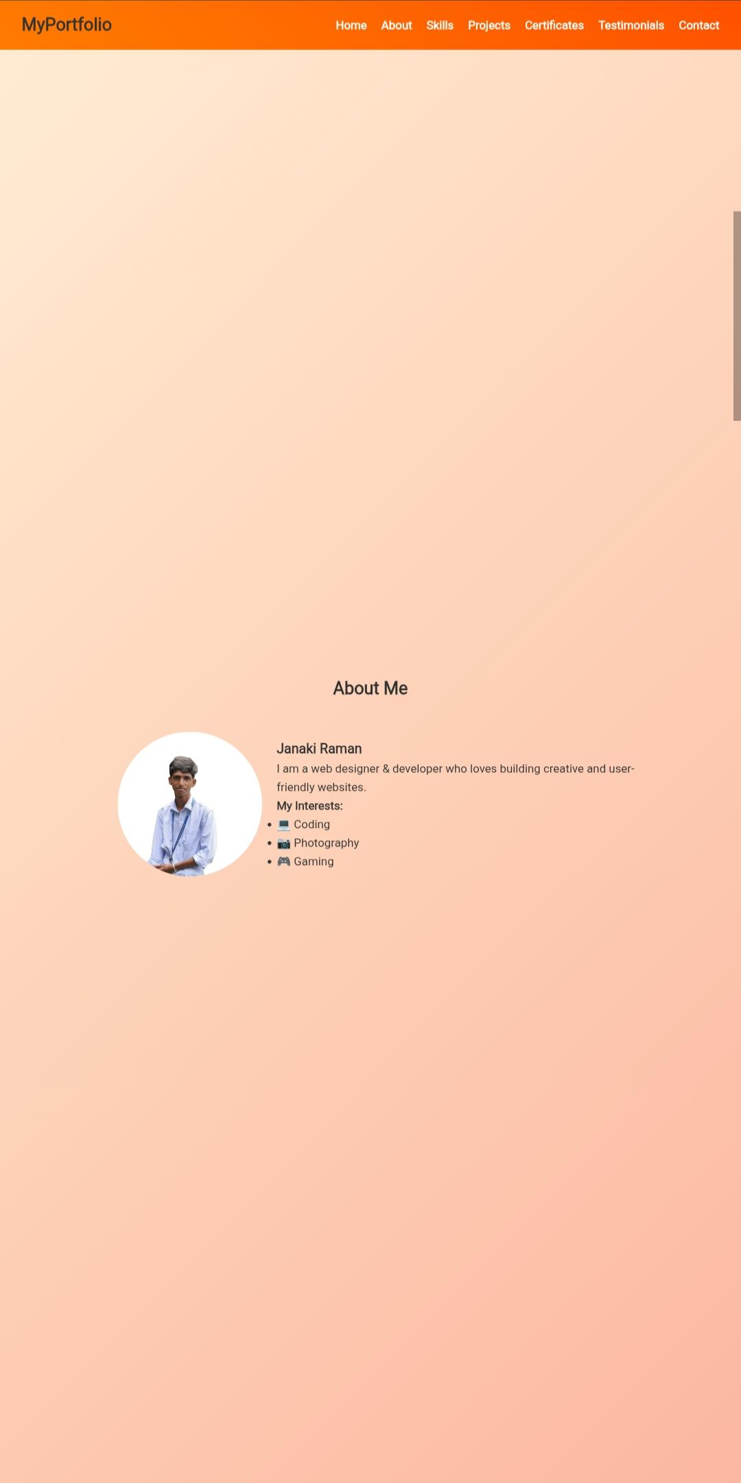
About Me
I am a web designer & developer passionate about building creative, user-friendly websites.
Mobile View Desktop View

Slide 13
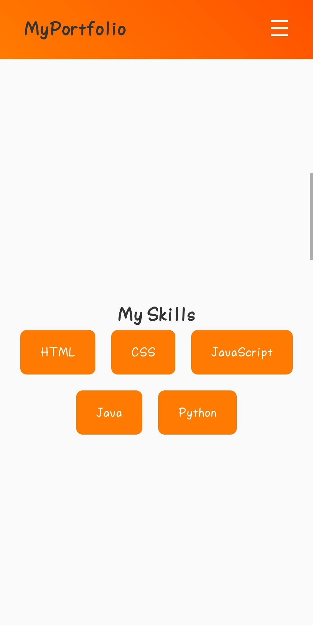
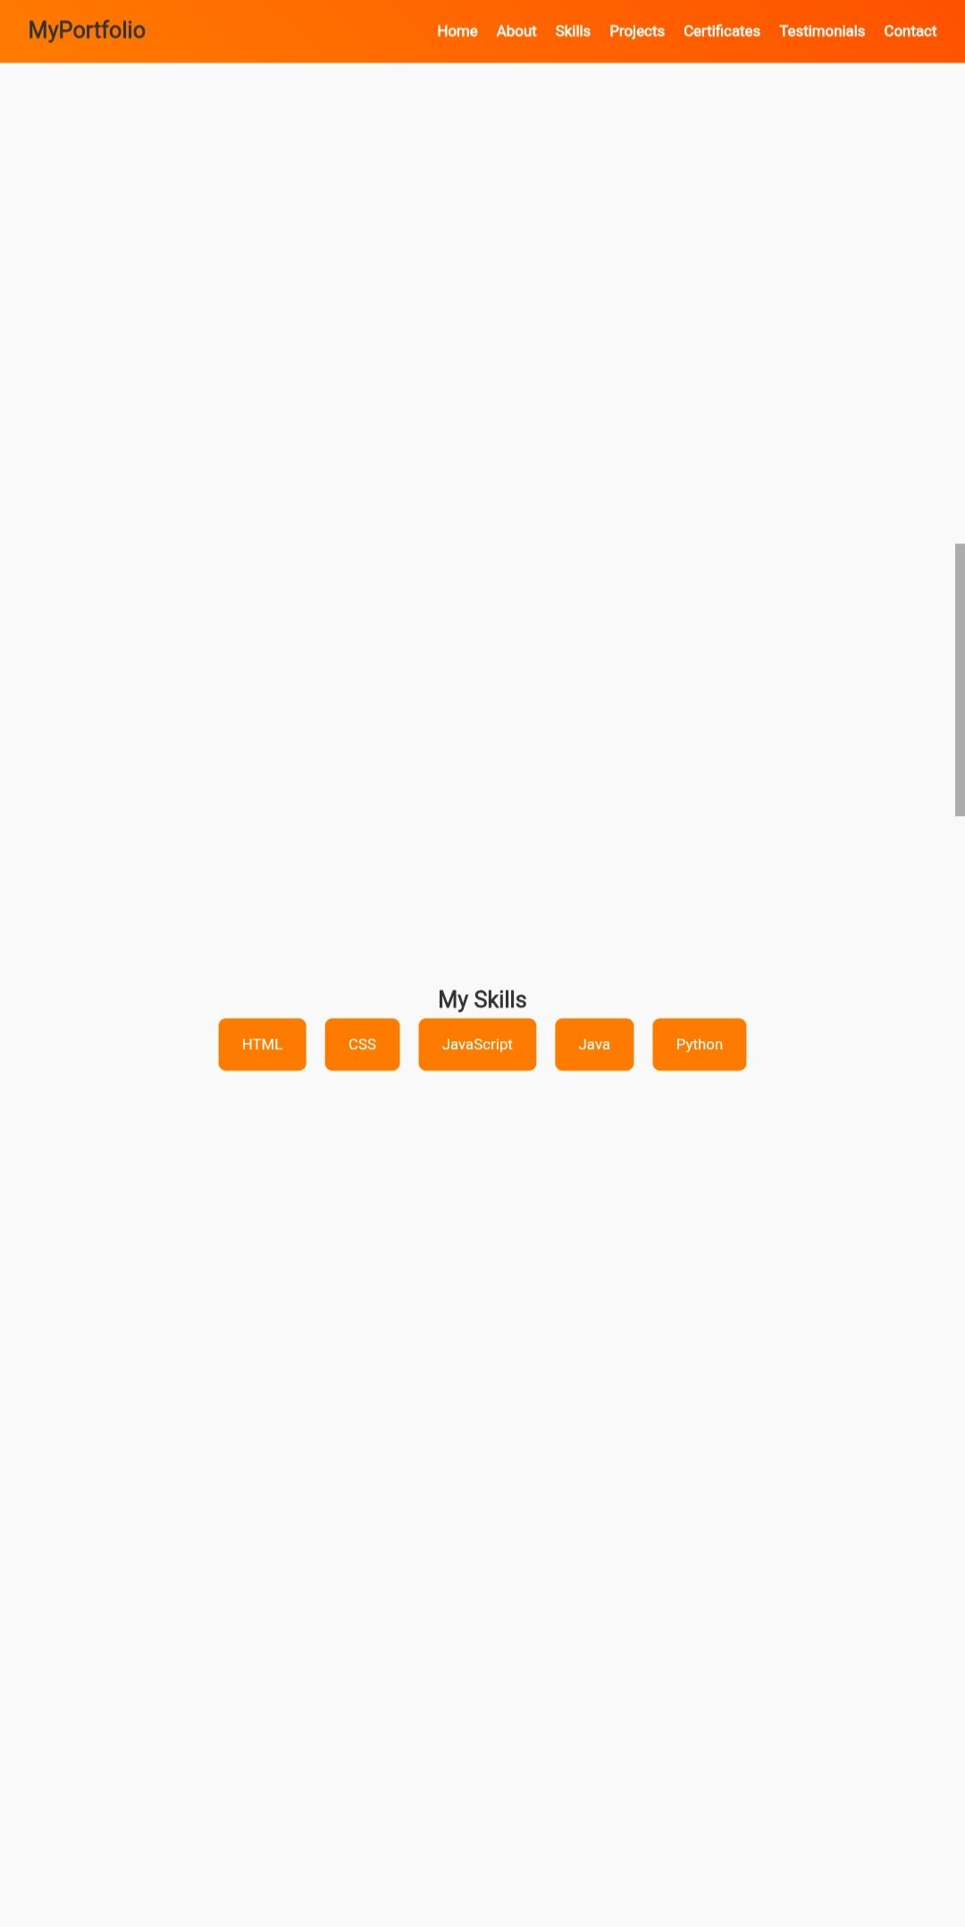
My Skills
HTML | CSS | JavaScript | Java | Python
Mobile View Desktop View

Slide 14
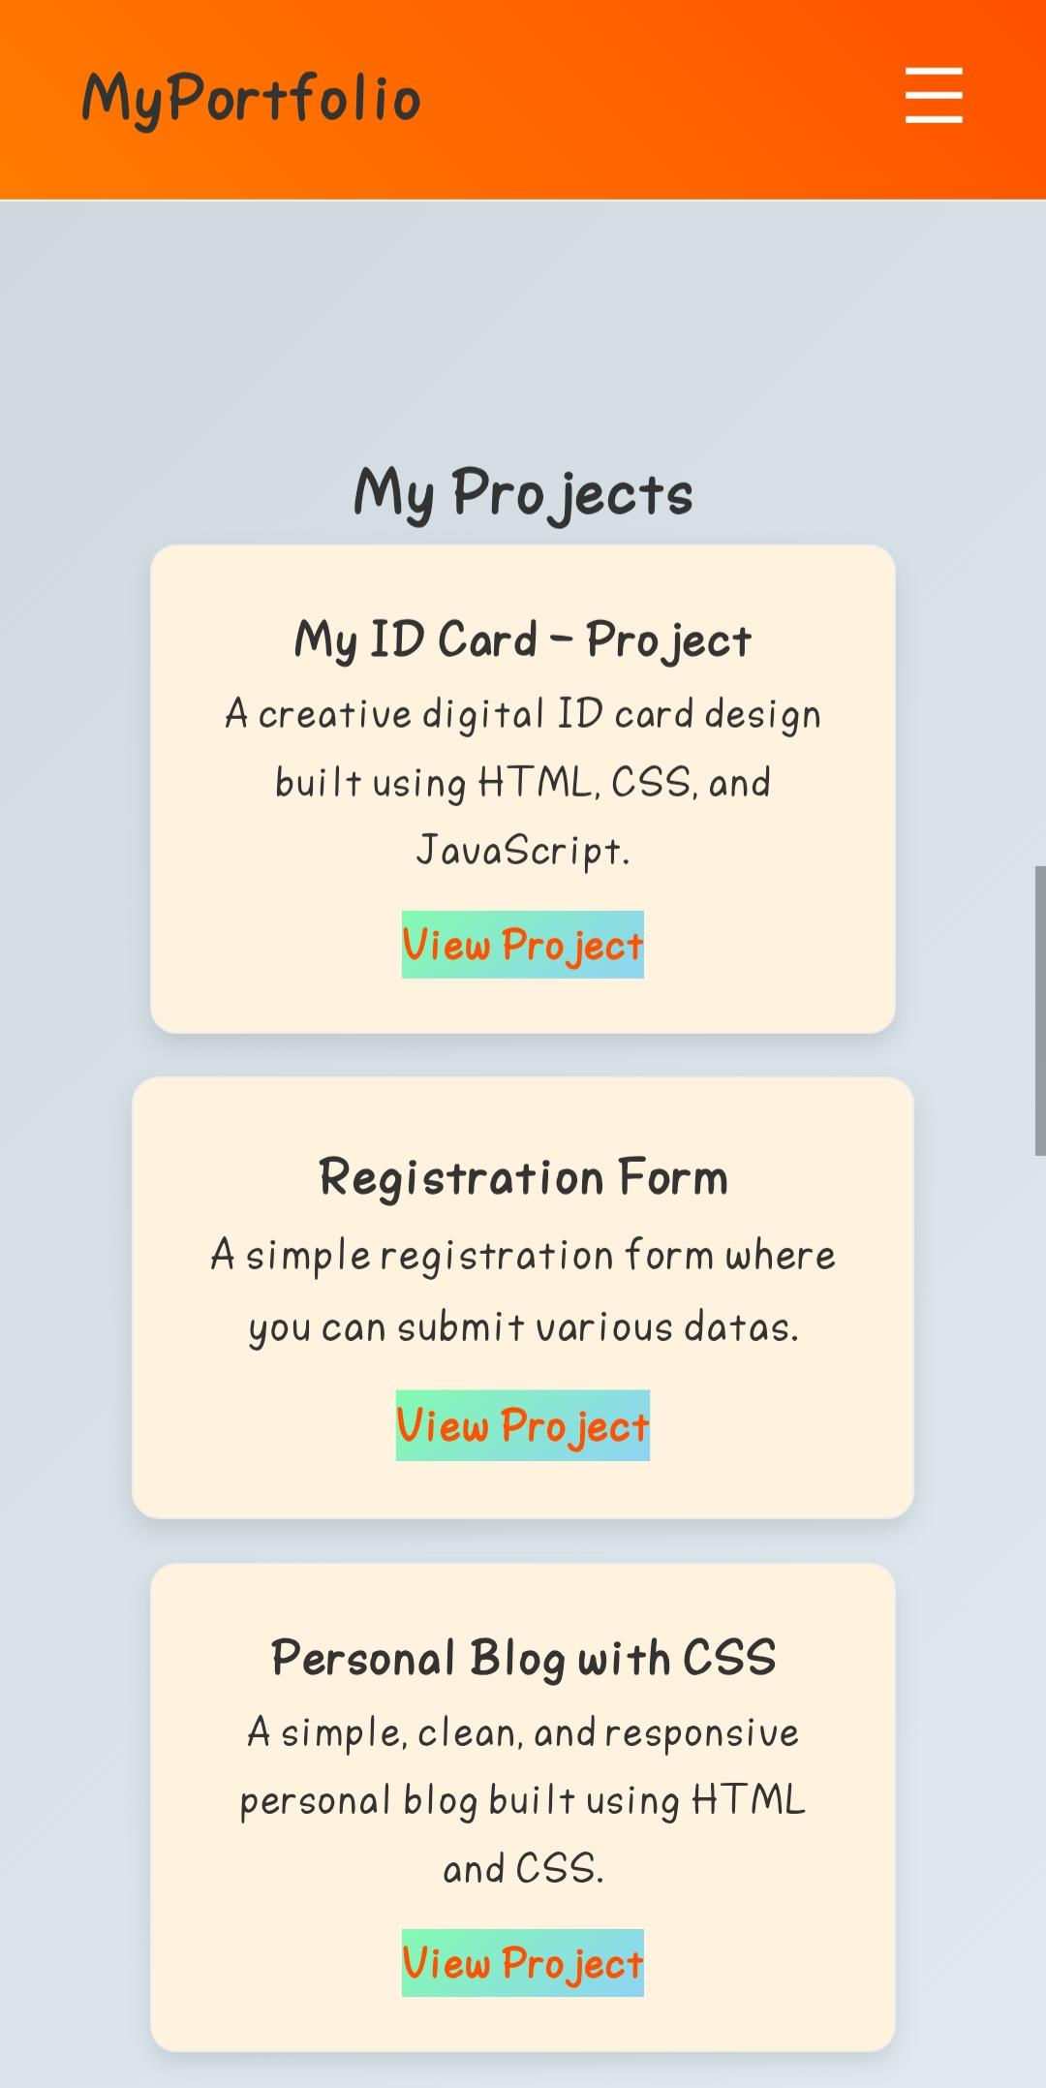
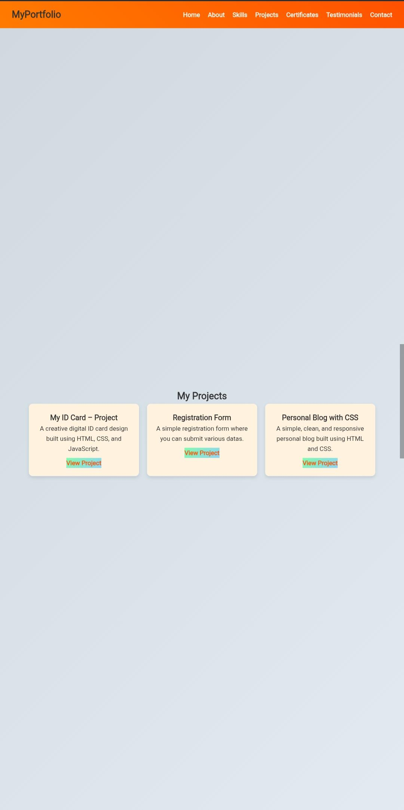
My Projects
Showcasing projects like ID Card, Registration Form, Blog.
Mobile View Desktop View

Slide 15
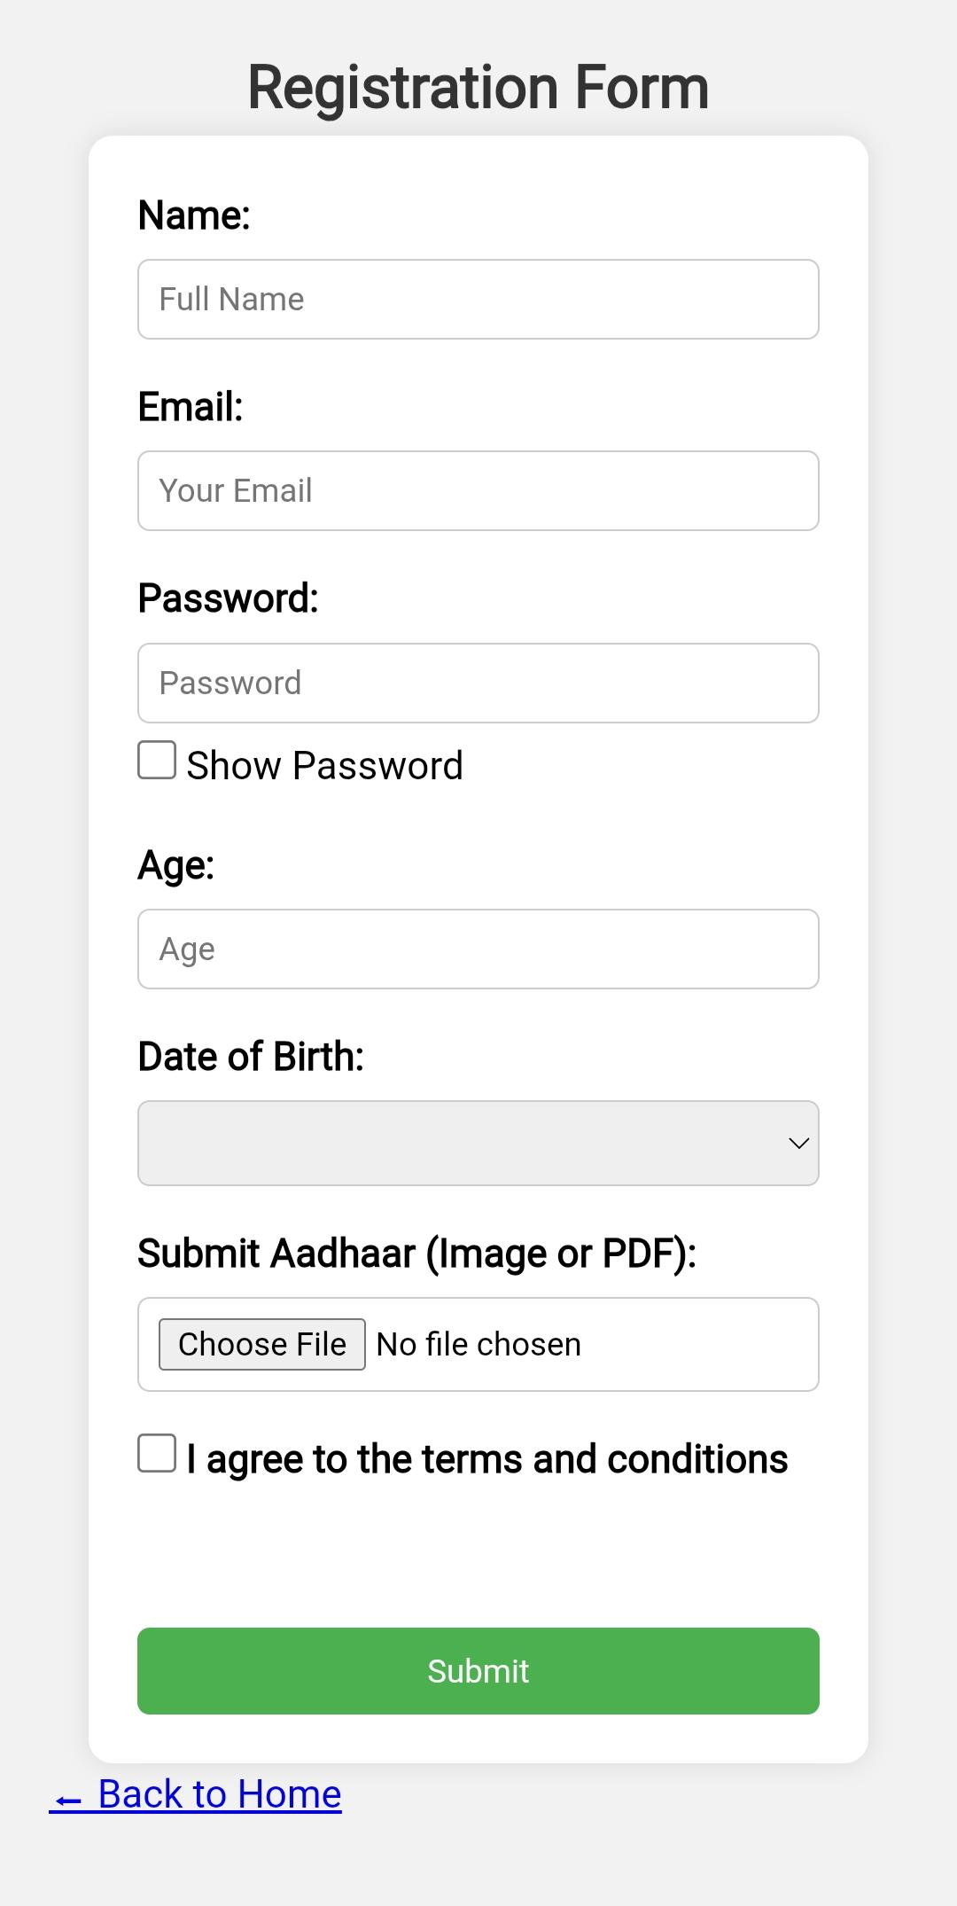
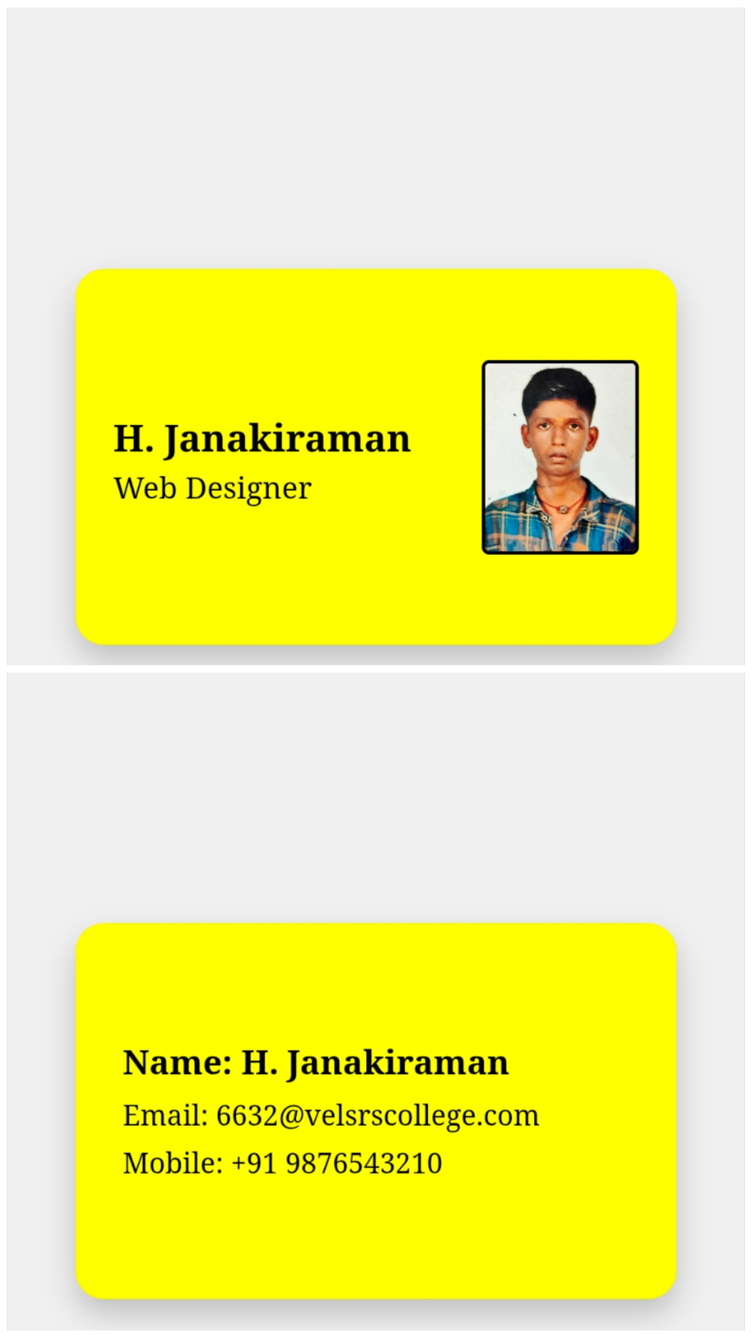
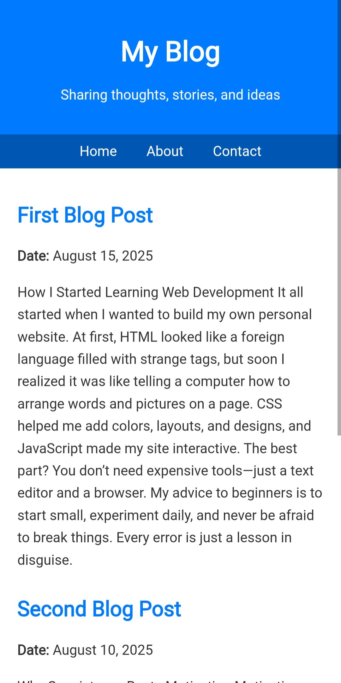
Projects

Slide 16
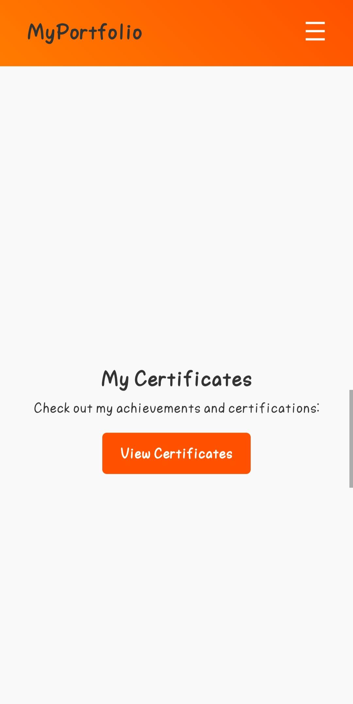
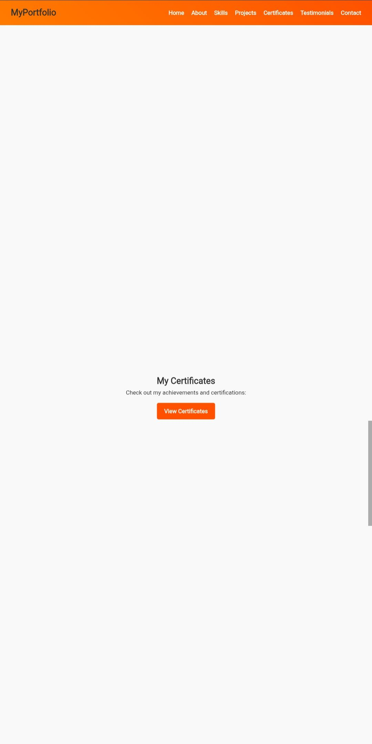
My Certificates
Achievements & certifications that reflect my learning journey.
Mobile View Desktop View

Slide 17
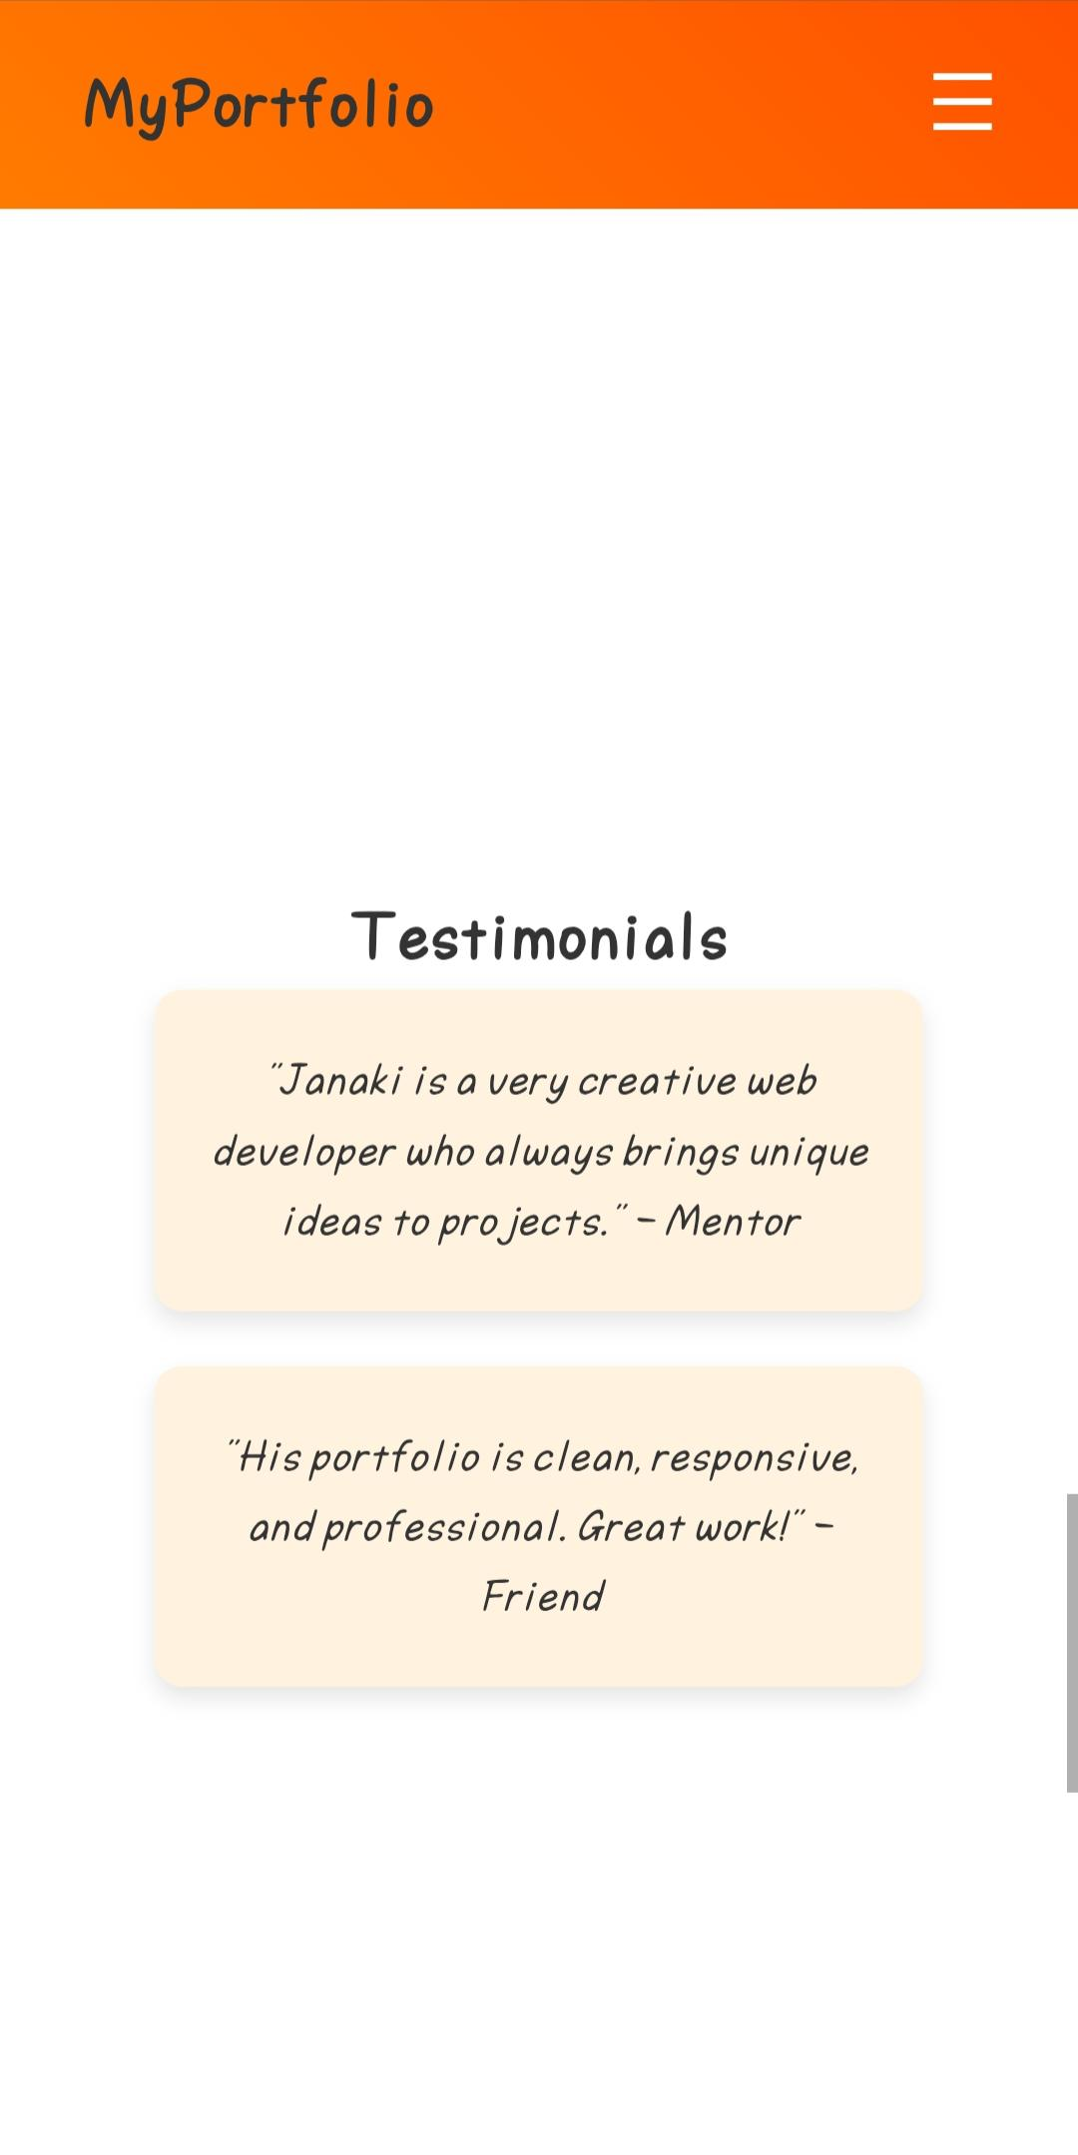
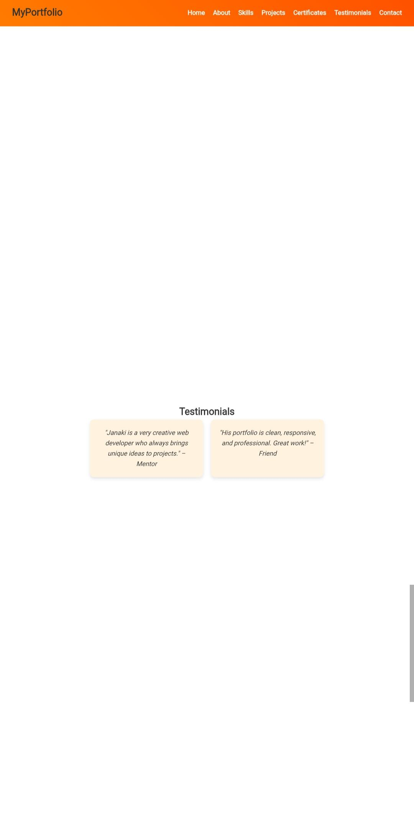
Testimonials
Mentor: JANAKIRAMAN is very creative and brings unique ideas.
Friend: Portfolio is clean, responsive, and professional.
Mobile View Desktop View

Slide 18

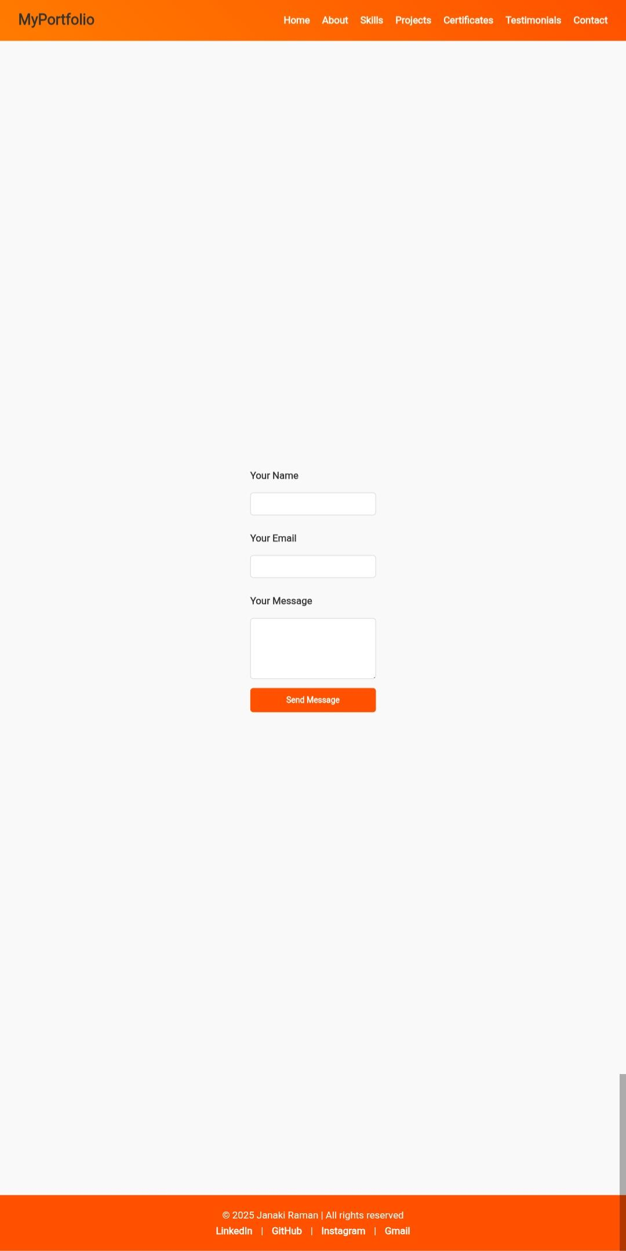
Contact Me
Portfolio includes a contact form and footer with LinkedIn, GitHub, Instagram, Gmail.
Mobile View Desktop View

Slide 19
CONCLUSION
Successfully developed a professional, responsive portfolio website.
Helps build a strong digital presence for career opportunities.
Easily extendable with more projects and certificates.
19

Slide 20
GitHub Link
https://github.com/6632-JR/My-Digital-Portfolio

Slide 21
Thank You
Thank you for viewing my portfolio project.
- Janaki Raman

