Slide 1
DSP Basics
Digital data representation
Sampling theorem
Quantization and number systems
Quantization errors
Entropy coding (Huffman coding)
Spectrum analysis
Notes:
In this part of the lecture, we will look into the details on how audio signal is represented digitally and the accuracy achieved by the digital representation.
Entropy coding has been proved that it requires the minimum number of bits to represent a sequence of symbols.
Spectrum analysis is the most important process in audio coding for identifying which signal component is to be ignored in the coding process.

Slide 2
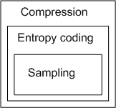
Coding Strategies
Compression coding – to minimize the required resources (downloading time, frequency bandwidth, memory space) for the application
Entropy coding – to minimize the number of bits to represent a sequence of symbols
Sampling and quantization – minimize the number of bits for a sample (symbol)
Compression coding needs extensive signal processing to identify the information to be ignored for human application
Coding for other purpose, i.e., reliability of transmission or disk writing/reading, is also needed.

Slide 3
Digital Signal Representation
Most practical signals are analogue, and must be converted into a discrete representation before being processed
Reconstructing the analogue signals from the processed samples is also necessary for the end user application
Sampling is the first step of processing the signals for almost all applications, and these sample values are represented by either a fixed-point or a floating-point format
Finite word length has effects on the resolution of sample representation and give the quantization noise.
For audio compression, we would like to reduce the number of bits representing the samples and keep the noise effects to be inaudible.
For audio applications, high resolution is particularly important for small amplitude signals

Slide 4
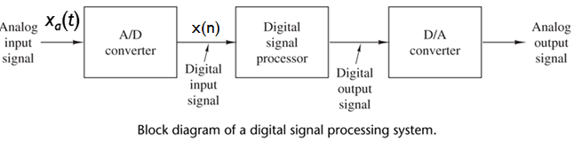
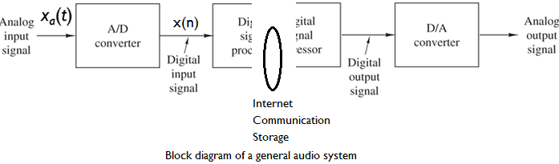
Digital Signal Representation
Note the difference of the two general structures for practical applications below:
For audio applications, the entire system may be at different physical locations. The channel is considered as another key element of the entire system.
Notes:
It is very common that the generation of the data and the use of data are at different physical locations. Therefore, another element of the entire system is the communication channel.

Slide 5
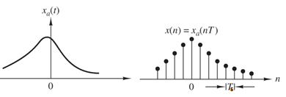
Digital Signal Representation
The analogue input signal x_{a}(t) is converted into digital one, x(n).
Two main operations are performed in the AD conversion are
Sampling: to get discrete samples from x_{a}(t) (what is the suitable sampling frequency?)
Quantization: to represent these samples in a set of given values (how many bits are used to approximate the sample values?)

Slide 6
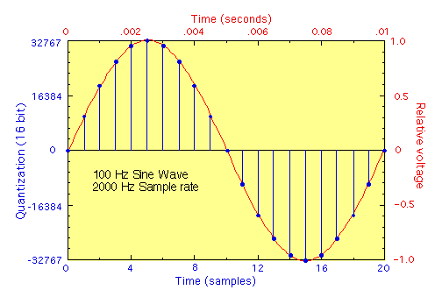
A simple PCM coder
Analog signal is sampled at regular time intervals, T_{s}.
The samples are then quantized into one of the digitized values (see below the linear PCM). The samples you received as input of the audio compression
Simple, but does not take into account of ear model.
Possible to use a nonlinear quantizer for coding of large and small amplitude signals with higher resolutions (non-linear PCM).
Notes:
Let us look at the signal sampling and quantization.
The PCM can be linear or nonlinear. The linear one is shown in the figure in which the sample values are linearly distributed with the dynamic range.
The non-linear PCM uses finer quantization step size for small amplitude signal (more accurate representation) and uses larger quantization step size for large signal amplitude (much less accurate representation). This is because human ears are not sensitive to the differences of large sample values. Therefore, we can obtain signal representation with a higher resolution without increasing the total number of bits in the coded stream.
For example, 12 bit resolution can be obtained by using 8 bit representation by a non-linear PCM, which has been used in fixed line telephone service.

Slide 7
Digital Signal Representation
The samples can be expressed by
(1.1)
where T_{s} is the sampling interval.
The main issue is to determine a suitable sampling freq. f_{s}=1/T_{s}.
High sampling freq. leads too much computation or costs
Aliasing effect is due to insufficient sampling frequency so that the recovered signal will not be uniquely related to the original input
High sampling frequency provides better accuracy and high computational complexity, which should be compromised
Note x(n) has to be quantized before being processed, which will be discussed latter.

Slide 8

Digital Signal Representation - Sampling
Band-limited signal
A signal is band-limited if there exists a finite frequency F₀ such that X_{a}(f) is zero for |f| > F₀. The frequency F₀ is called the signal bandwidth in Hz.
Sampling Theorem
A band-limited signal, x_{a}(t), with bandwidth F₀ can be reconstructed from its sample values x(n) = x_{a}(nT_{s}) if the sampling frequency F_{s} = 1/T_{s} is greater than twice the bandwidth F₀ of x_{a}(t) , i.e. F_{s} > 2F_{0.} Otherwise aliasing would result in x(n).
The sampling frequency of 2F₀ for an analog band-limited signal is also called the Nyquist rate.
Notes:
Note that the sampling theorem is valid on band limited signal only.

Slide 9
Quantization

Slide 10
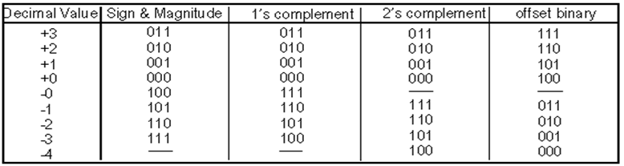
Digital Signal Representation - Quantization
Commonly used fixed point binary representations :
Sign and magnitude;
One’s complement;
Two’s complement;
Offset binary
DSP devices commonly use the 2’s complement

Slide 11
Digital Signal Representation - Quantization
Fractional point number in Qn format, where n is the number of bits to the right of the binary point.
Example : Q15 (or 1.15) number format
Example : Q0 (or integer) number format
DSP supports both fractional and integer notations and is optimized for fractional Q15 notation
S : sign bit
B : fractional bit
S. B B B B B B B B B B B B B B B
Binary point
S B B B B B B B B B B B B B B B .
Binary point
Notes:
Most DSP computations are carried out in the fixed-point format. We use S and B to represent the sign bit and fraction bits.
In a 16-bit DSP, Q15 is used by default: the MSB is the sign bit followed by 15 fractional bits. The range of the value is limited from –1 to +1.
Alternately, we can move the binary bit to the end and have the MSB as the sign bit and the remaining 15 bits as integer. This is also known as integer or Q0 format.
Why DSP is optimized for fractional of Q.15 format? This is because fractional multiplication is contained within the number range of -1 to +1.

Slide 12
Quantization or Finite Word Length Effects
Finite Word Length Effects :
The value to be represented: 0.000125481405920
Represented in Q15 (16-bit word length) = 0.0001220703125, Quantization error (word length effect) = 0.0000034111.
4 possible sources of quantization errors (finite word length effects) in DSP implementation:
ADC quantization error - reduce SNR Remedy : can be improved by using longer word length in ADC
Arithmetic Overflow - When partial sum is larger than the maximum/smallest permissible value, leads to wrong result.
Example:
In decimal representation: 0.6125 + 0.5 = 1.1125
or in binary sign and magnitude representation: 0.1011+0.1000 = 1.0011 which is equal to -0.1875. This is the effect of overflow.
Remedy : Scaling the values to be smaller to avoid overflow
Notes:
Let us consider the type of numerical arithmetic errors that can be encountered in fixed-point computation.
Normally, when we perform simulation and design in MATLAB, we do not bother on word length because the length of the data is long enough for the applications.
However, all the numbers are stored in finite precision memory and registers, there must be the maximum or minimum limits that can be represented by the given number systems.
Let us consider the example to express 0.000125481405920. In Q15, the best we can do is to approximate this value by 0.0001220703125 , leading to an error 0.0000034111.
In normal operation, such errors are likely to be accumulated so that the processing outputs may not be usable for the intended applications.
There are 4 possible sources whereby the above can occur :
ADC quantisation error : e.g 14-bit (2^14 level) to rep input dynamics
Arithmetic overflow in addition (we will show ways to overcome this)

Slide 13
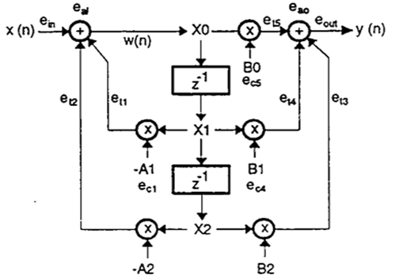
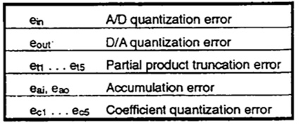
Quantization or Finite Word Length Effects
Coefficient quantization errors – Representing filter coefficients with a limited number of bits, leads to modify the true frequency response.
Remedy : Use more bits to reduce the error effects
Roundoff and truncation errors – The product of two N-bit samples is 2N-bits. Truncate the least significant bits before storing the result of multiplication, which reduces SNR.
Remedy : Use double-length summing of product.
The figure shows all the possible errors due to word length effects.
Notes:
Coeff quantisation in reg/mem
Due to the limit in the word length, we may need rounding and truncation of words before storing into the memory. For example, we may store most significant bits of the product only.

Slide 14
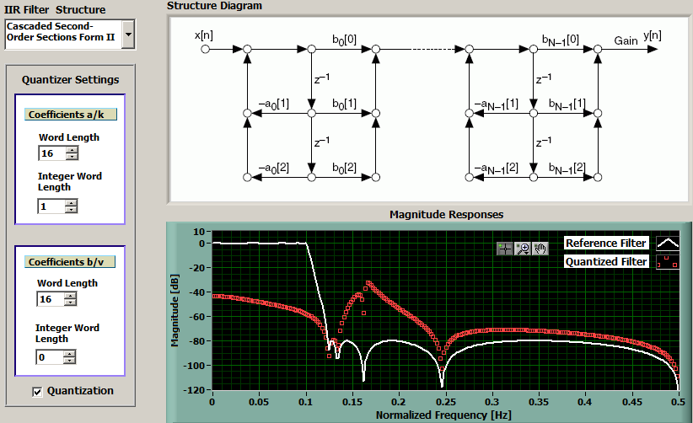
Quantization or Finite Word Length Effects
Example: Coefficient quantization errors
The red curves shows the frequency response of an IIR filter with 16-bit quantization.
Notes:
Coeff quantisation in reg/mem
Due to the limit in the word length, we may need rounding and truncation of words before storing into the memory. For example, we may store most significant bits of the product only.

Slide 15
The number systems used in Audio Coding
A uniform quantizer spans the positive and negative range of the input signal, in a symmetric manner (the same number of levels for positive and negative numbers).
Two types of symmetric and uniform quantizers:
Midtread Midrise
out
out
in
in
A zero output
No zero output
With a number of bits, B, the numbers of values using a midtread and a midrise quantizer are 2^{B}-1 and 2^{B}, respectively
Notes:
Midtread has 1 less level than the midrise. Midtread has a zero level and is good to represent a silence signal.
In contrast, Midrise does not have any level representing zero. (see figures in the slide)

Slide 16
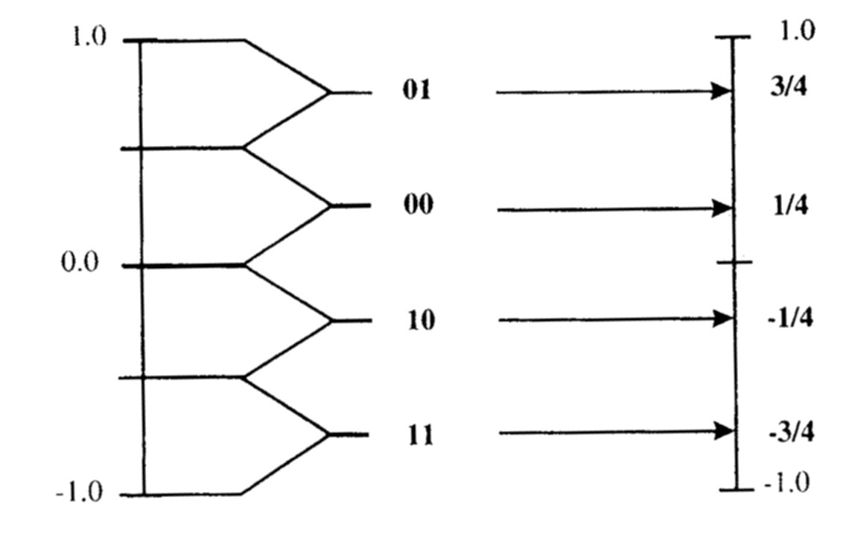
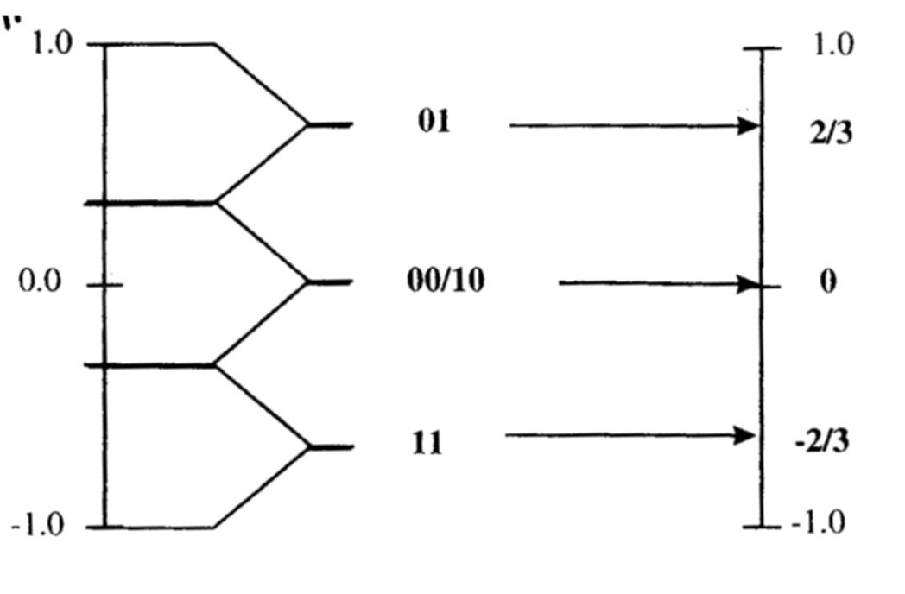
The number system used in Audio Coding
Some observations:
In the midrise quantizer, the quantization step is
Number of steps in midrise is even.
In the midtread quantizer, the quantization step is
The number of steps in midtread is odd.
2-bit midrise quantizer :
11 ➔ -0.75
10 ➔ -0.25
00 ➔ 0.25
01 ➔ 0.75
(No zero representation)
2-bit midtread quantizer :
11 ➔ -2/3
10 ➔ 0
00 ➔ 0
01 ➔ 2/3
(10 or 00 is redundant)
Notes:
In a 2-bit quantizer, midrise divides input into 4 code words; while midtread divides input into 3 code words.
Which is better for audio signal? Midtread is good to represent silence at the expense of throwing one possible code.
The examples show the different discrete levels for different digit representation.

Slide 17
Algorithms of Quantizing and Dequantizing
For Midrise
Quantizer: (ADC)
Code(number, B) = [s][code]
where s = 0 for number ≥ 0; and s = 1 for number < 0
Dequantizer: (DAC)
Number(code; B) = sign*|number|
where sign = 1 if s = 0
and sign = -1 if s = 1
For Midtread
Quantizer: (ADC)
Code(number, B) = [s][code]
where s = 0 for number ≥ 0; and s = 1 for number < 0
Dequantizer: (DAC)
Number(code;B) = sign*|number|
where sign = 1 if s = 0
and sign = -1 if s = 1
Notes:
Here shows the formula used to quantize/dequantize the samples.

Slide 18
Examples
For Midrise
Quantize:
number = 0.6,
s=0, B=4
|code|=int[2⁴⁻¹x0.6] =int[4.8]=4→100
Then we have 0100.
Dequantizer:
Number(0100; 4) = sign*|number|
sign = 1 when s = 0
The output is 1x0.5625=0.5625
|Error| = |0.6 – 0.5625|=0.0375
When B = 6, we have 010011
Error =0.009375
For Midtread
Quantizer:
number = 0.6,
s=0, B=4
|code|={int[(2⁴-1)x0.6+1]/2}
=int{15 x 0.6 +1)/2} =5→101
Then we have 0101
Dequantizer: (DAC)
Number(0101;4) = sign*|number|
sign = 1 when s = 0
The output is 1x0.666=0.666
|Error| = |0.6 – 0.666|=0.066
When B = 6, we have 010011
Error = 0.00317
Notes:
Try the procedures for B =6
Midrise: the code is 010011. The output of the dequantized value is (19+0.5)/31 = 0.609375. The error is 0.009375.
Midtread: the code is 010011. The output of the dequantized value is 2x19/63 = 0.603174. The error is 0.003174.
Obviously, the increase of B leads to more accurate representation.

Slide 19
Signal Representation - SNR
A general signal quality measure is the signal-to-noise ratio, (SNR), which tells how much of the signal energy compared with the noise energy
The theoretical SNR for a B-bit fixed point representation is 1.76+ 6.02*B dB
Example : If B = 16 bits, SNR ~ 96 dB.
What is the SNR when using Q.15 format?
How much SNR improvement when using a 16-bit over an 8-bit ADC?
Other ways to improve SNR include:
Maximize the input signal for the highest SNR
Filter noise above desired input frequency
Using oversampling, i.e., F_{s} >> 2F₀
For audio compression, the key concept is to keep the quantization noise effects below our hearing threshold.
Notes:
LSB = 2^-b, where b is the number of fractional bits in a B word (B = b+1 for Q15)
We can perform some statistic calculation to find out the mean and variance of the errors.
There is also a derivation stating that with every increase of one bit, there is a gain of 6dB in SNR

Slide 20
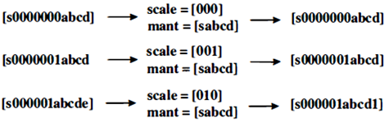
Floating Point Quantization
The total number of bits is R = R_{s}+R_{m}, where R_{s} is number of bits for scale factor and R_{m} is the number of mantissa bits
To convert from a number into a scaled-mantissa floating point coded with R_{s} scale bits and R_{m} mantissa bits:
Quantize the number as an R-bit code where R = 2^{Rs} -1 + R_{m}
Count the number of leading zeros in |code|.
If the number of leading zeros is less than 2^{Rs} -1, set the scale equal to 2^{Rs} -1 minus the number of zeros
Otherwise, set the scale equal to zero
If scale equals to zero, set the first mantissa bit equal to s and set the remaining R_{m}-1 bits equal to the bits following the 2^{Rs} -1 leading zeros in |code|;
Otherwise, set the first mantissa bit equal to s and set the remaining R_{m}-1 bits equal to the bits following the leading zeros (omitting the leading one).
Notes:
The procedures above describe the floating point quantization and dequantization processes.
The basic idea is to
first uniformly quantize the input signal using the highest number of bits for which the floating point quantizer is comparable.
then the scale bits are used to keep track of the number of
leading zeros in the uniformly quantized code so one can strip them off the code.
(c) finally, the mantissa bits are used to store the highest order bits in the remaining code, taking advantage of the fact knowing that the leading zeros were followed by a one.

Slide 21
Floating Point Quantization
To convert from a scaled-mantissa floating point code with R_{s} scale bits and R_{m} mantissa bits into a number:
Create an R=2^{Rs} -1+R_{m} bit code from the mantissa and scale factor where s is the first mantissa bit and |code|
has 2^{Rs} -1 scale leading zeros
followed by the remaining R_{m} -1 mantissa bits if scale is zero;
otherwise followed by a one and then the remaining mantissa bits
followed by a one and as many trailing zeros as will fit if scale is greater than one
Quantize the R bit code into a number.
Notes:
In order to dequantize, we apply the procedure in reverse.
The scale factor tells us how many zeros to add to the front of the stripped off code (and leading 1 , when appropriate) while we use the mantissa bits to recreate the rest of the code as accurately as possible.
For code bits beyond what we stored in the last mantissa bit we pick the middle of the unknown range by following the last mantissa bit with a 1 and then zeros.
For example, if we had three unknown trailing bits we would not know what they were ranging from [000] = 0 up to [ 1 1 1] = 7. We split the difference and use [ 100] = 4.
Finally, we dequantize this code to get our output amplitude.

Slide 22
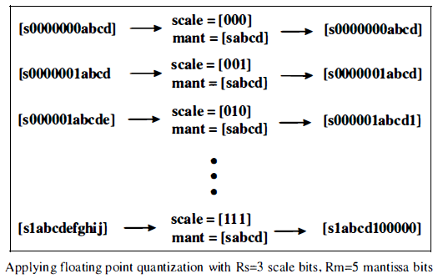
Floating Point Quantization
To convert from a scale-mantissa floating point code with R_{s} scale bits and R_{m} mantissa bits into a number:
Example (R_{m} = 5 and R_{s} =3)
This eight bit total floating point quantizer reaches an accuracy at low signal levels comparable to a 12-bit uniform quantizer
We first quantize our input signals using a 12-bit uniform quantizer.
We use one of the five mantissa-bits to store the sign bit, and the remaining four mantissa-bits and the three scale-bits for storing the code.

Slide 23
Floating Point Quantization
Convention: the scale factor is set equal to zero when there are the maximum allowed seven leading zeros
We use this representation until the signal power reaches a level where the 12-bit quantization has less than seven leading zeros.
In this case, we know that the first bit following those zeros is a one and does not need to be stored so we use the four mantissa-bits to store the four bits after the leading one.
From this point all the way up to overload levels the quantization acts like a uniform quantizer with six bits corresponding to the sign bit, plus the leading one, plus the four other mantissa bits.
As seen in the last line of the example, for the lower order bits beyond what we stored in the mantissa bits we split the difference and use a 1 followed by zeros when we recreate the 12-bit code.
Once the 12-bit code is created we dequantize it back onto output signals as described in the previous section for uniform quantizers.

Slide 24
Block Floating Point
Several floating point numbers are encoded using the same value of the scale factor to cut down on the number of scale bits used per number
If the numbers are of different sizes, this method limits the ability of adjusting its bin sizes to the numbers being quantized.
In this case, the signal SNR decreases for those values that are lower than the one used to set the exponent for the block.
In general, to implement block floating point quantization, the scale factor for the group of numbers is set to the scale factor of the number with the largest absolute value.
That single scale factor is then used to floating point quantize and dequantize all of the numbers in the group using floating point quantization.
Both scale factor and block floating point are used in MPEG-1 coding.
Notes:
Here introduces some tricks to reduce the number of bits to represent the scale bits.

Slide 25
Huffman Coding

Slide 26
Coding of Digital Symbols
Quantization is to represent one particular sample (symbol) value.
We now consider how to represent a set of symbols by using a minimum number of bits
Among all available digital symbols, some are more frequently used and the others may be used rarely
To transmit or store these symbols, we need to minimize the required channel bandwidth or storage capacity, and to maintain the required service quality, i.e., the quality of audios
Entropy coding is used to remove the redundancy of the code by exploiting the likelihood of the symbol occurrence
This is implemented by estimating the probability of each possible code, (as a descriptor for the source of the signals, for example, the probability of using a word in the dictionary).

Slide 27
Entropy Coding - Huffman Coding
To obtain a code of variable length for reducing the overall number of bits to be transmitted/stored.
The main idea is to use a shorter code length for frequently-occurring symbols and longer code length for seldom-occurring symbols.
Example: we may have
2-bit quantized signal that has symbols: [00],[01],[10],[11], with their respective probabilities of 70%,13%,10%, 7%.
Using Huffman coding to generate a variable-length code
Notes:
Entropy coding is to further reduce the no. of bits of audio samples without incurring any lost of information. An important operation of Entropy coding is to determine the statistics of the audio codes. Therefore, audio code does not need to be the same length.
The main idea to reduce coding length is to use a shorter code length for frequently-occurring symbols.
Eg: variable x and y with two events A and B. In x, prob of event A happening is 50% and B happening is 50%. In y, prob of event A happening is 90% and B happening is 10%. Therefore, x has a higher uncertainty measure and y has less uncertainty. We code y differently under events A (with shorter code) and B (with longer code). Use same code length for variable x.

Slide 28
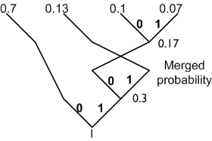
Steps of Huffman Coding
Arrange all these symbols according to the descending order of their probabilities of occurrence
Combine the pair of symbols with two smallest probabilities as one whose probability is the sum of the probabilities of these two symbols.
Assign 0 and 1 to the two branches that are merged
Repeat steps 1), 2) and 3) until all the symbols have been dealt with
The code words are obtained by reading 0 (or 1) along the branch from the top to the root.
Example:
Probabilities: 0.7 0.13 0.1 0.07
Symbols: 00 01 10 11
Code words: 0 11 001 101
Note: a swap of the branches is performed to meet the condition in 1), i.e., the branches with the probabilities of 0.13 and 0.17 are swapped.
Notes:
We will use a simple example to illustrate the concept of Huffman Coding.
Place all the symbols in a descending order of their probabilities. Assign 1 and 0 to the lowest probabilities of the two symbols.
Combine the probabilities of the two symbols into one. Assign 1 and 0 to the combined symbol and the symbol with the next lower probability.
This process repeats until all the symbols have been dealt with
.
Therefore, those symbols which have the lowest prob are assigned code words with more bits, and vice versa.
The final code words are obtained by reading the value of 1 or 0 from the top of the coding tree to the symbol. For example, for symbol 11, we read 1 1 1, for symbol 10, we read 1 1 0, for 01, we read 1 0 and for 00 we read 0.
On average fewer bit per code is obtained using Huffman coding.

Slide 29
Performance of Huffman Coding
Measures of coding efficiency
Average code length is defined by
where N is the number of symbols, l_{n} is the number of bits for the nth symbols and p_{n} is the probability of the nth symbol.
Entropy is a function of the probabilities, P_{n}, of the code symbol being the nth code:
log₂(p_{n}) is the uncertainty of a symbol., for example, p_{n} is 1 or 0 means very certain (E =0); p_{n} is 0.5 means not very certain (E = 1).
Shannon proved that entropy coding results in the lowest number of bits/symbol that any coder could produce.
Coding Efficiency = E/L
Notes:
We will use a simple example to illustrate the concept of Huffman Coding.
Place all the symbols in a descending order of their probabilities. Assign 1 and 0 to the lowest probabilities of the two symbols.
Combine the probabilities of the two symbols into one. Assign 1 and 0 to the combined symbol and the symbol with the next lower probability.
This process repeats until all the symbols have been dealt with
.
Therefore, those symbols which have the lowest prob are assigned code words with more bits, and vice versa.
The final code words are obtained by reading the value of 1 or 0 from the top of the coding tree to the symbol. For example, for symbol 11, we read 1 1 1, for symbol 10, we read 1 1 0, for 01, we read 1 0 and for 00 we read 0.
On average fewer bit per code is obtained using Huffman coding.

Slide 30
Entropy Coding - Huffman Coding
Example:
L = 0.7 x 1 + 0.13 x 2 + 0.1 x 3 + 0.07 x 3 =1.47
Coding Efficiency = E/L =1.3435/1.47=0.9139
Summary:
Entropy coding exploits the redundancy in the signal representation to provide new representation with fewer bits for the same information.
Entropy is a measure of the information with a minimum number of bits needed to represent a given signal.
p_{n} | 0.7 | 0.13 | 0.1 | 0.07 | Entropy
p_{n}log₂(1/p_{n}) | 0.3602 | 0.3826 | 0.3322 | 0.2685 | 1.3435
Notes:
Here shows how we can compute the effectiveness of employing EC.
Entropy is defined as the sum of [prob * log2 (inversed prob)]
If E is high (~1) there is no adv in using EC and has the same number of bits/code as normal code.
If E is low (~0), we can use a smaller bit/code.
Ex:
Using the E expression, we can plot E vs. p. When p = 0 or 1, E = 0. When p = 0.5, E = 1. It is a semi-circle.

Slide 31
Frequency Domain Representation

Slide 32
Frequency Domain Representation
Time domain signal representation may not be useful to reveal meaningful information
Frequency domain signal representation is effective to show the characteristics of the signals
Demo Example, which shows
The signal is a noise distorted single frequency sinusoidal wave
Different frequencies are associated with different sounds
Easily verify that it is much easier to reveal useful information in freq. domain
Signal analysis in frequency domain has been extremely important for many applications.
Among many available methods, discrete Fourier transform, (DFT) and discrete cosine transform (DCT) have been used in audio and image applications as well as other applications
Notes:
We shall look at the basics of signal analysis in the frequency domain.
It is much easier to reveal signal information in the frequency domain. The demo example shows the close relationship between the sound and the frequency, i.e., each frequency is associated a unique sound.
The discrete Fourier transform (DFT) is the most widely used transform used for the analysis of digital signals. The discrete cosine transform is also widely used, particularly for the audio signal processing.

Slide 33
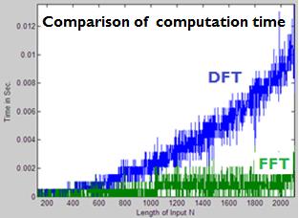
Frequency Domain Representation
THE DISCRETE FOURIER TRANSFORM (DFT)
The DFT takes an N-point sequence x(n) in the time domain to produce an N-point sequence, X(k), in the frequency domain. The N-point DFT of x(n) is defined by
where W_{N} = e^{-j2π/N}.
The inverse DFT to obtain x(n) from X(k) is
Because we compute the DFT of N-point only, a window of N-point has to be used to capture the segment of input data stream
Fast Fourier transform (FFT) has the same definition as the DFT and performs the significantly faster computation.
Notes:
The DFT is used to deal with the digital signal. It should be understand that DFT gives the samples of the signal spectrum. Therefore, the length of the DFT, N, is an important parameter
to determine the frequency resolution and temporal resolution. We shall discuss these concept soon.
To reduce the computational complexity, we use FFT to compute the DFT. The FFT gives the same output of the DFT, with a much smaller computation complexity.
For example, we may same 100 times of computation time for a 1024 point DFT computation by using FFT.

Slide 34
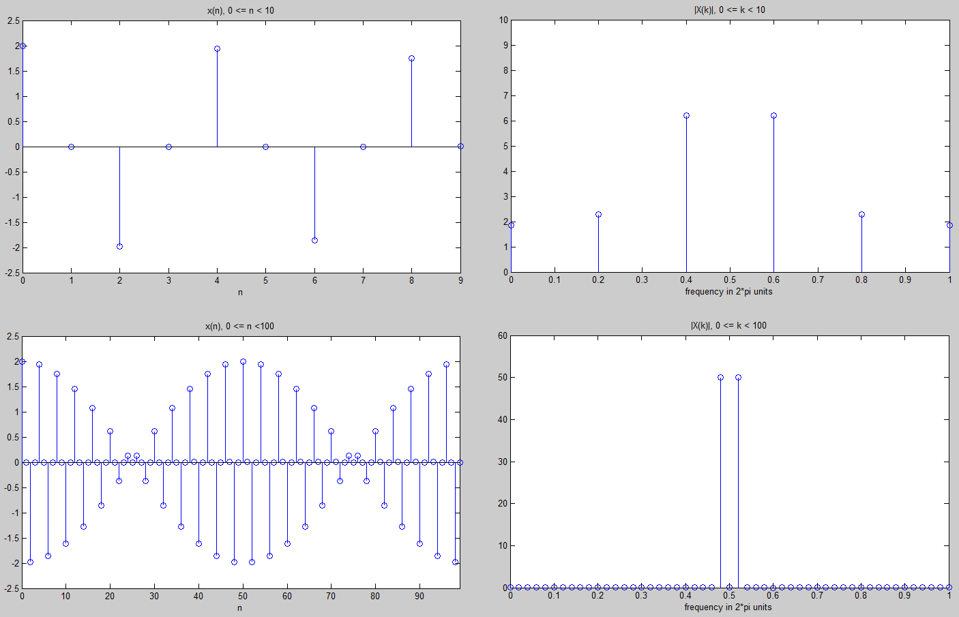
Frequency Domain Representation
Example: Consider x(n) = [cos(0.48πn) + cos(0.52πn)]w(n), where w(n) = 1 for n=0, N-1, otherwise w(n)=0.
Determine and plot the DFT of x(n) for N=10;
Determine and plot the DFT of x(n) for N=100.
Because N=10 is too small, the DFT of 10 points is not usable (poor resolution)
Better resolution in the frequency domain is obtained only when enough data (e.g. large N) are collected. For example, we can accurately guess the frequencies (the peak location) in the signal when N = 100
The obtained DFT is the DFT of the product, [cos(0.48πn) + cos(0.52πn)]*w(n), instead of the DFT of cos(0.48πn) + cos(0.52πn), where w(n) is the window function.
Notes:
This example shows the difference of using different lengths of the DFT. When N=100, the DFT outputs clearly give two values to indicate that the signal has two frequencies.
When N=10, such a conclusion is not possible. Therefore, the case of N=100 provides truthful information because it it has better frequency resolution.
In general, the more signal samples we have, the better information we can reveal from these samples. Therefore, sufficient frequency resolution has to be obtained from sufficient number of signal samples.

Slide 35
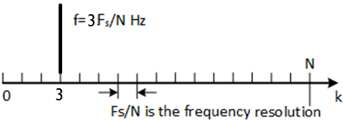
Frequency Domain Representation
The following understandings of the DFT outputs are most important.
The frequency resolution is defined as Δf = B_{s}/M, where B_{s} is the signal bandwidth and M is the number of points used to represent the signal spectrum.
In practice, we assume B_{s} = F_{s}/2 (Hz). and DFT uses N/2 values to represent B_{s} for real signal.
Therefore, Δf = (F_{s}/2 )/(N/2) = F_{s}/N, (Hz) see the figure below.
The kth DFT value there is a component at the frequency band kF_{s} /N Hz, i.e., for k=3, it is 3F_{s} /N Hz.
Notes:
The definition of frequency resolution is defined here.
Here also shows how to use the DFT output to calculate the frequency in Hz.

Slide 36
Frequency Domain Representation
Example: A digital data sequence is obtained by a sampling frequency of 8 kHz. Calculate the frequency resolution provided by a DFT (or FFT) of 256 and 512 samples, respectively.
Solution: The frequency resolution is defined by Δf = F_{s}/N. Therefore the frequency resolution is
ΔF= 8k/256 = 31.35 Hz and 8k/512=15.625 Hz
An FFT with a large N provides a better frequency resolution.
In general, a large N for FFT requires a large processing delay, which deduces the temporal resolution
The temporal resolution is defined by ΔT=1/Δf=NT_{s}=N/F_{s,} where T_{s} and F_{s} are the sample interval and sampling frequency, respectively
Another consequence for a large N is the increase of the computation complexity. For example, the FFT algorithm requires the number of multiplications and additions proportional to Nlog₂N.
Notes:
More information on frequency resolution. The smaller value of DF is, the higher the frequency resolution.
Also temporal resolution is also defined as 1/(DF). The temporal resolution indicates how long it will take to respond any change of the signal statistics. Considering the worst case, we assume the signal statistics change from the next input sample. Because the FFT need to wait for the next N samples before starting another computation, the time duration to respond the signal statistics change is N samples. Therefor DT = N/Fs.
These concepts will be used in latter lectures.
The computation complexity for a DFT is N*N and for FFT is N*log_2(N). For large N, the reduction of computational complexity by the FFT is significant.

Slide 37

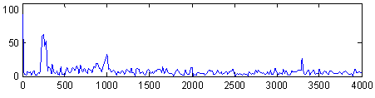
Frequency Domain Representation
The DFT is particularly useful for signals whose frequencies do not change with time.
It only tells what the frequencies are in the signal.
When the frequencies are changed with time, such as speech and audio, DFT does not tell when the frequencies are generated and when the frequencies disappears.
The top figure is easily related to the sound content, i.e., the frequency characteristics changing with time.
The DFT in the bottom figure does not provide good information on the sound contents.
Notes:
Here we introduce the concept of time varying signal. Audio signals usually have frequencies that changes with time. The DFT is not suitable to deal with the time varying signal. DFT also has the problem of dealing with very long signal because it will need inhibitive cost of hardware.
To deal with such signals, we generally divide the data stream into many small segment and perform the DFT of each segment to form a time-frequency representation.
Comparing the DFT (bottom) and the time frequency representation for a audio clip, it is obviously the STFT gives meaningful information.

Slide 38
Frequency Domain Representation
Also a DFT processes only N samples, and cannot deal with continuous data stream
An feasible method is to compute the consecutive segments of the input stream.
These segments are obtained by using a window function. The frequencies are assumed to be unchanged within the window duration.
The window shape should be adaptively selected according to the content of the input signal (more discussion in later weeks).
This operation is known as the short-time Fourier transform (STFT), which is often used for spectrum analysis.
In audio coding, we adaptively use different window lengths for spectrum analysis.

Slide 39
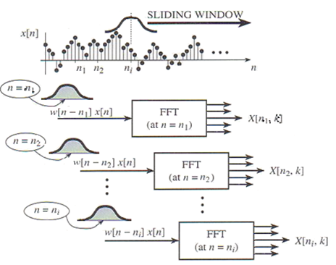
Frequency Domain Representation
The spectrum located at n₀ is defined as
where w[n] is an N-point window function to divide the input into N-point segments, n₀ is the current time index and k is the index of DFT.
For each n₀, the STFT is an DFT operation.
For better performance, an overlap between the adjacent segments is generally used.
The STFT is a sequence of N-point DFTs. The spectrogram of x(n) is defined as |STFT(x, n₀, k)| or log|STFT(x, n₀, k)|, which is a function of n₀ and k.
Notes:
Here is the definition of the STFT and illustration of the STFT.

Slide 40
Frequency Domain Representation
Effects of Windows
We should clearly understand that the window function is not a part of signal. It is necessary only because we use it to capture a signal segment.
The output of STFT is the spectrum of the product of the window function and the input signal segment, instead of the spectrum of the signal segment that we hope to have .
A process to remove the effect of the window function will be introduced in latter lectures
The length of the window function is also very much relevant to the frequency resolution and temporal resolution offered by the STFT.
Notes:
Here is an example of dealing with the piano notes by using the STFT.
Some issues of STFT are also mentioned.

Slide 41
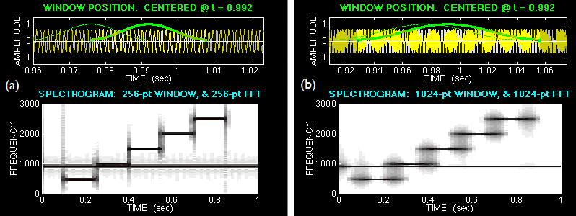
Frequency Domain Representation
The window lengths for (a) and (b) are 256 and 1024 points, respectively.
(a) maintains reasonable resolutions in both time and frequency domains (horizontal and vertical directions), and reveals the true information.
(b) uses a long window in the time domain (poor time resolution) and achieves a thinner line (high frequency resolution).
(b) is not usable since the frequency components are overlapped, which is not truthfully reveal the signal information.
The compromise between the resolutions in the time and frequency domains is made by carefully select window length, which will be further discussed latter.

Slide 42
Frequency Domain Representation
We generally compute the SPL of signal frequencies with the equation
where X(k) is the kth DFT value of input, <w²> is the window power factor, N is the length of the DFT.
The range of k for the sum is from 1 to N/2 and others are ignored, due to the symmetric property of the DFT.
For example, <w²> is the window energy which is 1 for rectangular window and 1/ 2 for hamming and sine windows.
This SPL is used in calculating the effect of masking
Notes:
Here gives the formula to compute the sound pressure level in terms of the frequency. This equation has been widely used in the audio coding process.
This equation is carefully derived for practical applications, some desirable features are to be mentioned in the tutorial questions.

Slide 43
Audio Applications

Slide 44
Current Practice of Audio Coding
The basic requirement is to reduce the data, as much as possible, to be transmitted or stored without losing the quality perceived by human hearing system
The main coding process is lossy to meet the above requirements by throwing away those audio information that is not audible.
Although not possible to reproduce the actual uncompressed audio at the audio player, our ears still perceive the audio with very good sound quality.
The term “CD quality” is often referred to compressed audio that sounds like true CD (44.1 kHz, 16 bits/samples), see comparisons below.
Example: Compare Serenade-op.6_wave (17.2 Mb) with
Serenade_op.6_mp3 (2.2 Mb)
Notes:
The MP3/AAC are all lossy audio coding. We are able to reduce the storage for these compressed audio by throwing away those audio samples that are not audible. Therefore, we cannot fully reproduce the actual uncompress audio at the audio player. However, we do not mind as our ears still perceive the audio signals with pretty good quality.
The term “CD quality” is often referred to compressed audio that sounds like CD (44.1 kHz, 16 bits/samples) which is not the original waveform, but it sounds as the original one.
Without compression, a CD is able to store about 40 minutes of stereo music only, compared to the compressed music of more than 500 minutes.

Slide 45
The Aim of Digital Audio Coding
What is a Digital Audio Coder?
Digital Audio Coder
Audio source
How to represent
sound source?
How to describe it?
Ear (perceptually identical to the input)
How to model the ear processing acoustical stimuli?
How to reduce amount of information (bits) needed to represent the signal by throwing away perceptually irrelevant information without sacrificing the sound quality?
Notes:
Here, we show a simple block diagram of the digital audio coder, which is known as DAC. At the input of the DAC, we have our audio source (from CD, wavefiles, etc).
The important issues here are description of the digital audio source by using the parameters of sampling rate (frequency), the number of bits per sample …
At the output of the DAC, the receiver is normally the human ear. We need to understand how human perceives sounds (which you may have already studied).
In fact, we now have devices that can replace the human ear and come up with a score on the audio quality.
The challenge in any DAC is how to reduce the amount of information, for example, the no. of bits or samples per second, needed to represent the signal and yet sound the same as the original one by the human ear.
In another word, how do we keep the information received by our ears (for the desired quality) and ignore those not perceived by our ears (for the minimization of the required amount of data)
The benefits are usually to use smaller storage, smaller bandwidth required for transmission, and possibly less delay from Internet audio applications.

Slide 46
Important Factors in Audio Coding
Fidelity: perceptual quality is equivalent between output and input of the coder
Data rate: down load throughput, storage and bandwidth of system
Complexity: hardware and software costs in encoder/decoder
Coding delay:
Due to all kinds of processes from the sources to the human ears.
The tolerance on the amount of delays depend on different applications of real time requirements
Robust: able to work with different audio sources in various environments
Scalability: able to deal with mono, stereo, multi-channel signals at different rates
Flexibility: applicable to as many signal types as possible
Standard: fatal for any commercial development

Slide 47
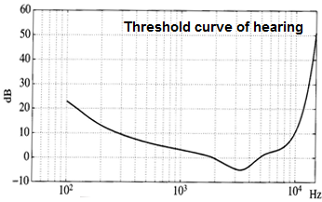
Human Hearing System
Human hearing system responds the signals in a frequency range as shown in the Figure below
Because the hearing systems respond differently to different frequency bands, we
divide the audio frequency range into different bands,
quantize each band separately with different number of bits
combine these coded signal bands for the restored signal
The figure is in terms of loudness in the frequency range.
Sound is not heard if the loudness level is below the curve
The most sensitive frequency range is from 1 to 6 kHz
Lower and higher frequency components require higher loudness level to be heard.

Slide 48
A more complex Audio Coder
In the frequency domain, we may allow users to allocate a suitable no. of bits to different frequency bands.
Because human ear is more sensitive at around 2-5 kHz, more bits are allocated for signal components in this frequency range and fewer bits allocated for signal components in other frequencies.
Further redundancy reduction can be performed by using:
Predicting the next few samples without using transmitted/stored samples (will be taught by Prof Lin)
Entropy coding for minimum transmitted /stored data
Perceptual masking to remove non audible data
The last two items will be considered.
Notes:
So far, the techniques we have learnt to reduce the bit rate are all based on manipulating the waveform in the time-domain.
A better approach is to examine the signal in its frequency domain. Working in this domain allows us to determine the number of bits/freq bin to transmit based on the human hearing mechanism.
We can combine different techniques to further reduce the bit rates needed to represent the audio samples without compromising the listening quality.

Slide 49
Applications
Consumer devices:
MP3 player
Mini Disc (Sony)
Game (Play Station)
DVD
Smart phone
Streaming and distribution:
Internet (communications, audio/video data distribution/braodcasting, online translation …)
Audio-on-demand (set-top box)
Satellite/Terrestrial audio broadcast (DAB)
Digital TV with multi-channel surround
Digital film
Audio is fast moving towards a total digital technology in capture, storage, post production, pre- and post-processing, exchange and distribution.
Notes:
Before moving into the details of coding techniques. Let us take a look at some easy stuff on applications.
Audio is fast moving towards a total digital technology in capture, storage, post production, pre- and post-processing, exchange and distribution for various applications.

Slide 50
Data reduction by quality reduction
Name | No. of Samples Per sec | No of bits Per Sample | No. of Channels | Freq range (Hz) | SNR (dB) | PCM bit rate (kbps)
DVD | 96000 | 24 | 6 | 48k | 144 | 13,824
DAT | 48000 | 16 | 2 | 24k | 96 | 1,536
CD | 44100 | 16 | 2 | 22k | 96 | 1,411
FM | 32000 | 12 | 2 | 16k | 72 | 768
PC | 22050 | 12 | 2 | 11k | 48 | 176
Phone | 8000 | 8 | 1 | 3.4k | 48 | 64
The above shows the parameters of a few common applications
The audio quality is reduced as the data rate decreases
The data rate is computed by
F_{s} (sample/sec) x b (bit/sample) x c (channel)
Notes:
This is a useful table that highlights the parameters of data streams for different media/player. For example, DVD requires 13,824 bits/sec, and the CD uses 1411 bits/second.
Note the important parameters in reducing the bit rate.
Since Fs and no. of channels are fixed for certain playback system, the only way to reduce bit rate is to reduce the number of bits/sample.

Slide 51
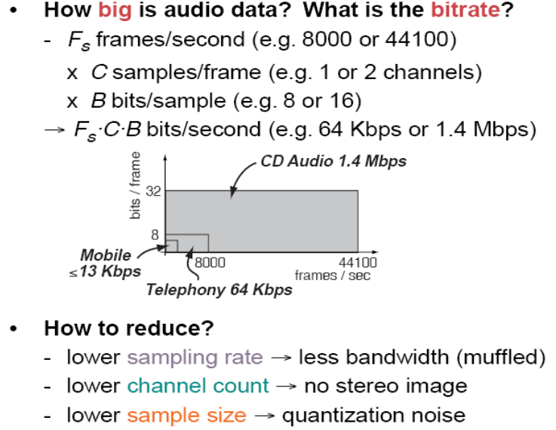
Notes:
Here shows you the way of calculating the number of bits per second to be transmitted or stored.
We can easily calculate the bitrate, by using the formula FsxCxB, needed by each application based on the formula given in this slide.
To reduce the bit rate, we can reduce the sampling rate, low channel count and the number of bits used for representing the samples. All these measures generally lead to low quality of the audios
The sampling rate reduction leads to the muffled sounds, the channel number reduction means the sound is not stereo and losing spatial information, and the low number of bit representation introduce more quantization noise.

Slide 52
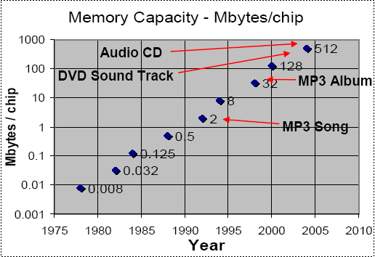
Memory Required for Audio
32 x 8 Mbits = 128 kbits/sec * T sec ➔ T = 34 mins
2 x 8 Mbits = 128 kbit/sec * T ➔ T = 2 mins
Notes:
This plot shows the memory capacity advancement over the years in the past.
32 x 8 Mbits = 128 kbits/sec * T sec
➔ T = 34 mins
2 x 8 Mbits = 128 kbit/sec * T
➔ T = 2 mins

Slide 53
Some Practical Questions
Example 1. How long (in minute) can a CD stereo sound tracks be saved onto a 1000 Mbyte in the hard disk drive? How much longer (in minute) can be saved if a compression algorithm with 4:1 ratio is used?
1000M * 8 /( 60 * 44.1k * 16 * 2) = 88.57 mins
88.57 x 4 = 354.3 mins
Example 2. The bit rate of the CD is 2x44.1kx16 = 1.41Mbps. But CD needs a significant overhead for runlength-limited line code for synchronization, error correction of up to 49 bits for every 16-bit audio samples. What is the total stereo bit rate? What is the % overhead ?
Total bit rate = 44.1k*2*49 = 4.32 Mbps
% overhead = (49-16)/49 * 100% = 67%
The overhead requires even more downloading time.
Notes:
Therefore, there is an urgent need for minimizing the amount of data to represent audio signals.

Slide 54
How much compression is required?
Example 3. Network channels have a bit rate capacity of 2 Mbps. What is the compression ratio to deliver a stereo audio signal (DAT) sampling with 16 bit/s? (Assuming 2/3 of network data are used for error correction)
Compression ratio =
(48 kHz x 16 bit/s x 2 channels x 3) / 2Mbps = 4.608/2
Can you listen on line this high quality audio? Why not?
Similarly, for a speech signal, sampling at 8 kHz, with PCM of 12 bits can be reduced to 8 bits using nonuniform quantizer to fit in a bit rate of 64 kbps for PSTN.
The compression ratio is only 1.5:1.
Notes:
These examples shows the importance of compression.

Slide 55
How to reduce data rate?
Do not transmit or store anything that the ears cannot hear (irrelevant data that are perceptually insignificant)
Allow some quantization noise that cannot be heard, (means that the samples can be represented by fewer bits).
We need to understand psychoacoustics:
Range of human hearing loudness curve (do not send these components that are out of hearing range, also do not send these components that below the hearing threshold)
Remove redundant information:
Sample at the right frequency
Remove correlated data
Make use of masking phenomena: frequency masking and temporal masking
Notes:
Let us have a close look at some phenomenon that can be used for compression of audio signals.
Our ear is more sensitive to the middle freq. range, and less sensitive to low and high freq. Then, those signal components falling below the hearing threshold needs not be coded.
Also, when there is a loud signal present, it raises the hearing threshold masking curve and prevents neighboring components from being heard. These components may not be necessarily coded.

Slide 56
Ear can accommodate a very wide dynamic range (DR) of about 140 dB. Equivalent to sound intensity of 10¹² to 1 (0 dB SPL)
Ear sensitivity is freq dependent. Max sensitivity occurs at 1 to 5kHz, where we hear signals several dB below 0 dB.
Relative insensitive at low and high freq., Eg. 20 Hz tone would have to be approx 70 dB louder than 1 kHz tone to be barely audible.
A perceptual coder compares the input signal to the minimum threshold, and discards signal that falls below the threshold, because the ear cannot hear this signal.

Slide 57
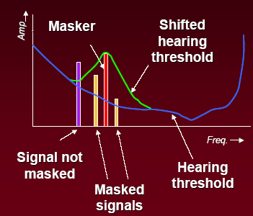
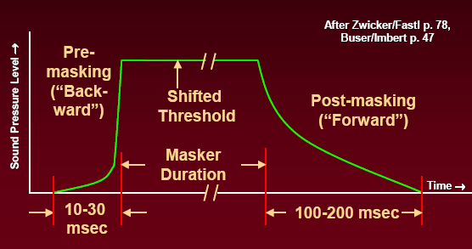
How to reduce data rate?
Masking: masking is the process by which the threshold of hearing for one sound is raised by the presence of another sound.
Frequency masking is due to the fact that the hearing system has a limited frequency resolution to distinguish different frequencies in the audio signal.
Temporal masking is also used for compression.
Notes:
Let us have a close look at some phenomenon that can be used for compression of audio signals.
Our ear is more sensitive to the middle freq. range, and less sensitive to low and high freq. Then, those signal components falling below the hearing threshold needs not be coded.
Also, when there is a loud signal present, it raises the hearing threshold masking curve and prevents neighboring components from being heard. These components may not be necessarily coded.
This effect is known as the freq or simultaneous masking. Please see the first figure.
There is yet another masking phenomenon (illustrated in the second figure), which is based on the time effects.
If a loud masker is present, a softer signal that comes before or after the main masker will NOT be heard. There were experiments conducted to show the effectiveness of temporal masking.
Why is there such an effect? It is because the ear needs some time to perceive the loudness. For postmasking, it is just like a capacitor that will take some time to discharge the loudness perception.
For premasking, we are temporary deaf before a loud signal comes in. But the effect is only for a very short period. Our hearing system needs some time process the received signal. When a louder sound arrives before the completion of receiving the previous sound, the hearing system stop the processing and start to receive the louder sound. For example, switching from one soft channel to another loud channel.
All these phenomena are related to the capacity of our reception system to deal with sudden events.

Slide 58
Frequency Masking
Masking refers to a process where one sound is rendered inaudible because of the presence of another sound.
It is mainly because the presence of a strong noise or tone masker creates an excitation of sufficient strength on the basilar membrane at the critical band location to block effectively detection of a weaker signal.
We shall mainly consider two types of simultaneous masking, namely noise-masking-tone (NMT), and tone-masking-noise (TMN).
Tone-masking-tone (TMT) can be easily described.
Noise-masking-noise (NMN) is more difficult to characterize.

Slide 59
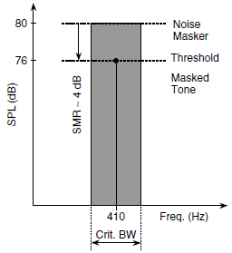
Noise masking tone
A narrowband noise (e.g., having 1 Bark bandwidth) masks a tone within the same critical band,
The intensity of the masked tone is below a predictable threshold given at the centre frequency of the masking noise.
The threshold of detection is the smallest difference between the SPL of the masking noise and the SPL of the masked tone when the frequency of the masked tone is close to the masker’s centre frequency.
The figure shows that, a critical band noise masker cantered at 410 Hz with an intensity of 80 db SPL masks a 410 Hz tone, and the resulting signal to minimum masking ratio (SMR) at the threshold of detection is 4 dB.

Slide 60
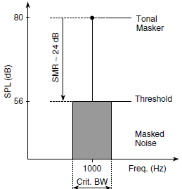
Tone masking noise
A pure tone at the centre of a CB masks narrow band noise, provided the noise spectrum is below a predictable threshold directly related to the strength of a centre frequency of the masking tone.
The smallest difference between the intensity of the masking tone and the intensity of the masked noise occurs when the masker frequency is close to the centre frequency of the probe noise, i.e., between 21 and 28 dB.
In the figure, a narrowband noise of one Bark bandwidth centred at 1 kHz is masked by a 1 kHz tone of intensity 80 dB SPL.
The resulting SMR at the threshold of detection is 24 dB.
Similar to NMT, the TMN masking power decreases for the narrow noise moving away from the masker.

Slide 61
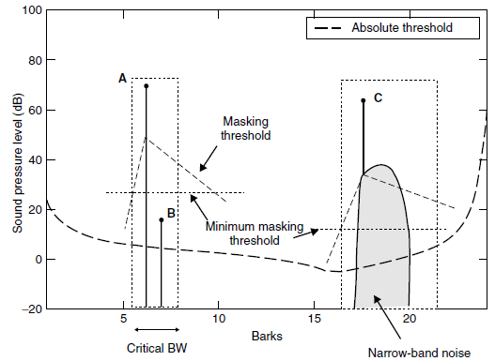
Example
Consider the Figure below. State whether tone B would be masked by tone A and whether tone C would mask the narrow-band noise. Give reasons.
Solutions:
Tone B is masked by tone A since B is near A and has a much smaller SPL
It is likely the narrow band noise C is audible since it SPL is higher than the masking threshold.
In general, the SMR is much larger for TMN than that for NMT since narrow band noise has more impact on our basilar membrane.

Slide 62
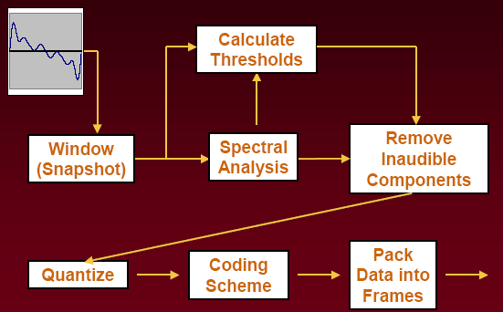
General Block Diagram for audio encoding
We would like to throw away the vast majority of data and still end up with something that sounds very much like the original
This is a general block diagram of an audio coder.
The input data stream is segmented into successive data segments. Each segment will be analyzed by the spectral analyzer.
At the same time, the masking threshold is also derived for the data segment.
Based on the masking threshold information obtained, only some frequencies and data samples are selected for quantization. Some inaudible components will be removed.

Slide 63
General Block Diagram for Lossy Audio Encoding
The survived data are quantized into some discrete values which are further coded by an efficient coding algorithms.
Finally, the coded data are arranged into a defined format for transmission or storage.
A reverse process is to be performed for recovering the original information from the coded data.
We will show the details on the techniques used to compute the power spectrum, derive the masking threshold and bit assignment in the following lectures.
Related signal processing techniques, such as sampling, quantization, Fourier transforms, filter banks, used for audio coding will be also examined.

Slide 64
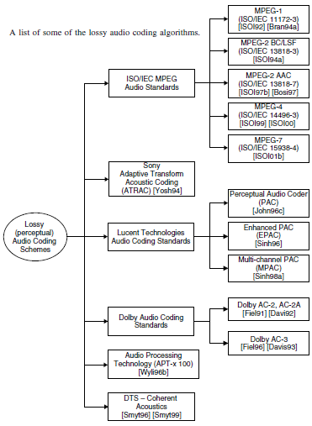
Lossy Compression Algorithms
We shall learn only some basic concepts for compression that are used to support MPEG standards
Although other standards (see figure) are still used, they are not widely used for the main applications.
Compatibilities among various standards have been maintained to ensure the compressed audio is playable.
Compression ratio is in the range of 10:1-25:1

Slide 65
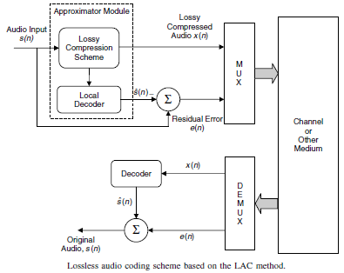
Lossless Coding Algorithms
The basic idea is to remove the statistical dependencies associated with the signal via prediction techniques.
This provides a close approximation to the input audio and a low variance prediction residual
The residual error is entropy coded and used for reconstruction of the original signal
Notes:
Here briefly introduce the principle of lossless coding concept. Due to the time constraint, we shall not pursuit this type of compression method.

Slide 66
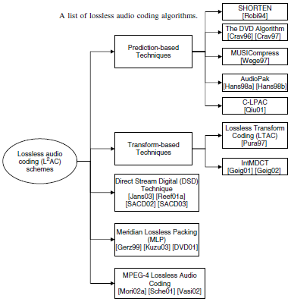
Lossless Coding Algorithms
Lossless audio coding (L²AC) is for high-end storage format such as DVD audio and super-audio CD (SACD)
Compression ratio of L²AC is 2:1-4:1.
Not for real-time storage processing and Internet streaming
Notes:
Here is the summary of lossless methods reported in the literature.

Slide 67
Sub-band coding
Notes:
As mentioned in the previous lecture, we need to reveal the frequency contents of the input signal for data compression. Therefore, translation of input signals from the time domain to frequency domain is one important step in audio coding.
In general, there are two ways of translating signals from the time to frequency domain. The first one is known as sub-band approach and the second one is transform approach. This lecture concerns with the sub-band approach and the next lecture is focused on the transform approach. General differences between these two approaches will be also pointed out.

Slide 68
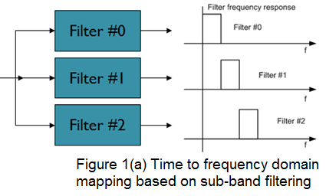
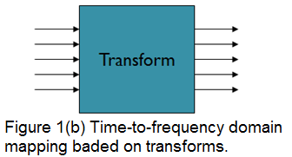
General concepts
Subband and transform approaches
Sub-band approaches use a small number of sub-band filters (time domain processing)
Transform approaches use a large number of subbands (frequency domain processing)
Notes:
The sub-band approach uses a bank of parallel filters, as shown in Figure 1(a), to separate the time-domain signal into a number of frequency bands. It is a time-domain operation because these sub-band filters are implemented in the time domain. It should be understood that the output of each filter will determine the energy of the signal that belongs to a particular band of frequencies.
In contrast, the transform approach (to be discussed latter) uses transforms such as fast Fourier transform (FFT), or modified discrete cosine transform (MDCT), to convert the time domain signal into frequency domain, as shown in Figure 1(b). The outputs of the transform are generally called frequency bins, which are represented by individual values. One way to differentiate the two approaches is that, the transform approach usually produces many parallel outputs compared to a few narrow signal bands produced by the sub-band approach.

Slide 69
General concepts
The signal energy that belongs to a particular band of frequencies can be measured from these parallel outputs
Because the sub-filters process the input signals whenever they are available, the sub-band filters provide a better time or temporal resolution.
The transform approach uses FFT or MDCT to convert the time domain signal into many spectrum bins in the frequency domain.
Because the transform based coders generally provide information of more subbands (or frequency bins), it may require higher computational costs
It may also have longer processing delay due to the block-based processing style.
Notes:
The outputs given by either the sub-band approach, or the transform approach are used to compute the signal energy, in the signal sub-band or carried by the frequency bins. Then a suitable coding strategy is to be determined based on the signal energy. We shall see how the coding strategies are determined in latter lectures
Because the sub-band filters process the input signals whenever they are available, the sub-band filters provide a better time domain or temporal resolution.
In contrast, the transform approach has poor time resolution because the transform needs to collect a block of N samples before processing. However, the transform approach generally has a better resolution in the frequency domain than that provided by the sub-band approach.
Because the transform approach generally provides more information in the frequency domain, it may require higher computational complexity compared to sub-band approach. Furthermore, the transform approach may have longer processing delay due to the block-based processing style, which may not be desirable for practical applications.

Slide 70
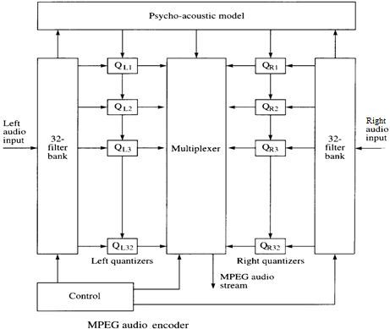
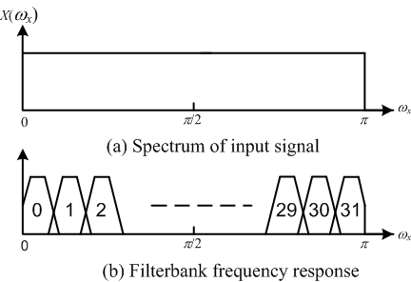
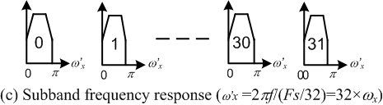
Subband Coding
Quantizing each channel output
A general block diagram of MPEG audio coder is shown.
It has left and right channels, each is divided into 32 subbands
Each subband is quantized individually.
Notes:
Let us consider a general encoder based on sub-band approaches. This figure shows a block diagram that deals with left and right channels of the audio signals. The input signal of each channel is firstly separated into 32 sub-bands by a filter bank. Each sub-channel is quantized by a quantizer.
Figure (b) shows the bandwidths of the input signal and each sub-band.
Figure (c) shows that the sub-band bandwidth is 32 time smaller than the input signal bandwidth.
In the figure of the encoder, the block of psycho-acoustic model computes the global masking threshold from the input signal. Because these separated narrow sub-band signals have different impacts on our hearing system, each quantizer will decide a suitable number of bits to represent its signal content, based on the information given by the psycho-acoustic model. It is very often that the entire sub-channel is ignored because it is not audible.
After quantization of these narrow band signals, the outputs of the quantizers are combined together and are placed into the output data frame.

Slide 71
Subband Coding
In the Figure:
The spectrum of the input signal
The frequency response of a filter bank
Each sub-band is treated as a baseband signal.
Because the bandwidth of each sub-band is 32 times smaller than the input signal bandwidth, the sampling frequency of the each sub-band should be also 32 times smaller of the input sampling frequency of the filter bank.
Notes:
This slide explicitly explains the figures in the previous slide.
Because the bandwidth of each sub-band is 32 times smaller than the input signal bandwidth, the sampling frequency of the each sub-band should be also 32 times smaller than that of the input signal of the filter bank.
To minimize the computational complexity, we generally hope to use the sampling frequency as small as possible. We have learnt the sampling theorem, that is the sampling rate should be larger than two times of the signal bandwidth. Therefore, a sampling frequency conversion is performed to reduce the sampling rate of these sub-band signals.

Slide 72
Sampling Rate Conversion
Based on sampling theorem, the minimum bandwidth of each sub-band should be F’_{s}=F_{s}/32 without any signal distortion for recovery.
Therefore, a sampling rate decrease by 32 times has to be performed on the filtered sub-band, which also reduces the work loads of quatizers.
A sampling rate increase by 32 times has also to be performed when these sub-band are assembled at the decoder side.
http://wiki.benchmarkmedia.com/wiki/index.php/Sample-rate
Notes:
Based on sampling theorem, the minimum bandwidth of each sub-band should be F_{s} /32 without any signal distortion for recovery.
A sampling rate reduction by 32 times has to be performed on the sub-bands before the quantizers. The operation to reduce the sampling frequency is known as decimation.
Of course, a sampling rate increase by 32 times has also to be performed when these sub-bands are assembled at the decoder side. The operation of increasing sampling frequency is called interpolation.
The operations of decimation and interpolation are performed by the combination of low pass filtering and up sampling, or down sampling. We will not spend more time on the topic of sampling rate conversion. Interested students may find more information from the given web site.

Slide 73
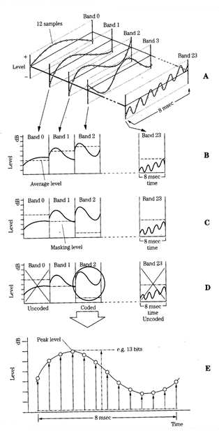
An Example of Subband Coder
A: 24-band sub-band filter
B: Calculate the average level in each subband
C: Calculate masking threshold in each sub-band
D: Subband below masking threshold are NOT coded
E: Bits allocated according to peak level above masking threshold.
Notes:
Let us consider an example to show how the outputs of the sub-band filters are used in audio compression. It is assumed that the input signal is divided into 24 sub-bands. Each sub-band has its own spectrum content in the frequency domain, as shown in step A. Then the average volume level of each sub-band is computed in step B. .
To consider the masking effects of some frequency components, step C calculates the masking threshold of each sub-band. The computation of the average volume and the masking threshold will be discussed in later lectures.
By comparing the average level of each sub-band with the masking threshold, we make decision if the sub-band is to be used for the coding output. In step D, the average levels of band 0 and band 23 are smaller than the masking threshold. Therefore, these two bands are ignored and are not to be used as the outputs of the coding process. We also observe that band one and band, two are used as the coding outputs since their volumes are larger than their own masking thresholds. The bands being ignored will not affect the audio quality since they are not audible by our hearing system.
In step E, a suitable number of bits are allocated to these bands according their frequency position and our hearing characteristics.

Slide 74
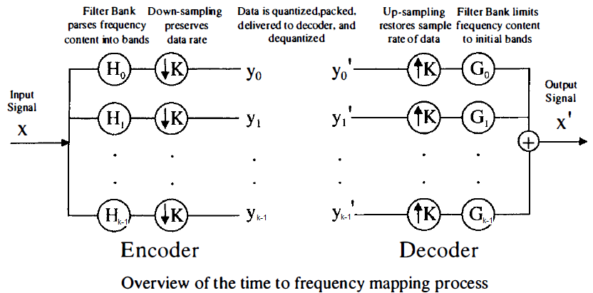
Details of Filter Bank
K sub-bands
Down sampling and up sampling are used.
Filters are needed before the down-sampler and down-sampler
Hope the input is the same as the output, i.e., x’(n) = Cx(n-D), known as perfect reconstruction.
Notes:
This slide shows a general block diagram of a filter bank. It divides the input signal into K sub-bands. To maintain the total output bit rate from all the sub-bands to be the same as the input bit rate, each filter output is down-sampled by K times as shown in the Figure.
The outputs of the down samplers are quantized and stored in the memory of transmitted.
At the decoder side, each branch input is firstly up-sampled and then filtered. These filtered outputs are combined together to produce an output signal. The up-sampling operation is necessary to provide the same bit rate as that of the output.
The concept of perfect reconstruction is important. Assuming connecting the outputs of down samplers to the inputs of the up-samplers, we hope the output of the decoder is the same as the input of the encoder, except a constant factor of amplitude scaling and a constant delay. It means that after all the signal processing operations, we can still obtain the original signal except a change of volume and a delay for applications.
To achieve the perfect reconstruction, the main task is to properly design the filters used in the encoder and those in the decoder, which will be discussed soon in this lecture.

Slide 75
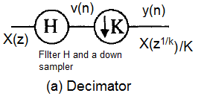
Details of Filter Bank
The decimator effectively decreases the sampling frequency by a factor of K without any distortion on the input signal
The time domain operation of the down-sampler is
y(n) = v(Kn)
and v(n) = x(n)ʘh(n), where ʘ is the linear convolution and h(n) is the impulse response of the filter H(z).
If the filter is properly designed, the input output relation of the decimator is described by
Y(z) = X(z^{1/k})/K
Notes:
Let us consider the basic operations used in the filter bank implementation.
Figure (a) shows the implementation of a decimator. It effectively decreases the sampling frequency of its input signal by a factor of K, without any distortion of the signal content.
The input signal first goes through a filter and then processed by a down sampler of factor K. The down sampler takes only one sample from every K samples as a valid output.
The time domain expression of the down sampler is given in the equation. The filter performs a linear convolution between the input x(n) and impulse response of the filter, h(n).
When the filter is properly designed to meet some condition, the relationship between the input and the output of the decimator is given by the equation below. It is seen that in Z-domain, the output Y(z) is expressed in terms its input with a variable of Z to power of 1 over K. Also the magnitude has a constant scaling factor of K.

Slide 76
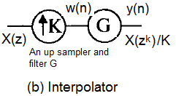
Details of Filter Bank
The interpolator effectively increase its input sampling frequency by a factor of K without any distortion on the input signal
The time domain operation of the up-sampler is
w(n) = x(m), if n = mK
otherwise y(n) =0.
It is equivalently to insert K-1 zero samples between any pare of input samples.
Then y(n) = w(n)ʘg(n), where ʘ is the linear convolution and g(n) is the impulse response of the filter G(z).
If the filter is properly designed, the input-output relation of the interpolator is described by
Y(z) = KX(z^{k})
Notes:
Similarly, we can describe some details of the interpolator, which performs the inverse operation of the decimator, that is to increase its input sampling frequency by a factor of K, without any distortion of the signal content.
Figure (b) shows the implementation of the interpolator. The input signal is first up sampled and then the outputs of the up-sampler are filtered.
The function of the up sampler is to insert K minus 1 zero valued samples in between any pair of adjacent input samples.
The time domain expression of the up-sampler is given in the equation.
The filter performs a linear convolution between its input w(n) and impulse response of the filter, g(n).
When the filter is properly designed to meet some condition, the relationship between the input and the output of the interpolator is given by the equation below.
It is seen that in Z-domain, the output Y(z) is expressed in terms its input, x(z), with a variable of z to power of K. Also the magnitude is multiplied by a constant scaling factor of K.
Without introducing further details of theoretical analysis of filter design, we shall consider how to achieve the perfect reconstruction.

Slide 77
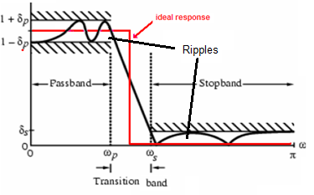
Details of Filter Bank
Because it is impossible to achieve the ideal filter response, ripples in the passband and stopband, as well as the transitional band distort the input signal.
It is desired to eliminate the distortions due to these phenomena.
By collectively considering the filters used in both the encoder and decoder, these undesirable distortions can be eliminated.
Notes:
The Figure in this slide shows the ideal filter response and the response we can possibly obtained. It has been proven that the physically implementable filter response must have the deviations in the pass band and stop band from the ideal filter response. These deviations are generally known as ripples. Also there exists a transitional band in the implementable filter response, as observed in the figure.
These ripples in the pass band and stop band, as well as the transitional band will bring about distortions to the input signal. For better performance, it is always desired that these distortions from imperfect filter design are to be removed.
By collectively considering the design of the filters used in the encoder and decoder, these undesirable distortions can be effectively eliminated.

Slide 78
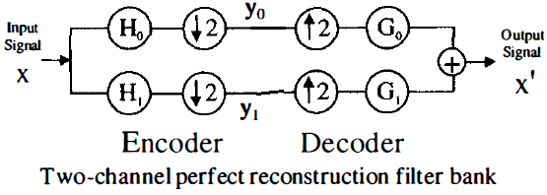
Details of Filter Bank
Assuming the outputs of the encoder, y₀ and y₁, are the inputs of the decoder, the output of the decoder is expressed by
X’(z) = Y₀(z²)G₀(z) + Y₁(z²)G₁(z) (1)
The outputs of the encoder are expressed by
Y_{i}(z) = [H_{i}(z^{1/2})X(z^{1/2}) + H_{i}(-z^{1/2})X(-z^{1/2})]/2, i= 0, 1 (2)
By putting (2) into (1) for i = 0, 1, we finally have
X’(z) ={[H₀(z)G₀(z)+H₁(z)G₁(z)]X(z) (3)
+[H₀(-z)G₀(z)+H₁(-z)G₁(z)]X(-z)}
The second term in (3) involving the aliasing, X(-z), from the filter transitional band and should be eliminated.
Notes:
Based on the understanding on the operations of the decimator and interpolator, let us consider how to achieve the perfect reconstruction for our system.
We will consider a simpler case, that is a two-channel perfect reconstruction filter bank, as shown in the figure.
To begin our analysis, we express the Z transform of the signal at the output of the decoder, X prime , in terms of the input signal, X, at the input of the encoder, and the four filter responses.
In equation (1), the z transform of the decoder X’(z) is expressed in terms of the z transforms of y0 and y1 that are processed by the filters G0 and G1.
Then we write down the Z transforms of y0, y1, in terms of input X and the two filters responses, H0 and H1. In equation (2), we have seen the second term to indicate the aliasing effects due to the filter transitional band.
Finally we put it all together to get the final result in the equation (3). Notice that equation (3) has the first term proportional to X(z), and the second term proportional to X minus z in the z domain .
The second term represents the aliasing of spectral components due to the transitional band of the filters. The first thing we need to do in our filter design is to make sure that the aliasing term is zero because it is the part of signal distortion.

Slide 79
Details of Filter Bank
X’(z) ={[H₀(z)G₀(z)+H₁(z)G₁(z)]X(z) (3)
+[H₀(-z)G₀(z)+H₁(-z)G₁(z)]X(-z)}
To make sure H₀(-z)G₀(z)+H₁(-z)G₁(z)]=0, we have
G₀(z) = -H₁(-z) and G_{I}(z) = H₀(-z)
which shows the necessary relationships among the filters used in both the analysis and synthesis sections.
In time domain, these relations are
g₀[n] = -(-I)^{n}h_{l}[n] g_{l}[n] = (-1)^{n} h[n]
where g₀[n], g_{l}[n], h₀[n] and h_{l}[n] are the impulse responses of these filters in the above figure.
Notes:
If the second term in equation (3) is zero, we can derive the equations. These equations are the relationships among the filters used in the encoder and decoder shown in the above Figure.
With these relationships, we can derive all the other three filter transfer functions from the prototype filter response H0(z).
It should be known that in these equations, those associating with negative z variable are the transfer function of high pass filters.
According to the transfer functions in the z domain, their corresponding time domain relationships are given.

Slide 80
Details of Filter Bank
Equation (3) now becomes
X’(z) =[H₀(z)G₀(z)+H₁(z)G₁(z)]X(z) (3)
To recover the original input signal X(z), equation (3) requires
H₀(z)G₀(z)+H₁(z)G₁(z) = Constant (4)
Then equation (3) becomes
X’(z) = Cz^{-D}X(z) (5)
where C is a nonzero real constant and D is the a positive integer.
Notes:
Let us continue to work on equation (3). To fully recover the original signal at the output of the filter bank, we need the left side of equation (4) to be a complex constant. Therefore equation (3) is simplified into equation (5)
By translating equation (5) into the time domain expression, equation (6) shows that the input signal x(n) is perfectly reconstructed at the output of the decoder with a magnitude change by a constant scaling factor and a delay of n0 samples.
For practical applications, the effects of scaling factor C is the same as changing the volume of sound and the effect of delay is to wait for period of time.
The content of the output signal remain the same as the input.

Slide 81
Details of Filter Bank
Translating equation (5) into the time domain, we have the perfect reconstruction shown as
x’(n) = Cx(n-D). (6)
In summary, we have the following results
H₁(z) = -H₀(-z) h₁(n) = -(-1)^{n}h₀(n)
G₀ (z) = H₀ (z) g₀(n) = h₀(n)
G₁(z) = H₀(-z) g₁(n) = (-1)^{n}h₀(n)
By putting the filter relationships above, equation (4) becomes
H₀(z)² - H₀(-z)² = Cz^{-D} (7)
where C is non-zero and D is a positive integer.
Therefore, we have X’(z) = Cz^{-D} X(z), or equivalently x’(n) = Cx(n-D),
Notes:
In this slide, we first summarize the relationships among all these four filters in the z domain and in the time domain.
The correspondence of these equations between the time and z domains can be easily verified. We will directly be using these results instead of proving them.
Using these relationships into equation (4) in the previous slide, we can easily obtain equation (7).
Equation (7) means that the transfer function of the two subband system in previous page is a complex constant whose magnitude is |C| > 0 and phase is z^(-D), where D should be an integer.
It means that the output of the synthesis filter bank is the original input signal whose magnitude has a multiplying factor of C with a delay of D samples.
With these results presented in the previous slides, let us now consider a simple example to demonstrate how the perfect reconstruction is obtained by a two channel filter bank.
We also assume that the impulse response of filter h0(n) has two non zero coefficients. Its z-transform is also given in the last equation of this slide.

Slide 82
Example
In the following, we shall select an audio input to observe the dynamic operations of this filter banks.
Demo of 4 channel filter bank
We shall listen to the original signal and each of the four sub-band signals.
Visual observation of the time domain waveforms of the original and the sub-band signals are also available.
The top figure shows the original signal waveform in either the time domain or frequency domain.
The middle left figure is the lowest sub-band signal, the middle right figure is the next higher frequency sub-band signal,
The bottom left figure is the next higher frequency sub-band signal and the bottom right figure is the highest frequency sub-band signal.
It will be seen that the amplitudes of the sub-band signals become significantly smaller as the sub-band frequency becomes higher.
Notes:
In the following, we shall select an audio input to observe the dynamic operations of this filter banks.
We shall listen to the original signal and each of the four sub-band signals. Visual observation of the time domain waveforms of the original and the sub-band signals are also available. The top figure shows the original signal waveform in either the time domain or frequency domain. The middle left figure is the lowest sub-band signal, the middle right figure is the next higher frequency sub-band signal, the bottom left figure is the next higher frequency sub-band signal and the bottom right figure is the highest frequency sub-band signal.
It will be seen that the amplitudes of the sub-band signals become significantly smaller as the sub-band frequency becomes higher.
We now listen to the sub-band signal one by one in the next few slides

Slide 83
Example
This demo program demonstrates an input signal is divided into four sub-band by using a filter bank.
This module allows
selecting input signal,
designing low pass filter and displaying filter responses in time and frequency domain
displaying the time domain wave forms and spectra of the separated sub-band signals
listen to the recovered signal, and the separated sub-band signals
Notes:
This example shows a simple application of a filter bank that divides the input signal into four sub-band signals. This operation is generally known as the analysis process.
We shall see that this program allows to selecting input signal from the computer directory, to design low pass filter and display filter responses in time and frequency domain.
It also displays the time domain waveforms and spectra of the separated sub-band signals. It also allow us to listen to the recovered signal, and the separated sub-band signals.

Slide 84
Example
We have the following conclusions from this experiment
The sub-band signal from the lowest frequency sub-band alone can be used as low quality audio signal.
When the higher frequency sub-band signal is also used, the quality of the recovered signal is improved.
When all the sub-band signals are used, the final synthesized signal sounds the same as the original one.
Some of the frequency components will be ignored because their magnitude are smaller than our minimum hearing threshold.
Because the amplitudes of different sub-band signals are different, fewer bits are used for representing higher sub-band signals. This will be performed by coding process to be discussed soon.

