Slide 1



Valerio «Lotti» Riva
Introduction to development of multiplayer HTML5 games (with Socket.io)
valerio.riva@gmail.com
@ValerioRiva
http://it.linkedin.com/in/valerioriva/

Slide 2
Who am I?
Web developer
Game developer @ Interactive Project
MyGPTeam, MyGPTeam Turbo, OverVolt: crazy slot cars
http://interactiveproject.com/
Game Jammer
Mentor @CoderDojo Roma
https://coderdojoroma.wordpress.com/

Slide 3
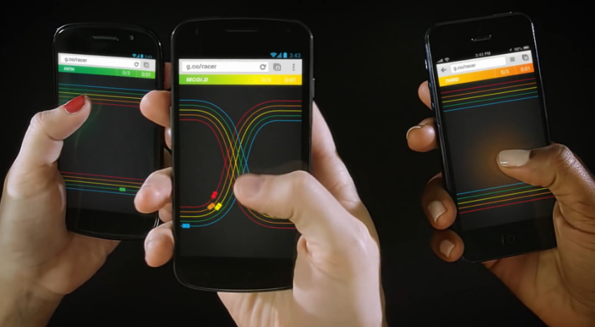
Intro
Multiplayer games!
Multiplayer architectures & technologies
Multiplayer services
Implementation of a simple multiplayer game

Slide 4
Multiplayer games
What is a multiplayer game?
Trivia Time
First multiplayer game?
Biggest (in terms of players) multiplayer game?
Pioneer multiplayer (as we know it) game?

Slide 5
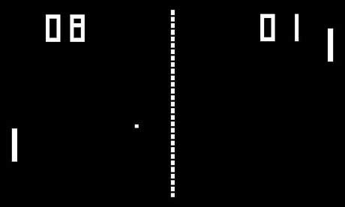
Trivia Time
First multiplayer game

Slide 6


Trivia Time
Biggest (in terms of players) multiplayer game

Slide 7

Trivia Time
Pioneer multiplayer game (as we know it)?

Slide 8

Multiplayer Architectures
Client - Server
Peer 2 Peer
Hybrid (a mix of both)

Slide 9
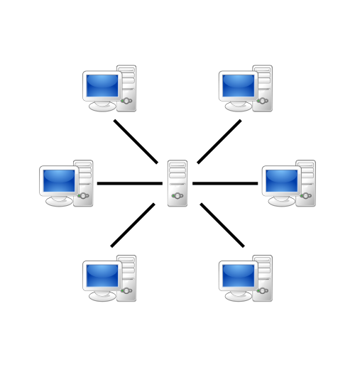
Client - Server Paradigm
Most used architecture
“Server” is now a cluster of computer
“Client” can be thin or fat
Easy to develop, hard to maintain, high costs

Slide 10
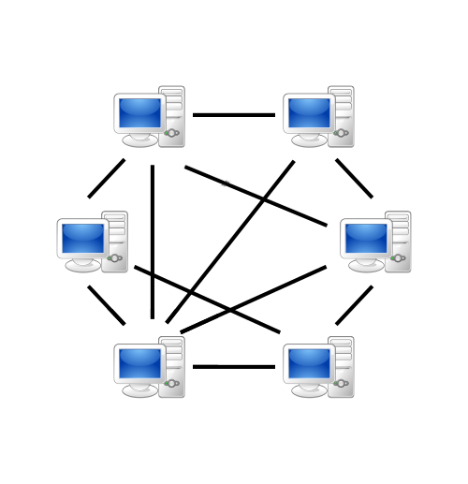
Peer 2 Peer Paradigm
Distributed logic and data
Suitable for not persistent game world (fps, racing)
Hard to develop, easy to maintain, low costs

Slide 11
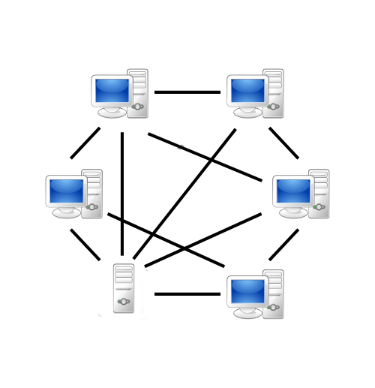
Hybrid Paradigm
Best of both worlds?
Easy to use in some aspect (matchmaking)
Hard to use in some other aspect (world consistency)

Slide 12
Multiplayer game types
Asynchronous (Ruzzle, Real Racing, Clash of Clans)
Synchronous (CoD, LoL, WoW)

Slide 13
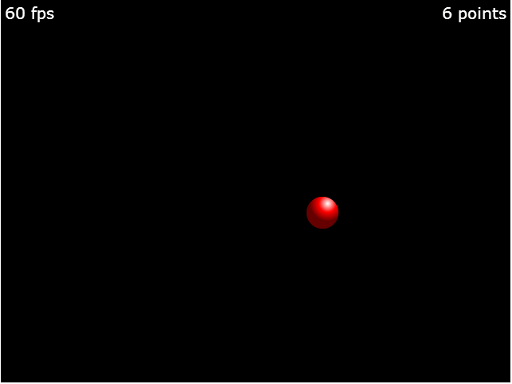
Hello Phaser!

Slide 14






Deployment
ROME 27-28 march 2015 – Valerio Riva
Web
Mobile
Any hosting!
Game portals
http://gamepix.com
http://kongregate.com
http://armorgames.com
Cordova (Phonegap)
Intel XDK
Accelerated webview
CocoonJS
Accelerated webview
API for Ads, IAP, accelerometer, etc.

Slide 15

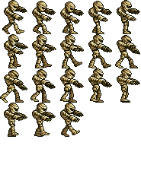
Sprite
“In computer graphics, a sprite is a two-dimensional image or animation that is integrated into a larger scene.”
Has a set of coordinates and sizes
Can be animated with sequential drawings
Main actor of a 2D game

Slide 16
ROME 27-28 march 2015 – Valerio Riva
What sprites can do
Be created
Scale
Rotate
Moves
Animate
Have physic body for collisions
and much more!
var s = game.add.sprite(x,y, "image");
s.scale.setTo(0.75,0.75);
s.angle=180 / s.rotation=3.141
s.x += 10; s.y -= 10;
s.animations.play("walk",fps);
game.physics.arcade.enable(s);

Slide 17
Group of sprites
Use it as z-ordered layer
Use it for fast pooling and object recycling too
Can apply transformation to all sprites of the group
Can call methods on all sprites of the group
var group = game.add.group();
var sprite = group.create(x, y, 'image');
group.x += 100;
group.callAll('kill');
var zombie = group.getFirstExists(false);
zombie.revive(); //cured!

Slide 18
Tilesprite
“A tilesprite is a sprite that has a repeating texture.”
var tilesprite = game.add.tileSprite(0, 0, 32, 64, 'image');
texture can be scrolled
tilesprite.tilePosition.setTo(10,20);
texture can be scaled
tilesprite.tileScale.setTo(1.5,1.5);

Slide 19
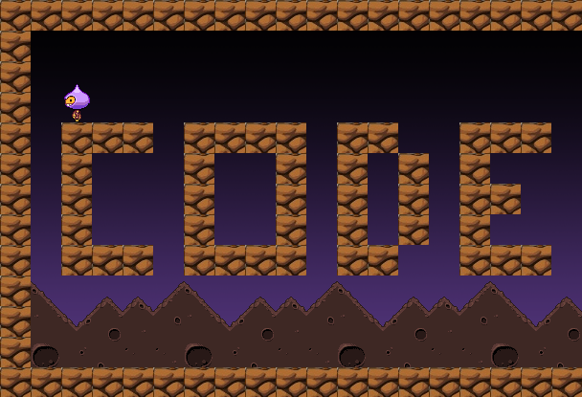
Tilemap

Slide 20
Tilemap
A tilemap is a map composed by a fixed number of same sized sprites (tiles)
Each tile can have different behavior
Used to create platform and map based games
Can be orthogonal or isometric
Easy to create with Tiled (http://www.mapeditor.org/)

Slide 21
Tilemap
function preload() {
game.load.tilemap('codem', 'tilemap/codem.json', null, Phaser.Tilemap.TILED_JSON);
game.load.image('block', 'sprites/block.gif');
}
function create() {
map = game.add.tilemap("codem");
map.addTilesetImage("block");
map.setCollisionByExclusion([]);
layer = map.createLayer("codemotion");
layer.resizeWorld(); }

Slide 22
Collision
“A collision is an instance of one moving object touching another.”
Both object must have a “body” (collider)
Object can be a sprite or a tilemap or even a group!
A body can be a rectangle, a circle or a polygon
Bodies can have a lot of properties (mass, gravity, velocity, material, …)
Last two statements depends on what physics engine you are using.
More complex is the engine, more computation is needed. Choose wisely!

Slide 23
Collision
function create() { game.physics.startSystem(Phaser.Physics.ARCADE);
sprite = game.add.sprite(0, 0, 'image');
game.physics.enable(sprite, Phaser.Physics.ARCADE);
sprite.body.collideWorldBounds = true;
sprite.body.bounce.set(1);
}
function update() {
game.physics.arcade.collide(sprite, [tilemap, group], function(sprite, other) { … });
}

Slide 24
Input
Phaser supports natively
Keyboard
Mouse
Multi-touch
Gamepads (up to four, each one with 10 axis and 16 buttons)
Supports even Xbox 360 gamepad! (button mapping depends on browser :\ )

Slide 25
Input: Keyboard
function update() {
if (game.input.keyboard.isDown(Phaser.Keyboard.UP)) {
ufo.y -= 10;
}
else if (game.input.keyboard.isDown(Phaser.Keyboard.DOWN)) {
ufo.y += 10;
}
if (game.input.keyboard.isDown(Phaser.Keyboard.LEFT)) {
ufo.x -= 10;
}
else if (game.input.keyboard.isDown(Phaser.Keyboard.RIGHT)) {
ufo.x += 10;
}
}

Slide 26
Input: Mouse
if (game.input.mousePointer.isDown) {
if (game.input.mousePointer.x < game.width*0.5) {
clickOnLeft = true;
}
else if (game.input.mousePointer.x > game.width*0.5) {
clickOnRight = true;
}
if (game.input.mousePointer.y < game.height*0.5) {
clickOnTop = true;
}
}
Swap mousePointer with activePointer to capture any active pointer (works with mouse and touch inputs)

Slide 27
Input: Multi-touch
Supports 10 pointers (= fingers)!
Two pointers are already available
Add another pointer
game.input.addPointer();
Read different pointers
game.input.pointer3; or game.input.pointer4;

Slide 28
Input: Gamepad
function create() {
game.input.gamepad.start();
pad1 = game.input.gamepad.pad1;
}
function update() {
if (game.input.gamepad.supported
&& game.input.gamepad.active
&& pad1.connected) {
//play with gamepad!
if (pad1.isDown(Phaser.Gamepad.XBOX360_DPAD_LEFT)) { … }
if (pad1.axis(Phaser.Gamepad.XBOX360_STICK_LEFT_X)) { … }
if (pad1.justPressed(Phaser.Gamepad.XBOX360_A)) { … }
}
else {
//play with boring keyboard!
}
}

Slide 29
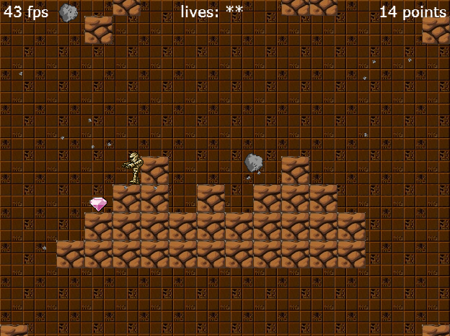
Dissecting the mummy

Slide 30
Want more?
Take a look to another example that implements P2 physics engine (http://github.com/Lotti/phaserTut)
Phaser examples (http://examples.phaser.io/)
Phaser docs (http://docs.phaser.io/)

Slide 31
Resources & Links
ROME 27-28 march 2015 – Valerio Riva
The mummy game
P2 physics engine example
Phaser’s forum
http://docs.phaser.io
http://examples.phaser.io
http://html5gameengine.com
http://brackets.io
http://www.pixijs.com
http://schteppe.github.io/p2.js
http://www.mapeditor.org
http://xdk-software.intel.com
https://www.ludei.com/cocoonjs
https://cordova.apache.org
http://phonegap.com

Slide 32
Thank you!
Any Questions?
valerio.riva@gmail.com
@ValerioRiva
http://it.linkedin.com/in/valerioriva/

