Slide 1
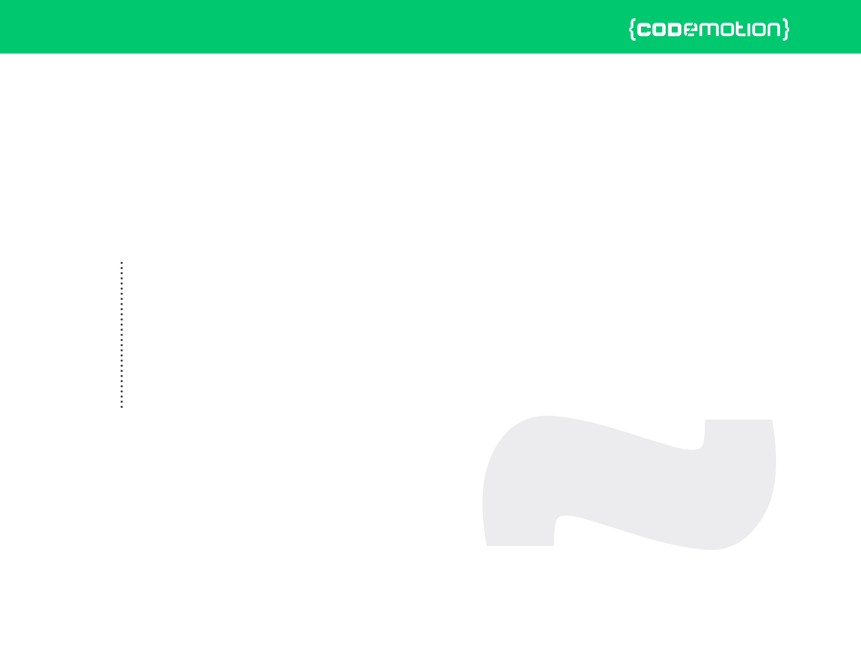



Valerio «Lotti» Riva
Introduction to development of multiplayer HTML5 games (with Socket.io)
valerio.riva@gmail.com
@ValerioRiva
http://it.linkedin.com/in/valerioriva/

Slide 2
Who am I?
Web developer
Game developer @Interactive Project
MyGPTeam, MyGPTeam Turbo, OverVolt: crazy slot cars
http://interactiveproject.com/
Game Jammer
https://www.facebook.com/RomeGameJams
Mentor @CoderDojo Roma
https://coderdojoroma.wordpress.com/

Slide 3
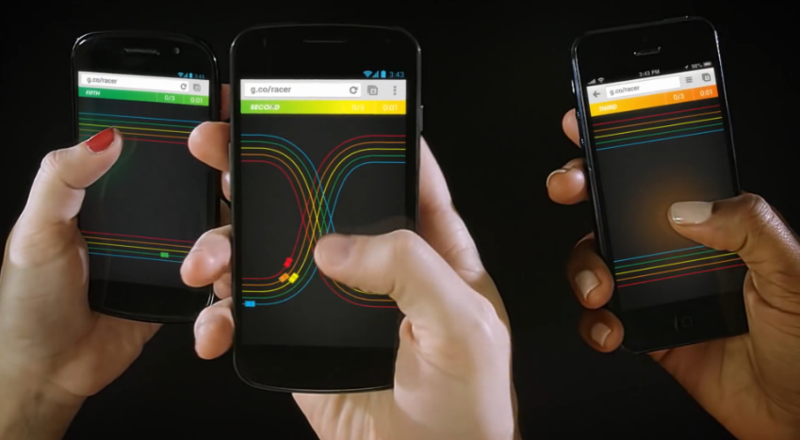
Intro
Multiplayer architectures & technologies
Multiplayer services
Implementation of a simple multiplayer game

Slide 4
Multiplayer games
What is a multiplayer game?
Trivia Time
First multiplayer game?
Biggest (in terms of players) multiplayer game?
Pioneer multiplayer (as we know it) game?

Slide 5
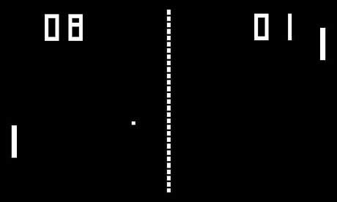
Trivia Time
First multiplayer game
1971!

Slide 6

Trivia Time
Biggest (in terms of players) multiplayer game
About 7.5 million concurrent players!

Slide 7

Trivia Time
Pioneer multiplayer game (as we know it)?
1999: it redefined the multiplayer online gaming experience.

Slide 8
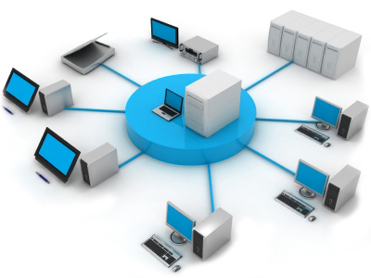
Multiplayer Architectures
Client - Server
Peer 2 Peer
Hybrid (a mix of both)

Slide 9
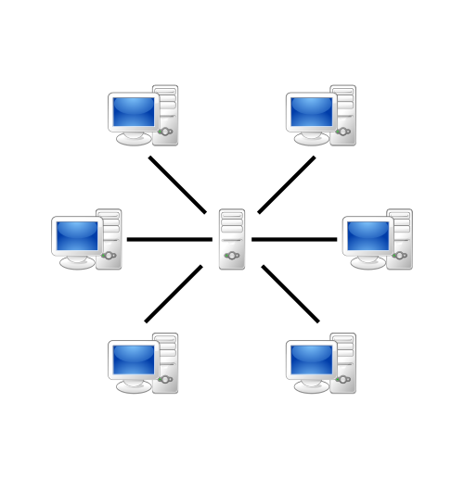
Client - Server Paradigm
Most used architecture
“Server” is now a cluster of computer
“Client” can be thin or fat
Easy to develop, hard to maintain, high costs

Slide 10
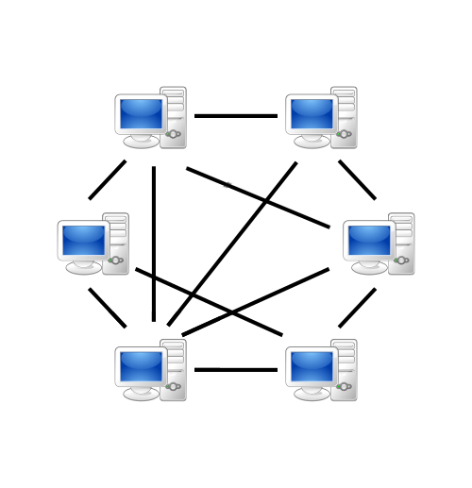
Peer 2 Peer Paradigm
Distributed logic and data
Suitable for not persistent game world (fps, racing)
Hard to develop, easy to maintain, low costs

Slide 11
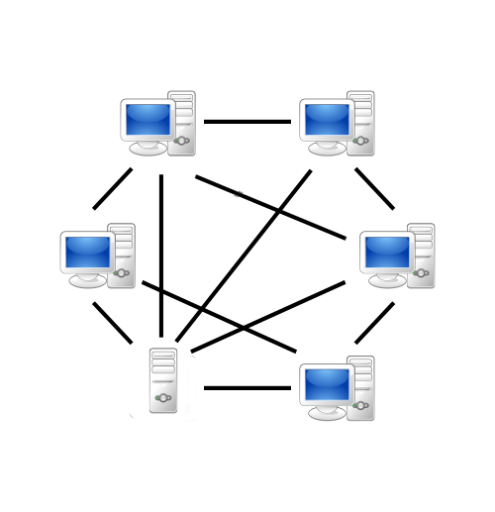
Hybrid Paradigm
Best of both worlds?
Easy to use in some aspect (matchmaking)
Hard to use in some aspect (world consistency)

Slide 12





«Multiplayer as a Service»
Provides you infrastructure and algorithms
Provides SDK for various game engines
Reliability and auto-scaling
Real-time / turn-based multiplayer
Match-making, leaderboards, achievements
Cloud storage (saved games)
Free or paid services

Slide 13
Networking technologies
Web API
Request-Response message system
Identified by a url
Permanent connection not required
Suitable on asynchronous games
Socket
Bidirectional communication between softwares
Identified by a protocol, an address and a port
Permanet connection required
Suitable on synchronous games

Slide 14





Networking technologies (2)
Web API
Socket

Slide 15


Socket instead of WebAPI
PRO
Full-duplex communication
Real time!
Can use UDP protocol
CON
A stream of byte
Permanent connection required
Firewall :\
NAT :\

Slide 16
WebSocket
Full-duplex channel over a single TCP connection
Works as an upgrade of standard HTTP connection
WebSocket instead of Socket
PRO
Full-duplex communication
Real time!
Firewall :)
CON
A stream of byte
Permanent connection required
Can’t use UDP protocol

Slide 17

Socket.io
A Javascript library that enhances WebSocket
Easy to use
Event-driven
Falls back to other technologies if WebSocket is not available
Adds broadcasting
Adds support to multiplexing with «namespaces»
Adds support to rooms

Slide 18
Socket.io instead of WebSocket
Full-duplex communication
Real time!
Firewall :)
Event-driven
Rooms!
Permanent connection required
Can’t use UDP protocol

Slide 19
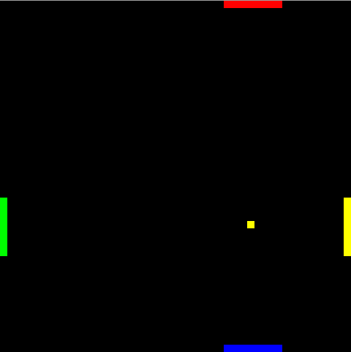
Pong4

Slide 20
Pong4 (2)
A simple real-time multiplayer "Pong" game
Built with
phaser.io (game)
socket.io (networking)
express.io (content delivery)
Runs on node.js
http://pong4.eu-gb.mybluemix.net
https://github.com/Lotti/codemotion2015

Slide 21
Pong4 (3)
Hybrid paradigm
Server
Forwards events and data between clients
Fat client (host): Game manager
Player movements
Checks collisions
Keeps scores
Starts and ends a game
Thin client
Player movements

Slide 22
Socket.io: Server example
var app = require('express')(); var http = require('http').Server(app); var io = require('socket.io')(http); io.on('connection', function(socket) { //a socket just connected! socket.on('ping', function(data) { //do something with received data console.log(data.user); socket.emit('pong', 'hello!'); }); });

Slide 23
Socket.io: Client example
<script src="/socket.io/socket.io.js"></script> <script> var socket = io(); socket.on('pong', function(data) {
//do something with received data
console.log(data); }); socket.emit('ping', { user: "Lotti" }); </script>

Slide 24
Pong4 Server: host join event
socket.on('host', function(data, ack) { var room = makeGameId(); socket.join(room, function (err) { if (!err) { clientPlayers[socket.id] = 0; clients[socket.id] = room; hosts[socket.id] = true; ack(room); log('host '+socket.id+' connected'); } else { log(err,'e'); sendError(1, "host: can't join room", socket); } }); });
1
2

Slide 25
Pong4 Server: client join event
socket.on('join', function(data, ack) { var room = data; if (roomExists(room)) { socket.join(room, function (err) { if (!err) { clients[socket.id] = room; var players = socketsInRoom(room); clientPlayers[socket.id] = players.length - 1; ack({ playersCount: players.length }); io.to(room).emit('joined', { playersCount: players.length }); } else { log(err, 'e'); sendError(3, "client: can't join room", socket); } }); } else { sendError(2, "that room doesn't exists", socket); } });
1
2

Slide 26
Pong4 Client: sending data
updateServer: function () {
//... var data = { socketId: socket.id }; if (master) { data['ball'] = true; data['ballX'] = ball.body.x; data['ballY'] = ball.body.y; } else data['ball'] = false;
data['player'] = parseInt(currentPlayer); switch(data['player']) { case 0: case 2: data['paddle'] = paddles[currentPlayer].body.x; break; case 1: case 3: data['paddle'] = paddles[currentPlayer].body.y; break; }
socket.emit('gameUpdate', data); },

Slide 27
Pong4 Server: broadcasting data
socket.on('gameUpdate', function(data) { var room = clients[data.socketId]; delete data.socketId; io.to(room).emit('clientUpdate', data); });

Slide 28
Pong4 Client: receiving data
updateClient: function (data) {
if (!master && data.ball == true) { ball.position.x = data.ballX; ball.position.y = data.ballY; } if (currentPlayer != data.player) { switch(parseInt(data.player)) { case 0: case 2: paddles[data.player].position.x = data.paddle; break; case 1: case 3: paddles[data.player].position.y = data.paddle; break; } } },

Slide 29
References
http://socket.io/
http://phaser.io/
http://pong4.eu-gb.mybluemix.net/
https://github.com/Lotti/codemotion2015/
https://console.ng.bluemix.net/
https://developers.google.com/games/services/
https://www.exitgames.com/en/Realtime
http://www.smartfoxserver.com/
https://developer.apple.com/game-center/
http://appwarp.shephertz.com/

Slide 30
Thank you!
Any Questions?
Leave your feedback on Joind.in!
https://joind.in/event/view/3347
valerio.riva@gmail.com
@ValerioRiva
http://it.linkedin.com/in/valerioriva/

