Slide 1
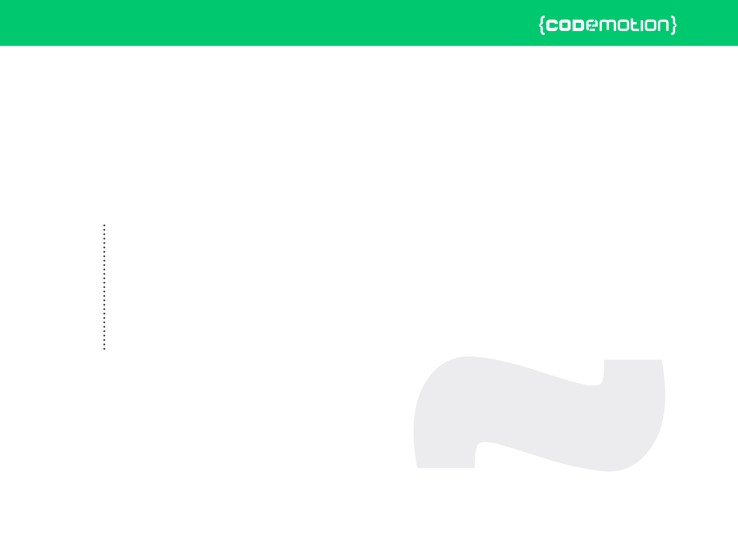



Valerio Riva
Introduction to development of multiplayer HTML5 games (with Socket.io)
valerio.riva@gmail.com
@ValerioRiva
http://it.linkedin.com/in/valerioriva/

Slide 2
Who am I?
Web developer
Game developer @ Interactive Project
MyGPTeam, MyGPTeam Turbo, OverVolt: crazy slot cars
http://interactiveproject.com/
Game Jammer
Mentor @CoderDojo Roma
https://coderdojoroma.wordpress.com/

Slide 3
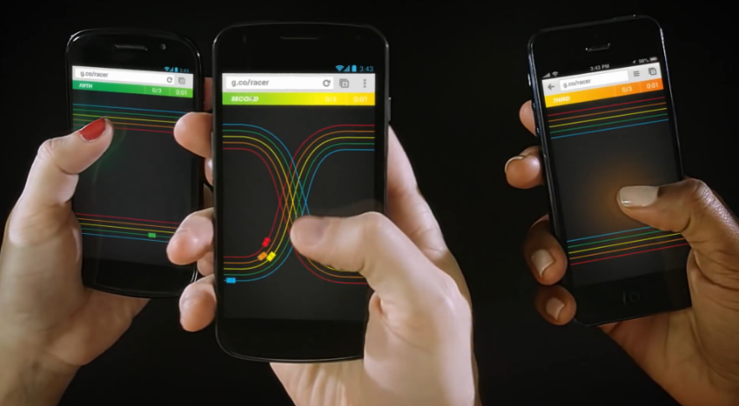
Intro
Multiplayer games!
Multiplayer architectures & technologies
Multiplayer services
Implementation of a simple multiplayer game

Slide 4
Multiplayer games
What is a multiplayer game?
Trivia Time
First multiplayer game?
Biggest (in terms of players) multiplayer game?
Pioneer multiplayer (as we know it) game?

Slide 5
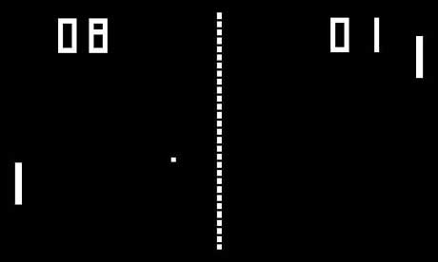
Trivia Time
First multiplayer game

Slide 6


Trivia Time
Biggest (in terms of players) multiplayer game

Slide 7

Trivia Time
Pioneer multiplayer game (as we know it)?

Slide 8

Multiplayer Architectures
Client - Server
Peer 2 Peer
Hybrid (a mix of both)

Slide 9
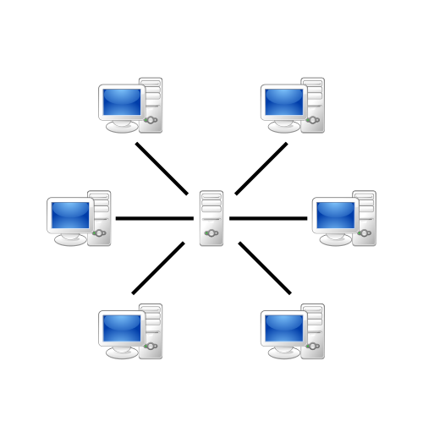
Client - Server Paradigm
Most used architecture
“Server” is now a cluster of computer
“Client” can be thin or fat
Easy to develop, hard to maintain, high costs

Slide 10
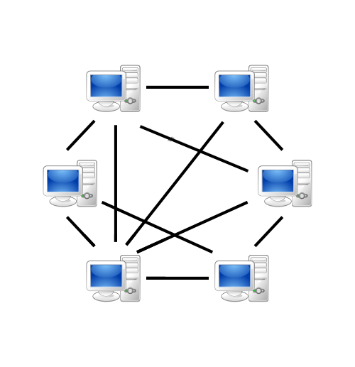
Peer 2 Peer Paradigm
Distributed logic and data
Suitable for not persistent game world (fps, racing)
Hard to develop, easy to maintain, low costs

Slide 11
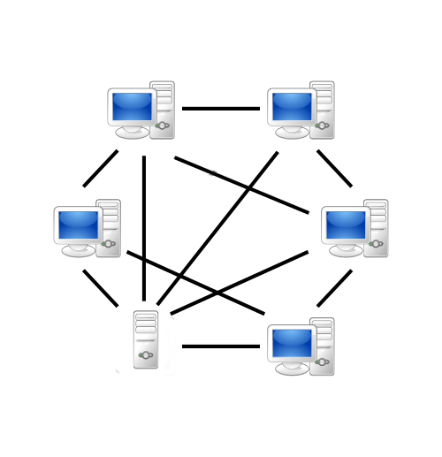
Hybrid Paradigm
Best of both worlds?
Easy to use in some aspect (matchmaking)
Hard to use in some other aspect (world consistency)

Slide 12
Multiplayer game types
Asynchronous (Ruzzle, Real Racing, Clash of Clans)
Synchronous (CoD, LoL, WoW)

Slide 13
Thank you!
Any Questions?
Leave your feedback on Joind.in!
https://joind.in/event/view/3347
valerio.riva@gmail.com
@ValerioRiva
http://it.linkedin.com/in/valerioriva/

Slide 14
Leave your feedback on Joind.in!
https://joind.in/event/view/3347

