Slide 1

The phenomenon of Hate Speech Between indonesian twitter user
Rakels agung setiawan
Binar dsc project

Slide 2
Content
Introduction : Background, Problem Statements, and Aims
Methodology : Data description and Preprocessing
Results and Summary : Visualizations and Key Points

Slide 3
BACKGROUND
Twitter was the second biggest platform for online abuse.
The most significant type of abuse was from online insults (O'driscoll, 2022).
Hate speech becomes Indonesia’s most frequently
reported online crime since 2016 and has been rapidly increase.
Indonesia's digital civility index is the worst in Southeast Asia. This assessment is based on Indonesia citizen online behavior such as spreading hoaxes, hate speech, trolling and cyberbullying.

Slide 4
PROBLEM STATEMENTS
How frequent tweets contain hate speech appear?
How many category does tweets contain hate speech have?
How frequent tweets contain hate speech can lead social conflict?
What is the most common word used in tweet contain hate speech?

Slide 5
Aims
Provide an overview of hate speech phenomenon in Indonesian Twitter by it’s frequency, category, most common hate word, and its potential to cause social conflict.

Slide 6
METHODOLOGY
Dataset is collected tweets contain hate speech and abusive which already group based on label.
Data source: https://www.kaggle.com/datasets/ilhamfp31/indonesian-abusive-and-hate-speech-twitter-text
Data sources: Twitter
Collection methodology: Crawl using Tweepy Library
Data type: string & boolean.

Slide 7
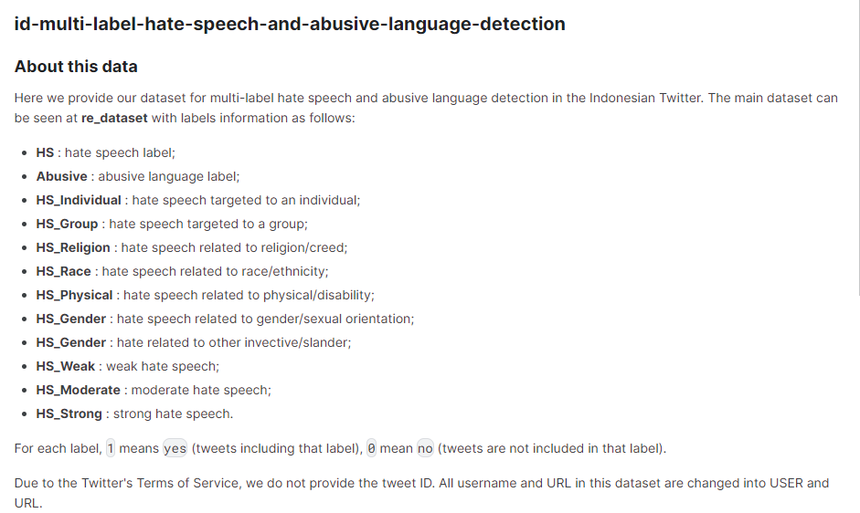
Data description

Slide 8
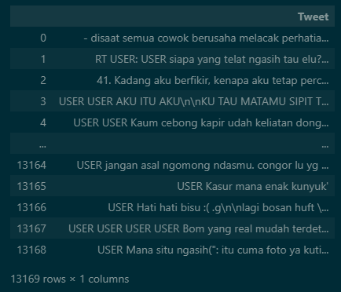
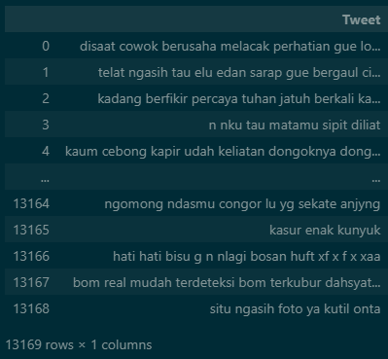
Pre-processing
Case Folding
Removing symbol / punc / emoticon using regex
Adding Stopwords
Drop duplicates

Slide 9
RESULTS & SUMMARY
Categories :
Severity
Weak
Moderate
Strong
Target
Individual
Group
Types
Physical
Race
Religion
Gender
Other

Slide 10
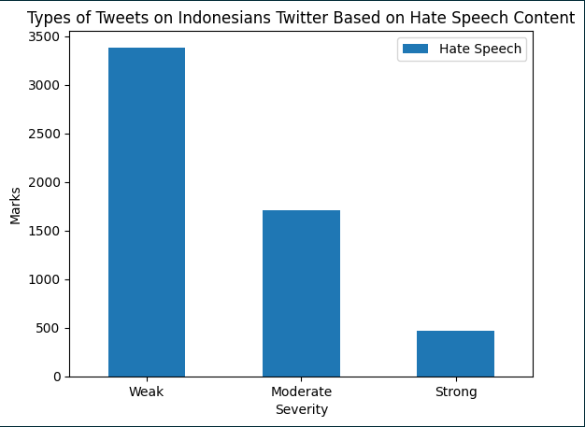
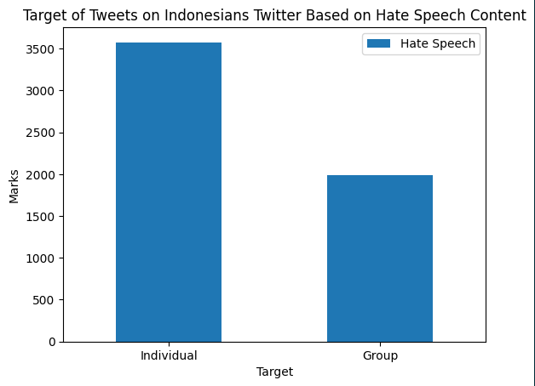
RESULTS
Among 13169 preprocessed tweets, 5561 tweets are contain hate speech.

Slide 11
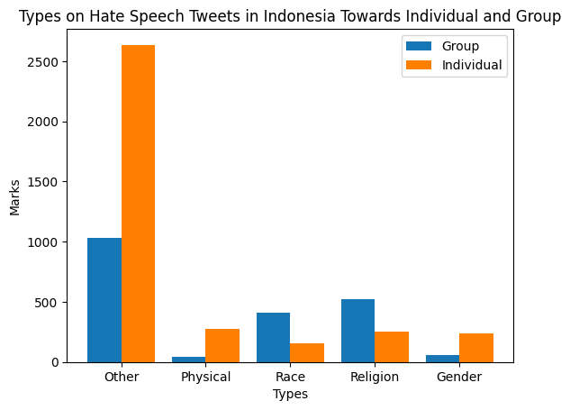
Results

Slide 12
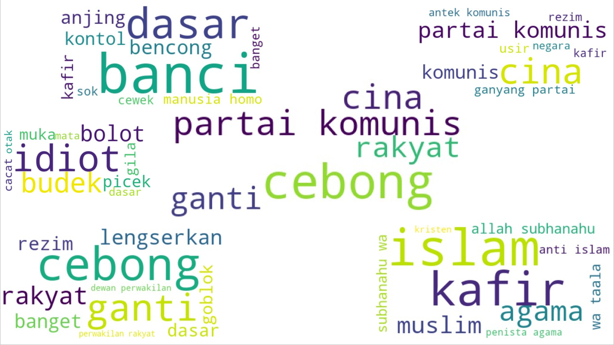
Most common words

Slide 13
SUMMARY
The percentage of tweets contain hate speech in analyzed data is around 40%.
Tweets contain hate speech were mainly directed at individuals instead of groups of people.
Other type of hate speech was found to be the most type used in tweets contain hate speech.
Most tweets contain hate speech severity level are weak followed by moderate and strong.
Most common word in tweets contain hate speech are "cebong" , "partai komunis" , "cina" , "rakyat" , and "ganti".
Around 55% analyzed tweets potentially cause social conflict

Slide 14
RECOMMENDATIONS
For Internet / Twitter users :
Don't be the perpetrators of making and spreading hate speech.
Activate block chain/block party to perform a positive algorithm.
Realizing social media is a public space not a personal space, so behave and respect others.
Remember anything shared will automatically become a digital track record.
For Stakeholders :
Policies towards online free speech need to be re-evaluate and upgrade.
System improvement such as filtering or banning bad words before it reach a greater mass or certain subject.

Slide 15
Thanks for the attention

