Slide 1
Assignment2
Shaofeng Li

Slide 2
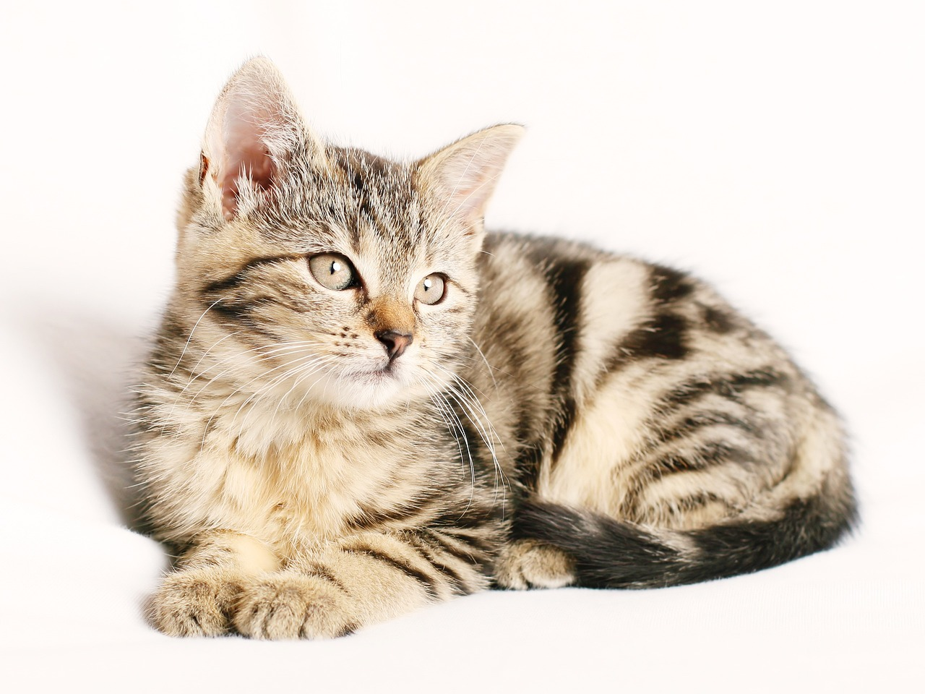
Assignment2—Problem1
1) Find the proportion of main colors in a picture.

Slide 3
Assignment2—Problem1
Approach
Load the Image
Reshape the Image Data(matplotlib)
K-means Clustering(Kmeans)
Find Cluster Centers(Kmeans)
Map Labels to Centers(Kmeans)
Calculate Proportions and Show Results

Slide 4
Assignment2—Problem1
Result

Slide 5
Assignment2—Problem2
2) Find the similarity between two sentences or paragraphs. This assignment will help you to become familiar with NLP functionalities such as tokenization, stemming, and word embeddings.

Slide 6
Assignment2—Problem2
Approach
Input the text
Clean the text(regex)
Tokenization(word2vec)
Stemming(nltk)
Word Embedding(Word2vec)
Vector Aggregation & Similarity Calculation:

Slide 7
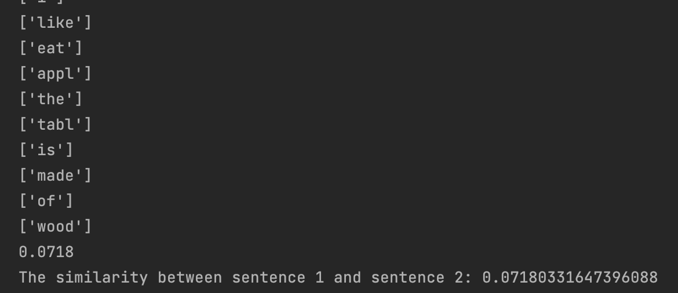
Assignment2—Problem2
Result

