Slide 1
Assignment 8
Shaofeng Li

Slide 2
Problem
build a chatbot for a travel agent company.
a front-end user interface client
a backend ChatGPT-based server.

Slide 3
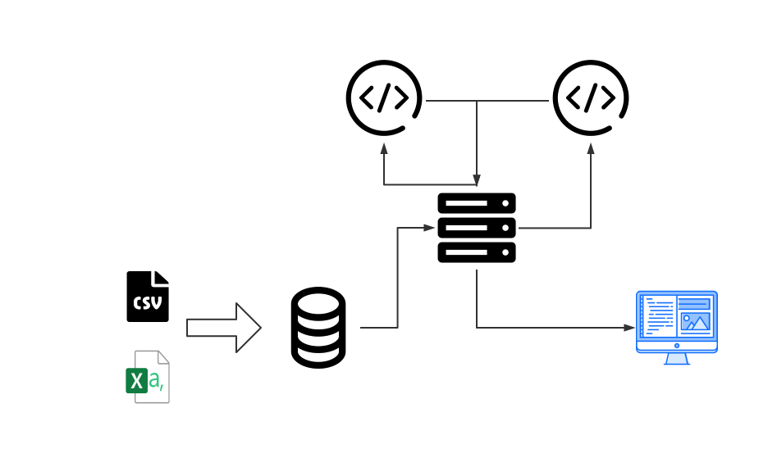
Technical Architecture and Technology
generator
translator

Slide 4
Libraries and Packages
Backend Framework: Django and OpenAI API
Database: pandas and sqlalchemy
Fronted Framework: React

Slide 5
Chatbot Fine-tuning
Generator:
model="gpt-4", temperature=0.9, messages=[ {"role": "system", "content": "You can reply general questions about traveling translate natural language to SQL queries."}, {"role": "system","content": "This is the schema of the packages of different travel routes."}, {"role": "system", "content": schema}, {"role": "system", "content": "if the questions are related to the schema respond with the SQL queries between triple backticks otherwise respond with your knowledge base."}, {"role": "user", "content": command}, ]

Slide 6
Chatbot Fine-tuning
Translator:
newGpt= OpenAI().chat.completions.create( model="gpt-4", messages=[ {"role": "system", "content":"you need to translate this string into natural language"}, {"role": "user", "content": json.dumps(msg)}, ] )

Slide 7

Results – General Questions

Slide 8
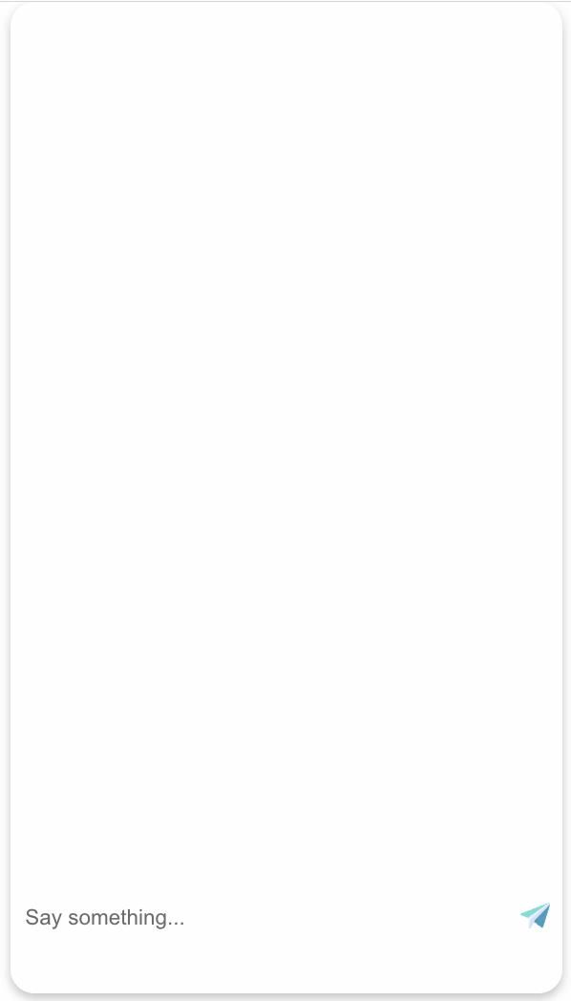
Results – Questions related to database

