Slide 1
METAVERSE DATA ANALYSIS FINAL PROJECT REPORT
BY
GROUP -3

Slide 2
Under The Guidance of: Jatinder Bedi
Members:
Piyush Chaudhari
Tanya Dhingra
Shweta Yaduraj Singh
Kshitija Dadasaheb Shevate
Ritik Kasana
Dr Harini Sridharan

Slide 3
METAVERSE:
The metaverse is a virtual universe where users can interact with each other through avatars in a 3D space. It's a combination of the physical and digital worlds, where users can work, play, and socialize. The metaverse is built on technologies like virtual reality (VR), augmented reality (AR), and blockchain-based decentralized finance tools

Slide 4
Our project deals with financial data of metaverse
OBJECTIVE:
To detect high risk anomaly and prevent financial fraudsand improve user efficiency

Slide 5
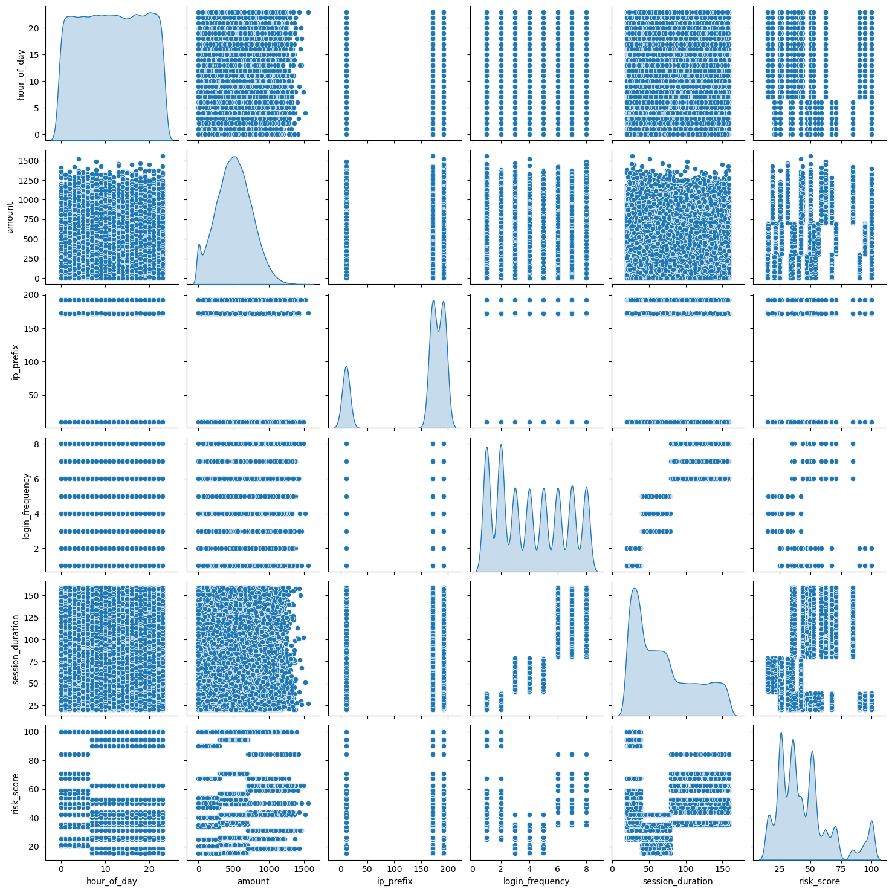
Some Insights into our analysis:
pair plot

Slide 6
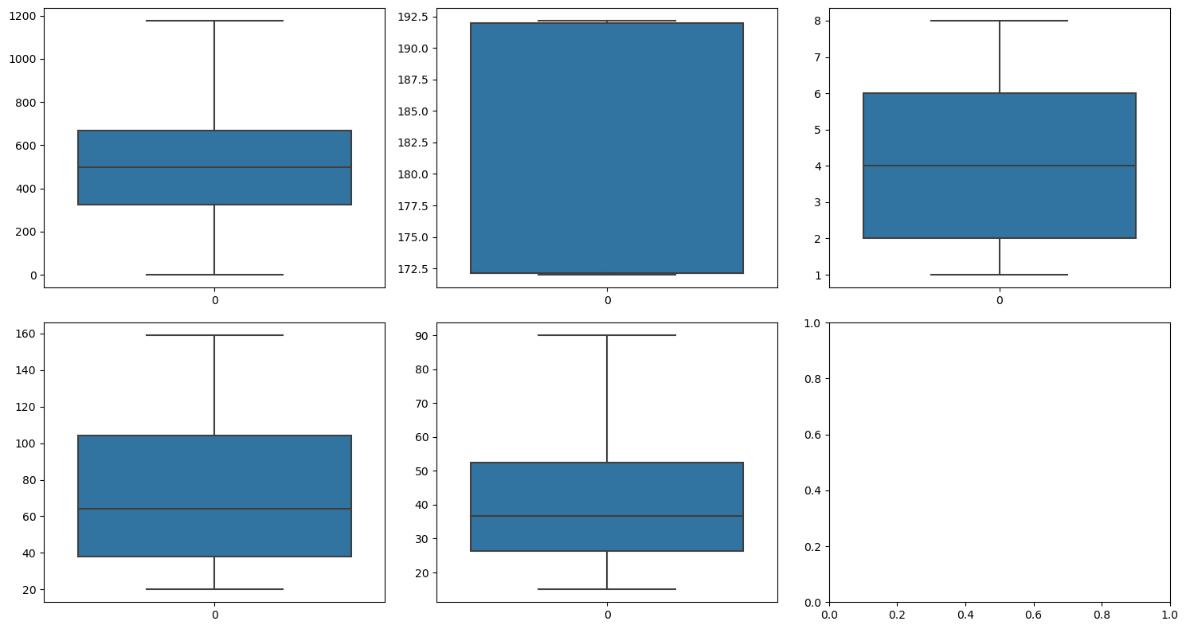
clearing outliers of numeric variable

Slide 7
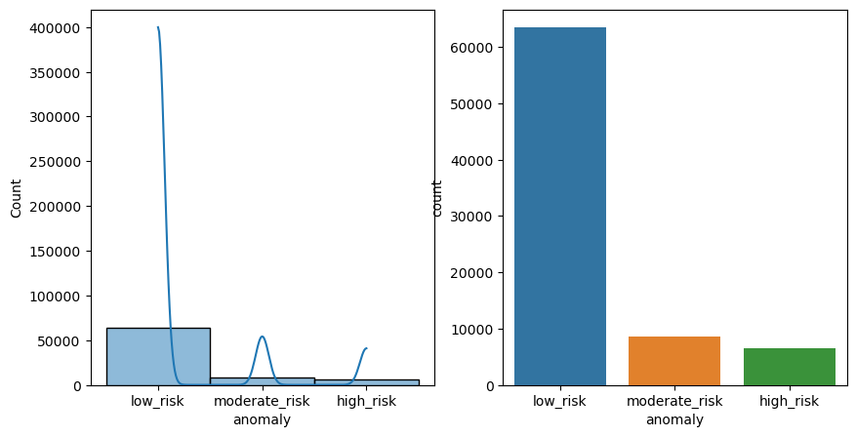
ANOMALY IDENTIFICATION

Slide 8
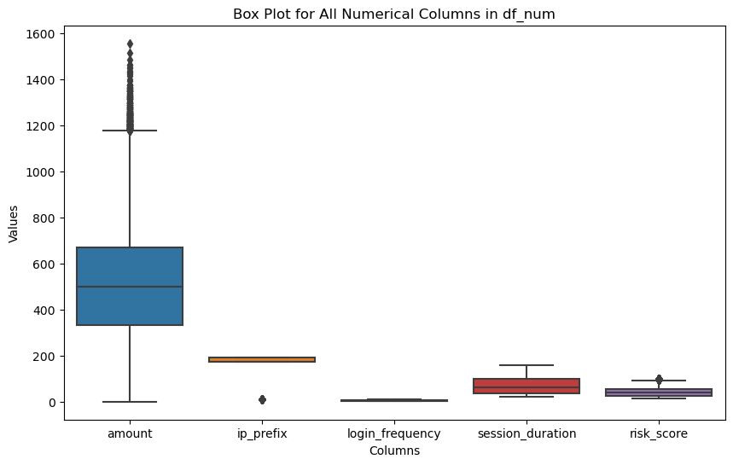
Boxplot of numeric variables

Slide 9
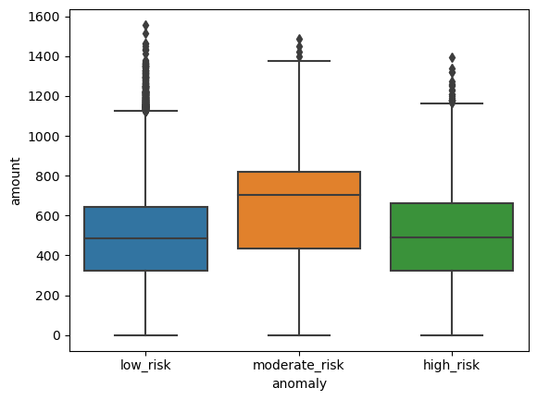
Amount vs Risk

Slide 10
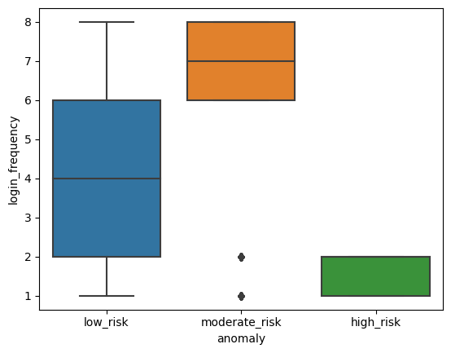
login frequency vs anomaly

Slide 11
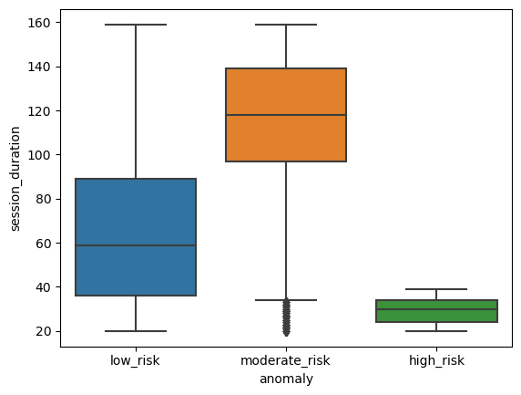
Session duration vs Anomaly

Slide 12
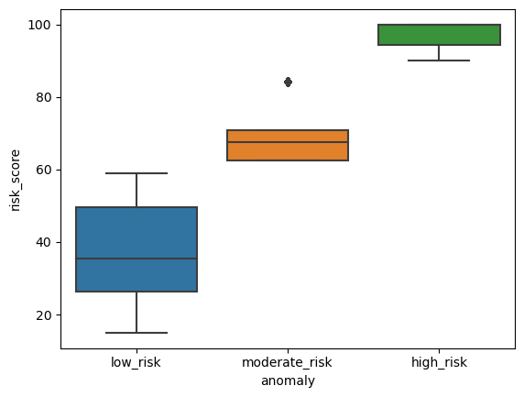
Risk Score vs Anomaly

Slide 13
Age-group vs Anomaly
anomaly | high_risk | low_risk | moderate_risk | All
age_group
established | 0 | 0.331209 | 0 | 0.331209
new | 0.082634 | 0.244987 | 0.005013 | 0.332634
veteran | 0 | 0.231616 | 0.104542 | 0.336158
All | 0.082634 | 0.807812 | 0.109555 | 1

Slide 14
Region vs Anomaly
location_region | Africa | Asia | Europe | North America | South America | All
anomaly
high_risk | 0.016578 | 0.016692 | 0.015687 | 0.017226 | 0.01645 | 0.082634
low_risk | 0.159987 | 0.16173 | 0.163066 | 0.162519 | 0.160509 | 0.807812
moderate_risk | 0.02131 | 0.021718 | 0.022354 | 0.021781 | 0.022392 | 0.109555
All | 0.197875 | 0.20014 | 0.201107 | 0.201527 | 0.199351 | 1

Slide 15
Purchase pattern Vs Anomaly
anomaly | high_risk | low_risk | moderate_risk | All
purchase_pattern
focused | 0 | 0.331209 | 0 | 0.331209
high_value | 0 | 0.231616 | 0.104542 | 0.336158
random | 0.082634 | 0.244987 | 0.005013 | 0.332634
All | 0.082634 | 0.807812 | 0.109555 | 1

Slide 16
Transaction type vs Anomaly
anomaly | high_risk | low_risk | moderate_risk | All
transaction_type
phishing | 0.032392 | 0 | 0 | 0.032392
purchase | 0 | 0.317303 | 0 | 0.317303
sale | 0 | 0.20902 | 0.109555 | 0.318575
scam | 0.050242 | 0 | 0 | 0.050242
transfer | 0 | 0.281489 | 0 | 0.281489
All | 0.082634 | 0.807812 | 0.109555 | 1

Slide 17
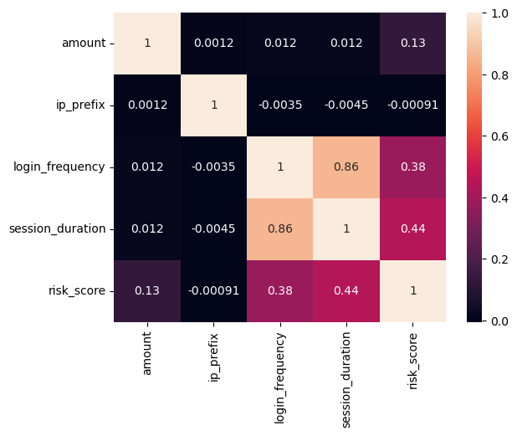
Correlation of numeric components

Slide 18
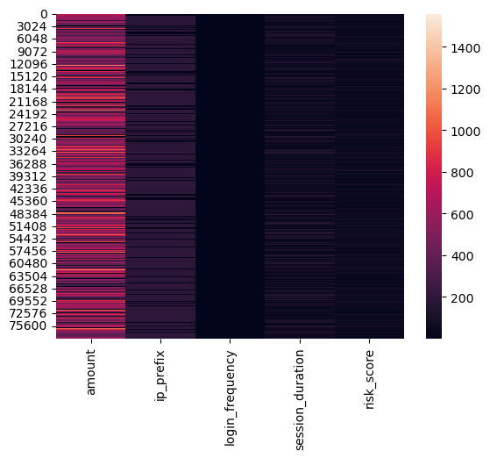
heatmap of numeric values

Slide 19
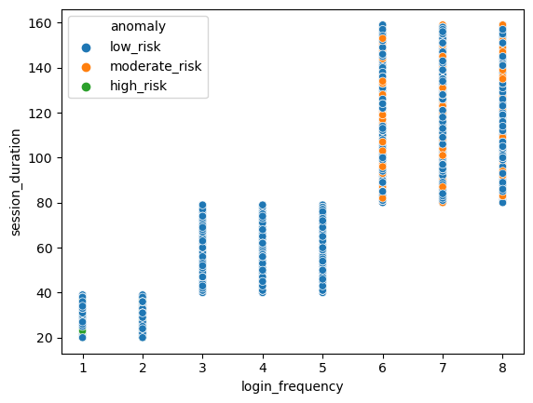
login frequency session duration vs
Anomaly

Slide 20
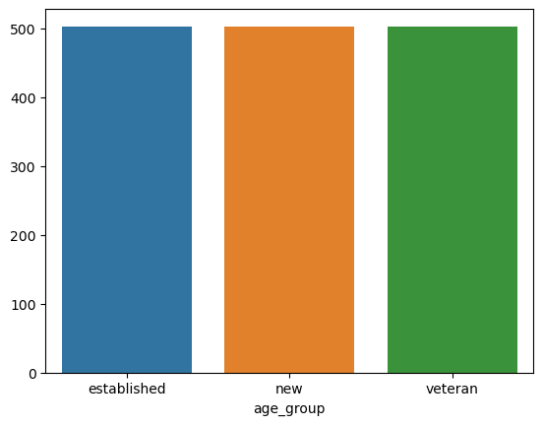
Age group vs Anomaly

Slide 21
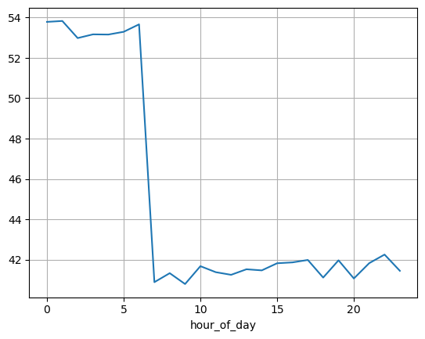
Risk Score vs Hours of day

Slide 22
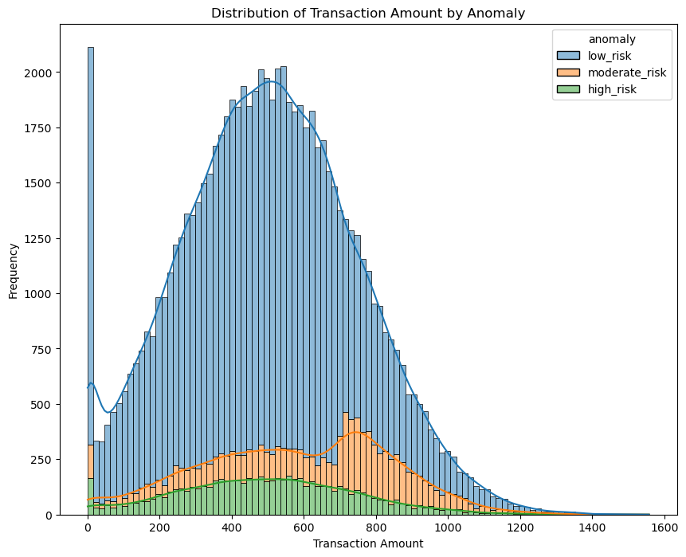
Transaction Amount by anomaly

Slide 23
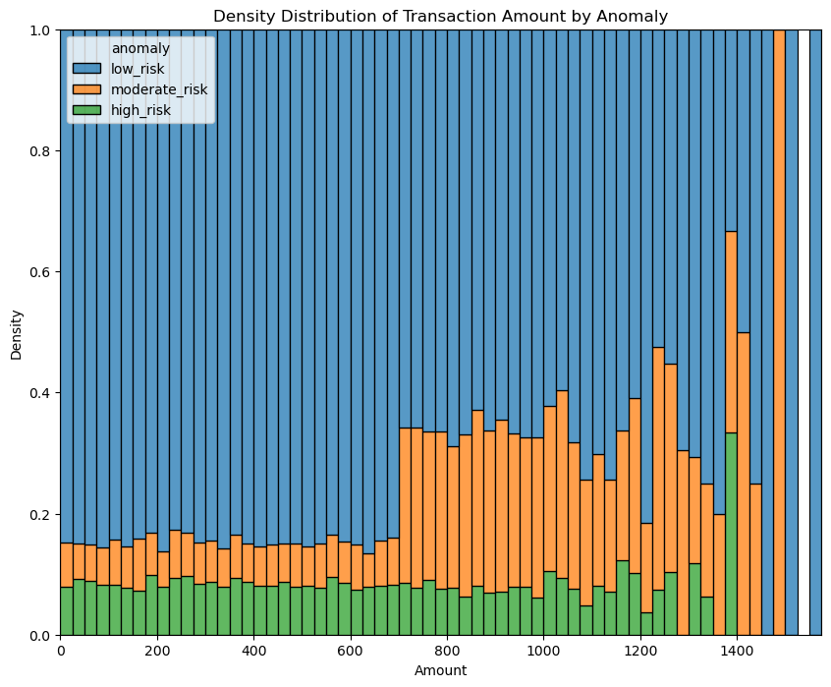
Amount vs Anomaly

Slide 24
Region,age group vs anomaly
age_group | established | new | veteran
location_region
Africa | 500.955968 | 499.831114 | 500.833306
Asia | 509.922536 | 503.666303 | 500.297765
Europe | 500.43779 | 501.152597 | 505.153146
North America | 502.865445 | 503.599285 | 501.635657
South America | 499.182661 | 505.352536 | 503.68761

Slide 25
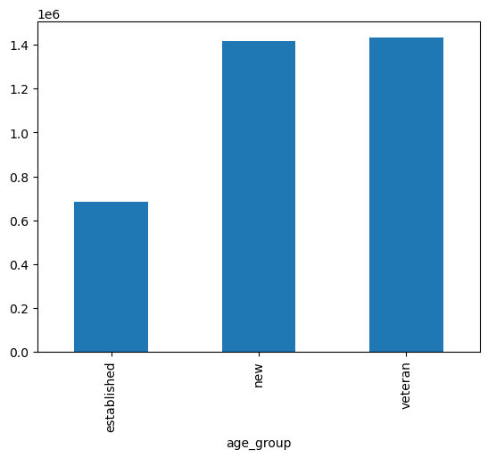
Age group vs risk score

Slide 26
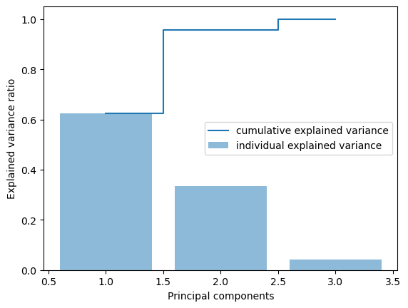
PCA to chose the numeric

Slide 27
linear regression
mse | 208.343662375051
r squared | 0.206451944885627
model coefficient | 0.00853153 0.00879884 -0.09263241 0.18184038]
model intercept | 21.8643473004952
Root Mean Squared Error RMSE: 14.43
Mean Absolute Error (MAE): 11.32

Slide 28
VIF & CROSS VALIDATION
Cross-Validation R² Scores: [0.20600695 0.21244531 0.2164299 0.21871915 0.21155899]
Mean R² Score: 0.21
Variable VIF
0 amount 1.000166
1 ip_prefix 1.000022
2 login_frequency 3.901573
3 session_duration 3.901585

Slide 29
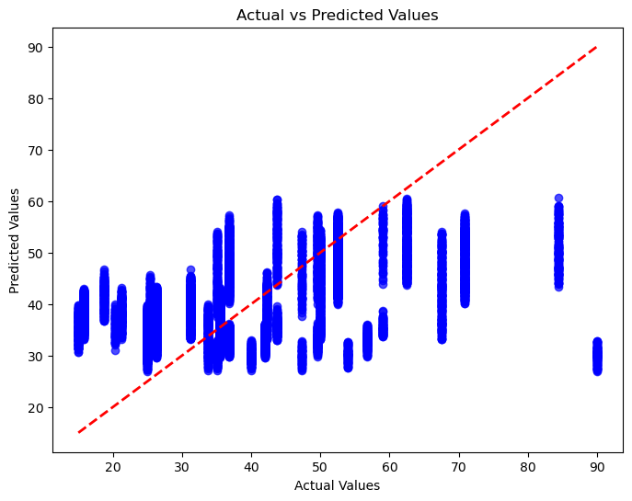

Slide 30
RIDGE
Best Alpha for Ridge: {'alpha': 100}
R² on Test Set: 0.20645214657923439

Slide 31
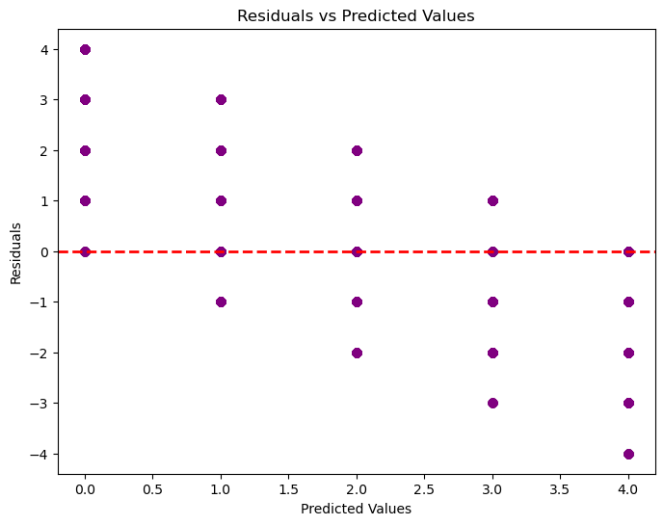

Slide 32
LOGISTIC REGRESSION CONFUSION MATRIX
accuracy 0.31 11584
macro avg 0.08 0.12 0.08 11584
weighted avg 0.16 0.31 0.18 11584
Accuracy: 0.3143
Cross-validated Accuracy: 0.3162 ± 0.0027

Slide 33
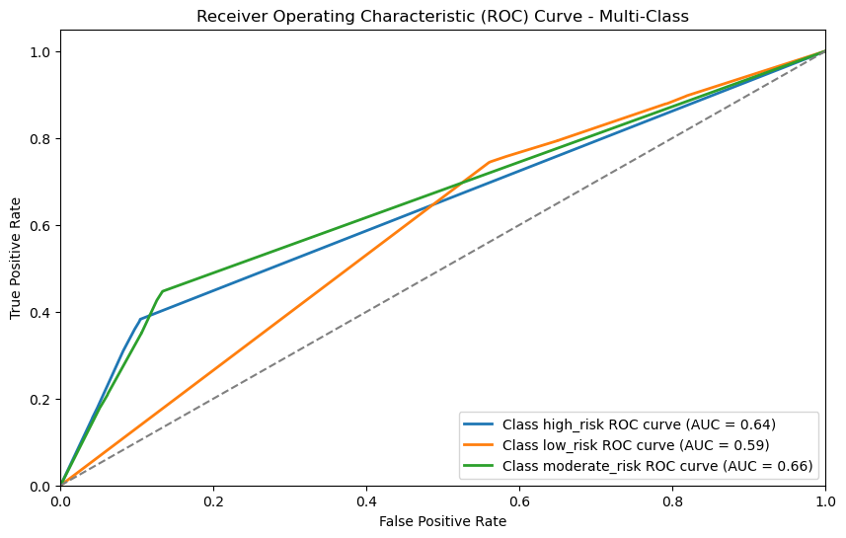
Decision tree for ANOMALY

Slide 34
Class high_risk ROC-AUC Score: 0.64
Class low_risk ROC-AUC Score: 0.59
Class moderate_risk ROC-AUC Score: 0.66
Classification Report:
precision recall f1-score support
high_risk 0.25 0.31 0.28 1906
low_risk 0.83 0.84 0.84 19198
moderate_risk 0.29 0.21 0.24 2476
accuracy 0.73 23580
macro avg 0.46 0.45 0.45 23580
weighted avg 0.73 0.73 0.73 23580
Accuracy: 0.7329516539440204

Slide 35
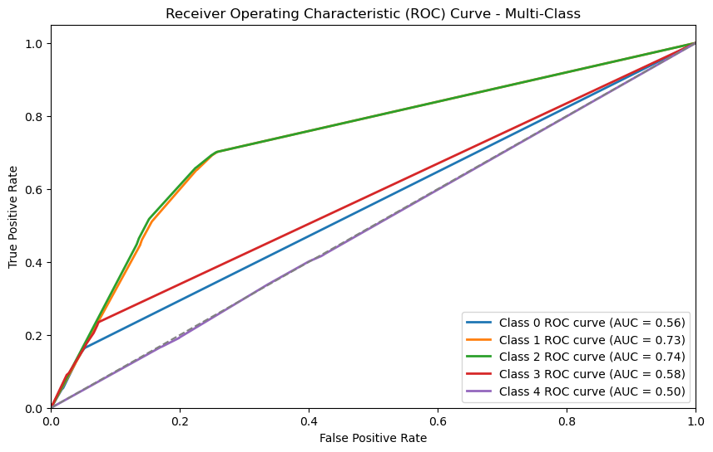
Decision Tree based on transaction type

Slide 36
Class 0 ROC-AUC Score: 0.56
Class 1 ROC-AUC Score: 0.73
Class 2 ROC-AUC Score: 0.74
Class 3 ROC-AUC Score: 0.58
Class 4 ROC-AUC Score: 0.50
Classification Report:
precision recall f1-score support
0 0.10 0.15 0.12 754
1 0.57 0.66 0.61 7529
2 0.59 0.64 0.62 7423
3 0.14 0.12 0.13 1152
4 0.28 0.19 0.23 6722
accuracy 0.48 23580
macro avg 0.34 0.35 0.34 23580
weighted avg 0.46 0.48 0.46 23580
Accuracy: 0.4785835453774385

Slide 37
Random FOREST
Random Forest Classifier Report:
precision recall f1-score support
high_risk 0.25 0.18 0.21 1251
low_risk 0.83 0.88 0.86 12848
moderate_risk 0.29 0.23 0.26 1621
accuracy 0.76 15720
macro avg 0.46 0.43 0.44 15720
weighted avg 0.73 0.76 0.74 15720

Slide 38
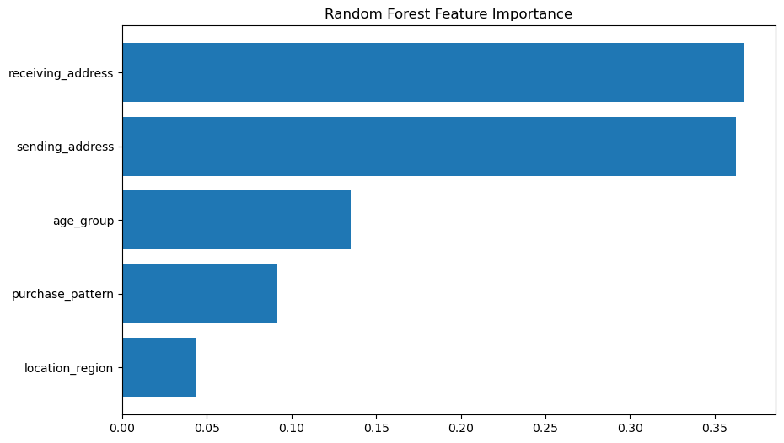

Slide 39
GRADIENT BOOSTING CLASSIFIER
Gradient Boosting Classifier Report:
precision recall f1-score support
high_risk 0.00 0.00 0.00 1251
low_risk 0.82 1.00 0.90 12848
moderate_risk 0.50 0.00 0.00 1621
accuracy 0.82 15720
macro avg 0.44 0.33 0.30 15720
weighted avg 0.72 0.82 0.74 15720

Slide 40
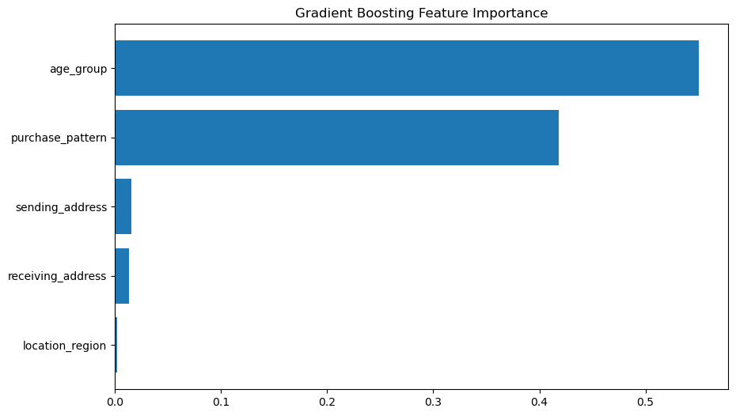

Slide 41
XGB Classifier
precision recall f1-score support
0 0.30 0.01 0.02 1251
1 0.82 0.99 0.90 12848
2 0.26 0.03 0.05 1621
accuracy 0.81 15720
macro avg 0.46 0.34 0.32 15720
weighted avg 0.72 0.81 0.74 15720

Slide 42
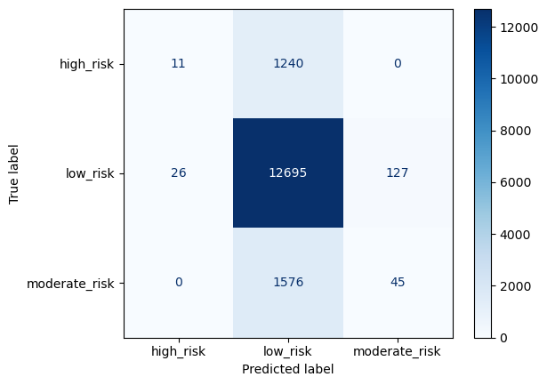

Slide 43
THANK YOU

