Slide 1
Sybil Detection of Hardened Registration Process for Mobile Croudsourcing
Name: Ronghua Li
E-mail: ronghua@kth.se

Slide 2
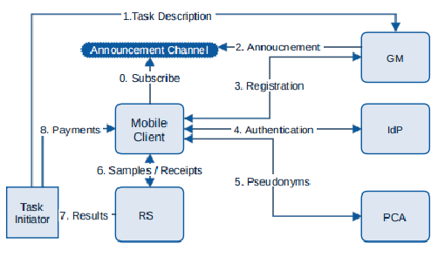
Background
Mobile crowd sensing can be used to retrieve information about the environment, weather, urban mobility,[4] congestion as well as any other sensory information that collectively forms knowledge.
e.g. Google Maps, Air quality detection with vehicle sensors
HRP
Figure 1. System design for Mobile crowdsoucing[1]
Notes:
need to explain what’s participatory sensing, what’s bad with the forged data.(Why we need hrp)
Allow users to contribute the data.
There are some mostly common exmp. of PS and MC. Google Maps -> crowdness in the street; Collect air quality or noise condition in urban area.
However, users to contribute data, the openess of system brings in hazard. Malicious adversary could contribute fake or forged data to pollute the database.
Prevent the system from corrupted data attack, we hope to eliminate bad data sources at the very beginning
This is one of the published system design for PS.
This project mainly focus on mobile devices

Slide 3
Previous HRP solution
Previous HRP system proposed in [2]:
Root Detection
Emulator Detection
IMEI Check
Bot-net Detection with Mo-Captcha
Notes:
the race between root detection and evasion is asymmetric, favoring evaders
also, some

Slide 4
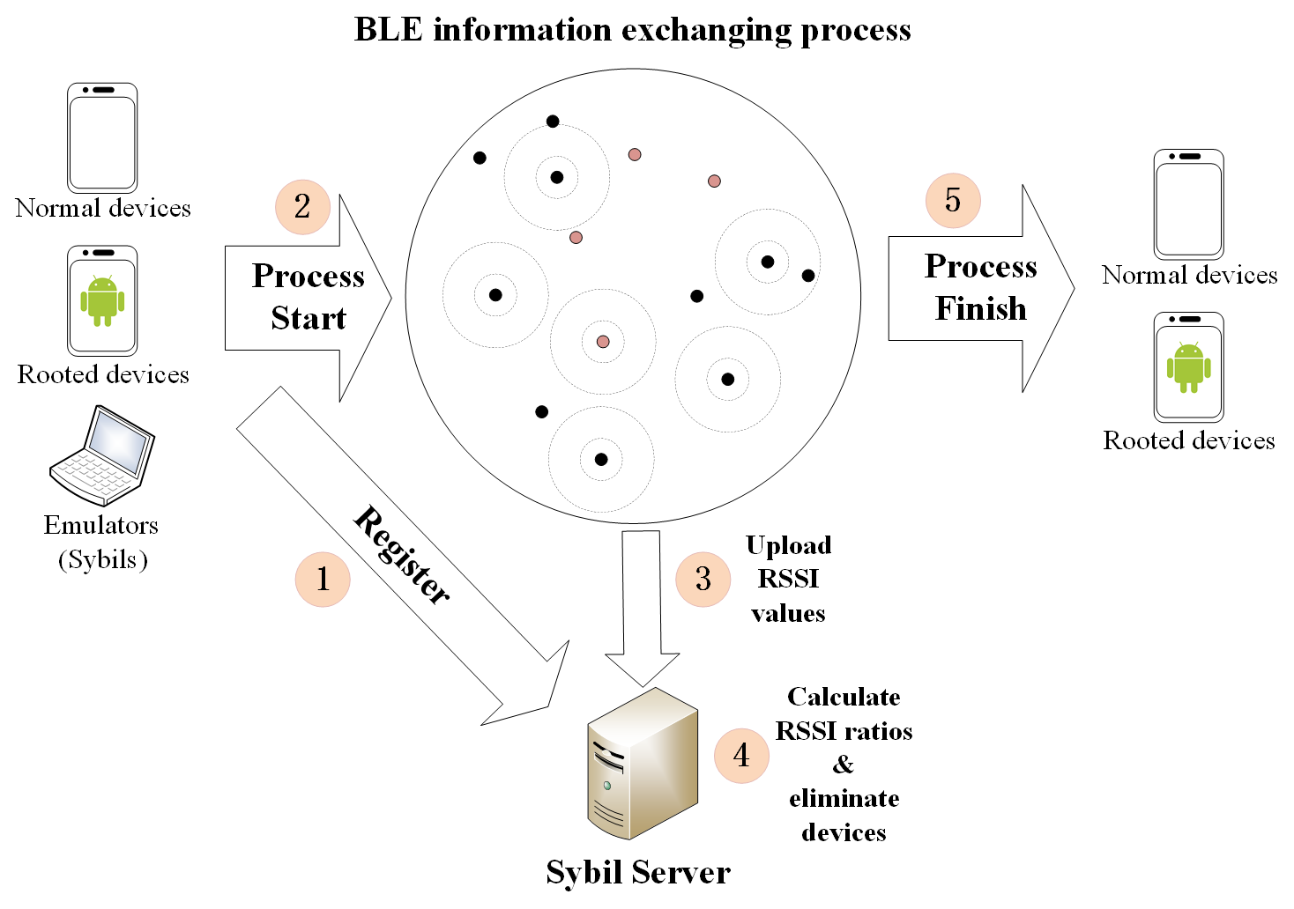
Sybil Detection for HRP
4 Phases:
Registration phase
Information Exchanging Phase
Score Calculation Phase
Elimination Phase
2*log₂(n) times
RP
IEP
SCP
EP
Workflow of Sybil detection
Fig. 2 Sybil detection mechanism for HRP
Notes:
1. devices register to the server
2. devices within a designated area start broadcasting and receiving BLE signals
3. receivers upload RSSI values of broadcasters to the server
4. server calculates RSSI ratio values -> calculate scores -> eliminate devices

Slide 5
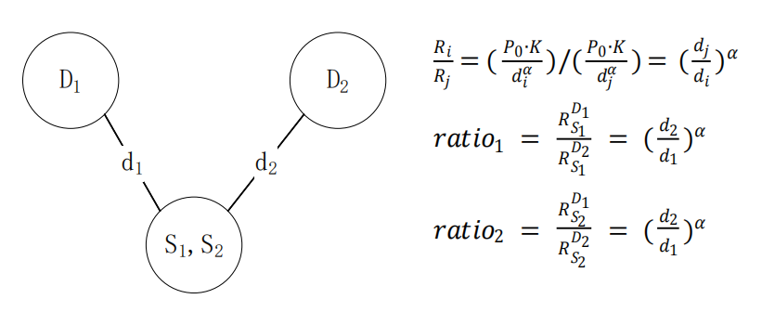
RSSI¹ ratio based Sybil detection method[3]
The precondition is that: D1-D4 detection nodes are honest and trusted
Figure. 3 RSSI ratio method
1. Received Signal Strength Indicator
Notes:
Reason why we choose this method

Slide 6
Registration Phase
256 bit ECDSA key pair
Public key collected by the server
Impersonation prevention

Slide 7
Information Exchanging Phase
Broadcasters
Detectors
Detectors Ready
Wait for all detectors to get ready
Start
detecting
Start broadcasting
Detection finishes
&
Upload data
Wait for next round instructions
Notes:
During IEP contents are all authenticated by ECDSA private key signature, no impersonation
Detectors start first, replay come later

Slide 8
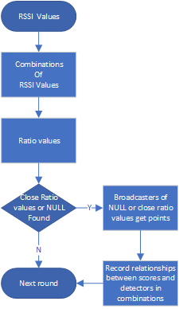
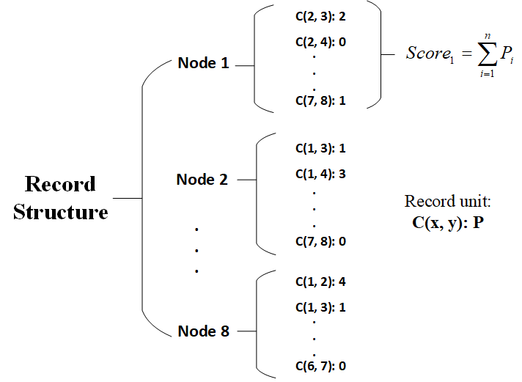
Score Calculation Phase
Example of Score Calculation
RSSI values from IEP
8 nodes system record
L_{D1} : { B₁: 1.0, B₂: 2.02, B₃: 3.0, B₄: NULL }
L_{D2} : { B₁: 2.0, B₂: 4.0, B₃: 5.0, B₄: NULL }
L_{D3} : . . . . .
. . . . . .
L_{Dn} : . . . . .
Ratio values of Combinations
Combination of D₁ and D₂
C(D₁, D₂): { B₁: 1.0/2.0, B₂: 2.02/4.0, B₃: 3.0/5.0, B₄: NULL/NULL }
C(D₁, D₃): . . . . . .
. . . . . . ,
C(D_{n-1}, D_{n})
Fig. 4 8 node system record structure example
Notes:
NULL means missing signals

Slide 9
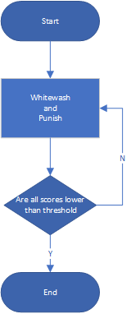
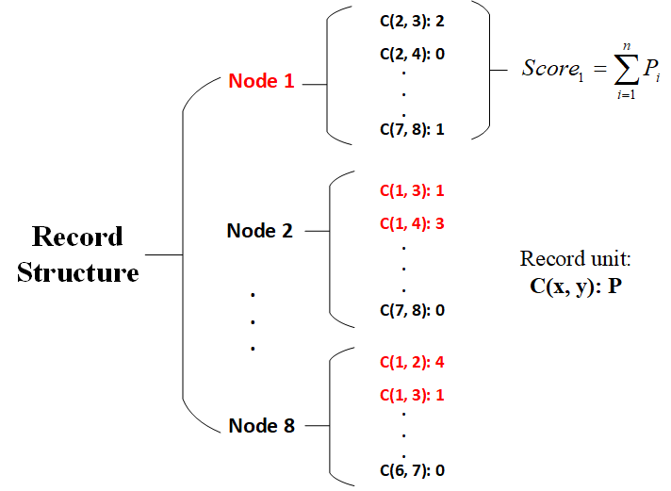
Elimination Phase
Threshold:
1 | 2 | 3 | 4 | 5 | 6 | 7 | 8
7 | 4 | 1 | 2 | x | x | x | 5
1 | 2 | 3 | 4 | 5 | 6 | 7 | 8
-1 | 4 | 3 | 5 | x | x | x | 0
Notes:
Suppose Node 1 is the Sybil node
Companion node: the other node in the same combination
Victims:
We whitewash victims and punish the companions by subtracting scores caused by these combinations from victims and adding them to the companions.

Slide 10
References
[1] Stylianos Gisdakis, Thanassis Giannetsos, and Panagiotis Papadimi-tratos. Security, privacy, and incentive provision for mobile crowd sens-ing systems.IEEE Internet of Things Journal, 3(5):839–853, 2016
[2] Jatesada Borsub and Panos Papadimitratos. Hardened registration process for participatory sensing. InProceedings of the 11th ACM Con-ference on Security & Privacy in Wireless and Mobile Networks, pages281–282, 2018.
[3] Murat Demirbas and Youngwhan Song. An rssi-based scheme for sybilattack detection in wireless sensor networks. In2006 International sym-posium on a world of wireless, mobile and multimedia networks (WoW-MoM’06), pages 5–pp. ieee, 2006.
[4] Xiao-Feng Xie & Zun-Jing Wang. (2015). "An empirical study of combining participatory and physical sensing to better understand and improve urban mobility networks.". Transportation Research Board (TRB) Annual Meeting. Washington, DC, USA.

