Slide 1
Sybil Detection of Hardened Registration Process for Mobile Croudsourcing
Name: Ronghua Li
E-mail: ronghua@kth.se

Slide 2
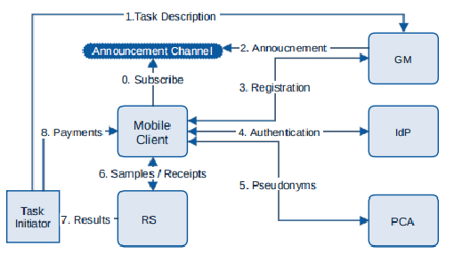
Background
Mobile crowd sensing can be used to retrieve information about the environment, weather, urban mobility,[4] congestion as well as any other sensory information that collectively forms knowledge.
e.g. Google Maps, Air quality detection with vehicle sensors
HRP
Figure 1. System design for Mobile crowdsoucing[1]
Notes:
need to explain what’s participatory sensing, what’s bad with the forged data.(Why we need hrp)
Allow users to contribute the data.
There are some mostly common exmp. of PS and MC. Google Maps -> crowdness in the street; Collect air quality or noise condition in urban area.
However, users to contribute data, the openess of system brings in hazard. Malicious adversary could contribute fake or forged data to pollute the database.
Prevent the system from corrupted data attack, we hope to eliminate bad data sources at the very beginning
This is one of the published system design for PS.
This project mainly focus on mobile devices

Slide 3
Previous HRP solution
Previous HRP system proposed in [2]:
Root Detection
Emulator Detection
IMEI Check
Bot-net Detection with Mo-Captcha
Notes:
the race between root detection and evasion is asymmetric, favoring evaders
also, some

Slide 4
Threat Model
T

Slide 5
Threat Model
This poster aims at advanced adversaries able to bypass the previous HRP.
Adversaries with multiple virtual devices would act independently, considering on colluding attacks in the future.
Adversaries own a mobile device and/or computer to control the Sybil attackers/devices.
Some adversaries own extra devices and can use them as extra access points to broadcast BLE signals.
We consider various percentage of nodes under adversaries control, up to 40%
Situation that the adversaries deploy attacks with many physical devices, e.g., many rooted Android physical devices are not within consideration.

Slide 6
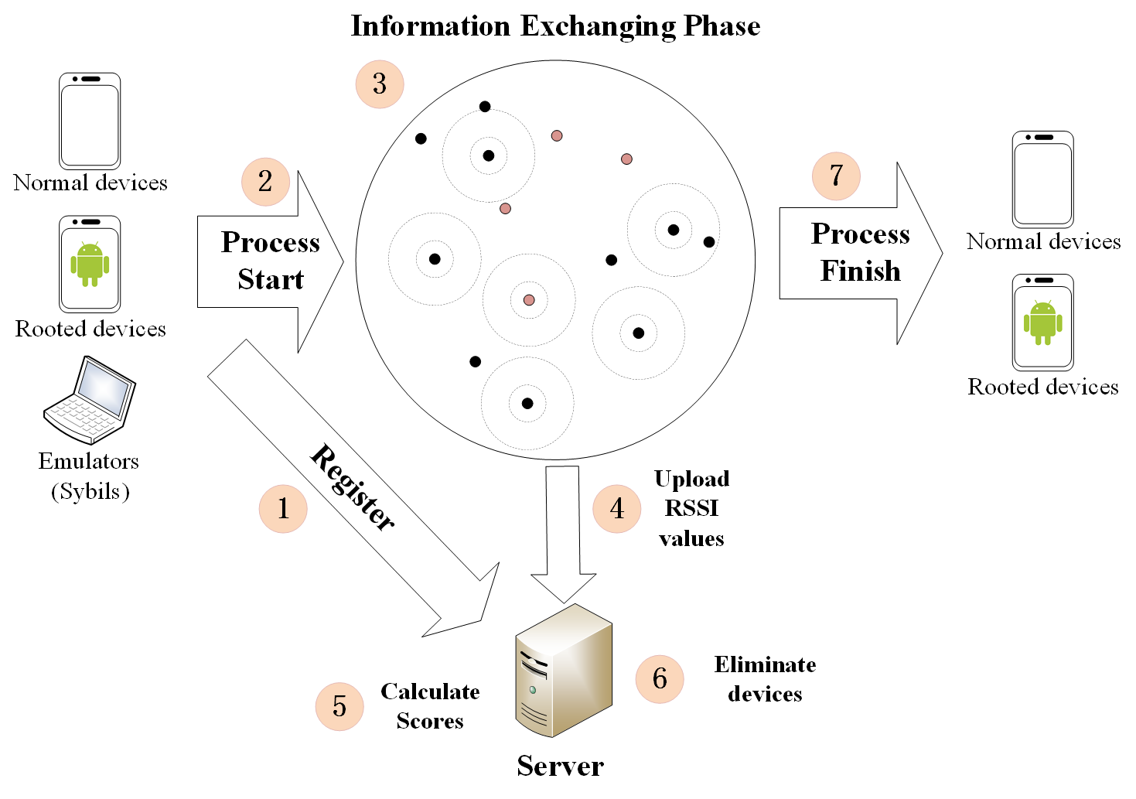
Sybil Detection for HRP
4 Phases:
Step 1, 2: Registration phase (RP)
Step 3, 4: Information Exchanging Phase (IEP)
Step 5: Score Calculation Phase (SCP)
Step 6, 7: Elimination Phase (EP)
2*log₂(n) Rounds
RP
IEP
SCP
EP
Workflow of Sybil detection
Fig. 2 Sybil detection mechanism for HRP
Notes:
1. devices register to the server
2. devices within a designated area start broadcasting and receiving BLE signals
3. receivers upload RSSI values of broadcasters to the server
4. server calculates RSSI ratio values -> calculate scores -> eliminate devices

Slide 7
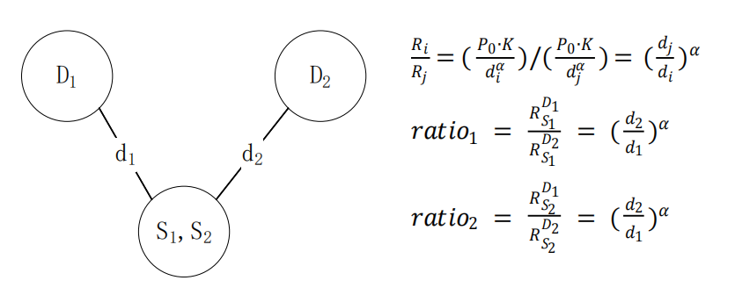
RSSI¹ ratio based Sybil detection method[3]
The precondition is that: D1-D4 detection nodes are honest and trusted
Figure. 3 RSSI ratio method
1. Received Signal Strength Indicator
Notes:
Reason why we choose this method

Slide 8
Registration Phase
256 bit ECDSA key pair will be generated by devices. Private keys will be used to sign data in BLE broadcasts to prevent impersonation.
Public keys will be collected by the server and certificates are distributed to all registered devices. These can be used to authenticate the broadcasting data.
Date authenticate with signature will also be used to prevent replay attacks in IEP. Without impersonation, replayed messages would most of the time come later than original ones. (Triangular rule)

Slide 9
Information Exchanging Phase
The server assigns half of the nodes broadcasters and the rest as detectors
Detectors start listening and broadcast signals indicating they are “ready”
Broadcasters not start broadcasting until all detectors are in “ready” state
Broadcasters start broadcasting and wait for next round instructions from the server
On detecting all signals from broadcasters, detectors stop listening and upload RSSI data to the server
The server asks broadcasters to stop and prepares the next round
Broadcasters
Detectors
Detectors Ready
Wait for all detectors to get ready
Start
detecting
Start broadcasting
Detection finishes
&
Upload data
Wait for next round instructions
from server
This round ends, next round starts
Notes:
During IEP contents are all authenticated by ECDSA private key signature, no impersonation
Detectors start first, replay come later

Slide 10
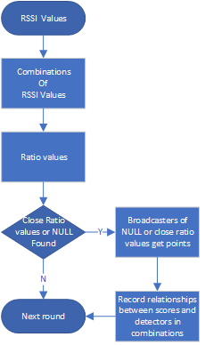
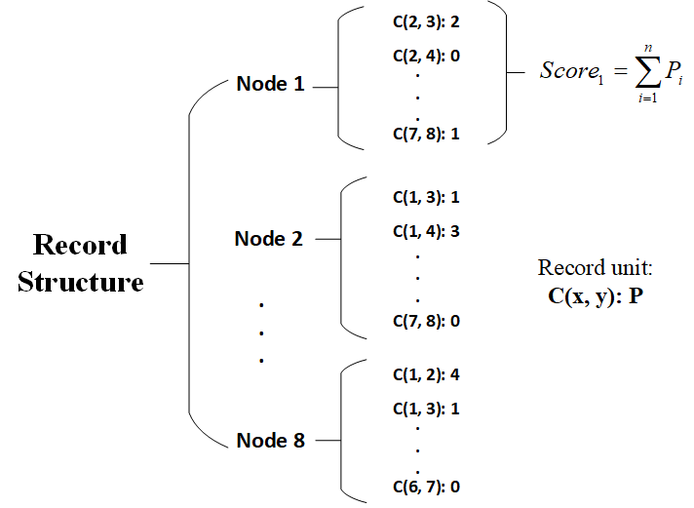
Score Calculation Phase
Example of Score Calculation
RSSI values from IEP
8 nodes system record
L_{D1} : { B₁: 1.0, B₂: 2.02, B₃: 3.0, B₄: NULL }
L_{D2} : { B₁: 2.0, B₂: 4.0, B₃: 5.0, B₄: NULL }
L_{D3} : . . . . .
. . . . . .
L_{Dn} : . . . . .
Ratio values of detector combinations
Combination of D₁ and D₂
C(D₁, D₂): { B₁: 1.0/2.0, B₂: 2.02/4.0, B₃: 3.0/5.0, B₄: NULL/NULL }
C(D₁, D₃): . . . . . .
. . . . . . ,
C(D_{n-1}, D_{n})
Fig. 4 8 node system record structure example
Notes:
NULL means missing signals

Slide 11
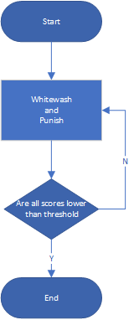
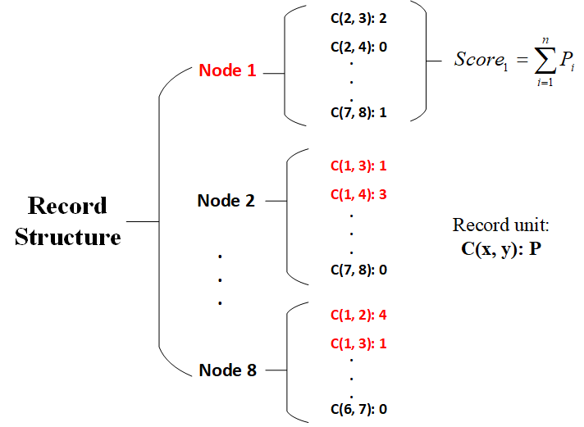
Elimination Phase
Threshold:
1 | 2 | 3 | 4 | 5 | 6 | 7 | 8
7 | 4 | 1 | 2 | x | x | x | 5
1 | 2 | 3 | 4 | 5 | 6 | 7 | 8
-1 | 4 | 3 | 5 | x | x | x | 0
Notes:
Suppose Node 1 is the Sybil node
Companion node: the other node in the same combination
Victims:
We whitewash victims and punish the companions by subtracting scores caused by these combinations from victims and adding them to the companions.

Slide 12
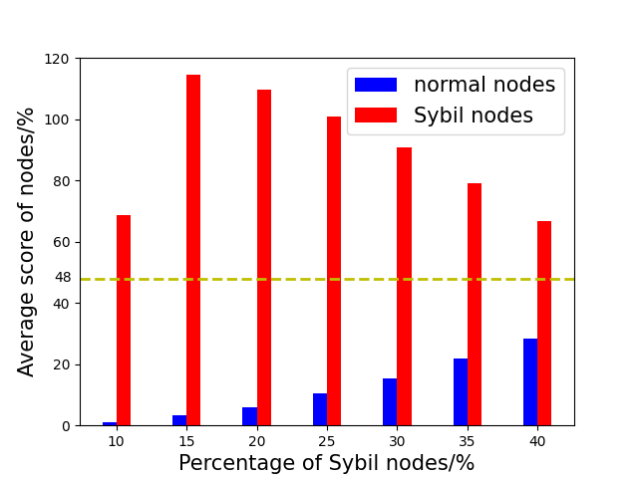
Simulation results
Fig. 5 Average Score of nodes in 20-node system
Notes:
In the simulation, we assume that Sybil nodes would forge fake RSSI values to frame legitimate nodes. Legitimate nodes would upload real RSSI values. Adversaries own extra devices and can be used to broadcast BLE signals. Every node can receive the BLE broadcasts. Fig. \ref{fig:simu} displays the average score of legitimate nodes and Sybil nodes in a 20 node system. Even when 40\% of the nodes are Sybil nodes, the average score of legitimate nodes is still a lot lower. Under such circumstances, the success rate of Sybil elimination based on "whitewash and punishment" mechanism can reach 99\%.

Slide 13
References
[1] Stylianos Gisdakis, Thanassis Giannetsos, and Panagiotis Papadimi-tratos. Security, privacy, and incentive provision for mobile crowd sens-ing systems.IEEE Internet of Things Journal, 3(5):839–853, 2016
[2] Jatesada Borsub and Panos Papadimitratos. Hardened registration process for participatory sensing. InProceedings of the 11th ACM Con-ference on Security & Privacy in Wireless and Mobile Networks, pages281–282, 2018.
[3] Murat Demirbas and Youngwhan Song. An rssi-based scheme for sybilattack detection in wireless sensor networks. In2006 International sym-posium on a world of wireless, mobile and multimedia networks (WoW-MoM’06), pages 5–pp. ieee, 2006.
[4] Xiao-Feng Xie & Zun-Jing Wang. (2015). "An empirical study of combining participatory and physical sensing to better understand and improve urban mobility networks.". Transportation Research Board (TRB) Annual Meeting. Washington, DC, USA.

