Slide 1
Sybil Detection of Hardened Registration Process for Mobile Croudsourcing
Name: Ronghua Li
E-mail: ronghua@kth.se

Slide 2
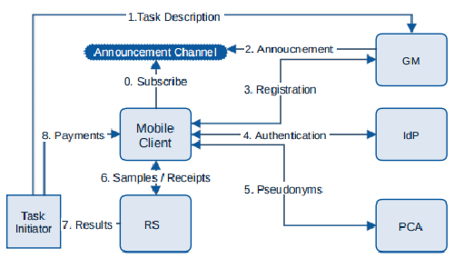
Introduction
Mobile crowd sensing can be used to retrieve information about the environment, weather, urban mobility,[4] congestion as well as any other sensory information that collectively forms knowledge.
e.g. Google Maps, Air quality detection with vehicle sensors
HRP
Figure 1. System design for Mobile crowdsoucing[1]
Notes:
Don’t explain too much
HRP can help prevent bad data sources from providing polluted data to the MSC system

Slide 3
Previous HRP solution
Previous HRP system proposed in [2]:
Root Detection
Emulator Detection
IMEI Check
Bot-net Detection with Mo-Captcha
Notes:
This HRP can prevent the majority of attackers from joining the sytem
the race between root detection and evasion is asymmetric, favoring evaders

Slide 4
System Model
Nodes: Registered devices
Normal nodes: legitimate devices controlled by normal users
Malicious nodes: rooted physical devices controlled by adversaries
Sybil nodes: emulated devices controlled by adversaries
Server: the server helps operate the Sybil detection process
General Assumption:
We assume that Sybil (emulated) devices running on computing platforms depend on physical sensors to receive or transmit signals.
Sybil devices controlled by the same attacker possibly share the access point; thus, their location is the same.
Based on this assumption, this poster uses the position-based Sybil detection method since this method detects Sybil nodes if they are in the same position.
General Idea:
Registered users involve in peer-to-peer interactions with Bluetooth Low Energy (BLE) 5 to corroborate the physical presence of each other.
Notes:
In order to strengthen the previous work, we proposed an Sybil detection process as a complementary work to help eliminate emulators controlled by advanced attackers

Slide 5
Threat Model
This poster aims at detecting advanced adversaries that are able to bypass the previous HRP.
Adversaries with multiple virtual devices would act independently, considering on colluding attacks in the future.
Adversaries own a mobile device and/or computer to control the Sybil attackers/devices.
We consider various percentage of nodes under adversaries control, up to 40%
Situation that the adversaries deploy attacks with many physical devices, e.g., many rooted Android physical devices, are not within consideration.

Slide 6
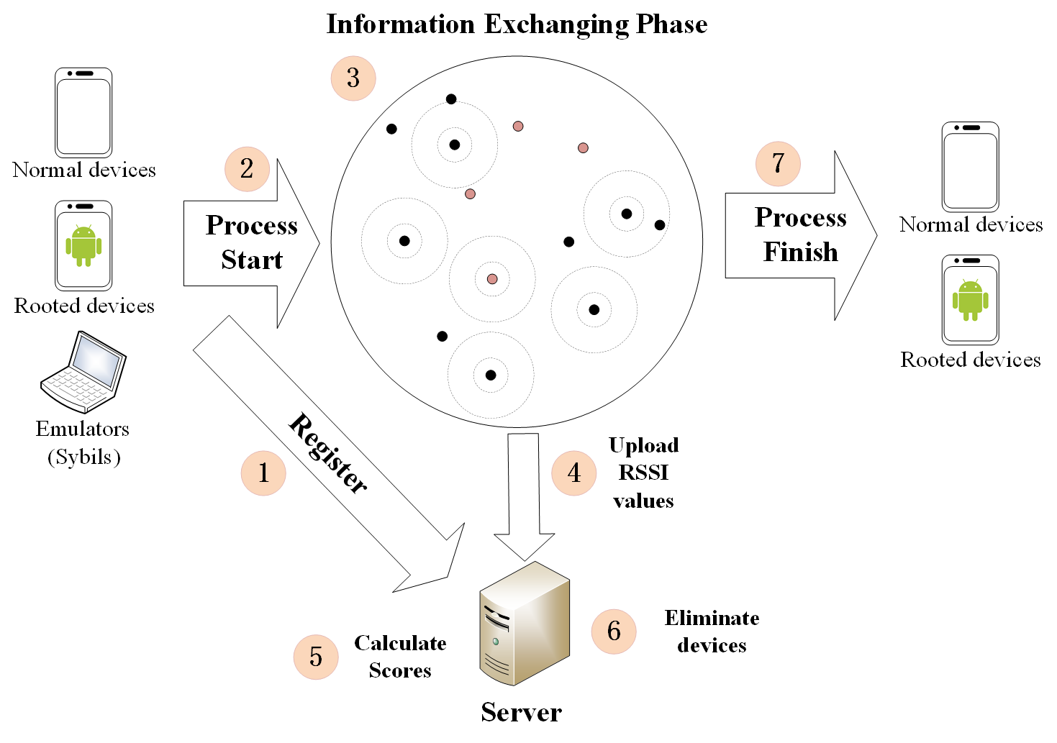
Sybil Detection for HRP
4 Phases:
Step 1, 2: Registration phase (RP)
Step 3, 4: Information Exchanging Phase (IEP)
Step 5: Score Calculation Phase (SCP)
Step 6, 7: Elimination Phase (EP)
2*log₂(n) Rounds
RP
IEP
SCP
EP
Workflow of Sybil detection
Fig. 2 Sybil detection mechanism for HRP
Notes:
This is an overview of the system
1. devices register to the server
2. devices within a designated area start broadcasting and receiving BLE signals
3. receivers upload RSSI values of broadcasters to the server
4. server calculates RSSI ratio values -> calculate scores -> eliminate devices
explain details later

Slide 7
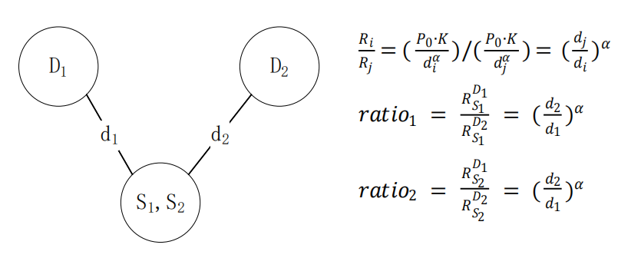
RSSI¹ ratio based Sybil detection method[3]
The precondition is that: D1-D4 detection nodes are honest and trusted
Figure. 3 RSSI ratio method
1. Received Signal Strength Indicator
Notes:
Before going to the four phases, first I’ll introduce the building blocks of our system
based on this, later we would use this method to help add scores to potential Sybil nodes

Slide 8
Registration Phase
256 bit ECDSA key pair will be generated by devices. Private keys will be used to sign data in BLE broadcasts to prevent impersonation.
Certificates will be collected by the server and signed certificates are distributed to all registered devices. These can be used to authenticate the broadcasting data.

Slide 9
Information Exchanging Phase
The server assigns half of the nodes to be broadcasters and the rest to be detectors. The server assigns time t₁ for detectors and t₂ for broadcasters. t₁ is earlier than t₂. This round ends at t₃.
Detectors start detecting at t₁ and keep listening until t₃, broadcasters wait until t₂
Broadcasters start broadcasting at t₂ and keep broadcasting until t₃
Detectors stop listening and upload RSSI data to the server
The server prepares the next round
Broadcasters
Detectors
t₁
t₂
Wait until t₂
Start
detecting
Start broadcasting
Detection finishes
&
Upload data
Wait until t₃ and stop
t₃
This round ends, next round starts
Security analysis:
Impersonations: data signed with private keys and can be authenticated by certificates
Replay attacks: attackers cannot forge signatures, detectors start detecting first; Replayed messages would mostly come later than original ones. (Triangular rule)
Notes:
During IEP contents are all authenticated by ECDSA private key signature, no impersonation
Detectors start first, replay come later
Detectors could simply negelect the replayed messages

Slide 10
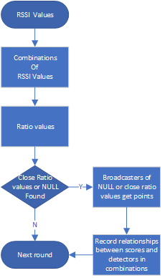
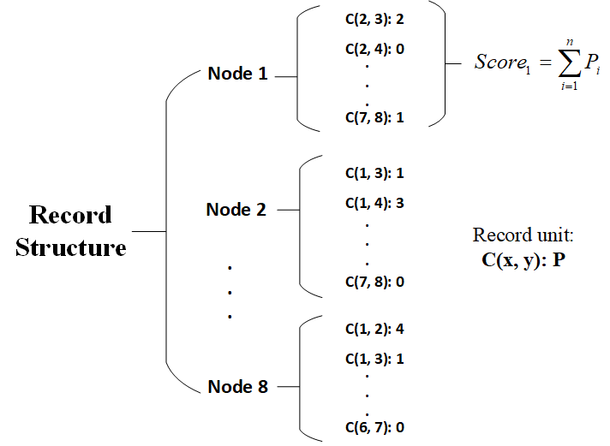
Score Calculation Phase
Example of Score Calculation
RSSI values from IEP
8 nodes system record
1 : { 5: 1.0, 6: 2.02, 7: 3.0, 8: null }
2 : { 5: 2.0, 6: 4.0, 7: 5.0, 8: null }
3 : . . . . .
4 : . . . . .
Ratio values of detector combinations
Combination of 1 and 2
C(1, 2): { 5: 1.0/2.0, 6: 2.02/4.0, 7: 3.0/5.0, 8: NULL(null/null) }
C(1, 3): . . . . . .
. . . . . . ,
C(3, 4)
Fig. 4 8 node system record structure example
Notes:
Workflow
explain RSSI values
null means missing signals NULL means null/null
how they give scores
However, the two detectors can be two Sybil nodes. Since the attackers we’re facing are advanced adversaries, we assume that they can exploit MCS app and upload forged identical RSSI values
for legitimate broadcasters. Therefore, the server would calculate the same ratio values for nodes. This kind of behavior would be called framing. Later in the elimination phase, we’ll introduce our solution to “framing”
record: more than one points

Slide 11
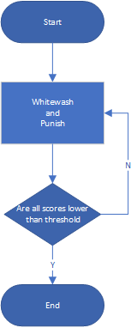
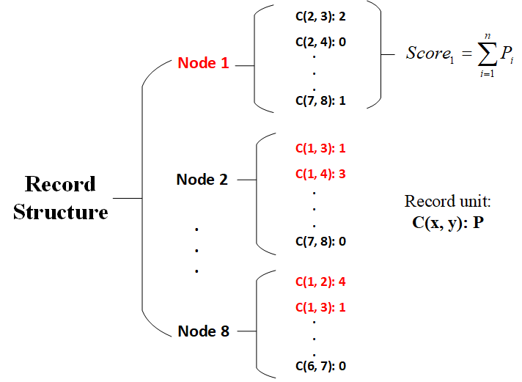
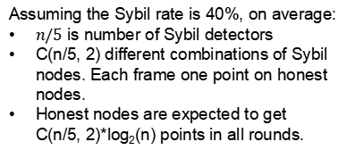
Elimination Phase
Threshold:
Assuming the Sybil rate is 40%, on average:
$n/5$ is number of Sybil detectors
C(n/5, 2) different combinations of Sybil nodes. Each frame one point on honest nodes.
Honest nodes are expected to get C(n/5, 2)*log₂(n) points in all rounds.
1 | 2 | 3 | 4 | 5 | 6 | 7 | 8
-1 | 0 | 3 | 5 | x | x | x | 4
1 | 2 | 3 | 4 | 5 | 6 | 7 | 8
-1 | 4 | 3 | 5 | x | x | x | 0
1 | 2 | 3 | 4 | 5 | 6 | 7 | 8
7 | 4 | 1 | 2 | x | x | x | 5
1 | 2 | 3 | 4 | 5 | 6 | 7 | 8
-1 | 1 | 1 | 5 | x | x | x | 5
Notes:
First look at the workflow.:
whitewash xxxx process. some will be eliminated, some would get points, some would lose points
When all nodes score lower than the threshold -> end
Suppose Node 1 is the Sybil node
Companion node: the other node in the same combination
Victims: nodes get score
We whitewash victims and punish the companions by subtracting scores caused by these combinations from victims and adding them to the companions.

Slide 12
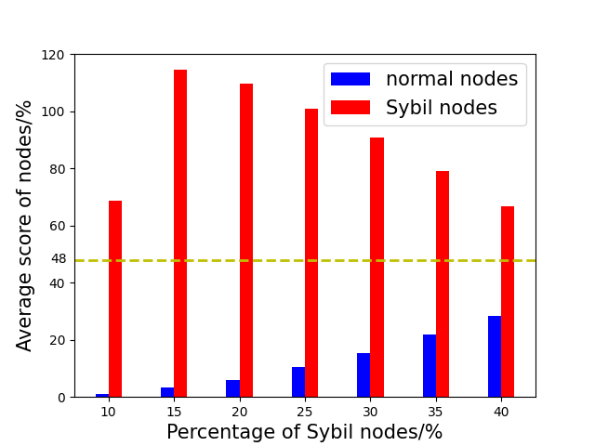
Simulation results
Fig. 5 Average Score of nodes in 20-node system
Notes:
In the simulation, we assume that Sybil nodes would forge fake RSSI values to frame legitimate nodes. Legitimate nodes would upload real RSSI values. Adversaries own extra devices and can be used to broadcast BLE signals. Every node can receive the BLE broadcasts. Fig. \ref{fig:simu} displays the average score of legitimate nodes and Sybil nodes in a 20 node system. Even when 40\% of the nodes are Sybil nodes, the average score of legitimate nodes is still a lot lower. Under such circumstances, the success rate of Sybil elimination based on "whitewash and punishment" mechanism can reach 99\%.

Slide 13
References
[1] Stylianos Gisdakis, Thanassis Giannetsos, and Panagiotis Papadimi-tratos. Security, privacy, and incentive provision for mobile crowd sens-ing systems.IEEE Internet of Things Journal, 3(5):839–853, 2016
[2] Jatesada Borsub and Panos Papadimitratos. Hardened registration process for participatory sensing. InProceedings of the 11th ACM Con-ference on Security & Privacy in Wireless and Mobile Networks, pages281–282, 2018.
[3] Murat Demirbas and Youngwhan Song. An rssi-based scheme for sybilattack detection in wireless sensor networks. In2006 International sym-posium on a world of wireless, mobile and multimedia networks (WoW-MoM’06), pages 5–pp. ieee, 2006.
[4] Xiao-Feng Xie & Zun-Jing Wang. (2015). "An empirical study of combining participatory and physical sensing to better understand and improve urban mobility networks.". Transportation Research Board (TRB) Annual Meeting. Washington, DC, USA.

