Slide 1
Hardened Registration Process for Mobile Croudsourcing
Name: Ronghua Li
E-mail: ronghua@kth.se
Supervisor: Cihan Eryonucu
Examinar: Panos Papadimitratos

Slide 2
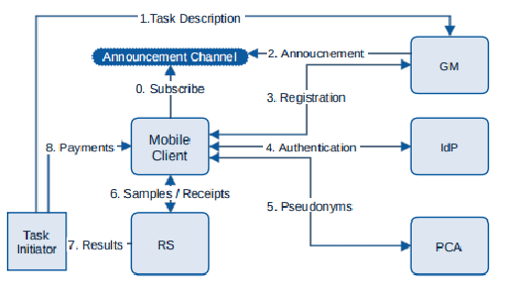
Background
What’s Participatory Sensing or Mobile crowdsourcing?
Participatory sensing can be used to retrieve information about the environment, weather, urban mobility,[7] congestion as well as any other sensory information that collectively forms knowledge.
e.g. Google Map
HRP
Figure 1. System design for Mobile crowdsoucing[1]
Notes:
need to explain what’s participatory sensing, what’s bad with the forged data.(Why we need hrp)

Slide 3
Example for information collection
1.Phone condition: sensors, root, IMEI number, real device or emulator
2.Scarce unique personal info: phone number, email addr, personal ID( strong but double-edged sword[2])
3.Environment condition: IP, network condition, location, surrounding devices

Slide 4
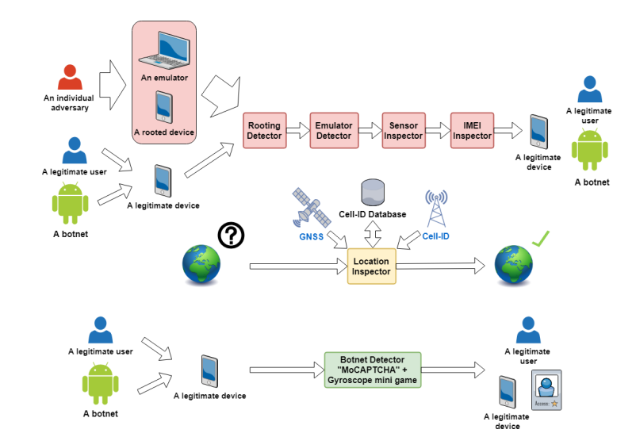
HRP solution
Sensors working properly
Hardware are not exploited
Software are not exploited
Client[3]
HRP
Additional examination on bypassed clients.
Clients vouch for each other and select accountable ones.
Server[4]
HRP system design in [3]

Slide 5
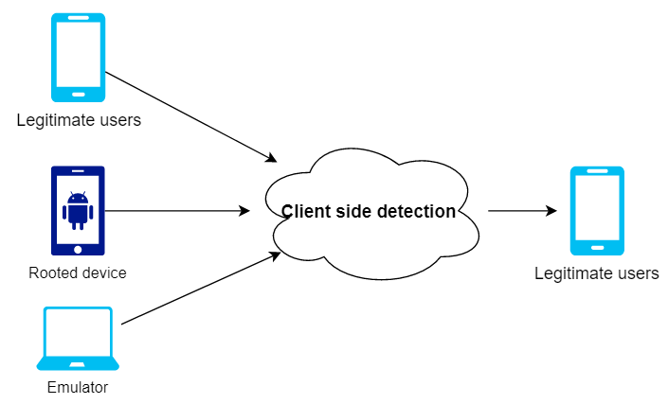
HRP system: Client
Why?
Rooted devices are too customized. Software can be exploited easily.
What is Magisk-Hide?
Magisk Hide is the feature that allows you to cloak root traits for certain apps
Improvement on [3]:
Native code are included to increase the cost for bypassing the detection
Isolated process is used to detect Magisk-Hide(most commonly used root evasion method)[5]
Figure 2. Root, emulator and hardware detection

Slide 6
HRP system: Server
 | Round1 | Round2 | Round3 | Round4 | Round5 | Round6
Node1 | L | B | L | B | L | B
Node2 | L | B | L | B | B | L
Node3 | L | B | B | L | L | B
Node4 | L | B | B | L | B | L
Node5 | B | L | L | B | L | B
Node6 | B | L | L | B | B | L
Node7 | B | L | B | L | L | B
Node8 | B | L | B | L | B | L
Model:
attacker with some malicious devices and emulators bypassing client side detection.
If they enter the system, they can upload forged or spoofed data.
Our goal is to detect these evil virtual deivices with WiFi signals.
Table 1. an example of the system.
Figure 3. 8-node system,
8 devices in the system
Notes:
Devices in the system will be callled nodes later.
The purpose of the server side is to find out Sybil(virtual) nodes.(explain the model)
There are 2*log(n) rounds in total.
Each round, half of the node would broadcast and the rest would receive.
Nodes in the system would broadcast in turn so that each node would get the secret keys from all other nodes.

Slide 7
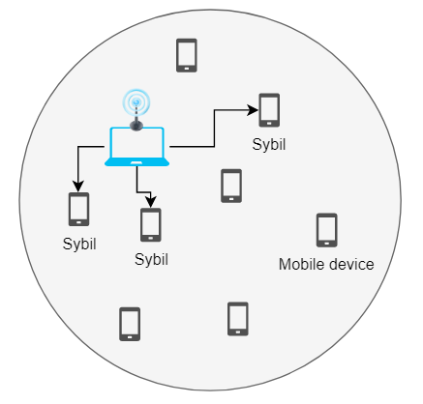
Threat model
Old Threat model: Sybil nodes need to rely on other nodes to broadcast.
Too strict. In fact, attackers can use any other devices to broadcast signals on Sybil nodes behalf.
New Threat model: Attacker can use a laptop(more powerful CPU) to broadcast signals on Sybil nodes behalf.
Figure 6. Laptop help broadcast signals

Slide 8
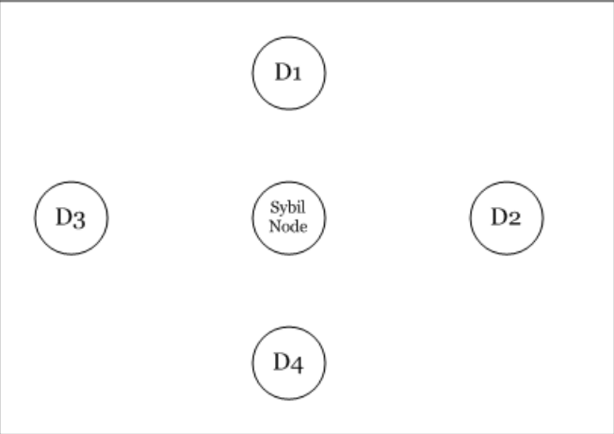



RSSI¹ ratio based Sybil detection method[6]
The precondition is that: D1-D4 detection nodes are honest and trusted
Figure 7. Sybil detection method
“two nodes are enough for detection”
1. Received Signal Strength Indicator
Notes:
With two nodes, we could determine whether there are nodes broadcasting with the same AP in the same round
Later, we are going to use node pairs to find out potential Sybil nodes.
These pairs would be called as sentry.

Slide 9
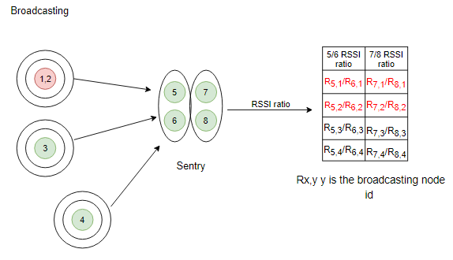
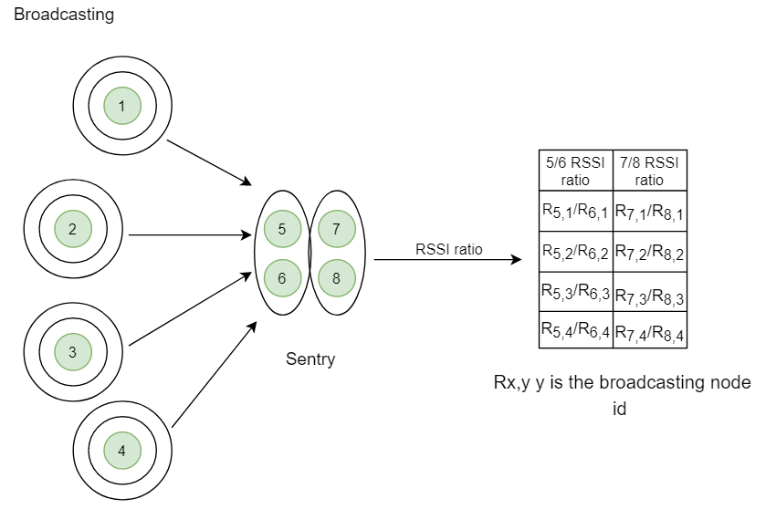
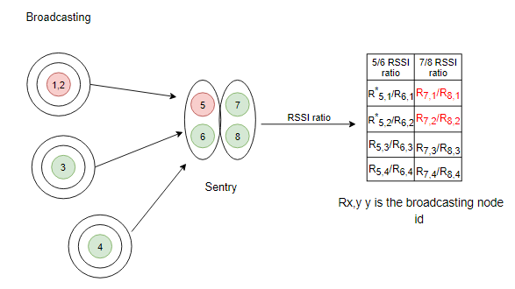
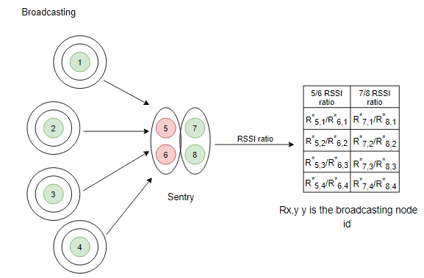
The Sentry based score system
i | ii | iii | iv | v | vi | vii | viii
0 | 0 | 0 | 0 | 0 | 0 | 0 | 0
Precondition: nodes are moving slowly in the system, therefore their position can be regarded as fixed in each round
Supposing node 1 and 2 are Sybil nodes and using the same AP, there will be:
R_{5,2}/R_{6,2}-R_{5,1}/R_{6,1} < σ
R_{7,2}/R_{8,2}-R_{7,1}/R_{8,1} < σ
Node 1 and 2 would get 2 points each.
In the end, nodes with the highest score are Sybil nodes.
 | Round1 | Round2 | Round3 | Round4 | ......
Node1 | L | B | L | B | ......
Node2 | L | B | L | B | ......
Node3 | L | B | B | L | ......
Node4 | L | B | B | L | ......
Node5 | B | L | L | B | .....
Node6 | B | L | L | B | .....
Node7 | B | L | B | L | .....
Node8 | B | L | B | L | ......
If two nodes in a sentry are both evil, they could collude and frame honest nodes(False positive)
If one evil node and one good node are in a Sentry, bad node can try to protect other broadcasting Sybil nodes(False negative).
Figure 7. Sentry based voting system in round 2
Notes:
From listeners, nodes are randomly divided into pairs, each pair is called a sentry.
Since each sentry has two nodes, it can detect Sybil nodes with RSSI ratio value.

Slide 10
Simulation model
There are 16 nodes in total in the system.
There is only one attacker in the system. He owns one laptop and one exploited mobile device.
The malicious node will only help Sybil nodes broadcast when it's vacant. The laptop can broadcast on behalf of discretionary number of Sybil nodes.
When two evil nodes are paired as a sentry, they will definitely vote out broadcasting honest nodes.
There are 6 evil nodes in the system(one malicious node and five Sybil nodes).
The emulation runs 2000 times.

Slide 11
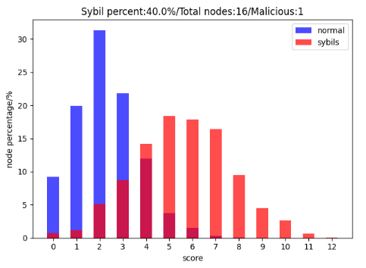
Simulation results
Most of the cases, when honest nodes get high score, Sybil nodes would get even higher score. Sybil nodes nearly always get the highest score.
Elimination:
the one with the highest score
Those honest nodes get framed would be whitewashed(subtract points from them).
This node’s sentry partner would get all the points causing by them.
i | ii | iii | iv | v | vi | vii | viii
1 | 0 | 2 | 4 | 3 | 2 | 0 | 1
Notes:
What’s colluders?

Slide 12
Limitations
Threshold: how to eliminate Sybil nodes when preventing false positive? Not determined yet.
If there are too few nodes in the system, FP and FN rate increase greatly
In some cases, Sybil nodes with high score accidentally don’t get the chance to frame others, thus elimination of these nodes won’t help find-ing their partners. Even worse, honest nodes cannot get whitewashed(subtract points) and might be eliminated as well.
i | ii | iii | iv | v | vi | vii | viii
1 | 0 | 2 | 4 | 3 | 2 | 0 | 1

Slide 13
References
[1] Stylianos Gisdakis, Thanassis Giannetsos, and Panagiotis Papadimi-tratos. Security, privacy, and incentive provision for mobile crowd sens-ing systems.IEEE Internet of Things Journal, 3(5):839–853, 2016
[2] Haifeng Yu, Phillip B Gibbons, Michael Kaminsky, and Feng Xiao.Sybillimit: A near-optimal social network defense against sybil attacks.In2008 IEEE Symposium on Security and Privacy (sp 2008), pages3–17. IEEE, 2008.
[3] Jatesada Borsub and Panos Papadimitratos. Hardened registration process for participatory sensing. InProceedings of the 11th ACM Con-ference on Security & Privacy in Wireless and Mobile Networks, pages281–282, 2018.
[4] Nickolai Verchok and Alex Orailo ̆glu. Hunting sybils in participatorymobile consensus-based networks. InProceedings of the 15th ACM AsiaConference on Computer and Communications Security, pages 732–743,2020.
[5] Darvin. Detecting magisk hide.https://darvincitech.wordpress.com/2019/11/04/detecting-magisk-hide/, April 2019.
[6] Murat Demirbas and Youngwhan Song. An rssi-based scheme for sybilattack detection in wireless sensor networks. In2006 International sym-posium on a world of wireless, mobile and multimedia networks (WoW-MoM’06), pages 5–pp. ieee, 2006.
[7] Xiao-Feng Xie & Zun-Jing Wang. (2015). "An empirical study of combining participatory and physical sensing to better understand and improve urban mobility networks.". Transportation Research Board (TRB) Annual Meeting. Washington, DC, USA.

