Slide 1
Advanced Hardened Registration Process for Mobile Crowd Sensing
Name: Ronghua Li
E-mail: ronghua@kth.se
Supervisor: Cihan Eryonucu
Examiner: Panos Papadimitratos

Slide 2
Introduction
Mobile crowd sensing can be used to retrieve information about the environment, weather, urban mobility,[4] congestion as well as any other sensory information that collectively forms knowledge.
e.g. the Google Maps, Noise condition detection
Notes:
Don’t explain too much
the openness of the system -> bad data collected
HRP can help prevent bad data sources from providing polluted data to the MSC system

Slide 3
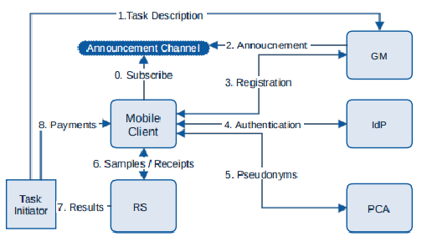
Secured Architecture for MCS
HRP
Figure 1. System design for Mobile crowd sensing [1]
Notes:
Proposed in 2015, this framework for Mobile crowd sensing system can guarantee that even when parts of the system are compromised, the privacy of users can still be protected.
Nonetheless, the main focus of the framework is on protecting the privacy of users, not the quality of sensing data.
A data guarding process : 2015 SHIELD can help identify and filter out faulty reports provided by adversaries
However, this data has already been accepted by the system.
Therefore, we want to design a work that can directly eliminate potential bad data sources from the beginning
-> Hardened Registration Process

Slide 4
Previous HRP solution
Previous HRP system proposed in [2]:
Root Detection
Emulator Detection
IMEI Check
Bot-net Detection with Mo-Captcha
Java level coding only!
Enhanced HRP solution
Client-side detection
Server-side detection
Native Acoding
Magisk Detection
Notes:
This HRP can prevent the majority of attackers from joining the sytem
It focuses on device examination: meaning it checks the devices users use and analyze whether it’s a legitimate device or devices that are capable of contributing bad data.
the race between root detection and evasion is asymmetric, favoring evaders
Client would be like an enhanced version of the previous HRP
Server would be like complementary work on the client-side detection

Slide 5
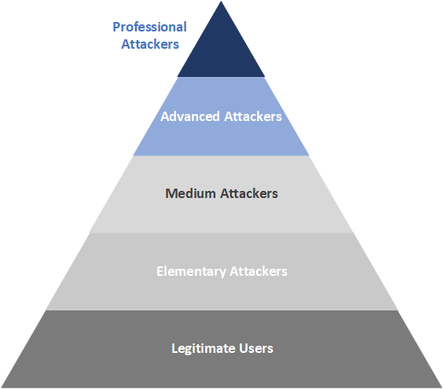
Threat Model
Server-side
Client-side
Notes:
professional attackers have two different devices: rooted devcies and rooted emulators (We can do nothing about the rooted devices)

Slide 6
Threat Model Cont’d
The professional adversaries have multiple Sybil (emulated) devices and seek to register them to the system
They have at most three computing platforms to run these Sybil devices
These computing platforms have sensors and antenne to help Sybil devices receive and broadcaster wireless signals
At most 40% of the devices are Sybil devices
They somehow know the exact mechanisms of our detection process and deploy mechanism-specific attacks
Notes:
professional attackers can modify emulators and make them bypass the client-side detection
since emulator and cause Sybil attacks, great impact on the system -> we need Sybil (emulator) detection

Slide 7
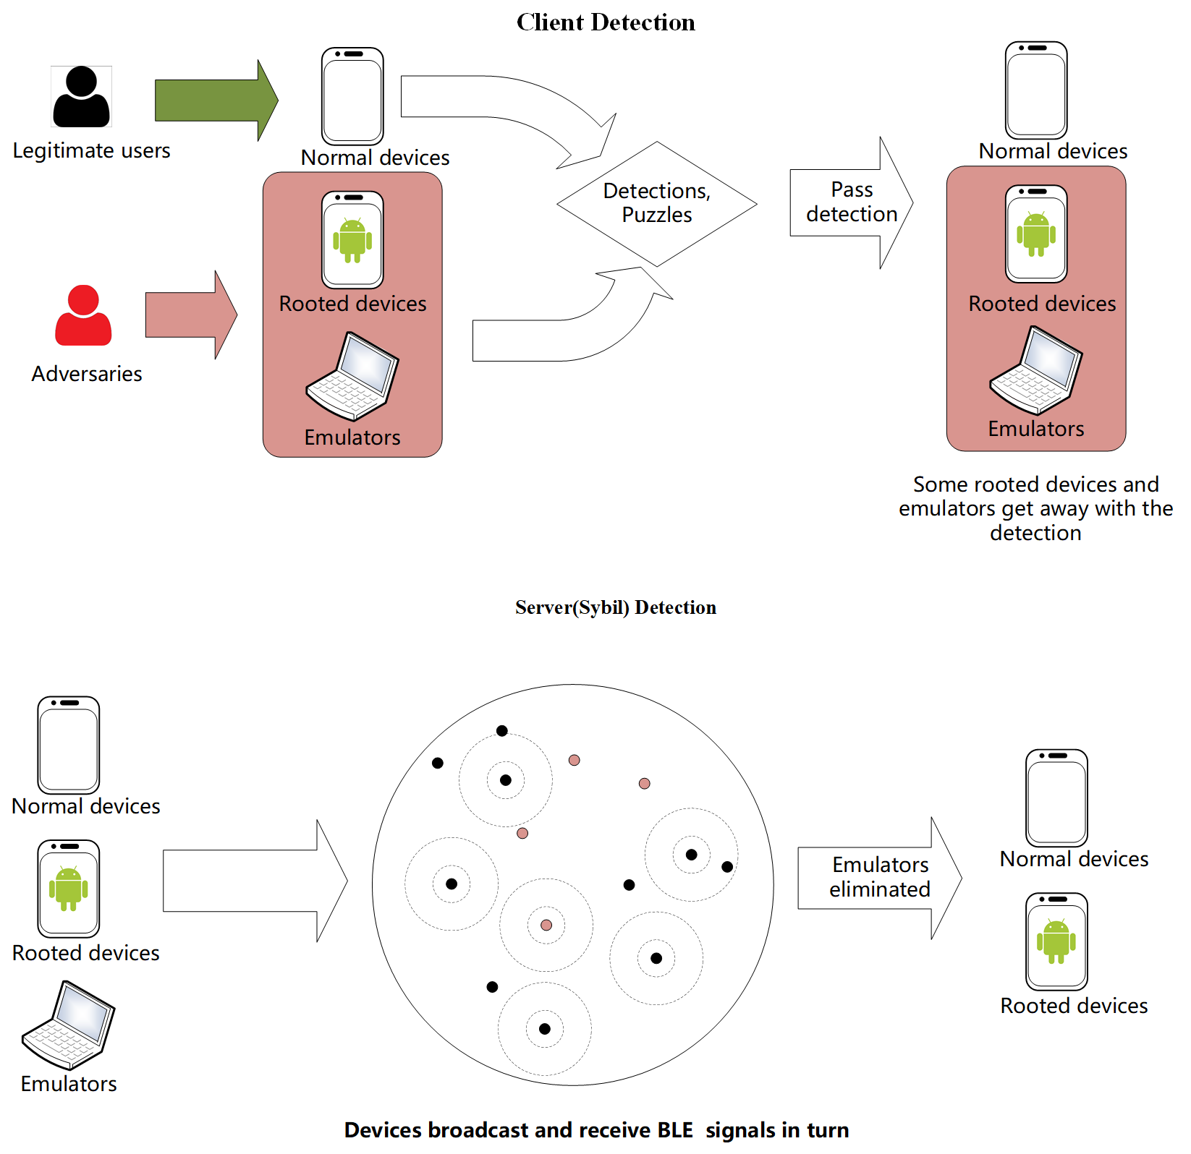
Hardened Registration Process Plus
Client-side detection: Device Examination
Server-side detection: Sybil Detection
Notes:
peer-to-peer interaction with Bluetooth Low Energy to corroborate the physical presence of the registered devices
Make it simple, during the process, nodes broadcast signals, as the evidence of their existence
The client-side detection, we are going to implement root and emulator detection with C(native code) to strengthen it, and implement Magisk detection to counter Magisk-Hide
This is the mandatory part of it. Every user has to join such process

Slide 8
Server-side detection Setups
Large region where we need MCS
16 nodes in the waiting list, assign small sub-regions
Each sub-region contains a group of nodes to start the server-side detection
All data used during the server-side detection is only valid within the group
50m

Slide 9
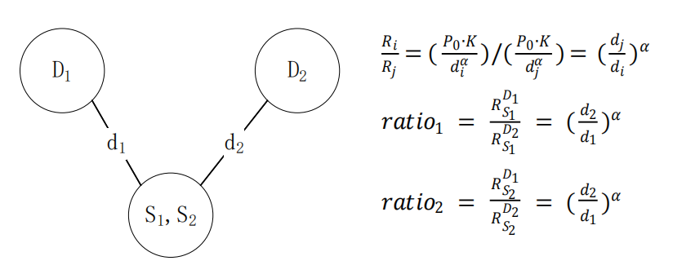
RSSI¹ ratio based Sybil detection method[3]
The precondition is that: D1, D2 detection nodes are honest and trusted
Figure. 3 RSSI ratio method
1. Received Signal Strength Indicator
Notes:
Before going to the four phases, first I’ll introduce the building blocks of our system
based on this, later we would use this method to help add scores to potential Sybil nodes

Slide 10
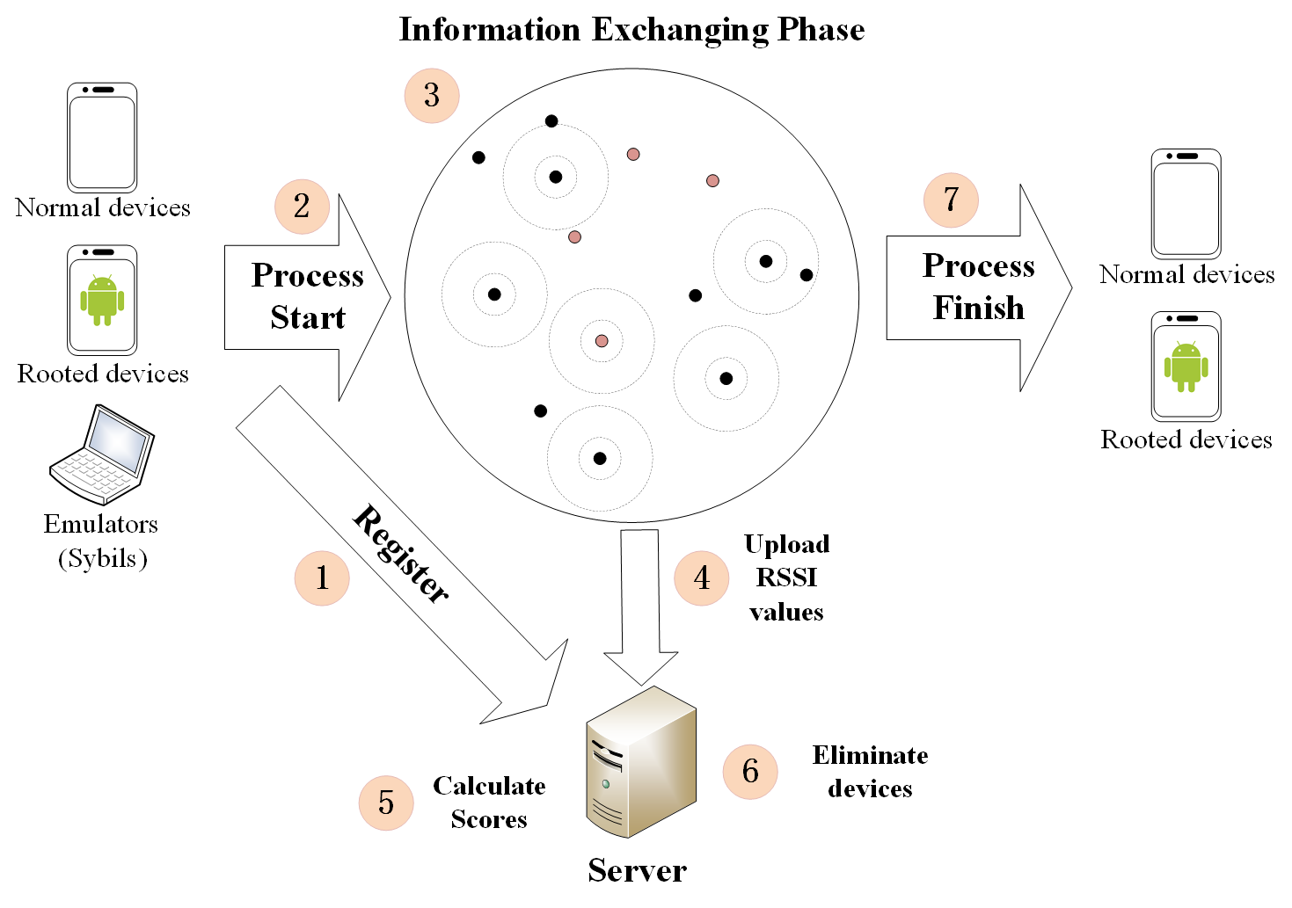
Server-side detection for HRP
4 Phases:
Step 1, 2: Registration phase (RP)
Step 3, 4: Information Exchanging Phase (IEP)
Step 5: Score Calculation Phase (SCP)
Step 6, 7: Elimination Phase (EP)
2*log₂(n) Rounds
RP
IEP
SCP
EP
Workflow of Sybil detection
Fig. 2 Sybil detection mechanism for HRP
Notes:
This is an overview of the system
1. devices register to the server
2. devices within a designated area start broadcasting and receiving BLE signals
3. receivers upload RSSI values of broadcasters to the server
4. server calculates RSSI ratio values -> calculate scores -> eliminate devices
explain details later

Slide 11
Registration Phase
256 bit ECDSA key pair will be generated by devices. Private keys will be used to sign data in BLE broadcasts to prevent impersonation.
Certificates will be collected by the server and signed certificates are distributed to all registered devices. These can be used to authenticate the broadcasting data.

Slide 12

Information Exchanging Phase
The server assigns half of the nodes to be broadcasters and the rest to be detectors. The server assigns time t₁ for detectors and t₂ for broadcasters. t₁ is earlier than t₂. This round ends at t₃.
Detectors start detecting at t₁ and keep listening until t₃, broadcasters wait until t₂
Broadcasters start broadcasting at t₂ and keep broadcasting until t₃
Detectors stop listening and upload RSSI data to the server
The server prepares the next round
Broadcasters
Detectors
t₁
t₂
Wait until t₂
Start
detecting
Start broadcasting
Detection finishes
&
Upload data
Wait until t₃ and stop
t₃
This round ends, next round starts
Security analysis:
Impersonations: data signed with private keys and can be authenticated by certificates
Replay attacks: attackers cannot forge signatures, detectors start detecting first; Replayed messages would mostly come later than original ones. (Triangular rule)
Notes:
During IEP contents are all authenticated by ECDSA private key signature, no impersonation
Detectors start first, replay come later
Detectors could simply negelect the replayed messages

Slide 13
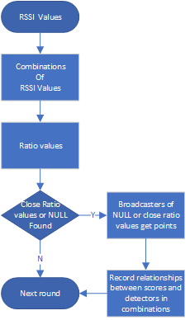
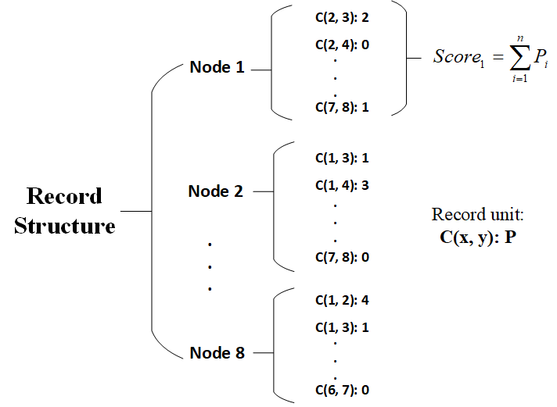
Score Calculation Phase
Example of Score Calculation
RSSI values from IEP
8 nodes system record
1 : { 5: 1.0, 6: 2.02, 7: 3.0, 8: null }
2 : { 5: 2.0, 6: 4.0, 7: 5.0, 8: null }
3 : . . . . .
4 : . . . . .
Ratio values of detector combinations
Combination of 1 and 2
C(1, 2): { 5: 1.0/2.0, 6: 2.02/4.0, 7: 3.0/5.0, 8: NULL(null/null) }
C(1, 3): . . . . . .
. . . . . . ,
C(3, 4)
Fig. 4 8 node system record structure example
Notes:
Workflow
explain RSSI values
null means missing signals NULL means null/null
how they give scores
I need to mention that Sybil nodes can upload forged data
However, the two detectors can be two Sybil nodes. Since the attackers we’re facing are advanced adversaries, we assume that they can exploit MCS app and upload forged identical RSSI values
for legitimate broadcasters. Therefore, the server would calculate the same ratio values for nodes. This kind of behavior would be called framing. Later in the elimination phase, we’ll introduce our solution to “framing”
record: more than one points
two behavior patterns of Sybil nodes.

Slide 14
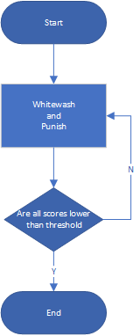
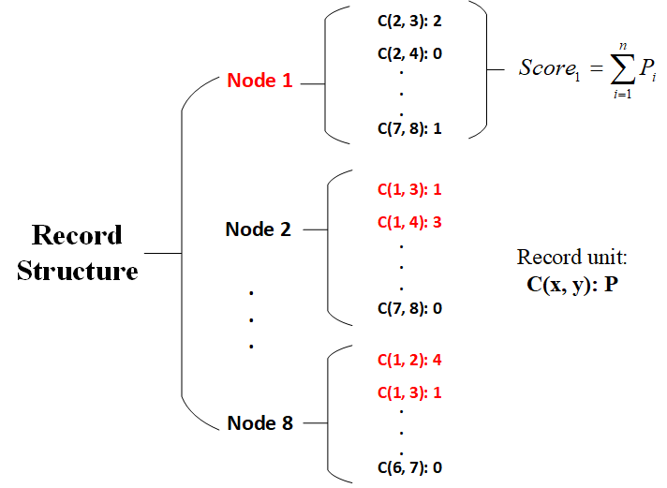
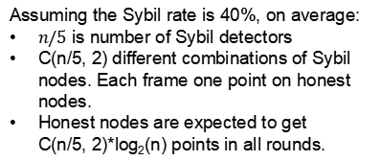
Elimination Phase
Threshold:
Assuming the Sybil rate is 40%, on average:
$n/5$ is number of Sybil detectors
C(n/5, 2) different combinations of Sybil nodes. Each frame one point on honest nodes.
Honest nodes are expected to get C(n/5, 2)*log₂(n) points in all rounds.
1 | 2 | 3 | 4 | 5 | 6 | 7 | 8
-1 | 0 | 3 | 5 | x | x | x | 4
1 | 2 | 3 | 4 | 5 | 6 | 7 | 8
-1 | 4 | 3 | 5 | x | x | x | 0
1 | 2 | 3 | 4 | 5 | 6 | 7 | 8
7 | 4 | 1 | 2 | x | x | x | 5
1 | 2 | 3 | 4 | 5 | 6 | 7 | 8
-1 | 1 | 1 | 5 | x | x | x | 5
Notes:
First look at the workflow.:
whitewash xxxx process. some will be eliminated, some would get points, some would lose points
When all nodes score lower than the threshold -> end
Suppose Node 1 is the Sybil node
Companion node: the other node in the same combination
Victims: nodes get score
We whitewash victims and punish the companions by subtracting scores caused by these combinations from victims and adding them to the companions.

Slide 15

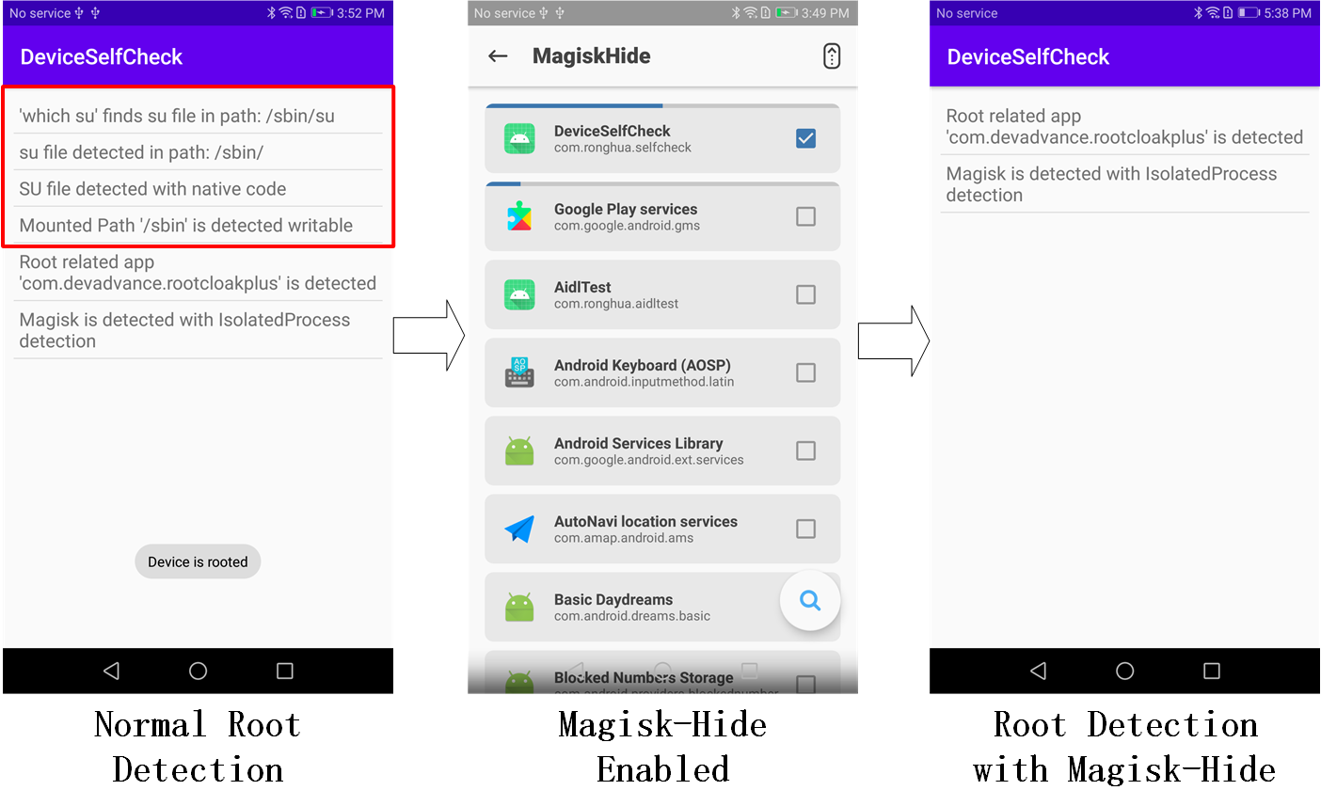
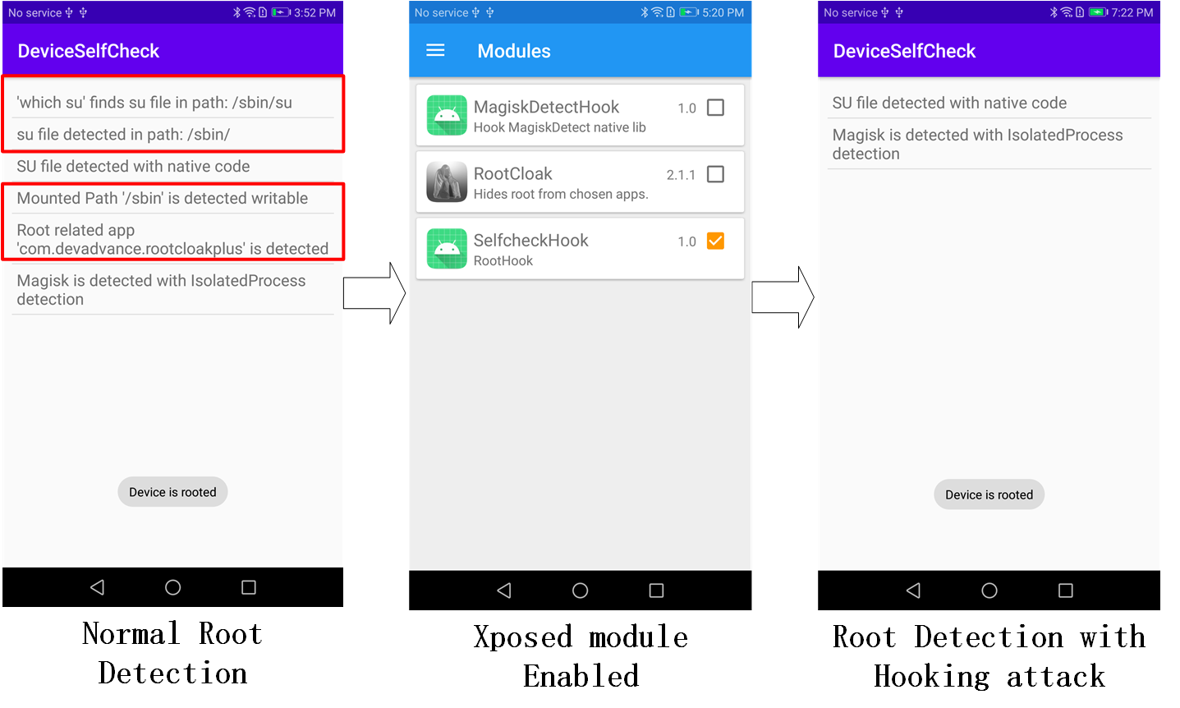
Results: Client-side
Notes:
6 lines of root traits detection report -> Magisk enabled -> all reports related to su files and paths are missing, but we detect Magisk related files successfully with the isolated process
xxxx frame up Java level detection results with red rectangle -> Xpoesd Java level hook enabled -> all reports related to Java level are missing, but we detect these files with native coding

Slide 16
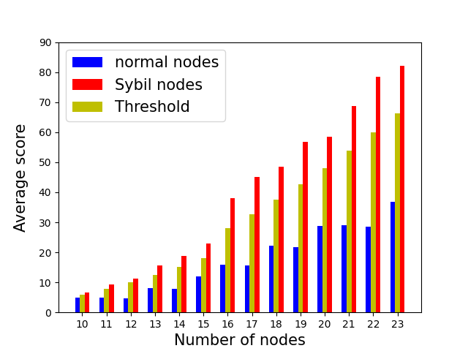
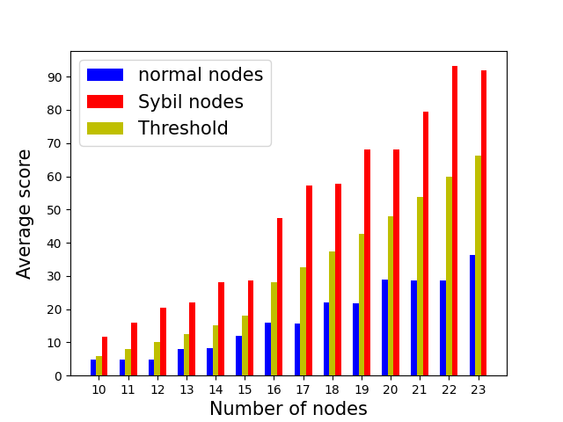
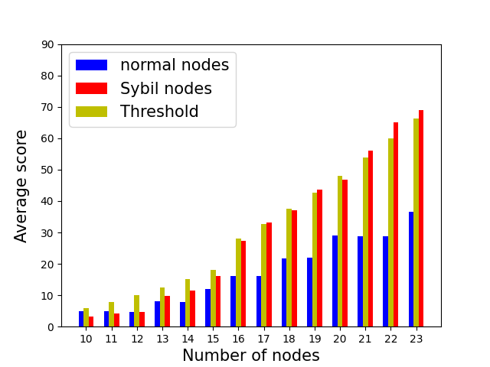
Results: Server-side
Average scores of nodes
2
1
3
Notes:
multiple computing platforms can be seen as colluding attacks.
When adversaries have multiple computing platforms, they can choose which one to use to broadcast signals for Sybil devices. Imagine if two Sybil devices are using two different laptops to broadcast signals, there’s no way for us to detect them.

Slide 17
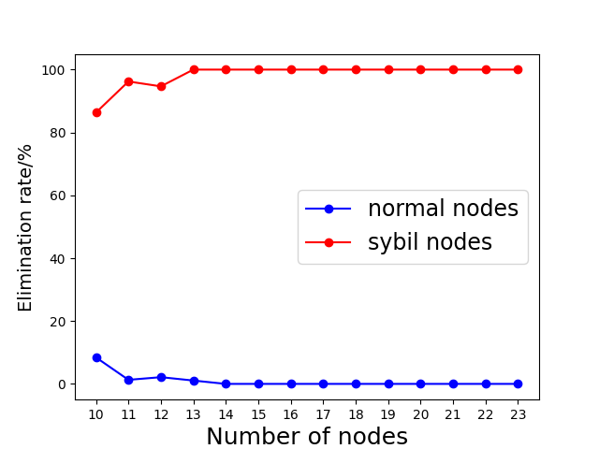
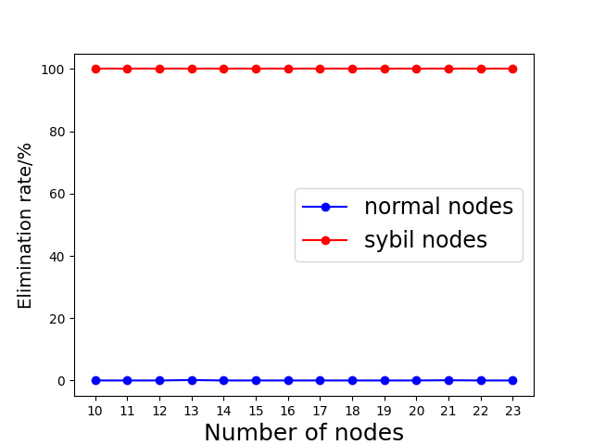
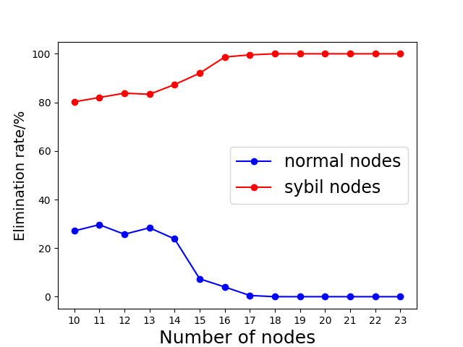
Results: Server-side
Elimination Rate
Sybil nodes only upload forged data
2
3
1

Slide 18
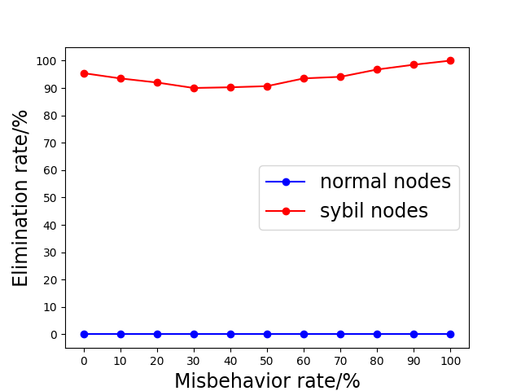
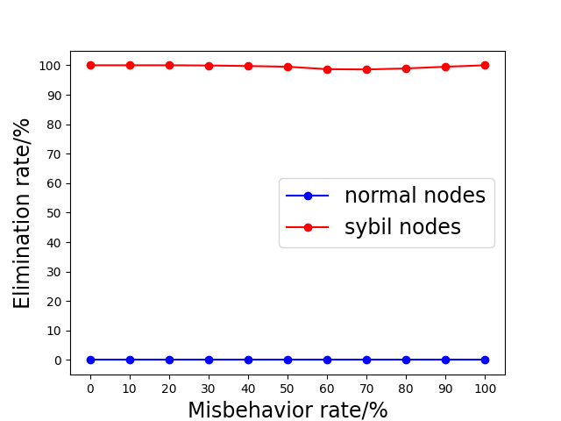
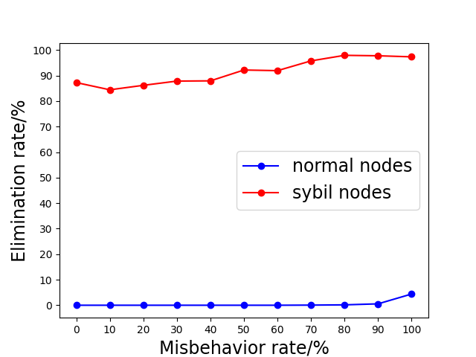
Results: Server-side
Elimination Rate
Change misbehavior ratio
2
1
3

Slide 19
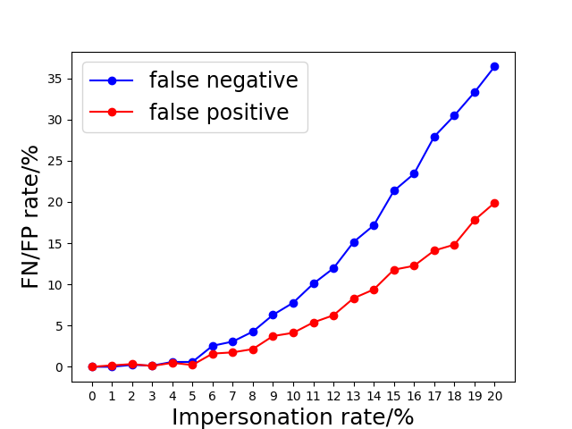
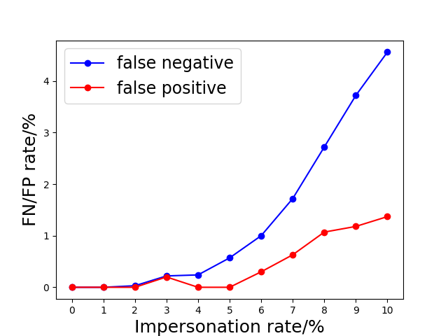
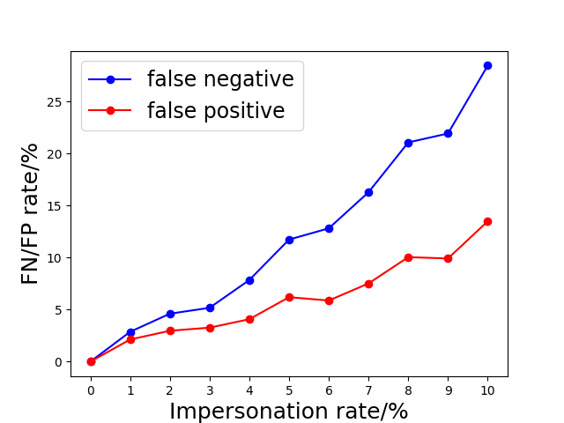
Results: Server-side
Effect of Reply attacks
change it to 10%
2
1
3

Slide 20
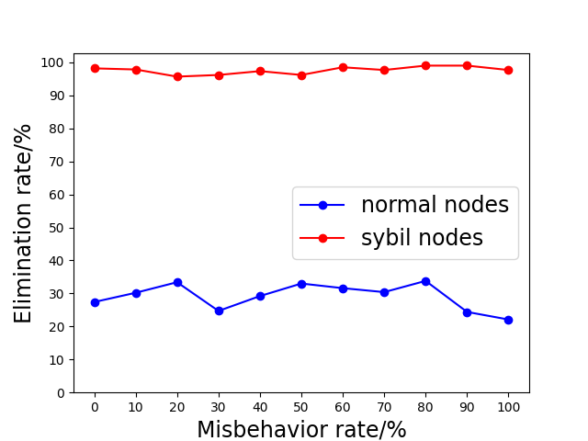
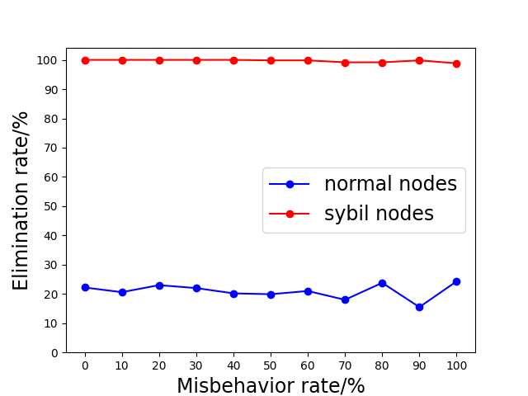
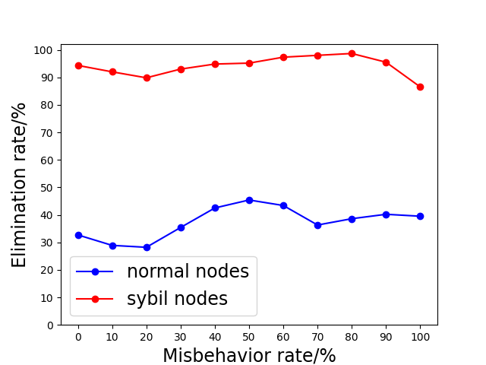
Results: Server-side
10% Reply attacks & random behavior
2
1
3

Slide 21
Conclusions & Future Work
Can pre-eliminate the majority of the adversaries
The server-side detection works properly in most of the cases
In the worst cases, false negative rate (elimination of normal nodes) is too high.
Strengthen the client-side detection. Try to even prevent hooking from native level
Deploy the system in real environments and validate the replay-attack prevention mechanism
Improve the server-side detection, especially the EP
Elaborate the system operation with other infrastructures (e.g. base stations, WiFi transmitter)
Notes:
About the worst case, I have an idea of improving it, but itS’s a lot complicated so I don’t have time to implement the code and see the effect of it.

Slide 22
References
[1] Stylianos Gisdakis, Thanassis Giannetsos, and Panagiotis Papadimi-tratos. Security, privacy, and incentive provision for mobile crowd sens-ing systems.IEEE Internet of Things Journal, 3(5):839–853, 2016
[2] Jatesada Borsub and Panos Papadimitratos. Hardened registration process for participatory sensing. InProceedings of the 11th ACM Con-ference on Security & Privacy in Wireless and Mobile Networks, pages281–282, 2018.
[3] Murat Demirbas and Youngwhan Song. An rssi-based scheme for sybilattack detection in wireless sensor networks. In2006 International sym-posium on a world of wireless, mobile and multimedia networks (WoW-MoM’06), pages 5–pp. ieee, 2006.
[4] Xiao-Feng Xie & Zun-Jing Wang. (2015). "An empirical study of combining participatory and physical sensing to better understand and improve urban mobility networks.". Transportation Research Board (TRB) Annual Meeting. Washington, DC, USA.

