Slide 1
Hunting Sybils in Consensus-Based Network
To make the system work properly, we should make sure malicious nodes and sybils function according to the rule:
1. There are malicious nodes in the sensing network
2. Malicious devices cannot impersonate sybils while it has to broadcast itself
3. Sybils have to rely on malicious as access point to broadcast its signal
If nodes obey to the rule, then we could eliminate sybils based on l value

Slide 2
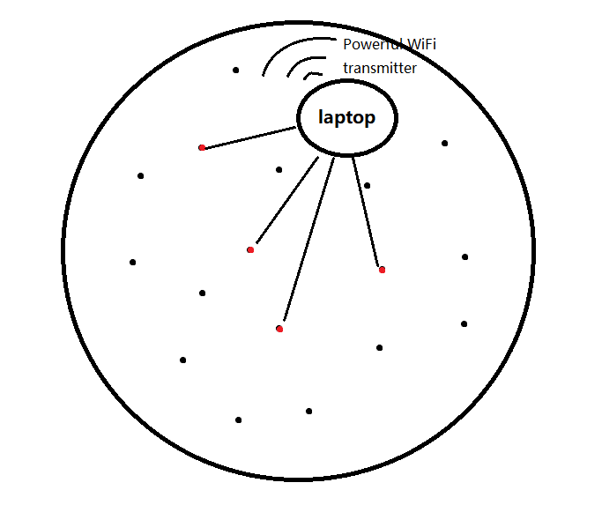
Attack Model
Assume two nodes are going to broadcast in the same round
A laptop can be a powerful processing and AP(access point) which allows a laptop to transmit on behalf of two nodes
Most importantly, almost everyone owns a laptop
We want to prevent this kind of individual attack

Slide 3
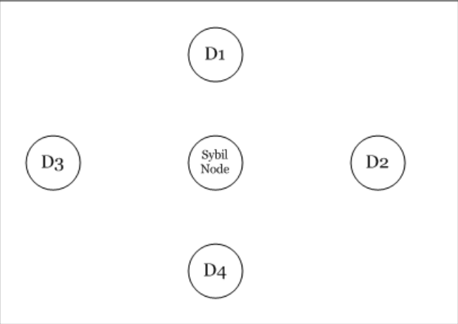



RSSI ratio based Sybil detection method
The precondition is that: D1-D4 detection nodes are honest and trusted
“two nodes are enough for detection”
(These four screenshots are from the paper, reference here)

Slide 4
Data Collection Procedure
Reporters in each round:
The first round:
1-2, 3-4
Second round:
5-6, 7-8
Third round:
1-2, 5-6
Fourth round:
3-4, 7-8
 | Rounds1 | Rounds2 | Rounds3 | Rounds4 | ......
Node1 | L | B | L | B | ......
Node2 | L | B | L | B | ......
Node3 | L | B | B | L | ......
Node4 | L | B | B | L | ......
Node5 | B | L | L | B | .....
Node6 | B | L | L | B | .....
Node7 | B | L | B | L | .....
Node8 | B | L | B | L | ......
Once two or more nodes found broadcasting at the same AP, they would get 1 point
In the end, we analyse the score result, and try to find out all sybils if they try to use the same AP

Slide 5
Tradeoff for Sybils in the model
B
BC report A(find A as a sybil):
A get higher l value
BC don't report A or miss the signal:
A get lower l value, but would't be taken as a sybil
A
C
Two occasion:
sybils broadcast on the same AP in the same round
being detected, however increase l value.
sybils try not to be reported by honest nodes:
not being detected, however get low l value

Slide 6
Problems in the Model(Attack Model)
Assumption: FP(fame up honest nodes) FN(protect detected sybils)
If the pair contains:
2 Sybils: They can upload false positive data
1 Sybil and 1 honest: can only upload false negative data
2 honest: can only upload true data
Extreme cases:
1. Sybils try not to be detected by other honest nodes, but whenever they have a chance, they would frame honest nodes.
2. Sybils expose themselves in the network, try to get higher l value, and frame no honest node.

Slide 7
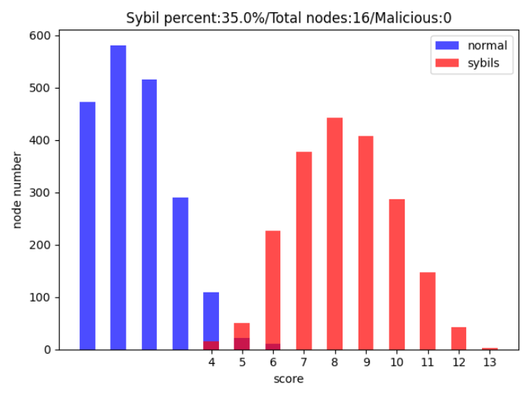
Model simulation
An individual attacker can have a laptop as powerful AP, and a mobile as malicious node
16 randomly chosen nodes from an area
They can broadcast WiFi signals strong enough for every node to receive theoretically
4, 5 or 6 nodes can belong to the malicious
Sybils would frame the honest whenever they have a chance
Two honest nodes pair must report sybils
If the broadcasting sybil number is greater than vacant malicious node + AP
sybils > vacant + 1
Sybils would be detected this round
35% means 5 bad nodes

Slide 8
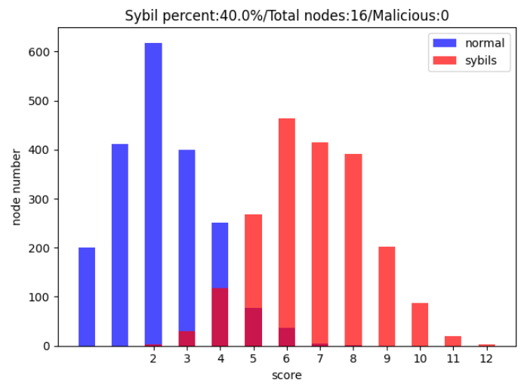
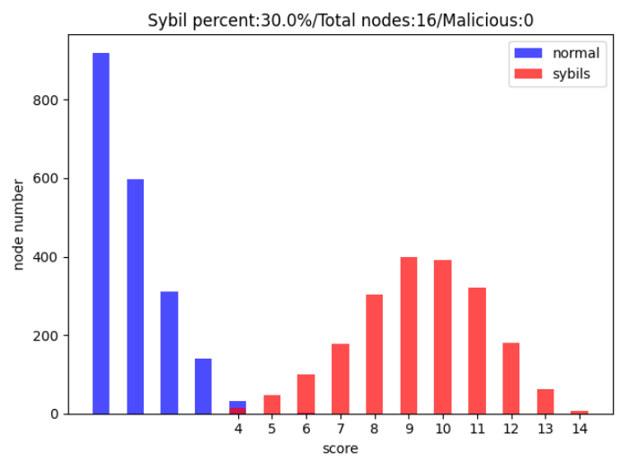
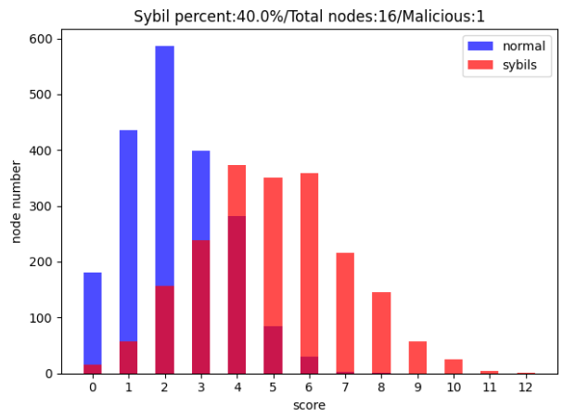
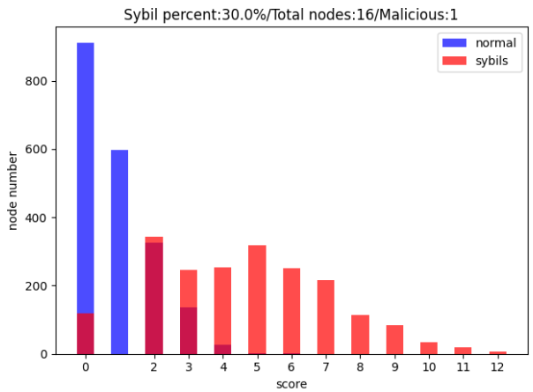
Threshold selection
dynamically add points to colluders
Leave the area, punishments, maybe elimated
graph label: percentage

Slide 9
Detection Method
16 Nodes: 1 Malicious node as example:
Whenever there is a non-zero score in the list, there are sybils in the system
An honest node would hardly get 6 or more scores. If so, such node would highly likey to be a sybil
When a node get 6 score or more, all of its company would be regarded as sybils
When there is no node get 6 or more score, we need to check the l value distribution.
1. All l values are high: Sybils must have exposed themselves, we eliminate node with the highest score and all of its company
2. l value distribution is normal: We could possibily find a Sybil and eliminate it. At the same time, we subtract points from the framed victims.

Slide 10
Possible extreme occasion
What if all scores are less than the threshold, and l values are high?
According to simple statistic results, when sybils expose themselves but get low score, honest nodes would get even lower score. We could eliminate node with the highest score first.
APs are always enough
sybil receivers is very hard
to be a pair, thus honest nodes get even lower score
Sybil
low
score
They hide themselves when APs are not enough
Hunting method would find out

