Slide 1
Hardened Registration Process for Mobile Croudsourcing
Name: Ronghua Li
E-mail: ronghua@kth.se
Supervisor: Cihan Eryonucu
Examinar: Panos Papadimitratos

Slide 2
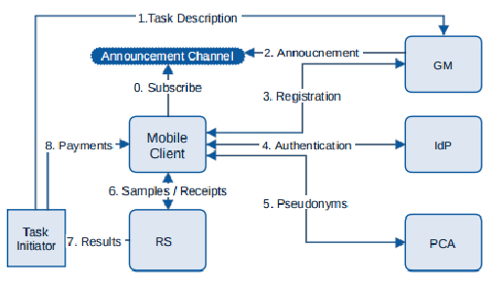
Background
Participatory sensing can be used to retrieve information about the environment, weather, urban mobility,[7] congestion as well as any other sensory information that collectively forms knowledge.
e.g. Google Maps, Air quality detection with vehicle sensors
HRP
Figure 1. System design for Mobile crowdsoucing[1]
Notes:
need to explain what’s participatory sensing, what’s bad with the forged data.(Why we need hrp)
Allow users to contribute the data.
There are some mostly common exmp. of PS and MC. Google Maps -> crowdness in the street; Collect air quality or noise condition in urban area.
However, users to contribute data, the openess of system brings in hazard. Malicious adversary could contribute fake or forged data to pollute the database.
Prevent the system from corrupted data attack, we hope to eliminate bad data sources at the very beginning
This is one of the published system design for PS.
This project mainly focus on mobile devices

Slide 3
Possible information collection
1.Phone condition: sensors, root, real device or emulator
2.Scarce unique personal info: phone number, email addr, personal ID( strong but double-edged sword[2])
3.Environment condition: IP, network condition, location, surrounding devices
Notes:
need info to determine whether a data source is bad or not

Slide 4
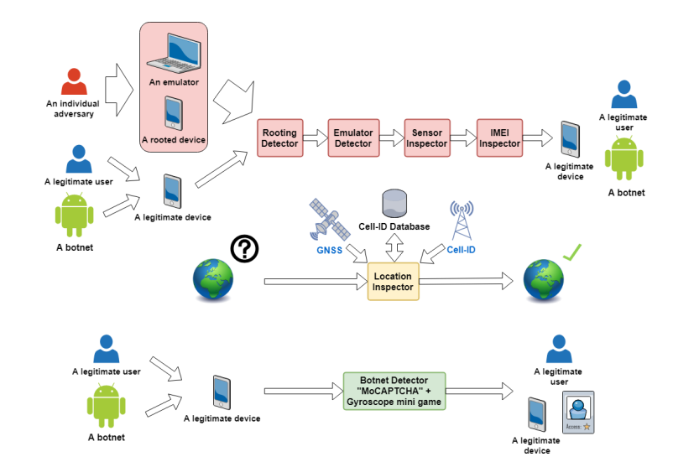
HRP solution
Software will not be exploited
Client[3]
HRP+
Additional examination on bypassed nodes.
Clients vouch for each other and select accountable ones.
Server
Previous HRP system design in [3]
Notes:
prototype published in 2018
There are lots of flaws in the system
Clients : refered to previous, some improvements
the race between root detection and evasion is asymmetric, favoring evaders

Slide 5
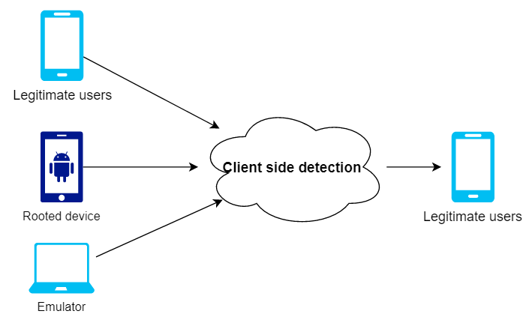
HRP system: Client
Why?
Rooted devices are too customized. Software can be exploited easily.
What is Magisk-Hide?
Magisk Hide is the feature that allows you to cloak root traits for certain apps
Improvement on [3]:
Native code are included to increase the cost for bypassing the detection
Isolated process is used to detect Magisk-Hide(most commonly used root evasion method)[5]
Figure 2. Root, emulator and hardware detection
Notes:
Magisk hide hides root traits by unmounting them in the filesystem for certain apps

Slide 6
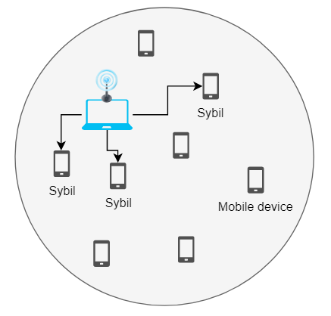
HRP system: Server
Model:
Attacker with some malicious devices and Sybils bypass client side detection.
Goal: Detect these sybil virtual deivices
Method: Broadcasting/ Receiving WiFi signals.
Nodes would get scores based on their physical presence condition, elimination of Sybil nodes will be based on these scores.
Threats
Attacker would try to evade his bad nodes as well as framing legitimate nodes -> bad nodes stay, legitimate nodes get eliminated
Old Threat model in [4]: Sybil nodes need to rely on other bad nodes to broadcast.
Too strict. In fact, attackers can use any other devices to broadcast signals on Sybil nodes behalf.
New Threat model: Attacker can use any other devices to broadcast signals on Sybil nodes behalf.
Figure 6. Laptop help broadcast signals
Notes:
Model:
The adversaries the system protecting from are those xxxxxx Malicious devices: rooted devices Sybils: Emulators
we are going to build a score system. Nodes would get scores after some procedures. Elimination would be based on score.
With a few rooted devices are not enough to deploy attack in a large scale. Main focus: detect Sybils Method: wiFi signals
If a node is real and physically presents in some location, the node would get low or zero score
if a node is virtual and not physically presents, the node would get high score
Threats: if adversary try to raise the score of legitimate nodes and lower the score of bad nodes
Improvements:
In paper 4, the auther make the assumption: xxxxxx with our new model, the hunting method in paper 4 would certainly fail
this server model more general, more similar to real circumstances

Slide 7
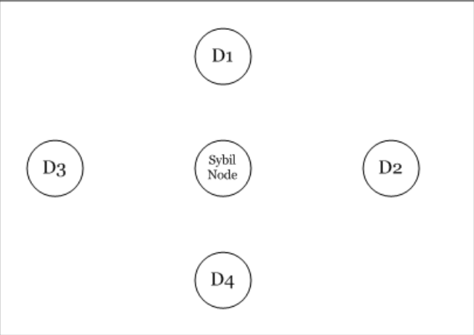



RSSI¹ ratio based Sybil detection method[6]
The precondition is that: D1-D4 detection nodes are honest and trusted
d_{i}
d_{j}
Figure 7. Sybil detection method
“two nodes are enough for detection”
Broadcasting nodes are examined
Listening nodes are examiner
1. Received Signal Strength Indicator
Notes:
With two nodes, we could determine whether there are nodes broadcasting with the same AP in the same round
Later, we are going to use node pairs to find out potential Sybil nodes.
These pairs would be called as sentry.

Slide 8
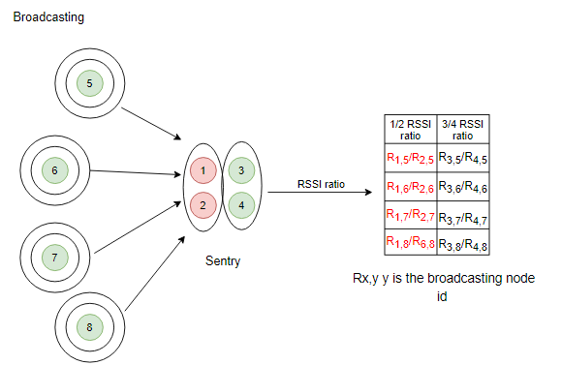
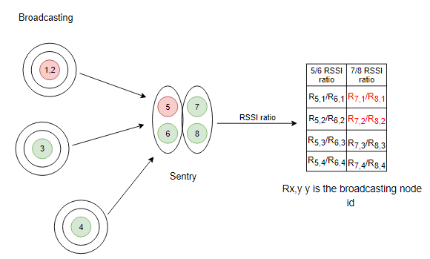
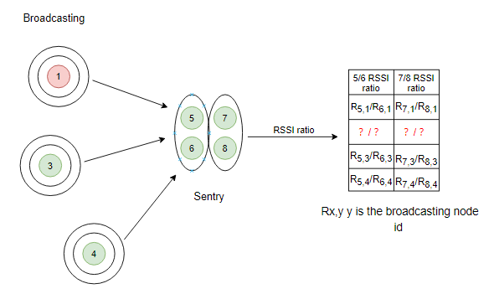
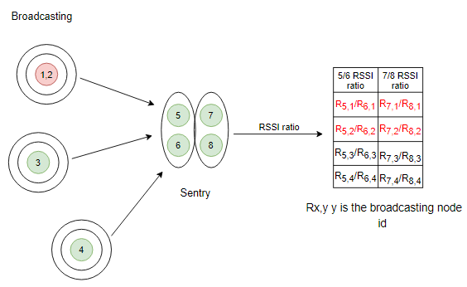
The Sentry based score system
1 | 2 | 3 | 4 | 5 | 6 | 7 | 8
0 | 0 | 0 | 0 | 0 | 0 | 0 | 0
Precondition: nodes are moving slowly in the system, therefore their position can be regarded as fixed in each round
Round | 1 | 2 | 3 | 4 | ......
Node1 | B | L | B | L | ......
Node2 | B | L | B | L | ......
Node3 | B | L | L | B | ......
Node4 | B | L | L | B | ......
Node5 | L | B | B | L | .....
Node6 | L | B | B | L | .....
Node7 | L | B | L | B | .....
Node8 | L | B | L | B | ......
Supposing node 1 and 2 are Sybil nodes and using the same AP, there will be:
R_{5,2}/R_{6,2}-R_{5,1}/R_{6,1} < σ
R_{7,2}/R_{8,2}-R_{7,1}/R_{8,1} < σ
Node 1 and 2 would get 2 points each.
In the end, nodes with the highest score are Sybil nodes.
If two nodes in a sentry are both bad, they could collude and frame honest nodes(False positive)
If one bad node and one good node are in a Sentry, bad node can try to protect other broadcasting Sybil nodes(False negative).
Figure 7. Sentry based voting system in round 1
Figure 7. Sentry based voting system in round 2
Figure 7. Sentry based voting system in round 1
Figure 7. Sentry based voting system in round 1
Notes:
From listeners, nodes are randomly divided into pairs, each pair is called a sentry.
Since each sentry has two nodes, it can detect Sybil nodes with RSSI ratio value.
Aforementioned score system, every node would get a score in the end, explain how nodes get scores.
Then I’m going to introduce how the nodes get score, what are the threats in the system
randomly put listeners into pairs, called sentry

Slide 9
Simulation model
There are 16 nodes in total in the system.
There is only one attacker in the system. He owns one laptop and one exploited mobile device(malicious node).
The malicious node will only help Sybil nodes broadcast when it's vacant. The laptop can broadcast on behalf of discretionary number of Sybil nodes.
When two bad nodes are paired as a sentry, they will definitely vote out broadcasting honest nodes.
There are 6 bad nodes in the system(one malicious node and five Sybil nodes).
The emulation runs 2000 times.

Slide 10
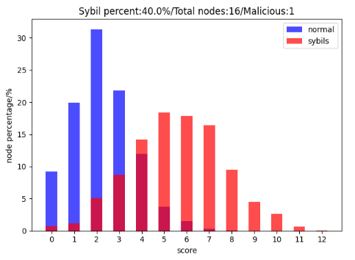
Simulation results
Elimination:
the one with the highest score
Those honest nodes get framed would be whitewashed(subtract points from them).
This node’s sentry partner would get all the points causing by them.
Most of the cases, when honest nodes get high score, Sybil nodes would get even higher score. Sybil nodes nearly always get the highest score.
1 | 2 | 3 | 4 | 5 | 6 | 7 | 8 | 9 | 10 | 11 | 12 | 13 | 14 | 15 | 16
5 | 2 | 3 | 4 | 5 | 6 | 3 | 4 | 3 | 4 | 0 | 9 | 6 | 4 | 8 | 7
Avg Scores: Normal: 2.2865 Sybil: 5.5165
Notes:
What’s colluders?
Red is the score distribution of Sybil nodes
Blue is the score distribution of normal nodes
nodes’score would follow the these distributions
Every normal nodes in such system get 2.3 avg, sybils get 5.5 avg

Slide 11
Limitations
Threshold: how to eliminate Sybil nodes when preventing false positive? Not determined yet.
If there are too few nodes in the system, FP and FN rate increase greatly
In some cases, Sybil nodes with high score accidentally don’t get the chance to frame others, thus elimination of these nodes won’t help find-ing their partners. Even worse, honest nodes cannot get whitewashed(subtract points) and might be eliminated as well.
1 | 2 | 3 | 4 | 5 | 6 | 7 | 8 | 9 | 10 | 11 | 12 | 13 | 14 | 15 | 16
5 | 2 | 3 | 4 | 5 | 6 | 3 | 4 | 3 | 4 | 0 | 9 | 6 | 4 | 8 | 7
change another example
Notes:
The node with the highest score doesn’t frame others.
Sometimes all nodes get low score: maybe two few sybils inthe system or just normal nodes also happen to miss some signals

Slide 12
References
[1] Stylianos Gisdakis, Thanassis Giannetsos, and Panagiotis Papadimi-tratos. Security, privacy, and incentive provision for mobile crowd sens-ing systems.IEEE Internet of Things Journal, 3(5):839–853, 2016
[2] Haifeng Yu, Phillip B Gibbons, Michael Kaminsky, and Feng Xiao.Sybillimit: A near-optimal social network defense against sybil attacks.In2008 IEEE Symposium on Security and Privacy (sp 2008), pages3–17. IEEE, 2008.
[3] Jatesada Borsub and Panos Papadimitratos. Hardened registration process for participatory sensing. InProceedings of the 11th ACM Con-ference on Security & Privacy in Wireless and Mobile Networks, pages281–282, 2018.
[4] Nickolai Verchok and Alex Orailo ̆glu. Hunting sybils in participatorymobile consensus-based networks. InProceedings of the 15th ACM AsiaConference on Computer and Communications Security, pages 732–743,2020.
[5] Darvin. Detecting magisk hide.https://darvincitech.wordpress.com/2019/11/04/detecting-magisk-hide/, April 2019.
[6] Murat Demirbas and Youngwhan Song. An rssi-based scheme for sybilattack detection in wireless sensor networks. In2006 International sym-posium on a world of wireless, mobile and multimedia networks (WoW-MoM’06), pages 5–pp. ieee, 2006.
[7] Xiao-Feng Xie & Zun-Jing Wang. (2015). "An empirical study of combining participatory and physical sensing to better understand and improve urban mobility networks.". Transportation Research Board (TRB) Annual Meeting. Washington, DC, USA.

