Slide 1
GenAI-Powered Retail Insights Assistant
Scalable Lakehouse Architecture on Azure Databricks

Slide 2
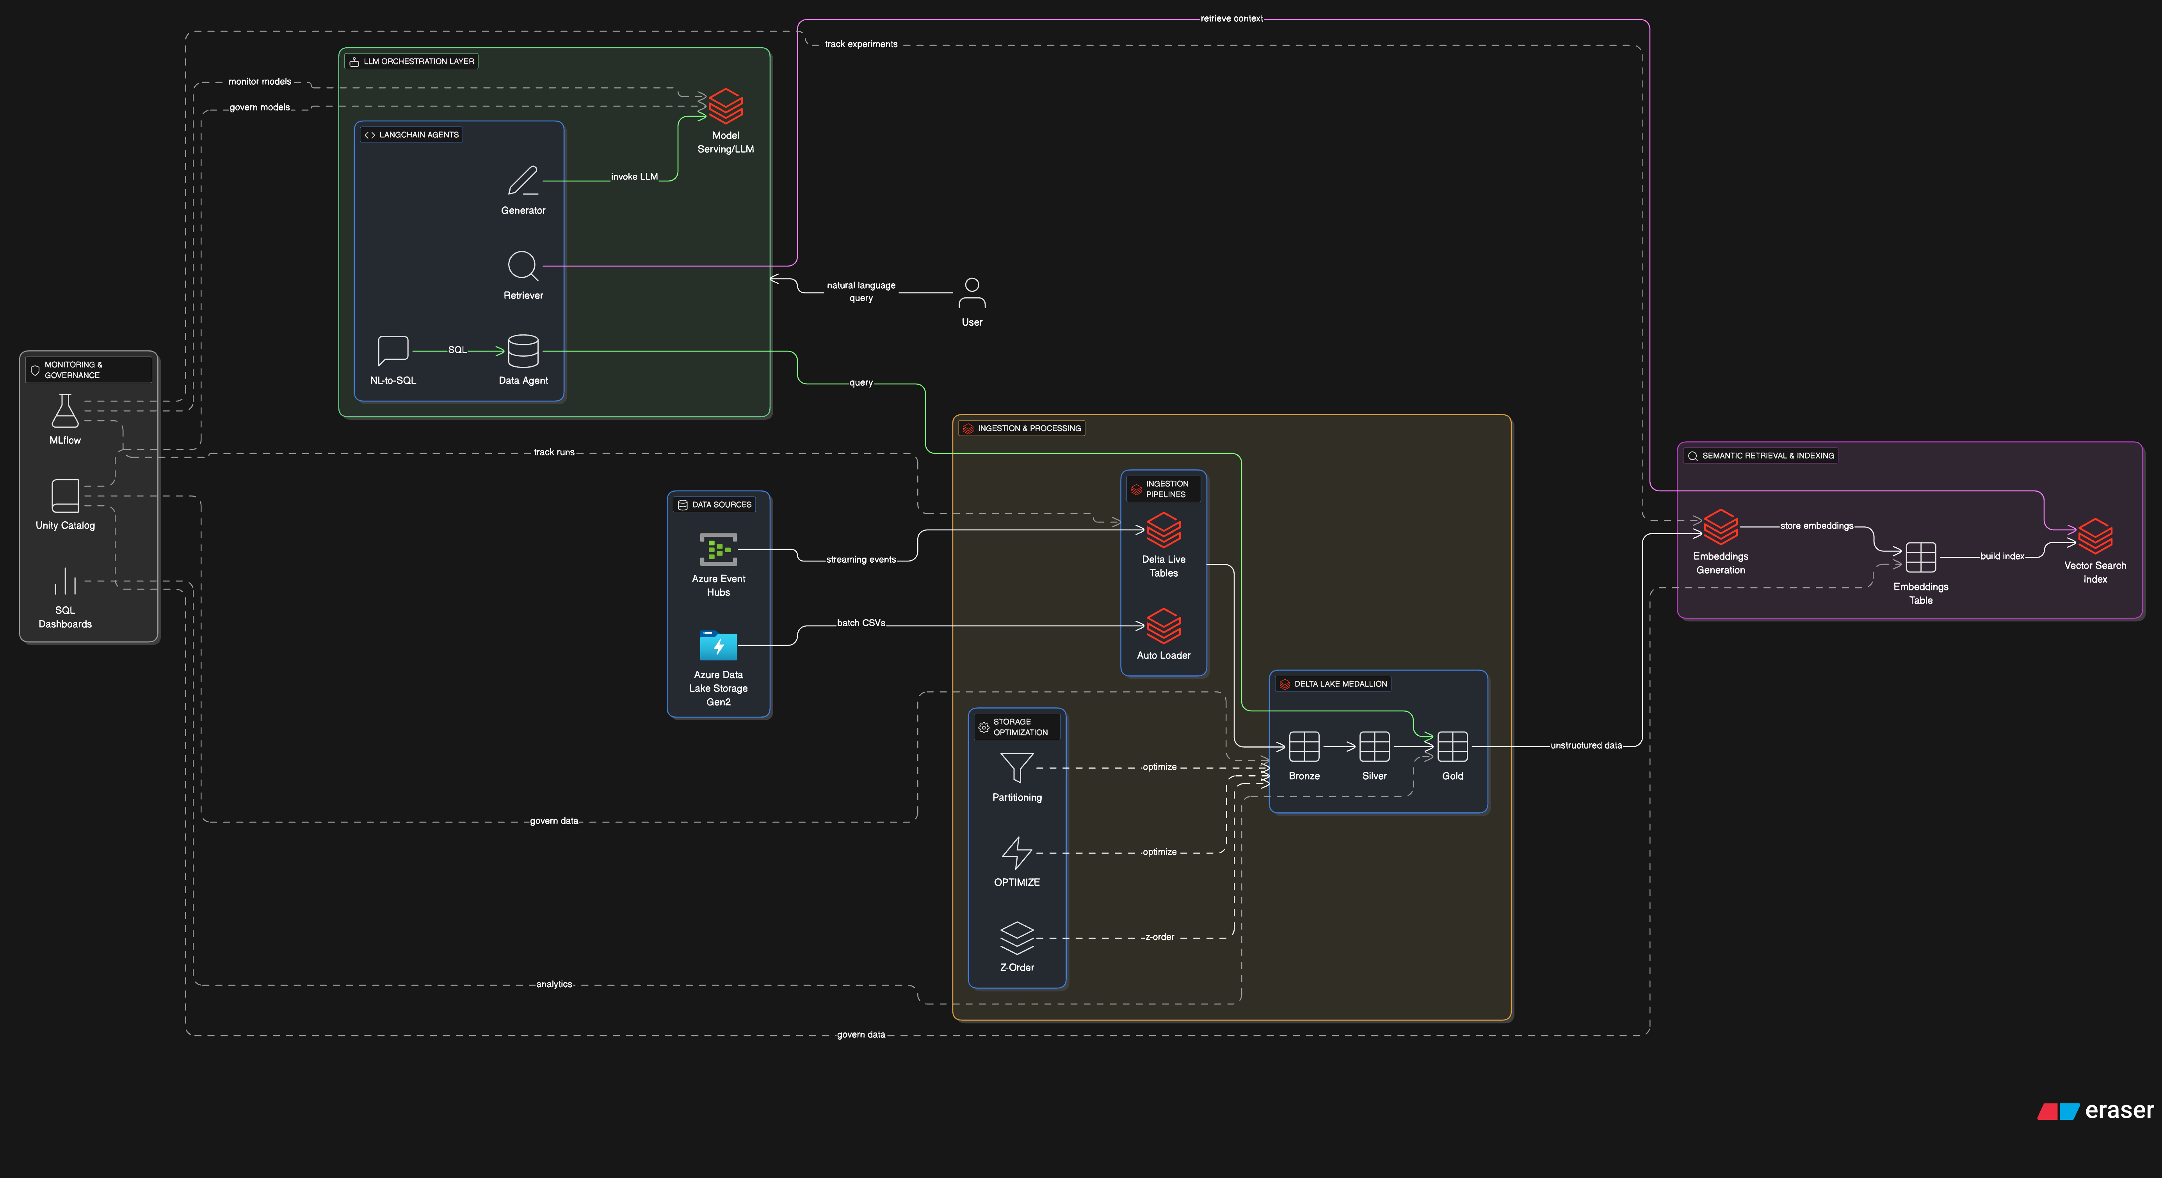
Proposed architecture

Slide 3
System Architecture & Data Flow
Data sources:
  Batch sales files from Azure Data Lake Storage Gen2 (ADLS Gen2)
  Real-time sales events from Azure Event Hubs
Ingestion pipelines:
  Auto Loader + Delta Live Tables (DLT) ingest new files and streaming events incrementally
  Handles schema inference/evolution and exactly-once processing
ETL & processing:
  PySpark / DLT jobs clean, validate, and enrich data
  Business logic applied for metrics, KPIs, and dimensions
Lakehouse storage (Delta Lake medallion):
  Bronze: raw ingested data with full history
  Silver: cleansed, conformed transactional data
  Gold: curated aggregates and business-ready fact tables
Downstream consumption:
  Gold tables + embeddings feed LLM orchestration, dashboards, and analytics

Slide 4
LLM Integration Strategy
LLM Orchestration Layer
Built with LangChain agents running on Databricks
Agents and Responsibilities
NL-to-SQL Agent:
Parses natural language into structured intent and generates SQL over Gold tables.
Data Agent:
Executes SQL on Delta Lake and returns numeric/tabular results.
Retriever Agent:
Queries the vector index to fetch semantically relevant context (descriptions, notes, summaries).
Generator / Validator Agent:
Combines SQL results + retrieved context, crafts the prompt, calls the LLM, and validates the answer.
Model Serving
Uses Databricks Model Serving / Foundation Models API to host LLMs
(e.g., Llama, Mistral, DB-hosted models).
All model versions tracked with MLflow and governed by Unity Catalog.
Conversation Handling
Maintains short-term context (session memory) for follow-up questions.
Reuses prompt templates for consistent, instruction-following responses.

Slide 5
Data Storage, Indexing & Retrieval (100GB+)
Data Storage, Indexing & Retrieval (100GB+)
Title: Data Storage, Indexing & Retrieval at 100GB+ Scale
Scalable storage:
  All structured data stored as Delta Lake tables on ADLS Gen2
  Medallion layout (Bronze/Silver/Gold) supports incremental processing and historical retention
Performance optimizations:
  Partitioning by date, region, product to enable partition pruning
  Regular OPTIMIZE and Z-ORDER on high-cardinality columns (e.g., customer_id, product_id) to reduce scanned data
  Avoid small files; compaction ensures efficient IO
Embeddings & vector index:
  Generate embeddings for product descriptions, category summaries, and key business narratives
  Store embeddings in a dedicated Embeddings Delta table
  Build a Vector Search Index (e.g., Databricks Mosaic AI Vector Search) over that table
Retrieval strategy:
  First filter with SQL (time, region, category) on Gold tables
  Then enrich with semantic search over embeddings for nuanced context
  Only a small, relevant subset of data is sent to the LLM (RAG pattern)

Slide 6
Query → Response Pipeline
User question:
“Which category saw the highest YoY growth in Q3 in the North region?”
Step-by-step:
User request:
  Analyst sends question from UI / notebook to the backend API.
NL-to-SQL Agent:
  Extracts filters: Q3, North region, metric = YoY sales growth, grain = category.
  Generates SQL against Gold sales_summary table.
Data Agent:
  Runs SQL on Delta Lake (using partitioned Gold table).
  Returns a small result set (categories + YoY growth values, sorted desc).
Retriever Agent (semantic):
  Uses the question + top category name to query the vector index.
  Retrieves related notes (promotions, supply issues, campaign summaries).
Generator / Validator Agent:
  Builds a prompt containing:
    User question
    SQL results (numbers)
    Retrieved contextual snippets
  Calls Databricks-served LLM to generate a natural-language explanation.
  Optionally checks for consistency (e.g., category names and numbers align).
Response back to user:
  Final answer: top category, YoY %, short explanation and optional recommendation.
  MLflow logs prompt, response, latency, and metrics for monitoring.

Slide 7
Cost Breakdown (Monthly Estimate):
Databricks ETL + streaming compute: $650–$1,050
LLM Model Serving (DB-hosted): $500–$700
Vector Search + Embeddings: $170–$300
ADLS + Delta storage: $3–$5
Dashboards + Governance: $50–$100
Total cost: ~$1,350–$2,150 per month

Slide 8
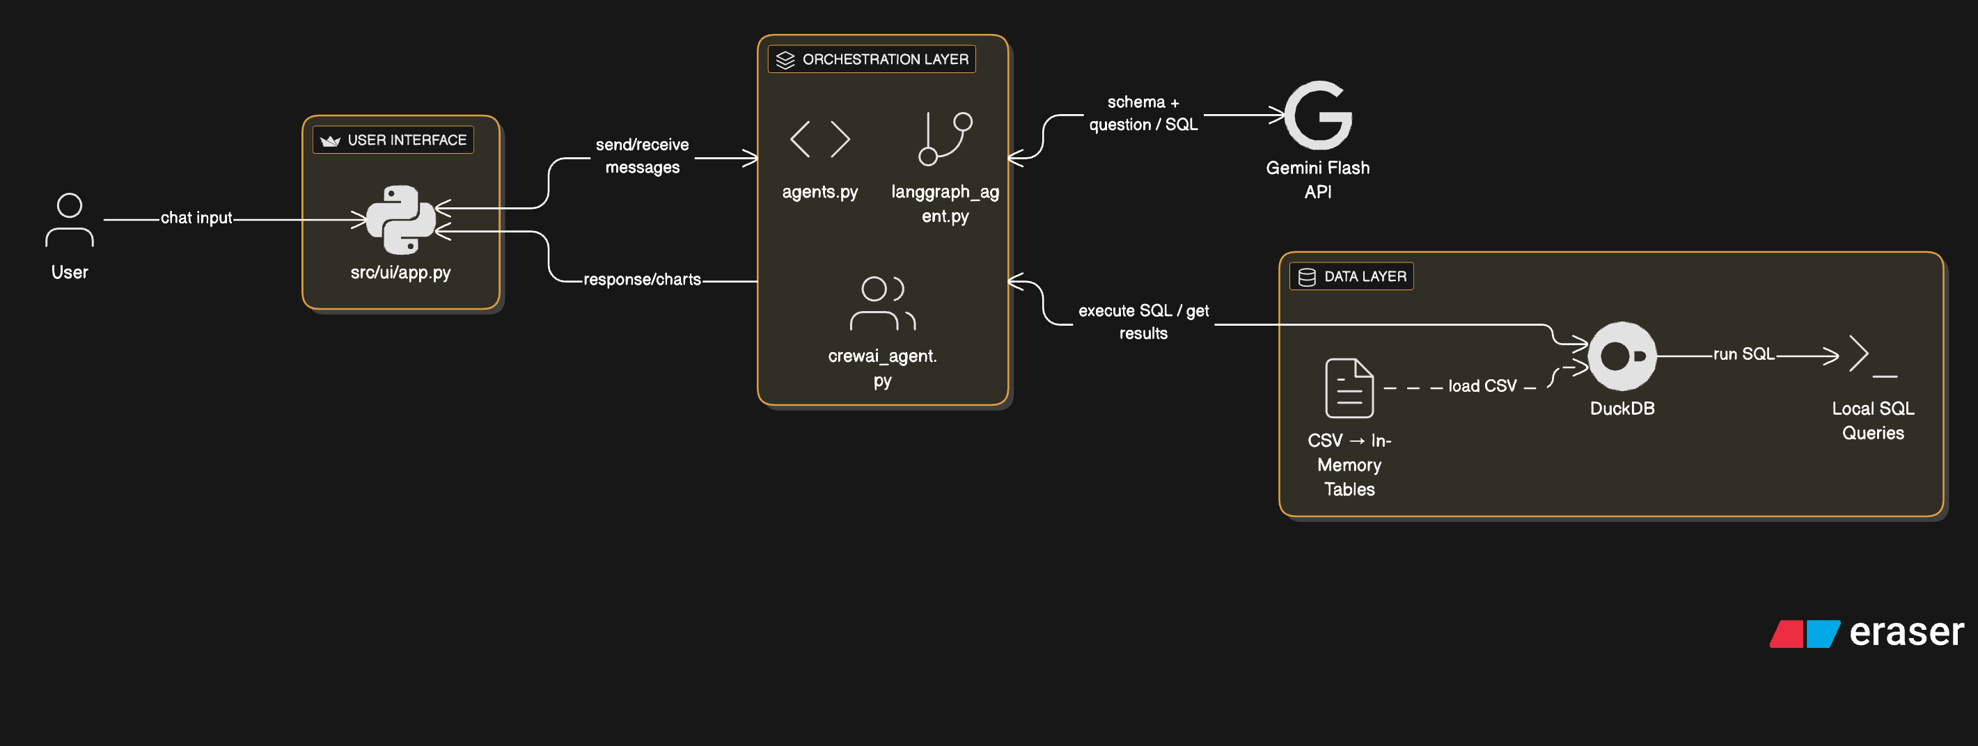
Current architecture

Slide 9
Thank you

