Slide 1
A Matlab toolbox to make optimization on manifolds feel as simple as unconstrained optimization
Manopt.org
A project of the RANSO group
Nicolas Boumal and Bamdev Mishra
P.-A. Absil, Y. Nesterov and R. Sepulchre
Notes:
Present yourself, Bamdev and the RANSO group at this point : it’s a collaboration UCL-ULg.

Slide 2
What is the minimal framework you need for steepest descent optimization?

Slide 3
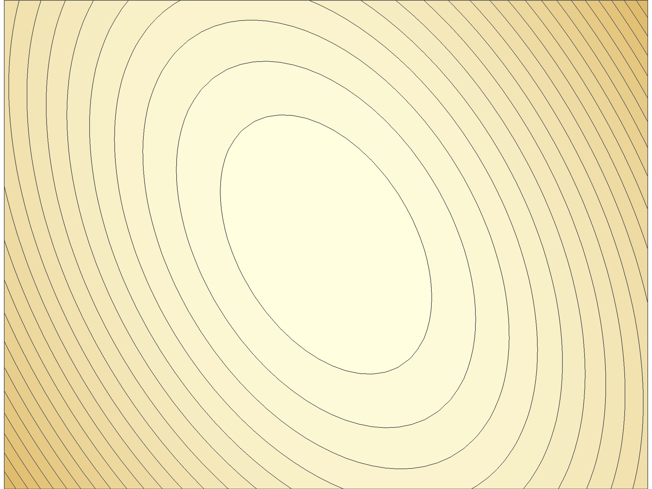
Notes:
But we really don’t have to constrain ourselves to unconstrained optimization.

Slide 4
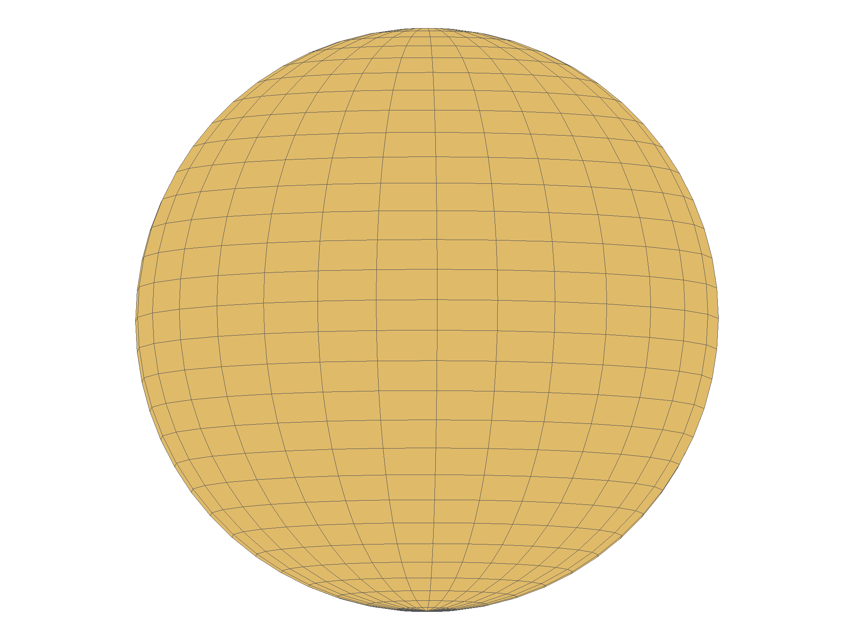

Slide 5
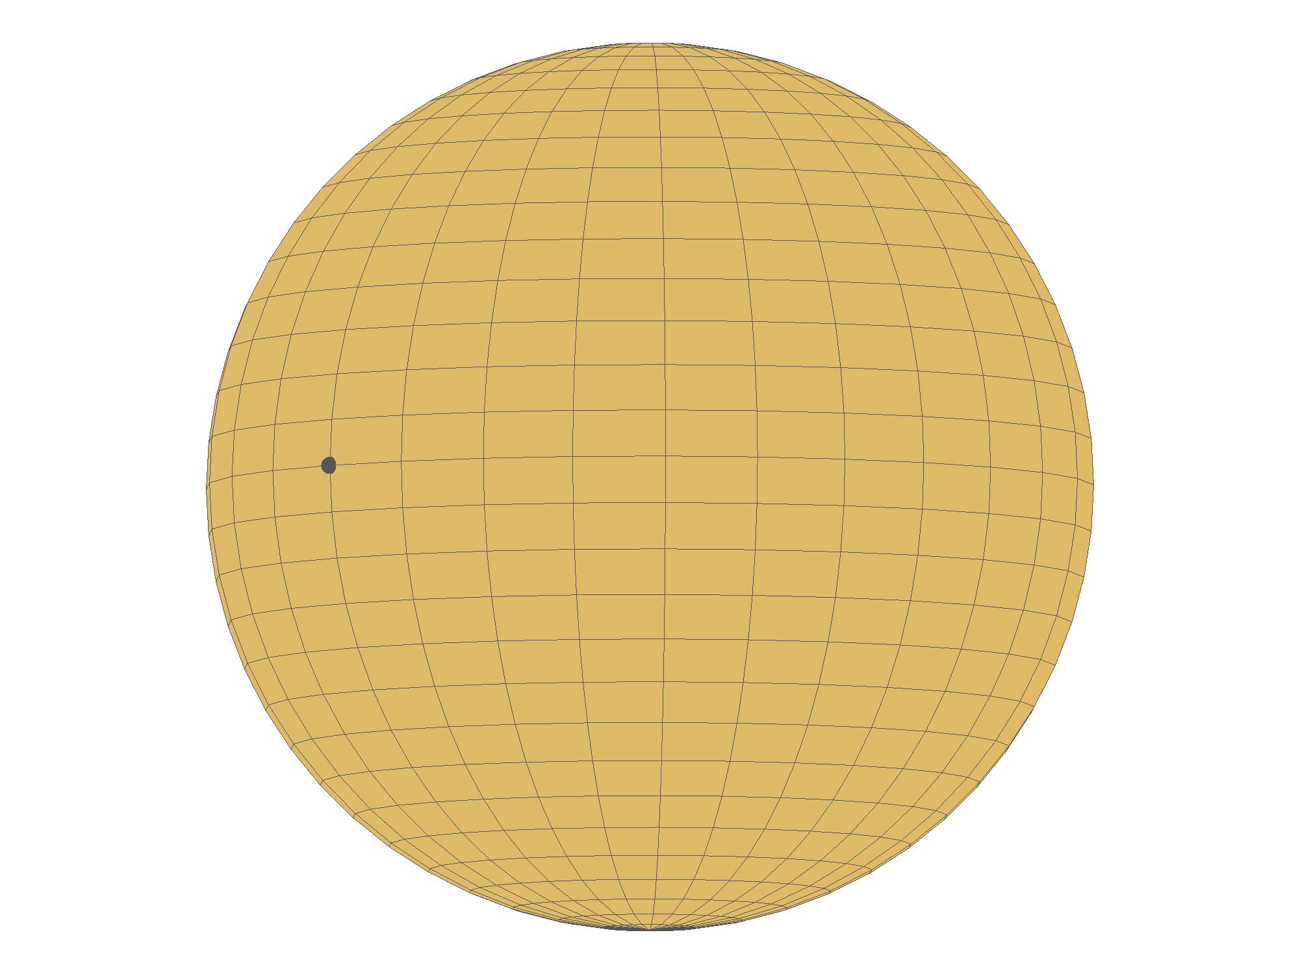

Slide 6
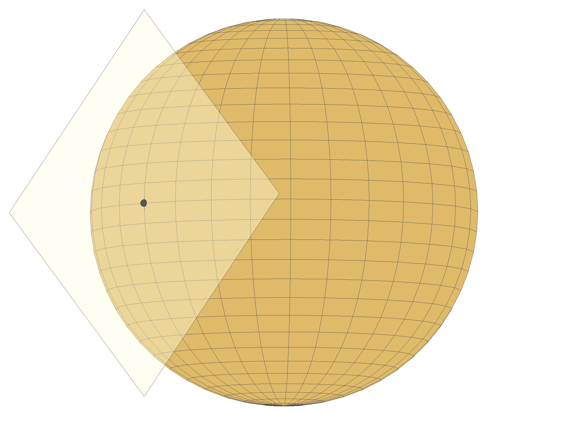

Slide 7
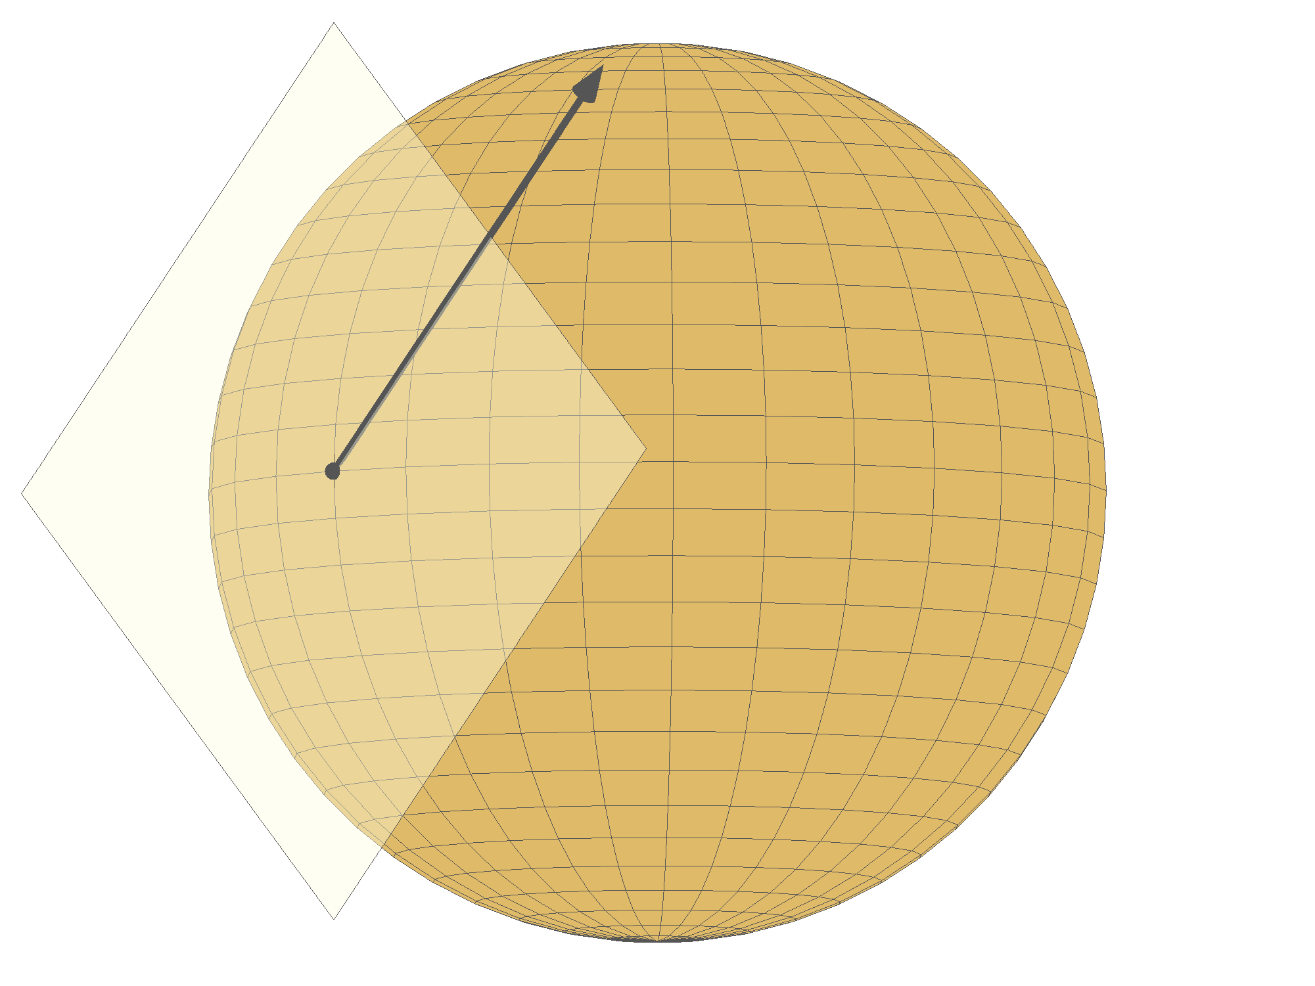

Slide 8
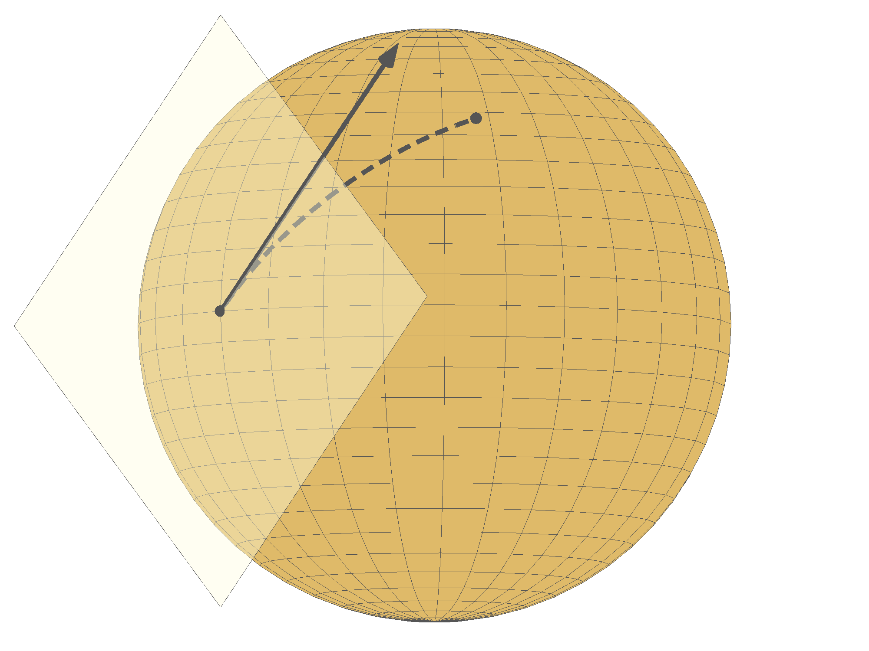

Slide 9
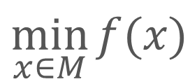
We only need the search space to be a Riemannian manifold
$$\min_{x∈M}{f(x)}$$
We need…
A notion of directions along which we can move tangent space, tangent vector
A notion of steepest descent direction inner product, gradient
A means of moving along a direction Geodesics, retractions
Notes:
And perhaps a little bit more for superlinear convergence, but that’s fine. These ideas have been around since the 70’s (Luenberger, Gabay): the algorithms are now well analyzed.

Slide 10
Symmetry leads to manifold structures
Unit norm vector independent comp. analysis
Orthonormal matrix sparse and robust PCA
Rotation matrix synchronization of rotations
Positive definite matrix diffusion tensor imaging
Fixed-rank matrix low-rank matrix completion
Semidefinite fixed-rank matrix covariance estim.
Euclidean distance matrix data visualization
. . .

Slide 11
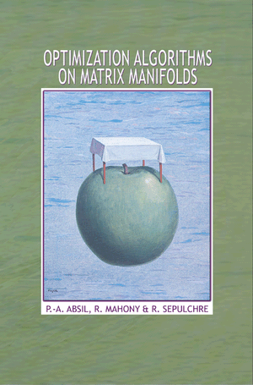
The theory is mature at this point.
What’s been missing is matching software.
Notes:
There’s a need and an opportunity for good software,

Slide 12
A Matlab toolbox to make optimization on manifolds feel as simple as unconstrained optimization
Manopt.org
With generic solvers, a library of manifolds and diagnostics tools
Notes:
Present yourself, Bamdev and the RANSO group at this point : it’s a collaboration UCL-ULg.

Slide 13
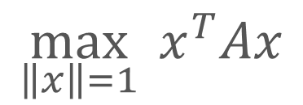



Example code for dominant eigenvectors
$$\max_{\left\|x\right\|=1}{x^{T}Ax}$$
$$M=\{x∈ℝ^{n} :\left\|x\right\|=1\}$$
$$f\left(x\right)=x^{T}Ax$$
$$∇f\left(x\right)=2Ax$$

Slide 14
% Generate the problem data.
n = 1000;
A = randn(n);
A = .5*(A+A');
% Create the problem structure and specify the manifold.
problem.M = spherefactory(n);
% Define the problem cost function and its gradient.
problem.cost = @(x) -x'*(A*x);
problem.egrad = @(x) -2*A*x;
% Numerically check gradient consistency.
checkgradient(problem);
Notes:
If we got the gradient riight, then we can use it to produce a first order approx of the cost. Thus, the error between this first order approx and the cost should be second order, meaning that in a log log plot, it should exhibit a slope of two. Based on this simple fact, we can numerically check whether the gradient is obviously incorrect or not.

Slide 15
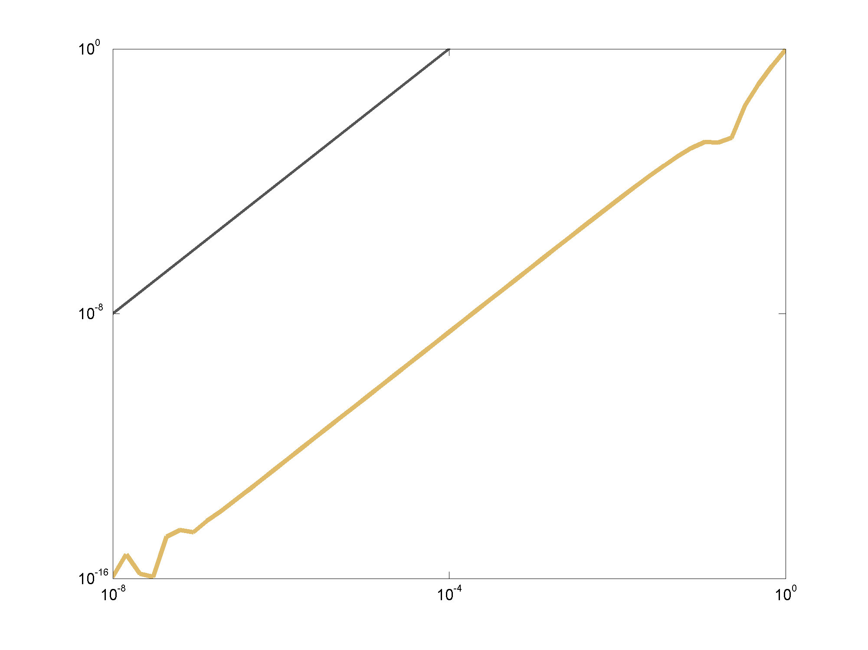
Gradient check
Approximation error
Step size in the Taylor expansion

Slide 16
% Generate the problem data.
n = 1000;
A = randn(n);
A = .5*(A+A');
% Create the problem structure and specify the manifold.
problem.M = spherefactory(n);
% Define the problem cost function and its gradient.
problem.cost = @(x) -x'*(A*x);
problem.egrad = @(x) -2*A*x;
% Numerically check gradient consistency.
checkgradient(problem);
% Solve.
[x, xcost, info] = trustregions(problem);

Slide 17
>> [x, xcost, info] = trustregions(problem);
f: 1.571531e+000 |grad|: 4.456216e+001
REJ TR- k: 1 num_inner: 1 f: 1.571531e+000 |grad|: 4.456216e+001 negative curvature
acc k: 2 num_inner: 1 f: -2.147351e+001 |grad|: 3.053440e+001 negative curvature
acc k: 3 num_inner: 2 f: -3.066561e+001 |grad|: 3.142679e+001 negative curvature
acc k: 4 num_inner: 2 f: -3.683374e+001 |grad|: 2.125506e+001 exceeded trust region
acc k: 5 num_inner: 3 f: -4.007868e+001 |grad|: 1.389614e+001 exceeded trust region
acc k: 6 num_inner: 4 f: -4.237276e+001 |grad|: 9.687523e+000 exceeded trust region
acc k: 7 num_inner: 6 f: -4.356244e+001 |grad|: 5.142297e+000 exceeded trust region
acc k: 8 num_inner: 8 f: -4.412433e+001 |grad|: 2.860465e+000 exceeded trust region
acc k: 9 num_inner: 20 f: -4.438540e+001 |grad|: 3.893763e-001 reached target residual-kappa
acc k: 10 num_inner: 20 f: -4.442759e+001 |grad|: 4.116374e-002 reached target residual-kappa
acc k: 11 num_inner: 24 f: -4.442790e+001 |grad|: 1.443240e-003 reached target residual-theta
acc k: 12 num_inner: 39 f: -4.442790e+001 |grad|: 1.790137e-006 reached target residual-theta
acc k: 13 num_inner: 50 f: -4.442790e+001 |grad|: 3.992606e-010 dimension exceeded
Gradient norm tolerance reached.
Total time is 2.966843 [s] (excludes statsfun)

Slide 18
% Generate the problem data.
n = 1000;
A = randn(n);
A = .5*(A+A');
% Create the problem structure and specify the manifold.
problem.M = spherefactory(n);
% Define the problem cost function and its gradient.
problem.cost = @(x) -x'*(A*x);
problem.egrad = @(x) -2*A*x;
% Numerically check gradient consistency.
checkgradient(problem);
% Solve.
[x, xcost, info] = trustregions(problem);
% Display some statistics.
semilogy([info.iter], [info.gradnorm], '.-');

Slide 19
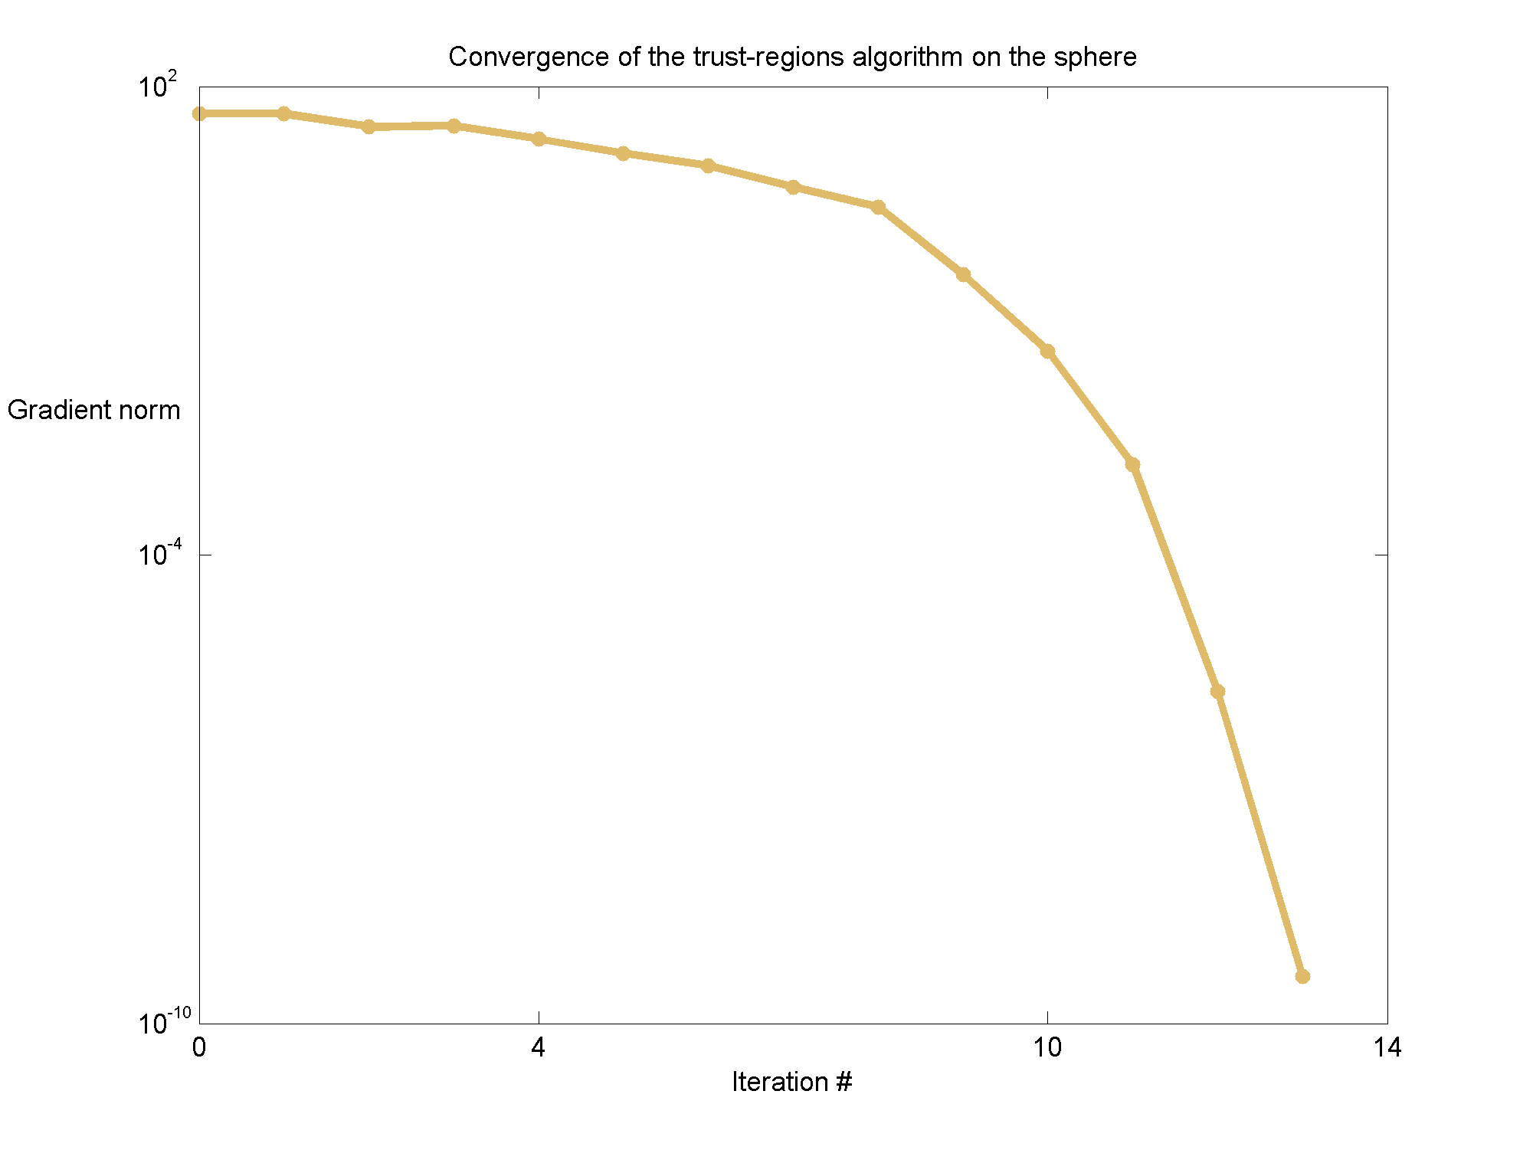
Convergence of the Riemannian trust-regions method
Gradient norm
Iteration #

Slide 20
Riemannian optimization is…
Well-understood
Theory is available for robust algorithms
Useful
Leverage the symmetry of your constraints
Easy
With Manopt, you simply provide the cost

Slide 21

Manopt is open source and documented
www.manopt.org

Slide 22
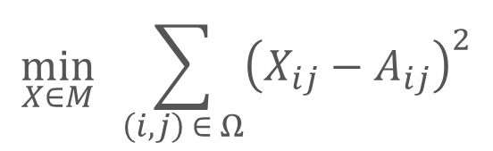

Low-rank matrix completion
$$\min_{X∈M}{ \sum_{\left(i,j\right) ∈ Ω}{{\left(X_{ij}−A_{ij}\right)}^{2}}}$$
$$M=\{X∈ℝ^{m×n} :rank\left(X\right)=r\}$$
Find a matrix X of rank r which matches A as well as possible on a subset of entries.

Slide 23
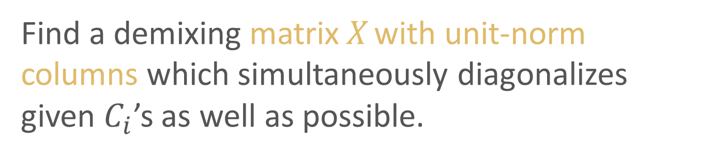

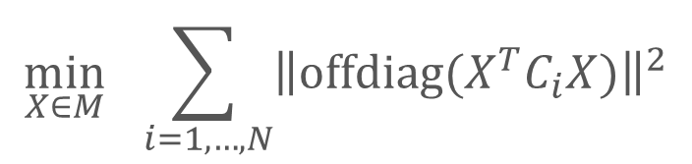
Independent component analysis
$$\min_{X∈M}{ \sum_{ i=1,…, N}{{\left\|offdiag(X^{T}C_{i}X)\right\|}^{2}}}$$
$$M=\{X∈ℝ^{n×p} :ddiag\left(X^{T}X\right)=I_{p}\}$$
Find a demixing matrix X with unit-norm columns which simultaneously diagonalizes given $C_{i}$’s as well as possible.

Slide 24
Distance matrix completion
$$\min_{X∈M}{ \sum_{\left(i,j\right) ∈ Ω}{{\left(X_{ij}−A_{ij}\right)}^{2}}}$$
$$M=\{X∈ℝ^{n×n} :q_{1},…, q_{n}∈ℝ^{p} and X_{ij}= {\left\|q_{i}−q_{j}\right\|}^{2}\}$$
Find a Euclidean distance matrix X which matches A as well as possible on a subset of entries.

Slide 25
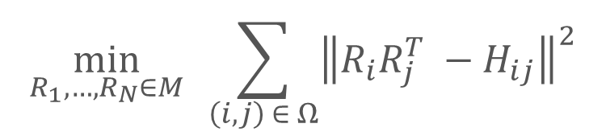
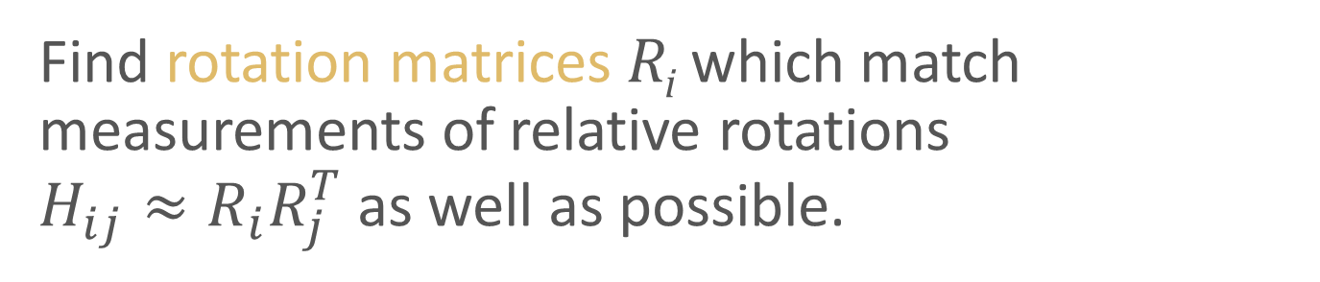
Estimation of rotations
$$\min_{R_{1}, …, R_{N}∈M}{ \sum_{\left(i,j\right) ∈ Ω}{{\left\|R_{i}R_{j}^{T} −H_{ij}\right\|}^{2}}}$$
$$M=\{Q∈ℝ^{n×n} :Q^{T}Q=I and\det\left(Q\right)=+1\}$$
Find rotation matrices R_{i} which match measurements of relative rotations $H_{ij}≈R_{i}R_{j}^{T}$ as well as possible.

Slide 26
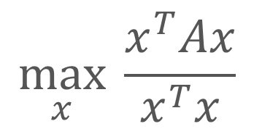
Example code for dominant eigenvectors
$$\max_{x}{\frac{x^{T}Ax}{x^{T}x}}$$

