Slide 1

Understanding the
Process Manager
Presented By :
Charita Tummala
- 16338814

Slide 2

What is a Process?
• A process is an instance of a program that is
running on a computer.

Slide 3

Process Manager?
It plays a vital role in
multitasking and
multiprocessing operating
systems to ensure efficient
utilization of system resources
and a smooth user experience.
A process manager is a crucial
component of an operating
system responsible for
managing and controlling the
execution of processes.

Slide 4

Functions Of Process
Manager:
• Scheduling
• Context Switching
• Synchronization
• Communication
Process Managers
used in Various OS:
Windows-Task Manager
MacOS – Activity Monitor
Linux - Scheduler

Slide 5

USER MODE
KERNEL MODE
User processes are initiated and controlled by users or
applications running on the computer.
System processes, also known as kernel processes, are
managed and controlled by the operating system's
kernel.
User processes run in user mode, which means they have System processes run in kernel mode, which gives them
limited access to system resources.
unrestricted access to system resources and hardware.
User processes cannot directly access system resources
or other processes' memory spaces without appropriate
permissions.
System processes can access system resources, hardware
components, and other processes' memory spaces
without restrictions.

Slide 6

Linux OS User Mode:
• In user mode, applications, including user-level processes and user-space programs, run with
restricted access to system resources.
• This level of privilege is designed for user applications, like web browsers, word processors.
• Commands in User Mode:
ps, top, pgrep, kill, nice, renice.

Slide 7

User Mode Demo

Slide 8
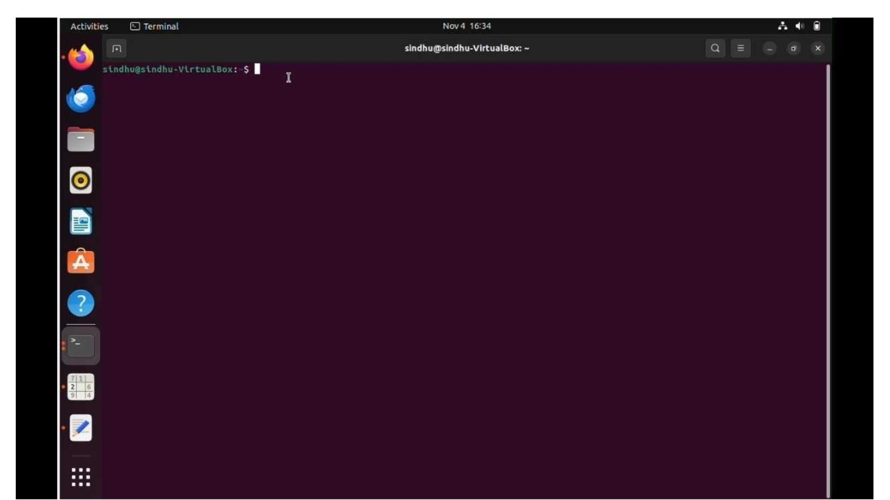

Slide 9
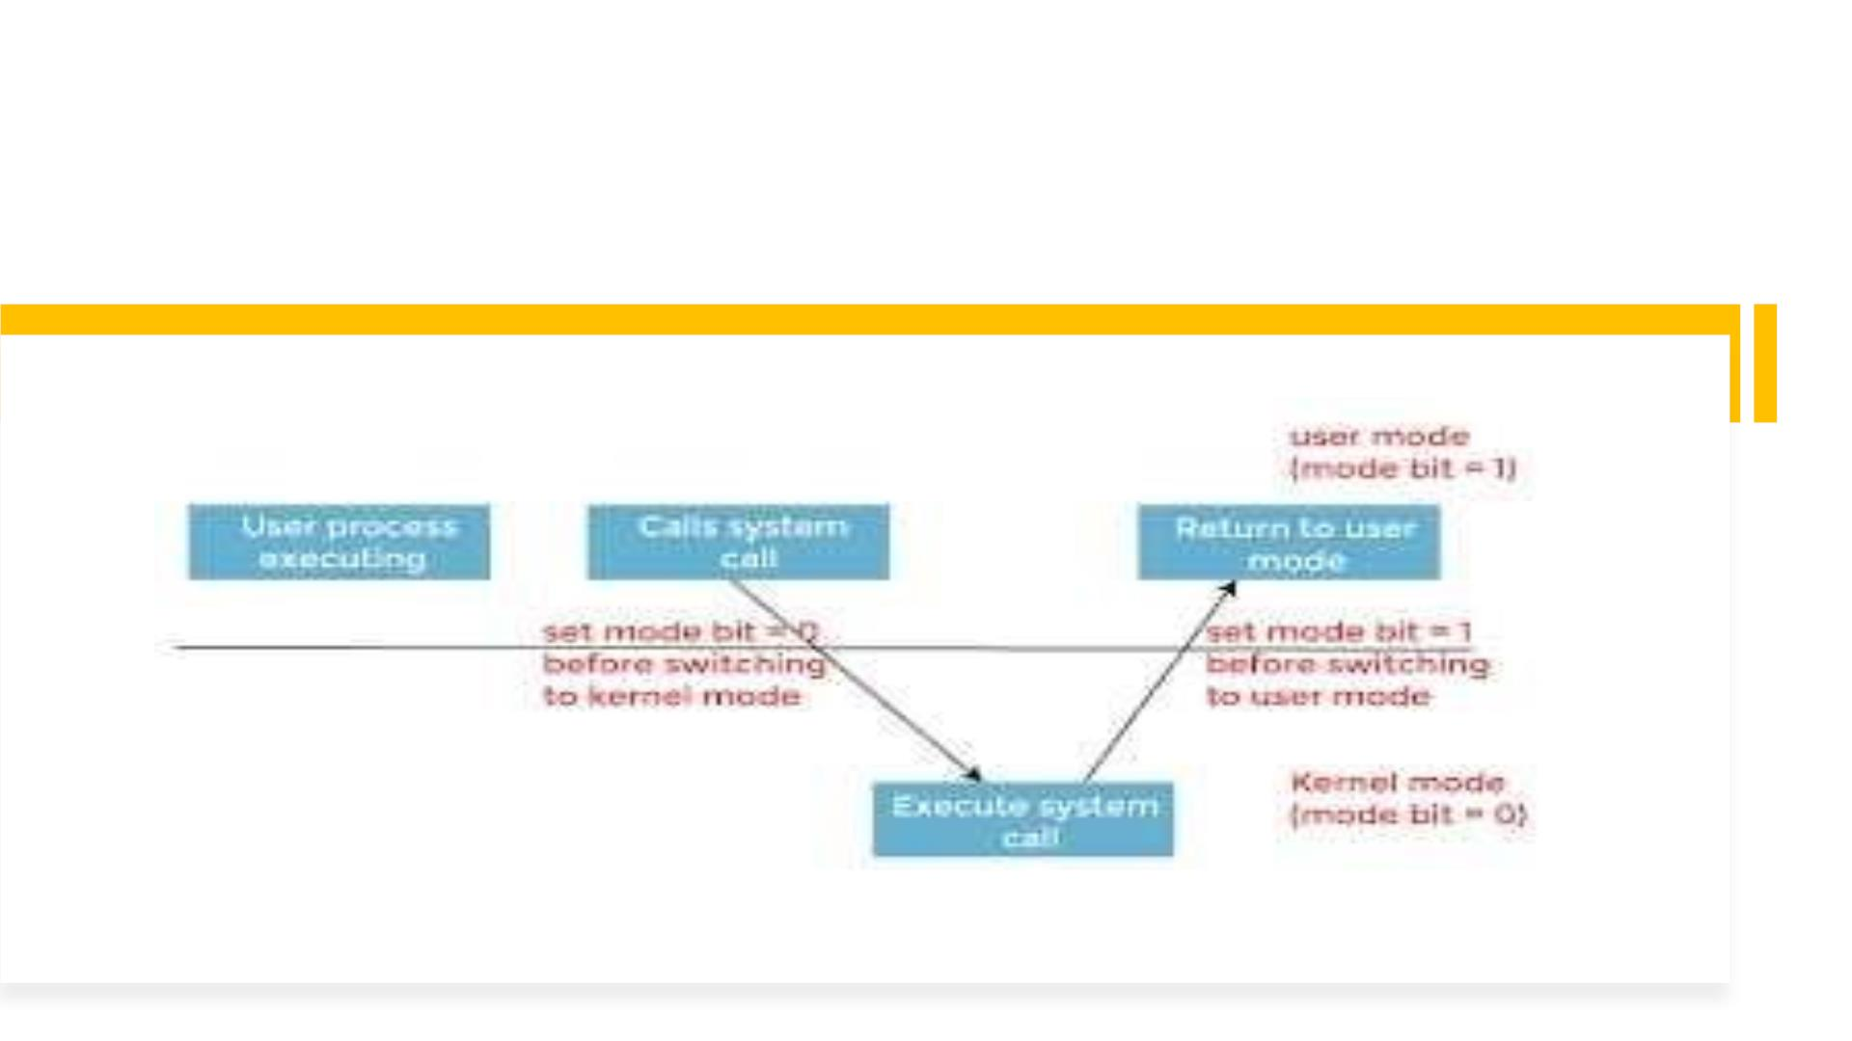
User mode To Kernel mode

Slide 10
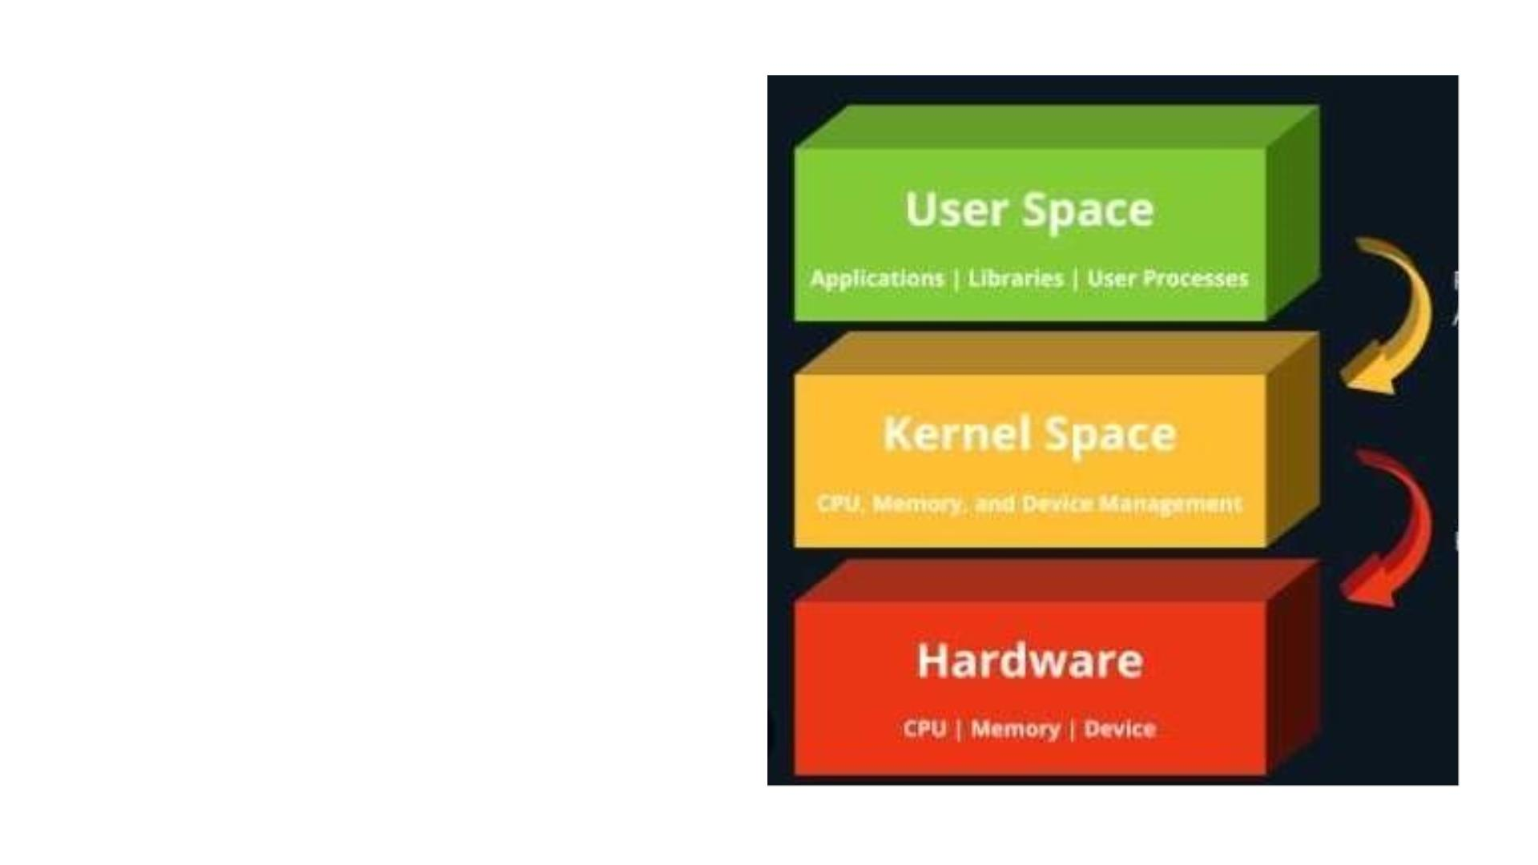
System calls:
• An interface between an operating
system and a process is provided via a
procedure known as a system call.
This is the process by which an
operating system program asks the
kernel for a service.
• System calls for process control in
Linux:
fork(), exit(), exec().
• Loading a user defined kernel module
into a system kernel module.

Slide 11
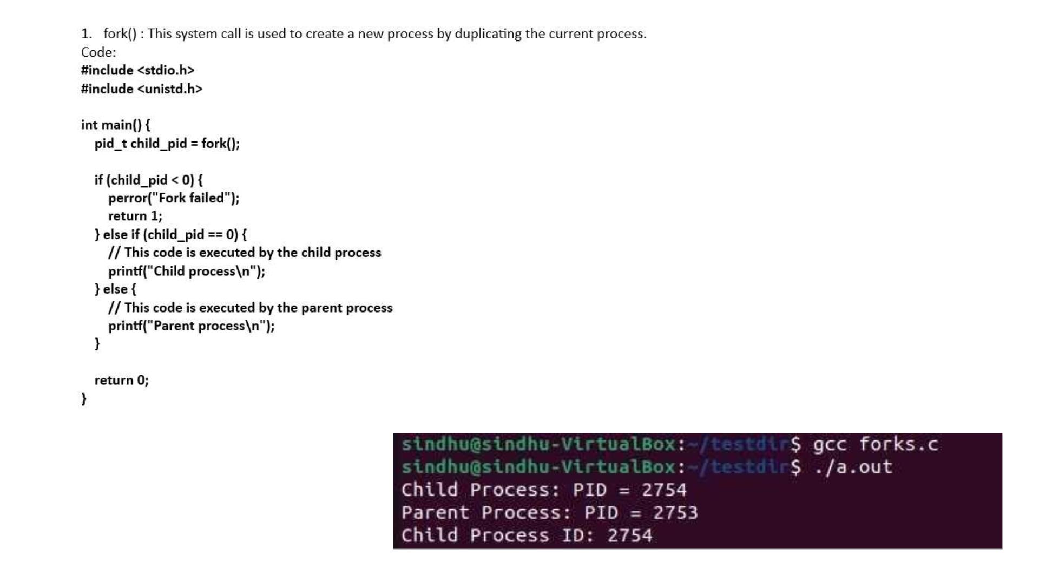

Slide 12
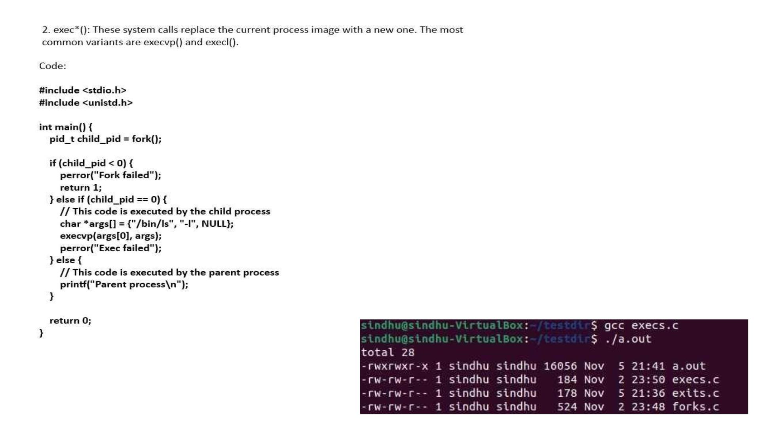

Slide 13

Kernel Mode:
• Kernel mode in Linux is the highest
privilege level where the core operating
system, known as the kernel, operates.
It has unrestricted access to system
resources and hardware, manages
system resources, handles system calls
from user processes, and enforces
security and isolation between user
processes and itself.
• Commands for Kernel Mode:
dmesg, lsmod, insmod, rmmod.

Slide 14

Kernel Module
Demo

Slide 15
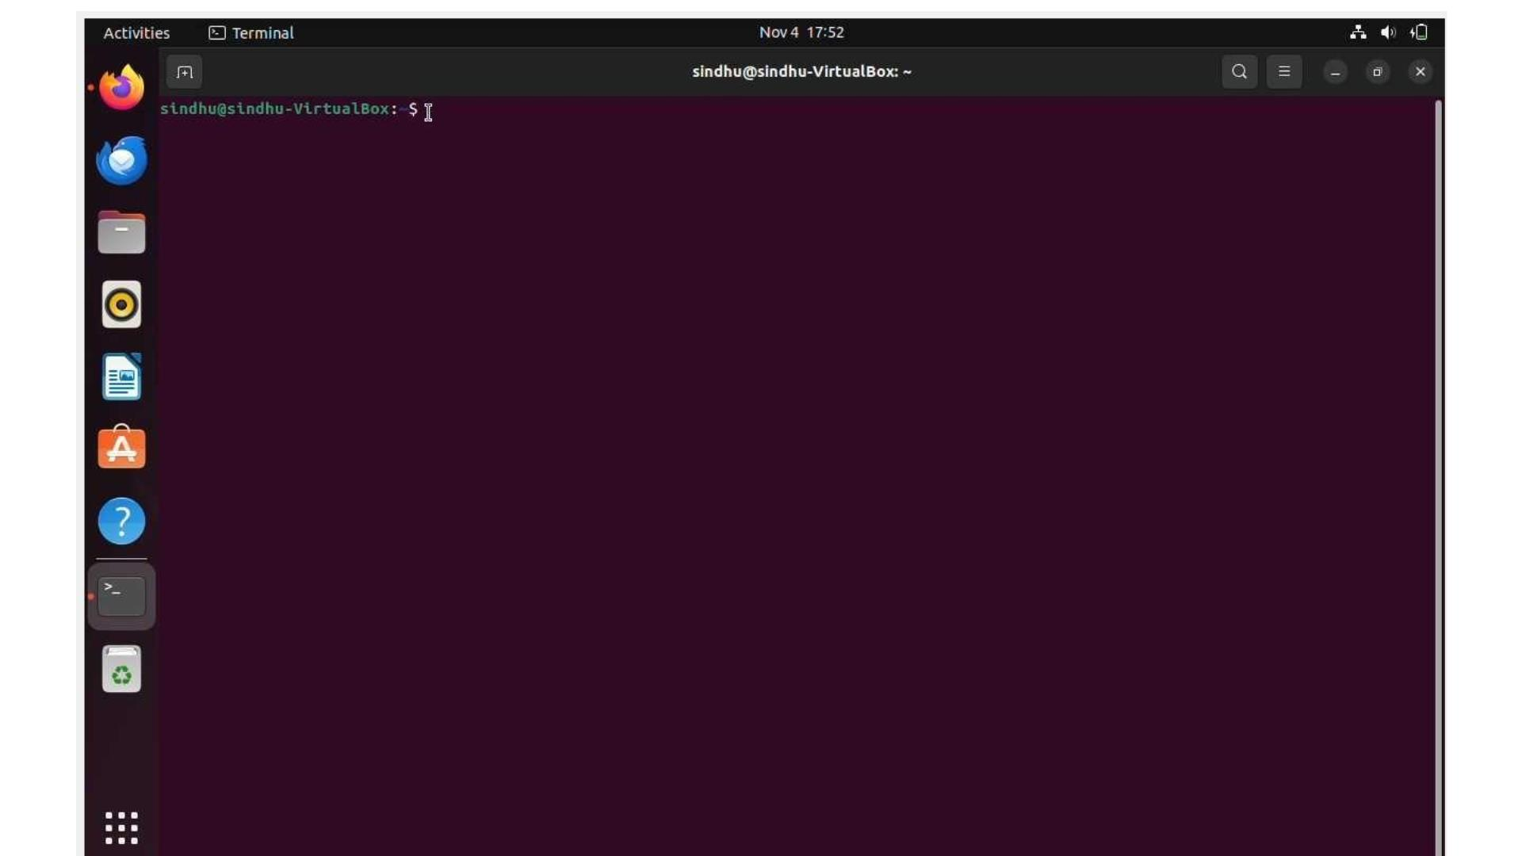

Slide 16

Memory Allocation
Demo

Slide 17
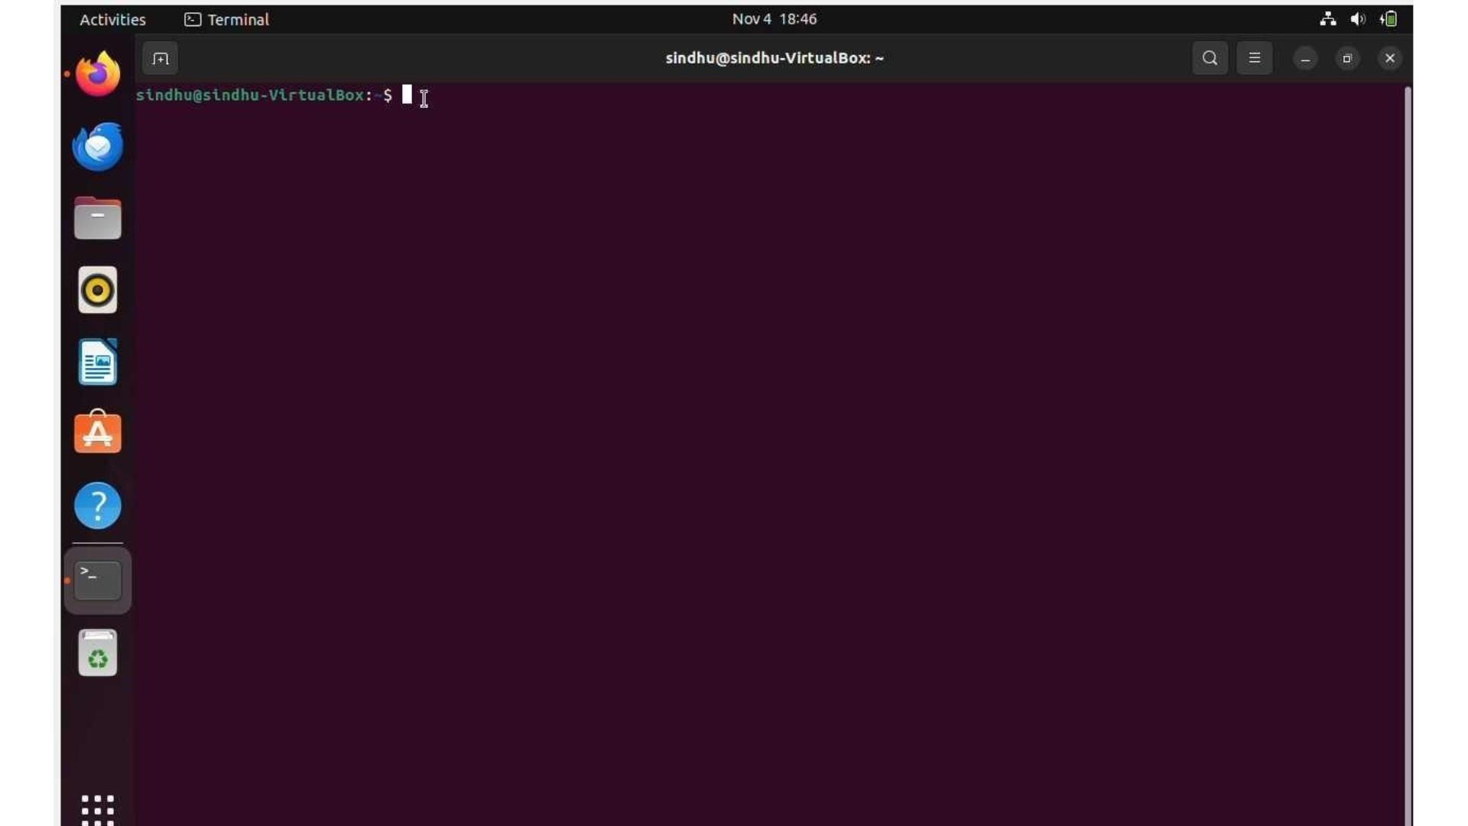

Slide 18

Thank You

