Slide 1

COLLEGE CHATBOT
Abhinayreddy Polimera – 16334737
Charita Tummala – 16338814
Sraawya Chintala – 16336773
Sindhu Chilukuri – 18234349

Slide 2
Overview
This College chatbot application designed to cater to the needs and queries of college or university students, faculty, and staff. These chatbots are typically implemented on the websites or mobile applications of educational institutions to provide quick and accessible information and support.
Here we created a Virtual Environment to host the Chatbot application in our Local server

Slide 3
TEAM : BETA BOTS
Charita Tummala:
Data Collection
Preprocessing of data using transformer library and components for model training.
Preparing the dataset to be fed into the GPT2 model.
Sindhu Chilukuri
Training the model using the preprocessed dataset
Monitor and adjusting the hyperparameters during training as needed.
Recording hyperparameters, and log performance metrics.
Evaluating the trained model.
Abhinayreddy Polimera:
Scripting of chatbot.py : Model Integration with website backend
Defining routing and endpoints for ‘filter_options’ and ‘ask’
Establishing communication with front-end
Sraawya Chintala :
Creation of GUI with the required components
Integration of GUI with website backend
Hosting the bot on a virtual environment

Slide 4
Technology Stack
Python, HTML, CSS
PyTorch and Transformers Library : GPT2 Component, GPT2Tokenizer.
Data Processing with Pandas
Machine Learning Algorithm: Natural Language Processing(NLP)- AdamW
Flask framework
System Requirements
RAM - Minimum > 8GB
SSD > 200GB
GPU

Slide 5
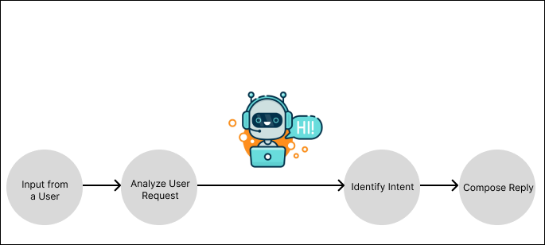
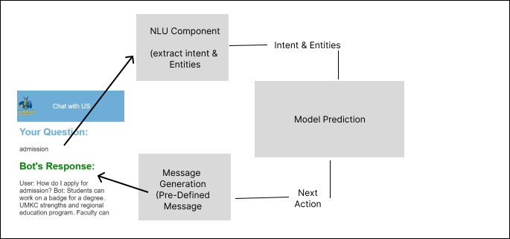
How Chatbot Works?

Slide 6
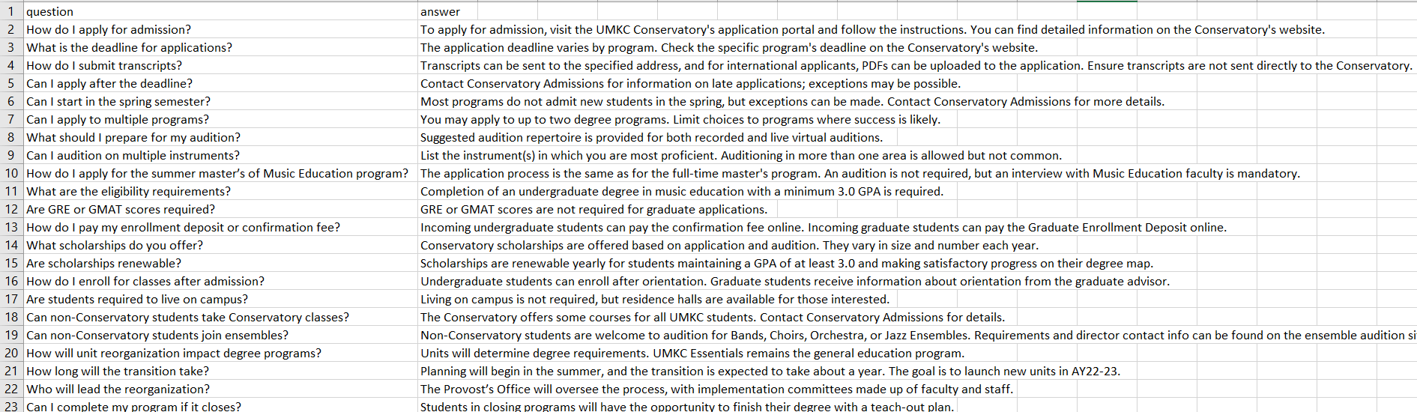
Data collection
https://www.umkc.edu/alert/faq.html
https://conservatory.umkc.edu/admissions/faqs.html
https://www.umkc.edu/finadmin/campus-facilities/faq.html
https://www.umkc.edu/cashiers/tuition-fees/simplified-tuition-faqs.html
https://www.umkc.edu/parking/campus-parking-faq.html
https://www.umkc.edu/cashiers/international-students-faq.html
https://faq.library.umkc.edu/questions/43457
Total : Approximately 240 questions

Slide 7
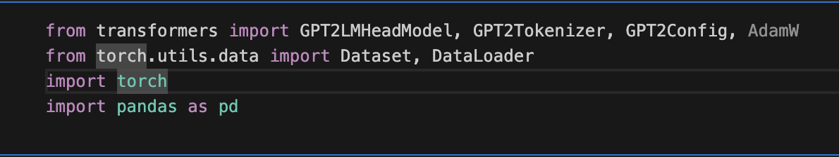
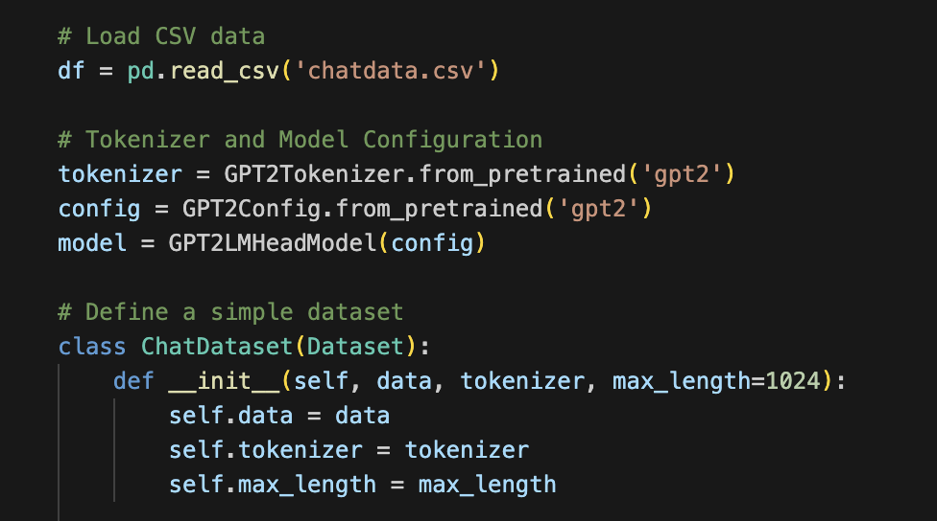
Pre-Processing
Transformers provides APIs and tools to easily download and train state-of-the-art pretrained models. Using pretrained models saves you the time and resources required to train a model from scratch.
Gpt2 is pre-trained model that predict the next word from the 1.5 billion parameters.
Gpt2Tokenizer is used to covert a string into a list of numbers or tokens that computer can understand.

Slide 8
AdamW
It is an optimization algorithm that optimises the network with the help of deep neural network with weight decay for training sessions.
AdamW parameters are updated by the parameters from the previous iteration weighted by weight decay.

Slide 9
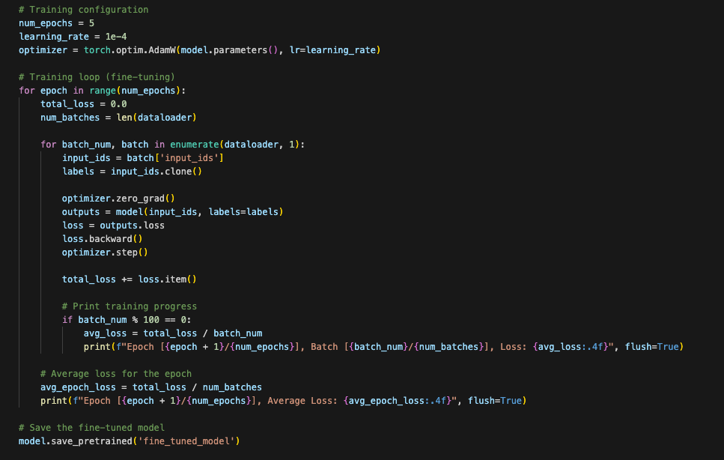
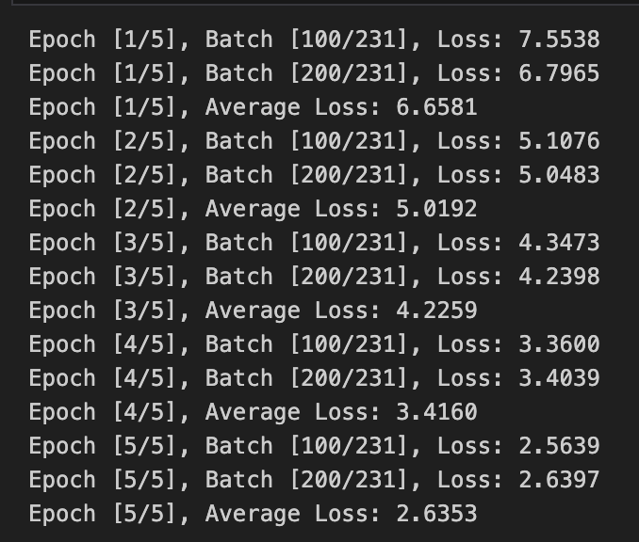
Training
We Used NLP Algorithm AdamW for Training the Model. We Created five epochs to train the model. The total loss after the five layers of training is 26%

Slide 10
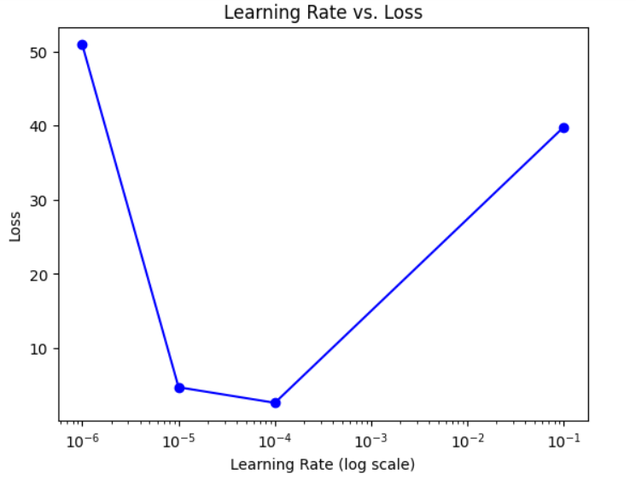
Plot of Learning rate vs Loss

Slide 11
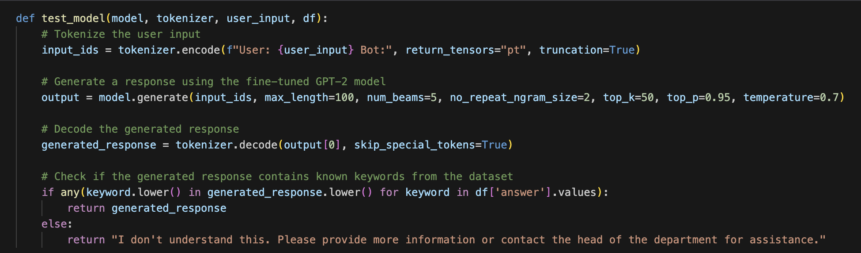
Testing

Slide 12
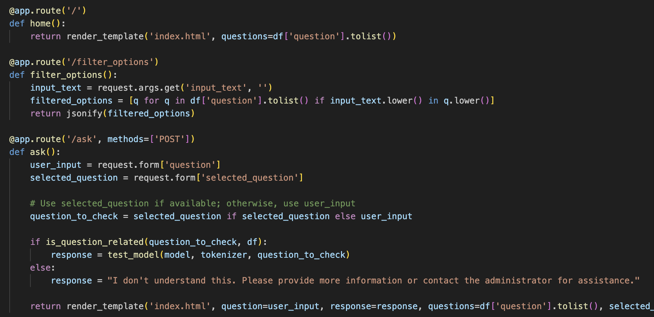
API’s
home() – Routes to default home page.
filter_options() – Filter’s the questions from database based on typed keys in question input box.
ask()- To fetch response for the selected question.

Slide 13
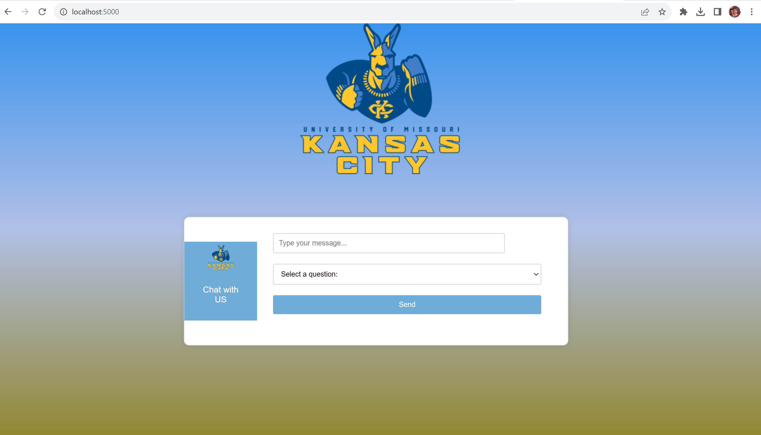
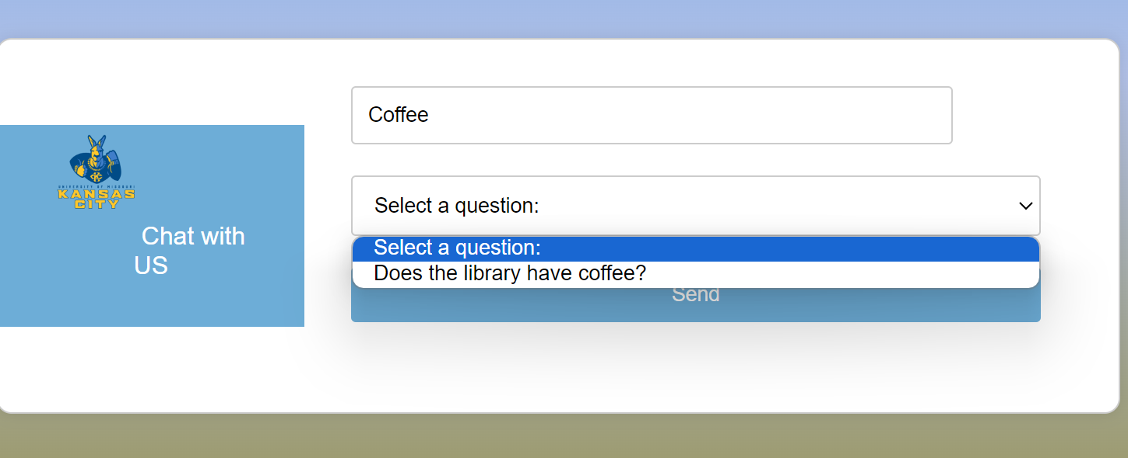
Landing Page and Query Process

Slide 14
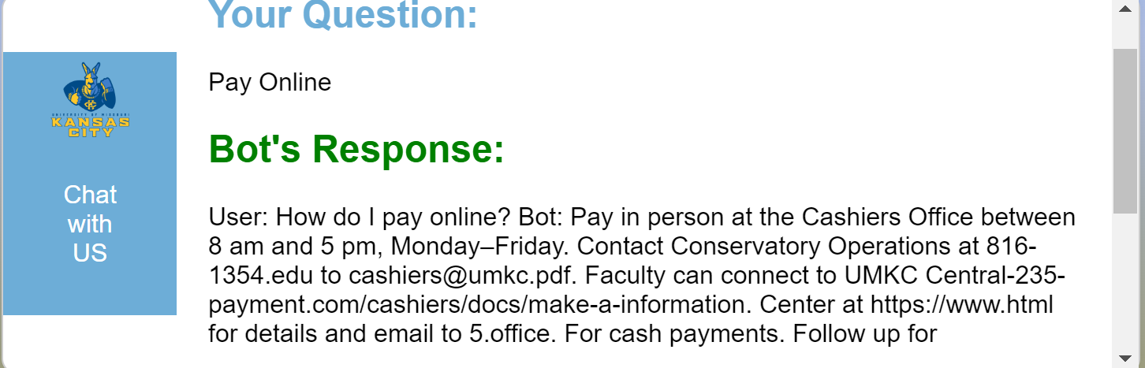
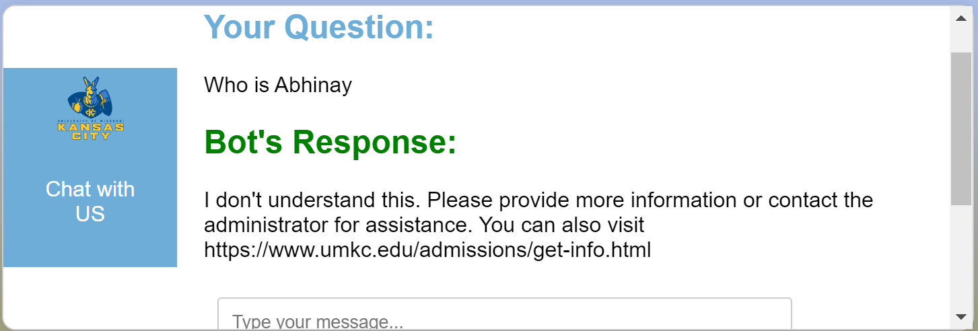
Response
If question within our data set
If question not present in our database

Slide 15
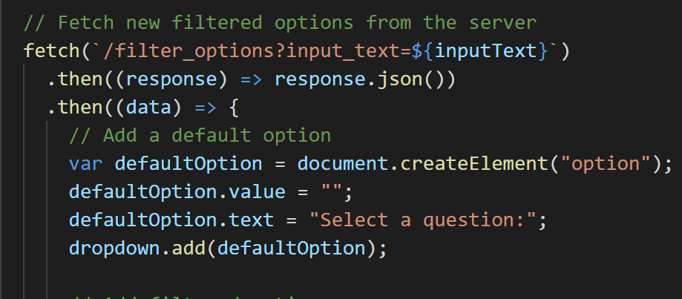
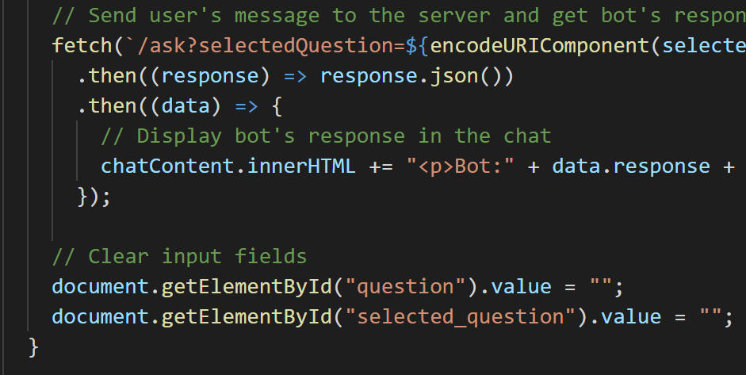
Index.html
filter_options() calls made on question input box
ask() call made on sending the query

Slide 16
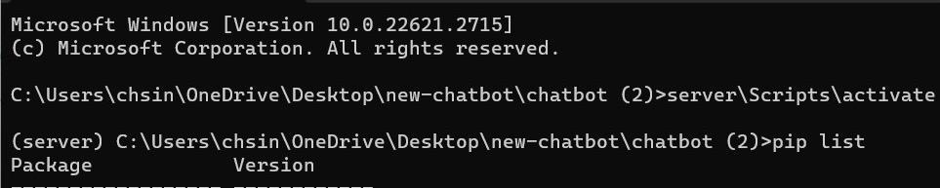
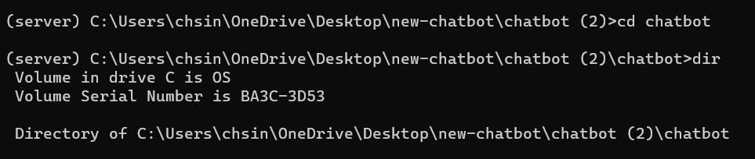
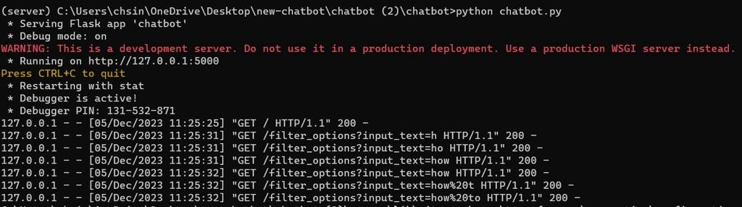
Virtual Environment

Slide 17
CONCLUSION
We have successfully built an interactive chatbot system with a user-friendly platform for instant and accurate inquiries. This streamlines operations, optimizes costs, and ensures 24/7 availability. It excels in delivering clear information about various aspects and departments of UMKC.
FUTURE SCOPE
As we move forward, we plan to host it on a cloud service to make to available publicly and further improve it by curating our dataset rich in size and diverse set of information. We can also look into the possibility of adding voice assistance using other optimizers namely ‘Allen’, to improve the accessibility of the application.
We can also integrate this bot into our main website further.

Slide 18
Thank You

