Slide 1
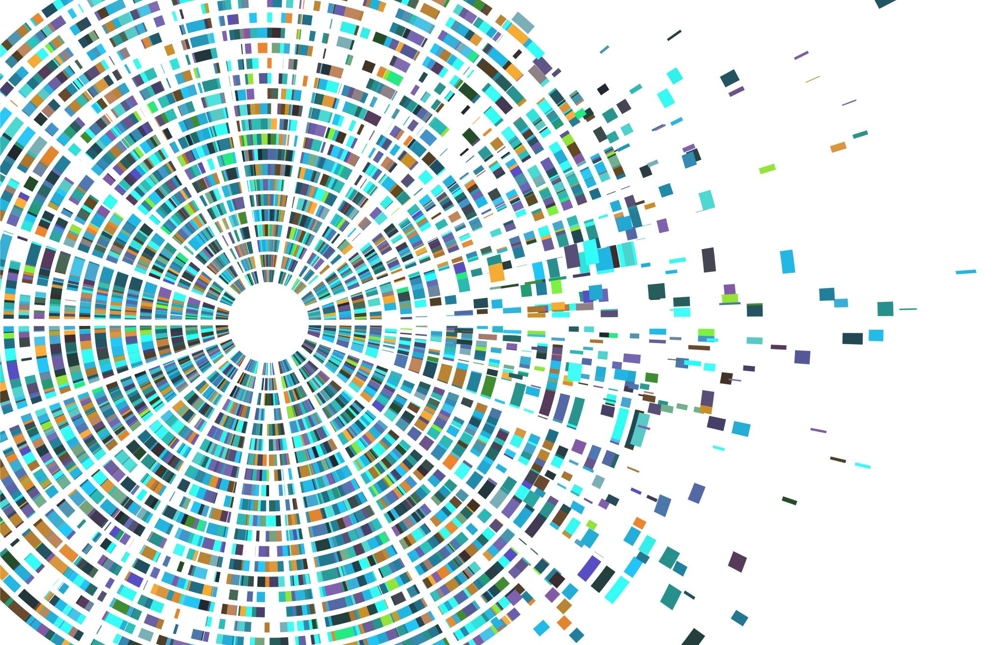
Vertex K-Labeling using Algorithmic Approach
Non-Homogeneous Caterpillar
Presented By :
Charita Tummala - 16338814

Slide 2
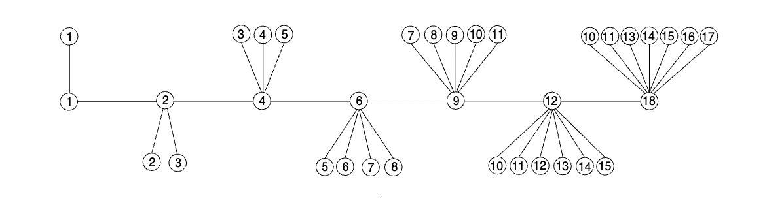
NON HOMOGENOUS CATERPILLAR
Tree obtained by passing a path through central vertices of each star.
Edge irregular k labeling

Slide 3
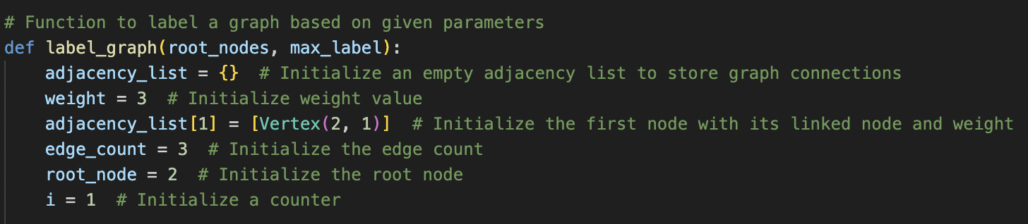
Best Data Structure to Represent/Store the Graph
The graph is represented using an adjacency list data structure.
Mainly used in the sparse graphs where it has relatively fewer connections between nodes.
Adjacency lists are a data structure that stores the relationship between vertices in a graph.
It provides space efficiency, Ease of traversal and memory efficiency.
The advantage of this list over a regular graph is that you can edit or remove nodes from it easily.

Slide 4
Algorithm for Vertex k-Labeling:
1. **Initialize Parameters:**
- Set the number of root nodes (`root_nodes`).
- Calculate the total number of nodes in the graph (`total_nodes`).
- Calculate the maximum label for the graph (`max_label`).
2. **Initialize Graph Structure:**
- Create an empty adjacency list (`adjacency_list`) to store graph connections.
3. **Initialize Graph Properties:**
- Set initial weight value (`weight = 3`).
- Set initial root node (`root_node = 2`).
- Set initial edge count (`edge_count = 3`).
- Initialize a counter (`i = 1`).
4. **Create Adjacency List:**
- While the counter (`i`) is less than the number of root nodes:
- Loop to populate the adjacency list:
- Calculate the next linked node (`next_link`).
- Create a new vertex with weight and linked node.
- Append the new vertex to the root node's list in the adjacency list.
- Increment the weight.
- Increment the loop counter.
- Increment the edge count.

Slide 5
- If it's the second-to-last iteration:
- Update the used weight.
- Add a vertex to the adjacency list with the maximum label.
- Update the root node.
- Else:
- Update the root node.
- Increment the outer loop counter.
5. **Output Graph Details:**
- Print the maximum label, number of root nodes, total nodes, and total edges.
6. **Format Output:**
- Create a function to format the adjacency list for output.
- Iterate through the adjacency list items and format each entry.
7. **Final Output:**
- Display the formatted output.

Slide 6

Design Strategy
The design strategy involves utilizing greedy algorithm for the graph.
At each level a locally optimized choice is made for labelling the vertex with the hope of finding a globally optimum solution.
Greedy algorithm is generally straightforward to understand and implement, making them computationally efficient.
Due to its Effectiveness, it can find optimal solution for the problem.

Slide 7
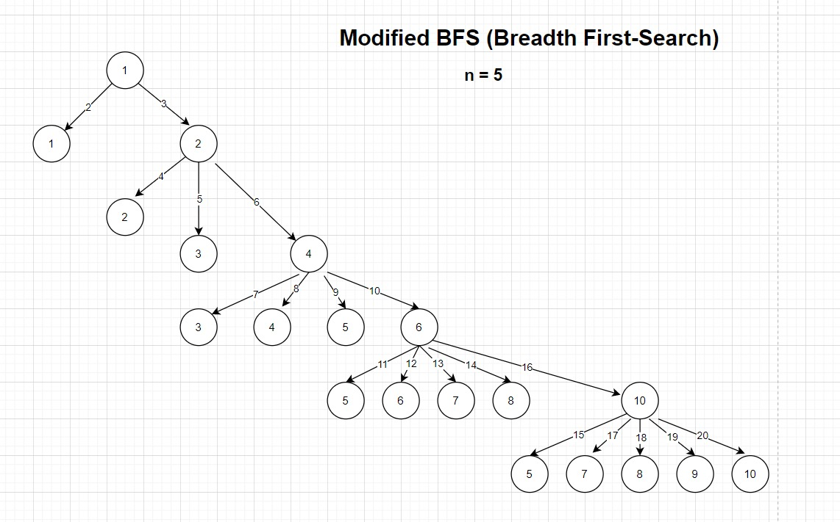
Traversing the Graph
BFS is applied for the graph by modifying it according to this algorithm.
The Breadth-First Search (BFS) is a graph traversal algorithm that explores a graph level by level.
Usually in the conventional BFS algorithm once the root is visited we have the flexibility to visit either of the left and right nodes of the root. However, we modified our BFS algorithm in such a way that after visiting the root, the next visit should be for the node which has no branches, once this is done we proceed to the other node of the root.

Slide 8
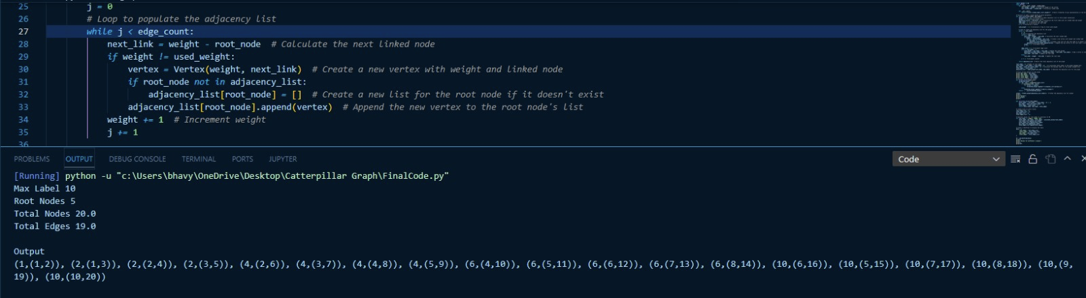
Storing Labels and Weights
The following image shows the edge weights and vertices stored in the output list.

Slide 9
Maintaining Unique Edge Weights
To guarantee that every vertex and edge in the Non-Homogenous Caterpillar graph is appropriately weighted, a careful method is used by the subroutine responsible for edge and vertex labeling maintenance.
Label-1 is the first vertex that we have assigned, and the edge weight begins at 2.
Edge weights can be adjusted by incrementing the previous edge weight and storing the current weight, starting with the first edge weight value.
The process is repeated for each subgraph, guaranteeing that the sum of any two connected vertex weights equals the corresponding edge weight and maintaining the mathematical integrity of the graph.
For vertices, the label is subtracted from the edge weight.
The result is then stored and assigned to the next vertex.

Slide 10
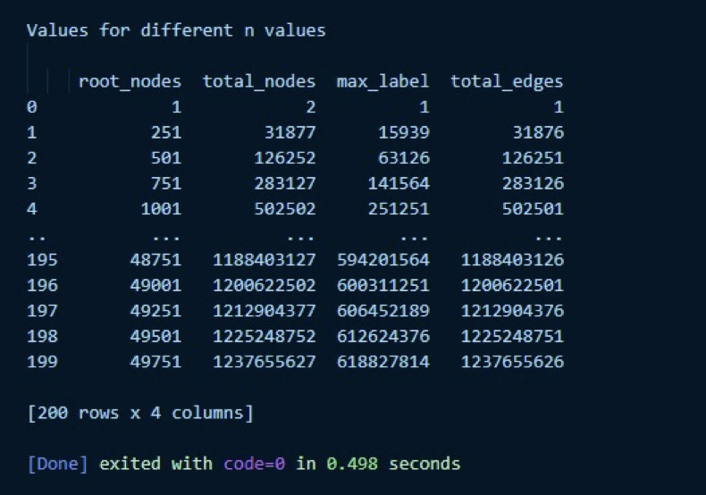
Computing V(G) & E(G)
Various values of n,

Slide 11
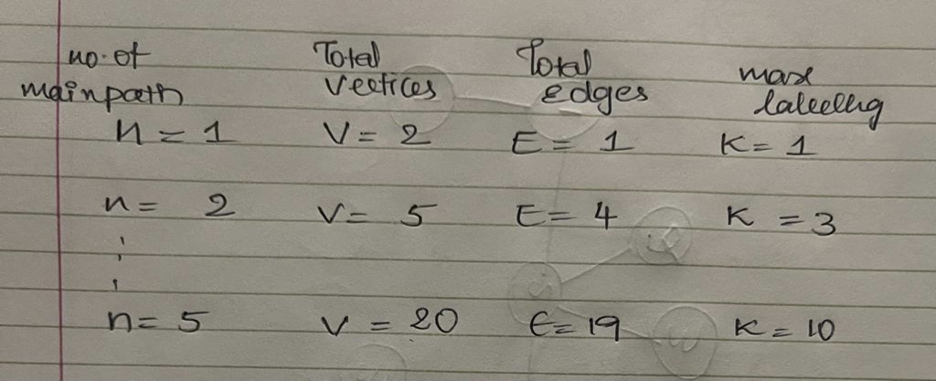
Comparing with Mathematical Property
Total No. of Vertices V= n(n+3)/2
Total No. of Edges E = V-1
Max Vertex label k= Ceil(V/2)
The table below is the results generated by algorithm using above formulas:
Here, we can see the values match with the computed values.

Slide 12
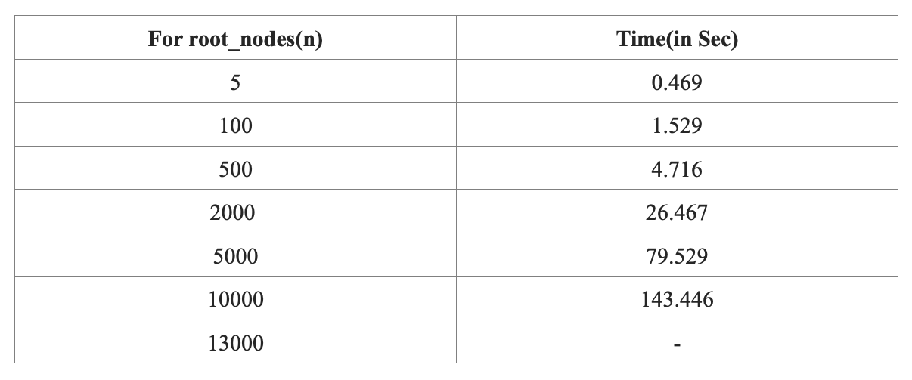
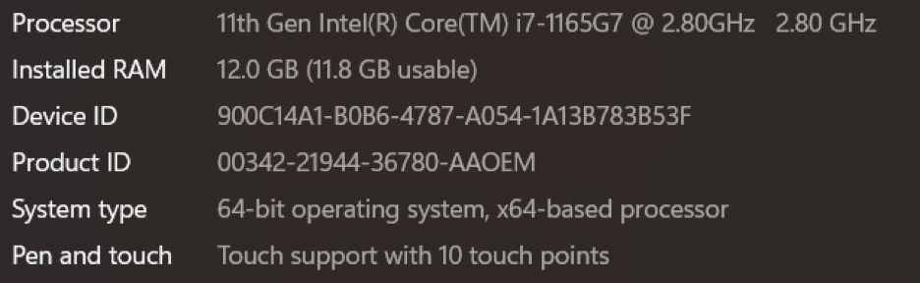
Hardware Resources
The following values show the maximum value of n and p.
At “n=13000” the code got exit by itself without giving the ouput.

Slide 13
Time Complexity
It is the amount of time taken by the algorithm to traverse through all the vertices calculating the edge weights.
Calculation of time complexity depends on edges and weights.
Time complexity helps understand the performance and efficiency of the algorithm.
Less time complexity gives best value.
The obtained time complexity also helps design more efficient algorithm.
For the graph we will be traversing through the central nodes that computes as nodes , and for each central node we will be visiting each child node, which can be represented as edges at each central node.
So for the graph O(N + E) is the overall time complexity.
Where ‘N’ refers to number of root nodes and ‘E’ refers to edge counts.

Slide 14
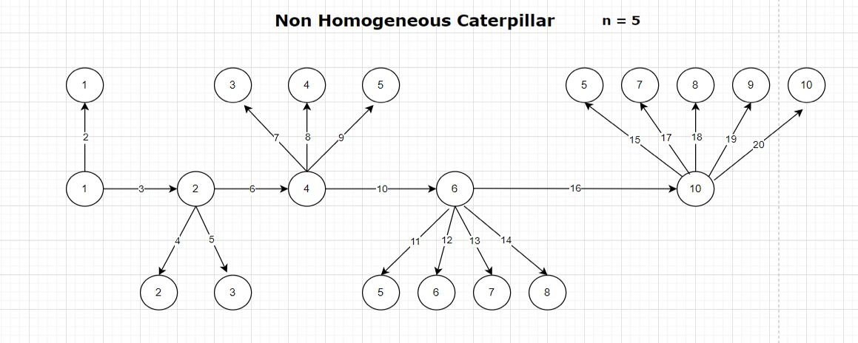
Results
For n=5, the obtained graph is as follows,

Slide 15

Thank You!!

