Slide 1
✦
JooN's Sushi
— M E N U —
✦
29910 Murrieta Hot Springs Rd L, Murrieta, CA
joonssushimurrieta.com

Slide 2
Popular
· · ·
6 Selections

Slide 3
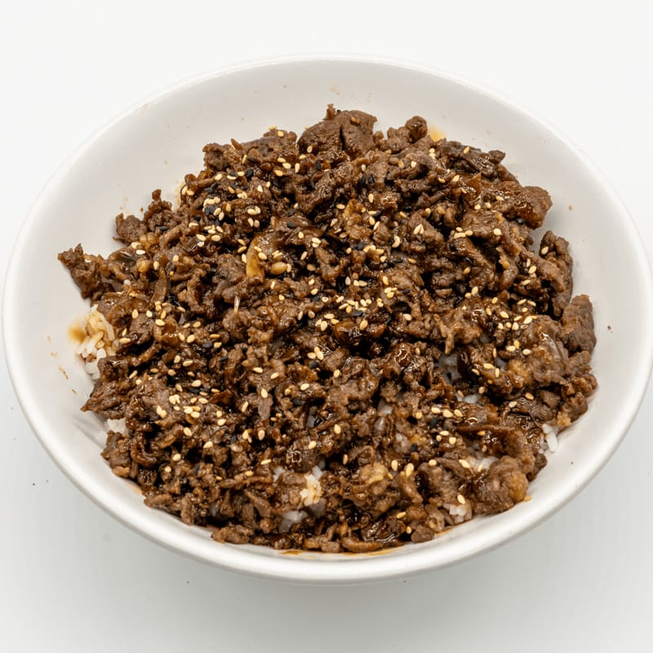
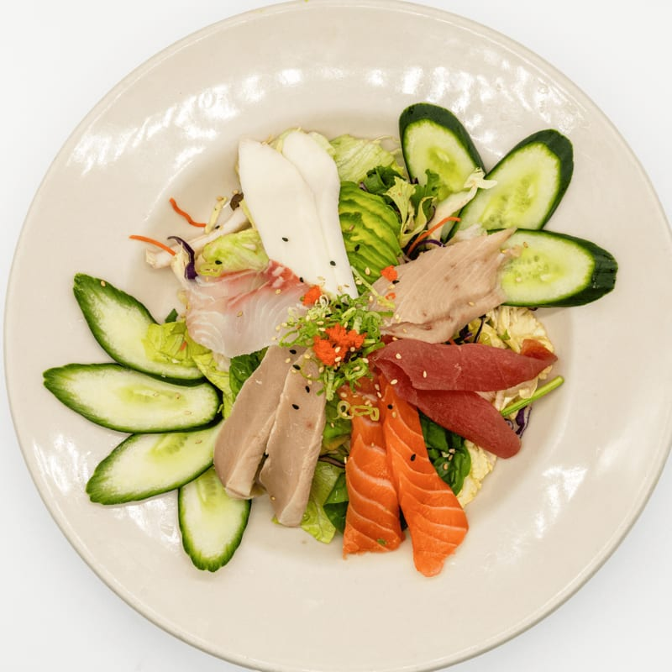
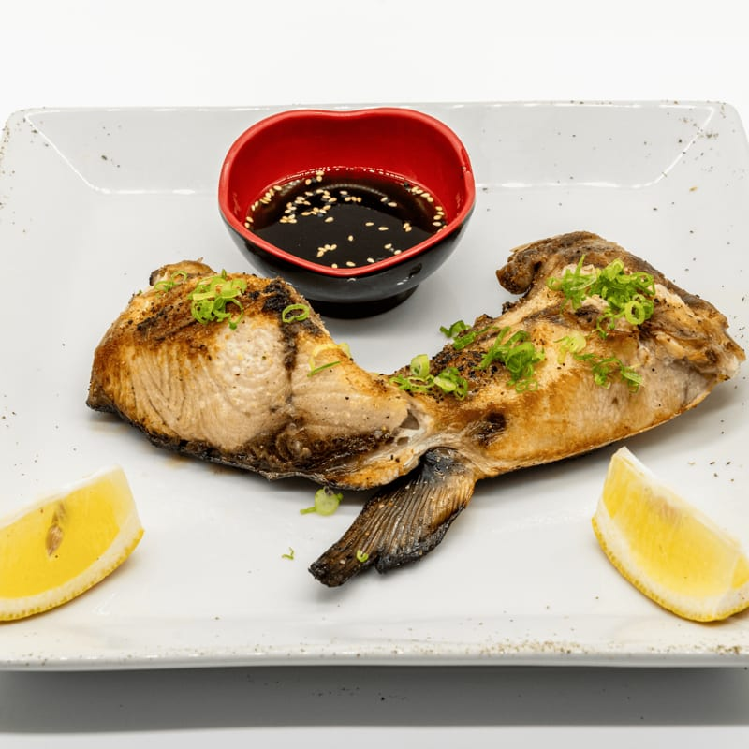
Popular
JooN's Sushi
Beef Teriyaki Bowl
Sashimi Salad
Grilled Yellowtail Kama
$16.50
$20.50
$12.50
Grilled beef with teriyaki sauce.
Assorted sashimi on top of fresh salad.
Grilled yellowtail collar served with ponzu sauce.

Slide 4
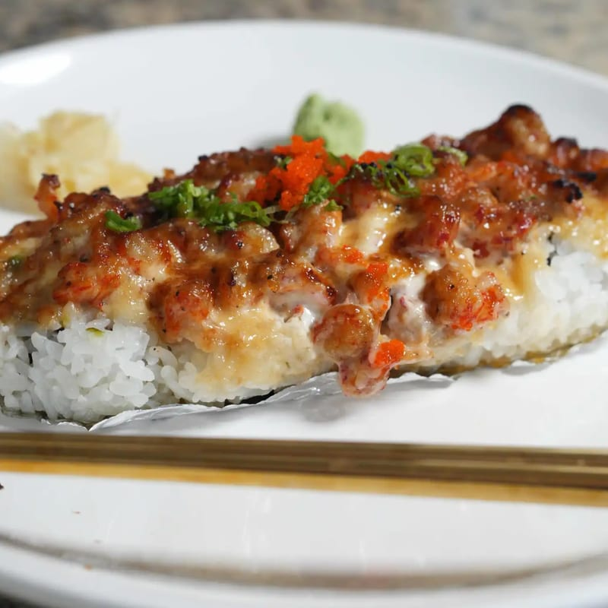
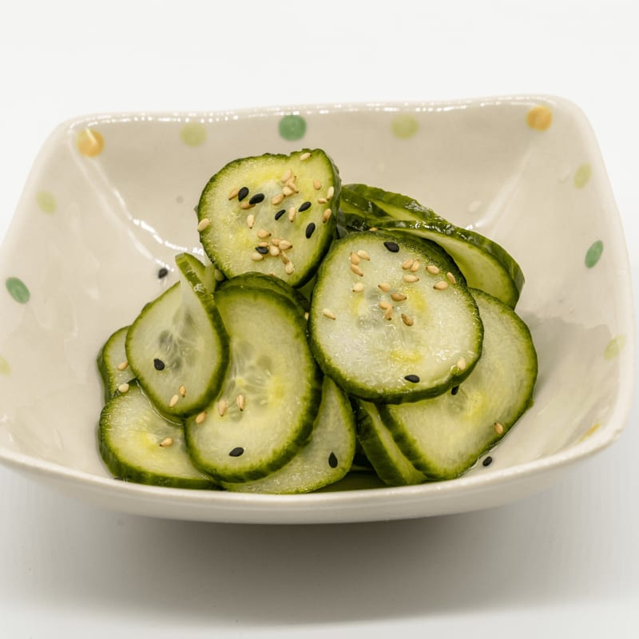
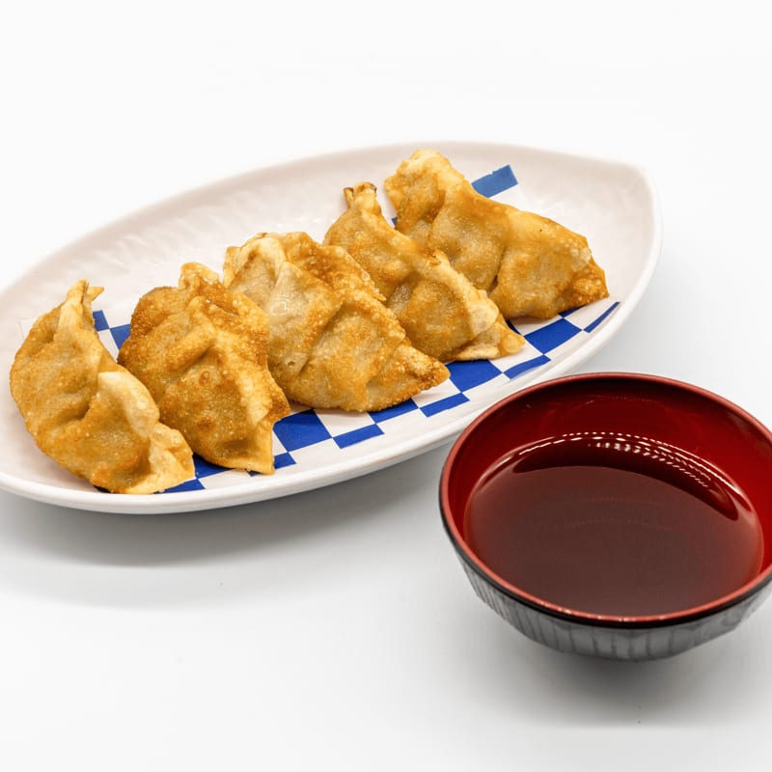
Popular
JooN's Sushi
Baked Lobster Roll
Cucumber Salad
Gyoza
$16.00
$6.50
$7.50
Crab, avocado baby lobster on top.
Fresh cucumber with sweet vinegar dressing.
Fried pork dumplings with tempura sauce.

Slide 5
APPETIZERS
· · ·
7 Selections

Slide 6
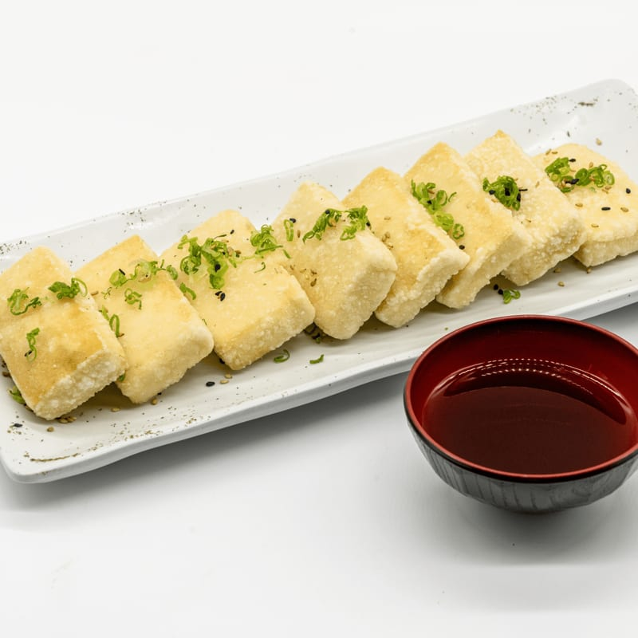
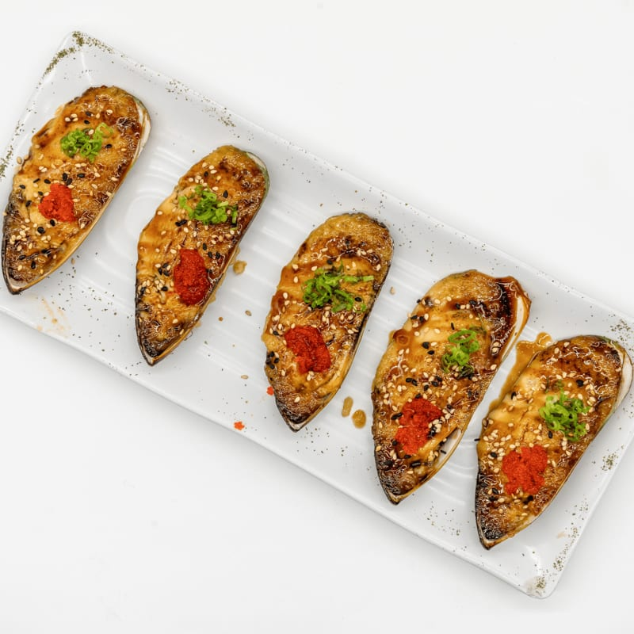
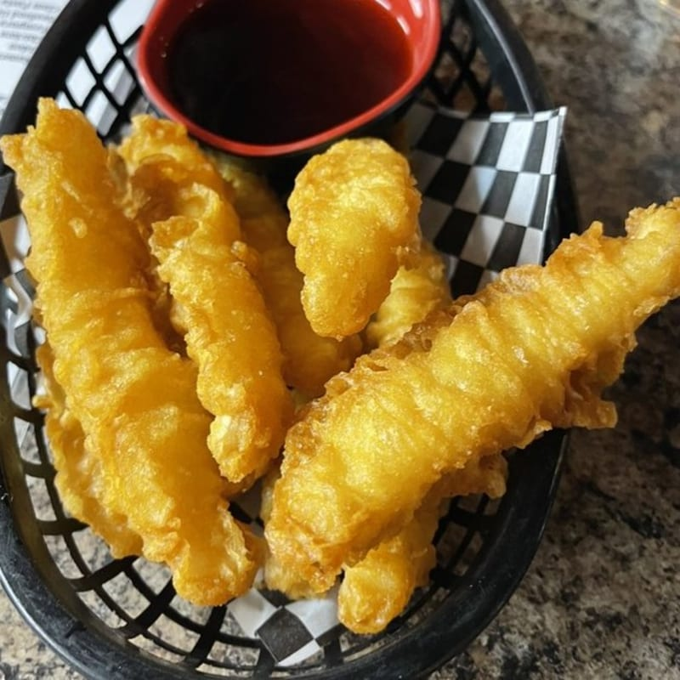
APPETIZERS
JooN's Sushi
Agedashi Tofu
Baked Green Mussels
Calamari Tempura
$10.50
$9.50
$12.50
Lightly fried tofu served with tempura sauce.
Green mussels baked with a cream sauce.
Lightly breaded and fried calamari.

Slide 7
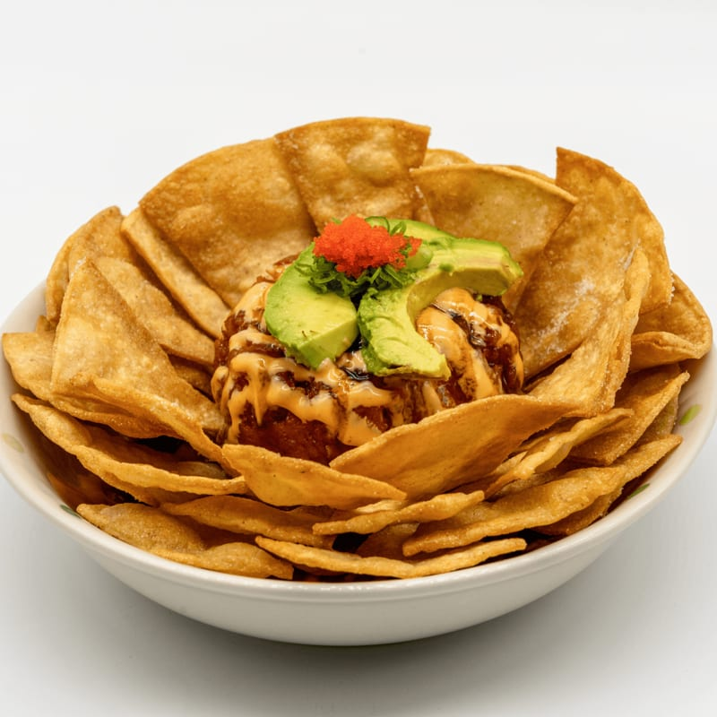
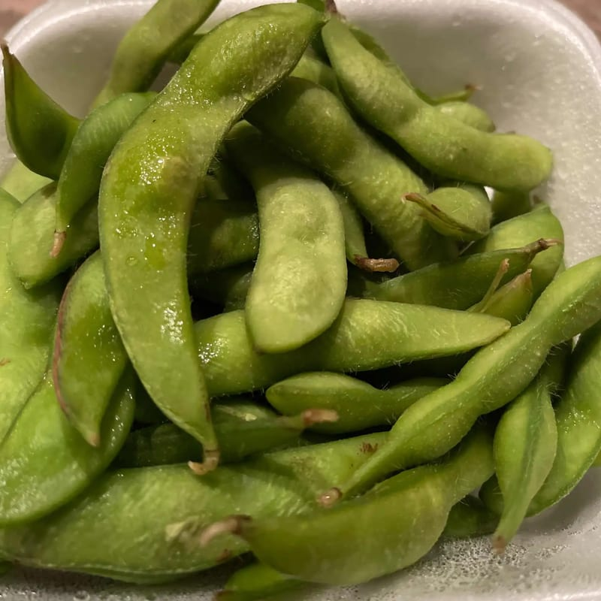
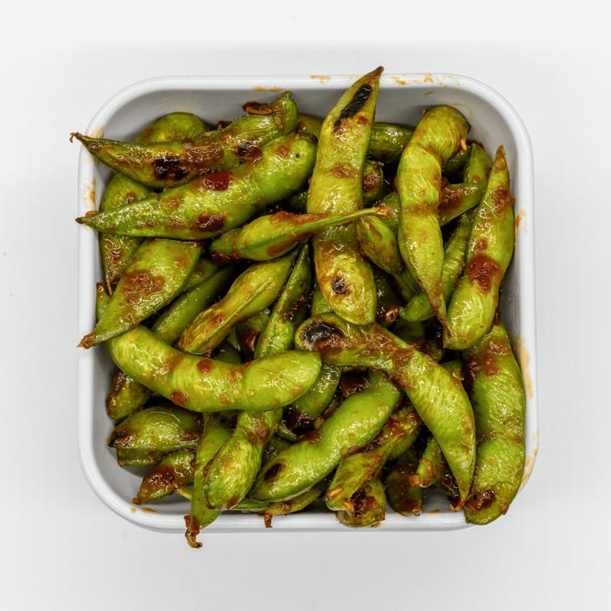
APPETIZERS
JooN's Sushi
Diablo Dip
Edamame
Garlic Edamame
$14.50
$5.50
$7.50
A spicy blend, typically including cream cheese and a fiery mix of peppers and spices, ...
Lightly salted steamed soy beans.
Edamame stir-fried in garlic butter.

Slide 8
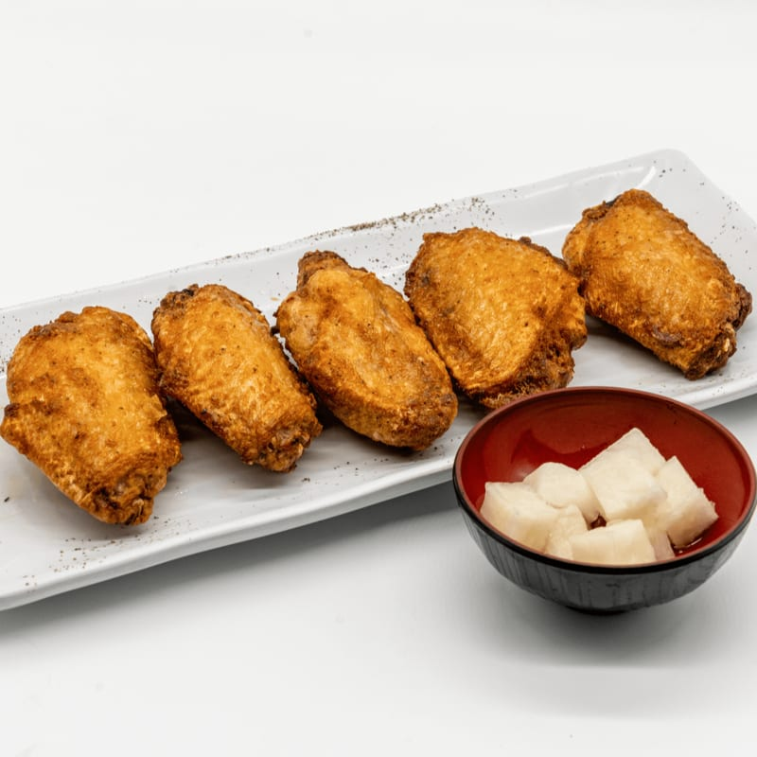
APPETIZERS
JooN's Sushi
JooN's Fried Chicken
$10.50
Fried chicken wings served with jalapeno oil

Slide 9
BAKED ROLLS
· · ·
2 Selections

Slide 10
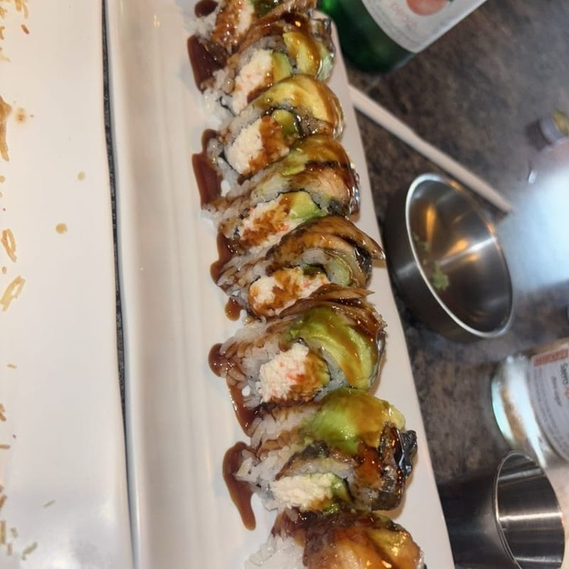
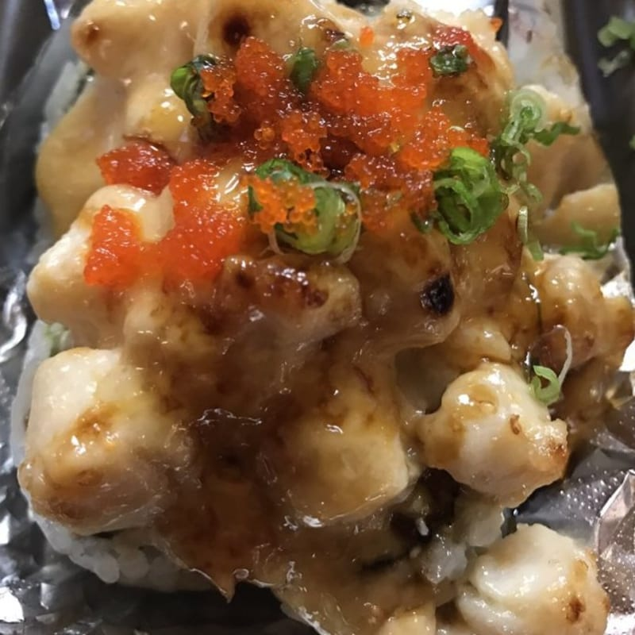
BAKED ROLLS
JooN's Sushi
Dragon Roll
Baked Scallop Roll
$14.00
$16.00
Crab, avocado eel and avocado on top.
Crab, avocado scallop on top.

Slide 11
ENTRÉE
· · ·
4 Selections

Slide 12
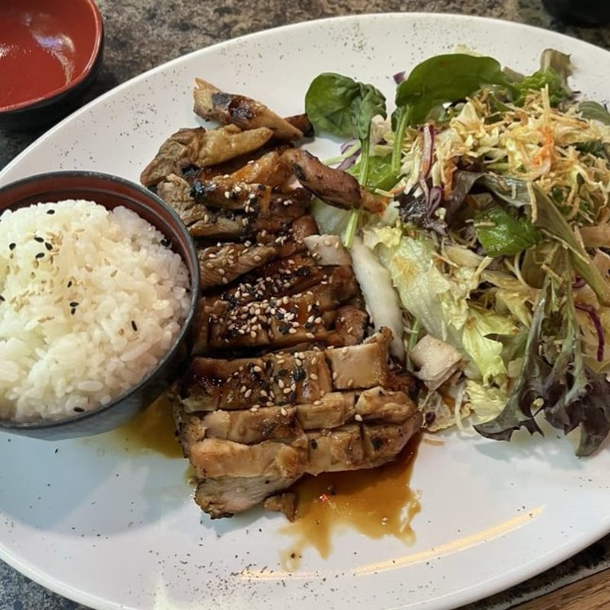
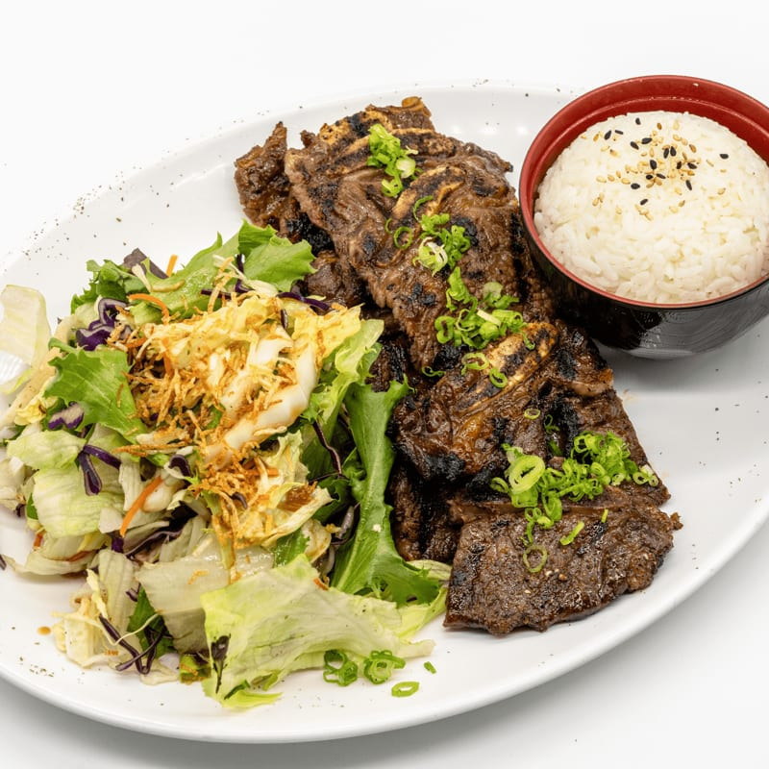
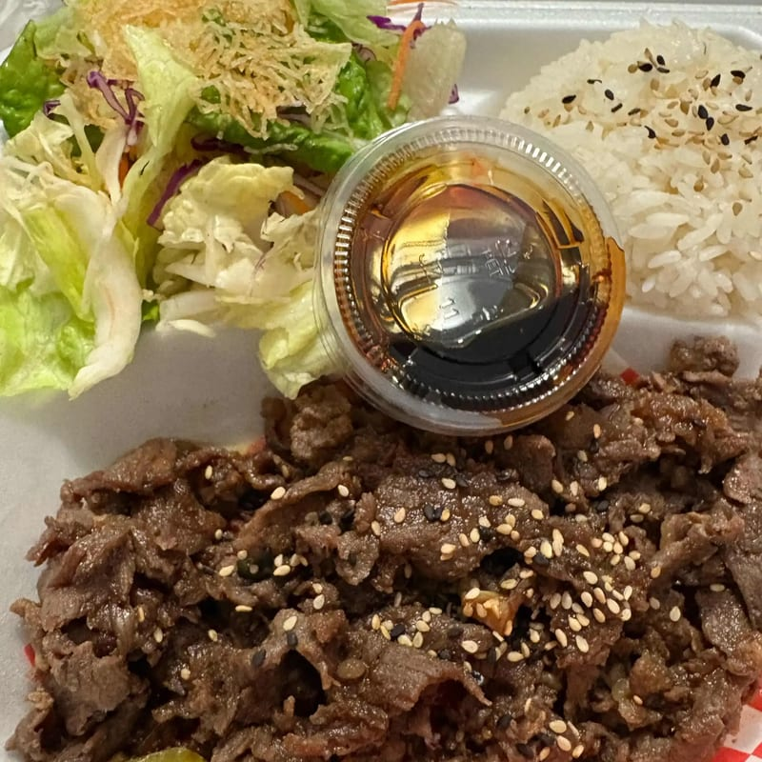
ENTRÉE
JooN's Sushi
Chicken Teriyaki Plate
Korean Short Ribs Plate
Bulgogi Plate
$16.50
$26.50
$20.50
Grilled chicken with teriyaki sauce. Served with miso soup, salad, and rice.
Marinated and grilled Korean BBQ short ribs. Served with miso soup, salad, and rice.
Grilled beef with teriyaki sauce. Served with miso soup, salad, and rice.

Slide 13
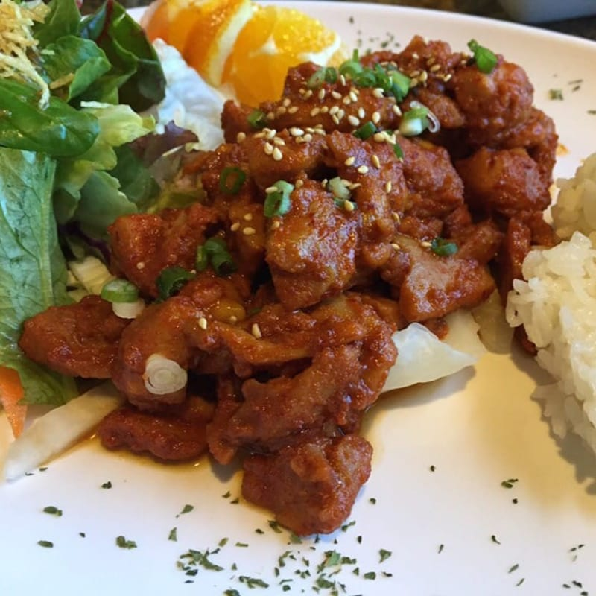
ENTRÉE
JooN's Sushi
Spicy Chicken Plate
$16.50
Grilled Chicken with spicy teriyaki sauce. Served with miso soup, salad, and rice.

Slide 14
FRESH ROLLS
· · ·
2 Selections

Slide 15
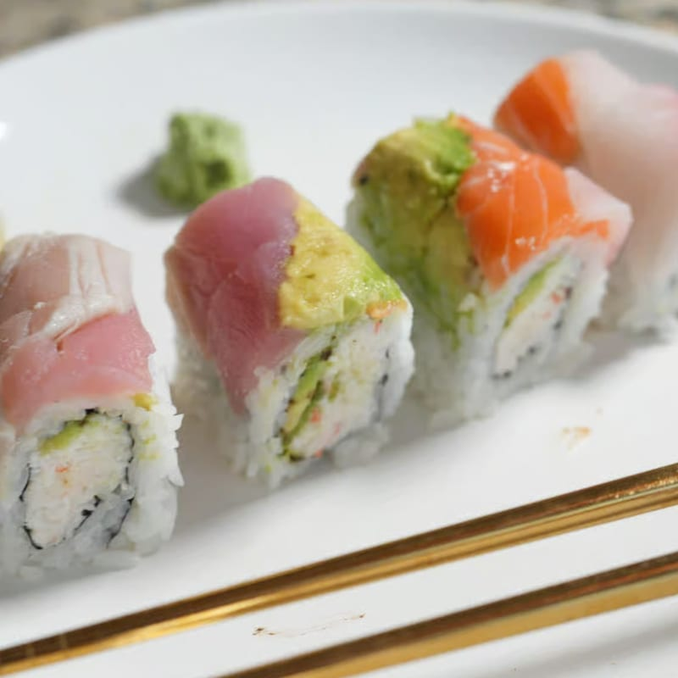
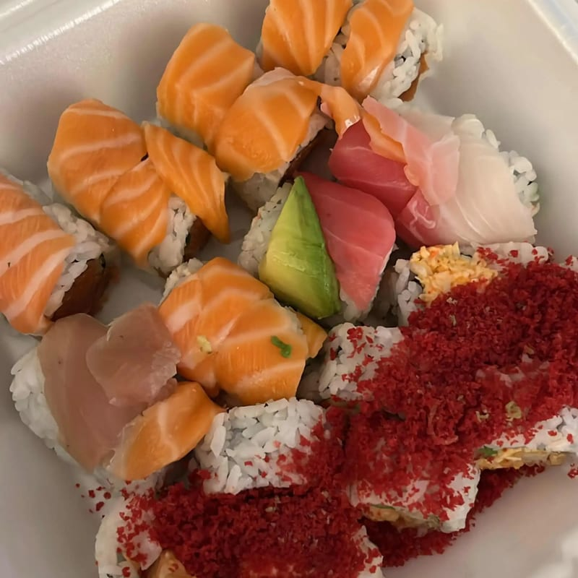
FRESH ROLLS
JooN's Sushi
Rainbow Cut Roll
Pink Lady Cut Roll
$13.00
$14.00
Crab, avocado, assorted fish on top.
Spicy tuna, salmon on top.

Slide 16
NOODLES
· · ·
2 Selections

Slide 17
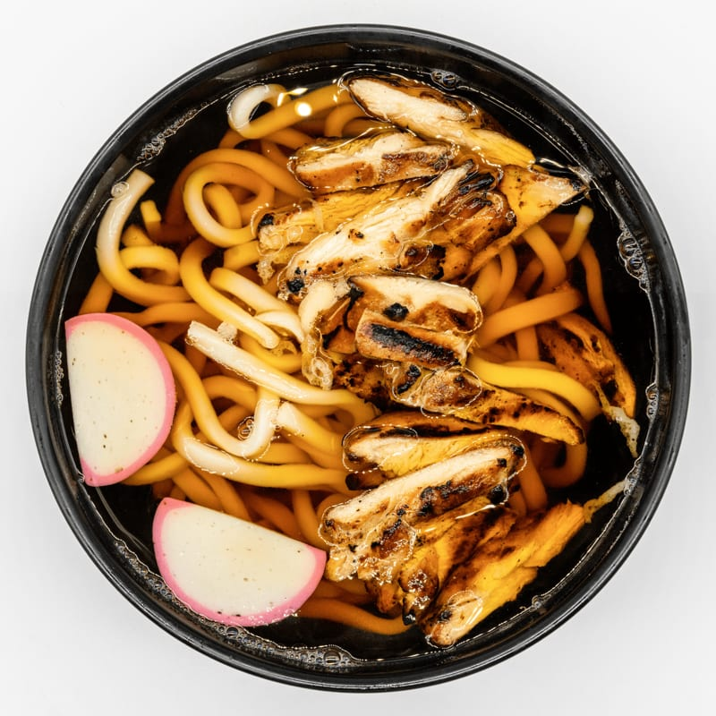
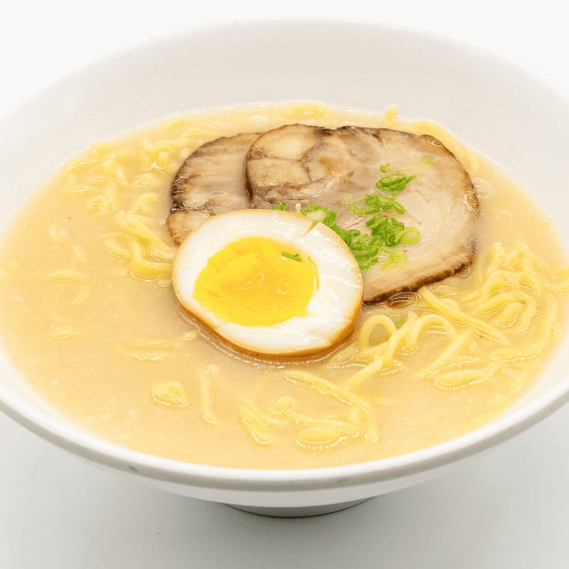
NOODLES
JooN's Sushi
Chicken Udon
Ramen
$14.50
$14.50
Japanese noodle soup with chicken and vegetables.
Choice of Miso, Shoyu, or Tonkotsu ramen.

Slide 18
ROLLS
· · ·
11 Selections

Slide 19
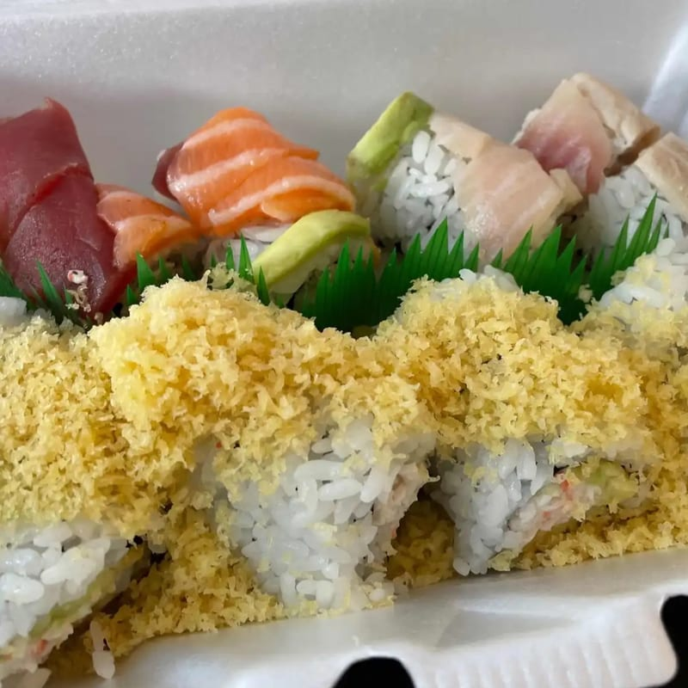
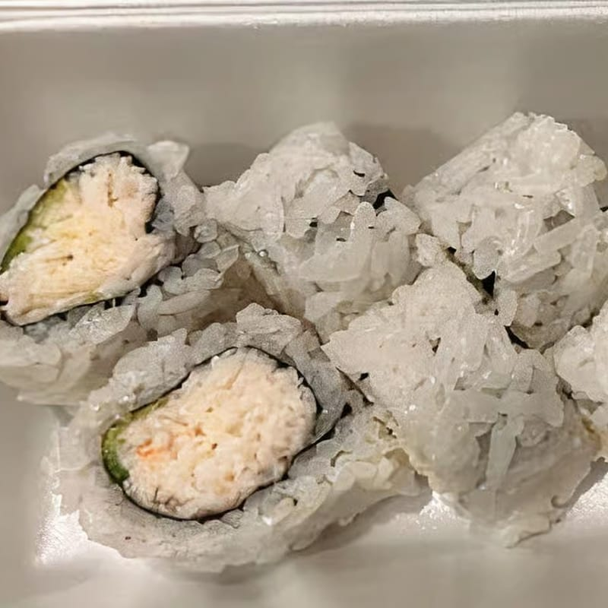
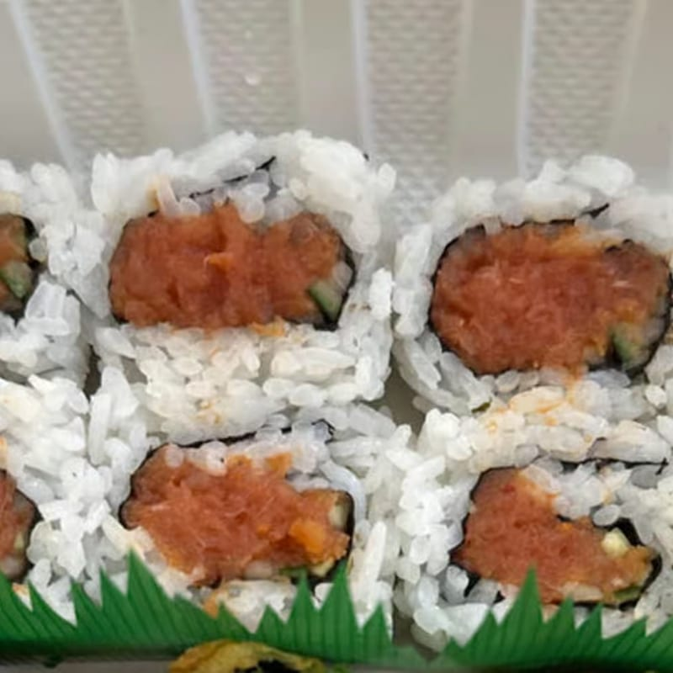
ROLLS
JooN's Sushi
Crunch Roll
California Roll
Spicy Tuna Roll
$12.00
$8.00
$9.50
Shrimp tempura, crab, avocado inside; crunch on top.
Crab, avocado, and cucumber.
Spicy tuna and cucumber.

Slide 20
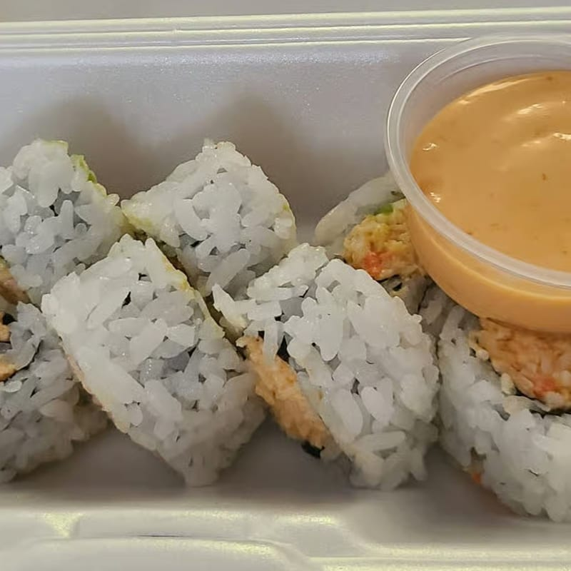
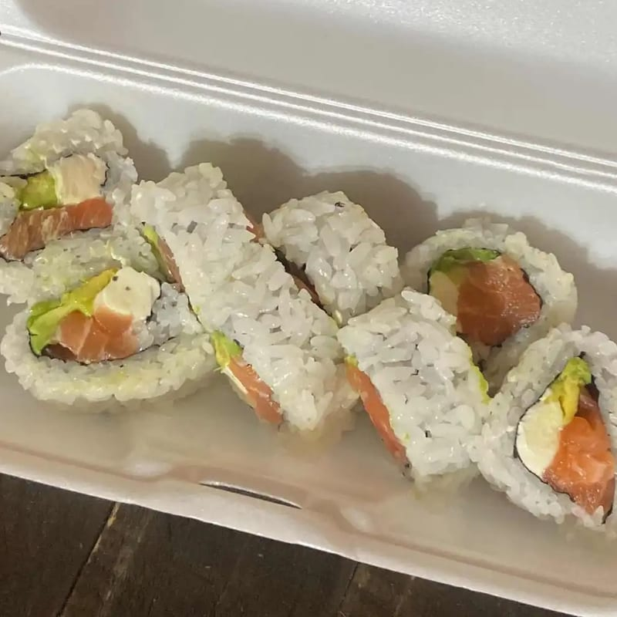
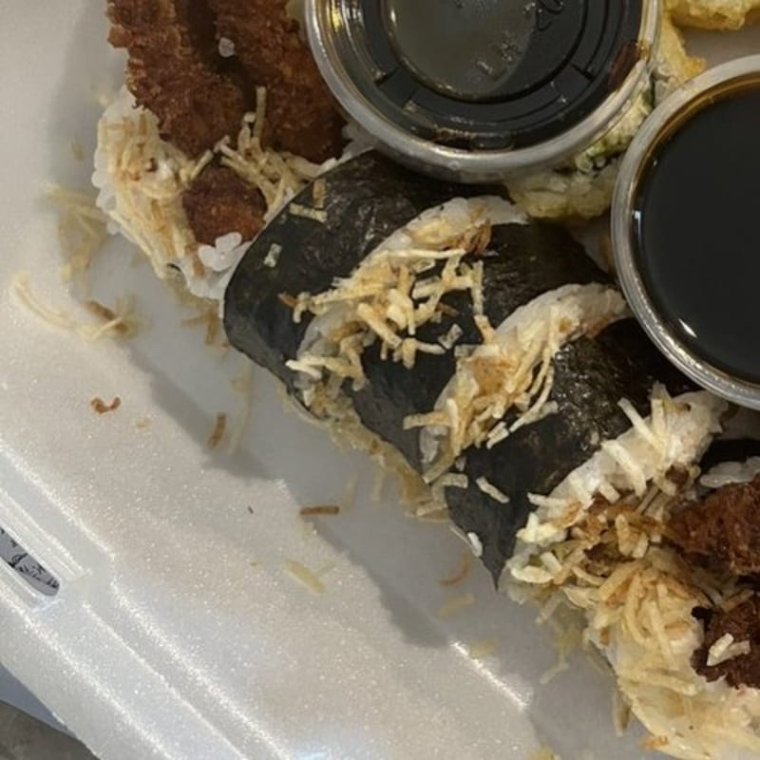
ROLLS
JooN's Sushi
Spicy California Roll
Philadelphia Roll
Spider Roll
$9.00
$10.50
$13.50
Spicy crab, avocado, and cucumber.
Salmon, avocado, and cream cheese.
Soft shell crab, crab, avocado, and cucumber.

Slide 21
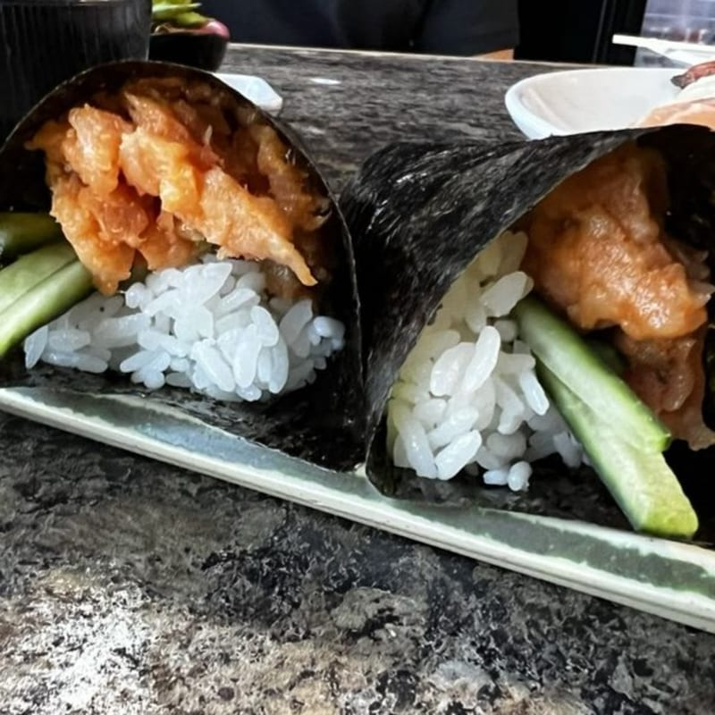
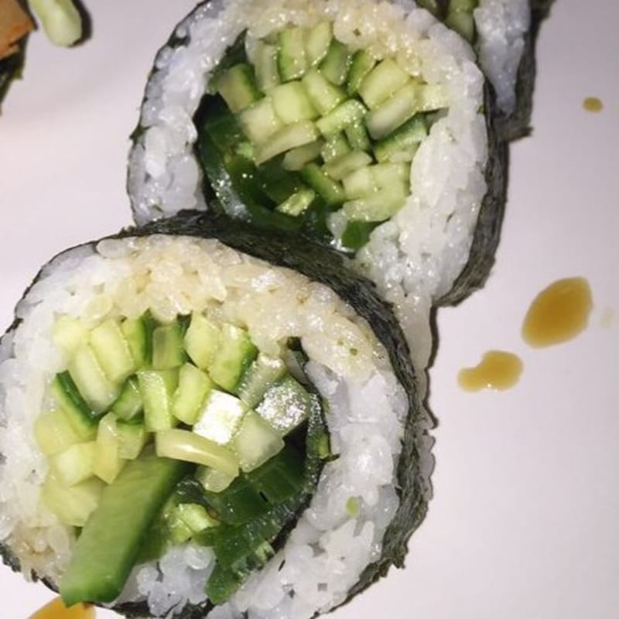
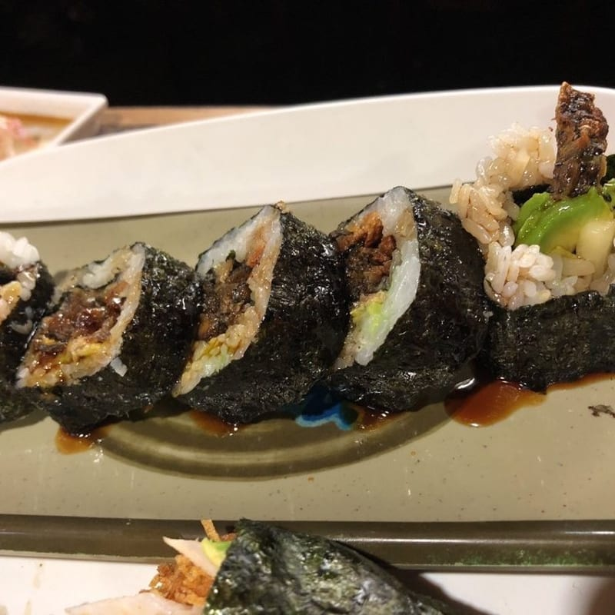
ROLLS
JooN's Sushi
Spicy Yellowtail Roll
Cucumber Roll
Salmon Skin Roll
$10.50
$6.50
$10.00
Spicy yellowtail and cucumber.
Fresh cucumber wrapped in seaweed and rice.
Baked salmon skin, cucumber, and gobo.

Slide 22
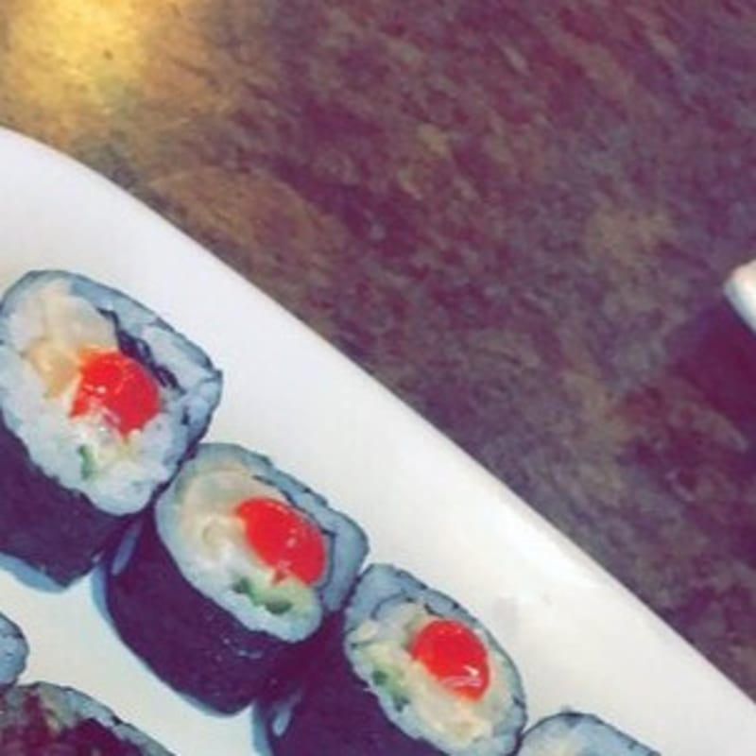
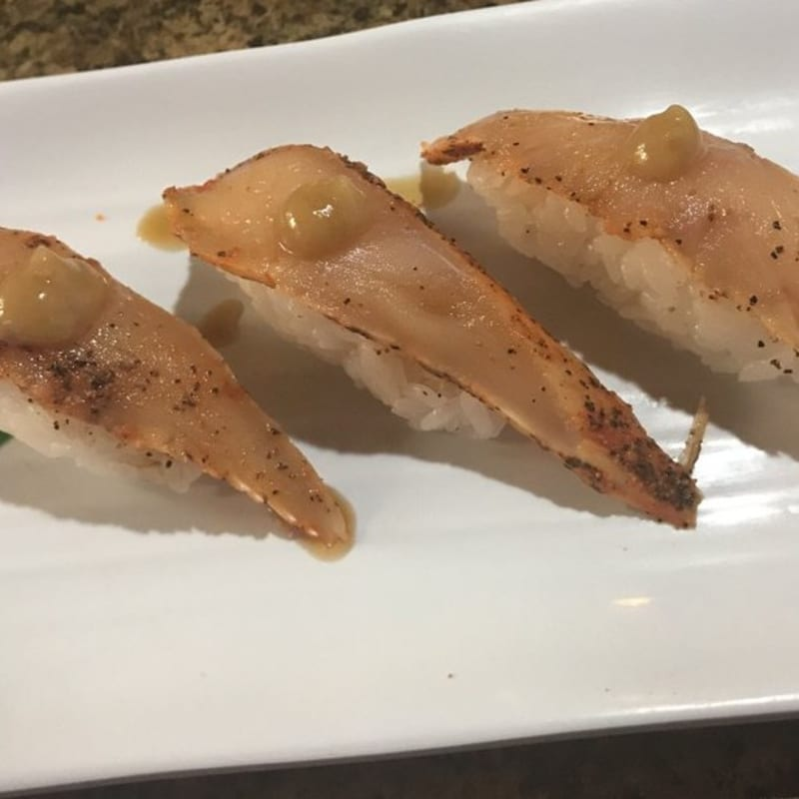
ROLLS
JooN's Sushi
Spicy Scallop Roll
Spicy Albacore Roll
$10.50
$10.50
Spicy scallop and cucumber.
Spicy albacore and cucumber.

Slide 23
SALADS
· · ·
4 Selections

Slide 24
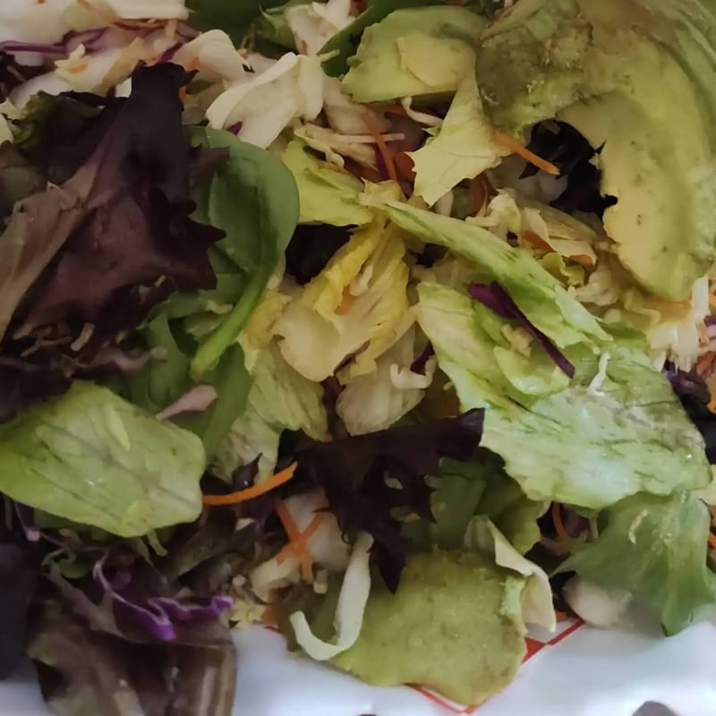
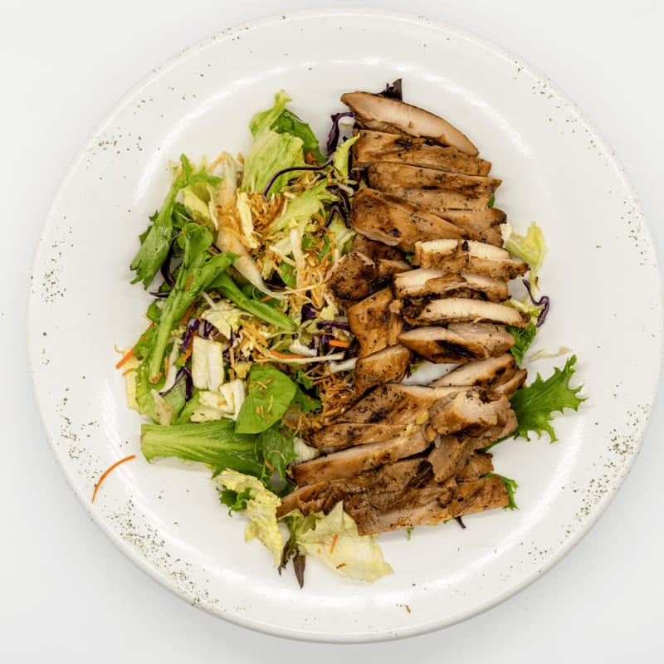
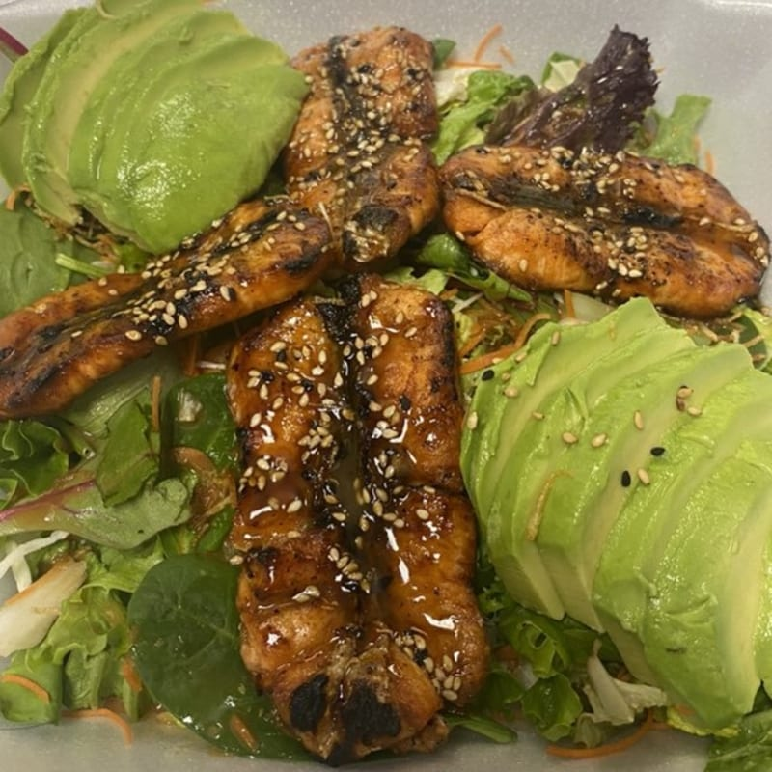
SALADS
JooN's Sushi
Avocado Salad
Grilled Chicken Salad
Grilled Salmon Salad
$10.50
$14.50
$16.50
House salad topped with fresh avocados.
House salad topped with grilled chicken.
House salad topped with grilled salmon.

Slide 25
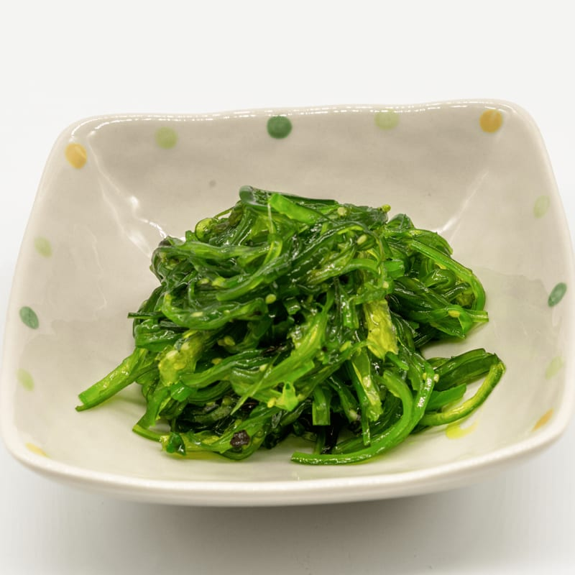
SALADS
JooN's Sushi
Seaweed Salad
$7.50
Japanese seaweed salad.

Slide 26
FROM THE SUSHI BAR
· · ·
2 Selections

Slide 27
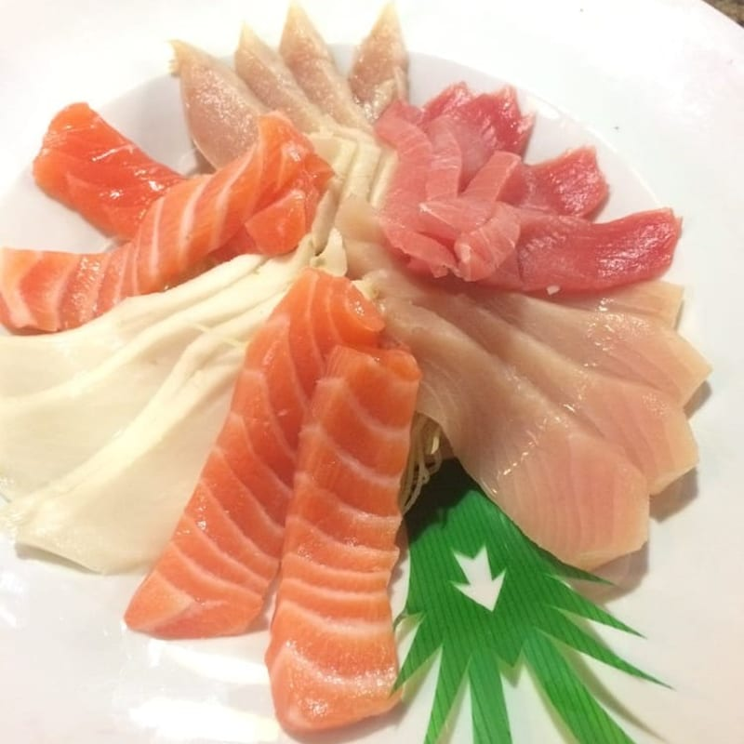
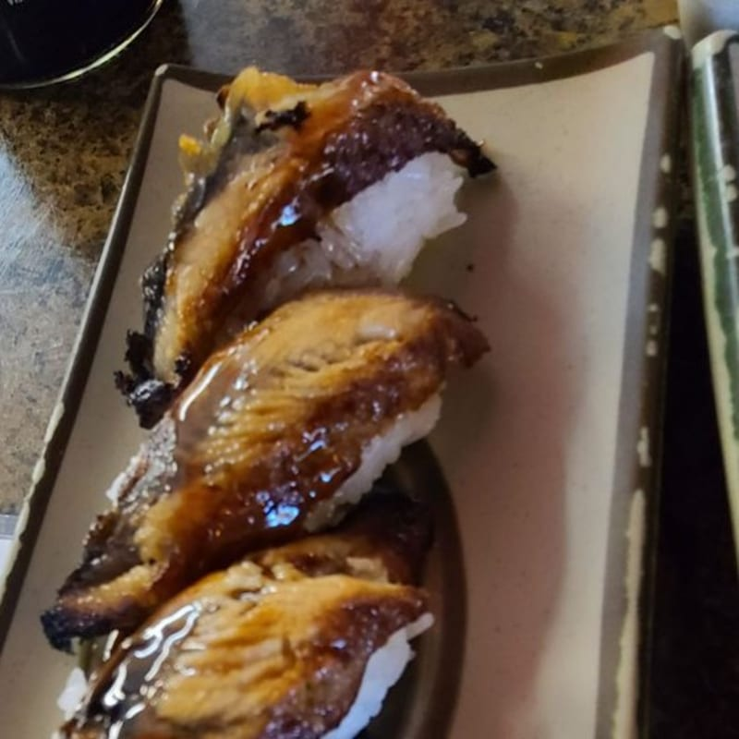
FROM THE SUSHI BAR
JooN's Sushi
Sashimi C
Unagi Special
$30.50
$20.50
Tuna, salmon, yellowtail, escolar, and albacore sashimi. Served with rice upon request....
Unagi and avocado served with rice. Served with miso soup and salad.

Slide 28
SPECIAL ROLLS
· · ·
6 Selections

Slide 29
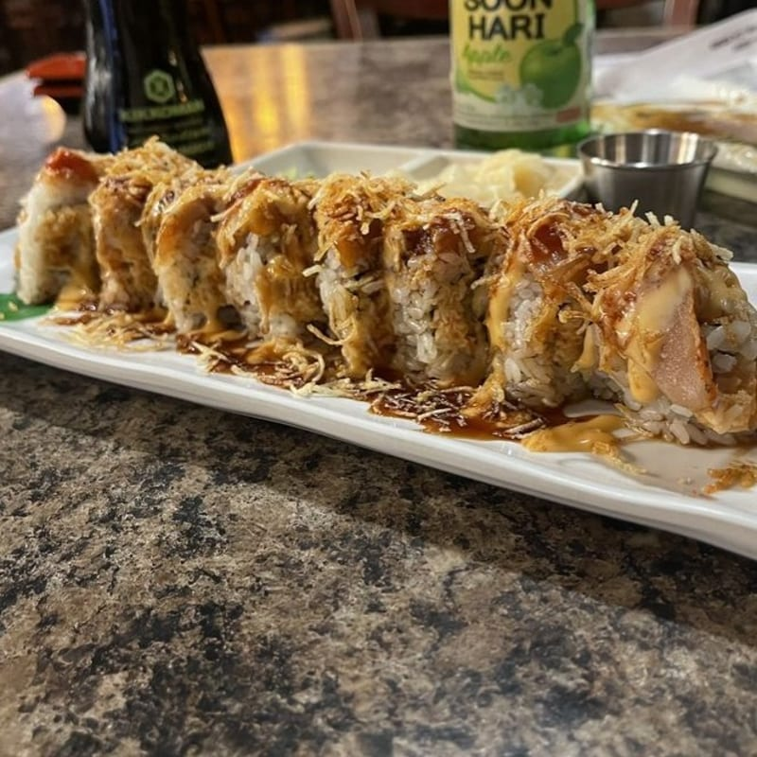
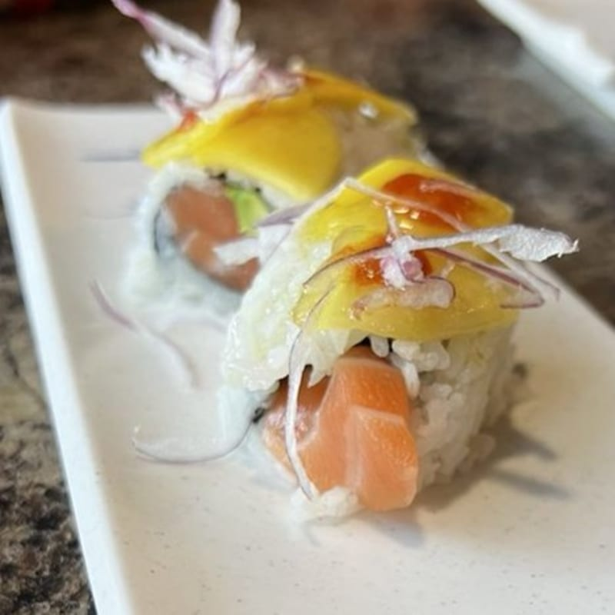
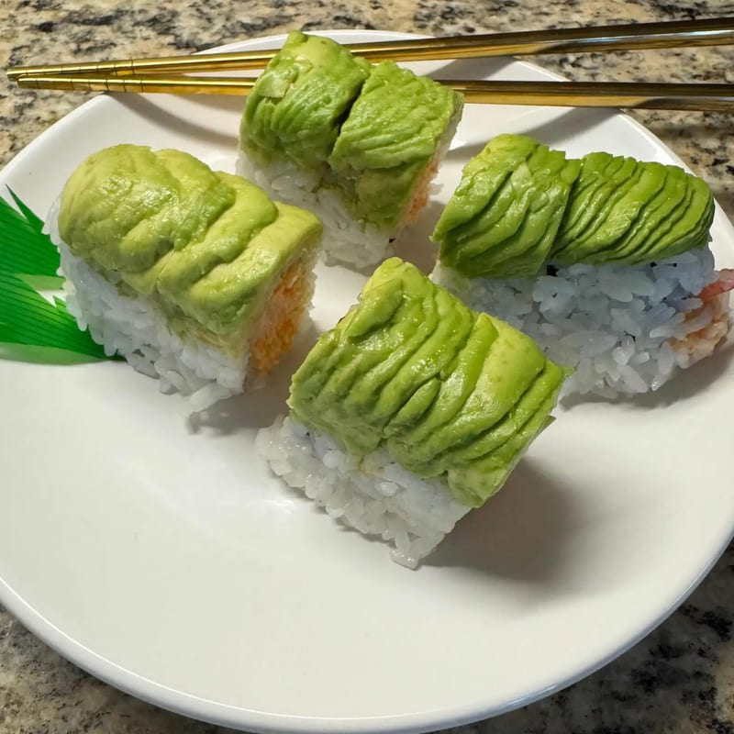
SPECIAL ROLLS
JooN's Sushi
JooN's Special Roll
Mango Tango Roll
Mexican Roll
$17.50
$16.50
$16.50
Spicy crab, shrimp tempura peppered albacore on top with garlic ponzu, spicy mayo, eel ...
Salmon, avocado mango, mango sauce, red onion, shichimi, and sriracha on top.
Spicy crab, avocado, cucumber shrimp and avocado on top with spicy mayo.

Slide 30
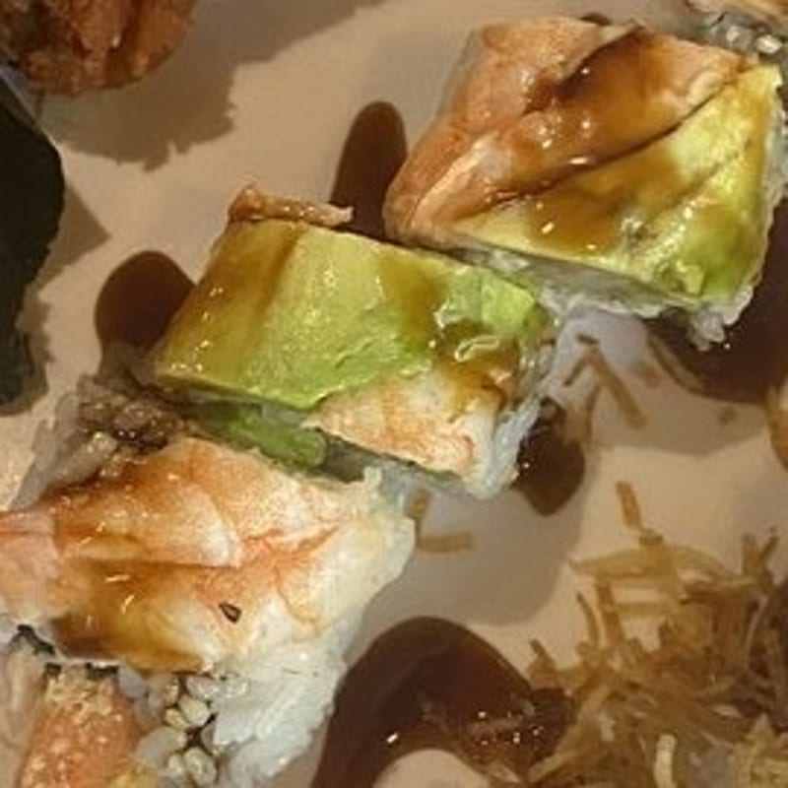
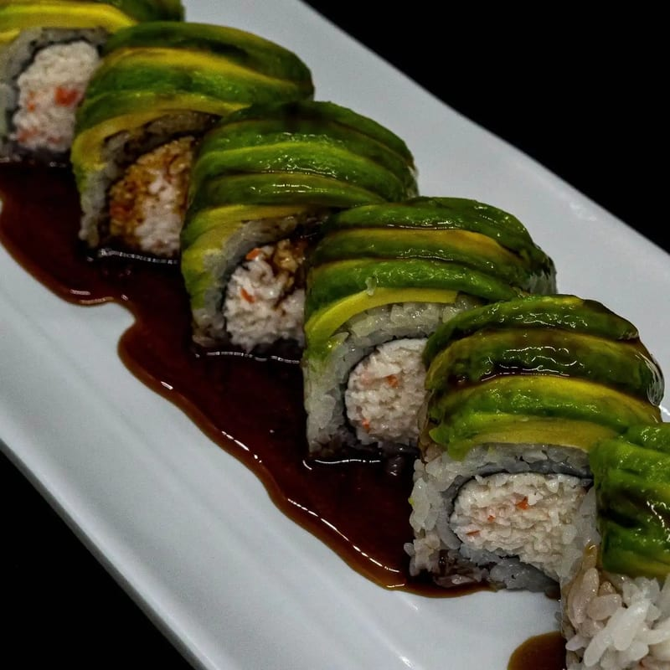
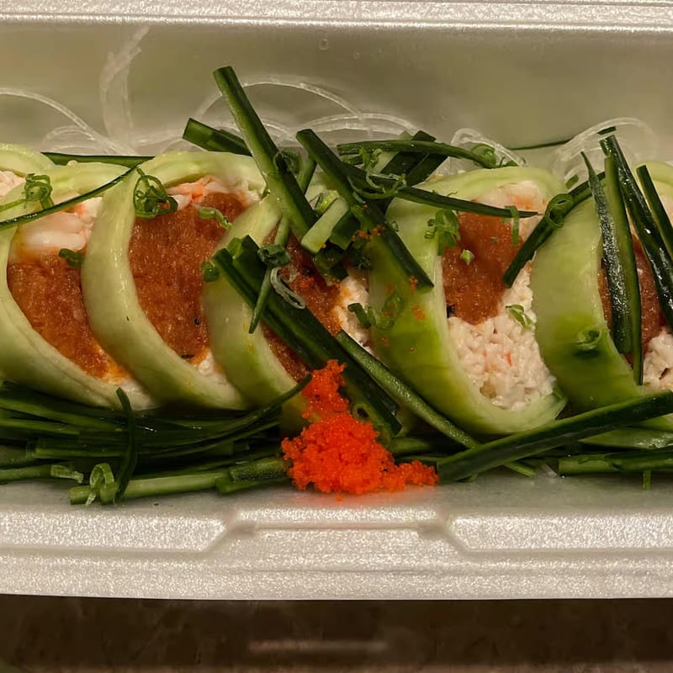
SPECIAL ROLLS
JooN's Sushi
Double Shrimp Roll
Caterpillar Roll
Spring Roll
$17.50
$16.50
$16.50
Crab, avocado, shrimp tempura shrimp and avocado on top.
Crab, eel avocado on top with eel sauce.
Crab, shrimp, spicy tuna wrapped in cucumber topped with green onion, masago, and ponzu...

Slide 31
SPICY ROLLS
· · ·
3 Selections

Slide 32
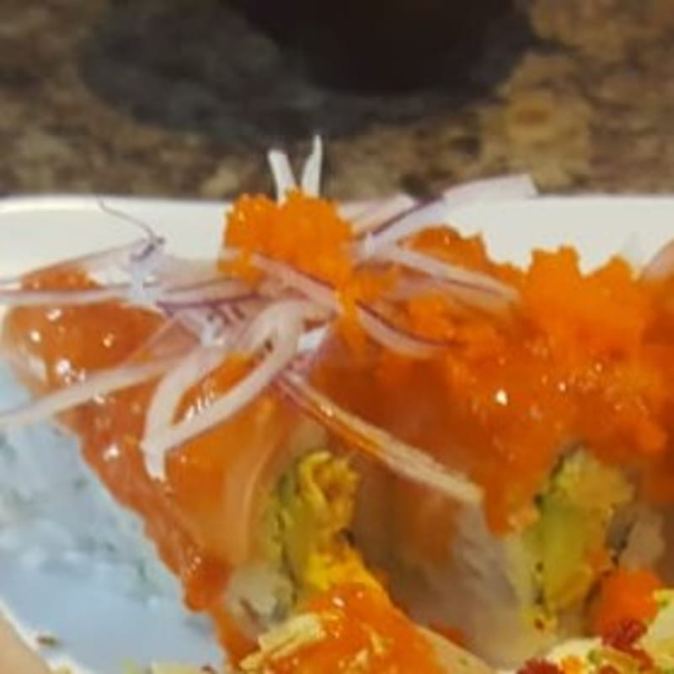
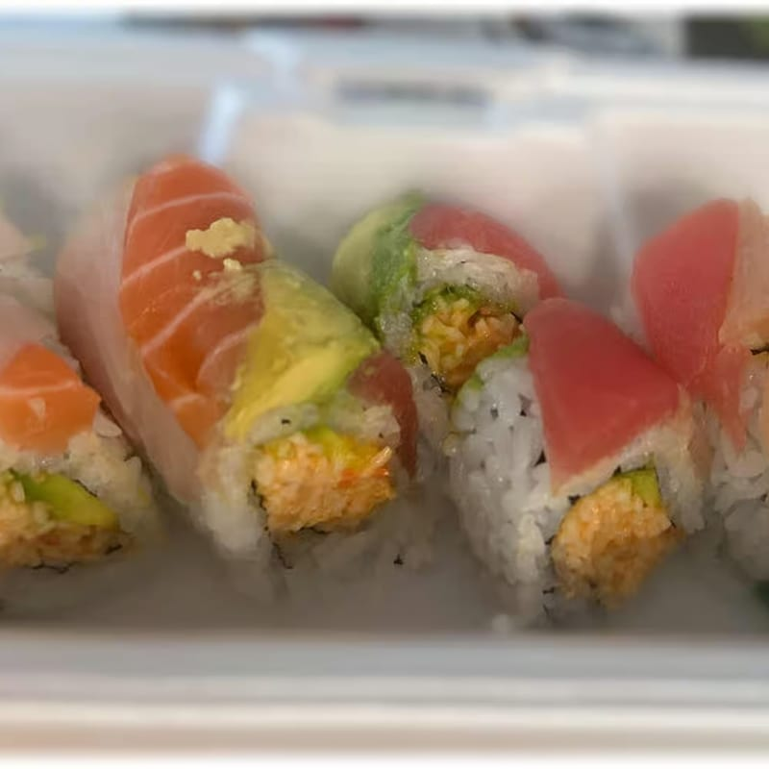
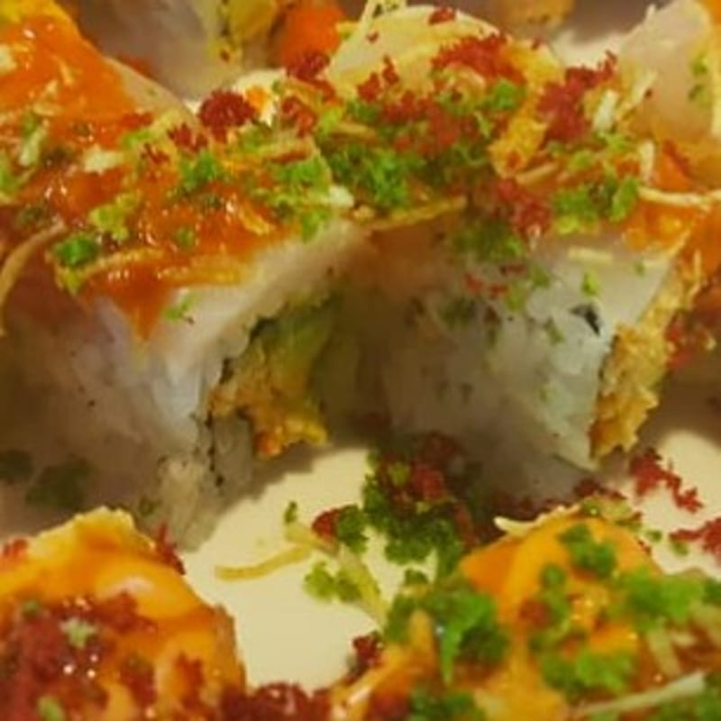
SPICY ROLLS
JooN's Sushi
Taste Like My Ex-Girl Fried Roll
Spicy Rainbow Roll
3 Alarm on Fire Roll
$15.50
$14.50
$14.50
Spicy crab, avocado salmon and red onion on top with house spicy sauce.
Spicy crab, avocado assorted fish on top.
Spicy crab, avocado white fish on top with house spicy sauce.

Slide 33
SUSHI
· · ·
2 Selections

Slide 34
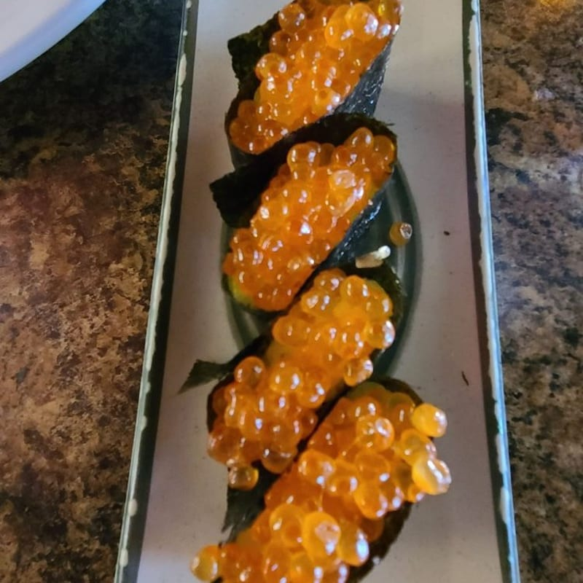

SUSHI
JooN's Sushi
Salmon Egg Sushi
Halibut Sushi
$8.50
$8.50
Glazed salmon roe atop vinegared rice, wrapped in crisp seaweed.
Thinly sliced halibut on sushi rice.

Slide 35
TEMPURA ROLLS
· · ·
2 Selections

Slide 36


TEMPURA ROLLS
JooN's Sushi
Golden Tiger Cut Roll
Oishi Cut Roll
$15.50
$13.50
Shrimp tempura, avocado, cream cheese fried spicy crab on top.
Eel, crab, avocado, cream cheese and deep fried.

