Slide 1
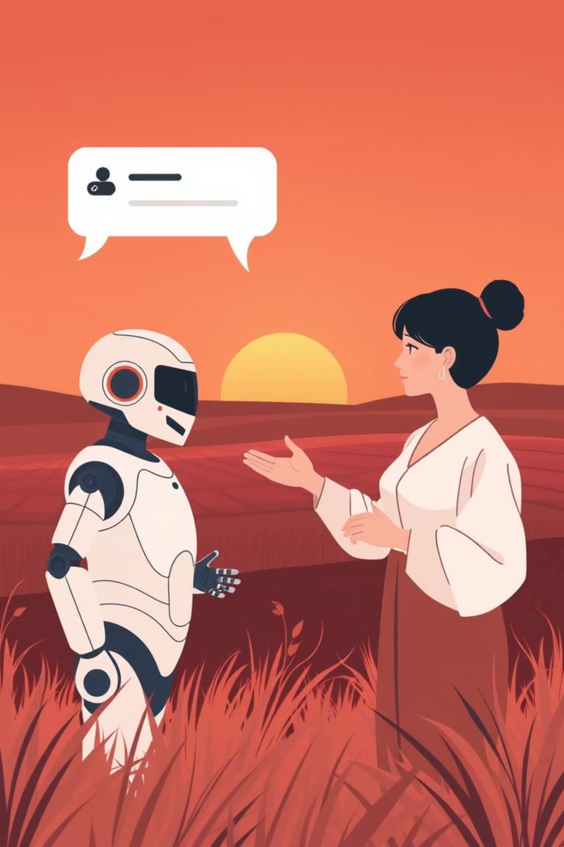

AI-Powered Chatbot for Rural Healthcare Accessibility
Transforming rural healthcare through innovative AI solutions, bridging the gap between patients and essential medical services.

Slide 2
The Challenge: Bridging the Rural Healthcare Gap
Rural communities often face significant barriers to timely and quality healthcare. Limited access to medical facilities and specialists can lead to delayed diagnoses and poorer health outcomes.
Limited Access
Delayed Interventions
Quality Concerns
Geographic isolation and fewer healthcare providers.
Symptoms worsen without timely medical attention.
Impact on the standard of medical care received.

Slide 3
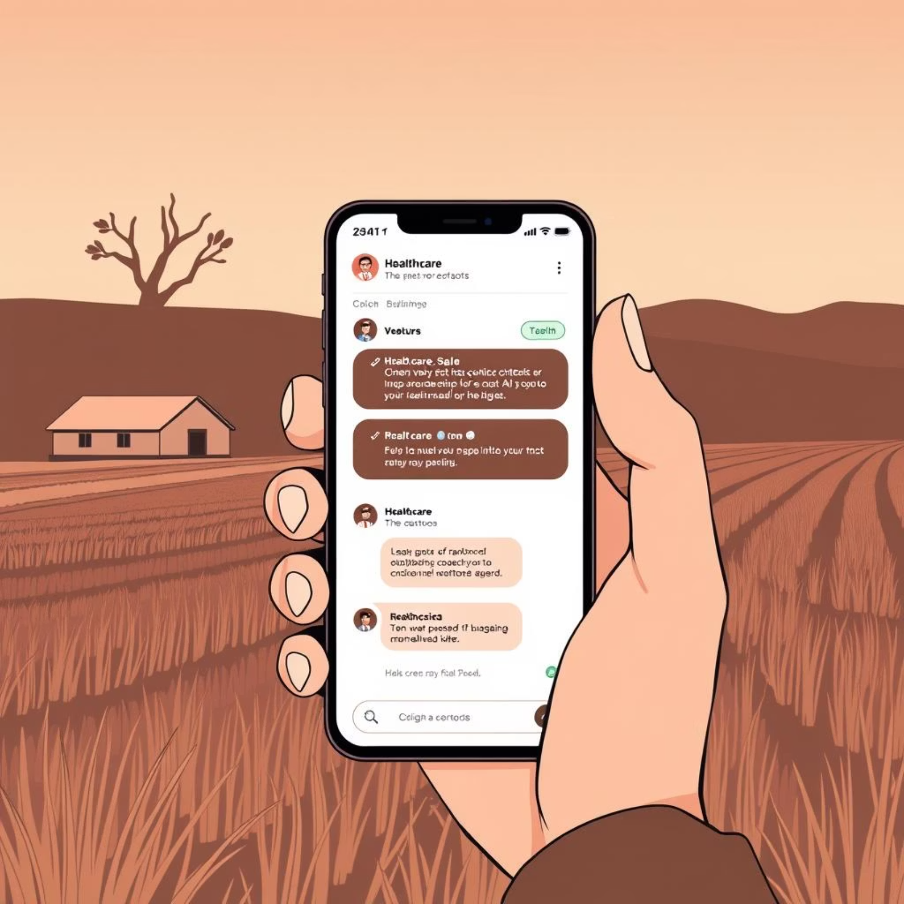
Our Solution: The AI Diagnostic Chatbot
An accessible, AI-driven chatbot platform designed to provide interactive symptom assessment and preliminary diagnostic reports for rural populations.
Voice or Text Interface
User-friendly interaction for diverse needs.
Symptom Assessment
Interactively assesses basic health symptoms.
Categorizes Issues
Identifies potential health concerns accurately.

Slide 4




Core Objectives of Our Platform
Our platform focuses on key functionalities to ensure effective and widespread adoption in rural areas.
Multilingual UI
Accurate AI Diagnosis
Simplified, interactive, and available in multiple languages for broad reach.
Provides reliable initial diagnoses and comprehensive preliminary reports.
Mobile Accessibility
Referral Mechanism
Accessible via basic mobile devices to maximize reach and utility.
Seamless integration for referrals to specialized urban medical care.

Slide 5
How the Chatbot Enhances Rural Healthcare
The AI chatbot serves as a critical first point of contact, providing immediate support and guiding users towards appropriate care.
Initial Symptom Evaluation
1
Users describe symptoms, and the AI chatbot asks targeted questions to gather necessary information.
Preliminary Report Generation
2
A detailed report summarizes potential issues, aiding in early identification and decision-making.
Qualified Referrals
3
Based on the assessment, the chatbot provides contact information for nearby urban specialists or clinics.

Slide 6
Next Steps and Impact
Our AI-powered chatbot is set to revolutionize rural healthcare by making essential services accessible to everyone, everywhere.
Key Takeaways:
Future Vision:
Improved accessibility to healthcare in underserved areas.
Pilot programs in key rural regions.
Partnerships with local healthcare providers.
Empowers individuals with preliminary health insights.
Continuous AI model refinement with real-world data.
Strengthens the connection between rural patients and urban specialists.
Join us in transforming rural healthcare for a healthier future!

