Slide 1
Opendaylight MD-SAL

Slide 2
MD-SAL Explained
MD-SAL: Architecture
CONTENTS
MD-SAL: RPC Service
MD-SAL: Data Store
MD-SAL: Clustering

Slide 3
MD-SAL Explained

Slide 4

MD-SAL Explained
Brief Explanation
Basic Modeling Concepts
Messaging Patterns

Slide 5
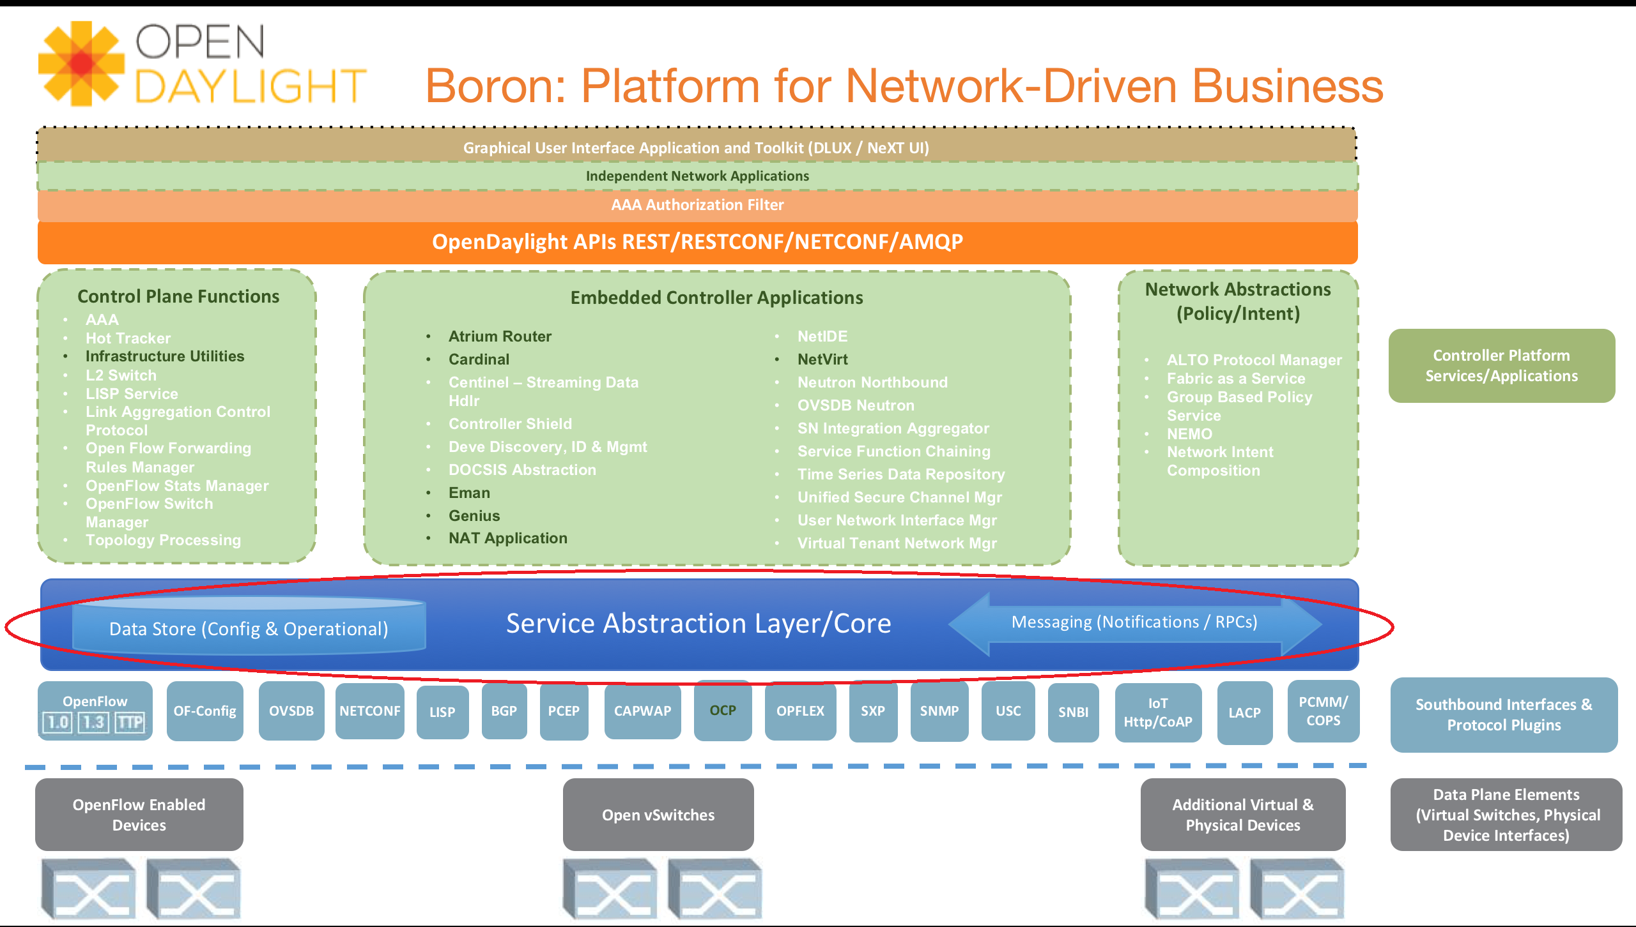
Brief Explanation

Slide 6
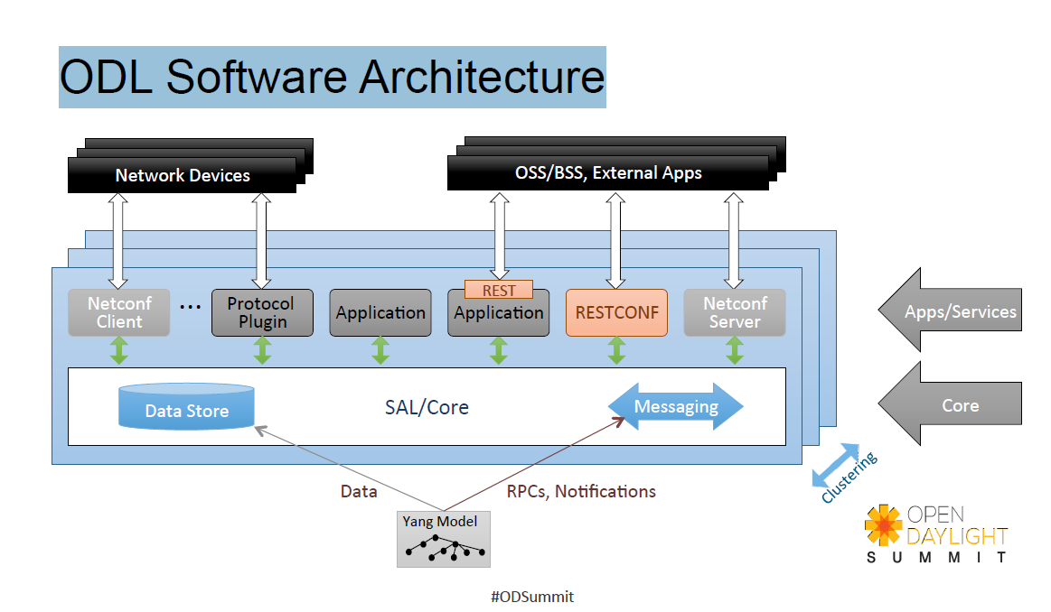
Brief Explanation

Slide 7
Brief Explanation
The Model-Driven SAL (MD-SAL) is an infrastructure component that provides messaging and data storage functionality for based on user-defined (application developers) data and interface models.
MD-SAL has two main objectives:
Provide a common-layer, concepts, data model building blocks and patterns which serves as building blocks applications
support of multiple transport and payload formats, serialization/adaptation them.
This objectives are achieved by using YANG as modeling language for interface and data definition and providing runtime for services using YANG modeling.

Slide 8
Basic Modeling Concepts
Basic concepts are building blocks, from which MD-SAL derives its services, behavior based on mapping of basic concepts to developer-supplied YANG models.
Data Tree - All state-related data are modeled and represented as data tree, with possibility to address any element / subtree
Operational Data Tree - Reported state of the system, published by the providers using MD-SAL. Represents a feedback loop for applications to observe state of the network / system.
Configuration Data Tree - Intended state of the system or network, populated by consumers, which expreses their intention.

Slide 9
Basic Modeling Concepts
Instance Identifier - Unique identifier of node / subtree in data tree, which provides unambiguous information, how to retrieve node / subtree from conceptual data trees.
Notification - Asynchronous transient event (from perspective of provider) which may be consumed by consumers and they may act upon it
RPC - asynchronous request-reply message pair, when request is triggered by consumer, send to the provider, which in future replies with reply message.

Slide 10
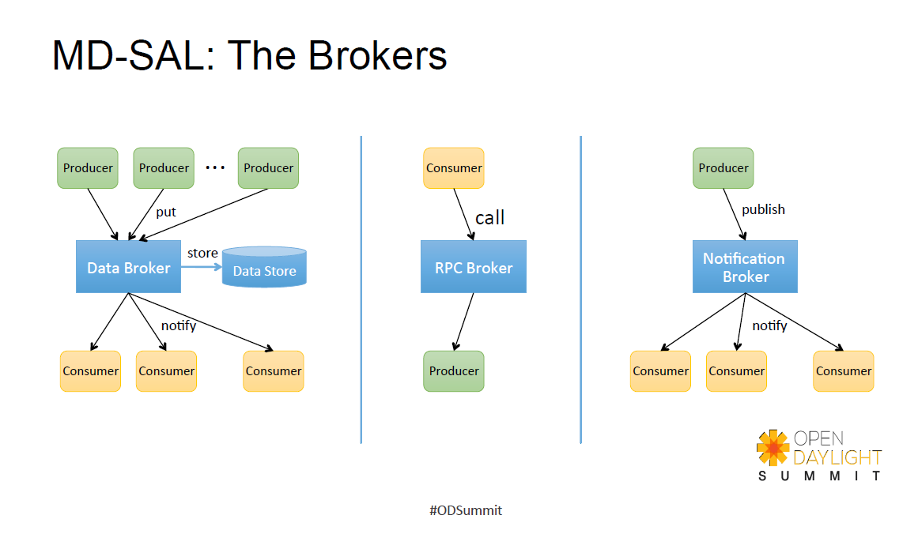
Messaging Patterns

Slide 11
Messaging Patterns
Unicast communication
RPC - unicast between consumer and provider, where consumer sends request message to provider, which asynchronously responds with replymessage
Publish / Subscribe
Notifications - multicast message which is send by provider and is delivered to subscribed consumers
Data Change Events - multicast asynchronous event, which is sent by data broker if there is change in conceptual data tree, and is delivered to subsribed consumers
Data access patterns
Transactional reads from conceptual data tree - read-only transactions
Transactional modification to conceptual data tree - write transactions
Transaction Chaining
Data Change Events

Slide 12
MD-SAL:
Architecture

Slide 13
MD-SAL: Architecture
Definitions and Acronyms
SAL Architecture
Subsystem Types

Slide 14
Definitions and Acronyms
Binding: Java interfaces, classes and contracts generated from a YANG schema describing functionality.
Binding-Aware: A component or functionality which uses a generated Binding for data and APIs.
BI, Binding-independent: A component or functionality which uses a neutral data DOM format for data and API calls, which is independent of generated Java language bindings.
Binding-independent type identifier: An identifier for a data structure or an RPC method in a QName-like format.
Consumer: A component (e.g. an application) which uses the model and/or APIs provided (implemented) by another Providers.

Slide 15
Definitions and Acronyms
Data operation: An operation on top of data subset describing the state of the system as a whole (configuration, running data).
DTO, Data Transfer Object: a simple object used to transfer data between Binding-Aware components. DTOs are part of binding.
Infrastructure Component: A component which is neither a Provider or a Consumer, but exposes or extends the SAL functionality.
Provider: A component which provides functionality to applications through either model-specific APIs or in a binding-independent format
SAL: Service Abstraction Layer.
NSF: Network Service Function (e.g. TopologyManager, ForwardingRulesManager).

Slide 16
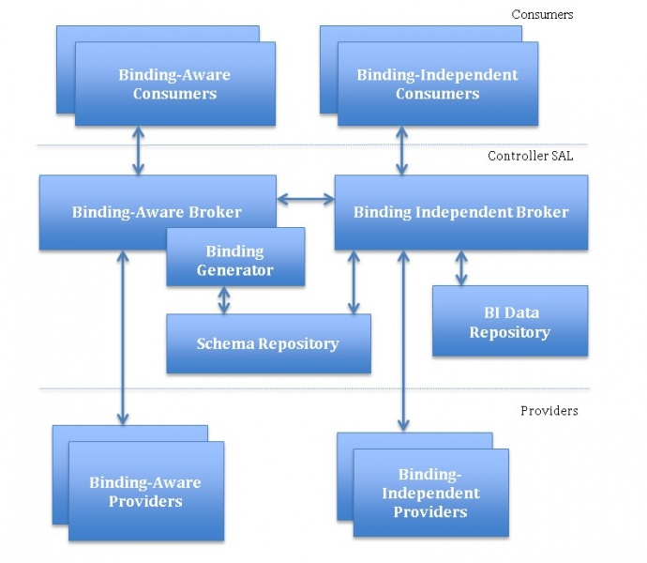
SAL Architecture

Slide 17
SAL Architecture
Provider – a component that exposes functionality to applications and other providers (plugins) through its northbound API. A provider can be a Consumer of other Providers. There are two types of Providers:
Binding Independent Providers: their functionality is exposed in the binding-independent Data DOM format
Binding Aware Providers: their functionality is exposed in a format compiled against one or more generated binding interfaces
Consumer – a component that consumes functionality provided by one or more Providers. There are two types of Consumers:
Binding Independent Consumers – the functionality is consumed in the binding-independent Data DOM format
Binding Aware Consumers – the functionality is consumed via one or more generated binding interfaces

Slide 18
SAL Architecture
Binding-Independent Broker - the core component of the model-driven SAL. It routes RPCs, notifications and data changes between various Providers and Consumers.
Binding-Aware Broker – provides programmatic APIs and Java language support to both Consumers (such as controller applications or plugins) and Providers. It is a façade / proxy built on top of the Binding Independent Broker that simplifies access to data and services provided by Binding-Independent Providers and Binding-Aware providers.
BI Data Repository – is a binding-independent infrastructure component of SAL that is responsible for storage of configuration and transient data
Binding Schema Repository – is infrastructure component, responsible for storing specifications of YANG–Java relationships and mapping between language-binding APIs to binding-independent API calls.
Binding Generator – a SAL infrastructure component, which generates implementations of binding interfaces and data mappers to the binding-independent format.

Slide 19
MD-SAL:
RPC Services

Slide 20
MD-SAL: Datastore
Global Service
Routed Service
Mounted Service

Slide 21
Global Service
There is only one instance of a Global Service per controller instance (Note that a controller instance can consist of a cluster of controller nodes.)
Routing
Binding-Aware MD-SAL (sal-binding)
Rpc Type - Identified by a generated RpcService class and a name of a method invoked on that interface
Binding-Independent MD-SAL (sal-dom)
Rpc Type - Identified by a QName

Slide 22
Routed Service
There can be multiple instances (implementations) of a service per controller instance
Can be used for southbound plugins or for horizontal scaling (load-balancing) of northbound plugins (services)
Routing
Routing is done based on the contents of a message, for example 'Node Reference'. The field in a message that is used for routing is specified in a YANG model by using the routing-reference statement from the yang-ext model.
Binding Aware MD-SAL (sal-binding)
Rpc Type - Identified by an RpcService subclass and the name of the method invoked on that interface
Instance Identifier - in a data tree, identifies the element instance that will be used as the route target. The used class is:
org.opendaylight.yang.binding.InstanceIdentifier
The Instance Identifier is learned from the message payload and from the model.

Slide 23
Routed Service
Binding Independent MD-SAL (sal-dom)
Rpc Type - Identified by a QName
Instance Identifier - in a data tree, identifies the element instance that will be used as the route target. The used class is: org.opendaylight.yang.data.api.InstanceIdentifier

Slide 24
Mounted Service
Mounted service is a special type of services, which could be nested at well-known points in the overall data tree. A Mounted service could be an implementations altenrative of a Routed Service or a Global service, but the caller would have to identify the target Mounted service instance.

Slide 25
MD-SAL:
Datastore

Slide 26
MD-SAL: Datastore
Concepts
Transaction
2PC & 3PC

Slide 27
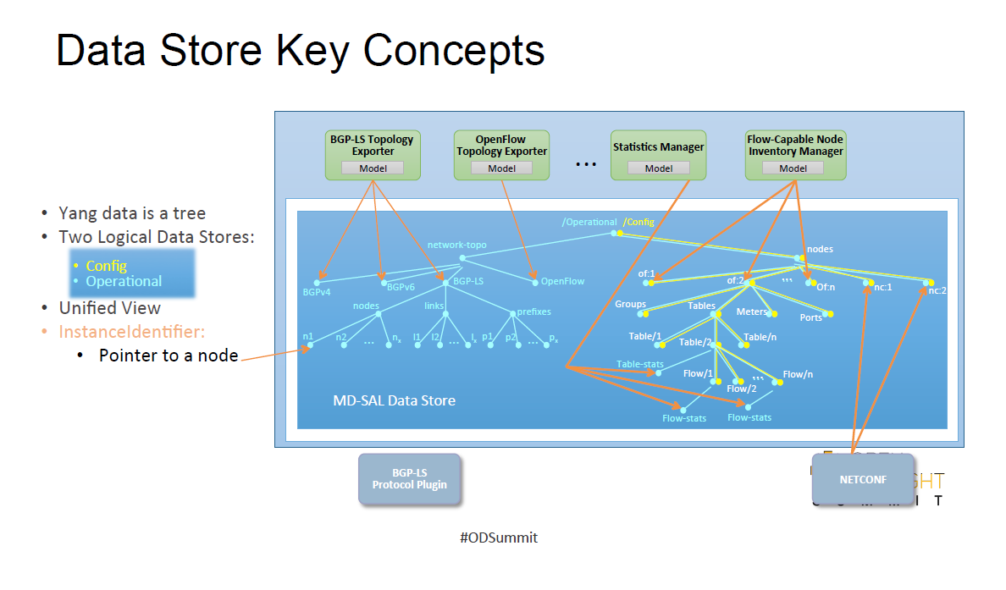
Concepts

Slide 28
Transaction
A transaction tracks the original state of the data tree and a set of proposed changes
(atomic operations) on the data tree that should be applied when the transaction succeeds.
A transaction is
A self-consistent snapshot of the overall data tree (reference to data tree snapshots from the creation time)
A set of atomic operations which should be applied to the data tree.
Consistent data store view during the transaction:
An application can read back all the modifications it made to the data store.
An application does not see any writes from transaction started after the current transaction (isolation).

Slide 29
Transaction Sub-Operations
Read - reads a subtree with all proposed changes (in scope of this transaction and the original snapshot) applied.
Data Changes - modifies a data tree:
Put (Write) - the actual operation (insert or replace) depends on the original state. Submits an Insert or Replace modification to the transaction backlog.
Remove - removes a subtree from the data tree. Submits a Remove change to the transaction backlog. A Remove operation also cleans the previously submitted writes associated with the removed subtree.
This in effect means that all subsequent reads on a transaction will result in a consistent view of data that was present at the time of the transaction start and all changes proposed by all consumers (in this transaction) applied.

Slide 30
Transaction Chain
MD-SAL APIs need to be extended to allow support for explicit transaction chaining that use
the core DOM Data Broker APIs and implicit chaining that uses various utility adapters.
Transaction chaining allows to create prerequisite chains between transactions
- one transaction is based on successful completion of one or more previous transactions.

Slide 31
2PC
The Data Store is a participant in the two-phase commit (as a commit handler).
The Request Commit Phase
Changes are applied starting from the deepest nodes in the data tree structure and
then propagated up the tree to the parent node.
Reference to the initial state is captured
Data store creates a new subtree by applying specified operations that affect that node
Data store captures the set of affected data change listeners with the initial state (reference to the old-subtree) and the new state (reference to the new subtree)
Data store propagates the new subtree to the parent node and applies atomic operations on the parent node until the root node of the data store is replaced.

Slide 32
2PC
The Finish Phase
Data store replaces the reference to the root element to newly created root element.
Data store finishes the transaction.
All captured affected listeners are notified with both the initial state and the new state.
The Rollback
Noop, since the reference to consistent (and public snapshot) is changed only in finish
phase. Data Store is only required to not reference newly created tree.

Slide 33
MD-SAL:
Clustering

Slide 34
MD-SAL: Clustering
Distributed Data Store
Shard
Persistence & Recovery
Replication
CAP

Slide 35
Distributed Data Store
Data Broker
Config DataStore
Operational DataStore

Slide 36
Distributed Data Store
Data Broker
Distributed Data Store
Inventory
Shard
InMemoryDataTree
ActorContext
Shard
Manager
Topology
Shard
InMemoryDataTree
Default
Shard
InMemoryDataTree

Slide 37
Distributed Data Store
ShardManager - ShardManager is an actor that creates the shard/shard replicas on system initialization based on configuration(modules.conf/module-shard.conf). It supports the ability to find a Shard and Monitor the Shard's health. It initiates the Shard "Primary" election scheme if any its created primary shards goes down. It also register to get cluster Node UP/DOWN events
ActorContext - The ActorContext class contains utility methods which could be used by to work with actors a little more easily. An ActorContext can be freely passed around to local object instances but should not be passed to actors especially remote actors

Slide 38
Shard
InMemoryDataTree
InMemoryDataTree
Shard
Shard
RaftActor
RaftActor
Akka System
Akka System
Member-1
Member-2

Slide 39
Shard
Shard - A Shard would be a processor which contains some of the data in the system. A Shard being an actor, communication with it would be by means of messages.
Persistence - Since the Shard is a Processor, in accordance with akka-persistence, it is a special actor which when passed a Persistent message will log it to a journal. This journal along with snapshots would be used as a method to recover the state of the DataStore
Module Based Shards
RaftActor - RaftActor encapsulates a state machine that needs to be kept synchronized in a cluster. It implements the RAFT algorithm, RaftActor has 3 states and each state has a certain behavior associated with it. A Raft actor can behave as
A Leader
A Follower
A Candidate

Slide 40
Shard
Akka System - We are going to rely heavily on Akka to provide us the building blocks for our clustering solution. The main components of Akka that we will use are:.
Akka Remoting - Akka Remoting is a communication module for connecting actor systems in a peer-to-peer fashion, and it is the foundation for Akka Clustering.
Akka Clustering - Akka Cluster provides a fault-tolerant decentralized peer-to-peer based cluster membership service with no single point of failure or single point of bottleneck. It does this using gossip protocols and an automatic failure detector
Akka Persistence - Akka persistence enables stateful actors to persist their internal state so that it can be recovered when an actor is started, restarted after a JVM crash or by a supervisor, or migrated in a cluster

Slide 41
Persistence
Everything that gets into a shard is stored in-memory and on the disk
Restarting the controller will reconstitute the state of the shards from the persisted data
Tx.put(path, data)
Tx.submmit()
Shard
Persist Actor
2. ApplyJournalEntries
1. ReplicatedLogEntry
Disk

Slide 42
Recovery
InmemoryDataTree
DataTreeCandidates.applyToModification()
Shard
RaftActorRecoverySupport
2. ApplyJournalEntries
1. ReplicatedLogEntry
3. RecoveryCompleted
Disk

Slide 43
Replication
AppendEntries1
ReplicatedLogEntry1
ReplicatedLogEntry1
ReplicatedLogEntry2
AppendEntries2
ReplicatedLogEntry2
ReplicatedLogEntryN
AppendEntriesN
ReplicatedLogEntryN
Leader
Follower

Slide 44
CAP
2. 1 AppendEntrieReply
Tx.put(path, data)
Tx.submmit()
Leader
1. 1 SendAppendEntrie
Follower-1
4.1 Submit SuccessFull
1. 2 SendAppendEntrie
3.1 Tx.Commit()
Follower-2
InmemoryDataTree
2. 2 AppendEntrieReply

Slide 45
THANKS

