Slide 1
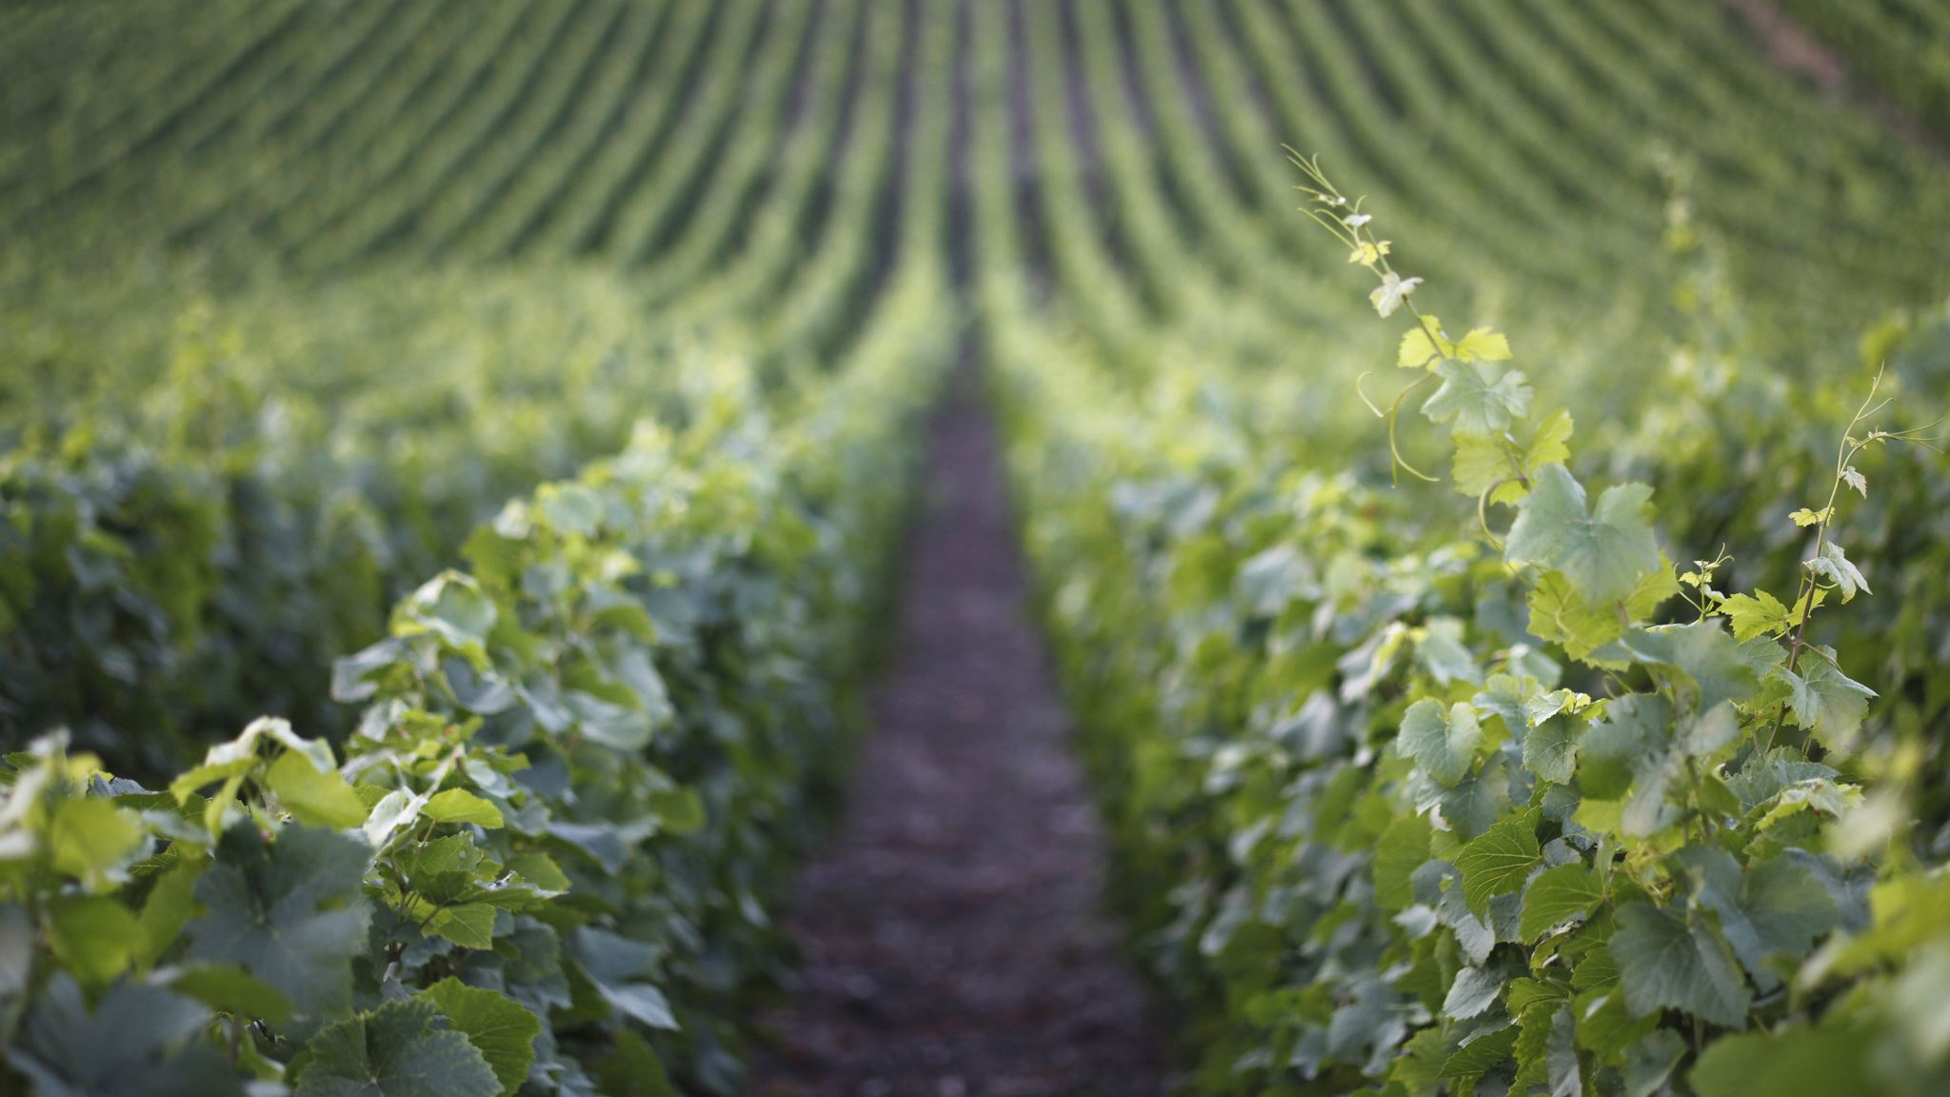
Bacchus Winery
Case Study by Jeremy Ginter, Daniel Preller and Melissa Favelli

Slide 2
Summary
Stan and Davis Bacchus recently inherited a winery from their father after his retirement. They have been eager to incorporate new business methods into the business, and they have decided to create a business database to do so. They have kept all prior personnel in place, which currently includes Janet Collins, in charge of finances; Roz Murphy, head of marketing; Bob Ulrich, Roz’s assistant; Henry Doyle, production manager; Maria Constanza, head of distribution; and twenty employees. Bacchus Winery grows grapes to produce several types of wines, and they order supplies from multiple suppliers. Their data needs include items such as how well each wine is selling and which distributors carry them, how many hours each employee has worked over the past four quarters, and the difference between the expected and actual delivery time for supply orders.

Slide 3
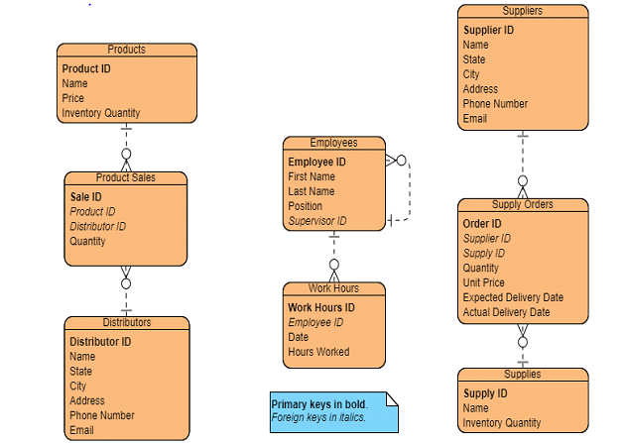

Slide 4
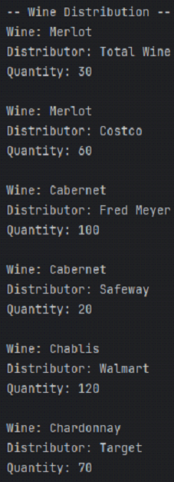
The Wine Distribution report displays information about how each wine is selling. The report displays the name of the wine, the distributor who placed the order, and the quantity of that wine the distributor purchased. This can be used to determine what wines are selling and in what amount, as well as if specific distributors are not buying as much as expected.

Slide 5
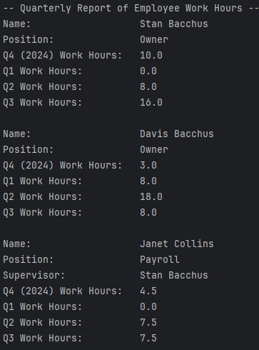
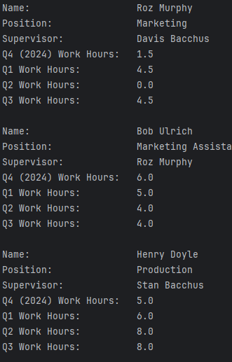
This report displays information about each employee at Bacchus Winery. It displays each employee’s full name, position, and supervisor, if applicable. It also shows how many hours each employee worked for each of the past four quarters. Its primary purpose is to show the work hours of each employee. The test data only includes work hours for quarter 3, but the report is tested to work with data from other quarters as well.

Slide 6
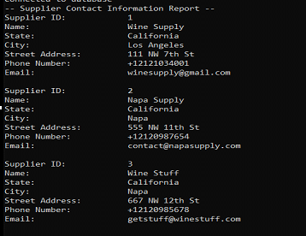
This report displays the information for the 3 suppliers used by Bacchus Winery. It displays the supplier's ID, their company name, and their full address besides zip code (street address, city, state) as well as their phone number and email address. The purpose is to show the contact information for each supplier in the instance that someone at Bacchus would need to contact the supplier or confirm information as it comes in.

Slide 7
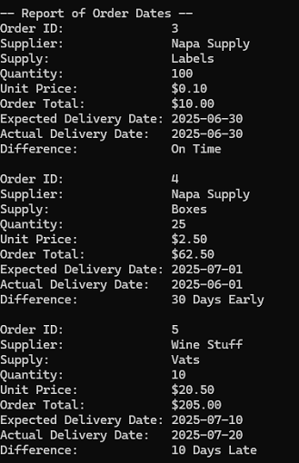
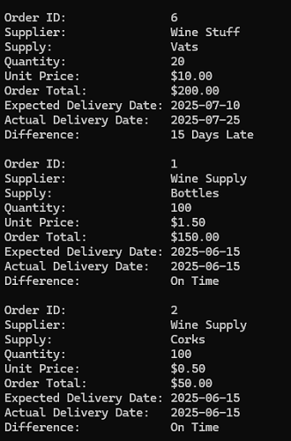
The second part of the report shows each order, grouped by supplier. It also shows how many days early or late each order arrived. The primary purpose is to show how each supplier is performing in terms of shipments so decisions about changing suppliers can be made.

Slide 8
Assumptions
During the design process, we assumed that each employee would have a position that could be stored. We also assumed that each distributor and supplier would have an address that could be stored in a three-field format of state, city, and street address. Additionally, we assumed that storing the current inventory quantity, as well as the quantity of items supplies bought and products sold, would be sufficient for the winery’s inventory tracking needs.

