Slide 1
Multithreading & Multiprocessing
communication

Slide 2

Content
Content
1
Background on Multithreading & Multiprocessing
2
Multithreading
3
Multiprocessing and Communication

Slide 3
1
Background
Background on Multithreading & Multiprocessing

Slide 4
Introduction
Multi-tasking is widely applied in modern operating systems. However, this is not based on using more CPU cores.
Processing and Threading
Besides, some programs like your web browsers also execute different tasks in parallel.

Slide 5
Introduction
What is a process?
An instance of a computer program that is being executed
program code
current activity
A computer program is a collection of instructions, while a process is the actual execution of those instructions.
Several processes may be associated with the same program

Slide 6
Introduction
How to share resources?
Multitasking--a method to allow multiple processes to share CPUs and other system resources
Each CPU executes a single task at a time.
switches could be performed between tasks.
This seeming execution of multiple processes simultaneously is called concurrency

Slide 7
Introduction
What is a thread?
The smallest sequence of programmed instructions
In most cases a thread is a component of a process
the threads of a process share its executable code and the values of its variables.

Slide 8
Introduction
Multiprocessing and multithreading in TS18
Process 1:Platform
Thread 1:Main loop
Thread 2:Communication server
Process 2:AI0
Thread 1:AIMain
Thread 2:Socket send
Thread 3:Socket receive
Process 3:AI0
Thread 1:AIMain
Thread 2:Socket send
Thread 3:Socket receive
Process 4:Unity replay
Thread 1:Main execution
Thread 2:Thread by unity
……

Slide 9
2
Multithreading
Programs with multithreading.

Slide 10
Multithreading
import threading def hello(): print('Hello, world!') t = threading.Thread(target=hello) # create a thread t.start() # start up the thread # Then to do something else
Import threading
Create a thread object
Start
threading.Thread(group=None, target=None, name=None, args=(), kwargs={}, *, daemon=None)

Slide 11
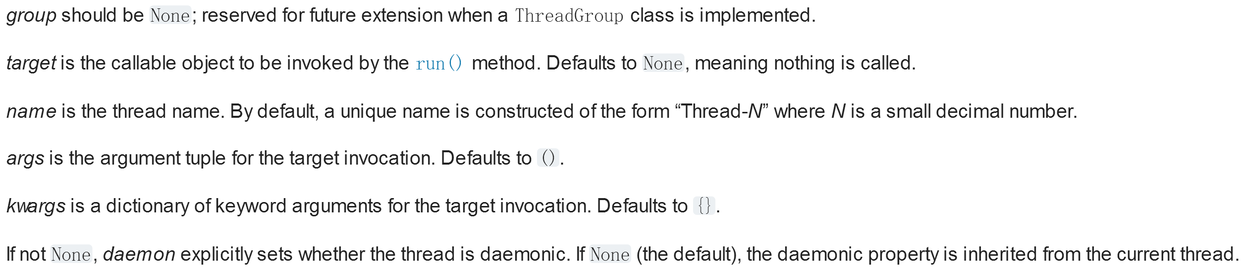
Multithreading
threading.Thread(group=None, target=None, name=None, args=(), kwargs={}, *, daemon=None)

Slide 12
Multithreading
threading.Thread(group=None, target=None, name=None, args=(), kwargs={}, *, daemon=None)

Slide 13
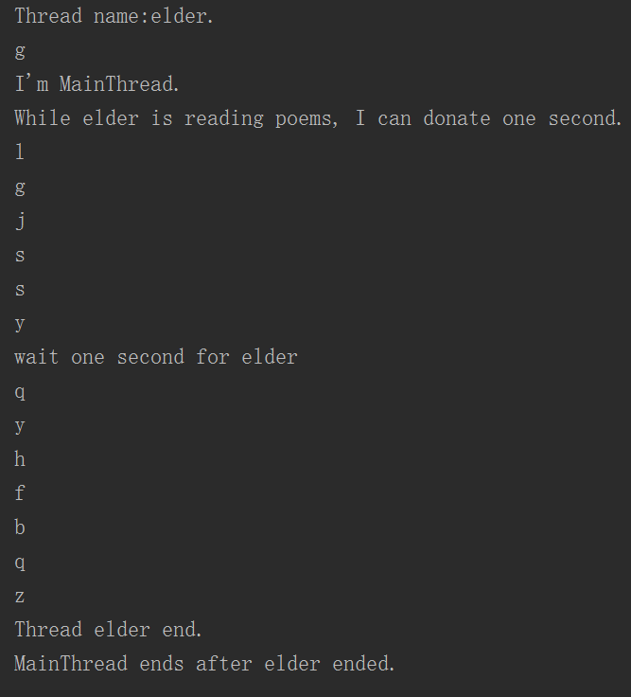
Multithreading
import threading import time def show_thread(): # get current thread object poem="glgjssyqyhfbqz" print('Thread name:%s.' % threading.current_thread().name) for i in poem: print(i) time.sleep(1) print('Thread %s end.' % threading.current_thread().name) t = threading.Thread(target=show_thread, name='elder') t.start() print('I\'m %s.' % threading.current_thread().name) print('While %s is reading poems, I can donate one second.' % t.name) print('wait one second for %s ' % t.name) t.join() print('%s ends after %s ended.' % (threading.current_thread().name, t.name))

Slide 14
Multithreading
t = threading.Thread(target=something)
t.start() # start thread t
t.join() # block the current running thread till thread t ends
t.join(timeout=1)
t.is_alive()

Slide 15
Multithreading
import threading count = 0 def foo(): global count for i in range(100000): count += 1 threads = [] for i in range(5): threads.append(threading.Thread(target=foo)) threads[-1].start() for t in threads: t.join() print(count)
Output value is uncertain.
Conflict of memory may occur.

Slide 16
Mutex
import threading count = 0 mutex = threading.Lock() def foo(): global count for i in range(100000): mutex.acquire() try: count = count + 1 finally: mutex.release() threads = [] for i in range(5): threads.append(threading.Thread(target=foo)) threads[-1].start() for t in threads: t.join() print(count)
Output :500000
Mutex:
acquire
…
release(DON’T forget)

Slide 17
Mutex
def foo(): global count for i in range(100000): with mutex: count = count + 1
Simplified version using “with” block

Slide 18
Queue
import queue import threading count=0 q = queue.Queue() def foo(): global count q.put(count) count+=1 for i in range(10): t = threading.Thread(target=foo) t.start() for i in range(10): s = q.get() print(s)
Queue in Python is thread-safe.
If block=False, when the queue is empty, it will throw an exception, or the current thread will be blocked until the queue get() items successfully.

Slide 19
GIL
“In CPython, the global interpreter lock, or GIL, is a mutex that prevents multiple native threads from executing Python bytecodes at once. This lock is necessary mainly because CPython’s memory management is not thread-safe. (However, since the GIL exists, other features have grown to depend on the guarantees that it enforces.”
Only one thread runs in any time
“One core CPU”
Parallel Python

Slide 20
Thread in C++
#include<thread>
void foo(string str) {
cout << str << endl;
}
int main() {
std::thread t(foo, "Hello, world!");
t.join();
}
Very easy to use in C++11
#include<mutex>
std::mutex mtx;
mtx.lock();
// Do something
mtx.unlock();

Slide 21
3
Multiprocessing and Communication
Socket etc.

Slide 22
Multiprocessing
import multiprocessing def hello(): print('Hello, world!') if __name__ == '__main__': p = multiprocessing.Process(target=hello,name='hehe') p.start() p.join()
The multiprocessing queue in Python has
same interfaces with the multithreading queue
It’s much expensive to start a new process.
A good choice is multiprocessing.Pool

Slide 23
Multiprocessing
#include <stdio.h>
#include <unistd.h>
int main() {
printf("Hello!\n");
pid_t pid = fork();
printf("%d\n", pid);
if (pid == 0) {
printf("I'm child process.\n");
} else {
printf("I'm main process, child pid = %d.\n", pid);
}
}
C++STL doesn’t support multiprocessing.
You can use fork in *nix systems or
CreateProcess in windows.h

Slide 24
Comparison
Multithreading
Multiprocessing
Share memory
Threading-safe problem
Cheaper to create or run
Coupling
GIL limited
Separate memory
Safer
More expensive
Decoupling
Non-GIL limited

Slide 25
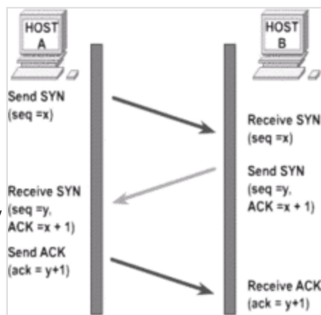
Socket
TCP/IP --recommended to learn after class
Socket
IP address
Protocol
Port

Slide 26
Socket
TCP/IP --recommended to learn after class
Socket
IP address
Protocol
Port

Slide 27
Socket
if __name__ == '__main__': # set protocol ipv4 s = socket.socket(socket.AF_INET, socket.SOCK_STREAM) # bind 127.0.0.1(loopback address),port 6666 s.bind(('127.0.0.1', 6666)) # listen backlog = 1 # max connections s.listen(backlog) print('Waiting for connection.') # accept a new connection sock, addr = s.accept() # create a thread to handle connections. t = threading.Thread(target=socket_link, args=(sock, addr)) t.start() print('nmbyztxyngdxw')
Server
def socket_link(sock, addr): print('Accept connection from %s:%s' % addr) try: sock.send(b'houa!') # send data by ascii code. while True: msg = sock.recv(4096) # receibe message of 4096 bytes. if(len(msg) > 0): print('Message from %s:%s : %s' % (*addr, msg.decode('ascii'))) else: # disconnect if not received. break finally: sock.close() # close socket to release port occupation.

Slide 28
Socket
import socket import time addr = ('127.0.0.1', 6666) # same as server s = socket.socket() s.connect(addr) # raise exception for a bad connection try: msg_get = s.recv(4096) print(msg_get.decode('ascii')) for i in range(5): msg = b'glgjssyqyhfbqz' s.send(msg) print('Message to %s:%s : %s' % (*addr, msg.decode('ascii'))) time.sleep(1) finally: s.close()
Client

Slide 29
Socket
Server
Client
Socket in std C++ is much more complex. You can use winsock in windows or Linux Socket in Linux.

Slide 30
JSON
JSON(JavaScript Object Notation)
"firstName": "John",
"lastName": "Smith",
"sex": "male",
"age": 25,
"address":
{
"streetAddress": "21 2nd Street",
"city": "New York",
"state": "NY",
"postalCode": "10021"
},
"phoneNumber":
[
{
"type": "home",
"number": "212 555-1234"
},
{
"type": "fax",
"number": "646 555-4567"
}
]
from json import *
json.encode()
json.decode()
json.dumps()
json.loads()

Slide 31
电子系科协软件部 武楚涵
Thanks!

