Slide 1

Graphic notes on “Linear Algebra for Everyone” authored by Prof. Gilbert Strang
$$=$$
Visualization to practically understand Linear Algebra
Kenji Hiranabe
Version 1.13(Sep.12, 2023)

Slide 2
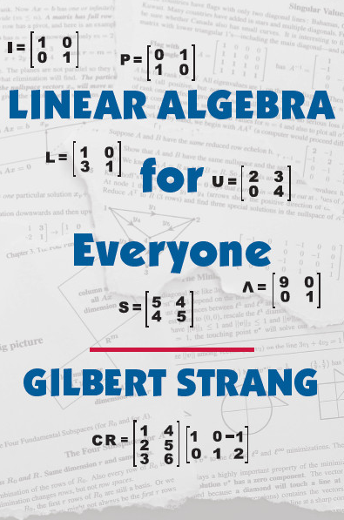
What is this?
Prof. Gilbert Strang‘s “Linear Algebra for Everyone” is a great book for an introduction to Linear Algebra!
Not theorem-proof chains but “matrix languages” and examples to get intuitive understanding for practical applications.
Linked to the best Linear Algebra course video MIT 18.06 and 18.065 youtube MIT OpenCourseWare playlist with over 2 milion subscribers(I am one of them!)
Hightlights…
Four ways to AB=C
The fundamental four subspaces.
The five factorization of matrix.
SVD as the climax, not Jordan block decoposition.
Introduction to Data Science
I tried to capture and convey the concepts in (1) and (2) graphically and wanted to share design ideas for educational use.
1
2

Slide 3
Why you read this note?
There are several ways to view, express and calculate matrix/vector multiplications.
This notes are my try to graphically illustrate those matrix operations in visual designs as an educational material.
So to ...
Understand matrix/vector operations intuitively, and
Connect the intuitions to concepts including the “five factorizations of matrix”.

Slide 4
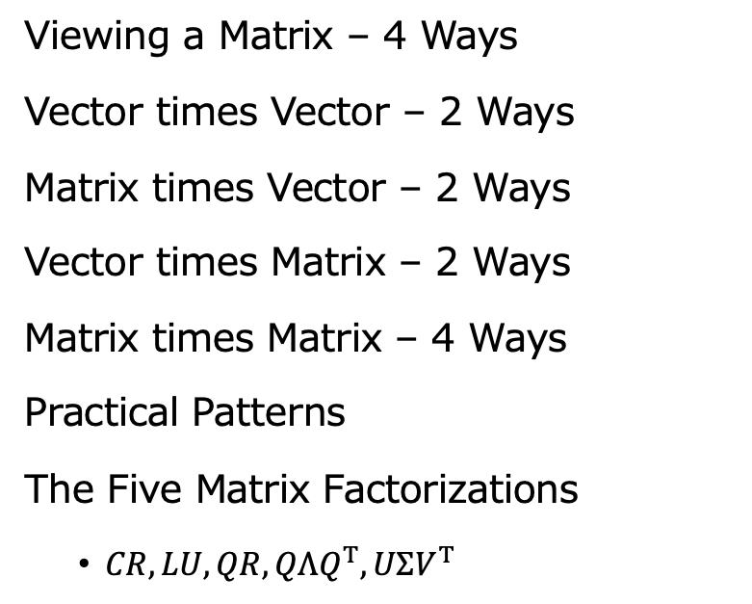
Table of Contents
Viewing a Matrix – 4 Ways
Vector times Vector – 2 Ways
Matrix times Vector – 2 Ways
Vector times Matrix – 2 Ways
Matrix times Matrix – 4 Ways
Practical Patterns
The Five Matrix Factorizations
$CR, LU, QR, QΛQ^{T}, UΣV^{T}$
v
Mv
vM
MM
P

Slide 5
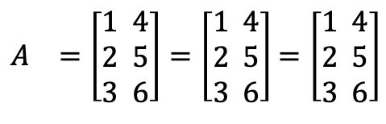



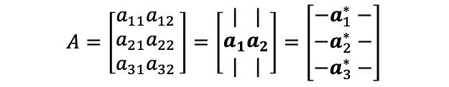
Viewing a Matrix – 4 Ways
$$=$$
$$=$$
$$=$$
$A =\left[\begin{aligned}1 4 \\ 2 5 \\ 3 6\end{aligned}\right]=\left[\begin{aligned}1 4 \\ 2 5 \\ 3 6\end{aligned}\right]$ $=\left[\begin{aligned}1 4 \\ 2 5 \\ 3 6\end{aligned}\right]$
1 matrix
6 numbers
2 column vectors
with 3 numbers
3 row vectors
with 2 numbers
$$A=\left[\begin{aligned}a_{11}a_{12 } \\ a_{21}a_{22 } \\ a_{31}a_{32 }\end{aligned}\right]=\left[\begin{matrix}| \\ a_{1} \\ |\end{matrix}\begin{matrix}| \\ a_{2} \\ |\end{matrix}\right]=\left[\begin{aligned}{−a}_{1}^{∗}− \\ {−a}_{2}^{∗}− \\ −a_{3}^{∗}−\end{aligned}\right]$$
Here, column vectors are in bold as $a_{1}$, row vectors are with * as $a_{1}^{∗}.$
And transposed vectors/matrices are with T on the shoulders as $a^{T}, A^{T}$

Slide 6


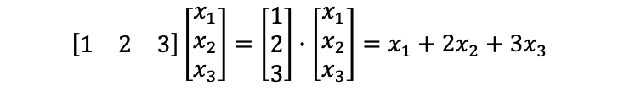

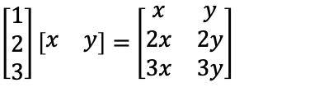



v
Vector times Vector – 2 Ways
v1
$$=$$
$$=$$
Dot product (number)
v2
$$=$$
$$=$$
Rank 1 Matrix
Dot product ($a∙b$) is expressed as $a^{T}b$in matrix language and yields a number.
$ab^{T}$ is a matrix $(ab^{T}=A)$. If neither $a, b$ are $0,$
the result $A$is a rank 1 matrix.
$$\left[\begin{aligned}\begin{matrix}1 & 2 & 3\end{matrix}\end{aligned}\right]\left[\begin{aligned}x_{1} \\ x_{2} \\ x_{3}\end{aligned}\right]=\left[\begin{matrix}1 \\ 2 \\ 3\end{matrix}\right]∙\left[\begin{aligned}x_{1} \\ x_{2} \\ x_{3}\end{aligned}\right]=x_{1}+2x_{2}+3x_{3}$$
$\left[\begin{matrix}1 \\ 2 \\ 3\end{matrix}\right]\left[\begin{matrix}x & y\end{matrix}\right]=$ $\left[\begin{matrix}x & y \\ 2x & 2y \\ 3x & 3y\end{matrix}\right]$

Slide 7
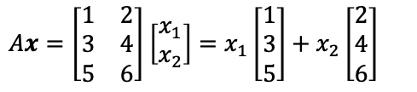
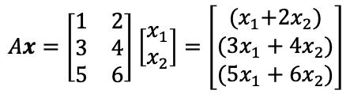




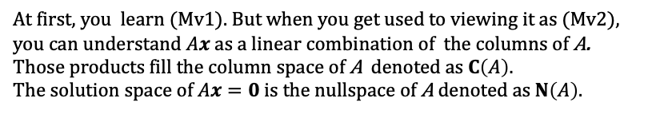
Mv
Matrix times Vector – 2 Ways
Mv1
$$=$$
Mv2
$$=$$
$$+$$
The row vectors of A are multiplied by a vector $x$
and become the three dot-product elements of $Ax$.
The product $Ax$is a linear combination of the column vectors of A.
$Ax=\left[\begin{matrix}1 & 2 \\ 3 & 4 \\ 5 & 6\end{matrix}\right]$ $\left[\begin{aligned}x_{1} \\ x_{2}\end{aligned}\right]=\left[\begin{matrix}{(x}_{1}+2x_{2}) \\ (3x_{1}+4x_{2}) \\ (5x_{1}+6x_{2})\end{matrix}\right]$
$Ax=\left[\begin{matrix}1 & 2 \\ 3 & 4 \\ 5 & 6\end{matrix}\right]$ $\left[\begin{aligned}x_{1} \\ x_{2}\end{aligned}\right]=x_{1}\left[\begin{matrix}1 \\ 3 \\ 5\end{matrix}\right]+x_{2}\left[\begin{aligned}2 \\ 4 \\ 6\end{aligned}\right]$
At first, you learn (Mv1). But when you get used to viewing it as (Mv2), you can understand $Ax$as a linear combination of the columns of A. Those products fill the column space of A denoted as $C\left(A\right)$.
The solution space of $Ax=0$ is the nullspace of A denoted as $N\left(A\right).$

Slide 8
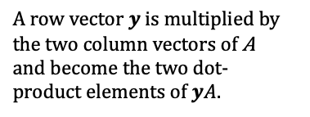

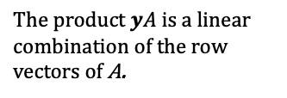
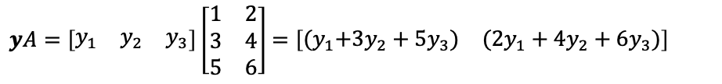
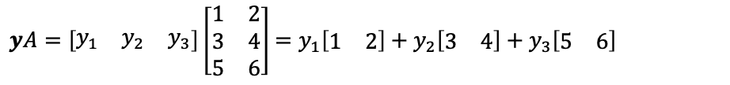



vM
Vector times Matrix – 2 Ways
vM1
$$=$$
$yA=\left[\begin{matrix}y_{1} & y_{2} & y_{3}\end{matrix}\right]\left[\begin{matrix}1 & 2 \\ 3 & 4 \\ 5 & 6\end{matrix}\right]$ $=\left[\begin{matrix}{(y}_{1}+3y_{2}+5y_{3}) & ({2y}_{1}+4y_{2}+6y_{3})\end{matrix}\right]$
A row vector $y$ is multiplied by the two column vectors of A
and become the two dot-product elements of $yA$.
vM2
$$=$$
$$+$$
$$+$$
$yA=\left[\begin{matrix}y_{1} & y_{2} & y_{3}\end{matrix}\right]\left[\begin{matrix}1 & 2 \\ 3 & 4 \\ 5 & 6\end{matrix}\right]$ $=y_{1}\left[\begin{matrix}1 & 2\end{matrix}\right]+y_{2}\left[\begin{matrix}3 & 4\end{matrix}\right]$ $+$ $y_{3}\left[\begin{matrix}5 & 6\end{matrix}\right]$
The product $yA$is a linear combination of the row vectors of A.

Slide 9














The Four Subspaces
$$A∈ℝ^{m×n}$$
$$ℝ^{n}$$
$$ℝ^{m}$$
$$C\left(A^{T}\right)$$
$$C(A)$$
dim
$$=r$$
dim
$$=r$$
row space
all $yA$
column space
all $Ax$
$$ℝ^{n}$$
$$ℝ^{m}$$
nullspace
$$Ax=0$$
left nullspace
$$yA=0$$
$$N(A)$$
$$N(A^{T})$$
dim
$$=n−r$$
dim
$$=m−r$$

Slide 10
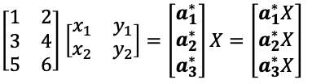


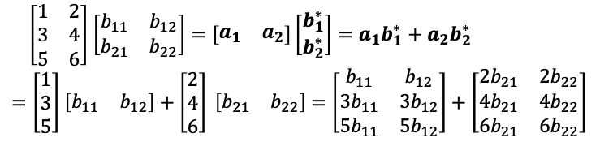
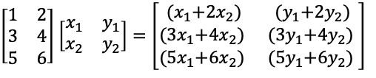


MM
Matrix times Matrix – 4 Ways
MM
1
$$=$$
MM
2
$$=$$
$$=$$
Every element becomes a dot product of row vector
and column vector.
$Ax$and $Ay$ are linear combinations of columns of A.
$\left[\begin{matrix}1 & 2 \\ 3 & 4 \\ 5 & 6\end{matrix}\right]$ $\left[\begin{matrix}x_{1} & y_{1} \\ x_{2} & y_{2}\end{matrix}\right]=\left[\begin{matrix}{(x}_{1}+2x_{2}) & {(y}_{1}+2y_{2}) \\ {(3x}_{1}+4x_{2}) & {(3y}_{1}+4y_{2}) \\ {(5x}_{1}+6x_{2}) & {(5y}_{1}+6y_{2}) \end{matrix}\right]$
$\left[\begin{matrix}1 & 2 \\ 3 & 4 \\ 5 & 6\end{matrix}\right]$ $\left[\begin{matrix}x_{1} & y_{1} \\ x_{2} & y_{2}\end{matrix}\right]=A\left[\begin{matrix}x & y\end{matrix}\right]=\left[A\begin{matrix}x & Ay\end{matrix}\right]$
MM
3
MM
4
$$=$$
$$+$$
$$=$$
$$=$$
Multiplication $AB$is broken down to a sum of rank 1 matrices.
$\left[\begin{matrix}1 & 2 \\ 3 & 4 \\ 5 & 6\end{matrix}\right]$ $\left[\begin{matrix}b_{11} & b_{12} \\ b_{21} & b_{22}\end{matrix}\right]=\left[\begin{matrix}a_{1} & a_{2}\end{matrix}\right]\left[\begin{aligned}b_{1}^{∗} \\ b_{2}^{∗}\end{aligned}\right]=a_{1}b_{1}^{∗}+a_{2}b_{2}^{∗}$
$=\left[\begin{matrix}1 \\ 3 \\ 5\end{matrix}\right]$ $\left[\begin{matrix}b_{11} & b_{12}\end{matrix}\right]+\left[\begin{matrix}2 \\ 4 \\ 6\end{matrix}\right] \left[\begin{matrix}b_{21} & b_{22}\end{matrix}\right]$ $=\left[\begin{matrix}b_{11} & b_{12} \\ 3b_{11} & 3b_{12} \\ 5b_{11} & 5b_{12}\end{matrix}\right]+\left[\begin{matrix}{2b}_{21} & {2b}_{22} \\ 4b_{21} & 4b_{22} \\ 6b_{21} & 6b_{22}\end{matrix}\right]$
The produced rows are linear combinations of rows.
$\left[\begin{matrix}1 & 2 \\ 3 & 4 \\ 5 & 6\end{matrix}\right]$ $\left[\begin{matrix}x_{1} & y_{1} \\ x_{2} & y_{2}\end{matrix}\right]=\left[\begin{aligned}a_{1}^{∗} \\ a_{2}^{∗} \\ a_{3}^{∗}\end{aligned}\right]X=\left[\begin{aligned}a_{1}^{∗}X \\ a_{2}^{∗}X \\ a_{3}^{∗}X\end{aligned}\right]$

Slide 11





Four Ways to Multiply AB
$$=$$
$$=$$
(Rows of A )・(Columns of B )
A times (Columns of B )
$$=$$
$$+$$
$$=$$
(Rows of A ) times B
Sum of (Columns of A ) (Rows of B )
SENT TO Prof. Strang (1/2) 6/18, 2022

Slide 12












P
Practical Patterns (1/3)
$$=$$
1
$$=$$
1
$$+$$
2
$$+$$
3
using
1
2
3
1
2
3
P1
MM
2
Mv2
Operations from the right act on the columns of the matrix. This expression can be viewed as the three linear combinations on the right in one formula.
2
$$=$$
1
$$+$$
2
$$+$$
3
3
$$=$$
1
$$+$$
2
$$+$$
3
1
$$=$$
1
1
$$=$$
1
$$+$$
2
$$+$$
3
P2
using
2
2
MM
3
vM2
3
3
2
$$=$$
1
$$+$$
2
$$+$$
3
Operations from the left act on the rows of the matrix. This expression can be viewed as the three linear combinations on the right in one formula.
$$=$$
$$+$$
$$+$$
3
1
2
3

Slide 13
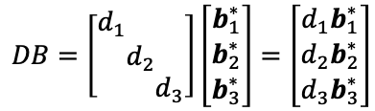
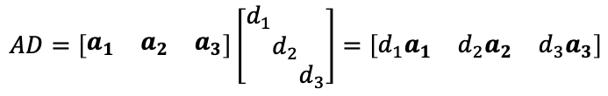
Practical Patterns (2/3)
P1’
$$=$$
P2’
$$=$$
Applying a diagonal matrix from the right
scales each column.
Applying a diagonal matrix from the left
scales each row.
$$AD=\left[\begin{matrix}a_{1} & a_{2} & a_{3}\end{matrix}\right]\left[\begin{aligned}d_{1} \\ \\ \end{aligned}\begin{aligned} \\ d_{2} \\ \end{aligned}\begin{aligned} \\ \\ d_{3}\end{aligned}\right]=\left[\begin{matrix}d_{1}a_{1} & d_{2}a_{2} & d_{3}a_{3}\end{matrix}\right]$$
$$DB=\left[\begin{aligned}d_{1} \\ \\ \end{aligned}\begin{aligned} \\ d_{2} \\ \end{aligned}\begin{aligned} \\ \\ d_{3}\end{aligned}\right]\left[\begin{aligned}b_{1}^{∗} \\ b_{2}^{∗} \\ b_{3}^{∗}\end{aligned}\right]=\left[\begin{aligned}{d_{1}b}_{1}^{∗} \\ {d_{2}b}_{2}^{∗} \\ {d_{3}b}_{3}^{∗}\end{aligned}\right]$$
Burn this into your memories and you can see …

Slide 14


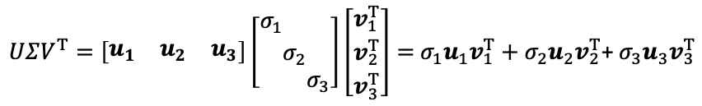
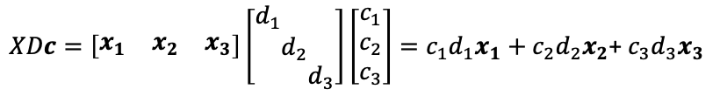



Practical Patterns (3/3)
P3
$$=$$
$$+$$
$$+$$
This pattern reveals another combination of columns.
You will encounter this in differential/recurrence equations.
$XDc=\left[\begin{matrix}x_{1} & x_{2} & x_{3}\end{matrix}\right]\left[\begin{aligned}d_{1} \\ \\ \end{aligned}\begin{aligned} \\ d_{2} \\ \end{aligned}\begin{aligned} \\ \\ d_{3}\end{aligned}\right]\left[\begin{aligned}c_{1} \\ c_{2} \\ c_{3}\end{aligned}\right]=c_{1}d_{1}x_{1}+c_{2}d_{2}x_{2}$+ $c_{3}d_{3}x_{3}$
P4
$$=$$
$$+$$
$$+$$
A matrix is decomposed into a sum of rank 1 matrices,
as in singular value/eigenvalue decomposition.
$UΣV^{T}=\left[\begin{matrix}u_{1} & u_{2} & u_{3}\end{matrix}\right]\left[\begin{aligned}σ_{1} \\ \\ \end{aligned}\begin{aligned} \\ σ_{2} \\ \end{aligned}\begin{aligned} \\ \\ σ_{3}\end{aligned}\right]\left[\begin{aligned}v_{1}^{T} \\ v_{2}^{T} \\ v_{3}^{T}\end{aligned}\right]=$ $σ_{1}u_{1}v_{1}^{T}+σ_{2}u_{2}v_{2}^{T}$+ $σ_{3}u_{3}v_{3}^{T}$

Slide 15
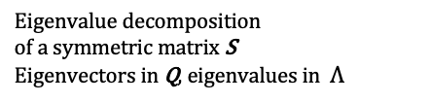
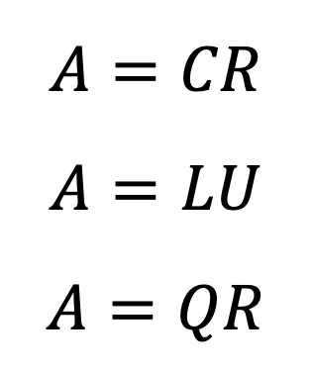
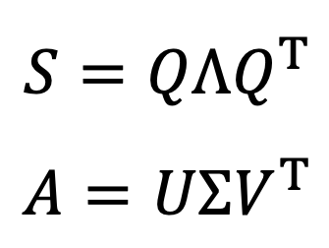
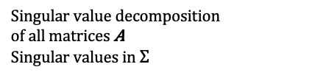
Five Factorizations of a Matrix
$$A=CR$$
$$A=LU$$
$$A=QR$$
Independent columns in C
Row echelon form in R
Leads to column rank = row rank
LU decomposition from
Gaussian elimination
(Lower triangular) (Upper triangular)
QR decomposition as
Gram-Schmidt orthogonalization
Orthogonal Q and triangular R
$$S={QΛQ}^{T}$$
$$A=UΣV^{T}$$
Eigenvalue decomposition
of a symmetric matrix S
Eigenvectors in Q, eigenvalues in $Λ$
Singular value decomposition
of all matrices A
Singular values in $Σ$
SENT TO Prof. Strang (1/2) 6/18, 2022

Slide 16









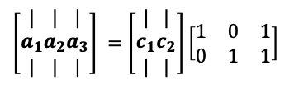







$$A=CR$$
Any general rectangular matrices A has the same row rank as the column rank. This factorization is the most intuitive way to understand this theorem. C consists of independent columns of A. And R is a row reduced echelon form of A.
$$A=CR$$
$$\left[\begin{matrix}1 & 2 & 3 \\ 2 & 3 & 5\end{matrix}\right]=\left[\begin{matrix}1 & 2 \\ 2 & 3\end{matrix}\right]\left[\begin{matrix}1 & 0 & 1 \\ 0 & 1 & 1\end{matrix}\right]$$
Procedure: Looking at the columns of A from left to right. Keep independent ones, discard dependent ones which can be created by the former columns. The col-1 and the col-2 survive, and the col-3 is discarded because it is expressed as col-1 + col-2. To rebuild A by the independent columns 1, 2, you find a row echelon form R. appears on the right.
using
$$A$$
$$C$$
$$R$$
P1
$$=$$
1
$$=$$
$$+$$
2
$$+$$
2
$$+$$
$\left[\begin{matrix}| \\ a_{1} \\ |\end{matrix}\begin{matrix}| \\ a_{2} \\ |\end{matrix}\begin{matrix}| \\ a_{3} \\ |\end{matrix}\right] =$ $\left[\begin{matrix}| \\ c_{1} \\ |\end{matrix}\begin{matrix}| \\ c_{2} \\ |\end{matrix}\right]\left[\begin{matrix}1 & 0 & 1 \\ 0 & 1 & 1\end{matrix}\right]$
2
1
1
1
2
All column vectors of A on the left are linear combinations of c₁ and c₂ . Meaning that the column rank = dim C(A)=2.
$a_{1}=$ $c_{1}$, ${ a}_{2}=$ $c_{2}, a_{3}=c_{1}+c_{2}$
$$A$$
$$C$$
$$R$$
using
P2
$$=$$
$$=$$
$$+$$
$\left[\begin{aligned}{−a}_{1}^{∗}− \\ {−a}_{2}^{∗}−\end{aligned}\right] =$ $\left[\begin{matrix}1 & 2 \\ 2 & 3\end{matrix}\right]\left[\begin{aligned}{−r}_{1}^{∗}− \\ {−r}_{2}^{∗}−\end{aligned}\right]$
1
1
2
2
1
$$+$$
2
$a_{1}^{∗}=$ $r_{1}^{∗}+$ ${2r}_{2}^{∗}, a_{2}^{∗}=$ ${2r}_{1}^{∗}+$ ${3r}_{2}^{∗}$
All row vectors of A are linear combinations of r₁ and r₂ .
The row rank = dim row space = dim C(A^{T}) = 2.

Slide 17



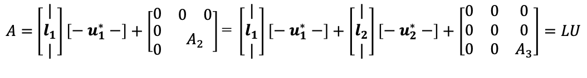





$$A=LU$$
Solving Ax=b via Gaussian Elimination can be expressed as a LU decomposition.
Usually, you apply elementary row operation matrices from the left. L is their inverse.
$$A$$
$$L$$
$$U$$
$$=$$
$$+$$
$$+$$
$$=$$
To find L and U, peel off the rank 1 matrix made of the row1 and col1 of A. This leaves A₂ . Do this recursively and decompose A into the sum of rank 1 matrices.
$A=$ $\left[\begin{matrix}| \\ l_{1} \\ |\end{matrix}\right]\left[\begin{aligned}{− u}_{1}^{∗}−\end{aligned}\right]+\left[\begin{matrix}0 & \begin{matrix}0 & 0\end{matrix} \\ \begin{matrix}0 \\ 0\end{matrix} & A_{2}\end{matrix}\right]$＝ $\left[\begin{matrix}| \\ l_{1} \\ |\end{matrix}\right]\left[\begin{aligned}{− u}_{1}^{∗}−\end{aligned}\right]+\left[\begin{matrix}| \\ l_{2} \\ |\end{matrix}\right]\left[\begin{aligned}{− u}_{2}^{∗}−\end{aligned}\right]+\left[\begin{matrix}0 & 0 & 0 \\ 0 & 0 & 0 \\ 0 & 0 & A_{3}\end{matrix}\right]=LU$
$$=$$
$$+$$
$$+$$
using
MM
4
To rebuild A from L times U is easy.

Slide 18





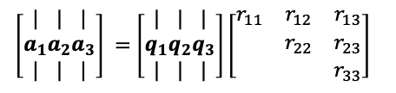



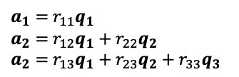

$$A=QR$$
Gram-Schmidt orthogonalization of a basis.
$$A$$
$$Q$$
$$R$$
$$a_{1}$$
$$a_{2}$$
$$a_{3}$$
$$=$$
$$+$$
2
3
using
$$=$$
$$+$$
2
1
$$+$$
1
2
3
1
1
P1
The columns vectors A of can be adjusted into an orthonormal set of vector Q. Each column vector of A can be
rebuilt from Q and an upper triangular matrix R .
$$A=QR$$
$\left[\begin{matrix}| \\ a_{1} \\ |\end{matrix}\begin{matrix}| \\ a_{2} \\ |\end{matrix}\begin{matrix}| \\ a_{3} \\ |\end{matrix}\right] =$ $\left[\begin{matrix}| \\ q_{1} \\ |\end{matrix}\begin{matrix}| \\ q_{2} \\ |\end{matrix}\begin{matrix}| \\ q_{3} \\ |\end{matrix}\right]\left[\begin{matrix}r_{11} & r_{12} & r_{13} \\ & r_{22} & r_{23} \\ & & r_{33}\end{matrix}\right]$
$a_{1}=$ $r_{11}q_{1}$
$a_{2}=$ $r_{12}q_{1}+r_{22}q_{2}$
$a_{2}=$ $r_{13}q_{1}+r_{23}q_{2}+r_{33}q_{3}$

Slide 19




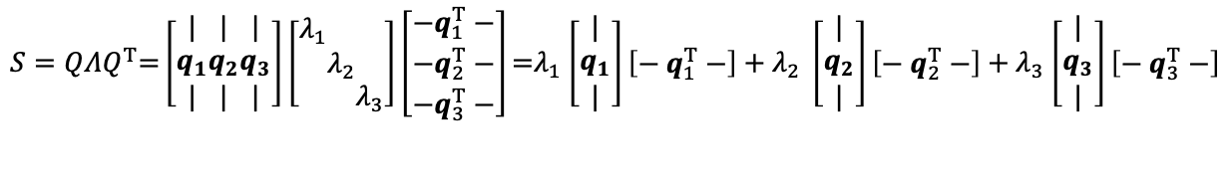






$$S=QΛQ^{T}$$
Eigenvalue decomposition of a symmetric matrix S.
All the eigenvalues are real, and all the eigenvectors can be chosen orthonormal.
$$S$$
$$Q$$
$$Λ$$
$$Q^{T}$$
$$λ_{1}q_{1}q_{1}^{T}$$
$$λ_{2}q_{2}q_{2}^{T}$$
$$λ_{3}q_{3}q_{3}^{T}$$
using
$$=$$
P4
1
2
3
$$=$$
1
$$+$$
2
$$+$$
3
1
1
2
3
2
3
A symmetric matrix S is diagonalized into Λ by an orthogonal matrix Q and its transpose.
And it is broken down into a sum of rank 1 projection matrices (known as the Spectrum Theory).
$S=QΛQ^{T}\text{=}\left[\begin{matrix}| \\ q_{1} \\ |\end{matrix}\begin{matrix}| \\ q_{2} \\ |\end{matrix}\begin{matrix}| \\ q_{3} \\ |\end{matrix}\right]\left[\begin{aligned}λ_{1} \\ \\ \end{aligned}\begin{aligned} \\ λ_{2} \\ \end{aligned}\begin{aligned} \\ \\ λ_{3}\end{aligned}\right]\left[\begin{aligned}{−q}_{1}^{T}− \\ {−q}_{2}^{T}− \\ −q_{3}^{T}−\end{aligned}\right]\text{=}λ_{1}$ $\left[\begin{matrix}| \\ q_{1} \\ |\end{matrix}\right]\left[\begin{aligned}{− q}_{1}^{T}−\end{aligned}\right]+λ_{2} \left[\begin{matrix}| \\ q_{2} \\ |\end{matrix}\right]\left[\begin{aligned}{− q}_{2}^{T}−\end{aligned}\right]+λ_{3}$ $\left[\begin{matrix}| \\ q_{3} \\ |\end{matrix}\right]\left[\begin{aligned}{− q}_{3}^{T}−\end{aligned}\right]$
$$=λ_{1}P_{1}+ λ_{2}P_{2}+ λ_{3}P_{3}$$
$$S=S^{T}$$
$$Q^{T}Q{=P}_{1}+P_{2}+P_{3}=I$$
$$P_{1}P_{2}=P_{2}P_{3}=P_{3}P_{1}=O$$

Slide 20




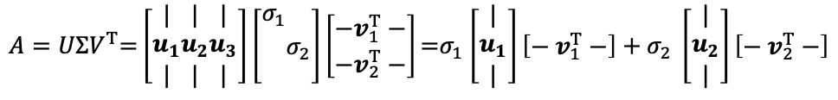






$$A=UΣV^{T}$$
All matrices including rectangular ones can be singular value decomposed (SVD).
$$A$$
$$U$$
$$Σ$$
$$V^{T}$$
$$σ_{1} u_{1}v_{1}^{T}$$
$$σ_{2} u_{2}v_{2}^{T}$$
using
$$=$$
$$=$$
$$+$$
P4
1
2
1
2
3
1
1
2
2
You can find V as an orthonormal basis of $ℝ^{n}$, and U as an orthonormal basis of $ℝ^{m}$ together they diagonalize A into $Σ$. This is the Singular Value Decomposition. And it is also also a sum of rank 1 matrices.
$A=UΣV^{T}\text{=}\left[\begin{matrix}| \\ u_{1} \\ |\end{matrix}\begin{matrix}| \\ u_{2} \\ |\end{matrix}\begin{matrix}| \\ u_{3} \\ |\end{matrix}\right]\left[\begin{aligned}σ_{1} \\ \\ \end{aligned}\begin{aligned} \\ σ_{2} \\ \end{aligned}\right]\left[\begin{aligned}{−v}_{1}^{T}− \\ {−v}_{2}^{T}−\end{aligned}\right]\text{=}σ_{1}$ $\left[\begin{matrix}| \\ u_{1} \\ |\end{matrix}\right]\left[\begin{aligned}{− v}_{1}^{T}−\end{aligned}\right]+σ_{2} \left[\begin{matrix}| \\ u_{2} \\ |\end{matrix}\right]\left[\begin{aligned}{− v}_{2}^{T}−\end{aligned}\right]$
$=σ_{1}u_{1}v_{1}^{T}+$ $σ_{2}u_{2}v_{2}^{T}$
$${UU}^{T}=I_{m}$$
$${VV}^{T}=I_{n}$$

Slide 21
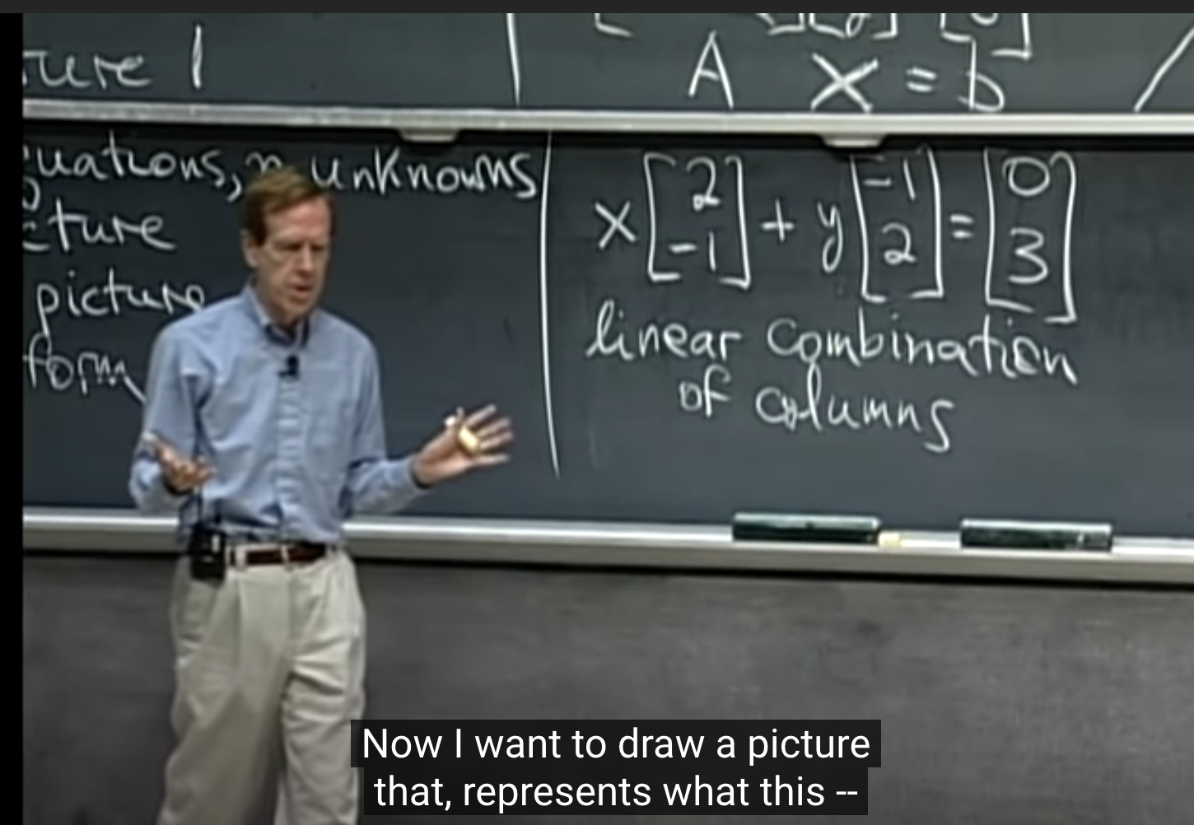
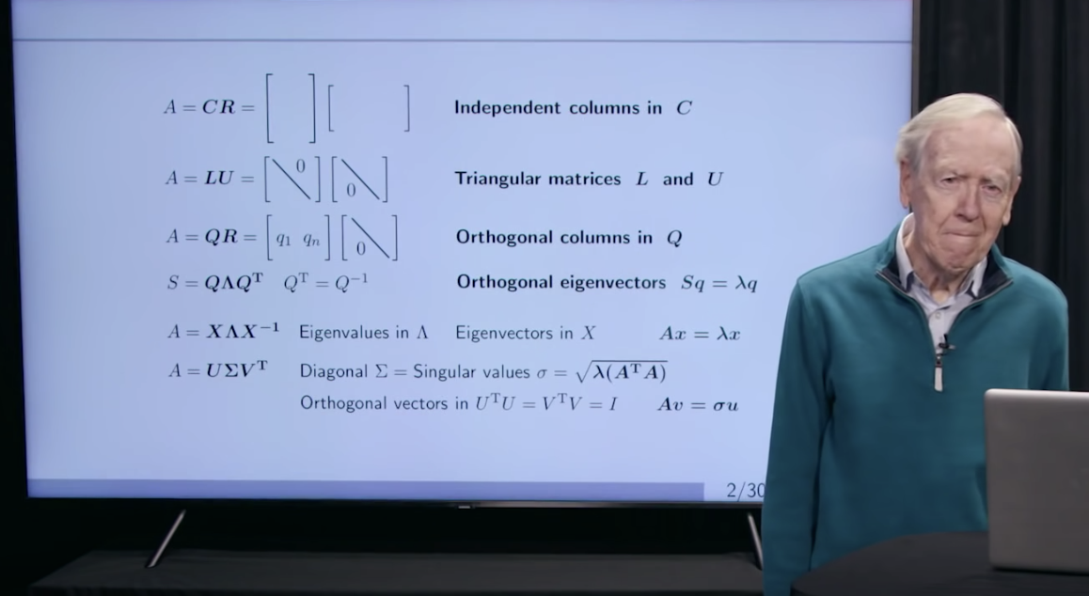
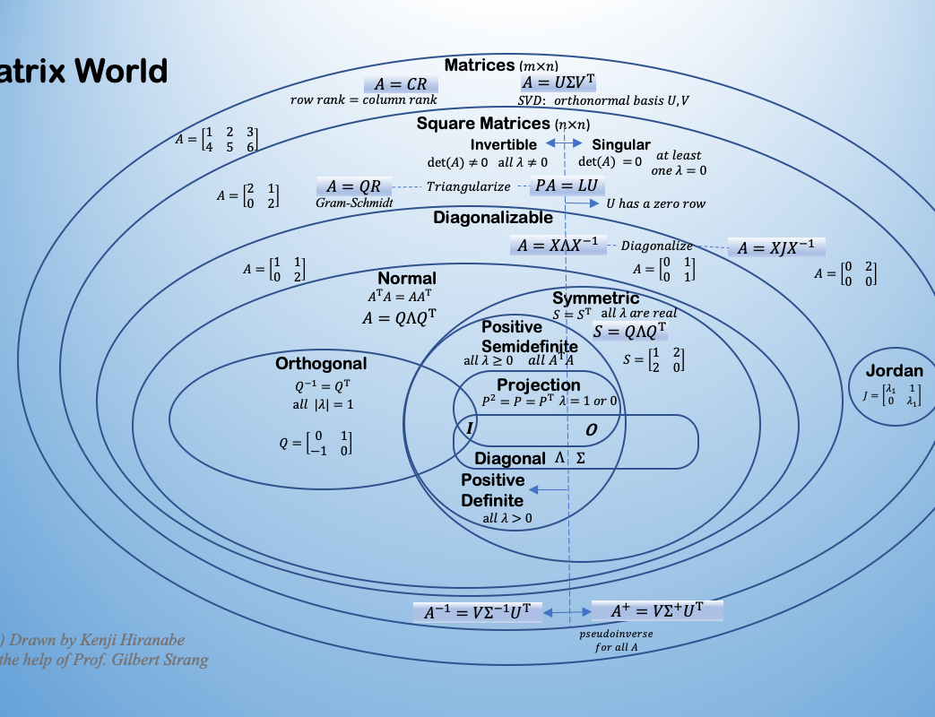
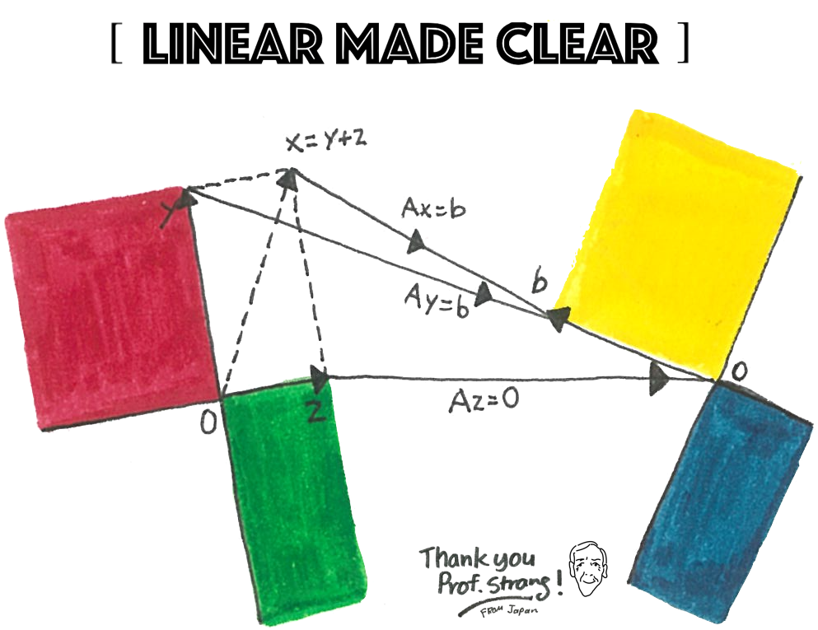

References and Credits
Linear Algebra for Everyone http://math.mit.edu/everyone/
MIT OpenCourseWare 18.06 http://web.mit.edu/18.06/www/videos.shtml
A 2020 Vision of Linear Algebra https://ocw.mit.edu/resources/res-18-010-a-2020-vision-of-linear-algebra-spring-2020/
My blog entry Matrix World https://anagileway.com/2020/09/29/matrix-world-in-linear-algebra-for-everyone/
The four subspaces T-shirt https://anagileway.com/2020/06/04/prof-gilbert-strang-linear-algebra/
This work is inspired by Prof. Strang’s books and lecture videos. I deeply appreciate his work, passion and personality.

Slide 22
Thank you for reading!
$$=$$
Any comments or feedbacks are welcome to:
Kenji Hiranabe (hiranabe@gmail.com)

Slide 23

$$=$$

