Slide 1
The Art of Linear Algebra Original illustrations
2022/9/22 Matrix World Update
2022/10/6 Separation of pics
2022/11/7 Color change for gray scale
2023/3/4 Adjustment for PREMUS (paper)
2023/8/22 Adjustment for PREMUS(darker color for map of eigenvalues)
2023/9/12 wording refinement from @jdlph

Slide 2


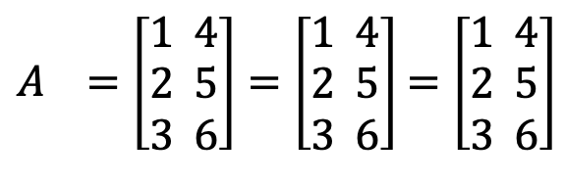

$$=$$
$$=$$
$$=$$
$A =\left[\begin{aligned}1 4 \\ 2 5 \\ 3 6\end{aligned}\right]=\left[\begin{aligned}1 4 \\ 2 5 \\ 3 6\end{aligned}\right]$ $=\left[\begin{aligned}1 4 \\ 2 5 \\ 3 6\end{aligned}\right]$
1 matrix
6 numbers
2 column vectors
with 3 numbers
3 row vectors
with 2 numbers

Slide 3
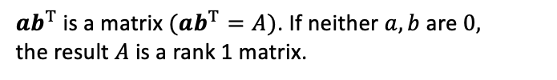

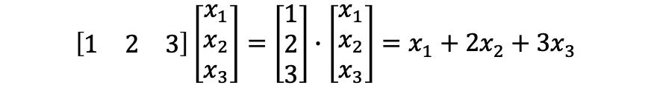

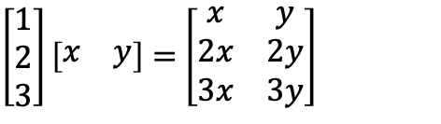



v1
$$=$$
$$=$$
Dot product (number)
v2
$$=$$
$$=$$
Rank 1 Matrix
Dot product ($a∙b$) is expressed as $a^{T}b$in matrix language and yields a number.
$ab^{T}$ is a matrix $(ab^{T}=A)$. If neither $a, b$ are $0,$
the result $A$is a rank 1 matrix.
$$\left[\begin{aligned}\begin{matrix}1 & 2 & 3\end{matrix}\end{aligned}\right]\left[\begin{aligned}x_{1} \\ x_{2} \\ x_{3}\end{aligned}\right]=\left[\begin{matrix}1 \\ 2 \\ 3\end{matrix}\right]∙\left[\begin{aligned}x_{1} \\ x_{2} \\ x_{3}\end{aligned}\right]=x_{1}+2x_{2}+3x_{3}$$
$\left[\begin{matrix}1 \\ 2 \\ 3\end{matrix}\right]\left[\begin{matrix}x & y\end{matrix}\right]=$ $\left[\begin{matrix}x & y \\ 2x & 2y \\ 3x & 3y\end{matrix}\right]$

Slide 4


v1
$$=$$
$$=$$
Dot product(number)

Slide 5


v2
$$=$$
$$=$$
Rank 1 Matrix

Slide 6
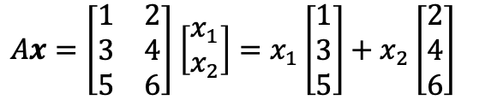

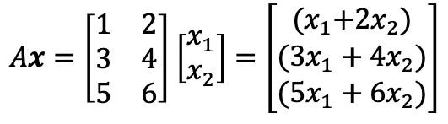

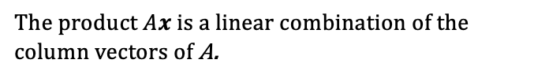
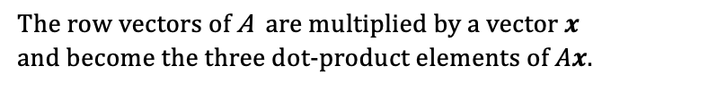

Mv1
$$=$$
Mv2
$$=$$
$$+$$
The row vectors of A are multiplied by a vector $x$
and become the three dot-product elements of $Ax$.
The product $Ax$is a linear combination of the column vectors of A.
$Ax=\left[\begin{matrix}1 & 2 \\ 3 & 4 \\ 5 & 6\end{matrix}\right]$ $\left[\begin{aligned}x_{1} \\ x_{2}\end{aligned}\right]=\left[\begin{matrix}{(x}_{1}+2x_{2}) \\ (3x_{1}+4x_{2}) \\ (5x_{1}+6x_{2})\end{matrix}\right]$
$Ax=\left[\begin{matrix}1 & 2 \\ 3 & 4 \\ 5 & 6\end{matrix}\right]$ $\left[\begin{aligned}x_{1} \\ x_{2}\end{aligned}\right]=x_{1}\left[\begin{matrix}1 \\ 3 \\ 5\end{matrix}\right]+x_{2}\left[\begin{aligned}2 \\ 4 \\ 6\end{aligned}\right]$

Slide 7
Mv1
$$=$$

Slide 8

Mv2
$$=$$
$$+$$

Slide 9
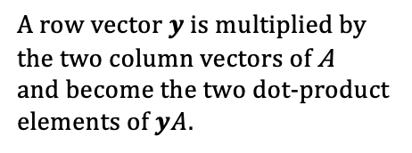

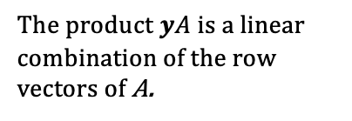
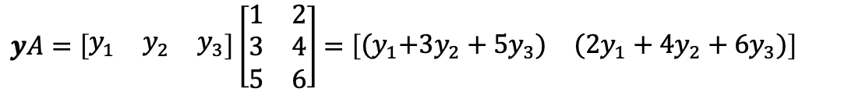
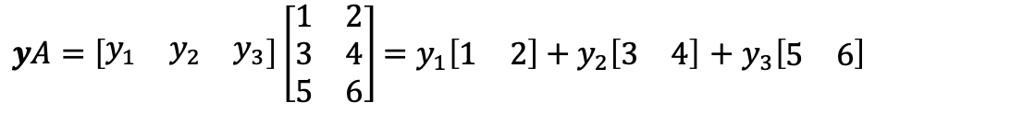



vM1
$$=$$
$yA=\left[\begin{matrix}y_{1} & y_{2} & y_{3}\end{matrix}\right]\left[\begin{matrix}1 & 2 \\ 3 & 4 \\ 5 & 6\end{matrix}\right]$ $=\left[\begin{matrix}{(y}_{1}+3y_{2}+5y_{3}) & ({2y}_{1}+4y_{2}+6y_{3})\end{matrix}\right]$
A row vector $y$ is multiplied by the two column vectors of A
and become the two dot-product elements of $yA$.
vM2
$$=$$
$$+$$
$$+$$
$yA=\left[\begin{matrix}y_{1} & y_{2} & y_{3}\end{matrix}\right]\left[\begin{matrix}1 & 2 \\ 3 & 4 \\ 5 & 6\end{matrix}\right]$ $=y_{1}\left[\begin{matrix}1 & 2\end{matrix}\right]+y_{2}\left[\begin{matrix}3 & 4\end{matrix}\right]$ $+$ $y_{3}\left[\begin{matrix}5 & 6\end{matrix}\right]$
The product $yA$is a linear combination of the row vectors of A.

Slide 10

vM1
$$=$$

Slide 11



vM2
$$=$$
$$+$$
$$+$$

Slide 12



















$$A∈ℝ^{m×n}$$
$$ℝ^{n}$$
$$ℝ^{m}$$
$$C\left(A^{T}\right)$$
$$C(A)$$
dim
$$=r$$
dim
$$=r$$
row space
all $yA$
column space
all $Ax$
perpendicular
perpendicular
$$ℝ^{n}$$
$$ℝ^{m}$$
nullspace
$$Ax=0$$
left nullspace
$$yA=0$$
$$N(A)$$
$$N(A^{T})$$
dim
$$=n−r$$
dim
$$=m−r$$
$$ℝ^{n}=N\left(A\right)+C\left(A^{T}\right)$$
$$N\left(A\right)⊥C\left(A^{T}\right)$$
$$ℝ^{m}=C\left(A\right)+N\left(A^{T}\right)$$
$$C\left(A\right)⊥N\left(A^{T}\right)$$

Slide 13


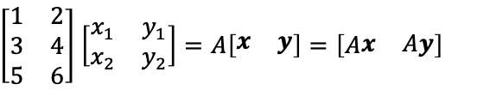
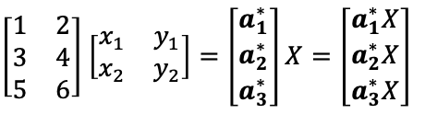
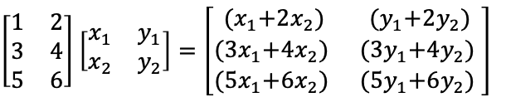

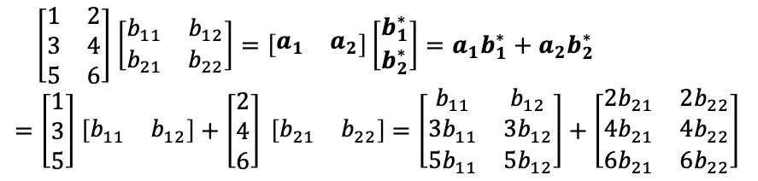
MM
1
$$=$$
MM
2
$$=$$
$$=$$
Every element becomes a dot product of row vector
and column vector.
$Ax$and $Ay$ are linear combinations of columns of A.
$\left[\begin{matrix}1 & 2 \\ 3 & 4 \\ 5 & 6\end{matrix}\right]$ $\left[\begin{matrix}x_{1} & y_{1} \\ x_{2} & y_{2}\end{matrix}\right]=\left[\begin{matrix}{(x}_{1}+2x_{2}) & {(y}_{1}+2y_{2}) \\ {(3x}_{1}+4x_{2}) & {(3y}_{1}+4y_{2}) \\ {(5x}_{1}+6x_{2}) & {(5y}_{1}+6y_{2}) \end{matrix}\right]$
$\left[\begin{matrix}1 & 2 \\ 3 & 4 \\ 5 & 6\end{matrix}\right]$ $\left[\begin{matrix}x_{1} & y_{1} \\ x_{2} & y_{2}\end{matrix}\right]=A\left[\begin{matrix}x & y\end{matrix}\right]=\left[A\begin{matrix}x & Ay\end{matrix}\right]$
MM
3
MM
4
$$=$$
$$+$$
$$=$$
$$=$$
Multiplication $AB$is broken down to a sum of rank 1 matrices.
$\left[\begin{matrix}1 & 2 \\ 3 & 4 \\ 5 & 6\end{matrix}\right]$ $\left[\begin{matrix}b_{11} & b_{12} \\ b_{21} & b_{22}\end{matrix}\right]=\left[\begin{matrix}a_{1} & a_{2}\end{matrix}\right]\left[\begin{aligned}b_{1}^{∗} \\ b_{2}^{∗}\end{aligned}\right]=a_{1}b_{1}^{∗}+a_{2}b_{2}^{∗}$
$=\left[\begin{matrix}1 \\ 3 \\ 5\end{matrix}\right]$ $\left[\begin{matrix}b_{11} & b_{12}\end{matrix}\right]+\left[\begin{matrix}2 \\ 4 \\ 6\end{matrix}\right] \left[\begin{matrix}b_{21} & b_{22}\end{matrix}\right]$ $=\left[\begin{matrix}b_{11} & b_{12} \\ 3b_{11} & 3b_{12} \\ 5b_{11} & 5b_{12}\end{matrix}\right]+\left[\begin{matrix}{2b}_{21} & {2b}_{22} \\ 4b_{21} & 4b_{22} \\ 6b_{21} & 6b_{22}\end{matrix}\right]$
The produced rows are linear combinations of rows.
$\left[\begin{matrix}1 & 2 \\ 3 & 4 \\ 5 & 6\end{matrix}\right]$ $\left[\begin{matrix}x_{1} & y_{1} \\ x_{2} & y_{2}\end{matrix}\right]=\left[\begin{aligned}a_{1}^{∗} \\ a_{2}^{∗} \\ a_{3}^{∗}\end{aligned}\right]X=\left[\begin{aligned}a_{1}^{∗}X \\ a_{2}^{∗}X \\ a_{3}^{∗}X\end{aligned}\right]$

Slide 14
MM
1
$$=$$

Slide 15


MM
2
$$=$$
$$=$$

Slide 16


MM
3
$$=$$
$$=$$

Slide 17

MM
4
$$=$$
$$+$$

Slide 18














$$=$$
1
$$=$$
1
$$+$$
2
$$+$$
3
using
1
2
3
1
2
3
P1
MM
2
Mv2
Operations from the right act on the columns of the matrix. This expression can be viewed as the three linear combinations on the right in one formula.
2
$$=$$
1
$$+$$
2
$$+$$
3
3
$$=$$
1
$$+$$
2
$$+$$
3
1
$$=$$
1
1
$$=$$
1
$$+$$
2
$$+$$
3
P2
using
2
2
MM
3
vM2
3
3
2
$$=$$
1
$$+$$
2
$$+$$
3
Operations from the left act on the rows of the matrix. This expression can be viewed as the three linear combinations on the right in one formula.
$$=$$
$$+$$
$$+$$
3
1
2
3

Slide 19

1
2
3
$$=$$
1
2
3
P1

Slide 20
1
$$=$$
1
$$+$$
2
$$+$$
3
using
MM
2
Mv2
2
$$=$$
1
$$+$$
2
$$+$$
3
3
$$=$$
1
$$+$$
2
$$+$$
3

Slide 21
1
$$=$$
1
P2
2
2
3
3

Slide 22
1
$$=$$
1
$$+$$
2
$$+$$
3
using
$$=$$
$$+$$
$$+$$
MM
3
vM2
2
1
2
3
3
$$=$$
1
$$+$$
2
$$+$$
3

Slide 23
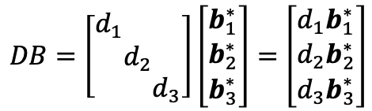
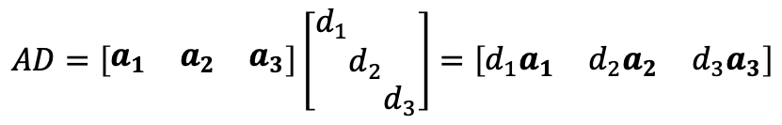
P1’
$$=$$
P2’
$$=$$
Applying a diagonal matrix from the right
scales each column.
Applying a diagonal matrix from the left
scales each row.
$$AD=\left[\begin{matrix}a_{1} & a_{2} & a_{3}\end{matrix}\right]\left[\begin{aligned}d_{1} \\ \\ \end{aligned}\begin{aligned} \\ d_{2} \\ \end{aligned}\begin{aligned} \\ \\ d_{3}\end{aligned}\right]=\left[\begin{matrix}d_{1}a_{1} & d_{2}a_{2} & d_{3}a_{3}\end{matrix}\right]$$
$$DB=\left[\begin{aligned}d_{1} \\ \\ \end{aligned}\begin{aligned} \\ d_{2} \\ \end{aligned}\begin{aligned} \\ \\ d_{3}\end{aligned}\right]\left[\begin{aligned}b_{1}^{∗} \\ b_{2}^{∗} \\ b_{3}^{∗}\end{aligned}\right]=\left[\begin{aligned}{d_{1}b}_{1}^{∗} \\ {d_{2}b}_{2}^{∗} \\ {d_{3}b}_{3}^{∗}\end{aligned}\right]$$

Slide 24

P1’
$$=$$

Slide 25
P2’
$$=$$

Slide 26

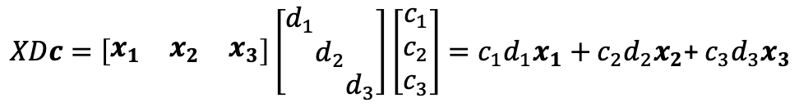


P3
$$=$$
$$+$$
$$+$$
This pattern reveals another combination of columns.
You will encounter this in differential/recurrence equations.
$XDc=\left[\begin{matrix}x_{1} & x_{2} & x_{3}\end{matrix}\right]\left[\begin{aligned}d_{1} \\ \\ \end{aligned}\begin{aligned} \\ d_{2} \\ \end{aligned}\begin{aligned} \\ \\ d_{3}\end{aligned}\right]\left[\begin{aligned}c_{1} \\ c_{2} \\ c_{3}\end{aligned}\right]=c_{1}d_{1}x_{1}+c_{2}d_{2}x_{2}$+ $c_{3}d_{3}x_{3}$

Slide 27



P3
$$=$$
$$+$$
$$+$$

Slide 28


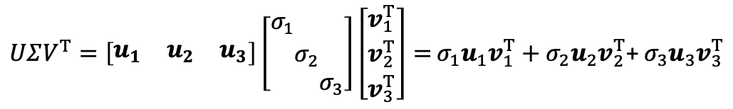

P4
$$=$$
$$+$$
$$+$$
A matrix is decomposed into a sum of rank 1 matrices,
as in singular value/eigenvalue decomposition.
$UΣV^{T}=\left[\begin{matrix}u_{1} & u_{2} & u_{3}\end{matrix}\right]\left[\begin{aligned}σ_{1} \\ \\ \end{aligned}\begin{aligned} \\ σ_{2} \\ \end{aligned}\begin{aligned} \\ \\ σ_{3}\end{aligned}\right]\left[\begin{aligned}v_{1}^{T} \\ v_{2}^{T} \\ v_{3}^{T}\end{aligned}\right]=$ $σ_{1}u_{1}v_{1}^{T}+σ_{2}u_{2}v_{2}^{T}$+ $σ_{3}u_{3}v_{3}^{T}$

Slide 29



P4
$$=$$
$$+$$
$$+$$

Slide 30
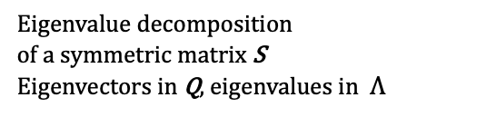
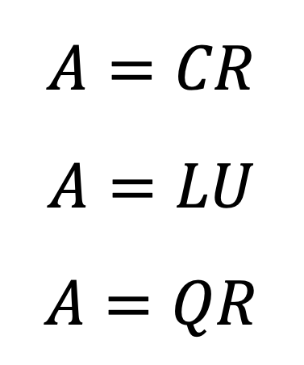
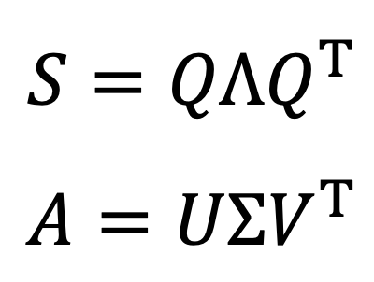
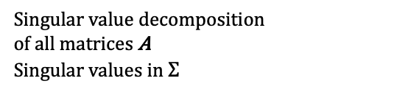
$$A=CR$$
$$A=LU$$
$$A=QR$$
Independent columns in C
Row echelon form in R
Leads to column rank = row rank
LU decomposition from
Gaussian elimination
(Lower triangular) (Upper triangular)
QR decomposition as
Gram-Schmidt orthogonalization
Orthogonal Q and triangular R
$$S={QΛQ}^{T}$$
$$A=UΣV^{T}$$
Eigenvalue decomposition
of a symmetric matrix S
Eigenvectors in Q, eigenvalues in $Λ$
Singular value decomposition
of all matrices A
Singular values in $Σ$

Slide 36





$$A$$
$$C$$
$$R$$
$$=$$
$$=$$
$$+$$
$$+$$
$$+$$
using
1
2
1
2
1
2
1
2
P1

Slide 37







$$A$$
$$C$$
$$R$$
$$=$$
$$+$$
using
1
$$=$$
1
2
P2
2
1
$$+$$
2

Slide 38



$$A$$
$$L$$
$$U$$
$$=$$
$$+$$
$$+$$
$$=$$

Slide 39



$$L$$
$$U$$
$$=$$
$$+$$
$$+$$
using
MM
4

Slide 40









$$A$$
$$Q$$
$$R$$
$$a_{1}$$
$$a_{2}$$
$$a_{3}$$
using
$$=$$
$$+$$
2
3
P1
$$=$$
$$+$$
2
1
$$+$$
1
2
3
1
1

Slide 41











$$S$$
$$Q$$
$$Λ$$
$$Q^{T}$$
$$λ_{1}q_{1}q_{1}^{T}$$
$$λ_{2}q_{2}q_{2}^{T}$$
$$λ_{3}q_{3}q_{3}^{T}$$
using
1
2
3
$$=$$
$$+$$
$$+$$
P4
$$=$$
1
2
3
1
1
2
3
2
3

Slide 42






$$A$$
$$U$$
$$Σ$$
$$V^{T}$$
$$σ_{1} u_{1}v_{1}^{T}$$
$$σ_{2} u_{2}v_{2}^{T}$$
using
$$=$$
$$=$$
$$+$$
P4
1
2
1
2
3
1
1
2
2

Slide 43








































Matrix World
Matrix ($m×n$)
Matrix Factorization
in
Linear Algebra
for Everyone
1.4
$$A=CR$$
$$A=UΣV^{T}$$
7.1
Appearing section
$$row rank=column rank$$
$$SVD: orthonormal basis U, V$$
(in Linear Algebra for Everyone)
$$A=\left[\begin{matrix}1 & 2 & 3 \\ 4 & 5 & 6\end{matrix}\right]$$
Square Matrix ($n×n$)
Invertible
Singular
$det⁡(A)≠$ 0, $all λ≠0$
$$at least one λ=0, det⁡(A) =\text{ 0}$$
4.4
$$A=QR$$
$$Triangularize$$
$$A=LU$$
2.3
$$A=\left[\begin{matrix}2 & 1 \\ 0 & 2\end{matrix}\right]$$
Gram-Schmidt
$U has at least one zero row$
Diagonalizable
$$A=\left[\begin{matrix}1 & 1 \\ 0 & 2\end{matrix}\right]$$
6.2
$$A={XΛX}^{−1}$$
$$Diagonalize$$
$$A={XJX}^{−1}$$
A7
A5
Normal
$$A=\left[\begin{matrix}0 & 1 \\ 0 & 1\end{matrix}\right]$$
$$J=Jordan form$$
$$A^{T}A={AA}^{T}$$
$$diagonalizable by orthogonal matrix$$
2.4
Symmetric
$$A=\left[\begin{matrix} 1 & 1 \\ −1 & −1\end{matrix}\right]$$
Positive Semidefinite
$$S=S^{T},all λ are real$$
$$A={QΛQ}^{T}$$
6.3
$$S={QΛQ}^{T}$$
6.3
$$J=\left[\begin{matrix}0 & 1 \\ 0 & 0\end{matrix}\right]$$
Orthogonal
4.4
$all λ≥0$, ${all A}^{T}A$
4.2
$$S=\left[\begin{matrix}1 & 2 \\ 2 & 0\end{matrix}\right]$$
2.4
Projection
$$Q^{−1}=Q^{T}$$
Permutation
$$P^{2}=P=P^{T},λ=1 or 0$$
$$all |λ|=1$$
$$permutation of I$$
$$all λ are roots of 1$$
$$I$$
O
$$Q=\left[\begin{matrix} 0 & 1 \\ −1 & 0\end{matrix}\right]$$
Diagonal
$$Σ=\left[\begin{matrix}σ^{2} & 0 \\ 0 & σ^{2}\end{matrix}\right]$$
$$Λ=\left[\begin{matrix}λ & 0 \\ 0 & λ\end{matrix}\right]$$
Positive
Definite
6.3
$$all λ>0$$
$$pseudoinverse for all A$$
$$A^{−1}=VΣ^{−1}U^{T}$$
$$A^{+}=VΣ^{+}U^{T}$$
3.5, 7.4
Drawn by Kenji Hiranabe
with the help of Prof. Gilbert Strang
(v1.5, Mar.2th,2023)
Notes:
Group28 is only for Linear Algebra for Everyone. Use Object visibility to hide.
3/2/2023 from Ashley; → v1.5
Within your figure MatrixWorld-simple.eps', these are 'suggested' corrections:
- Font sizes : Best to keep all text the same size. But due to space constraints, they seem okay.
Except 'pseudoinverse for all A' - Can this be made slightly larger (it seems too small) ?
- 'U has at lease one zero row' -> Change to 'least'
- Gram-Schmidt: There is enough space to make the font normal size, and shift slightly downward
- 'J=Jordan form' -> Move slightly down, so it does not touch gray shaded area above
- Prefer these two matrices elements right-aligned
A=1&1\\-1&-1\\ (that way all '1' align vertically)
Q=0&1\\-1&0\\ (Here o and -1 will align vertically)
- Prefer this matrix elements center-aligned
\Sigma=\sigma^2&0\\0^\sigma^2\\ (here it seems your alignments are cr, but they may actually be correct, i.e. cc)

Slide 44
Matrix World
Matrix ($m×n$)
Matrix Factorization
in
Linear Algebra
for Everyone
1.4
$$A=CR$$
$$A=UΣV^{T}$$
7.1
Appearing section
$$row rank=column rank$$
$$SVD: orthonormal basis U, V$$
(in Linear Algebra for Everyone)
$$A=\left[\begin{matrix}1 & 2 & 3 \\ 4 & 5 & 6\end{matrix}\right]$$
Square Matrix ($n×n$)
Invertible
Singular
$det⁡(A)≠$ 0, $all λ≠0$
$$at least one λ=0, det⁡(A) =\text{ 0}$$
4.4
$$A=QR$$
$$Triangularize$$
$$A=LU$$
2.3
$$A=\left[\begin{matrix}2 & 1 \\ 0 & 2\end{matrix}\right]$$
Gram-Schmidt
$U has at least one zero row$
Diagonalizable
$$A=\left[\begin{matrix}1 & 1 \\ 0 & 2\end{matrix}\right]$$
6.2
$$A={XΛX}^{−1}$$
$$Diagonalize$$
$$A={XJX}^{−1}$$
A7
A5
Normal
$$A=\left[\begin{matrix}0 & 1 \\ 0 & 1\end{matrix}\right]$$
$$J=Jordan form$$
$$A^{T}A={AA}^{T}$$
$$diagonalizable by orthogonal matrix$$
2.4
Symmetric
$$A=\left[\begin{matrix} 1 & 1 \\ −1 & −1\end{matrix}\right]$$
Positive Semidefinite
$$S=S^{T},all λ are real$$
$$A={QΛQ}^{T}$$
6.3
$$S={QΛQ}^{T}$$
6.3
$$J=\left[\begin{matrix}0 & 1 \\ 0 & 0\end{matrix}\right]$$
Orthogonal
4.4
$all λ≥0$, ${all A}^{T}A$
4.2
$$S=\left[\begin{matrix}1 & 2 \\ 2 & 0\end{matrix}\right]$$
2.4
Projection
$$Q^{−1}=Q^{T}$$
Permutation
$$P^{2}=P=P^{T},λ=1 or 0$$
$$all |λ|=1$$
$$permutation of I$$
$$all λ are roots of 1$$
$$I$$
O
$$Q=\left[\begin{matrix} 0 & 1 \\ −1 & 0\end{matrix}\right]$$
Diagonal
$$Σ=\left[\begin{matrix}σ^{2} & 0 \\ 0 & σ^{2}\end{matrix}\right]$$
$$Λ=\left[\begin{matrix}λ & 0 \\ 0 & λ\end{matrix}\right]$$
Positive
Definite
6.3
$$all λ>0$$
$$pseudoinverse for all A$$
$$A^{−1}=VΣ^{−1}U^{T}$$
$$A^{+}=VΣ^{+}U^{T}$$
3.5, 7.4
Drawn by Kenji Hiranabe
with the help of Prof. Gilbert Strang
(v1.5, Mar.2th,2023)
Notes:
Group21 is only for Linear Algebra for Everyone. Use Object visibility to hide.
3/2/2023 from Ashley; → v1.5
Within your figure MatrixWorld-simple.eps', these are 'suggested' corrections:
- Font sizes : Best to keep all text the same size. But due to space constraints, they seem okay.
Except 'pseudoinverse for all A' - Can this be made slightly larger (it seems too small) ?
- 'U has at lease one zero row' -> Change to 'least'
- Gram-Schmidt: There is enough space to make the font normal size, and shift slightly downward
- 'J=Jordan form' -> Move slightly down, so it does not touch gray shaded area above
- Prefer these two matrices elements right-aligned
A=1&1\\-1&-1\\ (that way all '1' align vertically)
Q=0&1\\-1&0\\ (Here o and -1 will align vertically)
- Prefer this matrix elements center-aligned
\Sigma=\sigma^2&0\\0^\sigma^2\\ (here it seems your alignments are cr, but they may actually be correct, i.e. cc)

Slide 45

































P
Projection
$$\left[\begin{matrix}1 & 0 & 0 \\ 0 & 1 & 0 \\ 0 & 0 & 0\end{matrix}\right]$$
$$\left[\begin{matrix}0 & 1 & 1 \\ 0 & 0 & 1 \\ 0 & 0 & 0\end{matrix}\right]$$
$$\left[\begin{matrix}z & 0 & 0 \\ 0 & z & 0 \\ 0 & 0 & z\end{matrix}\right]$$
$$\left[\begin{matrix}1 & 0 & 0 \\ 0 & −1 & 1 \\ 0 & −1 & −1\end{matrix}\right]$$
I
Identity
N
Nilpotent
zI
z times Identity
O
Zero
$$\left[\begin{matrix}1 & 0 & 0 \\ 0 & 1 & 0 \\ 0 & 0 & 1\end{matrix}\right]$$
$$\left[\begin{matrix}0 & 0 & 0 \\ 0 & 0 & 0 \\ 0 & 0 & 0\end{matrix}\right]$$
Invertible
$$P=P^{2}=P^{T}$$
$$N^{k}=O$$
z
$$|A|≠0$$
0
1
0
1
0
0
0
$$∀λ=0$$
$$∀λ=1$$
$$∀λ=0 or 1$$
$$∀λ=0$$
$$∀λ=z$$
$$∀λ≠0$$
Markov
$$\left[\begin{matrix}0 & 0 & 1 \\ 1 & 0 & 0 \\ 0 & 1 & 0\end{matrix}\right]$$
$$\left[\begin{matrix} 0 & 0.2 & 0.9 \\ 0.9 & 0 & 0.1 \\ 0.1 & 0.8 & 0\end{matrix}\right]$$
$$\left[\begin{matrix}0 & 0 & 0 \\ 0 & −1 & 1 \\ 0 & −1 & −1\end{matrix}\right]$$
$$\left[\begin{matrix}1 & 2 & 2 \\ 2 & 0 & 1 \\ 2 & 1 & 0\end{matrix}\right]$$
S₊
Positive definite
$$\left[\begin{matrix} 0 & 1 & 0 \\ −1 & 0 & 1 \\ 0 & −1 & 0\end{matrix}\right]$$
Q
Orthogonal
S
Symmetric
$$\left[\begin{matrix}2 & 0 & 1 \\ 0 & 1 & 0 \\ 1 & 0 & 1\end{matrix}\right]$$
Anti-symmetric
Singular
$$S=S^{T}$$
$$S=S^{T}, x^{T}Sx>0 (∀x)$$
$$A={−A}^{T}$$
$$QQ^{T}=I$$
$$1^{T}A=1$$
$$\left|A\right|=0$$
0
0
1
1
0
$$∀λ∈ℝ$$
$$∀λ >0$$
$$∀λ∈iℝ$$
$$∀|λ|=1$$
$$∃λ=1,$$
$$other |λ|≤1$$
$$∃λ=0$$

Slide 46
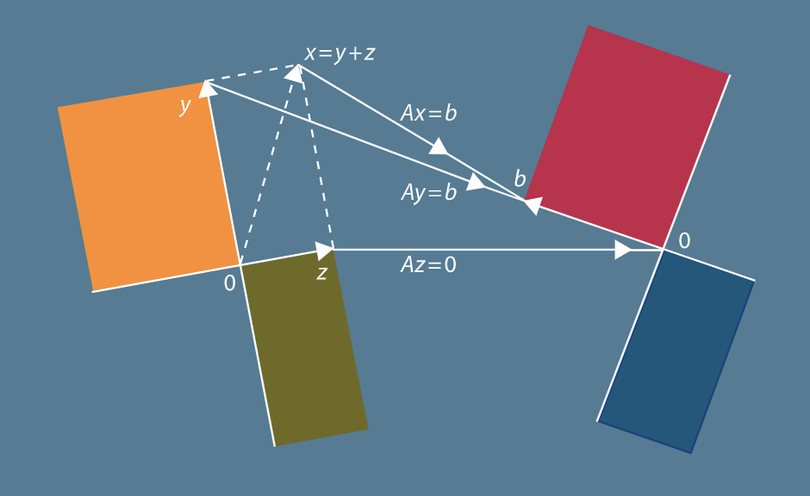



















$$A∈ℝ^{m×n}$$
$$ℝ^{n}$$
$$ℝ^{m}$$
$$x=y+z$$
$$y$$
$$Ax=b$$
$$C(A)$$
$$C\left(A^{T}\right)$$
dim
$$=r$$
dim
$$=r$$
$$Ay=b$$
$$b$$
$$z$$
$$0$$
$$0$$
$$Az=0$$
$$N(A)$$
$$N(A^{T})$$
dim
$$=n−r$$
dim
$$=m−r$$
$$ℝ^{n}=N\left(A\right)+C\left(A^{T}\right)$$
$$N\left(A\right)⊥C\left(A^{T}\right)$$
$$ℝ^{m}=C\left(A\right)+N\left(A^{T}\right)$$
$$C\left(A\right)⊥N\left(A^{T}\right)$$

Slide 47



$$S$$
$$Q$$
$$Λ$$
$$Q^{T}$$
$$λ_{1}q_{1}q_{1}^{T}$$
$$λ_{2}q_{2}q_{2}^{T}$$
$$λ_{3}q_{3}q_{3}^{T}$$
$$=$$
1
2
3
$$λ_{1}$$
$$=$$
1
$$+$$
2
$$+$$
3
$$λ_{2}$$
1
1
2
3
$$λ_{3}$$
2
3

Slide 48


$$A$$
$$U$$
$$Σ$$
$$V^{T}$$
$$σ_{1} u_{1}v_{1}^{T}$$
$$σ_{2} u_{2}v_{2}^{T}$$
$$=$$
$$σ_{1}$$
$$=$$
1
$$+$$
2
1
2
3
1
1
2
$$σ_{2}$$
2
Notes:
to PRE

