Slide 1
TOPIC : INTRODUCTION OF MYSELF

Slide 2

INTRODUCTION
Myself Karan Jinadra, I'm from Veraval But shifted to Ahmedabad in 1st August 2023 for my Study and Career Purpose. I'm very Cheerful and Creative Person

Slide 3

Secondary School In GSEB
EDUCATION BACKGROUND
Higher Secondary School In GSEB
Completed BCA In BKNM University, Junagadh
Tops Technology, Ahmedabad
Currently Pursuing Software Testing Course...

Slide 4


My Short Term Goal is to Became Manual And Automation Tester working in IT Company.
GOALS
My Long Term Goal is to Became QA Manager Working in Reputed IT Company.

Slide 5
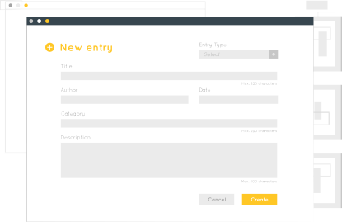

HOBBIES & LIKES
Reading self help books
Gaming
Doing Self Awareness
I like Reading books
I like listening music
I like to spend time in
nature because it makes me Present

Slide 6
STRENGTH AND WEAKNESS
Creative
Hard worker
Organized
Empathize with people
Perfectionist
Very Detail Oriented and
Over Analyse Things
Having Difﬁculty Delegating Tasks

Slide 7


Thanks!
Do you have any questions? jinadrakaran69@gmail.com
+91 8200627567

