Slide 1
Heart Disease Risk Modelling
Phase 1: EDA, Bayesian Networks and Classical Baselines
Advanced Machine Learning · Project 15 · UCI Cleveland data
Aaryan Yadav · Shivam Mishra · Satyam Kumar · Himank Kaushik · Mohammed Yaseen
Prediction exercise only — not clinical decision support
Notes:
Phase 1 covers EDA and classical models. The MLP and SHAP comparison is Phase 2 (Deep Learning).

Slide 2
What Phase 1 tests
H1 · Discretisation
H2 · Structure
H3 · Probabilities
Coarse bins lose information vs continuous inputs
Same learner, bins vs continuous
Domain graph beats Naive Bayes
Interaction-capable learner beats additive model
Families differ in calibration
Not only in ranking ability
Notes:
H1 and H2 come from the brief's 'identify the gap'. H3 is ours because the brief asks for calibration. Phase 1 answers them without a neural network so Phase 2 knows exactly what the MLP must add.

Slide 3
What the literature says
Models and data
Probability quality and testing
Cleveland data come from a multi-site coronary disease study (Detrano 1989)
BN = factorised joint, exact inference (Pearl 1988); BDeu smoothing (Heckerman 1995)
NB can rank well despite wrong independence (Domingos & Pazzani 1997)
Richer graphs do not always beat NB (Friedman 1997)
NB pushes probabilities to 0/1; logistic regression is usually calibrated; forests compress (Niculescu-Mizil & Caruana 2005)
Neural nets are often over-confident (Guo 2017): check calibration in Phase 2
Corrected resampled t-test for repeated CV (Nadeau & Bengio 2003)

Slide 4
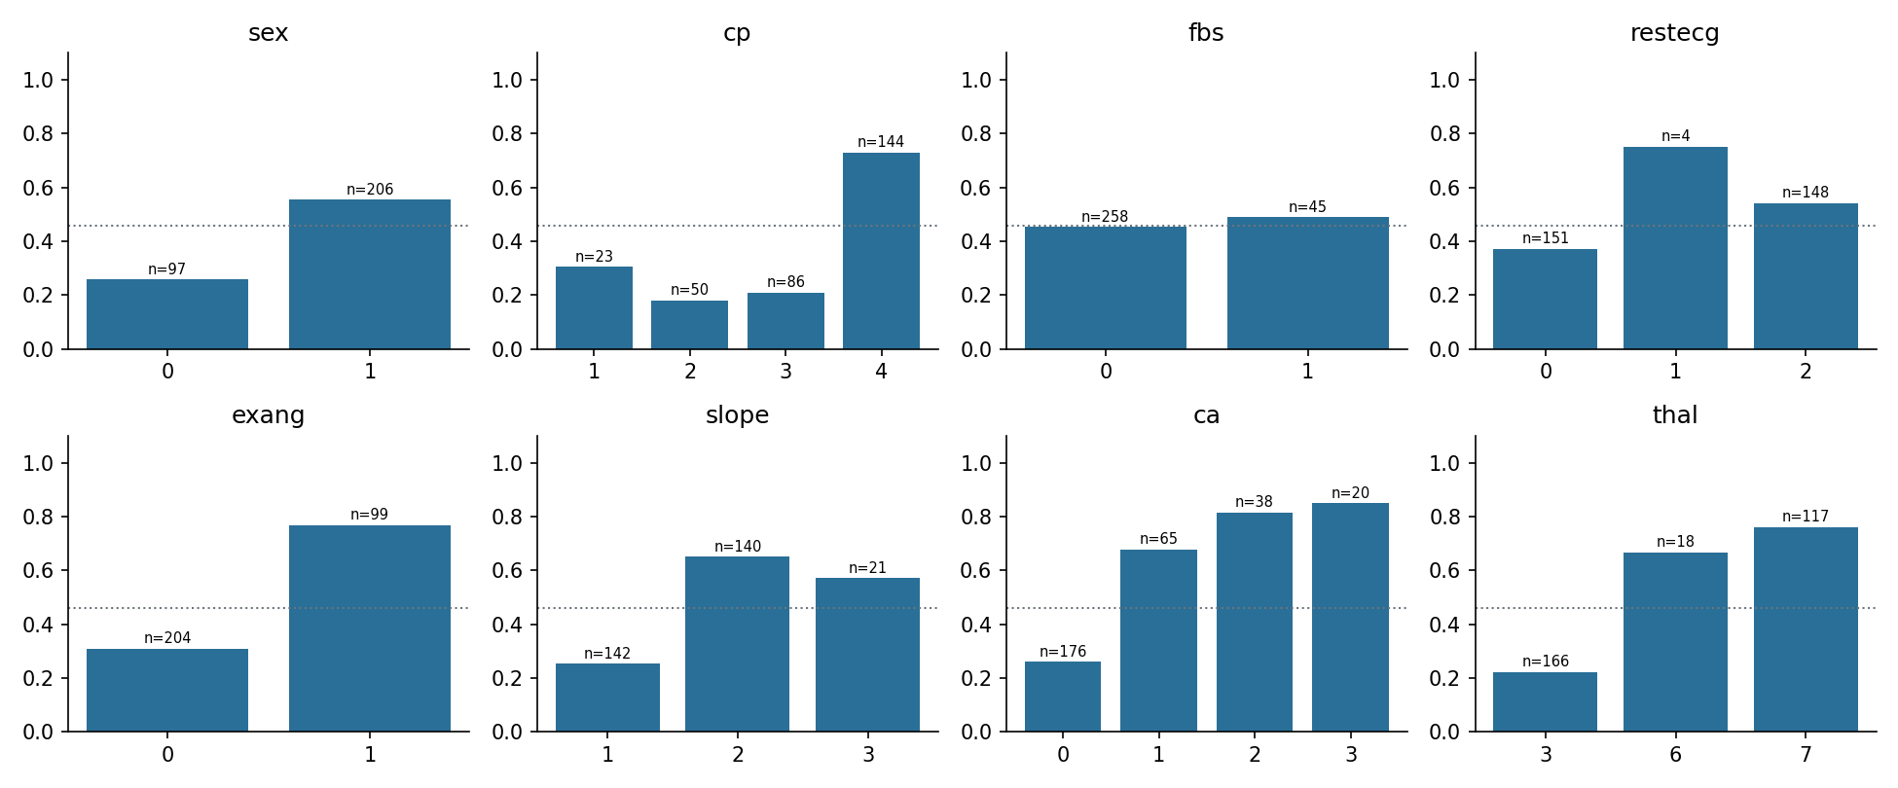
Data and what the EDA shows
303 patients, 13 predictors; target = existing angiographic disease (narrowing > 50%): 139 pos / 164 neg
68% male: disease 55% in men vs 26% in women
Asymptomatic chest pain: 73% disease (n = 144)
0 coloured vessels: 26% vs 68–85% with 1–3
Disease patients: older (56.6 vs 52.6), lower max HR (139 vs 158), more ST depression (1.57 vs 0.59)
6 missing values (ca 4, thal 2); no patient IDs, so independence is assumed
Notes:
Target is defined explicitly. Strongest signals: thal, cp, ca, oldpeak, exang. BP and cholesterol are weak on their own.

Slide 5
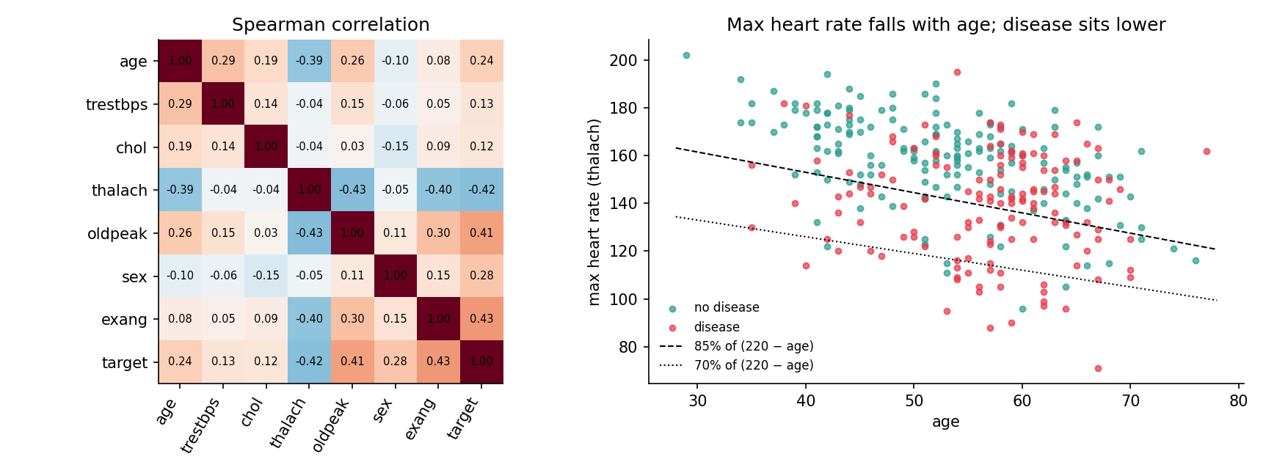
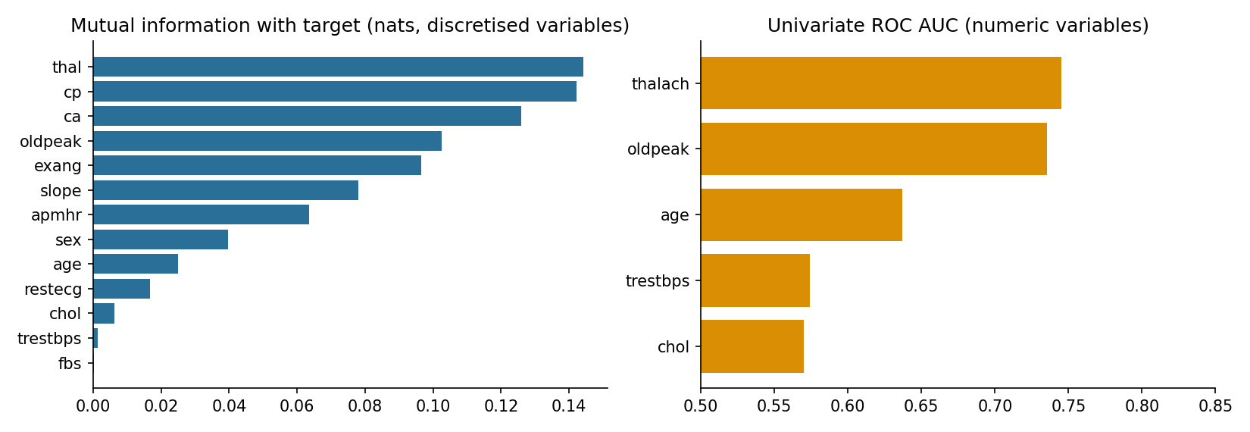
EDA motivates the model structure
Max heart rate falls with age (Spearman −0.39)
Blood pressure rises with age (+0.29) → edge age → BP
Use peak HR as % of (220 − age)
Top signals (full-data, exploratory; associations, not causes): thal, cp, ca, oldpeak, exang
Notes:
Max HR falls with age (-0.39) so we use an age-adjusted peak HR; BP rises with age (+0.29) so the BN has an age to BP edge.

Slide 6
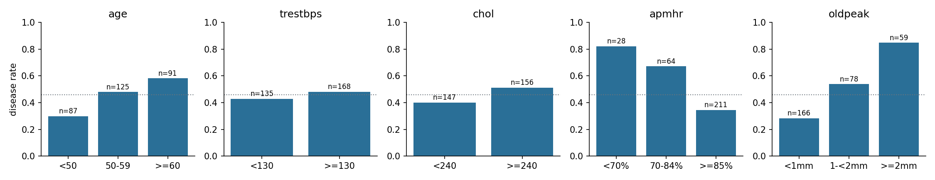
Fixed discretisation: modelling choices
Variable | Cut points | Rationale (not a diagnosis)
age | 50, 60 | decade bands
trestbps | 130 | common BP threshold
chol | 240 | common 'high' cholesterol cut
peak HR % | 70%, 85% of (220 − age) | age-adjusted HR feature
oldpeak | 1, 2 mm | ST-depression bands
Notes:
Cut points are clinical conventions fixed a priori, never learned, so they cannot leak test information.

Slide 7
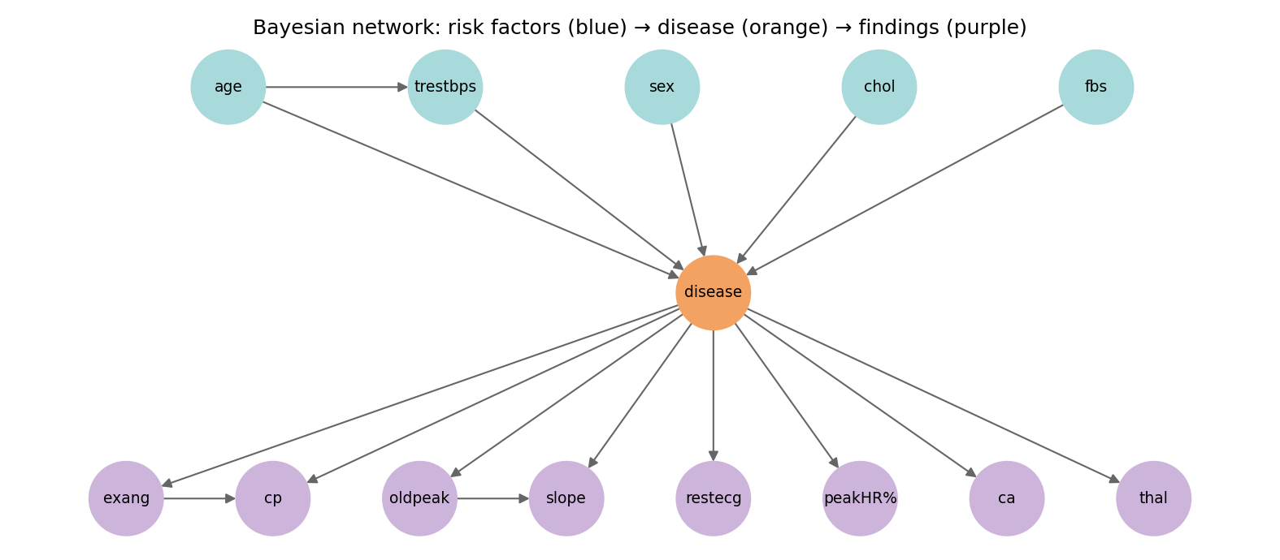
Models and fair-comparison protocol
Bayesian net (pgmpy)
14 nodes, 16 edges; risk factors → disease → findings; BDeu (ESS 5); exact inference
Naive Bayes: same pipeline, star graph
References
Logistic regression (binned / continuous), random forest, prior-only
Protocol: stratified 5-fold CV × 5 repeats (seed 2026) · same splits for all · training-fold-only preprocessing · ROC AUC, PR AUC (= average precision), sens./spec. at 0.5, Brier, ECE, calibration slope · 500-draw patient bootstrap + corrected t-test (exploratory; not an equivalence test)
Notes:
BN differs from NB only in structure; same estimator and inference. LogReg on discretised inputs isolates structure; LogReg continuous isolates discretisation.

Slide 8
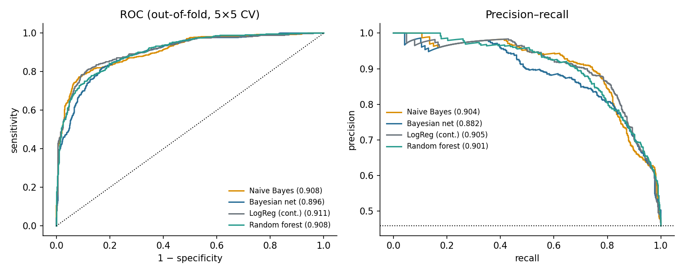
Discrimination: no differences detected
Model | ROC AUC [95% CI] | PR AUC (AP) | Sens. | Spec. | Brier
Naive Bayes | 0.908 [0.874, 0.939] | 0.904 | 0.791 | 0.888 | 0.126
Bayesian net | 0.896 [0.861, 0.927] | 0.882 | 0.778 | 0.851 | 0.139
LogReg (disc.) | 0.907 [0.870, 0.938] | 0.898 | 0.809 | 0.888 | 0.118
LogReg (cont.) | 0.911 [0.875, 0.941] | 0.905 | 0.804 | 0.889 | 0.116
Random forest | 0.908 [0.869, 0.938] | 0.901 | 0.787 | 0.855 | 0.125
Notes:
No pairwise AUC difference is significant (corrected p between 0.13 and 0.59). BN is slightly lowest on PR AUC and Brier.

Slide 9
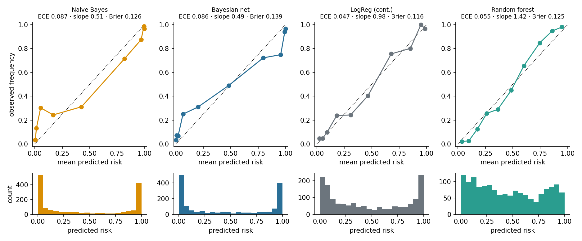
The real difference: calibration
Calibration slope (ideal 1): NB 0.51 · BN 0.49 · LogReg 0.98 · RF 1.42 (below 1 = over-extreme, above 1 = compressed)
Notes:
H3 supported. BN/NB are over-confident (slope ~0.5): correlated evidence is double counted. RF is under-confident. Logistic regression is near-calibrated, hence best Brier.

Slide 10
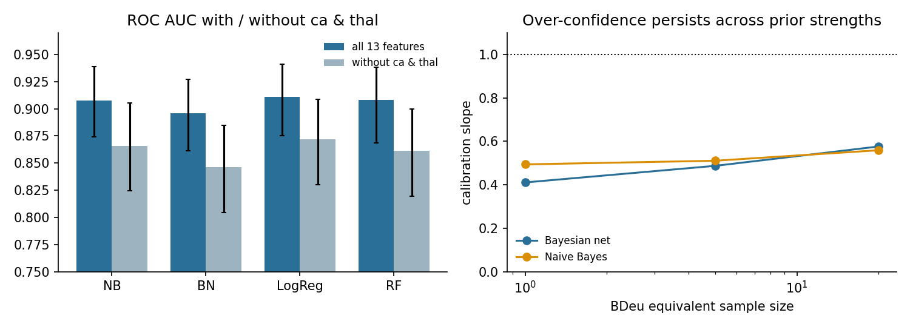
H1 and H2: not supported here
Matched-HR control: binned − continuous ΔAUC −0.004 [−0.013, 0.004], p = 0.62; no loss detected
BN not better than NB; RF not better than logistic regression
On identical binned inputs BN trails logistic regression in Brier (+0.021): points to model form rather than binning
Without ca/thal: all models −0.04 to −0.05 AUC; BN still over-confident
Notes:
Binning cost -0.004 AUC for logistic regression, CI includes 0. RF vs logistic regression -0.003, p = 0.59. Dropping ca/thal lowers every model by 0.04-0.05 AUC.

Slide 11
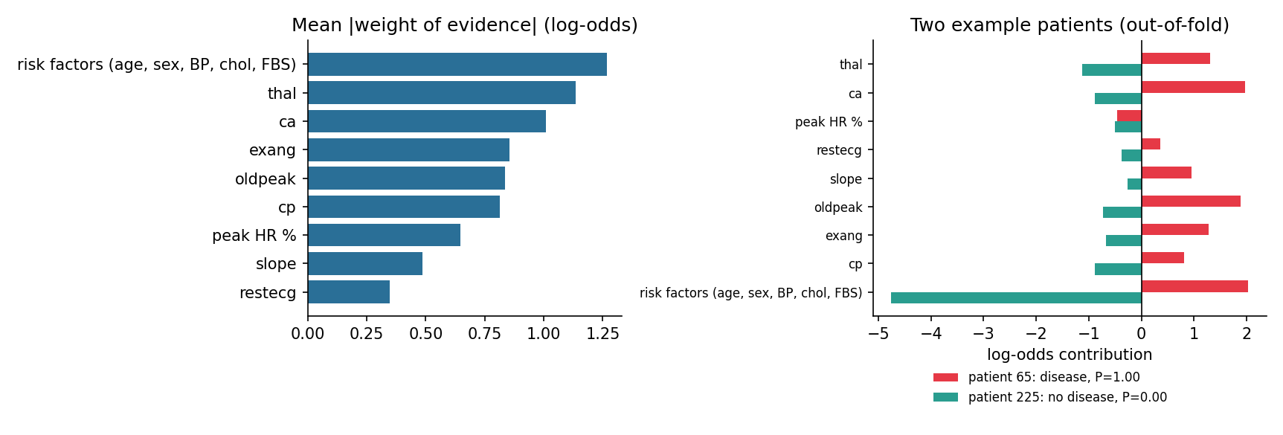
Exact explanations from the Bayesian net
Posterior log-odds = risk-factor term + one weight of evidence per finding (exact; checked on the 297 complete-evidence rows)
Illustration, not a tested cause: in patient 252 several positive findings add up to P = 1.00 (no disease)
Notes:
The decomposition matches pgmpy's variable elimination to 2e-16. Patient 252 (no disease) gets P=1.00 from several moderately positive terms multiplied together.

Slide 12
Conclusions, limits and Phase 2
Phase 1 conclusions
Limits and Phase 2
Ranking is similar (AUC 0.896–0.911); no differences detected
No benefit from bins or the domain graph here
BN and NB over-confident; LogReg near-calibrated
Clearest gap: probability quality, not ranking
n = 303, one clinic, 1980s; no external validation
EDA-informed graph and cuts; no nested tuning
Phase 2 (planned): regularised MLP on the same splits, compared on AUC and calibration; SHAP vs BN weights
Notes:
Be upfront: small historical single-centre dataset, ca and thal near-diagnostic, no external validation, not medical advice.

