Slide 1
Machine Learning for 6G Indoor Localization Using 802.11az and Chirp Fingerprinting
FH13: Gagan Kaushik, Jean Lee, Brian Menezes, Matthew Qin, Justin Swinney
Faculty Mentor: Dr. Brian Evans

Slide 2
Current indoor localization strategies provide insufficient estimates for 6G applications such as…
Digital twins
XR
Compliant manufacturing
Indoor navigation
Autonomous vehicles
1 meter
1 cm
Notes:
https://www.ericsson.com/en/blog/2020/12/5g-positioning--what-you-need-to-know
Intro
6g 2030 target: Wireless indoor localization towards 1cm 1ms accuracy to make better digital twins/extended reality
Our goal in 2022: approach that standard (so we can support that demand) with current broadband technologies powered by machine learning
Meta changed 6gs priorities of indoor localization from improving data rate to also prioritizing low latency and reliability so that we can create better digital analogies of the world around us
(7mx5mx2m sim environment)

Slide 3

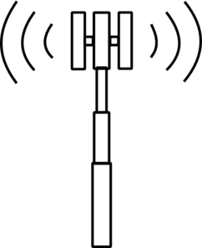

Notes:
https://www.vectorstock.com/royalty-free-vector/mobile-phone-icon-vector-2382356
http://www.clker.com/cliparts/p/J/4/h/8/Y/cell-tower-md.png
https://static.thenounproject.com/png/61163-200.png

Slide 4
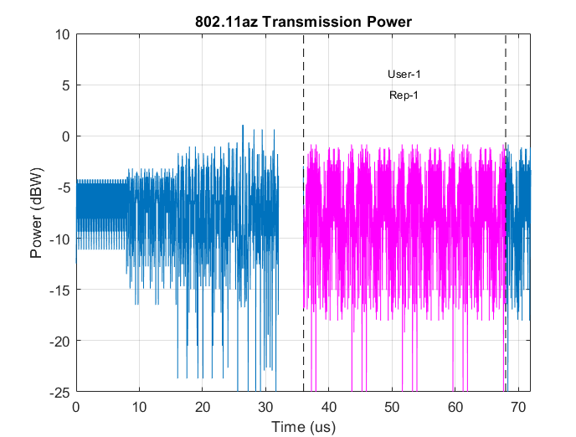
802.11az Fingerprint Simulation
Current wi-fi standard
Tailored for indoor localization
160 MHz band
70 microsecond transmission
Notes:
Justin

Slide 5
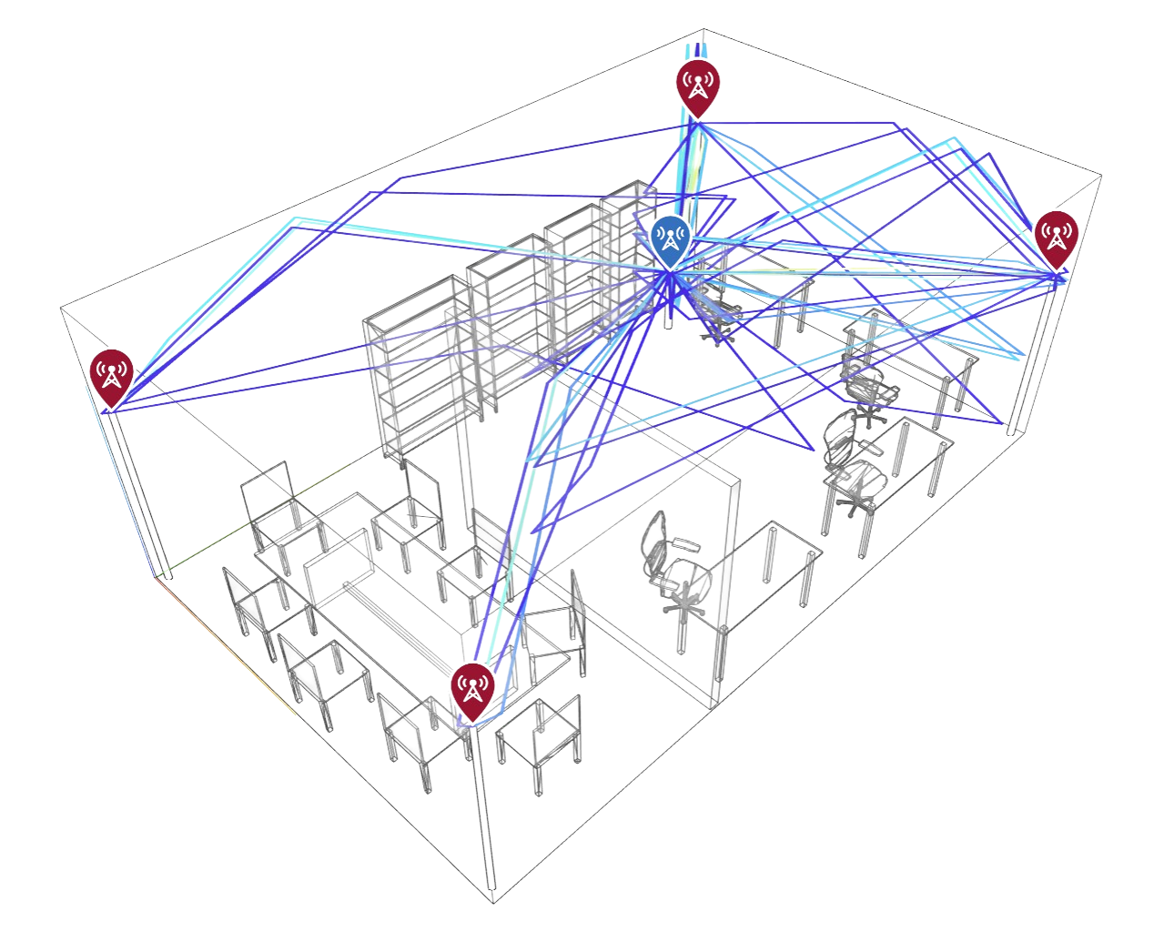
802.11az Fingerprint Simulation
Transmission is simulated from 4 access points and supports…
Propagation
Reflection
Absorption
Notes:
Justin

Slide 6
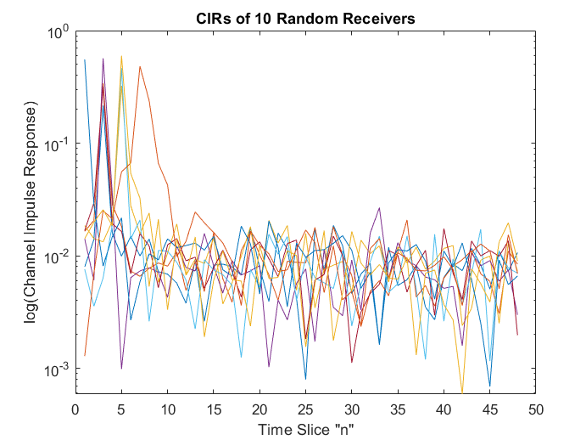
802.11az Fingerprint Simulation
Complex behaviors→Unique received signal
Recorded as CIR (Channel Impulse Response)
48 slices per transmission channel, 4 channels per transmitter, 4 transmitters
Notes:
Justin

Slide 7
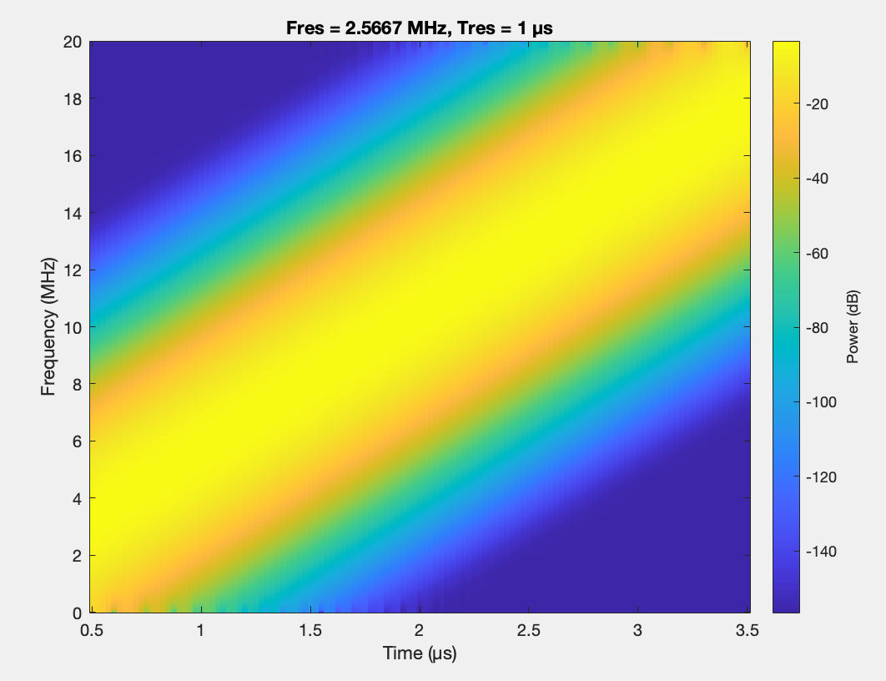
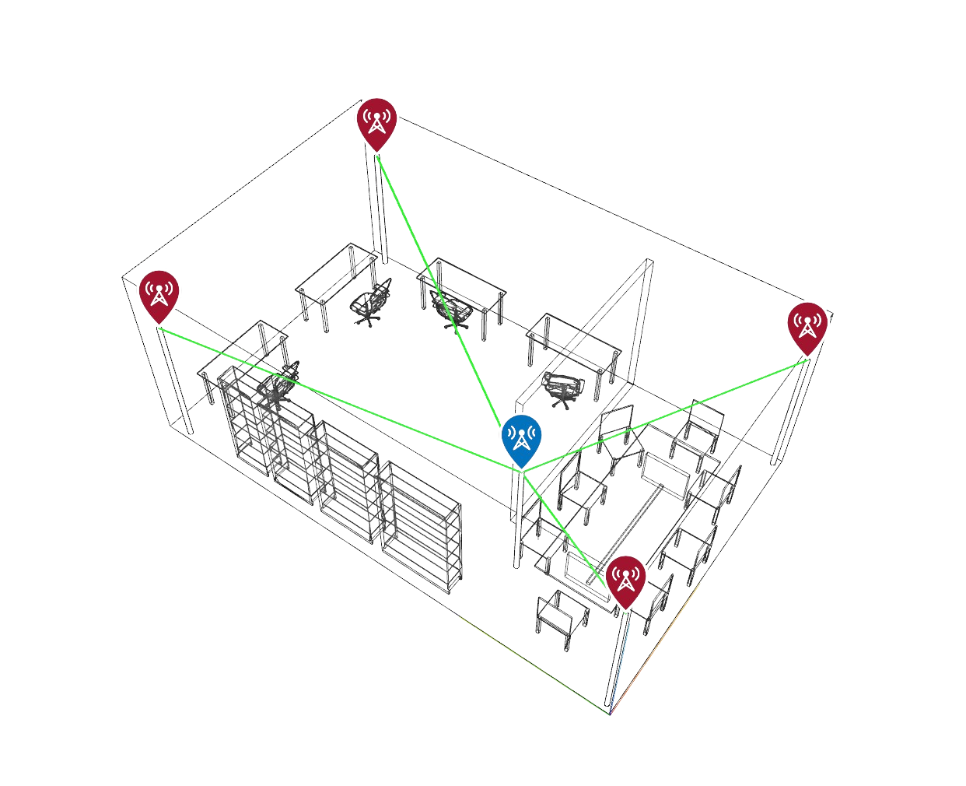
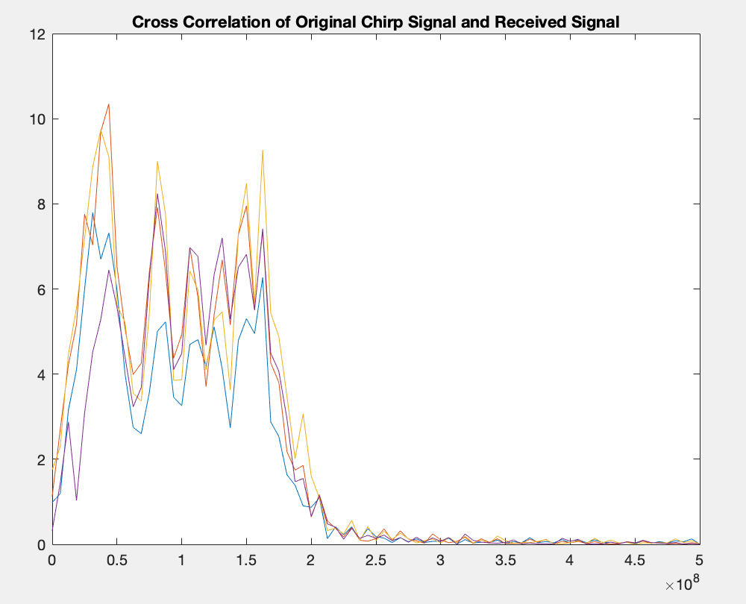
Chirp Cross-Correlation Simulation
Why Chirp?
Approach
4 transmitters take turns
Cross-correlation of reference chirp signal with received signal
Fast Fourier Transform of correlated signal
Trilateration: 2 to 3 meter-accuracy
Notes:
Jean

Slide 8
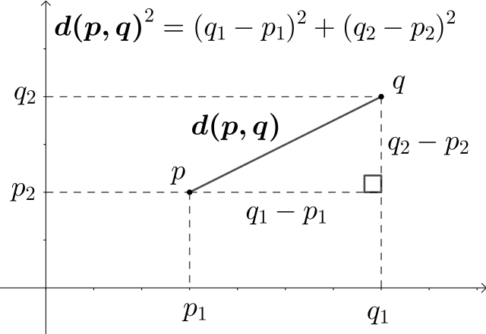
Machine Learning - Model Goal
The neural networks are trained to predict the location of the user.
The output of the network are the predicted (X,Y,Z) coordinates of the device in 3D space.
Design Goals
Predict location of end user with accuracy of at least 1m
Minimize complexity of network to increase speed and memory efficiency
Notes:
Matthew

Slide 9
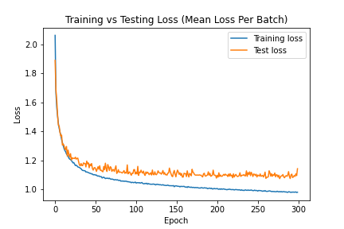
Machine Learning - Initial Findings
Initial attempt trained on 802.11az dataset using Keras
Shallow network with 1 fully connected layer
Achieved accuracy of ~1.1m
Notes:
Matthew

Slide 10
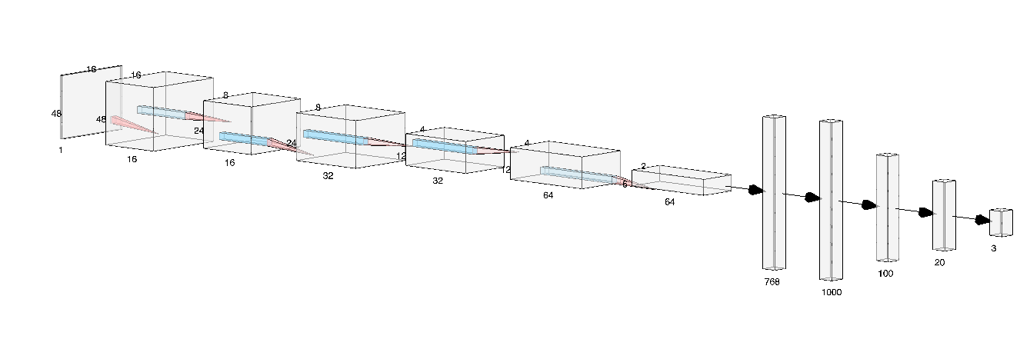
Machine Learning - Further Development
Convolutional Neural Network with an architecture similar to that of VGG (Visual Geometry Group CNN).
Consists of convolutional layers, batch normalization layers, ReLU activations, max pooling layers, and linear layers.
Notes:
Gagan

Slide 11
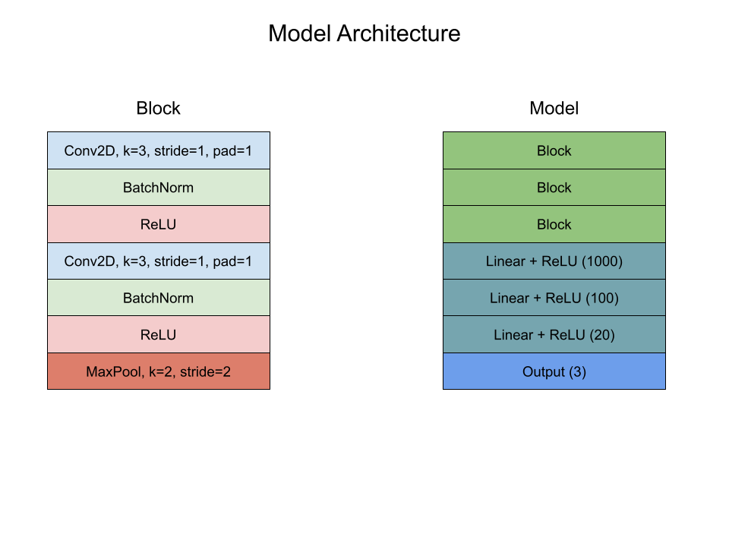
Machine Learning - CNN cont.
Preprocessing
Reshaped transmitter and channel dimensions into a single dimension
Standardization based on training set statistics
Training
Data parallel training on DGX
802.11az waveform simulation dataset
Batch size = 128
Training loss function: MSE
Test metric: Euclidean Distance
Adam Optimizer, lr = 0.001
100 epochs
Notes:
Gagan

Slide 12
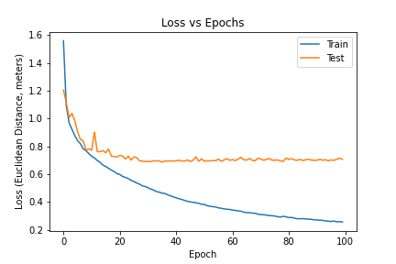
Machine Learning - End Result
Model trained on 802.11az dataset achieved an accuracy of 70 cm
Chirp signal dataset underperformed and had an accuracy of 2.2 m
Overfitting was significant
Dropout did not seem to help
Notes:
Gagan

Slide 13
Machine Learning - Further Work
Larger and more diverse datasets
Different types of networks or combination of networks
Apply online learning
Notes:
Matthew

Slide 14
Conclusion
Outperforms 5G by 30% and trilateration by 65%
Time scale is assumed to be almost instant
802.11az provides the most information about waveform
While further work is needed, 6G has shown to work well in indoor microcell settings and outperforms previous generations

