Slide 1


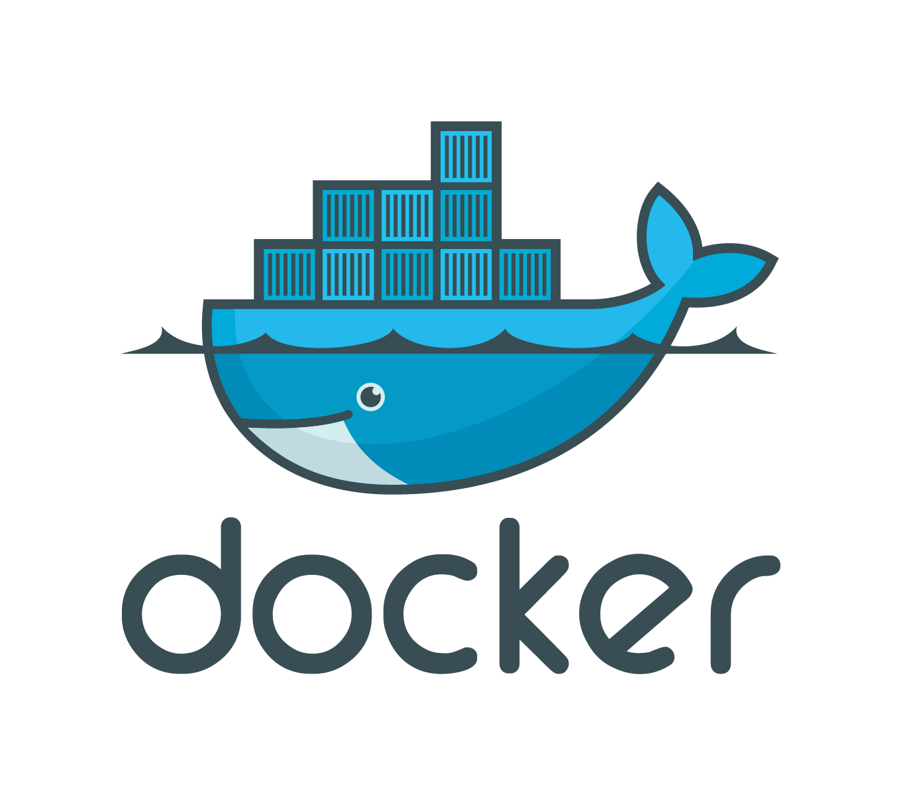




ALB
CE | VE
CE | VE
BIG-IP
BIG-IP
< VNET >
ELB
Microsoft Azure
Clients
CE | VE
CE | VE
VPN
IPsec
BIG-IP
BIG-IP
< VPC >
VPN
IPsec
Amazon Web Services
Firewall
Lab Environment
San Jose DC
Boston DC
Seattle DC
Paris DC
SSLO
VE
FPS
SSLO
VE
Management and Analytics
BIG-IP
VE
VE
VE
BIG-IP
HTTP/TCP Traffic
BIG-IP
BIG-IP
BIG-IP
SSLo Traffic
SSLo Service
TAP (fireEye)
SSLo Service Inline L2 (TrandMicro DDi)
VE
VE
BIG-IQ
BIG-IQ
GitLab
F5® BIG-IQ®
CM
DCD
Centralized
Management
Console
Data
Collection
Device

Slide 2

ALB
SSG1
Auto Scale Group
CE | VE
CE | VE
< VNET >
BIG-IP
BIG-IP
ELB
Microsoft Azure
SSG1
Clients
Auto Scale Group
VPN
IPsec
CE | VE
CE | VE
< VPC >
BIG-IP
BIG-IP
VPN
IPsec
Amazon Web Services
Firewall
Lab Environment
San Jose DC
Boston DC
Seattle DC
Paris DC
SSLO
VE
FPS
SSLO
VE
Management and Analytics
BIG-IP
VE
VE
VE
BIG-IP
HTTP/TCP Traffic
BIG-IP
BIG-IP
BIG-IP
SSLo Traffic
SSLo Service
TAP (fireEye)
SSLo Service Inline L2 (TrandMicro DDi)
VE
VE
BIG-IQ
BIG-IQ
GitLab
F5® BIG-IQ®
CM
DCD
Centralized
Management
Console
Data
Collection
Device

