Slide 1
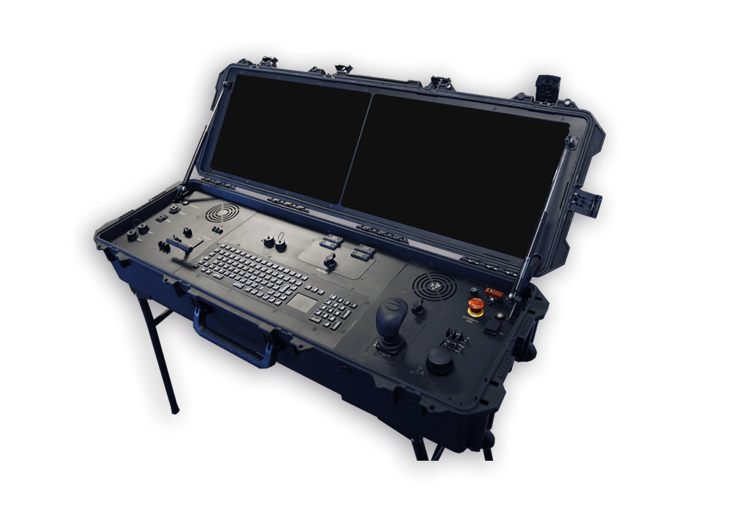
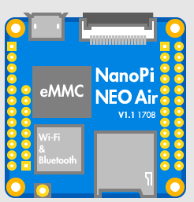
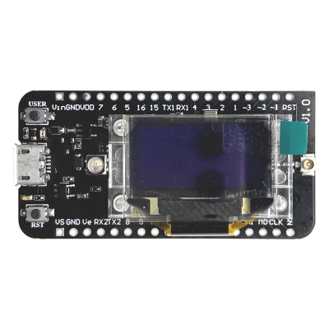
Message Received:
cpu temp: 37c
Satellite
Ground Station
Nanopi
Nanopi ON
cpu temp: 37c
Nanopi OFF
LoRa 2.4Ghz Signals
Cube Cell Receiver
Cube Cell Sender
MSG: cpu

Slide 2
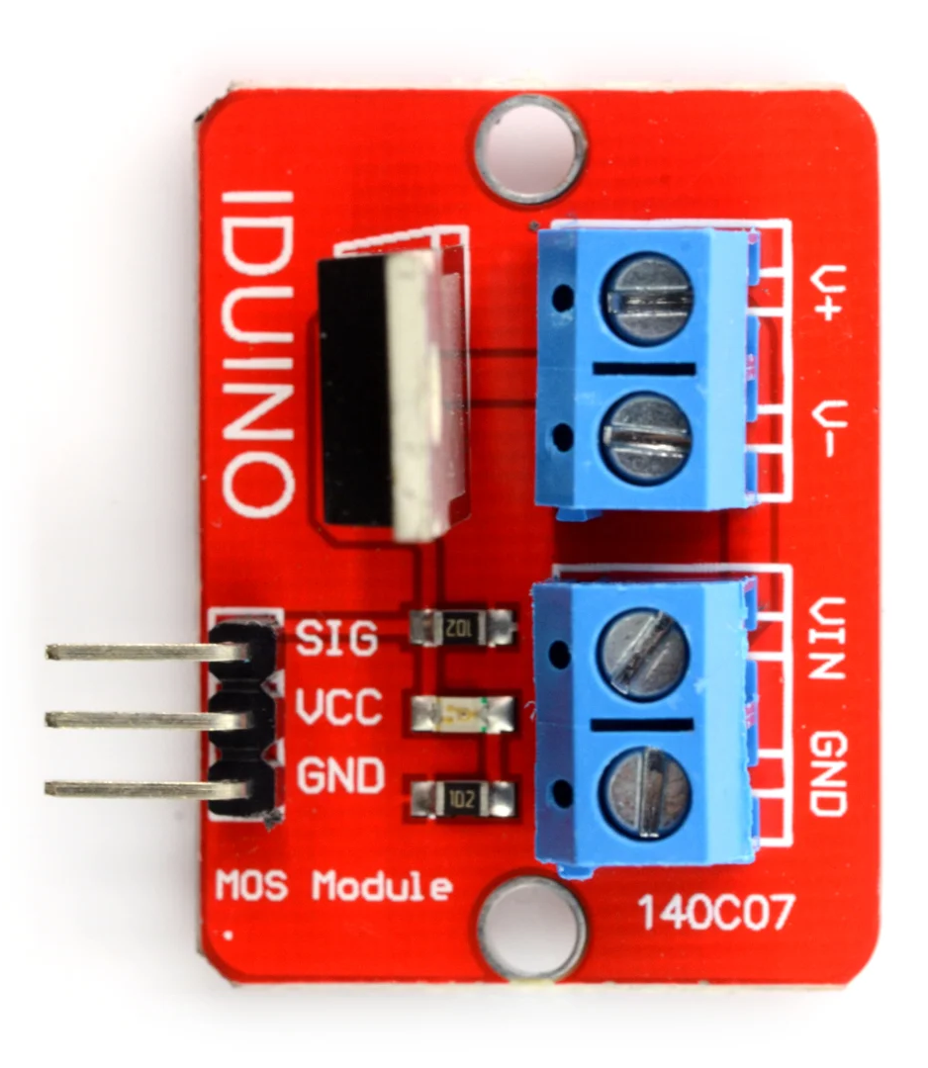
Nanopi neo air
Wiring
PIN2
PIN3
PIN7
PIN2
Mosfet 140c07
RX2
TX2
Cube Cell AB02S (GPS)

