Slide 1
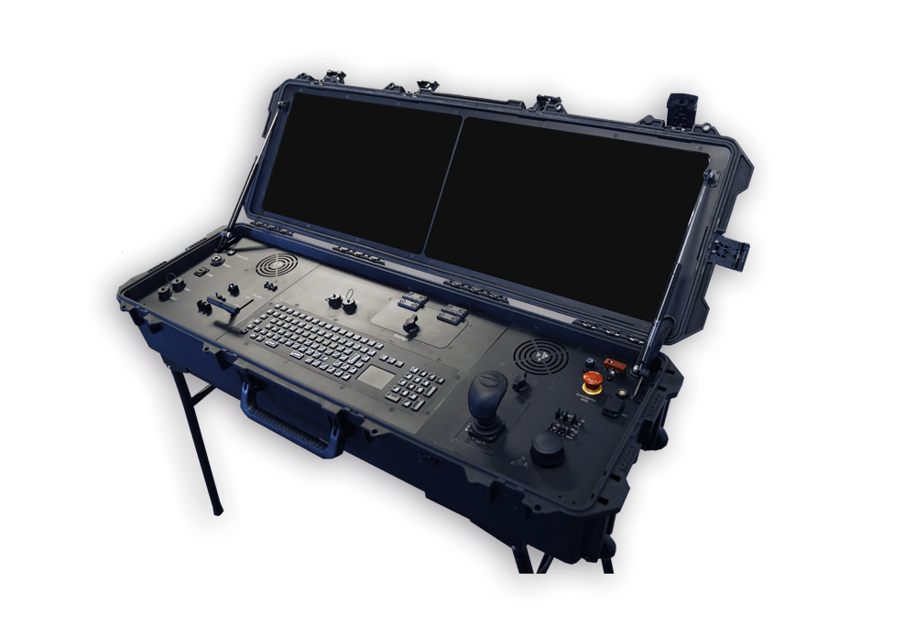
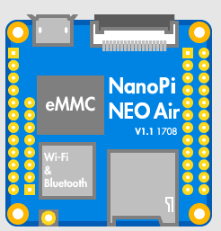
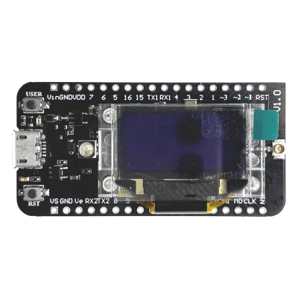
Message Received:
cpu temp: 37c
Satellite
Ground Station
Nanopi
Nanopi ON
cpu temp: 37c
Nanopi OFF
LoRa 2.4Ghz Signals
Cube Cell Receiver
Cube Cell Sender
MSG: cpu

