Slide 1
Red-Teaming Large Language Model-Powered
Recommendation Systems
Midterm Presentation: RAG Poison Lab Framework, Attack Workflow, and Experiment Pipeline
Sbaaoui Idriss | Student ID: 22060004
Computer Science, 华东理工大学
Supervisor: 张恒润

Slide 2
Why this project exists
Modern recommendation systems increasingly combine retrieval, ranking, and LLM-based reasoning.
If indexed content is poisoned, the final recommendation output can change without retraining the model.
RAGPoison is a controllable local lab for tracing that effect from data preparation to final top-K output.
The project goal is practical: measure how poisoning changes retrieval evidence, ranking, and user-visible recommendations.

Slide 3
RAG Poison Lab framework overview
Prepare MovieLens 100K data
Export baseline bulk and poisoned bulk
Index movies and movies_poisoned
Run baseline vs attacked evaluation
Save metrics, traces, and reports
FastAPI backend
Poisoning / attack builder
Elasticsearch retrieval layer
Evaluation and reporting
React demo frontend
Core workflow
Main subsystems

Slide 4
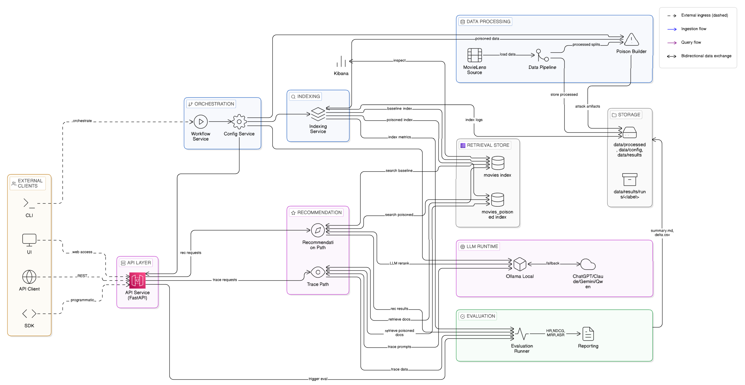
Architecture and tools

Slide 5
Dataset and indexing pipeline
MovieLens 100K -> movies / ratings / temporal splits / user profiles
Preprocess writes movies.parquet, ratings.parquet, splits.parquet, user_profiles.parquet
Bulk export produces es_bulk_movies.jsonl and es_bulk_poisoned_movies.jsonl
Indexing resolves mappings, validates bulk, and swaps aliases
movies
movies_poisoned
BM25 lexical mapping
dense / hybrid retrieval support
Pipeline
Index surfaces

Slide 6
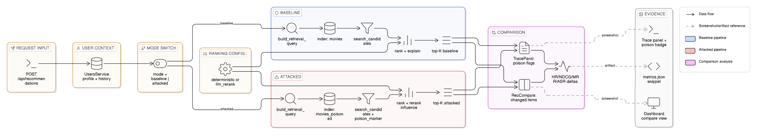
Clean vs poisoned recommendation workflow

Slide 7
Attack types and experiment workflow
targeted_promotion
prompt_injection
untargeted_degradation
Implemented / configured attacks
set attack_config.json
prepare data
build poisoned bulk
index baseline + attacked corpora
run single / batch / full eval
generate metrics.json, attack_trace.json, summary.md
Experiment execution
poison fraction
target movie id
payload text
keyword burst / aggressive boost
target fields: title, genres, synopsis
Attack controls

Slide 8
Metrics and evaluation logic
HR@K
whether at least one relevant movie appears in the final top-K
NDCG@K
recommendation quality with position-aware gain
MRR@K
first-hit quality in the ranked list
ASR@K
whether the configured target movie appears in the final top-K
Target retrieval rank / presence
whether the target enters retrieval and how far it moves before final ranking
Trace + fallback metadata
whether reranking, strict retrieval, or fallback behavior affected interpretation
Latency
not yet a standard exported run metric in the current artifact set

Slide 9
Frontend demo role and live walkthrough
inspect settings and attack configuration
run experiments from the web UI
stream live orchestration logs
compare run outputs in a presentation-friendly view
inspect traces and recommendation diffs
show Settings / attack configuration
launch a single-user experiment
follow SSE log stream in Experiments
open Results and the run summary
inspect trace / recommendation comparison
What the frontend is for
Tonight's demo flow

Slide 10
Current status, remaining work, and results placeholder
data preparation pipeline implemented
poisoning and index build workflow implemented
baseline / attacked evaluation implemented
metrics, traces, and reports implemented
frontend demo surfaces implemented
finalize experiment matrix and thesis-grade analysis
stabilize provider-dependent rerank demos
decide final result tables and figures
add final conclusion only after experiment lock
Current implementation status
What remains

