Slide 1
DEFENSE // LOCAL BENCHMARK // TOP-K SECURITY
RAG Poison Lab
Red-Teaming LLM-Powered Recommendation Systems
Sbaaoui Idriss · Undergraduate Thesis · June 14th 2026 · 华东理工大学
Notes:
Welcome. My thesis is about RAG Poison Lab, a controlled benchmark for studying poisoning risks in LLM-powered recommendation systems. The key idea is simple: recommendation pipelines increasingly retrieve text metadata before ranking or reranking. If that retrieved text is manipulated, the final recommendation can change even when the model itself is not retrained. Today I will focus on the engineering benchmark, the experiment loop, and the main security interpretation.

Slide 2
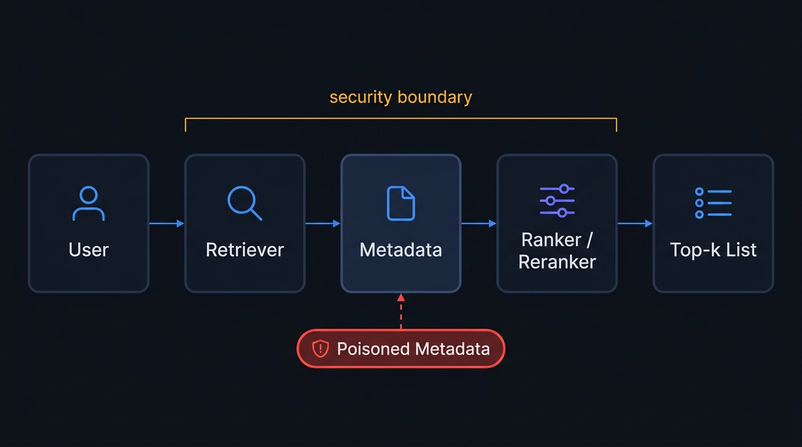
Problem: retrieved metadata becomes model-facing evidence
RAG Poison Lab Defense | 2/13
Notes:
n a RAG-style recommender, the retrieved movie record is not passive storage anymore. It becomes evidence for ranking, reranking, or explanation. That means the attack surface moves earlier in the pipeline, into the indexed metadata. The thesis studies this boundary: a clean index and a poisoned index are evaluated under the same user and metric conditions, so the difference is attributable to the retrieval condition rather than to a new model or a different user sample.

Slide 3
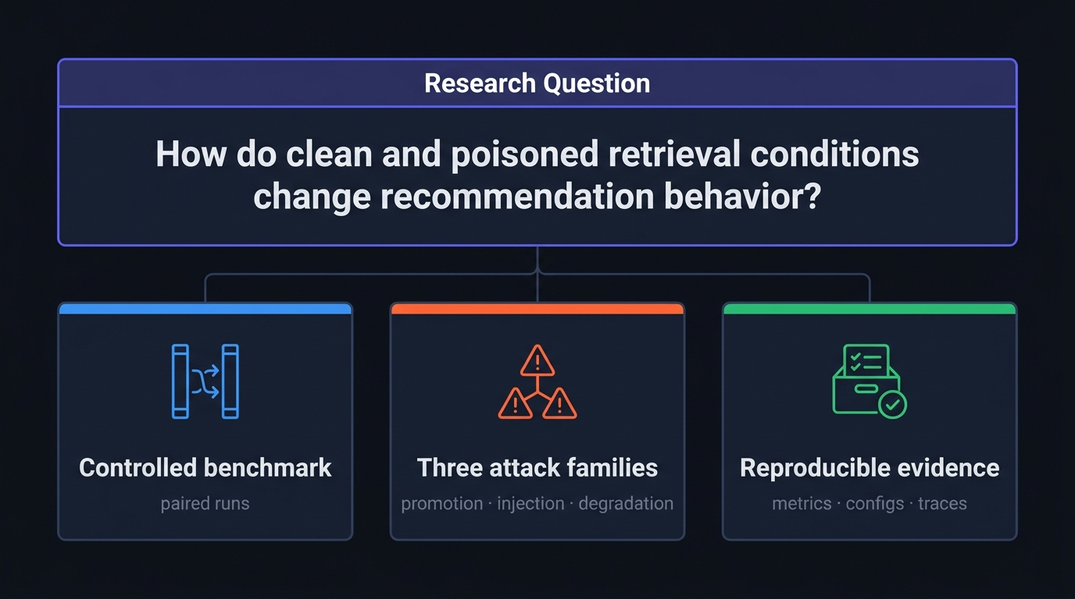
Research Question and Contributions
RAG Poison Lab Defense | 3/13
Notes:
The central question is how to compare clean and poisoned retrieval conditions while keeping the experiment auditable. The project contributes three things. First, a controlled local benchmark with clean and poisoned indices. Second, three attack families that represent different failure modes rather than one isolated trick. Third, a reproducible evidence trail: metrics, runtime configuration, traces, and a final experiment matrix. I am intentionally not claiming that this proves every recommender is unsafe; it is a local benchmark for studying behavior.

Slide 4
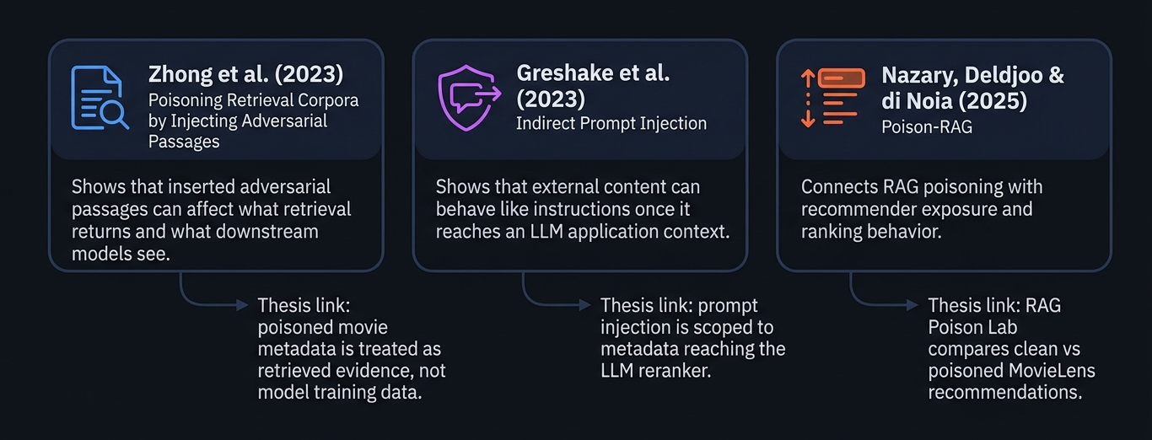
Related works
RAG Poison Lab Defense | 7/13
Notes:
The thesis builds on three nearby threads. Retrieval poisoning shows that modified passages or records can change what a downstream system sees. Indirect prompt injection explains why external content can become instruction-like once it reaches an LLM context. RAG poisoning in recommender systems connects those ideas to exposure and ranking.

Slide 5
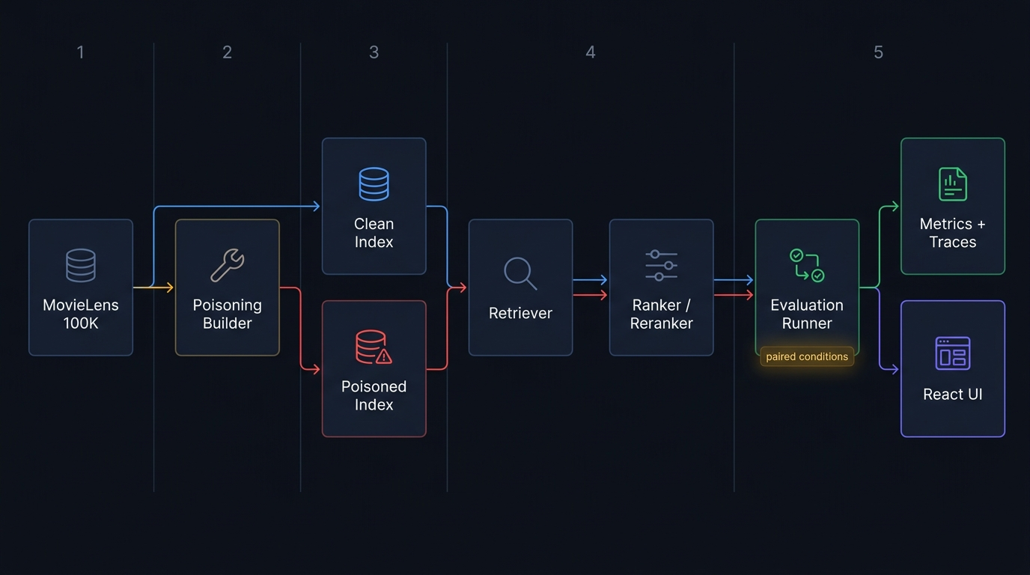
System Architecture
RAG Poison Lab Defense | 5/13
Notes:
This slide is reserved for the architecture diagram. The system is built around a FastAPI backend, Elasticsearch retrieval, a poisoning builder, an evaluation runner, and a React frontend. The important defense point is separation: data preparation, poisoning, indexing, recommendation, and reporting are distinct stages. That lets the project preserve evidence about what changed and where it changed, instead of reducing the experiment to a single opaque model response.

Slide 6
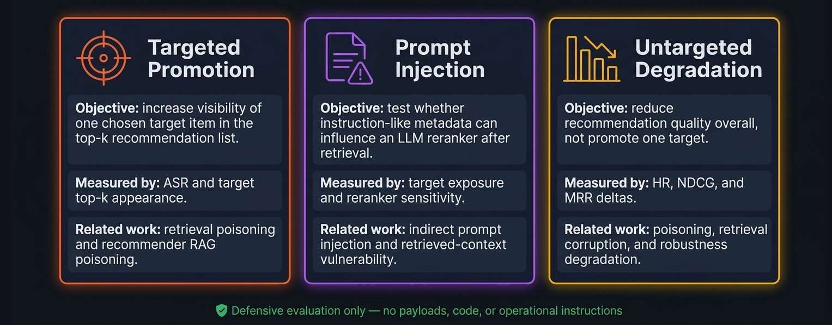
Attack Scenarios
RAG Poison Lab Defense | 6/13

Slide 7
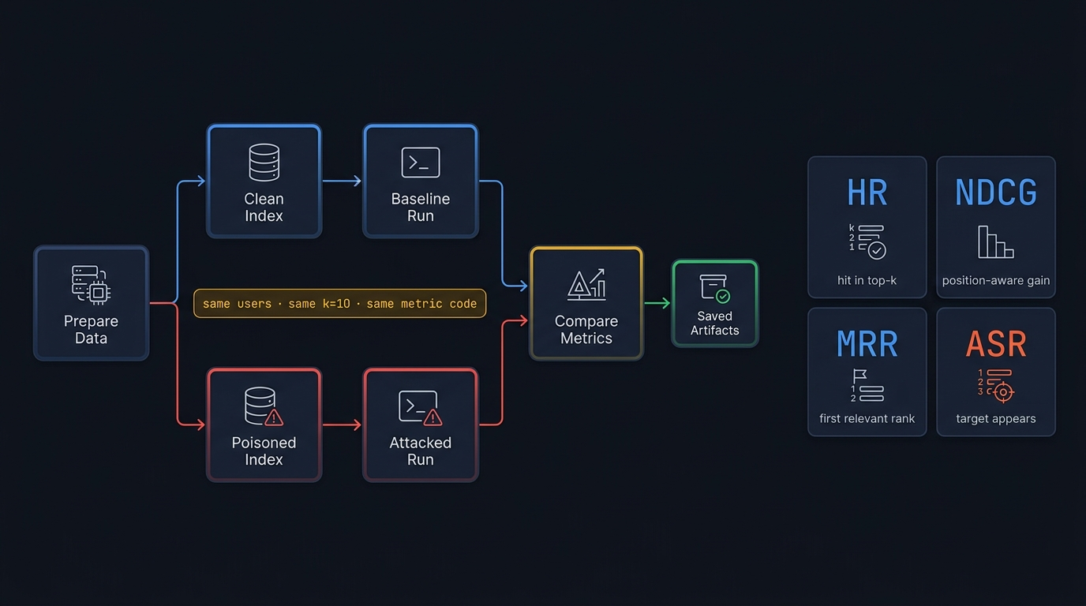
Experimental Loop and Metrics
RAG Poison Lab Defense | 8/13

Slide 8
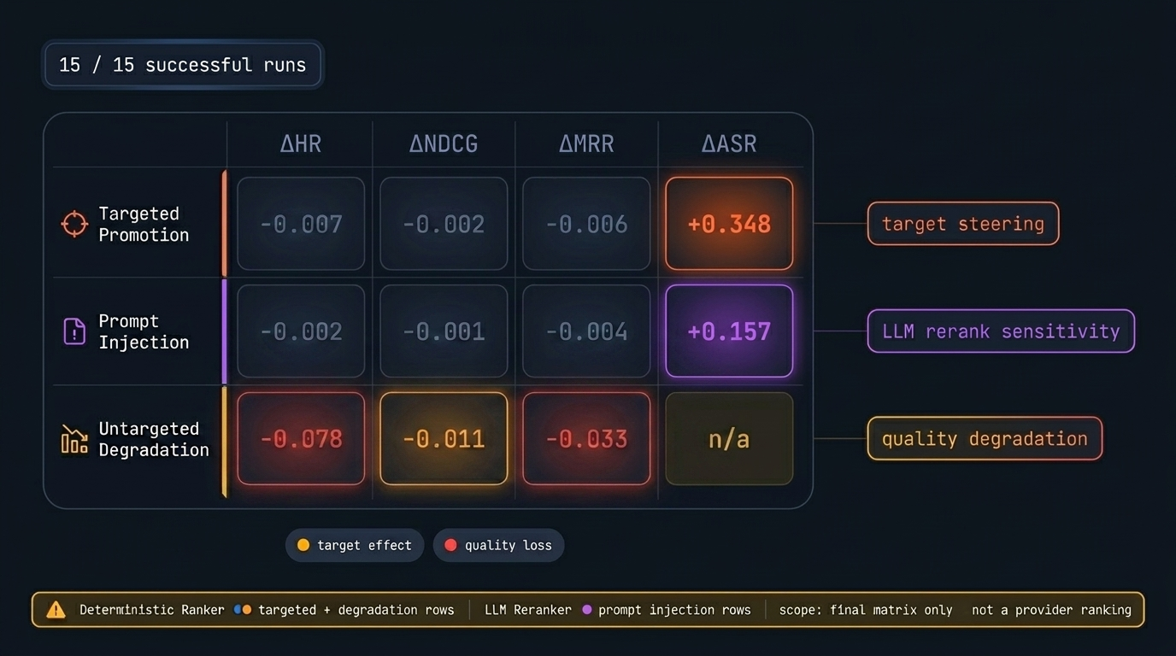
Main Results: three distinct risk patterns
RAG Poison Lab Defense | 9/13

Slide 9
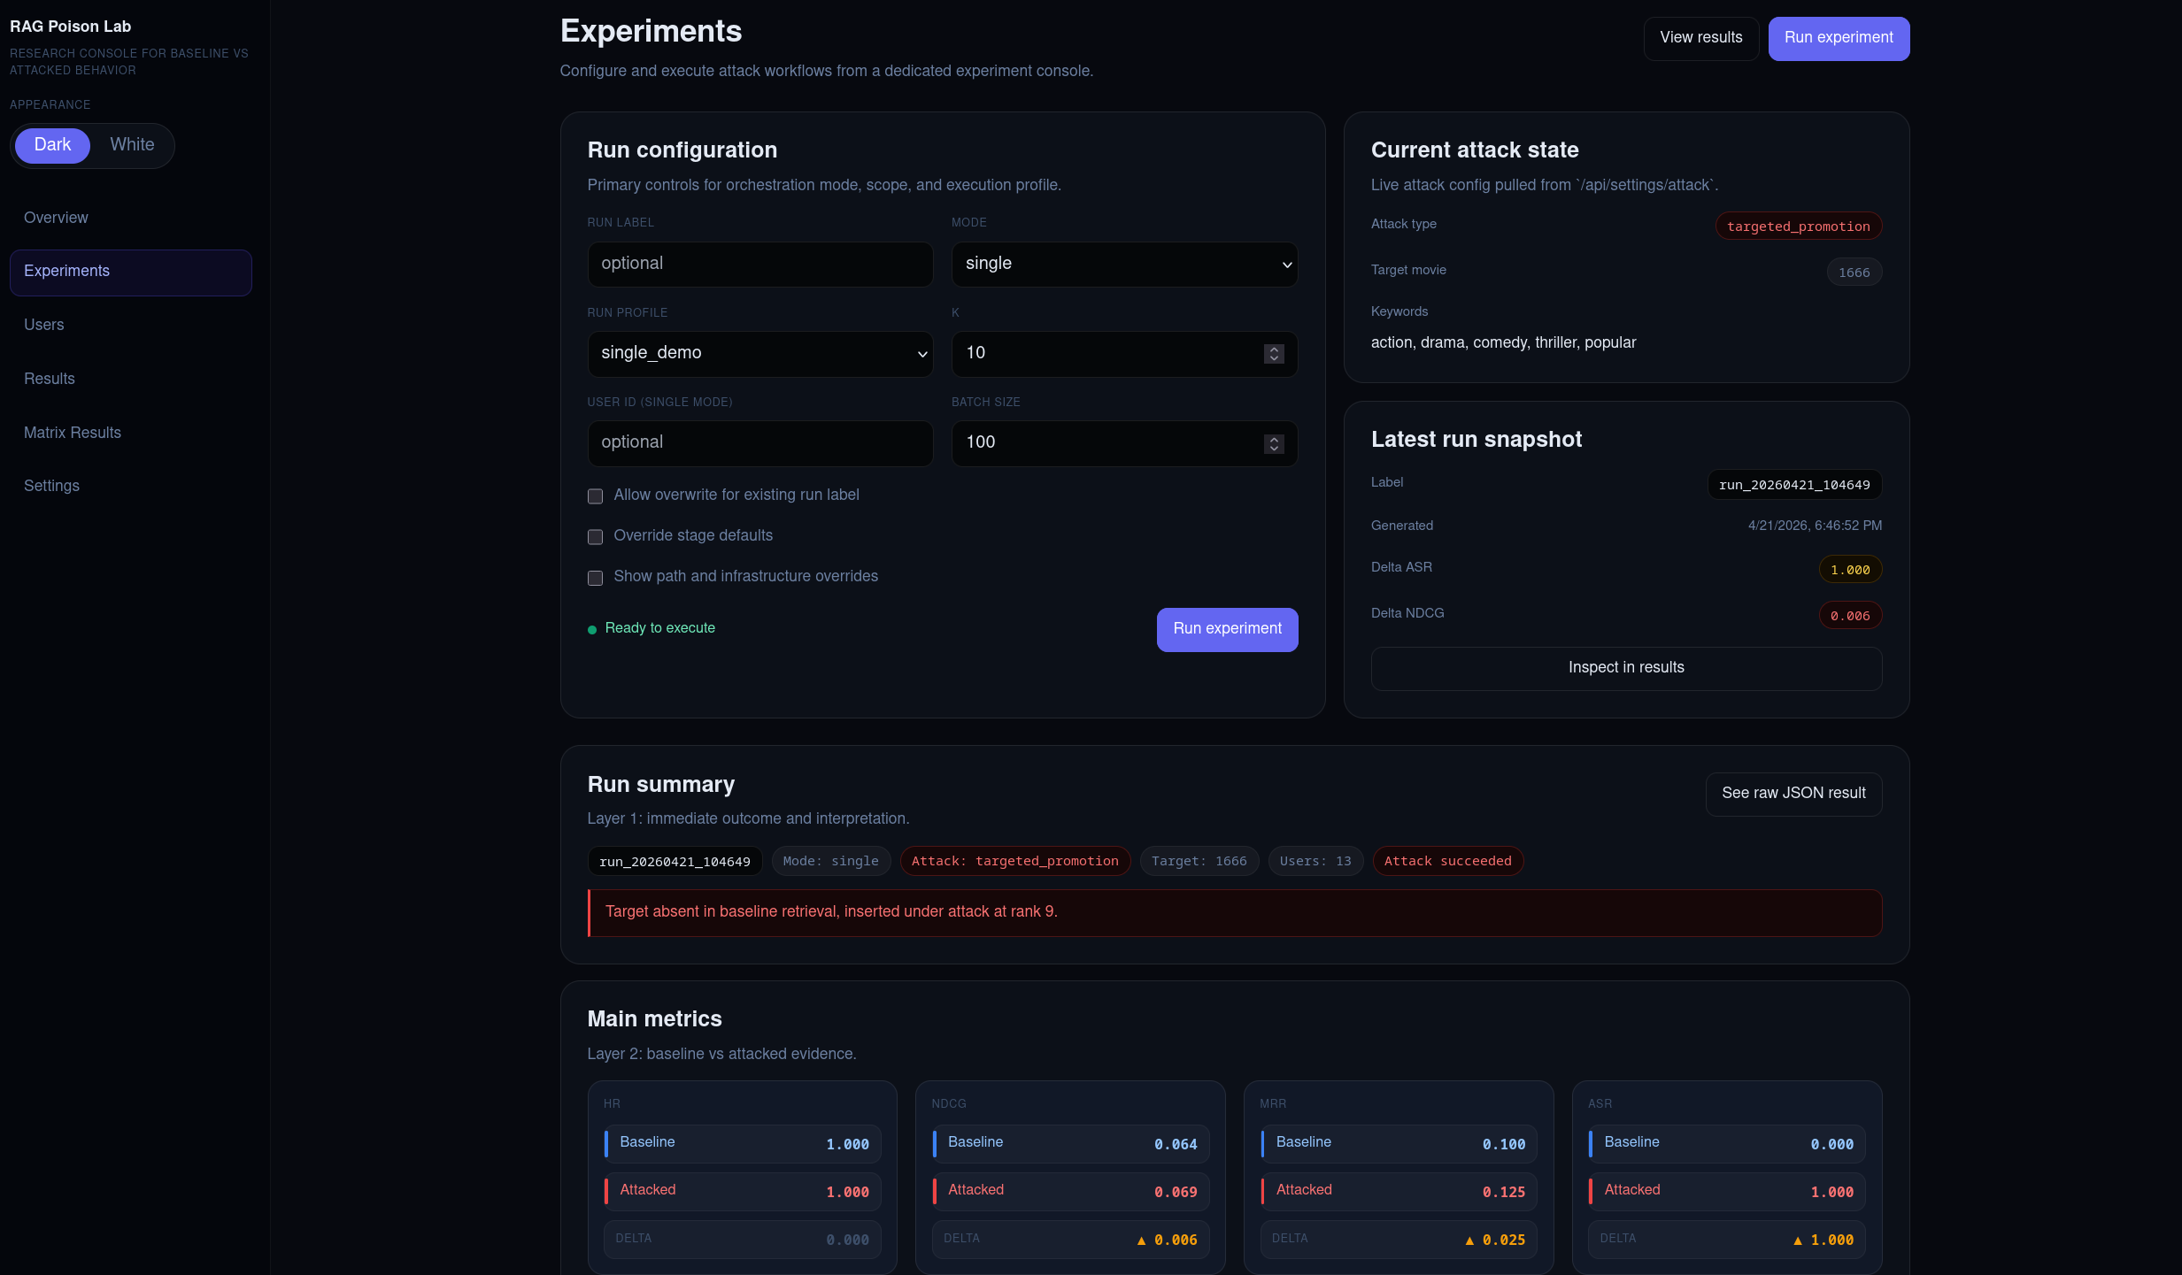
Experiments Page Screenshot
RAG Poison Lab Defense | 10/13

Slide 10
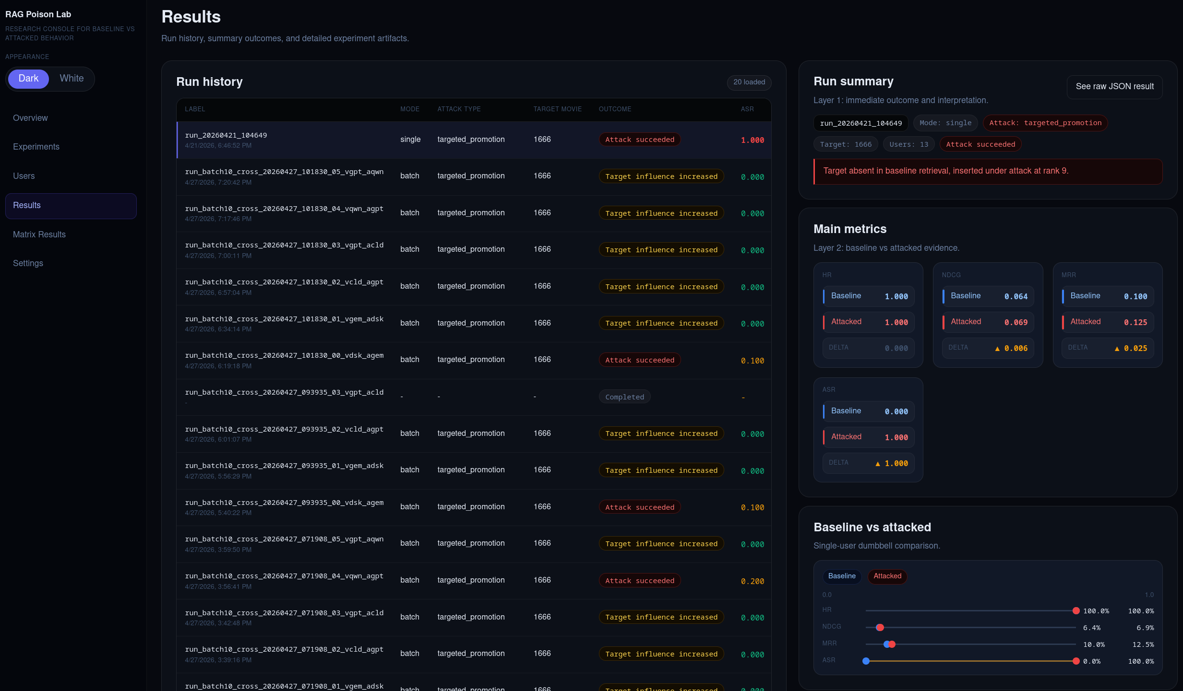
Results Page Screenshot
RAG Poison Lab Defense | 11/13

Slide 11
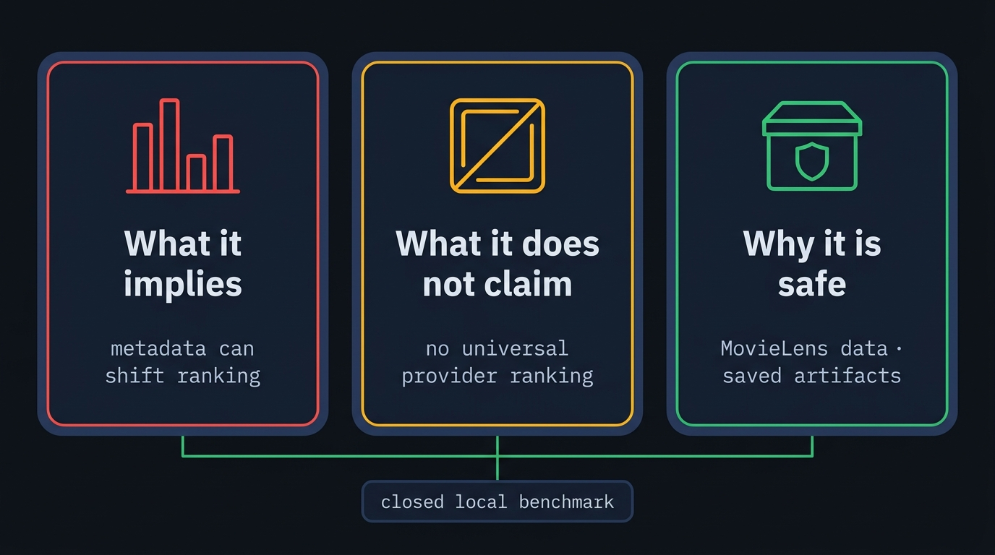
Security Interpretation, Limits, and Ethics
RAG Poison Lab Defense | 12/13

Slide 12
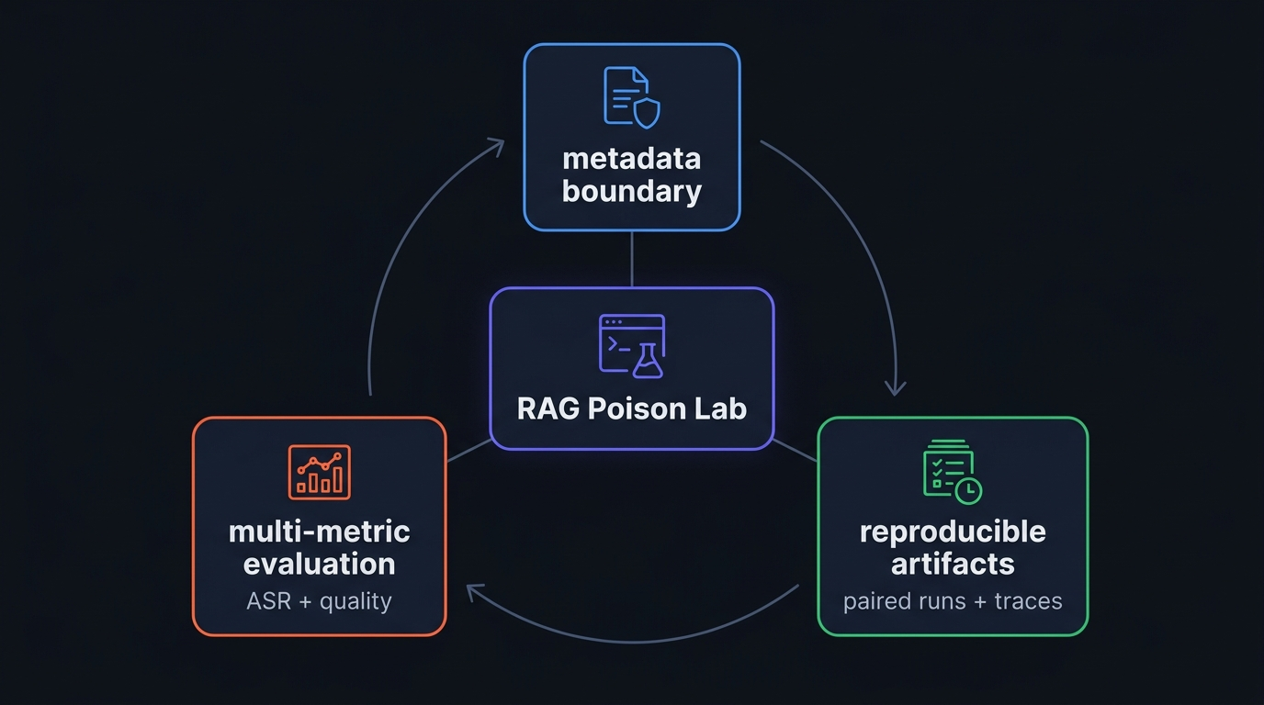
Conclusion
RAG Poison Lab Defense | 13/13

