Slide 1
Hokie Wallet
Budgeting guidance for everyday
student decisions
Carlos and Neha
Frontend
Bilguun and Grant
Backend
sudoWin / VTHacks 14
Hokie Wallet
01
Notes:
Carlos | 0:00–0:15 · 15 seconds
Hi, I’m Carlos. Together with Neha, Bilguun, and Grant, we built Hokie Wallet: a student budgeting prototype that helps Hokies plan everyday spending and make their dining money last.
Context, not spoken: Student-built hackathon prototype, not the official Virginia Tech account portal.
Sources and image credits, not spoken:
- https://github.com/6bilguun9/vthacks/blob/0c04e56e145e6ab242b62edec231b6f2e33781d5/README.md

Slide 2
The student budgeting problem
A balance tells you what remains.
“What can I spend today
and still have enough later?”
Students still connect dining funds, everyday spending,
and savings goals themselves.
Hokie Wallet
02
Notes:
Carlos | 0:15–0:35 · 20 seconds
Virginia Tech lets us check balances and transaction history, and offers budgeting resources. But a balance still leaves a practical question: what should I spend today? We want to connect dining choices with everyday spending and savings, so students can plan ahead.
Context, not spoken: This is the team’s problem framing, not a finding from a student survey. VT already offers a dining dollar use calculator and financial wellness resources.
Sources and image credits, not spoken:
- https://www.hokiepassport.vt.edu/pages/general.php?div2=account
- https://dining.vt.edu/plans_overview.html
- https://well-being.vt.edu/finances.html

Slide 3
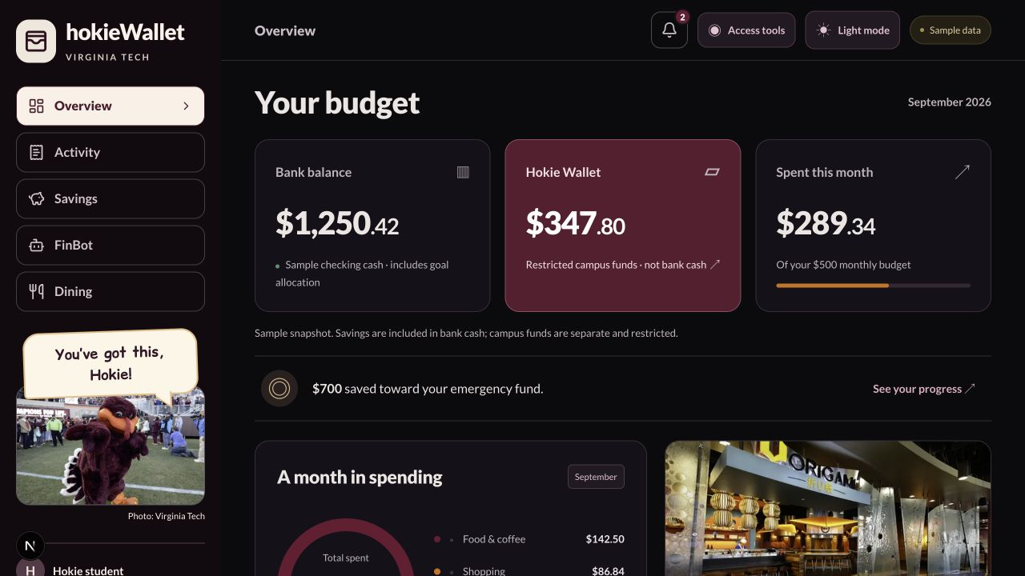
Your money at a glance
Overview
Bank cash, campus
funds, monthly spend
Activity
See where money
goes
Savings
Keep a goal in view
Hokie Wallet
03
Notes:
Carlos | 0:35–1:00 · 25 seconds
Neha and I built the frontend around that decision. Overview brings bank cash, restricted campus funds, and monthly spending together. Activity helps explain spending patterns, while Savings shows progress toward a goal. We keep campus funds separate from cash so the numbers do not suggest money you can spend anywhere.
Context, not spoken: All financial values in this screenshot are the fixed sample profile. The $700 goal allocation sits within bank cash, not on top of it.
Sources and image credits, not spoken:
- https://github.com/6bilguun9/vthacks/blob/0c04e56e145e6ab242b62edec231b6f2e33781d5/frontend/src/features/dashboard/dashboard.tsx
- https://github.com/6bilguun9/vthacks/blob/0c04e56e145e6ab242b62edec231b6f2e33781d5/frontend/src/features/dashboard/demo-data.ts
- Screenshot of team prototype, main commit 0c04e56. HokieBird photo: Virginia Tech, https://www.archive.vtmag.vt.edu/fall18/HokieBirdGallery.php . Origami photo supplied by Neha; source record: https://github.com/6bilguun9/vthacks/blob/0c04e56e145e6ab242b62edec231b6f2e33781d5/frontend/public/campus/README.md

Slide 4
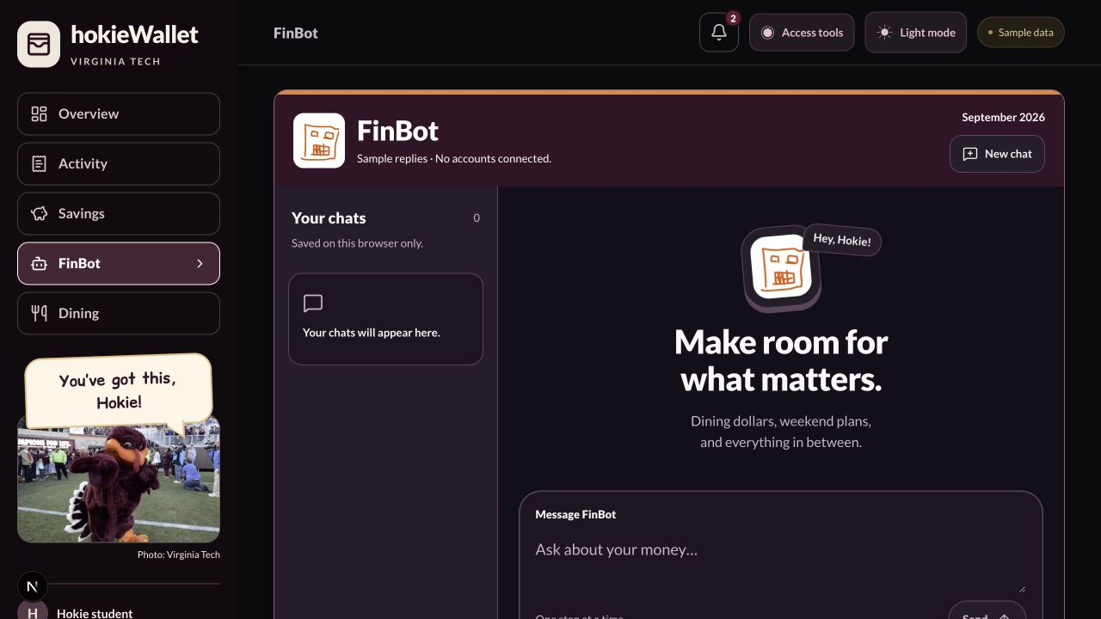
FinBot: a place to ask
Money questions
in plain language
Saved conversations
Chats you can rename
Room for follow-ups
Current demo:
scripted sample replies
Hokie Wallet
04
Notes:
Neha | 1:00–1:35 · 35 seconds
I’m Neha. FinBot gives students a familiar place to ask about their money instead of interpreting every number themselves. I worked on the chat experience, including saved conversations, renaming chats, and a multiline message box. A student can return to a question as their plans change. The current demonstration uses scripted replies and sample balances. Bilguun will explain the backend coach and planner that are ready for the next integration step.
Context, not spoken: Chat history is stored in this browser. The visible chat UI does not yet call the live coach endpoint. The logo belongs to the team.
Sources and image credits, not spoken:
- https://github.com/6bilguun9/vthacks/blob/0c04e56e145e6ab242b62edec231b6f2e33781d5/frontend/src/features/chat/ChatPanel.tsx
- https://github.com/6bilguun9/vthacks/blob/0c04e56e145e6ab242b62edec231b6f2e33781d5/frontend/src/features/chat/use-chat-history.ts
- https://github.com/6bilguun9/vthacks/blob/0c04e56e145e6ab242b62edec231b6f2e33781d5/frontend/src/features/chat/demo-replies.ts
- Screenshot of team prototype, main commit 0c04e56. HokieBird photo: Virginia Tech, https://www.archive.vtmag.vt.edu/fall18/HokieBirdGallery.php . Origami photo supplied by Neha; source record: https://github.com/6bilguun9/vthacks/blob/0c04e56e145e6ab242b62edec231b6f2e33781d5/frontend/public/campus/README.md

Slide 5
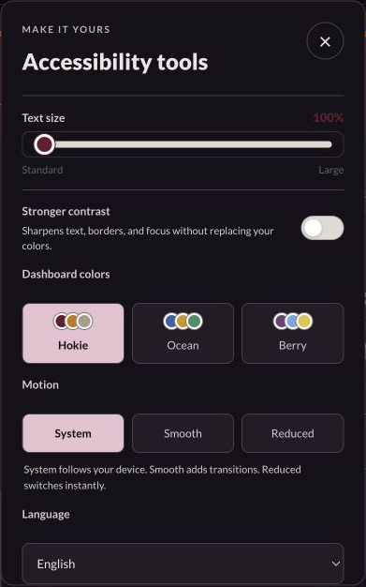
Comfortable for more students
Adjustable text size
Color choices and reduced motion
Read-aloud controls
Ten interface languages
Available across the dashboard and dining planner
Hokie Wallet
05
Notes:
Neha | 1:35–2:00 · 25 seconds
We also wanted students to use this comfortably. They can adjust text size, choose clearer color palettes, reduce motion, or listen to the current view. Ten language options translate core interface labels. These controls stay available in dining, so students do not lose their preferences when they switch tasks.
Context, not spoken: Text size ranges from 100% to 140%. Translation covers core labels and selected dashboard text, not every detailed demo answer. Read-aloud depends on available browser voices. This is not a claim of full accessibility certification.
Sources and image credits, not spoken:
- https://github.com/6bilguun9/vthacks/blob/0c04e56e145e6ab242b62edec231b6f2e33781d5/frontend/src/features/dashboard/accessibility-tools.tsx
- https://github.com/6bilguun9/vthacks/blob/0c04e56e145e6ab242b62edec231b6f2e33781d5/frontend/src/features/dashboard/interface-language.ts
- https://github.com/6bilguun9/vthacks/blob/0c04e56e145e6ab242b62edec231b6f2e33781d5/frontend/src/features/dashboard/campus-shell.tsx
- Screenshot of team prototype, main commit 0c04e56. HokieBird photo: Virginia Tech, https://www.archive.vtmag.vt.edu/fall18/HokieBirdGallery.php . Origami photo supplied by Neha; source record: https://github.com/6bilguun9/vthacks/blob/0c04e56e145e6ab242b62edec231b6f2e33781d5/frontend/public/campus/README.md

Slide 6
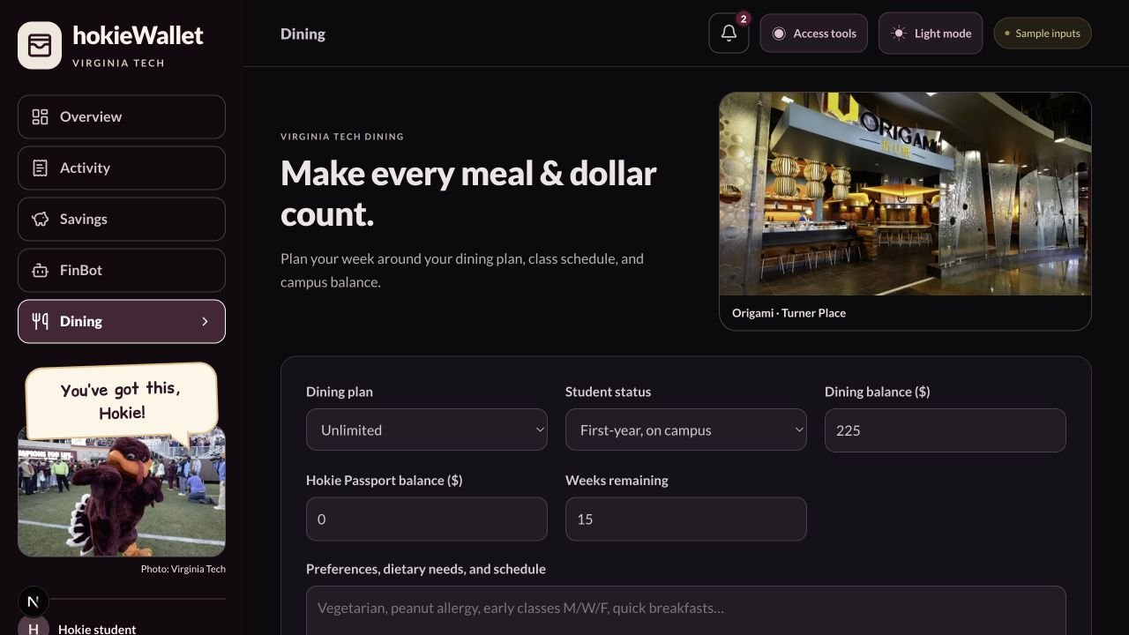
A dining plan for your week
Your inputs
Meal plan and balance
Weeks left
Preferences and schedule
The result
A weekly meal calendar
with estimated costs
Hokie Wallet
06
Notes:
Grant | 2:00–2:40 · 40 seconds
I’m Grant. Dining makes this useful for Hokies. Students enter their meal plan, balance, weeks left, and preferences or class schedule. Our dining backend asks VT ARC for a representative week of meals, prioritizing included swipes and exchanges before dining dollars. It checks the response and recalculates costs from the individual meals. It rejects estimates that exceed the supplied balance. Prices remain estimates, with current hours linked, so students can check before they go. The goal is to use the benefits they already paid for.
Context, not spoken: The screenshot is the latest UI with sample inputs. Dining is a separate ARC workflow, not a third ANS agent. It proposes a budget-conscious representative week, not a mathematically optimal plan. Current menus and prices are not fetched live.
Sources and image credits, not spoken:
- https://github.com/6bilguun9/vthacks/blob/0c04e56e145e6ab242b62edec231b6f2e33781d5/backend/src/routes/dining-plan.ts
- https://github.com/6bilguun9/vthacks/blob/0c04e56e145e6ab242b62edec231b6f2e33781d5/backend/src/agents/dining-prompt.ts
- https://github.com/6bilguun9/vthacks/blob/0c04e56e145e6ab242b62edec231b6f2e33781d5/backend/src/agents/dining.ts
- https://github.com/6bilguun9/vthacks/blob/0c04e56e145e6ab242b62edec231b6f2e33781d5/frontend/src/app/dining/page.tsx
- Screenshot of team prototype, main commit 0c04e56. HokieBird photo: Virginia Tech, https://www.archive.vtmag.vt.edu/fall18/HokieBirdGallery.php . Origami photo supplied by Neha; source record: https://github.com/6bilguun9/vthacks/blob/0c04e56e145e6ab242b62edec231b6f2e33781d5/frontend/public/campus/README.md

Slide 7
How the backend connects
Inputs
Nessie banking sandbox
Student-entered
campus balances
Saved financial plan
Dashboard
Backend API
Authenticated
requests
Plans and projections
Supabase storage
Connection
in progress
Backend workflows are implemented.
The current interface uses labeled sample data.
Hokie Wallet
07
Notes:
Grant | 2:40–3:00 · 20 seconds
Behind the screens, our API combines a saved financial plan with Nessie sandbox banking data and student-entered campus balances. Supabase stores each guest’s state. Those backend workflows are implemented. The dashboard’s authenticated connection is still in progress, which is why these screens show sample data.
Context, not spoken: The diagram represents the finance API architecture. Dining takes its inputs directly from the form and does not yet share this saved snapshot. Nessie is a sandbox, not a connection to actual student bank accounts.
Sources and image credits, not spoken:
- https://github.com/6bilguun9/vthacks/blob/0c04e56e145e6ab242b62edec231b6f2e33781d5/backend/src/application/finance-api.ts
- https://github.com/6bilguun9/vthacks/blob/0c04e56e145e6ab242b62edec231b6f2e33781d5/backend/src/persistence/infrastructure.ts
- https://github.com/6bilguun9/vthacks/blob/0c04e56e145e6ab242b62edec231b6f2e33781d5/backend/src/auth/supabase.ts
- https://github.com/6bilguun9/vthacks/blob/0c04e56e145e6ab242b62edec231b6f2e33781d5/frontend/src/lib/api.ts
- https://api.nessieisreal.com/

Slide 8
How our agents communicate
GoDaddy ANS discovers the configured planner
Coach
Planner
Signed request
VT ARC parses intent
Asks for missing details
Explains the result
Calculates cash flow
Checks savings impact
Returns a comparison
Before / after result
The student previews a trade-off before saving a change.
Implemented workflow. Live ANS execution still needs verification.
Hokie Wallet
08
Notes:
Bilguun | 3:00–3:40 · 40 seconds
I’m Bilguun. Our coach and planner have different jobs. VT ARC turns a supported money question into a structured request. For a purchase comparison, the coach discovers our planner through GoDaddy ANS, then sends a signed, authenticated message. The planner uses deterministic calculations to compare cash flow and savings goals before and after that purchase. It returns the comparison, and the coach explains it in plain language. This helps students understand a trade-off before spending. Previewing a scenario never changes the saved plan.
Context, not spoken: This is the implemented purchase-comparison path, not a captured live ANS run. Coach and Planner are separate agent identities within one backend deployment. Explanations use templates. A configured local fallback is explicitly labeled in the API response. No claim that dining communicates through ANS.
Sources and image credits, not spoken:
- https://github.com/6bilguun9/vthacks/blob/0c04e56e145e6ab242b62edec231b6f2e33781d5/backend/src/agents/service.ts
- https://github.com/6bilguun9/vthacks/blob/0c04e56e145e6ab242b62edec231b6f2e33781d5/backend/src/integrations/planner-client.ts
- https://github.com/6bilguun9/vthacks/blob/0c04e56e145e6ab242b62edec231b6f2e33781d5/backend/src/services/planning.ts
- https://github.com/6bilguun9/vthacks/blob/0c04e56e145e6ab242b62edec231b6f2e33781d5/backend/src/routes/agents.ts
- https://github.com/6bilguun9/vthacks/blob/0c04e56e145e6ab242b62edec231b6f2e33781d5/backend/src/application/finance-api.ts

Slide 9
Challenge alignment
Capital One / Nessie
Banking context for student planning
GoDaddy / ANS
Discovery and verified agent requests
Deloitte × Databricks
AI guidance for campus dining decisions
Help Hokies plan today’s spending
with tomorrow in mind.
Hokie Wallet
09
Notes:
Bilguun | 3:40–4:00 · 20 seconds
That connects our work to the challenges: Nessie supplies banking context, ANS enables agent discovery, and campus dining planning fits Deloitte and Databricks’ student-experience theme. Our goal is straightforward: help Hokies understand what they can afford today while protecting what they need tomorrow. Thank you.
Context, not spoken: This slide describes relevant challenge alignment, not a claim that every sponsor requirement is already fulfilled. Real configured Nessie and ANS execution and final frontend integration need end-to-end verification. Deloitte × Databricks alignment is with its student-experience theme, not a claim that the project uses Databricks.
Sources and image credits, not spoken:
- https://vthacks.com/guide
- https://github.com/6bilguun9/vthacks/blob/0c04e56e145e6ab242b62edec231b6f2e33781d5/backend/src/integrations
- https://github.com/6bilguun9/vthacks/blob/0c04e56e145e6ab242b62edec231b6f2e33781d5/backend/src/agents

