Slide 1

rapidPF Simulation Results
Xinliang Dai

Slide 2
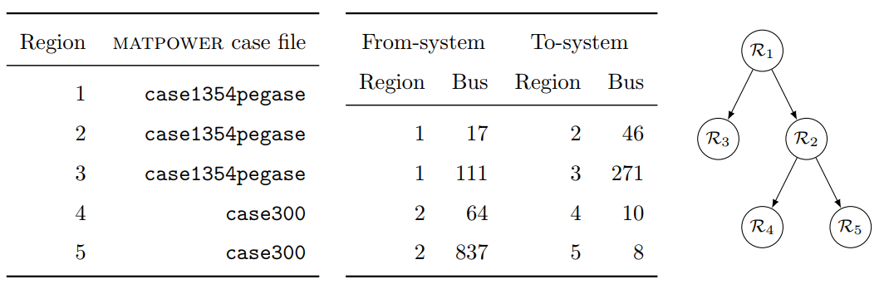
Purpose of Simulation
Main Purpose
Add Multi-Trafo between regions
Add DSO-DSO Connection
Decrease generated active power
in DSOs
Increase Complexity
Increase Power Flow between Regions
Fig 1: Region Topology of largest example case

Slide 3
Simulation Process
Steps
Increase Complexity for smallest case
Multi-Trafos
DSO-DSO connection
One TSO with One DSO tests
Multi-Trafos
Increase Complexity for largest case
Multi-Trafos in step 2
DSO-DSO connection
Smallest case
(53-bus System)
(1)
Complexity Test
(53-bus System)
(2)
(3)
TSO-DSO tests
(118/300/1354bus)
Complexity Test
(4662 -bus System)
Fig 2: Diagram of Simulation Process

Slide 4
Necessary Definition
Principle of selecting connection bus
Transmission system
NOT slack bus
NOT gen-bus with high active power
Distribution system
NOT gen-bus with high active power (will be removed)
Generation Shift Key (GSK)
The percent of active power shifted from distribution system(s) to Transmission system

Slide 5
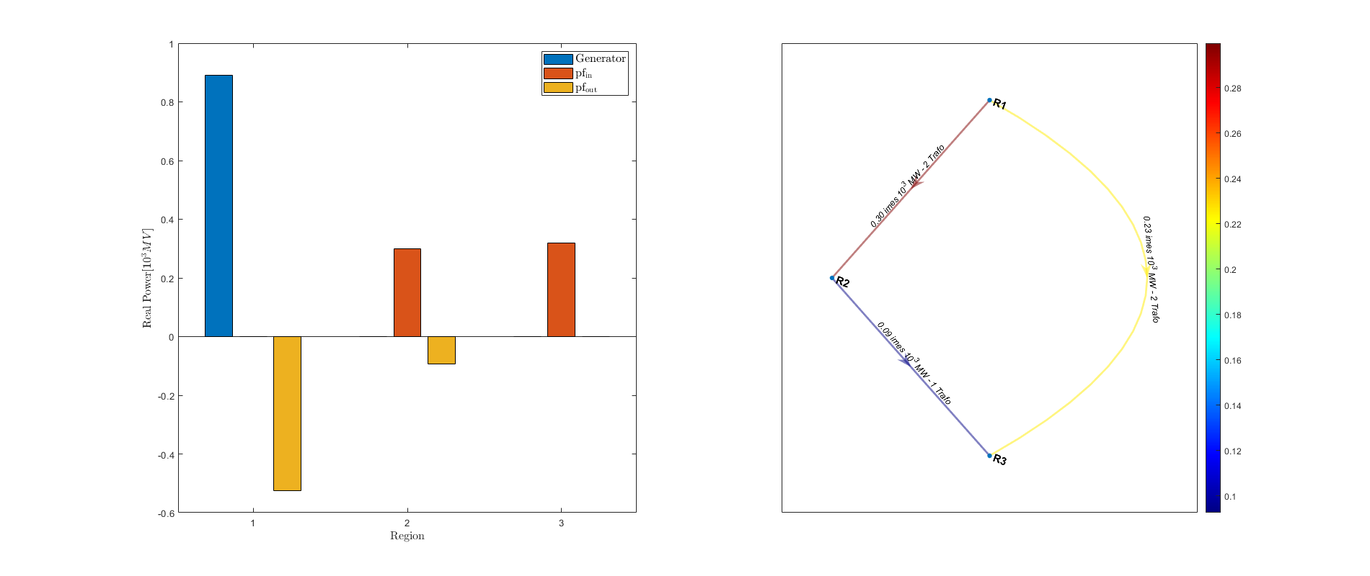
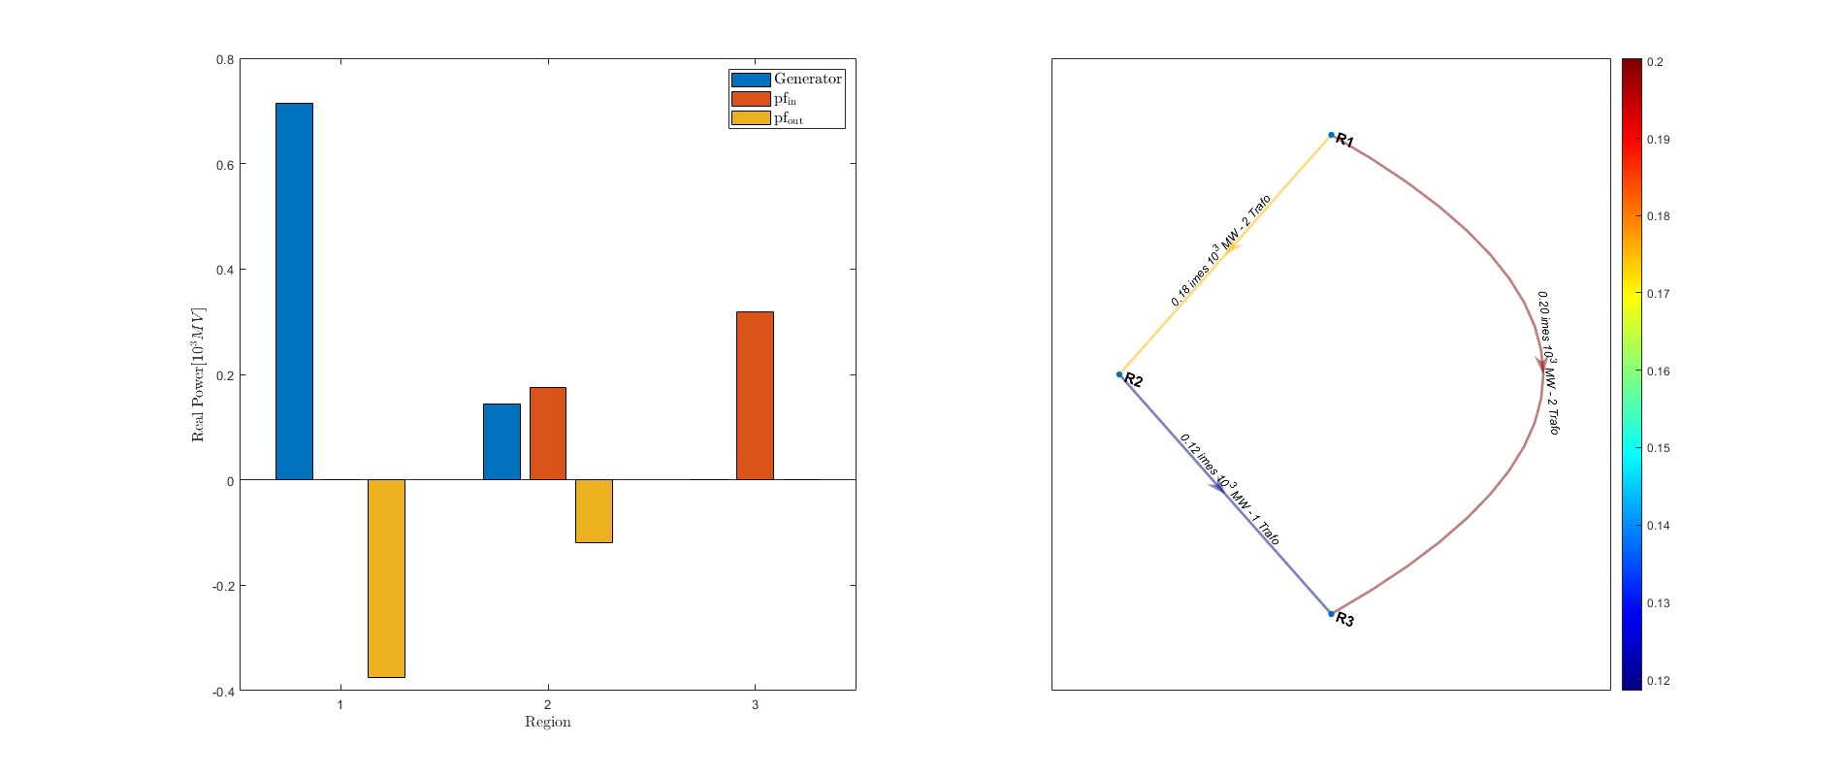
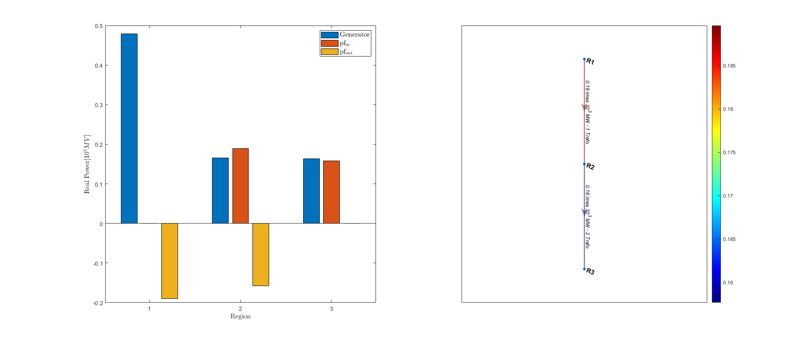
Simulation Results – Smallest Case
Fig 3-c: 53-System with Multi-Trafo and GSK = 1
Fig 3-b: 53-System with Multi-Trafo
Fig 3-a: Original 53-System

Slide 6
Simulation Results – TSO-DSO Test (118-bus)
Bus num of DSO | Trafos num | Generation Shift Key |  |  |  | Deviation between initial point and optimum | Iterations | Computing time | Accuracy
 |  | GSK | Active power demand [MW] | Shifted power [MW] | Shifted power [%]
118 | 1 | 0 | 4242 | 1.57711 | 0.04% | 10.509 | 5 | 4.2 | 8.06E-13
 |  | 0.1 | 4242 | 457.32 | 10.78% | 10.683 | 5 | 4.5 | 8.22E-13
 |  | 0.2 | 4242 | 1148.1 | 27.07% | 11.062 | 6 | 4.5 | 4.79E-09
 |  | 0.3 | 4242 | NaN
 | 3 | 0 | 4242 | 407.93 | 9.62% | 10.863 | 5 | 3.3 | 7.47E-13
 |  | 0.1 | 4242 | 795.82 | 18.76% | 10.914 | 5 | 4.8 | 2.39E-12
 |  | 0.2 | 4242 | 1196.5 | 28.21% | 11.002 | 5 | 4.3 | 1.58E-12
 |  | 0.3 | 4242 | 1610.9 | 37.98% | 11.127 | 6 | 4.3 | 3.41E-12
 |  | 0.4 | 4242 | 2040.2 | 48.10% | 11.292 | 6 | 4.8 | 1.28E-11
 |  | 0.5 | 4242 | 2486.1 | 58.61% | 11.501 | 6 | 4.2 | 2.26E-10
 |  | 0.6 | 4242 | 2951.1 | 69.57% | 11.764 | 6 | 3.8 | 1.45E-08
 |  | 0.7 | 4242 | 3439.4 | 81.08% | 14.269 | 6 | 4.3 | 1.49E-12
 |  | 0.8 | 4242 | 3958 | 93.31% | 19.506 | 7 | 4.9 | 4.26E-13
 |  | 0.9 | 4242 | NaN
 | 5 | 0 | 4242 | 887.4 | 20.92% | 24.794 | 8 | 5.9 | 5.91E-11
 |  | 0.1 | 4242 | 1227.3 | 28.93% | 19.487 | 7 | 4.2 | 8.35E-13
 |  | 0.2 | 4242 | 1573 | 37.08% | 16.617 | 6 | 4.2 | 1.05E-08
 |  | 0.3 | 4242 | 1924.5 | 45.37% | 14.564 | 6 | 3.7 | 1.28E-09
 |  | 0.4 | 4242 | 2282.1 | 53.80% | 13.008 | 6 | 3.8 | 4.82E-10
 |  | 0.5 | 4242 | 2645.9 | 62.37% | 11.814 | 6 | 4.2 | 3.70E-10
 |  | 0.6 | 4242 | 3016.3 | 71.11% | 11.816 | 6 | 3.9 | 4.75E-10
 |  | 0.7 | 4242 | 3393.5 | 80.00% | 11.978 | 6 | 3.4 | 9.39E-10
 |  | 0.8 | 4242 | 3777.9 | 89.06% | 12.258 | 7 | 4.2 | 2.69E-09
 |  | 0.9 | 4242 | 4169.9 | 98.30% | 12.59 | 6 | 4.7 | 1.06E-08
 |  | 1 | 4242 | 4570.1 | 107.73% | 12.923 | 6 | 3.7 | 4.91E-13

Slide 7
Simulation Results – TSO-DSO Test (300-bus)
Bus num of DSO | Trafos num | Generation Shift Key |  |  |  | Deviation between initial point and optimum | Iterations | Computing time | Accuracy
 |  | GSK | Active power demand [MW] | Shifted power [MW] | Shifted power [%]
300 | 1 | 0 | 23526 | 481.65 | 2.05% | 11.11 | 5 | 18.9 | 3.07E-12
 |  | 0.1 | 23526 | NaN
 | 3 | 0 | 23526 | 1098.2 | 4.67% | 11.698 | 5 | 20.1 | 4.88E-12
 |  | 0.1 | 23526 | 3553.9 | 15.11% | 13.87 | 6 | 23.9 | 4.41E-10
 |  | 0.2 | 23526 | NaN
 | 5 | 0 | 23526 | 1688.2 | 7.18% | 17.884 | 5 | 140.6 | 6.27E-12
 |  | 0.1 | 23526 | 3893.4 | 16.55% | 17.093 | 5 | 237.2 | 8.12E-12
 |  | 0.2 | 23526 | 6188.5 | 26.30% | 18.099 | 5 | 24 | 5.97E-12
 |  | 0.3 | 23526 | 8597.3 | 36.54% | 21.356 | 6 | 25.6 | 4.10E-11
 |  | 0.4 | 23526 | 11222 | 47.70% | 33.135 | 7 | 30.3 | 6.58E-12
 |  | 0.5 | 23526 | NaN
 | 8 | 0 | 23526 | 2867.3 | 12.19% | 30.331 | 5 | 21.7 | 8.82E-12
 |  | 0.1 | 23526 | 4951.3 | 21.05% | 28.098 | 5 | 22.4 | 6.87E-12
 |  | 0.2 | 23526 | 7100.1 | 30.18% | 27.25 | 5 | 21 | 4.20E-12
 |  | 0.3 | 23526 | 9322.5 | 39.63% | 27.943 | 5 | 22.2 | 4.56E-12
 |  | 0.4 | 23526 | 11640 | 49.48% | 30.542 | 6 | 28.3 | 6.80E-12
 |  | 0.5 | 23526 | 14113 | 59.99% | 36.016 | 6 | 178.5 | 3.88E-12
 |  | 0.55 | 23526 | 15484 | 65.82% | 40.973 | 7 | 33.1 | 4.34E-09
 |  | 0.6 | 23526 | NaN
 | 10 | 0.55 | 23526 | 15534 | 66.03% | 41.199 | 7 | 30.6 | 3.23E-09
 | 12 | 0.55 | 23526 | 15503 | 65.90% | 39.3 | 7 | 30.1 | 3.63E-11
 | 16 | 0.55 | 23526 | 15440 | 65.63% | 37.139 | 7 | 136 | 1.21E-10
 | 20 | 0.55 | 23526 | 15515 | 65.95% | 34.213 | 7 | 28.3 | 9.94E-11
 | 25 | 0.55 | 23526 | 15914 | 67.64% | 37.732 | 7 | 27.3 | 8.36E-10
 | 30 | 0.55 | 23526 | 16667 | 70.85% | 46.596 | 7 | 312.6 | 7.74E-10
 |  | 0.6 | 23526 | NaN

Slide 8
Simulation Results – TSO-DSO Test (1354-bus)
Bus num of DSO | Trafos num | Generation Shift Key |  |  |  | Deviation between initial point and optimum | Iterations | Computing time | Accuracy
 |  | GSK | Active power demand [MW] | Shifted power [MW] | Shifted power [%]
1354 | 1 | 0 | 73060 | 36.989 | 0.05% | 3.5756 | 4 | 27 | 4.57E-12
 |  | 0.1 | 73060 | NaN
 | 5 | 0 | 73060 | 1401.7 | 1.92% | 15.161 | 5 | 38.2 | 7.71E-12
 |  | 0.1 | 73060 | 9212.7 | 12.61% | 31.226 | 6 | 47.7 | 5.91E-12
 |  | 0.2 | 73060 | NaN
 | 10 | 0 | 73060 | 1604 | 2.20% | 17.115 | 5 | 32.4 | 3.55E-12
 |  | 0.1 | 73060 | 9073.5 | 12.42% | 23.255 | 5 | 39.2 | 4.60E-12
 |  | 0.2 | 73060 | 17058 | 23.35% | 41.945 | 5 | 41.2 | 6.53E-12
 |  | 0.3 | 73060 | 25834 | 35.36% | 83.773 | 6 | 270.9 | 1.57E-11
 |  | 0.4 | 73060 | NaN
 | 15 | 0 | 73060 | 1584.9 | 2.17% | 16.404 | 5 | 34.8 | 6.05E-12
 |  | 0.1 | 73060 | 8915.5 | 12.20% | 18.496 | 5 | 37.4 | 5.49E-12
 |  | 0.2 | 73060 | 16546 | 22.65% | 26.859 | 5 | 44.1 | 1.31E-11
 |  | 0.3 | 73060 | 24514 | 33.55% | 43.013 | 5 | 45.2 | 3.87E-12
 |  | 0.4 | 73060 | 32892 | 45.02% | 70.057 | 6 | 53.3 | 4.97E-12
 |  | 0.5 | 73060 | 41844 | 57.27% | 115.22 | 6 | 306.1 | 1.11E-08
 |  | 0.6 | 73060 | 51997 | 71.17% | 207.97 | 7 | 207.7 | 2.95E-11
 |  | 0.7 | 73060 | NaN
 | 20 | 0.6 | 73060 | 50826 | 69.57% | 147.56 | 6 | 57.8 | 6.47E-12
 | 30 | 0 | 73060 | 3414.7 | 4.67% | 35.085 | 5 | 161.5 | 3.78E-11
 |  | 0.1 | 73060 | 10620 | 14.54% | 34.968 | 5 | 37.1 | 6.71E-11
 |  | 0.2 | 73060 | 18019 | 24.66% | 38.626 | 5 | 164.2 | 1.19E-10
 |  | 0.3 | 73060 | 25624 | 35.07% | 46.514 | 5 | 270.3 | 2.11E-10
 |  | 0.4 | 73060 | 33457 | 45.79% | 59.416 | 6 | 157.8 | 3.74E-10
 |  | 0.5 | 73060 | 41550 | 56.87% | 78.635 | 6 | 84.2 | 6.69E-10
 |  | 0.6 | 73060 | 49956 | 68.38% | 106.41 | 6 | 183.3 | 1.22E-09
 |  | 0.7 | 73060 | 58762 | 80.43% | 147 | 6 | 416 | 9.66E-09
 |  | 0.8 | 73060 | 68152 | 93.28% | 210.35 | 7 | 381.3 | 6.34E-12
 |  | 0.85 | 73060 | 73201 | 100.19% | 259.55 | 7 | 137 | 3.14E-11
 |  | 0.9 | 73060 | NaN

Slide 9
Simulation Results – Largest Case
Total Bus Num | Generation Shift Key |  |  |  | Deviation between initial point and optimum | Iterations | Computing time | Accuracy
 | GSK | Active power demand [MW] | Shifted power [MW] | Shifted power [%]
4662 | 0 | 193170 | 18042 | 9.34% | 278.18 | 7 | 344.7 | 6.07E-12
4662 | 0.1 | 193170 | 34870 | 18.05% | 263.86 | 7 | 279.5 | 4.63E-12
4662 | 0.2 | 193170 | 52176 | 27.01% | 264.78 | 7 | 369.3 | 4.87E-12
4662 | 0.3 | 193170 | 70010 | 36.24% | 283.49 | 7 | 432.7 | 6.52E-12
4662 | 0.4 | 193170 | 88463 | 45.80% | 326.79 | 7 | 328.7 | 4.62E-12
4662 | 0.5 | 193170 | 107720 | 55.76% | 413.96 | 33 | 1023.2 | 1.43E-11
4662 | 0.55 | 193170 | 117820 | 60.99% | 495.8 | 27 | 1006.5 | 2.76E-09
4662 | 0.6 | 193170 | NaN

Slide 10
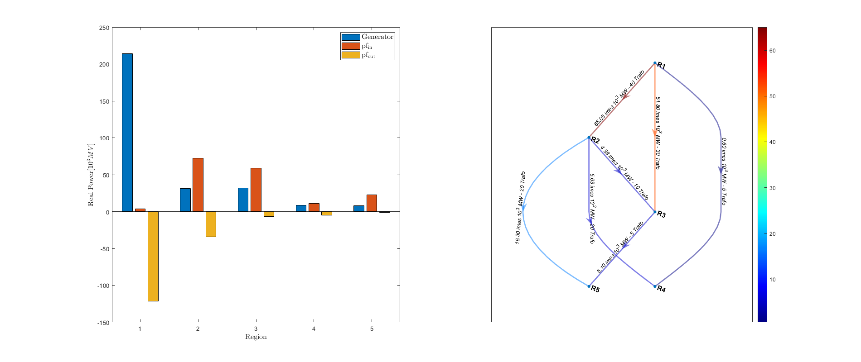
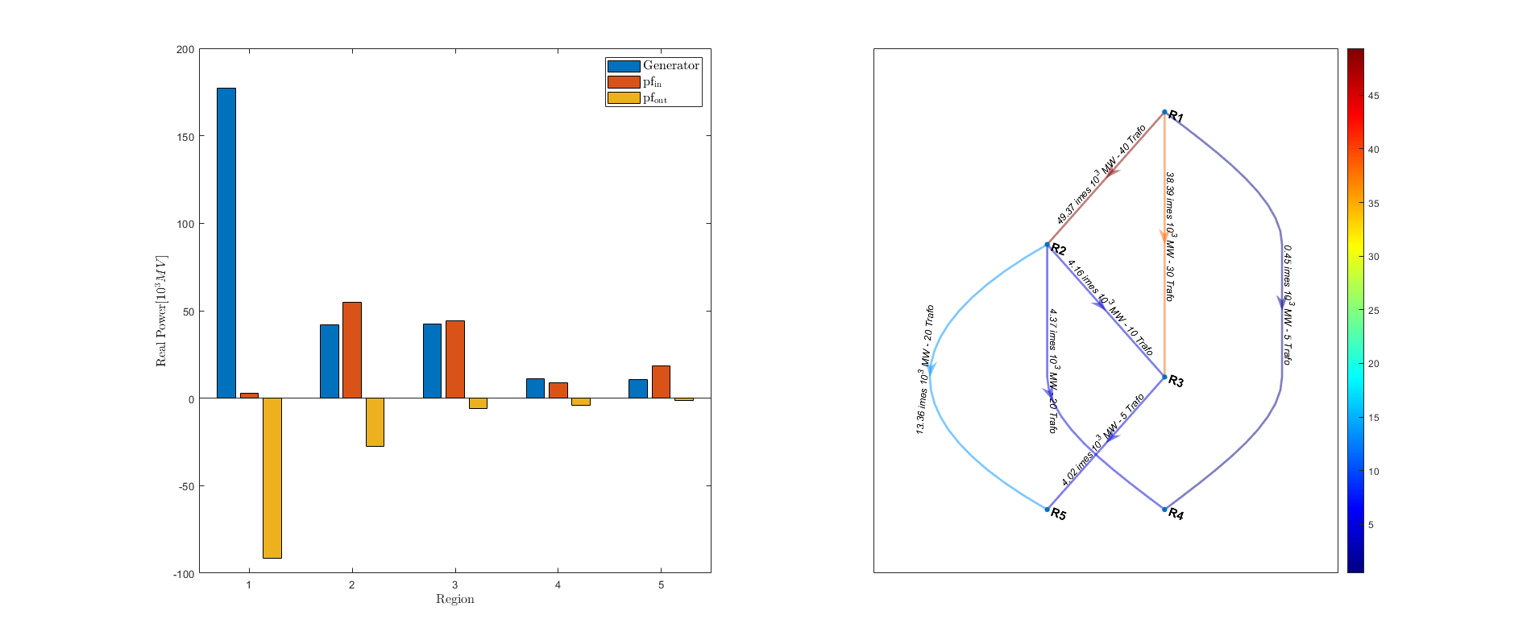
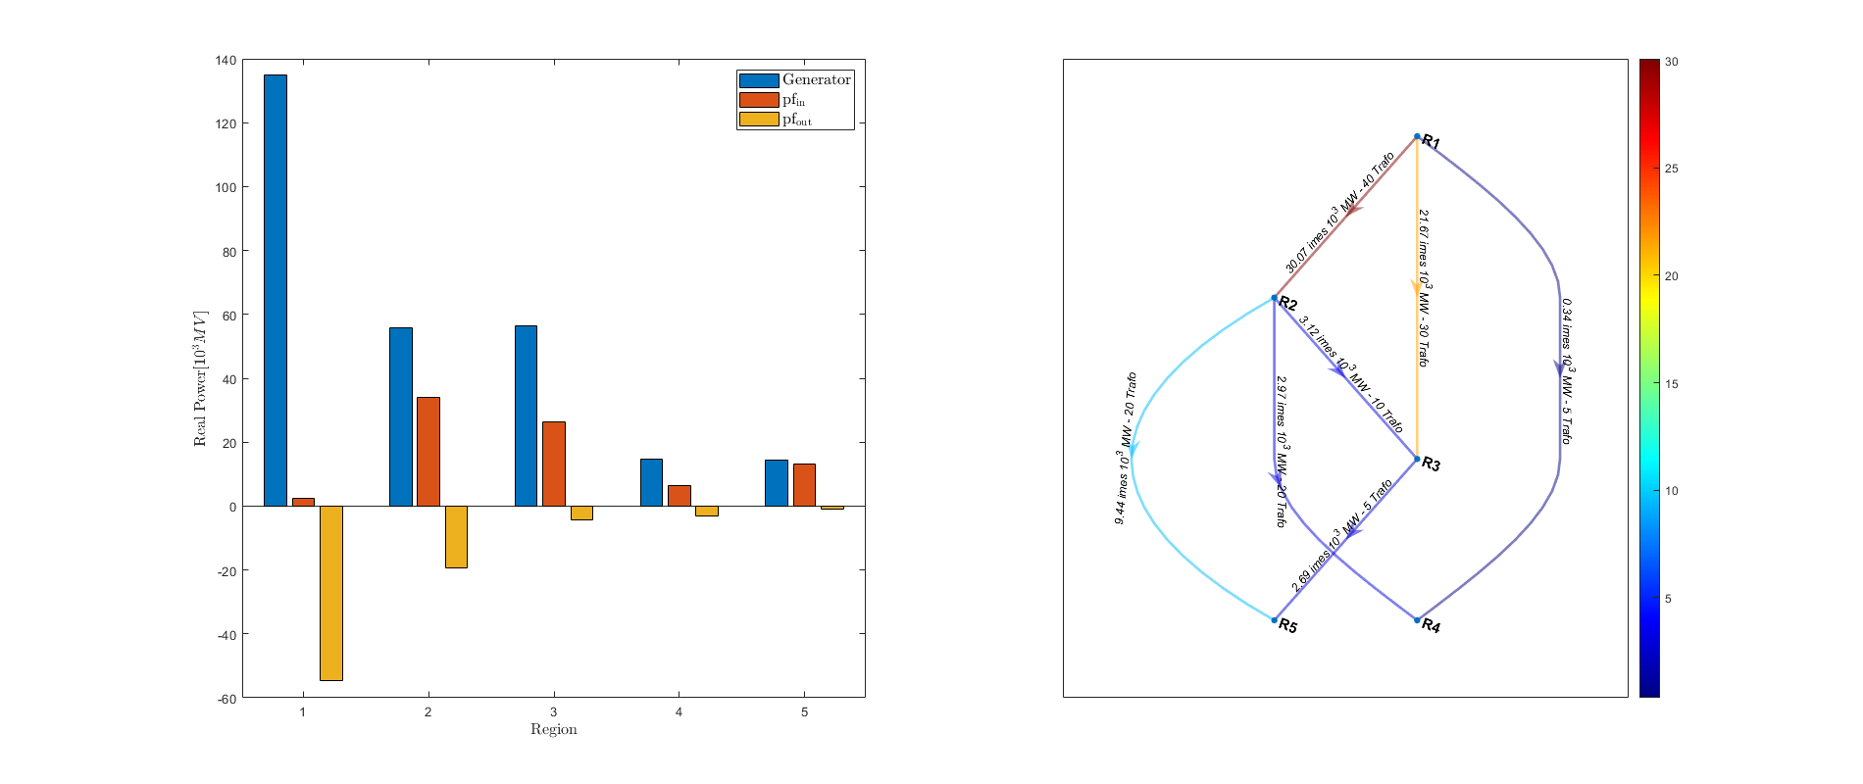
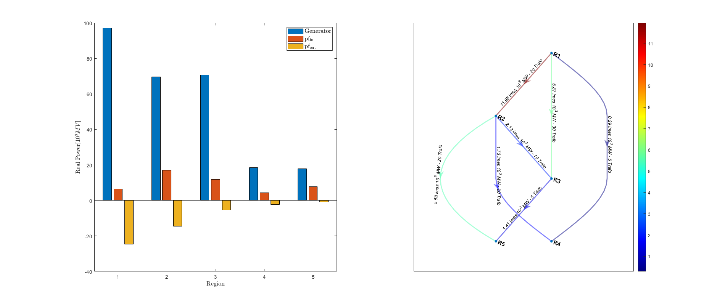
Simulation Results – Largest Case
Fig 1: Region Topology of largest example case
Fig 3-d: 4662-System with GSK = 0.55
Fig 3-c: 4662-System with GSK = 0.4
Fig 3-b: 4662-System with GSK = 0.2
Fig 3-a: 4662-System with GSK = 0

Slide 11
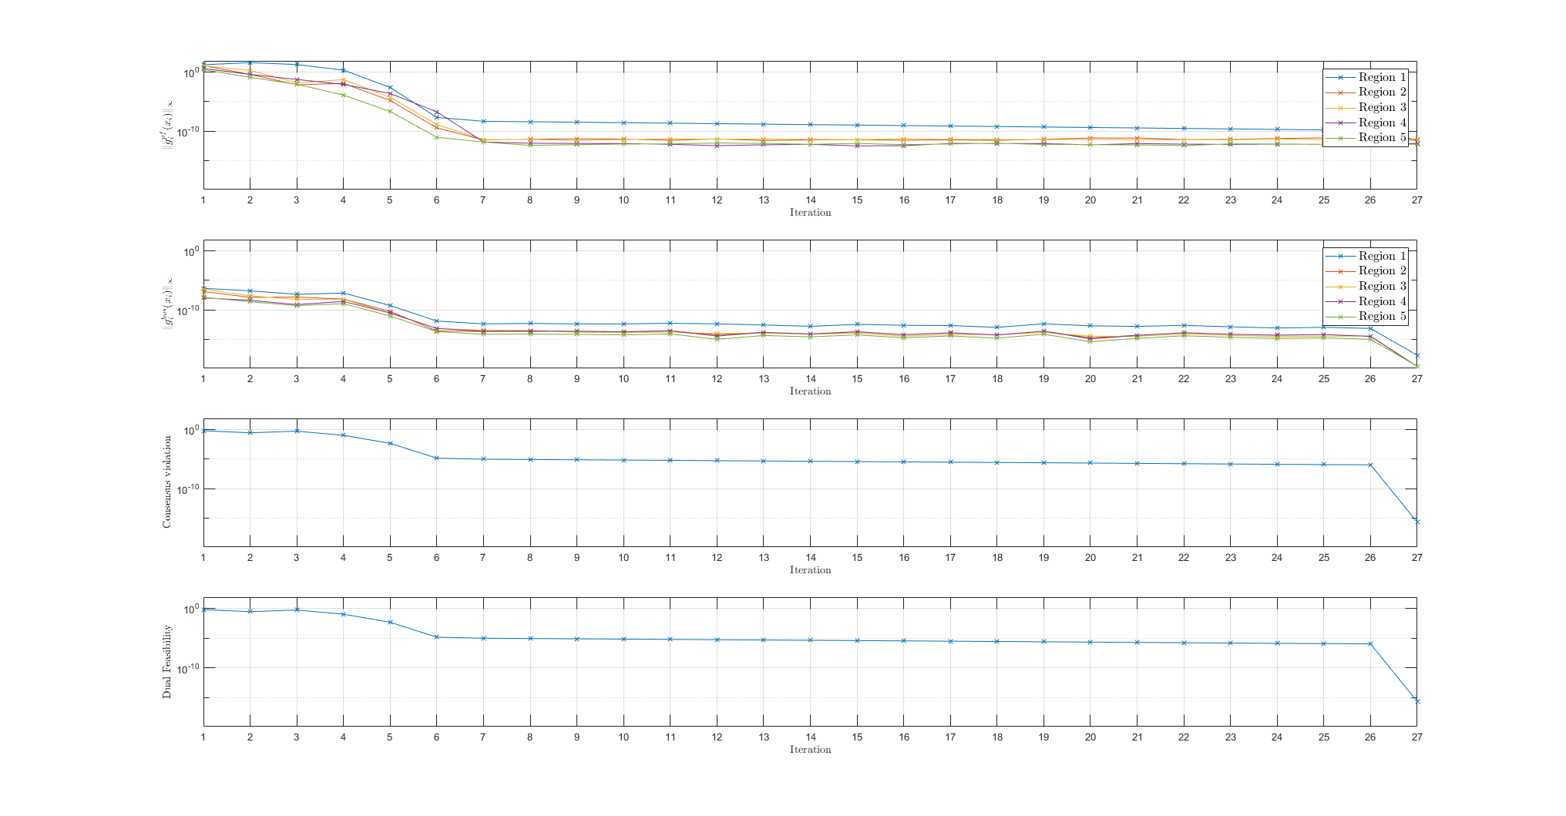
Simulation Results – Largest Case
Fig 3-d: 4662-System with GSK = 5.5
Fig 3-e: Convergence behaviour of 4662-System with GSK = 0.55

Slide 12
Issues – Mathematical Model
GSK
Max GSK value of 300-bus distribution system is limited to 0.55
Without two 300-bus Regions, the largest case is feasible
and GSK can be increased to 0.85
Fig 1: Region Topology of largest example case

Slide 13
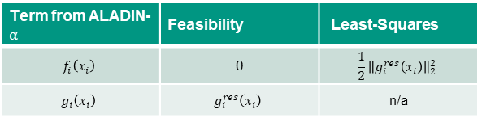
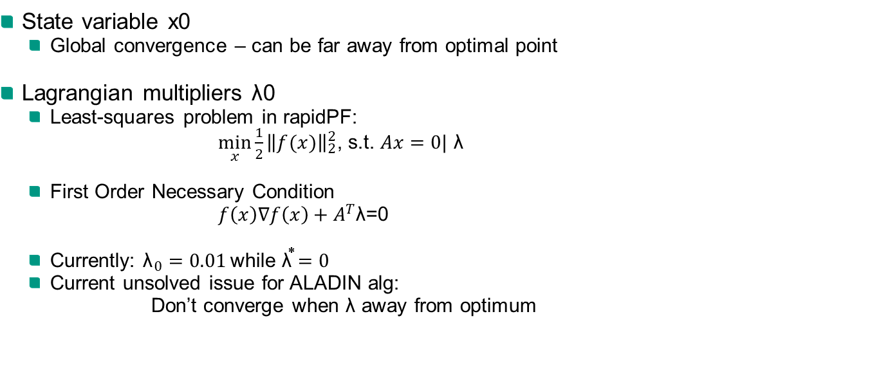
Issues – Initial Point
State variable x0
Global convergence – can be far away from optimal point
Lagrangian multipliers λ0
Least-squares problem in rapidPF:
$\min_{x}{{\frac{1}{2}\left\|f(x)\right\|}_{2}^{2}}$, s.t. $Ax=0|$ λ
First Order Necessary Condition
$f\left(x\right)∇f\left(x\right)+A^{T}\text{λ}\text{=0}$
Currently: ${\text{λ}}_{0}=0.01$while ${\text{λ}}^{⃰⃰}=0$
Current unsolved issue for ALADIN alg:
Don’t converge when $\text{λ}$ away from optimum
Term from ALADIN-$α$ | Feasibility | Least-Squares
$$f_{i}\left(x_{i}\right)$$ | 0 | $${\frac{1}{2}\left\|g_{i}^{res}\left(x_{i}\right)\right\|}_{2}^{2}$$
$$g_{i}\left(x_{i}\right)$$ | $$g_{i}^{res}\left(x_{i}\right)$$ | n/a

Slide 14
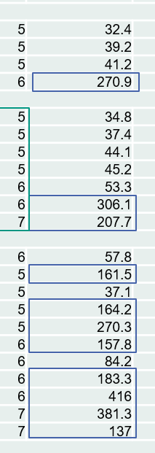

Issues – Dramatically Increasing of Computing time
Information from local solver
F-count increases dramatically at some iterations
Optimization stopped because the relative changes in all elements of x are less than options.StepTolerance = 1.000000e-10
Warning by fmincon:
Warning: Matrix is close to singular or badly scaled. Results may be inaccurate. RCOND = 8.825324e-17.
Solution: Algs for Nonlinear LS problem
LS problem
Gauss-Newton
Hessian-Approximation:
$${∇ }^{2}f\left(x\right)= J_{k}^{T}J_{k}$$
Gauss-Newton method
Levenberg-Marquardt method
We are here
Fig 4: Issue with Computing time

Slide 15
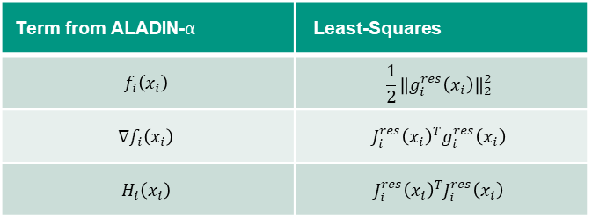

Algs for Nonlinear LS problem
Standard Problem: Newton Method
${∇ }^{2}f\left(x_{k}\right)p_{k}^{NT}=−$ $∇$ $f\left(x_{k}\right)$
Least-Squares Problem
Gauss-Newton Hessian-Approximation:
${∇ }^{2}f\left(x\right)= J_{k}^{T}J_{k}$
Gauss-Newton method – GN Step:
$J_{k}^{T}J_{k} p_{k}^{NT}=−J_{k}^{T}g_{k}$
Levenberg-Marquardt method
Equivalent problem:
$\min_{p}{{\frac{1}{2}\left\|f(x+p)\right\|}_{2}^{2}}$, s.t. $\left\|p\right\|≤∆$ ,where ($∆$ is the trust-region radius)
LM Step:
${\left(J_{k}^{T}J_{k}+\text{λ}I\right)p}_{k}^{LM}=−J_{k}^{T}g_{k}$
QR Zerlegung, Conjugate Gradient method …
Term from ALADIN-$α$ | Least-Squares
$$f_{i}\left(x_{i}\right)$$ | $${\frac{1}{2}\left\|g_{i}^{res}\left(x_{i}\right)\right\|}_{2}^{2}$$
$${∇f}_{i}\left(x_{i}\right)$$ | $${J_{i}^{res}\left(x_{i}\right)}^{T}g_{i}^{res}\left(x_{i}\right)$$
$$H_{i}\left(x_{i}\right)$$ | $${J_{i}^{res}\left(x_{i}\right)}^{T}J_{i}^{res}\left(x_{i}\right)$$

Slide 16
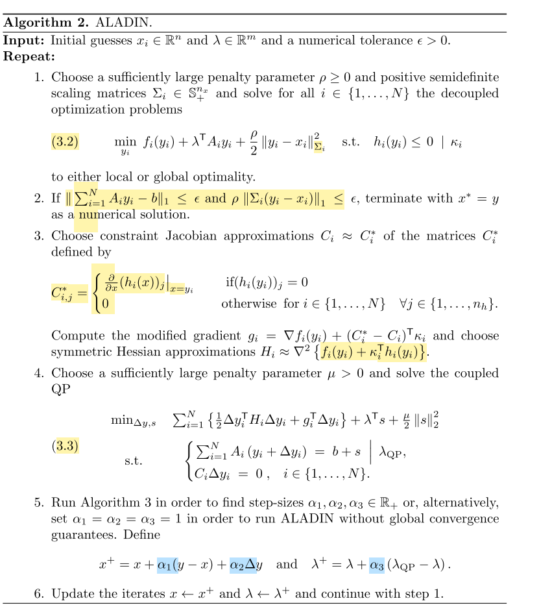
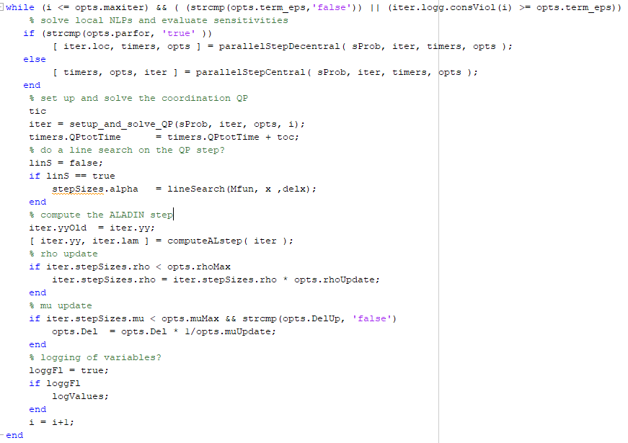
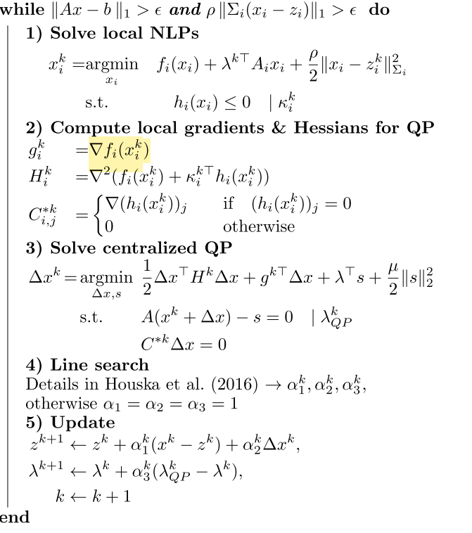
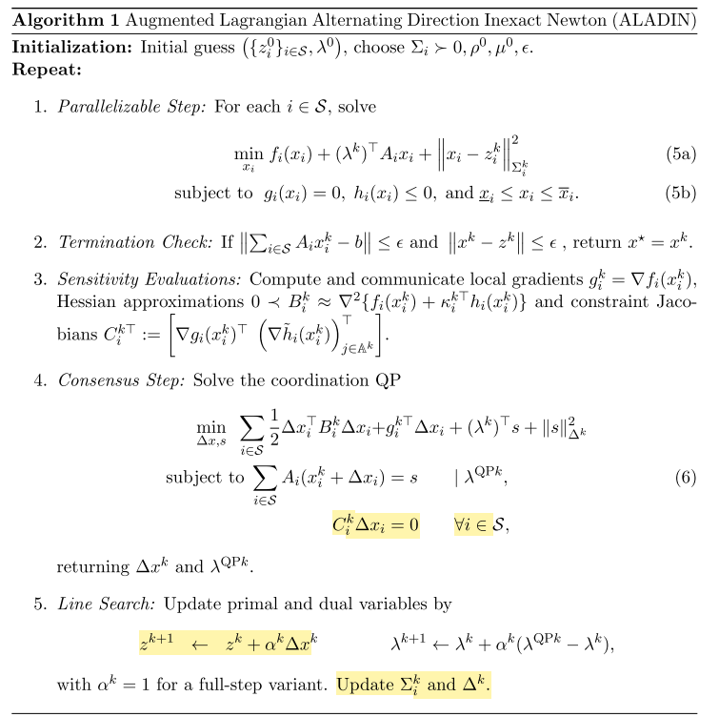



Issues – Termination Condition

Slide 17
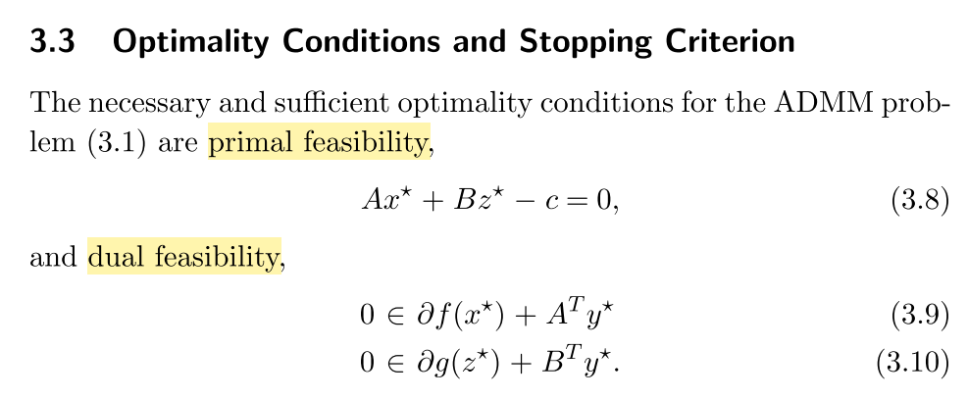
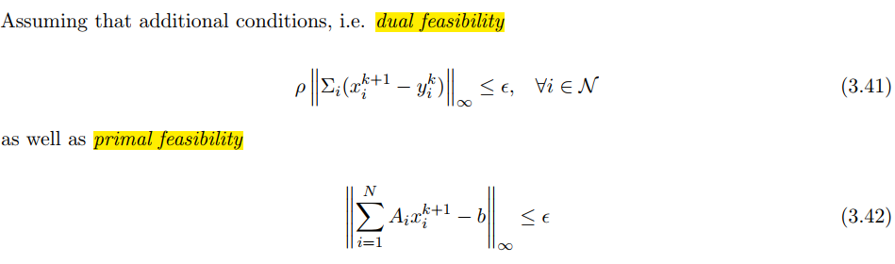
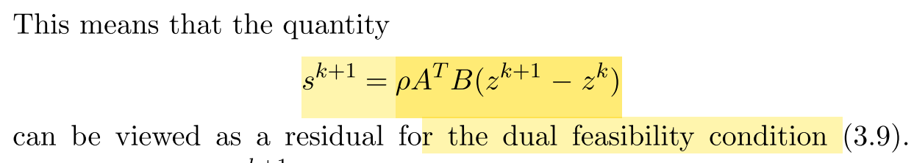
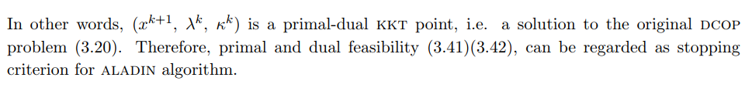


Issues – Termination Condition
ADMM
…
ALADIN
…

Slide 18

Thank you for your time

