Slide 1
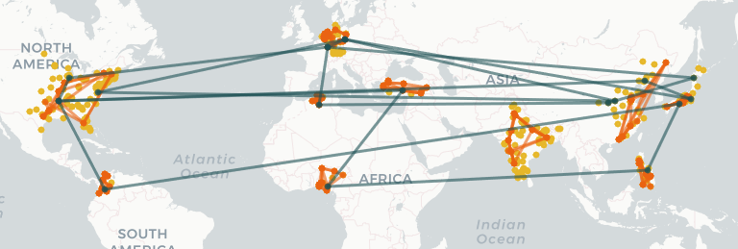
Network Analysis

Slide 2
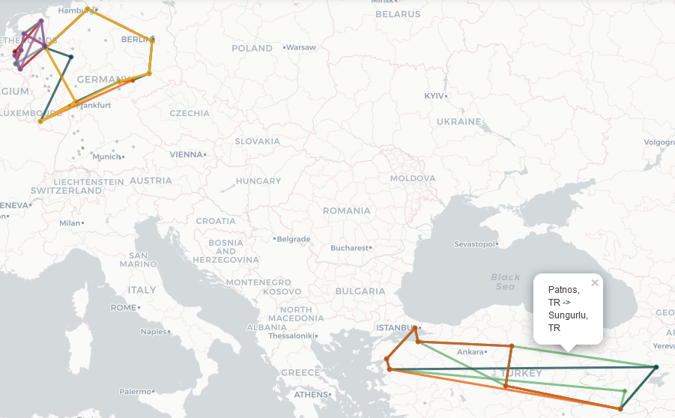
How many drones are deployed in regional services in Europe?
Nine drones are deployed in nine regional services in Europe.
Approach
check number of drones per service
check number of regional services in Europe

Slide 3
How many station pairs are directly connected in the network?
418 stations are connected without changing services.
171 stations are directly connected without changing or waiting at a different station.
Approach (by service connected stations)
find unique combinations of all stations in service (first) and overall (second)
Approach (directly connected stations)
change directed to undirected network
count edges
Assumption
direction of connection is not relevant

Slide 4
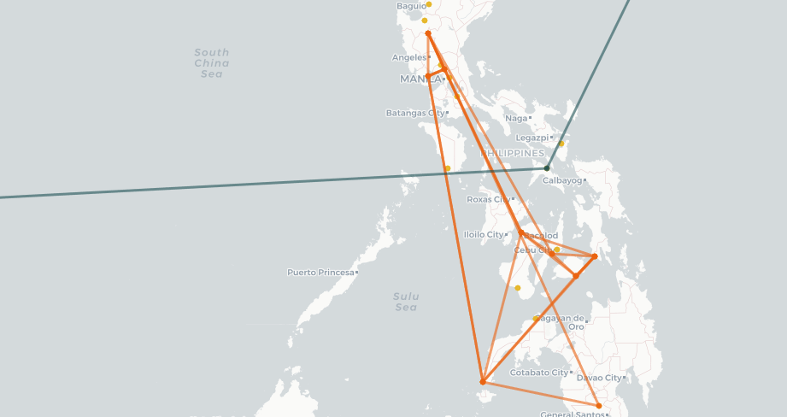
Which countries cannot be reached from Germany?
India and the Netherlands cannot be reached from Germany.
The services in the Netherlands and in India are isolated.
Other countries with isolated services (China, Philippines) still have connected stations.
Approach
determine stations and respective countries that have a path from Germany
subtract all possible countries

Slide 5
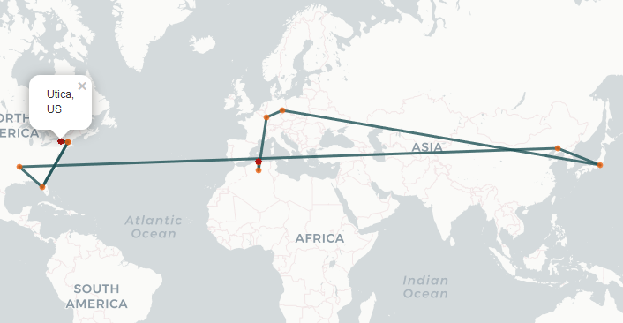
What's the fastest route from Utica in the US to Boumerdas in Algeria in the current network?
Utica → Keene → Lutz → Searcy → Haicheng → Shimotoda → Oschatz → Losheim → Messaad → Thenia → Boumerdas
1 day and 46 minutes
Approach
weight edges with flight time
calculate shortest weighted (=fastest) path
Assumption
‘fast’ in respect of flight time only
waiting or transfer time is not included
alternative approaches regarding travel time are attached in the Notebook

Slide 6
What's the average time it takes to get from a random station to another random station?
On average flying from a random station to another connected random station takes 19 hours and 40 minutes.
Approach
compute fastest paths for all connections like in 1.4
average paths
Assumption
in respect to flight time (not travel time)

Slide 7
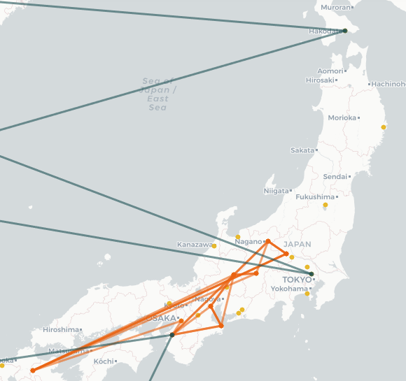
How would you improve this average time if you could set up an additional service?
The largest reduction in average flight time would be a service that links Shimotoda in Japan to the Japanese regional network. The same, but to a smaller extent applies for Hakodate in northern Japan.
Approach
compare distance and flight time between two stations
connect stations with a low km/hour
Assumption
new connections, not additional scheduled service
only already (indirectly) connected stations can be part of the service

Slide 8
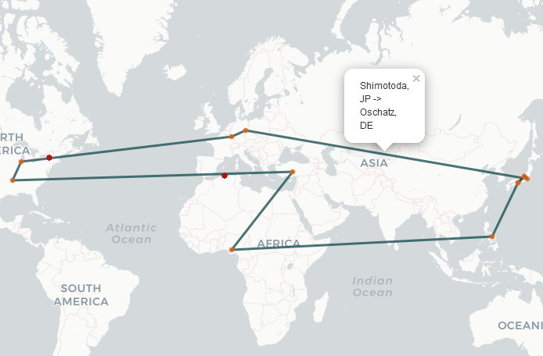
How would you improve this average time if you could set up an additional service?
Fastest connection from Shimotoda to Annaka in current network

Slide 9
Which station in your network would you consider the most important one?
Searcy (US) is the most important station in the network.
highest number of directly connected stations
highest probability that it is part of the shortest and fastest trips between two random stations
shortest and fastest connection to all other stations
Losheim has outgoing direct connections.
Messaad has more flights.
Approach
compute centrality algorthms
Assumption
regarding flight time instead of travel time
direct connections don‘t include a stop at another station
‘short‘ refers to the number of changes at stations

Slide 10
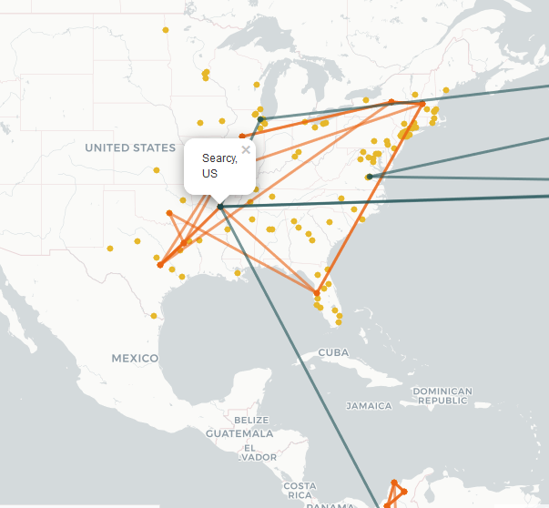
Which station in your network would you consider the most important one?

Slide 11
If you could set up the network from scratch with the existing drones, what would you change?
include isolated networks
connect all stations in a country to regional network
determine 1 to 2 regional hub
connect them to global network
assumes unlimited capacity
but reduces changes at stations and time
Trade-off
efficiency?
fastest regional connections
fastest global connections
centralized network
capacity?
decentralized network
reliability?
decentralized network

Slide 12
Predicting on-time Arrivals

Slide 13
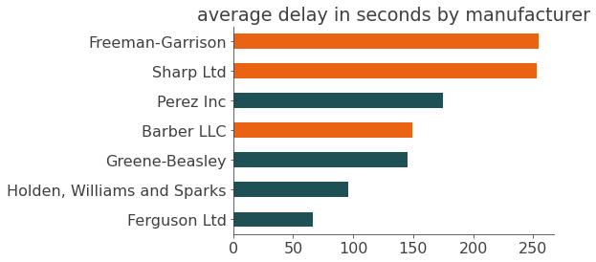
Before starting the analysis, you ask your colleagues about their opinion on what influences the on-time arrival of a service. Which statement is correct?
This is correct for Freeman-Garrison and Sharp Ltd., but not for Barber LLC.
controlled for other factors it is also correct for Barber LLC. (see question 2.2)
“From my former experience as a pilot I can say that drones from 'Barber LLC', 'Sharp Ltd', and 'Freeman-Garrison' are very difficult to get to the destination on time.”

Slide 14
Before starting the analysis, you ask your colleagues about their opinion on what influences the on-time arrival of a service. Which statement is correct?
This is almost correct, there exists a positive but low correlation.
controlled for other factors, the statement is not correct (see question 2.2)
“The technology of drones is already so sophisticated that wind has no impact on the arrival time.“

Slide 15
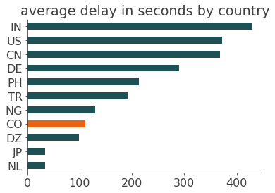
Before starting the analysis, you ask your colleagues about their opinion on what influences the on-time arrival of a service. Which statement is correct?
This is not correct. Services in Colombia are almost always on time.
“Services in Colombia are almost never on time because of the difficult climate close to the equator.“

Slide 16
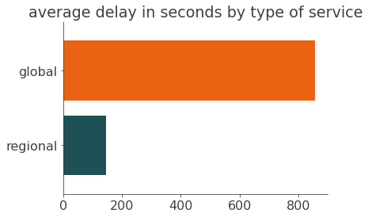
Before starting the analysis, you ask your colleagues about their opinion on what influences the on-time arrival of a service. Which statement is correct?
This is not correct. On average delays in global services are larger and more frequent.
mean and median
percentage of delayed flights
“Customers pay much more for the global services. So I assume that these services have less delays.”

Slide 17
Before starting the analysis, you ask your colleagues about their opinion on what influences the on-time arrival of a service. Which statement is correct?
There are no delayed departure, therefore it is not necessary to catch up a delay from the previous connection.
But, if delayed during the flight, it is true. The more passengers a drone can carry the more likely that the flight is delayed (positive correlation).
“The heavier the drone, the more expensive it is to do a speed up in order to catch up delays. Therefore the bigger drones will have more delays.“

Slide 18
What is the biggest driver of the arrival delay?
TOP 3
travel distance in km
somehow intuitive, the longer the distance, the longer the travel time and the larger the delay
alternatively arrival delay in seconds per km as the dependent variable
passenger capacity
indicates drone size
no information about actual number of passengers
wind speed in knt.
Approach
find possible drivers
correlated with delays
not correlated with each other
scale variables
execute linear regression
Assumption
observations are independent of each other (no delayed departures)
linear relationship

Slide 19
If your only goal is to bring your passengers to the destination on time, which drones would you replace with new ones?
The drone operating the service World_2, has by far the highest probability of a delay irrespective of wind speed, travel distance and latitude, followed by the drones of World_0 and In_0.
Approach
define delays (> 15 min according to FAA standard)
scale variables
execute logistic regression
construct dataset with drone characteristics and average values for flight attributes (e.g. wind speed)
predict delay probability
Assumption
like 2.3

Slide 20
Can you predict the delays of all station arrivals in the last days of July?
Yes.
With Random Forrest the R-squared is 0.98.
Actually this is too his, but usual for this data type. The goal is not to predict changes in delays or influencing factors.
No further improvement.
Approach
predict delay in sec. → regression
start model: Random Forest
metric: R-squared
calculate model and metric
improve model with respect to metric
alternative approach
use time series
if observations are independent time series are not necessary

Slide 21
Which service will have the least delays in the last days of July?
TR_1 has only 3 predicted arrivals that are more than 15 minutes delayed.
Approach
drop August schedule
categorize if predicted delay is larger than 15 min
sum by service
alternative approach
predict if service is delayed (0,1)
classification
Random Forrest Classifier
Support Vector Machine
…

