Slide 1
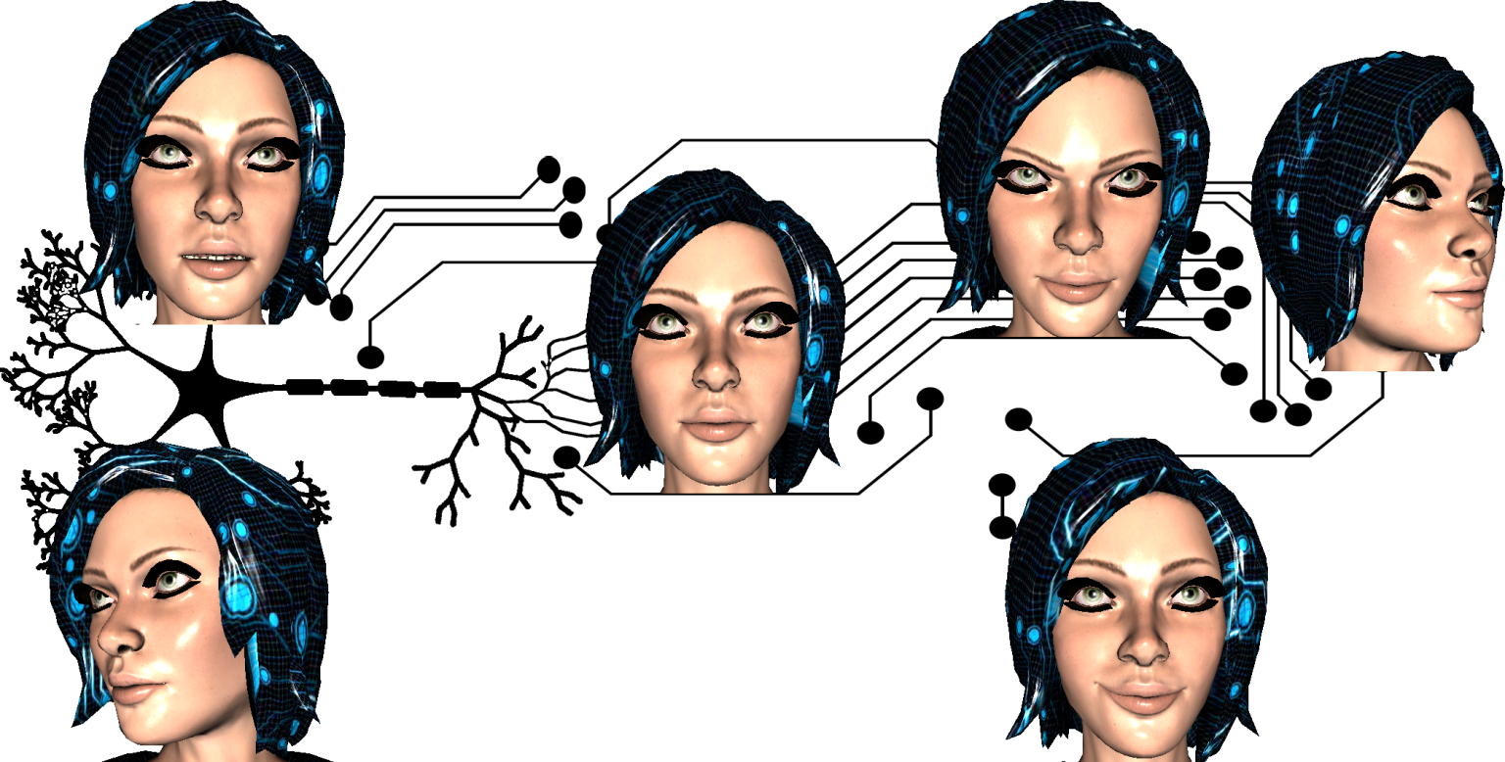
Marinescu Alexandru
Reflecta
Keywords: Kinect, body joints, facial expressions, animation, avatars, noise reduction
https://github.com/Zerseu/Reflecta

Slide 2
What is Reflecta?
… a small framework for motion capture acquisition using the Kinect for Windows v2 sensor targeting Unity game developers.

Slide 3
Why Reflecta?
… because it frees artists from the burden of creating animation clips for 3D models and allows them to focus on more important tasks.
… because it opens up virtually limitless possibilities for NUI driven applications.
… because it integrates into the workflow of the most widely used 3D modelling tools (BVH exporter).
… because it is open-source.

Slide 4
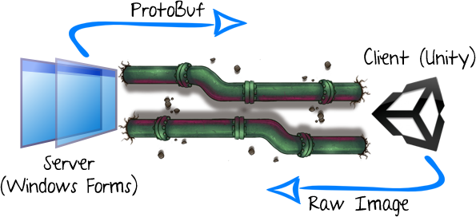
Architecture

Slide 5
Advantages of loose coupling…
Provides access to mocap data in a uniform way through protocol buffers – a lightweight and compact serialization protocol;
Clear separation of responsibility between server (acquires raw data from sensor) and client (processes raw data and renders 3D avatar);
Allows us to swap the two components with other, custom made implementations;

Slide 6
Drawbacks of loose coupling…
Have to provide an extra layer of abstraction situated above the Kinect and Unity animation systems;
Need to define the Kinect body skeleton, the Mecanim avatar body joints and map between them;
Need to define the Kinect facial expression system, which is based on the Candide-3 model, the Mixamo rig facial blends and map between them;
Must implement our own mathematical computation library since we can not include dependencies to Unity's math structures and operations;

Slide 7
Core entities
Reflecta is based upon a hierarchy of entities which grow progressively more complex based on a “has-a” relationship…
Position (Vector3) & Rotation (Quaternion) & Scale (Vector3) & Time (float) => TransformTime
SkeletonTransforms (TransformTime[]) => MoCapBodyFrame
ExpressionWeights (float[]) & FaceTransform (TransformTime) => MoCapFaceFrame
BodyFrames (MoCapBodyFrame[]) & FaceFrames (MoCapFaceFrame[]) => MoCapData

Slide 8
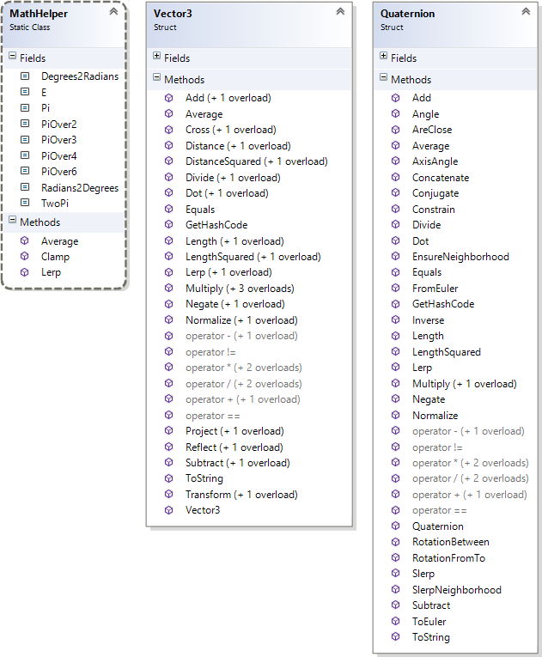

Slide 9
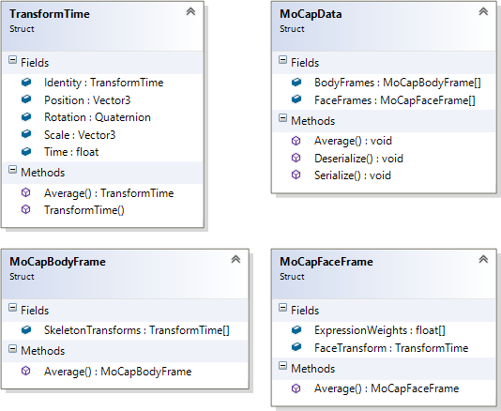

Slide 10
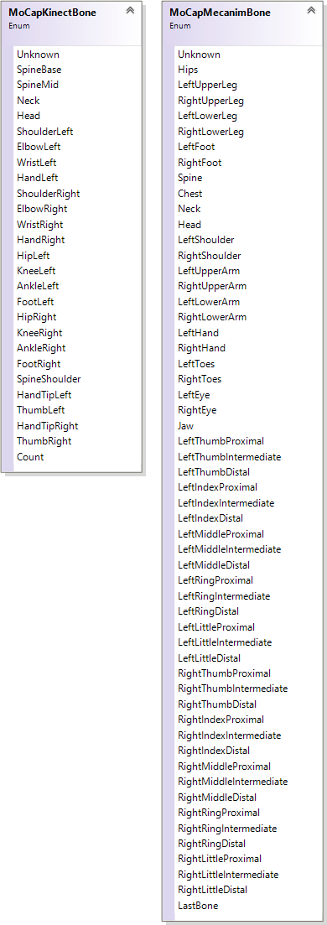
Bone mapper…
Kinect: 25 bones
Mecanim: 54 bones

Slide 11
Mapping…
Map[Kinect.SpineBase] = Mecanim.Hips;
Map[Kinect.SpineMid] = Mecanim.Spine;
Map[Kinect.SpineShoulder] = Mecanim.Chest;
Map[Kinect.Neck] = Mecanim.Neck;
Map[Kinect.Head] = Mecanim.Head;
Map[Kinect.ShoulderLeft] = Mecanim.RightShoulder;
Map[Kinect.ElbowLeft] = Mecanim.RightUpperArm;
Map[Kinect.WristLeft] = Mecanim.RightLowerArm;
Map[Kinect.HandLeft] = Mecanim.RightHand;
Map[Kinect.ThumbLeft] = Mecanim.RightThumbDistal;
Map[Kinect.HandTipLeft] = Mecanim.RightMiddleDistal;
Map[Kinect.ShoulderRight] = Mecanim.LeftShoulder;
Map[Kinect.ElbowRight] = Mecanim.LeftUpperArm;
Map[Kinect.WristRight] = Mecanim.LeftLowerArm;
Map[Kinect.HandRight] = Mecanim.LeftHand;
Map[Kinect.ThumbRight] = Mecanim.LeftThumbDistal;
Map[Kinect.HandTipRight] = Mecanim.LeftMiddleDistal;
Map[Kinect.HipLeft] = Mecanim.Unknown;
Map[Kinect.KneeLeft] = Mecanim.RightUpperLeg;
Map[Kinect.AnkleLeft] = Mecanim.RightLowerLeg;
Map[Kinect.FootLeft] = Mecanim.RightFoot;
Map[Kinect.HipRight] = Mecanim.Unknown;
Map[Kinect.KneeRight] = Mecanim.LeftUpperLeg;
Map[Kinect.AnkleRight] = Mecanim.LeftLowerLeg;
Map[Kinect.FootRight] = Mecanim.LeftFoot;

Slide 12
To be noted…
Implemented our own custom mapper entity;
The Kinect bone orientations are not readily usable in Unity;
Compensation factors need to be applied when extrapolating the local rotation (Unity) from the absolute rotation (Kinect);
Remark that we have swapped left joints for right joints and vice-versa;

Slide 13
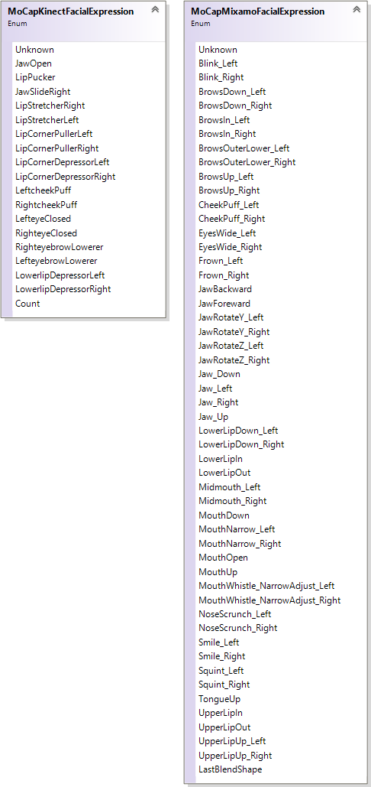
Facial expression mapper…
Kinect: 17 expressions
Mixamo: 50 expressions

Slide 14
Mapping…
JawOpen => Jaw_Down;
LipPucker => NULL;
JawSlideRight => Jaw_Right/Jaw_Left;
LipStretcherRight => NULL;
LipStretcherLeft => NULL;
LipCornerPullerLeft => Smile_Left;
LipCornerPullerRight => Smile_Right;
LipCornerDepressorLeft => Frown_Left;
LipCornerDepressorRight => Frown_Right;
LeftcheekPuff => CheekPuff_Left;
RightcheekPuff => CheekPuff_Right;
LefteyeClosed => Blink_Left;
RighteyeClosed => Blink_Right;
RighteyebrowLowerer => BrowsDown_Right/BrowsUp_Right;
LefteyebrowLowerer => BrowsDown_Left/BrowsUp_Left;
LowerlipDepressorLeft => LowerLipDown_Left;
LowerlipDepressorRight => LowerLipDown_Right;

Slide 15
To be noted…
Implemented our own custom mapper entity;
The Kinect input follows the Candide-3 model, whilst Mixamo uses its own proprietary system for facial expression morphs;
The documentation for the Kinect v2 sensor states that expression weights are in the range [-1, 1]; in practice, this differs from action unit to action unit;
One expression from the Kinect can have multiple mappings (usually at most two) in the Mixamo system;

Slide 16
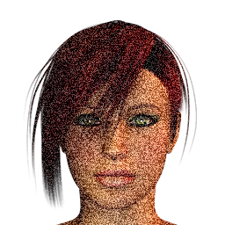
Noise…
… is everywhere…

Slide 17
Our proposed solution…
A combined approach consisting of:
a simple average scheme over a given number of frames;
specially designed and tuned double-exponential smoothing predictors (DESP) for float, Vector3 and Quaternion types;
raising the expression weights (given their [-1, 1] range) to an odd integer power (in order to conserve the sign) – usually 3;

Slide 18

End result…
… an animation clip for designers to drag on a rigged model.
… a BVH file to be imported in other 3D modelers.
Extensibility…
… any rig which is Mecanim compatible (for body) and at least Candide-3 compatible (for face).

Slide 19


Tech Demo…
Q&A

