Slide 1


Cloud Computing in Nepal
Presented By
Noble Koirala
Navaraj Kafle

Slide 2
Cloud Computing
Cloud computing is the delivery of computing services including servers, storage, databases, networking, software, analytics, and intelligence over the Internet to offer faster innovation, flexible resources, and economies of scale. We typically pay only for cloud services we use, helping us lower our operating costs, run our infrastructure more efficiently, and scale as our business needs change.
Rather than keeping files on a proprietary hard drive or local storage device, cloud based storage makes it possible to save them to a remote database. As long as an electronic device has access to the web, it has access to the data and the software programs to run it.
Cloud computing is a popular option for people and businesses for a number of reasons including cost savings, increased productivity, speed and efficiency, performance, and security.
Cloud Computing

Slide 3
History of Cloud Computing
In 1999, Salesforce.com started delivering of applications to users using a simple website. The applications were delivered to enterprises over the Internet, and this way the dream of computing sold as utility were true.
In 2002, Amazon started Amazon Web Services, providing services like storage, computation and even human intelligence.
However, only starting with the launch of the Elastic Compute Cloud in 2006 a truly commercial service open to everybody existed.
In 2009, Google Apps also started to provide cloud computing enterprise applications.
Cloud Computing

Slide 4
Advantages of Cloud Computing
There are many benefits of using cloud computing some of them are as below :-
Cloud-based software offers companies from all sectors a number of benefits, including the ability to use software from any device either via a native app or a browser. As a result, users can carry their files and settings over to other devices in a completely seamless manner.
Cloud computing is far more than just accessing files on multiple devices. Thanks to cloud computing services, users can check their email on any computer and even store files using services such as Dropbox and Google Drive. Cloud computing services also make it possible for users to back up their music, files, and photos, ensuring those files are immediately available in the event of a hard drive crash.
Cloud Computing

Slide 5
It also offers big businesses huge cost-saving potential. Before the cloud became a viable alternative, companies were required to purchase, construct, and maintain costly information management technology and infrastructure. Companies can swap costly server centers and IT departments for fast Internet connections, where employees interact with the cloud online to complete their tasks.
The cloud structure allows individuals to save storage space on their desktops or laptops. It also lets users upgrade software more quickly because software companies can offer their products via the web rather than through more traditional, tangible methods involving discs or flash drives.

Slide 6


Disadvantages of Cloud Computing
With advantages there are also many disadvantages of using cloud computing some of them are as below
Security has always been a big concern with the cloud especially when it comes to sensitive medical records and financial information. While regulations force cloud computing services to shore up their security and compliance measures, it remains an ongoing issue. Encryption protects vital information, but if that encryption key is lost, the data disappears.
Servers maintained by cloud computing companies may fall victim to natural disasters, internal bugs, and power outages
As with any technology, there is a learning curve for both employees and managers. But with many individuals accessing and manipulating information through a single portal, simple mistake can occur which can transfer across an entire system.
Cloud Computing

Slide 7
Cloud Service Models
There are the following three types of cloud service models
SAAS(software as a service): Required software, operating system and network is provided
PAAS(Platform as a service): Operating system and network are provided.
IAAS(infrastructure as a service): Just Network is provided.
Cloud Computing

Slide 8
Scope of Cloud Computing in Nepal
Due to huge number of large and small business shifting towards E-commerce cloud computing has huge benefit in Nepali market.
Leading companies are already on cloud nowadays because of security and price effective factors
Distance learning to remote areas and school can be implemented with the help of cloud computing.
Cloud computing has huge opportunity in Nepal market due to large number of small and medium businesses.
Increasing trend of outsourcing job.
Cloud Computing

Slide 9
Cloud Computing Companies in Nepal
Some of the big and famous companies providing cloud services in Nepal are as below
Cloud Himalaya
It is the largest data center in Nepal which excels in managing data, network, cloud architecture and security services.
Baato
The main services offered by Baato are Geocoding, Navigation, Vector Maps, Route Planning which are mainly used by ride sharing companies that are growing rapidly in Nepal.
Genese
Genese is an official Cloud Consulting Provider of Amazon web services giving international services here in Nepal
Cloudalaya
Services provided by cloudalaya are as follow cloud services, cloud data analysis, Application Development, Data recovery and backup of consumer’s data
Cloud Computing

Slide 10
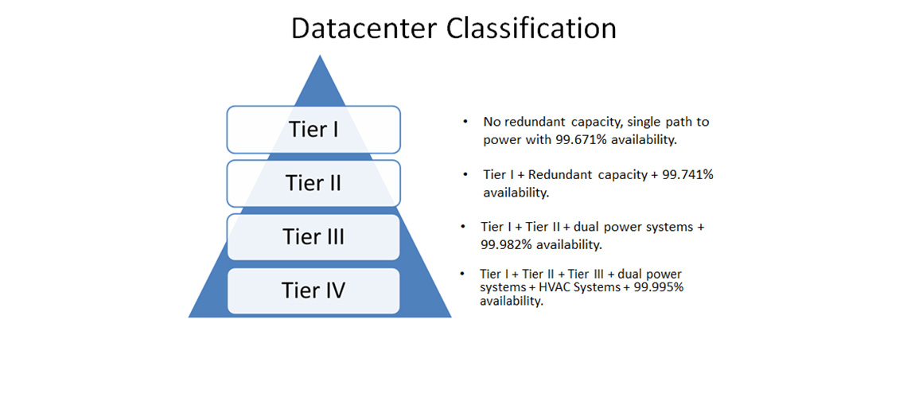

Slide 11
Example of some company that provide cloud service in Nepal.
Cloud Himalaya is the largest Tier-4 Data Center in Nepal, accommodating the entire country’s public and private sector data for the next five years.
Managing critical business data has become essential for small to large enterprises in Nepal.
As the demand for professional solutions to the needs of these organizations increase.
Cloud Himalaya was established with the slogan, “YOU TAKE CARE OF YOUR BUSINESS, WE TAKE CARE OF YOUR DATA”. Offering our customers.
Certified by ISO : 27001 in 2013
Client of cloud Himalaya are Sastodeal, IME pay, Nepal bangledesh bank, Kantipur publication, etc
Cloud Computing

Slide 12
GIDC (Government Integrated Data Center)
GIDC (Government Integrated Data Center) is an international standard Government’s Data Center running under NITC(National Information Technology center).
GIDC started providing services to only Government organizations in 2009.
Initially, GIDC was providing only webhosting, email hosting and server co-location services.
Currently GIDC is proving cloud services to few Government organizations. The type of cloud services provided by GIDC is mostly infrastructure as aservice (IaaS) and Platform as a service (PaaS).
Since all the services provided by GIDC are free of cost, so there is no clear SLA between clients and GIDC. GIDC provides cloud services through single data center and they do not have DR center yet.
They have targeted to build their own DR center in Hetauda within 2016.
Cloud Computing

Slide 13
Access World (AWT) Clouds Services Nepal
AWT is the First Complete Cloud Service Provider of Nepal having largest Data Centre in Nepal with single foor space, which is expandable to 15,000 sq feet and backed by its redundant data centers around the world.
AWT Nepal is focusedon website hosting for business, cloud hosting (VPS), enterprisesecure email and platform hosting.
Cloud Computing

Slide 14
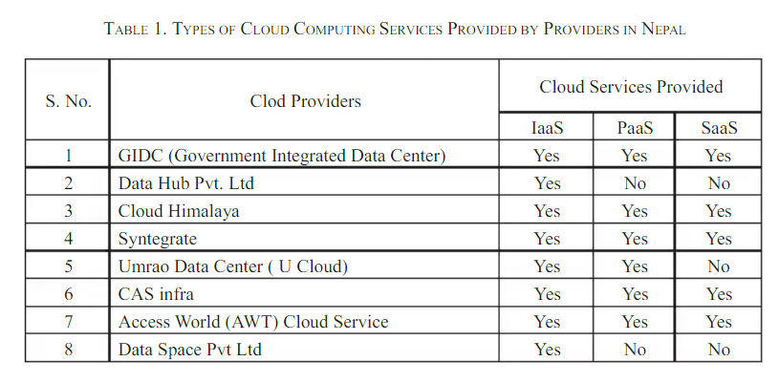

Slide 15
Limitations of Cloud Computing
Requires Constant internet connection
Doesn’t works properly in slow internet connection
Limited features
Can be slow at times
Stored data can be lost
Cloud Computing

Slide 16


