Slide 1


Presentation on Database tier in Cloud Computing
Prepared By:
Siddhika Dhakal, Yashoda Subedi, Goma Thapa, Jeevan Malla, Jenisha Munikar
(BIT 6th Semester )

Slide 2
Database architecture
Database architecture is a well-established software design architecture that helps to design, develop and maintain the database management system.
Database stores critical information and helps access data quickly and securely.
Correct architecture is must for easy and efficient data management.
Cloud Computing

Slide 3
Types of Database Architecture
1-tier architecture
Simplest architecture of database
Client, server and database reside on same machine.
2-tier architecture
Presentation layer runs on a client(PC, Mobile, etc.) and data is stored on server called second tier.
3-tier architecture
Most important client server architecture.
Contains presentation tier, application tier and data tier.
Cloud Computing

Slide 4
1-tier architecture
It is the simplest architecture of Database in which the client, server, and Database all reside on the same machine.
Presentation, Application and data layers are tightly connected.
Cloud Computing

Slide 5
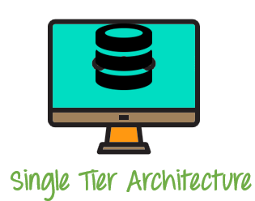
1-tier architecture (cont.)
Cloud Computing

Slide 6
Example of 1-tier Architecture
MS office
Cloud Computing

Slide 7
Advantages And Disadvantages of 1-tier Architecture
Advantages
Fast for a single user
Easy to implement and optimize performance.
Disadvantage
Completely unscalable only one user can access the system at a given time via the local client.
Cloud Computing

Slide 8
2- tier architecture
A 2 Tier Architecture is a Database architecture where the presentation layer runs on a client (PC, Mobile, Tablet, etc.), and data is stored on a server called the second tier.
It also provides direct and faster communication.
The two-tier architecture is like client server application. The direct communication takes place between client and server.
Cloud Computing

Slide 9
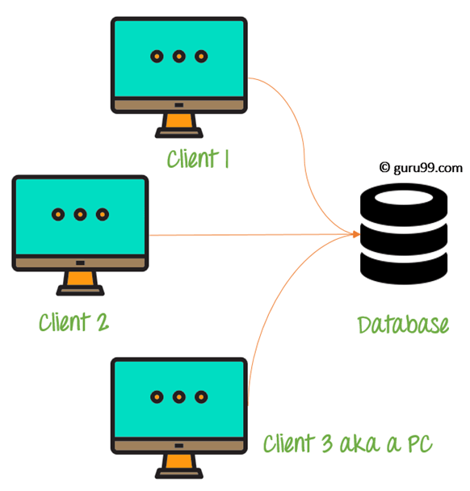
2-tier architecture (cont.)
2 Tier architecture Diagram
Cloud Computing

Slide 10
2- tier architecture (cont.)
Examples of 2-tier:
Desktop applications, excel sheets, word document, desktop games.
Advantages
Understanding and maintenances is easier.
Disadvantages:
It is not easily scalable, thus performance degrades as users scale.
Data integrity issue may arise due to the server responding to multiple requests at the same time.
Cloud Computing

Slide 11
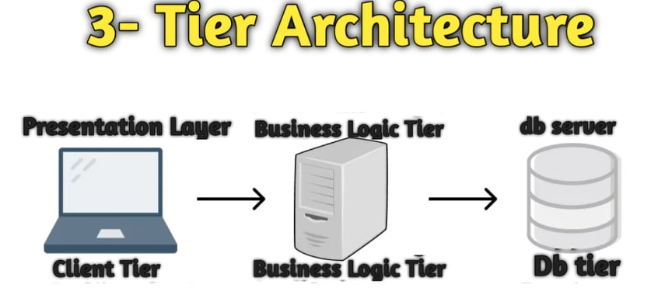
3-Tier Architecture
Three-tier is well-established software application architecture that organizes applications into three logical and physical computing tiers: the presentation tier shows user interface, the application tier shows where data is processed and the data tier shows where the data associated with the application is stored and managed.
It completely depends upon
networking and internet.
Nowadays, it depends upon cloud.
Cloud Computing

Slide 12
Presentation Tier
User interface and communication layer of the application, , where the end user interacts with the application.
Main purpose: To display information to the users and collect information from the user.
Runs on a web browser, as desktop application, or a graphical user interface (GUI).
It is usually developed using HTML, CSS, JavaScript, or any other front-end programming language.
Cloud Computing

Slide 13
Application Tier
Logic or middle tier
Uses an application server and processes the business logic for the application.
The information collected in the presentation tier is processed.
The application tier can also add, delete or modify data in the data tier.
It is typically developed using Python, Java, Perl, PHP or Ruby, and communicates with the data tier using API calls.
Cloud Computing

Slide 14
Database Tier
Data tier, data access tier or back-end
The information processed by the application is stored and managed.
Relational database management system such as PostgreSQL, MySQL, MariaDB, Oracle, DB2, Informix or Microsoft SQL Server, or in a NoSQL Database server such as Cassandra, CouchDB or MongoDB.
Cloud Computing

Slide 15
Benefits of 3-tier Architecture
Logical and physical separation of functionality
Faster development
Improved scalability
Improved reliability
Improved security
Cloud Computing

Slide 16
3-tier Architecture in Web Development
The tiers have different names but perform similar functions.
Web server = Presentation Tier
Application server = Application Tier
Database server = Database Tier
Cloud Computing

Slide 17
Thank You
Cloud Computing

