Slide 1
IP Addresses
IP Addresses:
Classful Addressing

Slide 2

What is an IP Address?
An IP address is a
32-bit
address.
The IP addresses
are
unique.

Slide 3
Address Space
…………..
…………..
addr1
addr15
addr2
…………..
…………..
…………..
addr41
addr226
addr31
…………..
…………..

Slide 4
Address space rule
…………..
…………..
addr1
addr15
addr2
…………..
The address space in a protocol
That uses N-bits to define an
Address is:
        2^{N}
…………..
…………..
addr41
addr226
addr31
…………..
…………..

Slide 5
IPv4 address space
The address space of IPv4 is
2³²
or
4,294,967,296.

Slide 6
Binary Notation
01110101 10010101 00011101 11101010

Slide 7
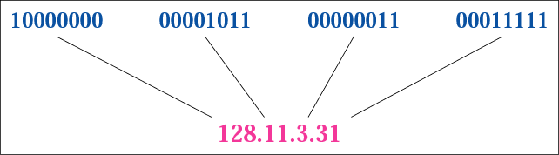
Figure 4-1
Dotted-decimal notation

Slide 8
Hexadecimal Notation
0111 0101 1001 0101 0001 1101 1110 1010
75 95 1D EA
0x75951DEA

Slide 9
Example 1
Change the following IP address from binary notation to dotted-decimal notation.
10000001 00001011 00001011 11101111
Solution
129.11.11.239

Slide 10
Example 2
Change the following IP address from dotted-decimal notation to binary notation:
111.56.45.78
Solution
01101111 00111000 00101101 01001110

Slide 11
Example 3
Find the error in the following IP Address
111.56.045.78
Solution
There are no leading zeroes in
Dotted-decimal notation (045)

Slide 12
Example 3 (continued)
Find the error in the following IP Address
75.45.301.14
Solution
In decimal notation each number <= 255
301 is out of the range

Slide 13
Example 4
Change the following binary IP address
Hexadecimal notation
10000001 00001011 00001011 11101111
Solution
0X810B0BEF or 810B0BEF16

Slide 14
CLASSFUL
ADDRESSING

Slide 15
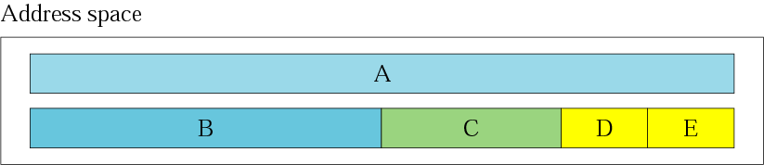
Figure 4-2
Occupation of the address space

Slide 16
In classful addressing the address space is
divided into 5 classes:
A, B, C, D, and E.

Slide 17
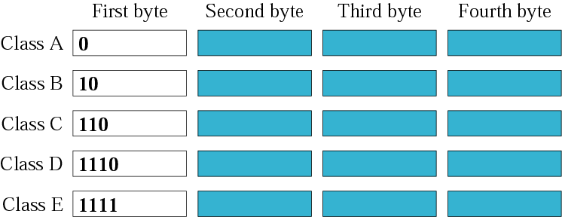
Figure 4-3
Finding the class in binary notation

Slide 18
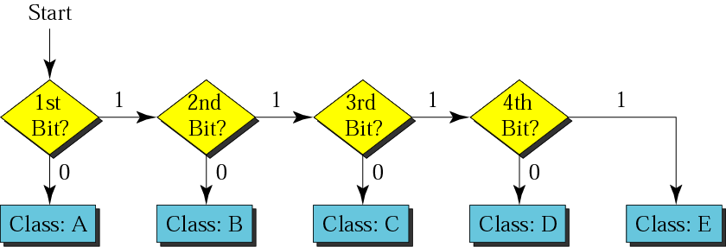
Figure 4-4
Finding the address class

Slide 19
Example 5
Show that Class A has
2³¹ = 2,147,483,648 addresses

Slide 20
Example 6
Find the class of the following IP addresses
00000001 00001011 00001011 11101111
11000001 00001011 00001011 11101111
Solution
00000001 00001011 00001011 11101111
1st is 0, hence it is Class A
11000001 00001011 00001011 11101111
1st and 2nd bits are 1, and 3rd bit is 0 hence, Class C

Slide 21

Figure 4-5
Finding the class in decimal notation

Slide 22
Private Address Range
Address Class | Reserved Address Space
Class A | 10.0.0.0 - 10.255.255.255
Class B | 172.16.0.0 - 172.31.255.255
Class C | 192.168.0.0 - 192.168.255.255

Slide 23
Example 7
Find the class of the following addresses
158.223.1.108
227.13.14.88
Solution
158.223.1.108
1st byte = 158 (128<158<191) class B
227.13.14.88
1st byte = 227 (224<227<239) class D

Slide 24
IP address with appending port number
158.128.1.108:25
The four octets before colon is the IP address
The number of colon (25) is the port number

Slide 25
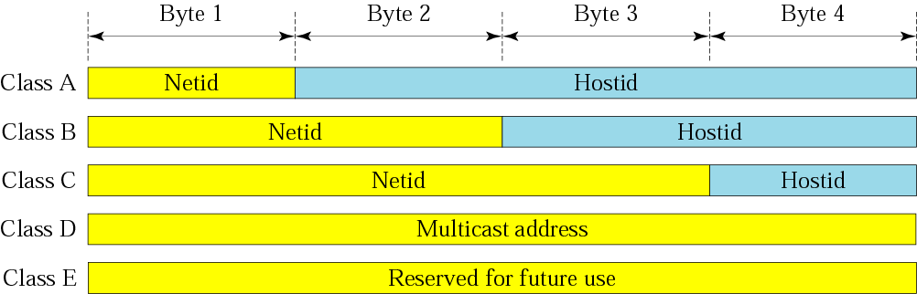
Figure 4-6
Netid and hostid

Slide 26
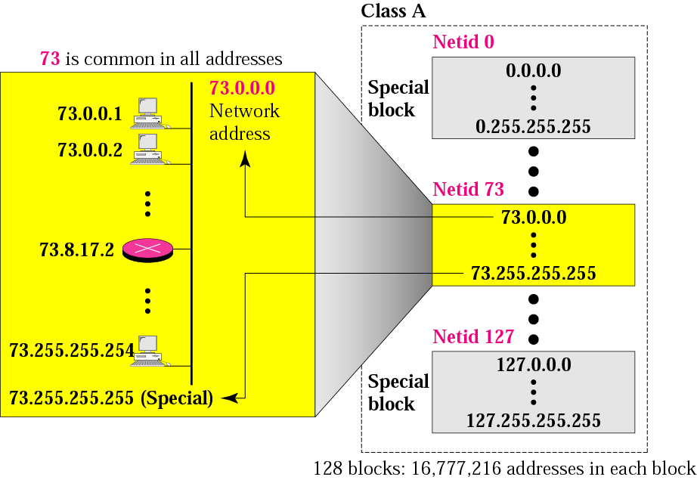
Figure 4-7
Blocks in class A

Slide 27
Millions of class A addresses
are wasted.

Slide 28
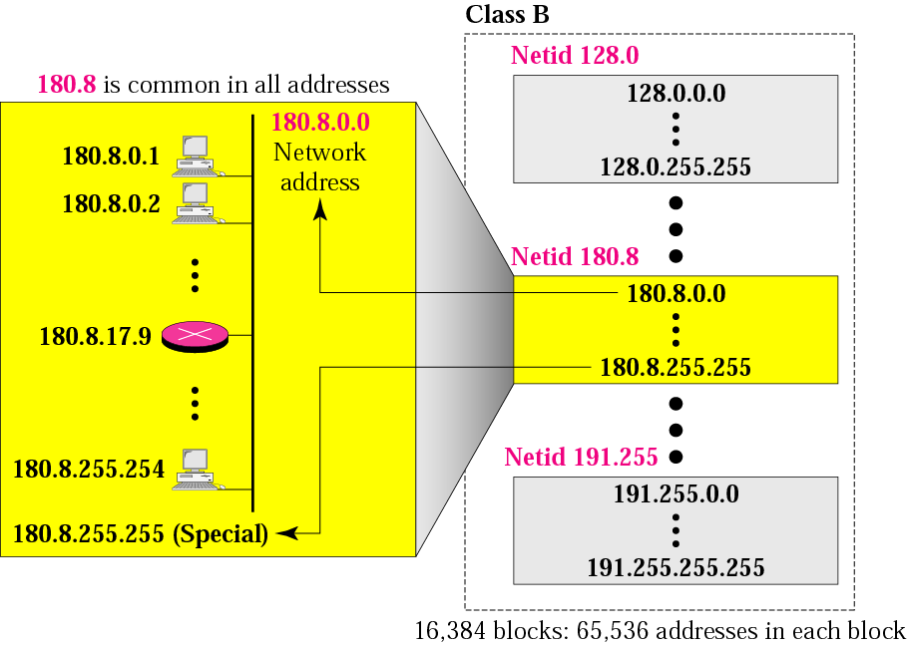
Figure 4-8
Blocks in class B

Slide 29
Many class B addresses
are wasted.

Slide 30
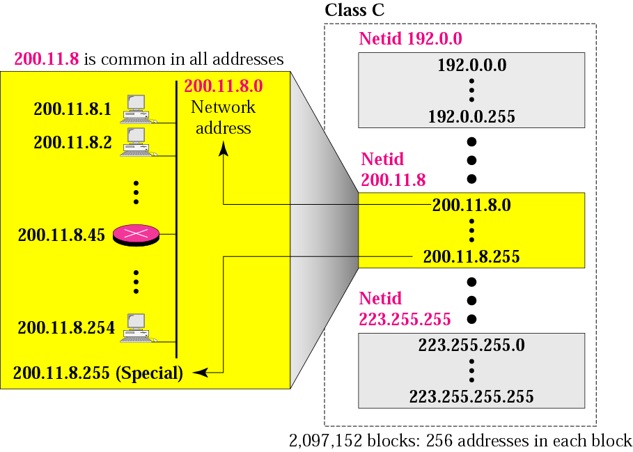
Figure 4-9
Blocks in class C

Slide 31
The number of addresses in
a class C block
is smaller than
the needs of most organizations.

Slide 32
Class D addresses
are used for multicasting;
there is only
one block in this class.

Slide 33
Class E addresses are reserved
for special purposes;
most of the block is wasted.

Slide 34
Network Addresses
The network address is the first address.
The network address defines the network to the rest of the Internet.
Given the network address, we can find the class of the address, the block, and the range of the addresses in the block

Slide 35
In classful addressing,
the network address
(the first address in the block)
is the one that is assigned
to the organization.

Slide 36
Example 8
Given the network address 132.21.0.0, find the
class, the block, and the range of the addresses
Solution
The 1st byte is between 128 and 191.
Hence, Class B
The block has a netid of 132.21.
The addresses range from
132.21.0.0 to 132.21.255.255.

Slide 37
Mask
A mask is a 32-bit binary number.
The mask is ANDeD with IP address to get
  The block address (Network address)
  Ie Mask And IP address = Block Address

Slide 38
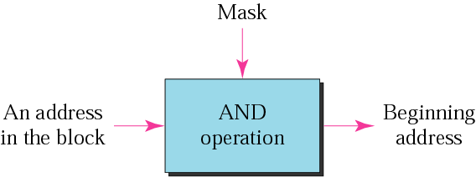
Figure 4-10
Masking concept

Slide 39
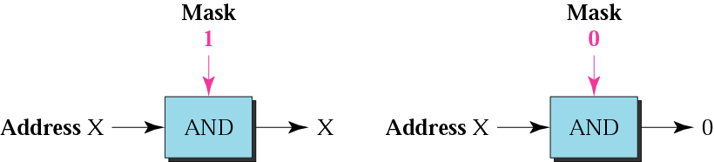
Figure 4-11
AND operation

Slide 40
The network address is the
beginning address of each block.
It can be found by applying
the default mask to
any of the addresses in the block
(including itself).
It retains the netid of the block
and sets the hostid to zero.

Slide 41
Default Subnet Mask
Class A default Subnet mask is 255.0.0.0
Class B default Subnet mask is 255.255.0.0
Class C Default Subnet mask 255.255.255.0

Slide 42
Subnetting

Slide 43
Subnetting
Creates multiple logical networks that exist within a single Class A, B, or C network.
If you do not subnet, you will only be able to use one network from your Class A, B, or C network, which is unrealistic
Each data link on a network must have a unique network ID, with every node on that link being a member of the same network

Slide 44
Benefits of Subnetting
Reduced network traffic
Optimized network performance
Simplified management
Facilitated spanning of large geographical distances

Slide 45
IP Subnet-Zero
This command allows you to use the first and last subnet in your network design.
For example, the Class C mask of 192 provides subnets 64 and 128, but with the IP subnet-zero command, you now get to use subnets 0, 64, 128, and 192

Slide 46
How to create subnets
Determine the number of required network IDs:
  One for each subnet
  One for each wide area network connection
Determine the number of required host IDs per subnet:
  One for each TCP/IP host
  One for each router interface
Based on the above requirements, create the following:
  One subnet mask for your entire network
  A unique subnet ID for each physical segment
  A range of host IDs for each subnet

Slide 47
Subnetting a Class A/B/C Address
How many subnets does the chosen subnet mask produce?
How many valid hosts per subnet are available?
What are the valid subnets?
What’s the broadcast address of each subnet?
What are the valid hosts in each subnet?

Slide 48
Practice Example #1C: 255.255.255.128 (/25)
Network 192.168.10.0
How many subnets? Since 128 is 1 bit on (10000000), the answer would be 2¹= 2.
How many hosts per subnet? We have 7 host bits off (10000000), so the equation would be 2⁷– 2 = 126 hosts.
What are the valid subnets? 256 – 128 = 128. Remember, we’ll start at zero and count in our block size, so our subnets are 0, 128.
What’s the broadcast address for each subnet? The number right before the value of the next subnet is all host bits turned on and equals the broadcast address. For the zero subnet, the next subnet is 128, so the broadcast of the 0 subnet is 127.
What are the valid hosts? These are the numbers between the subnet and broadcast address

Slide 49
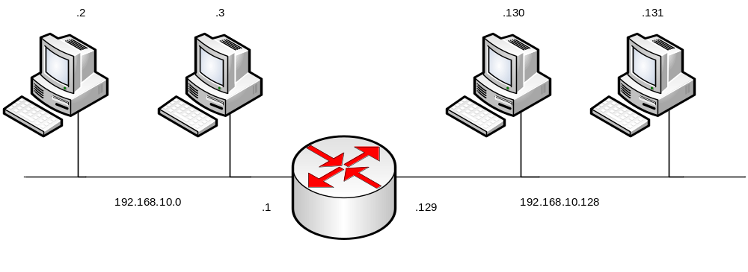
Logical Network Implementation

Slide 50
Practice Example #2C: 255.255.255.224 (/27)
Network 192.168.10.0
How many subnets? 224 is 11100000, so our equation would be 2³ = 8.
How many hosts? 2⁵– 2 = 30.
What are the valid subnets? 256 – 224 = 32. We just start at zero and count to the subnet mask value in blocks (increments) of 32: 0, 32, 64, 96, 128, 160, 192, and 224.
What’s the broadcast address for each subnet (always the number right before the next subnet)?
What are the valid hosts (the numbers between the subnet number and the broadcast address)?

Slide 51
Practice Example #2C: 255.255.255.224 (/27)
Network 192.168.10.0
Subnet Address | 0 | 32 | …………. | 192 | 224
First Host | 1 | 33 |  | 193 | 225
Last Host | 30 | 62 |  | 222 | 254
Broadcast Address | 31 | 63 |  | 223 | 255

Slide 52
Practice Example #1B: 255.255.128.0 (/17)
Network 172.16.0.0
Subnets? 2¹ = 2
Hosts? 2¹⁵– 2 = 32,766 (7 bits in the third octet, and 8 in the fourth)
Valid subnets? 256 – 128 = 128. 0, 128. Remember that subnetting is performed in the third octet, so the subnet numbers are really 0.0 and 128.0, as shown in the next table
Broadcast address for each subnet?
Valid hosts?

Slide 53
Practice Example #1B: 255.255.128.0 (/17)
Network 172.16.0.0
Subnet | 0.0 | 128.0
First Host | 0.1 | 128.1
Last Host | 127.254 | 255.254
Broadcast | 127.255 | 255.255

Slide 54
Practice Example #2B: 255.255.240.0 (/20)
Network 172.16.0.0
Subnets? 2⁴= 16.
Hosts? 2¹² – 2 = 4094.
Valid subnets? 256 – 240 = 0, 16, 32, 48, etc., up to 240.
Broadcast address for each subnet?
Valid hosts?

Slide 55
Practice Example #2B: 255.255.240.0 (/20)
Network 172.16.0.0
Subnet | 0.0 | 16.0 | ……….. | 240.0
First Host | 0.1 | 16.1 |  | 240.1
Last Host | 15.254 | 31.254 |  | 255.254
Broadcast | 15.255 | 31.255 |  | 255.255

Slide 56
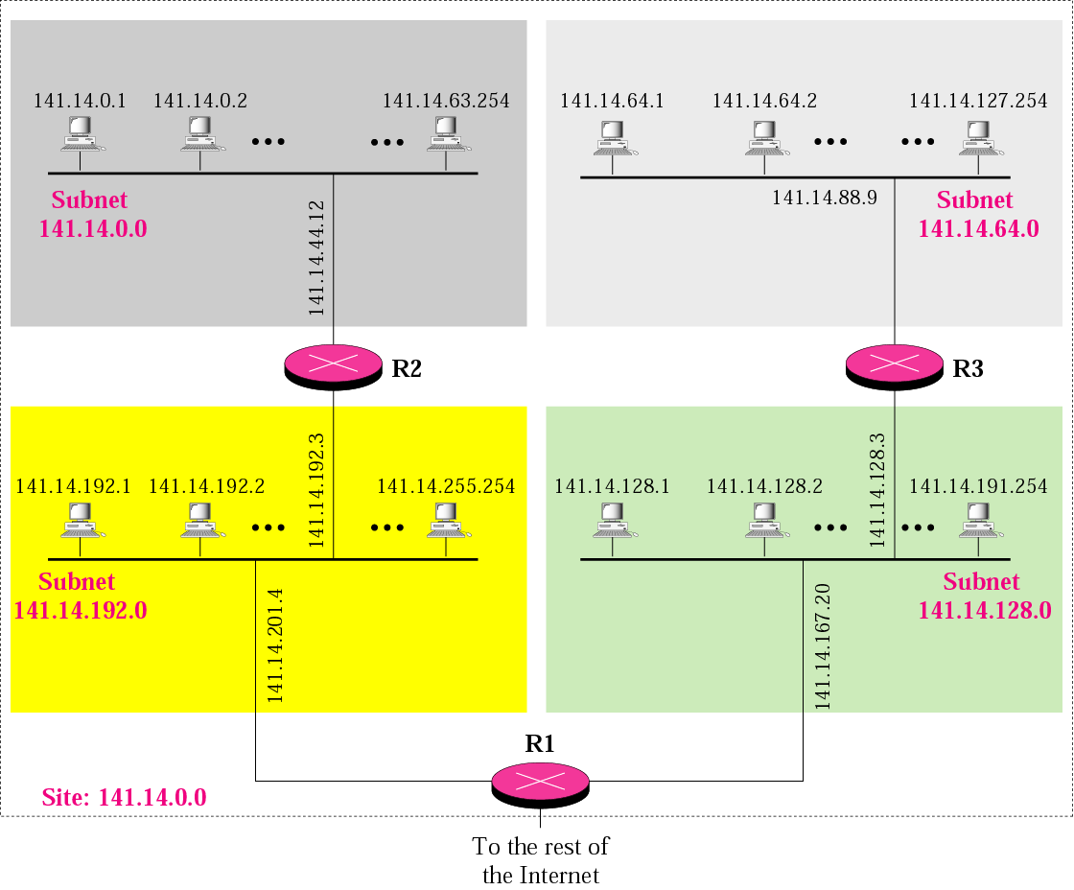
Figure 5-2
A network with three levels of
hierarchy (subnetted)

Slide 57
Note
Subnetting is done by borrowing bits from the host part and add them the network part

Slide 58
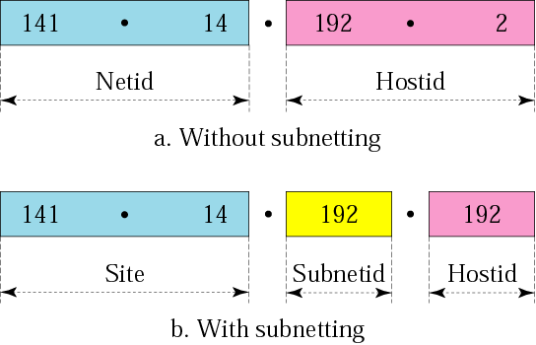
Figure 5-3
Addresses in a network with
and without subnetting

Slide 59
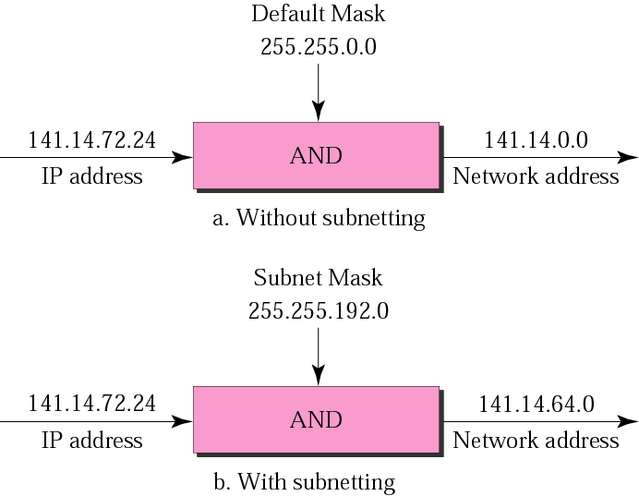
Figure 5-5
Default mask and subnet mask

Slide 60
Finding the Subnet Address
Given an IP address, we can find the subnet address the same way we found the network address. We apply the mask to the address. We can do this in two ways: straight or short-cut.

Slide 61
Straight Method
In the straight method, we use binary notation for both the address and the mask and then apply the AND operation to find the subnet address.

Slide 62
Example 9
What is the subnetwork address if the destination address is 200.45.34.56 and the subnet mask is 255.255.240.0?

Slide 63
Solution
11001000 00101101 00100010 00111000
11111111 11111111 11110000 00000000
11001000 00101101 00100000 00000000
The subnetwork address is 200.45.32.0.

Slide 64
Short-Cut Method
    ** If the byte in the mask is 255, copy the byte in the address.
    ** If the byte in the mask is 0, replace the byte in the address with 0.
    ** If the byte in the mask is neither 255 nor 0, we write the mask and the address in binary and apply the AND operation.

Slide 65
Example 10
What is the subnetwork address if the destination address is 19.30.80.5 and the mask is 255.255.192.0?
Solution
See next slide

Slide 66
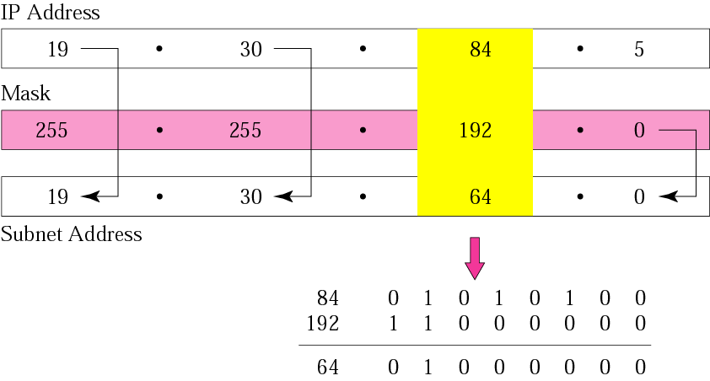
Figure 5-6
Solution

Slide 67
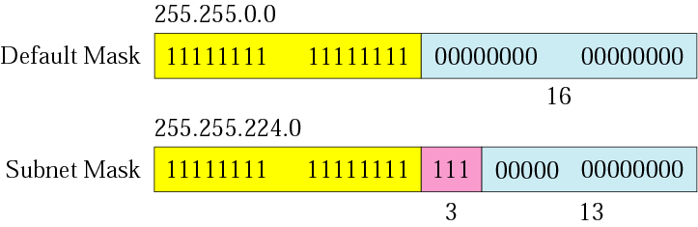
Figure 5-7
Comparison of a default mask and
a subnet mask

Slide 68
The number of subnets must be
a power of 2.

Slide 69
Example 11
A company is granted the site address 201.70.64.0 (class C). The company needs six subnets. Design the subnets.
Solution
The number of 1s in the default
mask is 24 (class C).

Slide 70
Solution (Continued)
The company needs six subnets. This number 6 is not a power of 2. The next number that is a power of 2 is 8 (2³). We need 3 more 1s in the subnet mask. The total number of 1s in the subnet mask is 27 (24 + 3).
The total number of 0s is 5 (32 − 27). The mask is

Slide 71
Solution (Continued)
11111111 11111111 11111111 11100000
or
255.255.255.224
    The number of subnets is 8.
    The number of addresses in each subnet is 2⁵ (5 is the number of 0s) or 32.
See Next slide

Slide 72
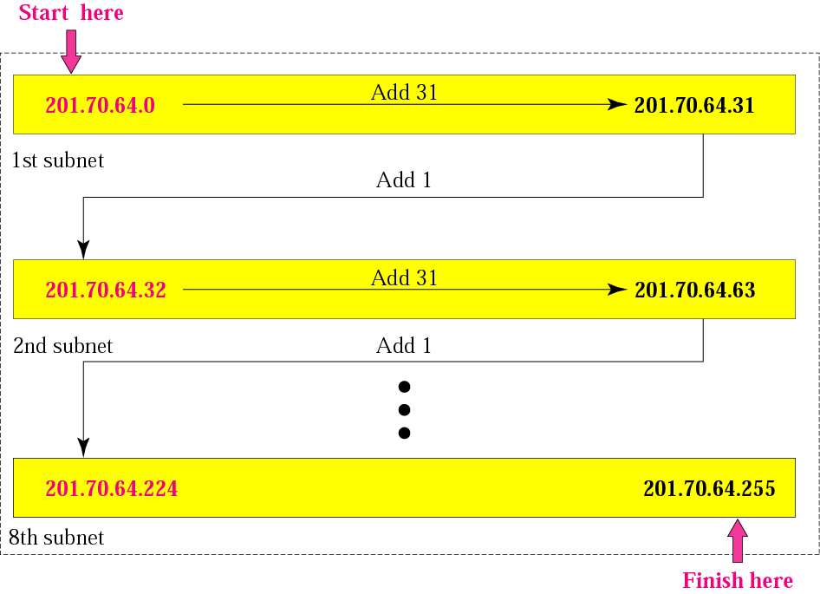
Figure 5-8
Example 3

Slide 73
Example 12
A company is granted the site address 181.56.0.0 (class B). The company needs 1000 subnets. Design the subnets.
Solution
The number of 1s in the default mask is 16 (class B).

Slide 74
Solution (Continued)
The company needs 1000 subnets. This number is not a power of 2. The next number that is a power of 2 is 1024 (2¹⁰). We need 10 more 1s in the subnet mask.
The total number of 1s in the subnet mask is 26 (16 + 10).
The total number of 0s is 6 (32 − 26).

Slide 75
Solution (Continued)
The mask is
11111111 11111111 11111111 11000000
or
255.255.255.192.
The number of subnets is 1024.
The number of addresses in each subnet is 2⁶ (6 is the number of 0s) or 64.
See next slide

Slide 76
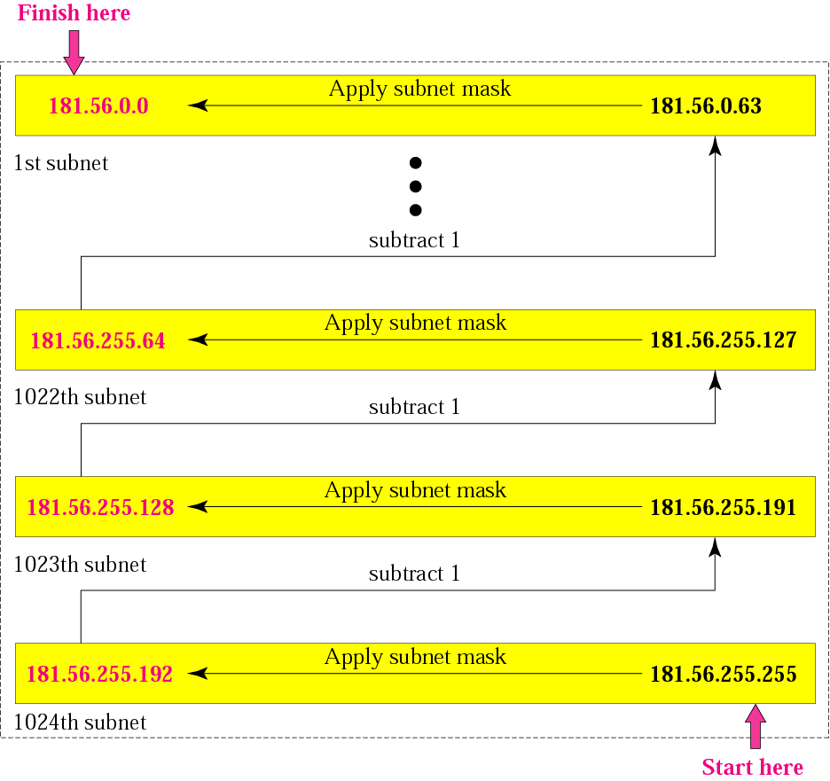
Figure 5-9
Example 4

Slide 77
Figure 5-9
VLSM
Without VLSM we are just wasting a number of IP Addresses in each subnet. So to save a certain IP address in each network, we do use VLSM concept.
VLSM is a process of dividing an IP network into the subnets of different sizes without wasting IP addresses.
When we perform Subnetting, all subnets have the same number of hosts, this is known as FLSM ( Fixed length subnet mask). In FLSM all subnets use same subnet mask, this lead to inefficiencies.

Slide 78
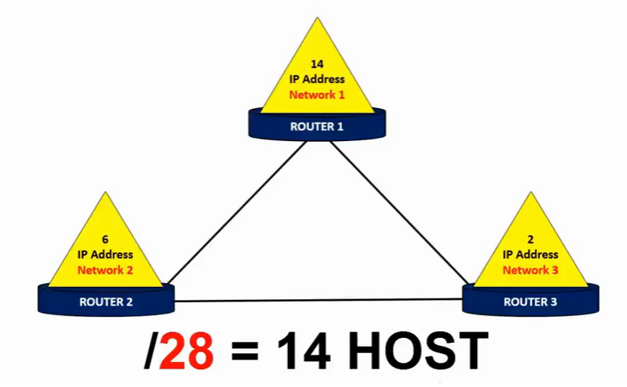
Figure 5-9
VLSM

Slide 79
Figure 5-9
VLSM
VLSM Subnetting
In VLSM Subnetting, we do Subnetting of subnets according the
network requirement.
Steps for VLSM Subnetting
Find the largest segment. Segment which need largest number of
hosts address.( largest to smallest)
Do Subnetting to fulfill the requirement of largest segment.
Assign the appropriate subnet mask for the largest segment.
For second largest segments, take one of these newly created
subnets and apply a different, more appropriate, subnet mask to it.
Assign the appropriate subnet mask for the second largest segment.
Repeat this process until the last network.

Slide 80
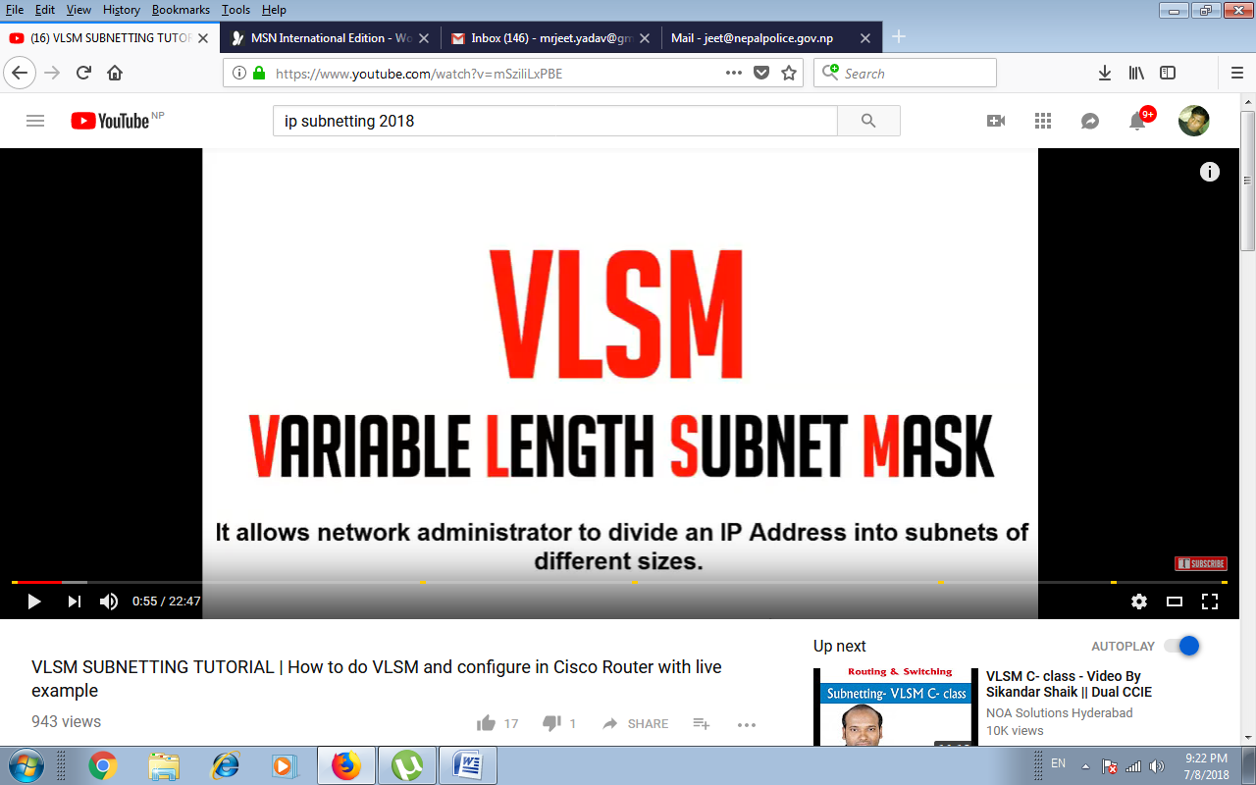
Figure 5-9
VLSM

Slide 81
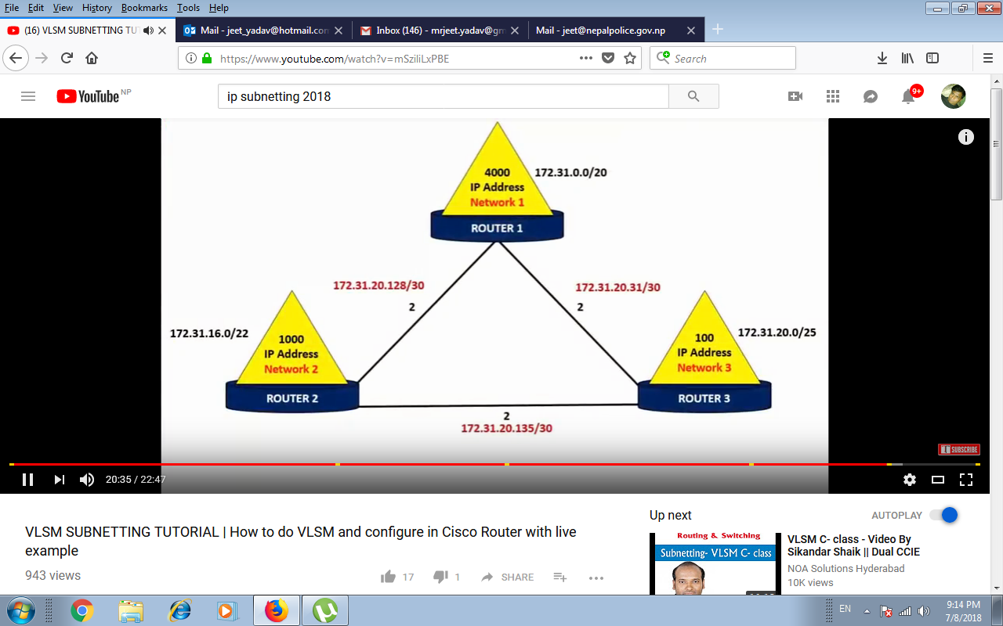
Figure 5-9
VLSM
Design the VLSM for this below scenario.

Slide 82
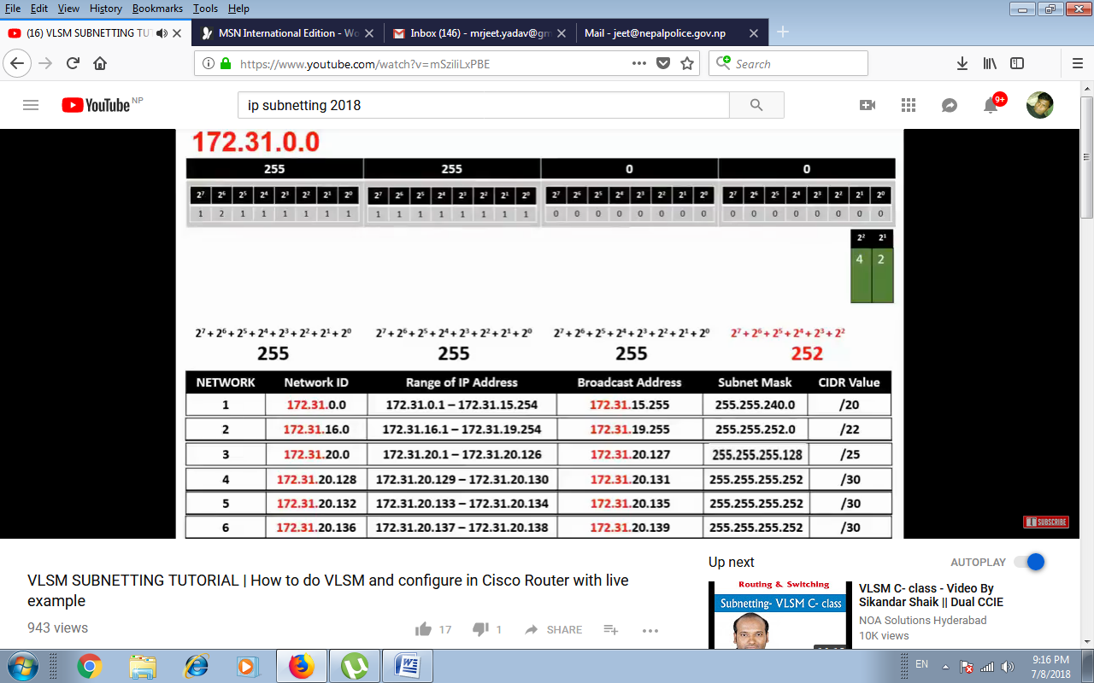
Figure 5-9
VLSM

