Slide 1
MAC Address
The Media Access Control (MAC) address is just as important as the IP address. The MAC address is a unique value associated with the network adapter (NIC).
MAC addresses are known as the hardware addresses or physical addresses. They uniquely identify the adapter on the LAN.

Slide 2
MAC Address
Format of the MAC address:
MM:MM:MM:SS:SS:SS
or
MM-MM-MM-SS-SS-SS
The first half of the MAC address contains the ID number of the adapter manufacturer.
These IDs are regulated by an Internet standards organization.
The second half of the MAC address represents the serial number assigned to the adapter by the manufacturer.

Slide 3
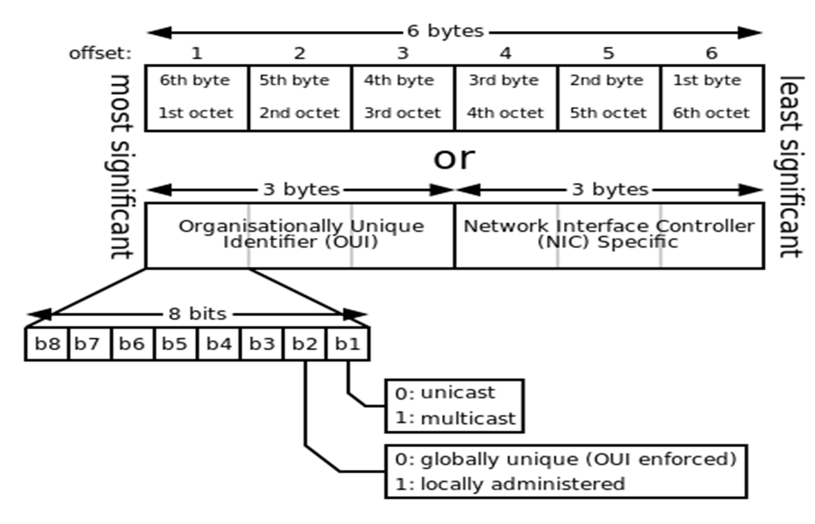
MAC Address

Slide 4
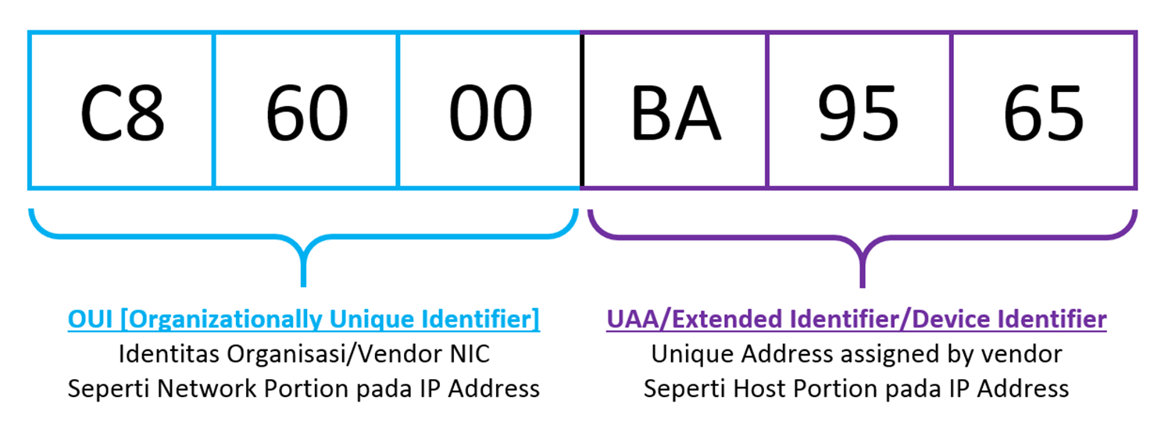
MAC Address

Slide 5
MAC Address
Format of the MAC address:
The following prefix indicates the manufacturer is Intel Corporation:
00:A0:C9:14:C8:29

Slide 6
MAC Address
MAC and IP address functionality:
The MAC addresses function at the data link layer (layer 2) and the IP addresses function at the network layer (layer 3).
It’s a bit of oversimplification, but the IP addresses support the software implementation and the MAC addresses support the hardware implementation of the network stack (OSI model).
The MAC address generally remains fixed and follows the network device, but the IP address changes as the network device moves from one network to another.

Slide 7
MAC Address
MAC and IP address functionality:
The IP network maintains a mapping between the IP address of a device and its MAC address. This mapping is know as the ARP cache or ARP table.
The DHCP also relies on MAC addresses to manage the unique assignment of IP addresses to devices.

Slide 8
ARP and RARP
The IP protocol uses 32-bit addresses.
Ethernet networks use 48-bit Ethernet (MAC) addresses
The ARP and RARP protocols perform the translation between IP addresses and MAC layer addresses.
We will discuss ARP for broadcast LANs, particularly Ethernet LANs.

Slide 9
Finding MAC address of an interface whose IP address is available
(1) HOST-A wants to send an IP datagram to HOST-B.
(2) HOST-A broadcasts an ARP request to all stations on the network: “What is the hardware address of HOST-B?”
(3) HOST-B responds with an ARP Reply which contains its hardware address.
(4) HOST-A transmits the IP datagram to HOST-B.

Slide 10
ARP reply
The ARP reply is sent by the node whose IP address matches the address sent in the ARP request
All other nodes receiving the broadcast ARP ignore the request (since their IP addresses do not match the address that is being resolved)

Slide 11
ARP cache
Clearly, sending an ARP request/reply for each IP datagram is inefficient.
Each station maintains a cache (ARP Cache) of current entries. The entries expire after 20 minutes.
Everytime the ARP cache is consulted for a MAC address, the expiry timer is reset in common implementations.) at (incomplete)

Slide 12
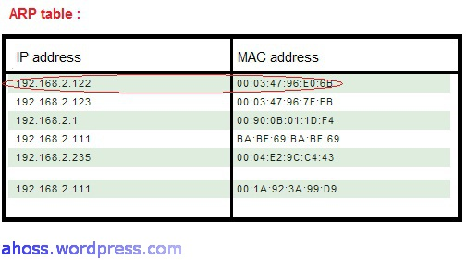
MAC Address

