Slide 1
Computer Industry Laws (rules of thumb)
Metcalf’s law
Moore’s First Law
Bell’s Computer Classes (7 price tiers)
Gilder’s Law of the Telcosom.
Bell’s Platform Evolution
Bell’s Platform Economics
Bill’s Law
Software Economics
Grove’s law
Moore’s second law
Is Info-Demand Infinite?
The Death of Grosch’s Law

Slide 2
Metcalf’s Law
Network Utility = Users²
How many connections can it make?
  1 user: no utility
  1K users: a few contacts
  1M users: many on net
  1B users: everyone on net
That is why the Internet is so “hot”
  Exponential benefit

Slide 3
Moore’s First Law
XXX doubles every 18 months 60% increase per year
  Micro Processor speeds
  chip density
  Magnetic disk density
  Communications bandwidth
  WAN bandwidth approaching LANs
Exponential Growth:
  The past does not matter
  10x here, 10x there, soon you're talking REAL change.
PC costs decline faster than any other platform
  Volume & learning curves
  PCs will be the building bricks of all future systems
1GB
128MB
1 chip memory size
( 2 MB to 32 MB)
8MB
1MB
128KB
8KB
1980
1990
1970
2000
bits: 1K
4K
16K
64K
256K
1M
4M
16M
64M
256M

Slide 4
Bumps in the Moore’s Law Road
$/MB of DRAM
1000000
DRAM:
  1988: US Anti-Dumping rules
  1993-1995: ?? price flat
Magnetic Disk
  1965-1989: 10x/decade
  1989-1996: 4x/3year!
  100X/decade
10000
100
1
1970
1980
1990
2000
$/MB of DISK
10,000
100
1
.01
1970
1980
1990
2000

Slide 5
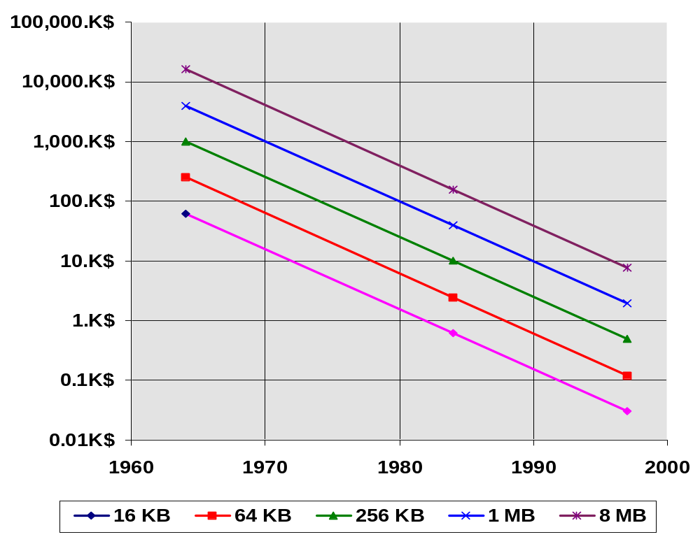
Gordon Bell’s 1975 VAX planning model...
He didn’t believe it!
System Price = 5 x 3 x .04 x memory size/ 1.26 ^{(t-1972)} K$
5x: Memory is 20% of cost
3x:DEC markup
.04x: $ per byte
He didn’t believe:
The projection
500$ machine
He couldn’t comprehend
implications

Slide 6
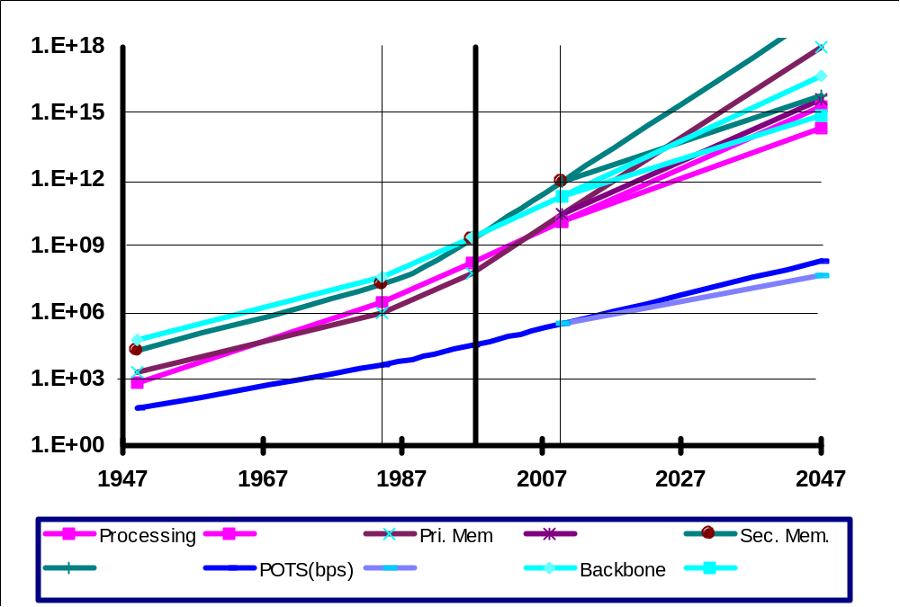
Gordon Bell’s
Processing, memories, & comm 100 years

Slide 7
Gordon Bell’s Seven Price Tiers
10$: wrist watch computers
100$: pocket/ palm computers
1,000$: portable computers
10,000$: personal computers (desktop)
100,000$: departmental computers (closet)
1,000,000$: site computers (glass house)
10,000,000$: regional computers (glass castle)
SuperServer: Costs more than 100,000 $
“Mainframe” Costs more than 1M$
Must be an array of processors,
disks, tapes
comm ports

Slide 8
Gilder’s Telecosom Law:
3x bandwidth/year for 25 more years
Today:
  10 Gbps per channel
  4 channels per fiber: 40 Gbps
  32 fibers/bundle = 1.2 Tbps/bundle
In lab 3 Tbps/fiber (400 x WDM)
In theory 25 Tbps per fiber
1 Tbps = USA 1996 WAN bisection bandwidth
1 fiber = 25 Tbps

Slide 9
Many little beat few big
$1
million
3
1 MM
$100 K
$10 K
Pico Processor
Micro
Nano
1 MB
10 pico-second ram
Mainframe
Mini
10
10 nano-second ram
0
MB
1
0 GB
10 microsecond ram
1
TB
10 millisecond disc
1
10 second tape archive
00 TB
3.5"
2.5"
1.8"
5.25"
1 M SPEC marks, 1TFLOP
10⁶ clocks to bulk ram
Event-horizon on chip
VM reincarnated
Multi-program cache,
On-Chip SMP
9"
14"
Smoking, hairy golf ball
How to connect the many little parts?
How to program the many little parts?
Fault tolerance?

Slide 10
God Loves Standards:
That’s why he made so many of them.
Microsoft DCOM based
on OSF-DCE Technology
DCOM and ActiveX extend it
1985
UNIX
International
Open software
Foundation (OSF)
X/Open
1990
ODBC
XA / TX
Object
Management
Group (OMG)
NT
OSF
DCE
DCE
RPC
GUIDs
IDL
DNS
Kerberos
Solaris
1995
Open
Group
COM
CORBA
COM

Slide 11
Bell’s Evolution of Computer Classes
Technology enable two evolutionary paths:
1. constant performance, decreasing cost
2. constant price, increasing performance
Mainframes (central)
Minis (dep’t.)
Log Price
WSs
PCs (personals)
??
Time
1.26 = 2x/3 yrs -- 10x/decade; 1/1.26 = .8
1.6 = 4x/3 yrs --100x/decade; 1/1.6 = .62

Slide 12
Gordon Bell’s Platform Economics
Traditional computers: Custom or Semi-Custom
high-tech and high-touch
New computers:
high-tech and no-touch
units
100000
10000
1000
$
100
Price (K$)
10
Volume (K)
App price
1
0.1
0.01
WS
WS
Browser
Mainframe
Browser
Mainframe
Computer type

Slide 13
Software Economics
An engineer costs about
150 k$/year
R&D gets [5%…15%] of budget
Need [3M$…1M$] revenue
per engineer
Microsoft: 9 B$
Profit
24%
R&D
16%
Tax
13%
SG&A
34%
Product&Service
13%
Intel 16 B$
IBM: 72 B$
Oracle: 3 B$
R&D
8%
Profit
6%
Profit
15%
R&D
9%
Profit
R&D
8%
22%
Tax
Tax
7%
SG&A
5%
11%
SG&A
Tax
22%
Product&
Services
26%
SG&A
12%
Product&Service
59%
43%
Product&Service
47%

Slide 14
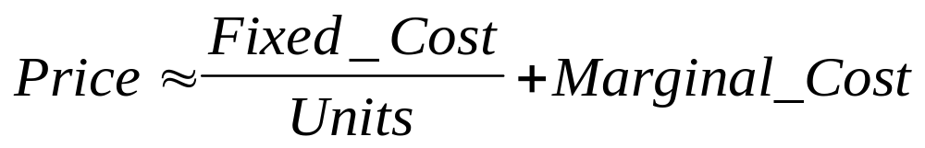
Software Economics: Bill’s Law
Bill Joy’s law (Sun):
Don’t write software for less than 100,000 platforms.
@10M$ engineering expense, 1,000$ price
Bill Gate’s law:
Don’t write software for less than 1,000,000 platforms.
@10M$ engineering expense, 100$ price
Examples:
  UNIX vs NT: 3,500$ vs 500$
  Oracle vs SQL-Server: 100,000$ vs 6,000$
  No Spreadsheet or Presentation pack on UNIX/VMS/...
Commoditization of base Software & Hardware

Slide 15
Grove's Law
The New Computer Industry
Horizontal integration
is new structure
Each layer picks best
from lower layer.
Desktop (C/S) market
  1991: 50%
  1995: 75%
Function
Example
Operation
AT&T
Integration
EDS
Applications
SAP
Middleware
Oracle
Baseware
Microsoft
Systems
Compaq
Silicon & Oxide
Intel & Seagate

Slide 16
Moore’s Second Law
The Cost of Fab Lines Doubles Every Generation
(3 years)
Money Limit:
hard to imagine
10 B$ line
20 B$ line
40 B$ line
Physical limit:
  Quantum Effects
  at 0.25 micron now
  0.05 micron seems hard
  12 years, 3 generations
  Lithograph:
  need Xray below 0.13 micron
$10,000
$1,000
$100
M$ / Fab Line
$10
$1
1960
1970
1980
1990
2000
Year

Slide 17
Constant Dollars vs Constant Work
Constant Work:
  One SuperServer can do all the world’s
  computations.
Constant Dollars:
  The world spends 10% on information processing
  Computers are moving from 5% penetration to 50%
    300 B$ to 3T$
    We have the patent on the byte and algorithm

Slide 18
Crossing the Chasm
New
Market
product finds
customers
No Product
No Customers
hard
Very
Hard
Old
Market
Boring
Competitve
Slow Growth
hard
Customers
find product
Old
Technology
New
Technology

Slide 19
Billions of Clients Need
Millions of Servers
All clients are networked to servers
    may be nomadic or on-demand
Fast clients want faster servers
Servers provide
  data,
  control,
  coordination
  communication
Clients
mobile
clients
fixed
Servers
clients
server
super
server
Super Servers
Large Databases
High Traffic shared data

Slide 20
The Parallel Law of Computing
Grosch's Law:
Parallel Law:
Needs
  Linear Speedup and Linear Scaleup
  Not always possible
2x $ is 4x performance
1,000 MIPS
32 $
2x $ is
2x performance
1 MIPS
1 $
.03$/MIPS
1,000 MIPS
1 MIPS
1,000 $
1 $

Slide 21
Useful Aphorisms
There are no silver bullets.
Fred Brooks
There is no such thing as a heterogeneous system.
Butler Lampson
You know you have a distributed system
when a computer you have never heard of
prevents yours from working.
Leslie Lamport
Hubris: the Greek word for “second system.”
Bob Stewart
Software is like entropy,
it weighs nothing,
it is hard to understand, and
it always increases.
Norman Augustine

