Slide 1
SEQUENTIAL CIRCUIT
Flip-Flops

Slide 2
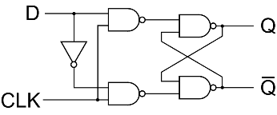
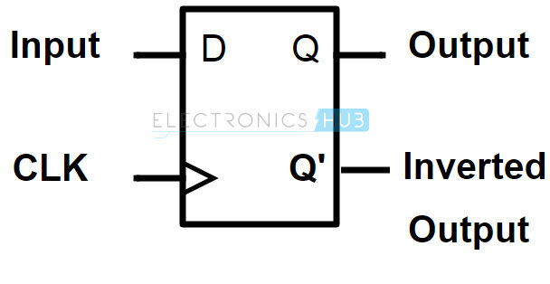
D Flip-Flop – Modified ver. Of SR Flip-Flop. Only one Input.
CLK | S | R | Q_{n+1}
0 | X | X | Q_{n}
1 | 0 | 0 | Q_{n}
1 | 0 | 1 | 0
1 | 1 | 0 | 1
1 | 1 | 1 | Invalid
CLK | D | Q_{n+1}
0 | X | Q_{n}
1 | 0 | 0
1 | 1 | 1
T.T for D Flip-Flop
T.T for S-R Flip-Flop

Slide 3
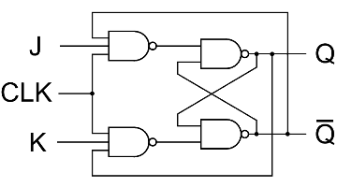
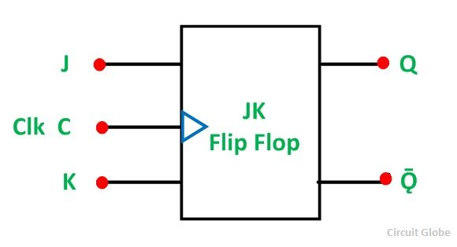
J-K Flip-Flop – Refinement of SR F/F. Invalid state is defined.
T.T fo S-R Latch using NAND
S | R | Q | Q’
0 | 0 | Invalid
0 | 1 | 1 | 0
1 | 0 | 0 | 1
1 | 1 | Memory
CLK | S | R | Q_{n+1}
0 | X | X | Q_{n}
1 | 0 | 0 | Q_{n}
1 | 0 | 1 | 0
1 | 1 | 0 | 1
1 | 1 | 1 | Invalid
CLK | J | K | Q_{n+1}
0 | X | X | Q_{n}
1 | 0 | 0 | Q_{n}
1 | 0 | 1 | 0
1 | 1 | 0 | 1
1 | 1 | 1 | Q_{n}’
T.T for S-R Flip-Flop
T.T for J-K Flip-Flop

Slide 4
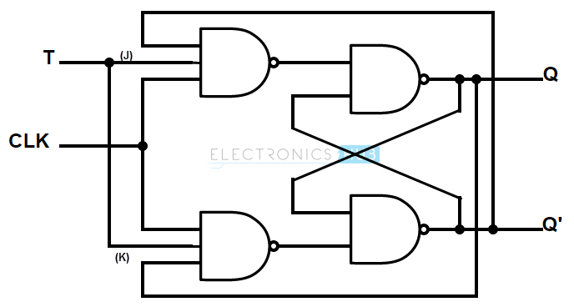
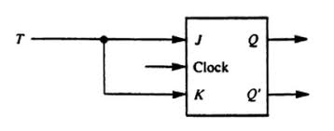
T Flip-Flop – Derived from JK Flip-Flop . One input
CLK | J | K | Q_{n+1}
0 | X | X | Q_{n}
1 | 0 | 0 | Q_{n}
1 | 0 | 1 | 0
1 | 1 | 0 | 1
1 | 1 | 1 | Q_{n}’
CLK | T | Q_{n+1}
0 | X | Q_{n}
1 | 0 | Q_{n}
1 | 1 | Q_{n}’
T.T for T Flip-Flop
T.T for J-K Flip-Flop

Slide 5
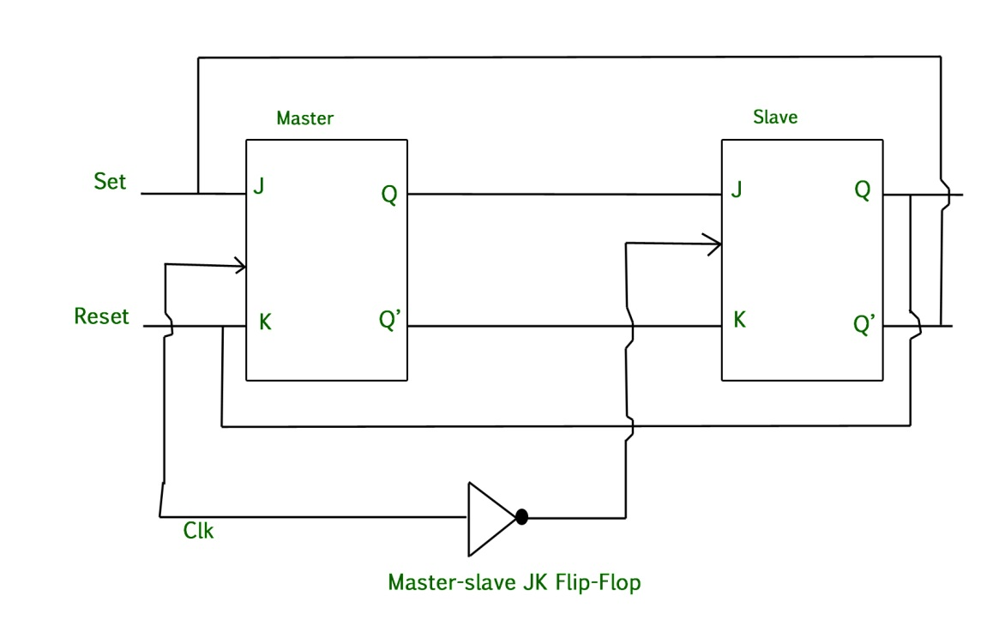
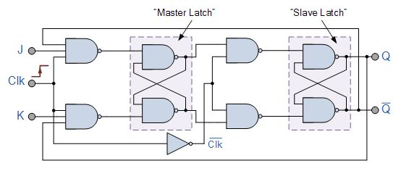
Master Slave JK Flip-Flop

Slide 6
Master Slave JK Flip-Flop
Combination of 2 JK flip-flops in series.
One acts as ‘master’ and the other as ‘slave’
It also includes an Inverter.
CLK | J | K | Q_{n+1}
0 | X | X | Q_{n}
1 | 0 | 0 | Q_{n}
1 | 0 | 1 | 0
1 | 1 | 0 | 1
1 | 1 | 1 | Q_{n}’
T.T for J-K Flip-Flop

Slide 7
When the clock is high, master is operational but slave is not operational(it will keep memory)
When the clock is low, master is not functional but slave is. The output at salve is fed back to master but the clock is low. So, In this case effect of feedback is eliminated(which eliminates racing)

