Slide 1
SEQUENTIAL CIRCUIT
Conversion of Flip-Flop
(Realization of one Flip-Flop using other Flip-Flop)

Slide 2
Steps for Flip-Flop Conversion
Make Characteristics table for required flip-flop.
Make Excitation table for available flip-flop.
Write Boolean expression for available flip-flop.
Draw the circuit.

Slide 3
Example 1 – JK to D
Required flip-flop : D, Available flip-flop : JK
Q_{n} | D | Q_{n+1}
0 | 0 | 0
0 | 1 | 1
1 | 0 | 0
1 | 1 | 1
Q_{n} | Q_{n+1} | J | K
0 | 0 | 0 | X
0 | 1 | 1 | X
1 | 0 | X | 1
1 | 1 | X | 0

Slide 4
Example 2 – SR to JK
Required flip-flop : JK, Available flip-flop : SR
Q_{n} | J | K | Q_{n+1}
0 | 0 | 0 | 0
0 | 0 | 1 | 0
0 | 1 | 0 | 1
0 | 1 | 1 | 1
1 | 0 | 0 | 1
1 | 0 | 1 | 0
1 | 1 | 0 | 1
1 | 1 | 1 | 0
Q_{n} | Q_{n+1} | S | R
0 | 0 | 0 | X
0 | 1 | 1 | 0
1 | 0 | 0 | 1
1 | 1 | X | 0

Slide 5
Direct Inputs
Also called asynchronous inputs.
Flip-flop have control over the outputs (Q and Q’) regardless of clock signal.
These inputs are called the preset (PRE) and clear (CLR).
When preset = 0, Q equals to 1
When clear = 0, Q equals to 0

Slide 6
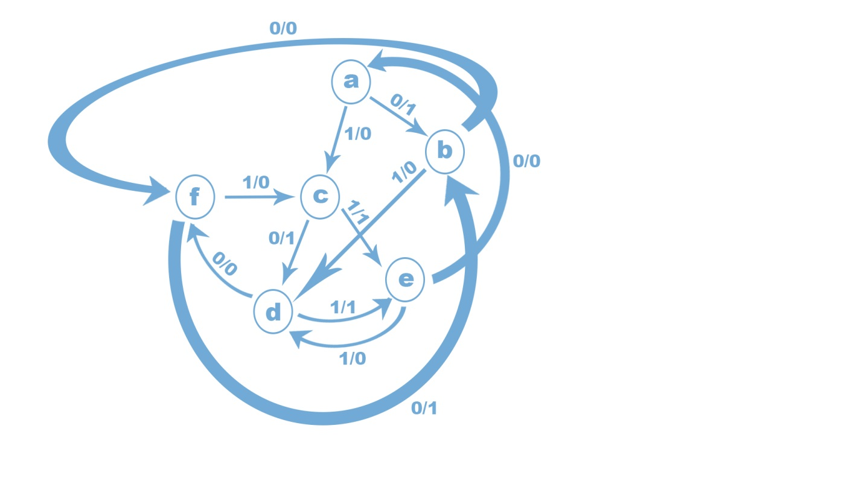
State Reduction and Assignment

Slide 7
Present State | Next State |  | Output
 | x=0 | x=1 | x=0 | X=1
A | B | C | 1 | 0
B | F | D | 0 | 0
C | D | E | 1 | 1
D | F | E | 0 | 1
E | A | D | 0 | 0
F | B | c | 1 | 0
Present State | Next State |  | Output
 | x=0 | x=1 | x=0 | X=1
A | B | C | 1 | 0
B | F | D | 0 | 0
C | D | E | 1 | 1
D | F | E | 0 | 1
E | A | D | 0 | 0

Slide 8
Present State | Next State |  | Output
 | x=0 | x=1 | x=0 | X=1
A | B | C | 1 | 0
B | F | D | 0 | 0
C | D | E | 1 | 1
D | F | E | 0 | 1

Slide 9
Design Procedure for Sequential Circuit
Obtain the state table.
Reduce the no. of state using state reduction method(If possible)
Do state assignment(if required)
Determine the number of flip flop required.
Derive circuit excitation table from state table.
Obtain the expression for circuit output and flip flop output.
Implement the circuit

Slide 10
T_{a} = Q’_{a}Q_{b}x’+ Q_{a}Q’_{b}x T_{a} = Q’_{a}Q’_{b}x+ Q_{a}Q_{b}x’ y=Q_{a}Q’_{b}x’+ Q_{a}Q’_{b}x = Q_{a}Q’_{b}
Present State |  |  | Next State |  | Output (y) | Using T f/f
Q_{a} | Q_{b} | x | Q_{a}⁺ | Q_{b}⁺ |  | T_{a} | T_{b}
0 | 0 | 0 | 0 | 0 | 0 | 0 | 0
0 | 0 | 1 | 0 | 1 | 0 | 0 | 1
0 | 1 | 0 | 1 | 1 | 0 | 1 | 0
0 | 1 | 1 | 0 | 1 | 0 | 0 | 0
1 | 0 | 0 | 1 | 0 | 1 | 0 | 0
1 | 0 | 1 | 0 | 0 | 1 | 1 | 0
1 | 1 | 0 | 1 | 0 | 0 | 0 | 1
1 | 1 | 1 | 1 | 1 | 0 | 0 | 0

Slide 11
