Slide 1
OPERATING SYSTEM Processes
Process Definition
Scheduling Processes
What Do Processes Do?
Inter-process Communication
1

Slide 2
A process is defined as an entity which represents the basic unit of work to be implemented in the system.
3: Processes

Slide 3
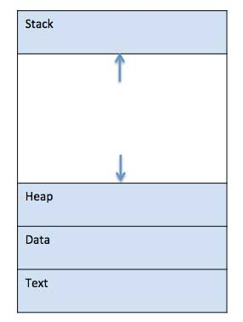
3: Processes

Slide 4
Stack
The process Stack contains the temporary data such as method/function parameters, return address and local variables.
Heap
This is dynamically allocated memory to a process during its run time.
3: Processes

Slide 5
Text
This includes the current activity represented by the value of Program Counter and the contents of the processor's registers.
Data
This section contains the global and static variables.
3: Processes

Slide 6
PROCESSES
PROCESS CONCEPT:
A program is passive; a process active. Attributes held by a process include
hardware state
memory
CPU
progress (executing)
WHY HAVE PROCESSES?
  Resource sharing
  logical (files)
  physical(hardware)
  Computation speedup - taking advantage of multiprogramming – i.e. example of a customer/server database system.
3: Processes

Slide 7

PROCESSES
New The process is just being put together.
Running Instructions being executed. This running process holds the CPU.
Waiting For an event (hardware, human, or another process.)
Ready The process has all needed resources - waiting for CPU only.
Suspended Another process has explicitly told this process to sleep. It will be
      awakened when a process explicitly awakens it.
Terminated The process is being torn apart.

Slide 8

PROCESSES
PROCESS CONTROL BLOCK:
CONTAINS INFORMATION ASSOCIATED WITH EACH PROCESS:
It's a data structure holding:
PC, CPU registers,
memory management information,
accounting ( time used, ID, ... )
I/O status ( such as file resources ),
scheduling data ( relative priority, etc. )
Process State (so running, suspended, etc. is simply a field in the PCB ).

Slide 9
Naming the process
State of the process
Resources allocated to the process
Memory allocated to the process
Scheduling information
Input / output devices associated with process
3: Processes

Slide 10
Pointer – It is a stack pointer which is required to be saved when the process is switched from one state to another to retain the current position of the process.
Process state – It stores the respective state of the process.
Process number – Every process is assigned with a unique id known as process ID or PID which stores the process identifier.
Program counter – It stores the counter which contains the address of the next instruction that is to be executed for the process.
Register – These are the CPU registers which includes: accumulator, base, registers and general purpose registers.
Memory limits – This field contains the information about memory management system used by operating system. This may include the page tables, segment tables etc.
Open files list – This information includes the list of files opened for a process.

Slide 11
SCHEDULING
The process scheduling is the activity of the process manager that handles the removal of the running process from the CPU and the selection of another process on the basis of a particular strategy.
The act of Scheduling a process means changing the active PCB pointed to by the CPU. Also called a context switch.
A context switch is essentially the same as a process switch - it means that the memory, as seen by one process is changed to the memory seen by another process.
SCHEDULING QUEUES:
(Process is driven by events that are triggered by needs and availability )
  Ready queue = contains those processes that are ready to run.
  I/O queue (waiting state ) = holds those processes waiting for I/O service.
What do the queues look like? They can be implemented as single or double linked.

Slide 12

PROCESSES
The CPU switching from one process to another.
3: Processes

Slide 13
Job queue − This queue keeps all the processes in the system.
Ready queue − This queue keeps a set of all processes residing in main memory, ready and waiting to execute. A new process is always put in this queue.
Device queues − The processes which are blocked due to unavailability of an I/O device constitute this queue.
3: Processes

Slide 14
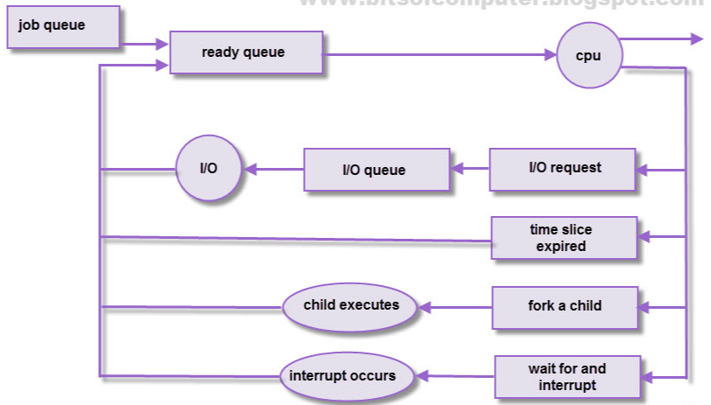

Slide 15
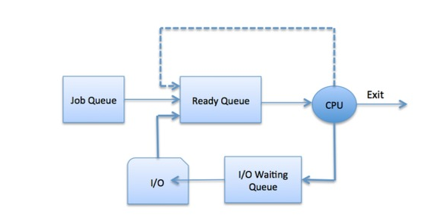
3: Processes

Slide 16
PROCESSES
LONG TERM SCHEDULER
Long-Term Scheduler is also known as Job Scheduler. long-term scheduler
regulates the programs which are selected to system for processing.
programs are setup in the queue and as per the requirement the best one job is selected and it takes the processes from job pool.
Run seldom ( when job comes into memory )
Controls degree of multiprogramming
Tries to balance arrival and departure rate through an appropriate job mix.
SHORT TERM SCHEDULER
Short-Term Scheduler is also known as CPU Scheduler. Short-Term Scheduler ensures which program is suitable or important for processing
Contains three functions:
Code to remove a process from the processor at the end of its run.
  a)Process may go to ready queue or to a wait state.

Slide 17
PROCESSES
SHORT TERM SCHEDULER (cont.)
Code to put a process on the ready queue –
  a)Process must be ready to run.
  b)Process placed on queue based on priority.
Code to take a process off the ready queue and run that process (also called dispatcher).
  a) Always takes the first process on the queue (no intelligence required)
  b) Places the process on the processor.
This code runs frequently and so should be as short as possible.
MEDIUM TERM SCHEDULER
Medium-term scheduling is a part of swapping.
Mixture of CPU and memory resource management.
Swap out/in jobs to improve mix and to get memory.
Controls change of priority.

Slide 18
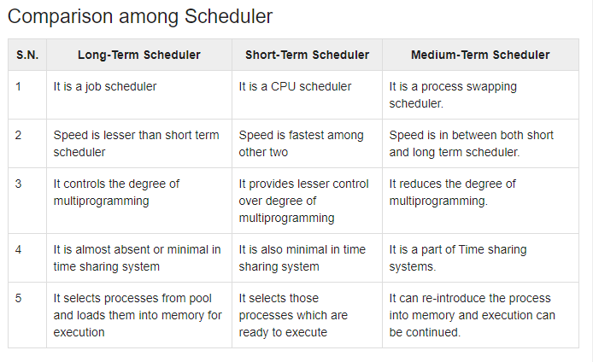
3: Processes

Slide 19
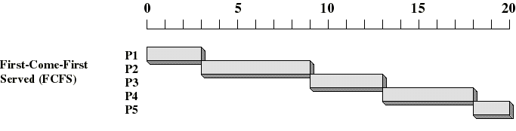
First Come First Served (FCFS)
Selection function: the process that has been waiting the longest in the ready queue (hence, FCFS)
Decision mode: non preemptive
  a process run until it blocks itself

Slide 20
FCFS drawbacks
A process that does not perform any I/O will monopolize the processor
Favors CPU-bound processes
  I/O-bound processes have to wait until CPU-bound process completes
  They may have to wait even when their I/O are completed (poor device utilization)
  we could have kept the I/O devices busy by giving a bit more priority to I/O bound processes

