Slide 1
Unit- 9
Software Configuration Management

Slide 2
What is Software Configuration Management?
In Software Engineering, Software Configuration Management(SCM) is a process to systematically manage, organize, and control the changes in the documents, codes, and other entities during the Software Development Life Cycle. The primary goal is to increase productivity with minimal mistakes. SCM is part of cross-disciplinary field of configuration management and it can accurately determine who made which revision.

Slide 3
Why do we need Configuration management?
There are multiple people working on software which is continually updating
It may be a case where multiple version, branches, authors are involved in a software config project, and the team is geographically distributed and works concurrently
Changes in user requirement, policy, budget, schedule need to be accommodated.
Software should able to run on various machines and Operating Systems
Helps to develop coordination among stakeholders
SCM process is also beneficial to control the costs involved in making changes to a system

Slide 4
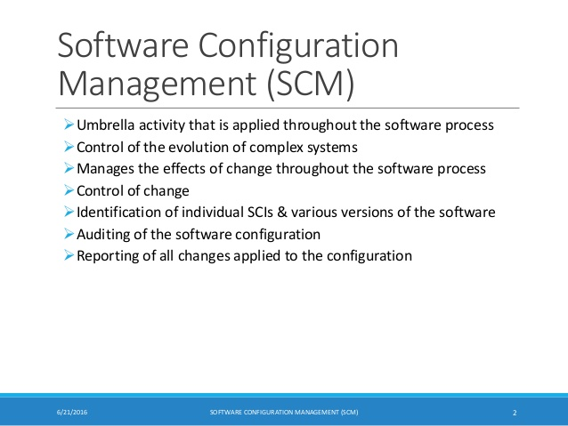

Slide 5
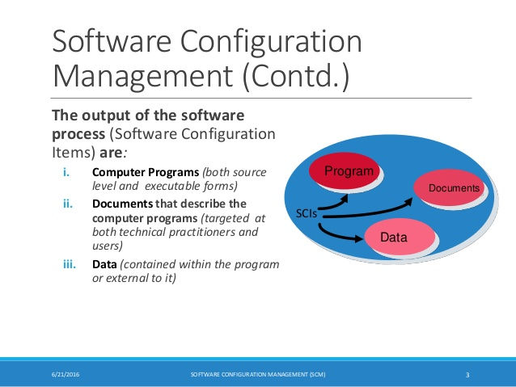

Slide 6
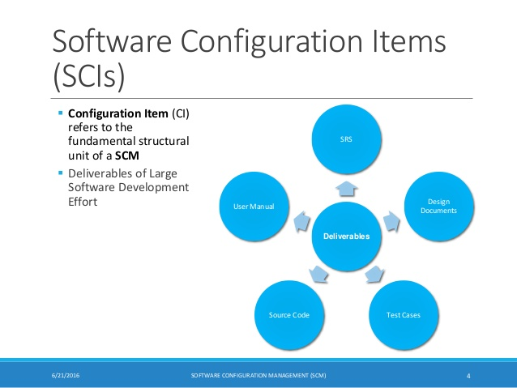

Slide 7
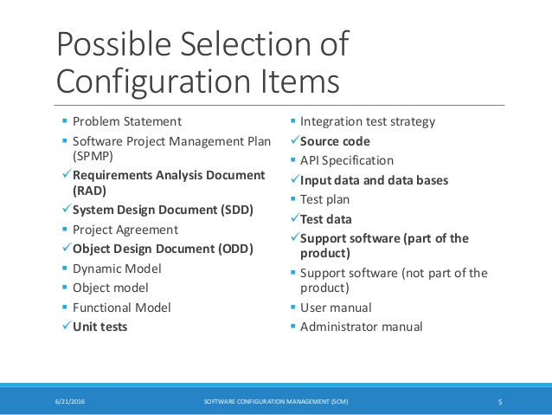

Slide 8
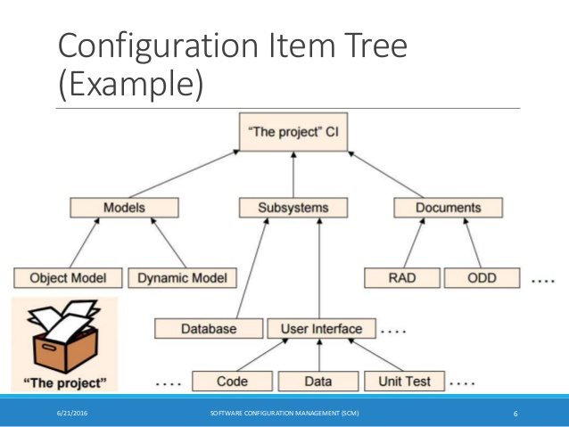

Slide 9
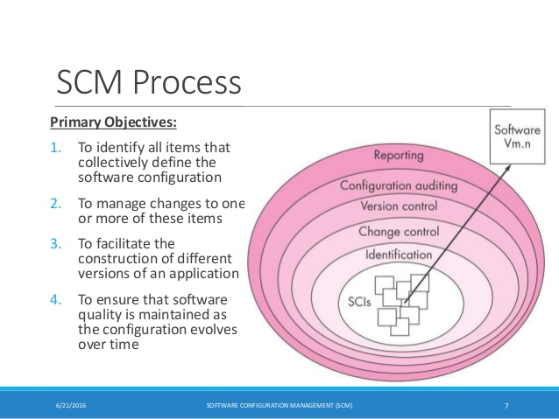

Slide 10
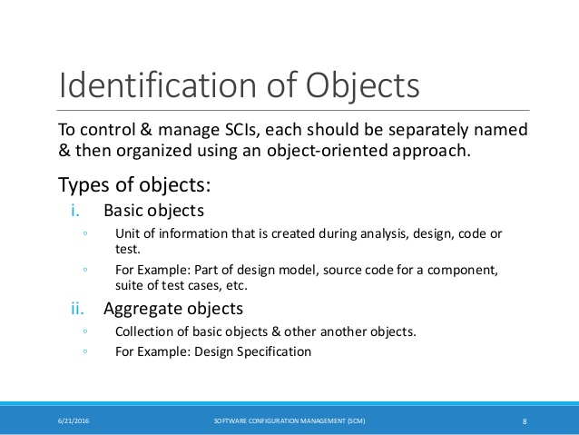

Slide 11
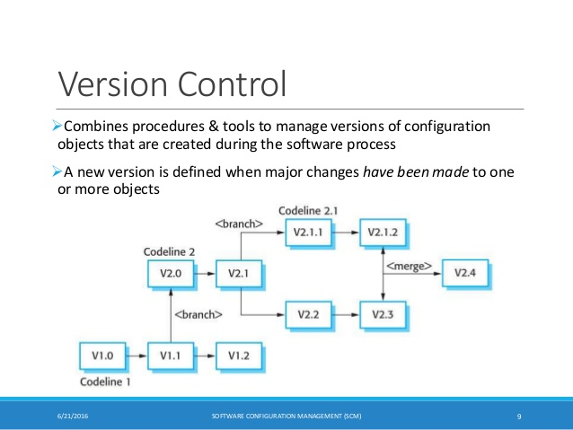

Slide 12
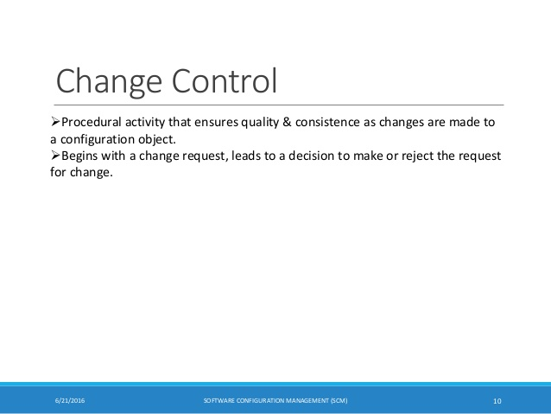

Slide 13
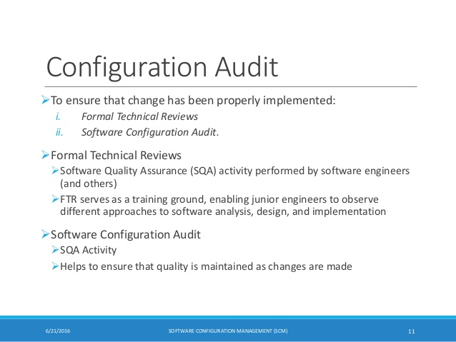

Slide 14
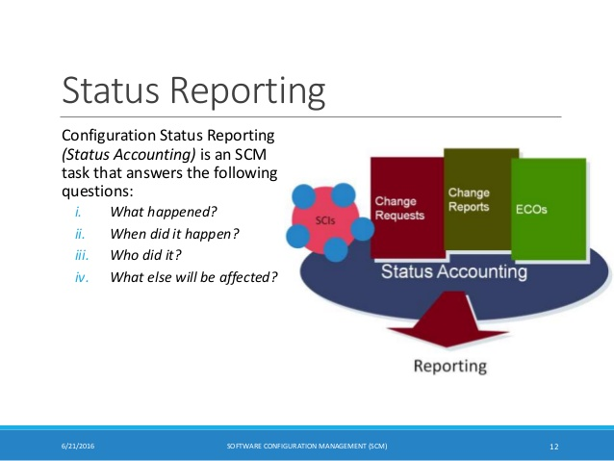

Slide 15
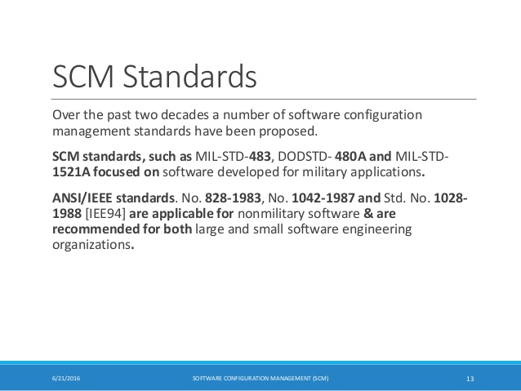

Slide 16


